Slide 1

ThinkCollege description
Federally funded since 2010 to provide coordination, training and technical assistance to any college or university who wants to establish or improve postsecondary education opportunities to students with intellectual disability on their campus, and to provide information and support to K-12 educators, families and students interested in PSE options.
https://thinkcollege.net/projects/ncc
Notes:
Cate and Kathy introduce themselves, mention the other staff we have

Slide 2

ThinkCollege Description continued
Federally funded since 2020, The Think College Network disseminates research and best practices for improving and expanding inclusive postsecondary education opportunities for students with intellectual disability through regional and national training, collaborative workgroups, and
public awareness activities.
https://thinkcollege.net/projects/tcn

Slide 3
What do the Centers do?
National Coordinating Center
Inclusive Higher Education Network
Evaluation of TPSIDs
Public Awareness
Accreditation
State & Regional Alliance
Technical Assistance
Career & Technical Ed
Dissemination
Employment Partnerships
Searchable Resources
Training Development
Community Building
Membership Organization

Slide 4
Types of College Programs
Transition and Postsecondary Programs for Students with Intellectual Disabilities (TPSID) Model Demonstration projects funded by the US Department of Education, Office of Postsecondary Education
Currently 22 grantees 2020-2025
Comprehensive Transition Programs (CTP) Programs that have been through an approval process and can offer access to federal financial aid to their students who are financially eligible
Currently 153
Dual/concurrent enrollment program Programs that serve students while still in high school, typically a partnership between a school district and a local college
Currently 35 exclusively DE, 98 who serve HS and adult students
Notes:
When a program is neither a CTP or a TPSID – there is no standard of practice – it does not mean they are not high quality programs, but they can operate in any number of ways – be completely segregated to completely inclusive, have a strong academic focus to offering only special education classes or even no classes at all – prepare students for employment or have no opportunities to work while in the program. No requirement to track student outcomes..

Slide 5
Approved Comprehensive Transition and Postsecondary (CTP) Programs
Jun 2023: 153 currently operating
3
1
1
1
3
10
1
1
2
1
13
2
3
9
7
2
2
1
1
1
4
3
4
1
3
5
7
3
3
6
1
4
4
8
1
4
6
21
Last Updated:6/15/23

Slide 6
Approved Comprehensive Transition and Postsecondary (CTP) Programs (June 2023)
Alabama - 4
Alaska - 0
Arizona - 0
Arkansas - 4
California - 4
Colorado - 4
Connecticut - 0
Delaware - 1
Florida - 21
Georgia - 8
Hawaii - 0
Idaho - 1
Illinois - 9
Indiana - 1
Iowa - 2
Kansas - 1
Kentucky - 5
Louisiana - 6
Maine - 0
Maryland - 0
Massachusetts - 1
Michigan - 1
Minnesota - 3
Mississippi - 1
Missouri - 3
Montana - 1
Nebraska - 0
Nevada - 2
New Hampshire - 0
New Jersey - 3
New Mexico - 1
New York - 10
North Carolina - 3
North Dakota - 0
Ohio - 7
Oklahoma - 3
Oregon - 1
Pennsylvania - 13
Rhode Island - 0
South Carolina - 6
South Dakota - 1
Tennessee - 7
Texas - 4
Utah - 2
Vermont - 0
Virginia - 3
Washington - 3
West Virginia - 1
Wisconsin – 2
Wyoming - 0

Slide 7
College Options for Students with Intellectual Disability, June 2023
Total Number of Programs: 318
3
3
1
1
2
3
19
1
4
31
3
1
6
3
6
19
2
5
9
2
8
2
16
4
3
1
1
5
4
18
2
4
5
10
7
13
3
6
3
2
5
8
9
2
1
16
6
28
1
Last Updated: 3/23/23

Slide 8
College Options for Students with Intellectual Disability (June 2023)
Alabama - 8
Alaska - 1
Arizona - 3
Arkansas - 5
California - 18
Colorado - 5
Connecticut - 3
Delaware - 1
Florida - 28
Georgia - 9
Hawaii - 1
Idaho - 3
Illinois - 16
Indiana - 4
Iowa - 5
Kansas - 2
Kentucky - 5
Louisiana - 6
Maine - 1
Maryland - 9
Massachusetts - 19
Michigan - 6
Minnesota - 4
Mississippi - 2
Missouri - 4
Montana - 2
Nebraska - 2
Nevada - 2
New Hampshire - 1
New Jersey - 9
New Mexico - 2
New York - 30
North Carolina - 14
North Dakota - 3
Ohio - 8
Oklahoma - 3
Oregon - 1
Pennsylvania - 19
Rhode Island - 2
South Carolina - 6
South Dakota - 1
Tennessee - 7
Texas - 16
Utah - 3
Vermont - 3
Virginia - 4
Washington - 3
West Virginia - 1
Wisconsin – 6
Wyoming - 0

Slide 9
Think College Search
A searchable database of college programs for students with intellectual disability
Search|Review|Save Favorites|Compare
https://thinkcollege.net/college-search
Notes:
This is a screen shot of a resource on our website which is a listing of all college programs in the US that we are aware of – it has several tools to help you find the right college – college listings that are searchable by state, and multiple other factors. Details on each program, and a way to save favorites and download key features to compare.

Slide 10

Some Key Features of College Programs
Unique admissions process & requirements
Accepts students who are non-degree seeking
Vary in length from 1 to 4 years
Vary in level of inclusion
Students earn a certificate, not a degree
May offer federal student aid (not loans)

Slide 11

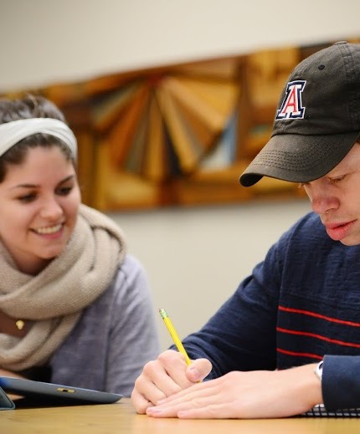



Student Experience
Enrolling in college courses for credit or audit
Internships/work study
Paid jobs (on/off campus)
Campus Life/Organizations
Learning to live independently

Slide 12
Data
Historic follow-up and recent exit data show us close to
60%
of students who complete TPSID programs have jobs when they graduate and in the years following program completion.
The current employment rate of adults with ID in the community is 19%

Slide 13

Funding
Sources of funding for students
Paying for College resources
Sources of funding for programs
Federal grants (TPSID) every 5 years
State funding
Donors
Institutional funds
External agencies, such as Vocational Rehab
Notes:
2022: CO, KY, NC, LA, MA
2023: MN
Pre 2020 -- FL, GA
DD Council – CA, TN

