Slide 1
5.11: Low Effort, Big Impact: Disability & Career Service Collaborations Preparing Disabled Students for Work
Heather D. Evans Ph.D., University of Washington
David R. Parker Ph.D., Gregory S. Fehribach Center at Eskenazi Health
Larry Markle, Gregory S. Fehribach Center at Eskenazi Health
Travis Hyde, University of Washington
Notes:
HEATHER reads
Next slide: Heather

Slide 2
About Us…
University of Washington
Gregory S. Fehribach Center at Eskenazi Health
Travis Hyde (he/him)
Operations Manager, Disability Resources for Students (DRS)
Heather D. Evans (she/her)
Ph.D. in Sociology
Director, Disability Studies Program
Assistant Professor, Rehabilitation Medicine
David Parker, Ph.D.
Program Manager for Educational Outreach & Communication
Larry Markle
Director, Fehribach Center at Eskenazi Health
Notes:
ALL read
Next slide: heather

Slide 3
Agenda
The need for better career preparation for disabled students
The Fehribach Center’s mission and programming
Campus Connections: an evidence-based model
Piloting the model in a new setting: partnership with UW
Reflections on the UW experience
Implications for other campuses
Notes:
HEATHER reads
Next slide: Heather

Slide 4
Learning Objectives
Identify ways that Disability Resource professionals can collaborate with Career Services colleagues that are both feasible and effective
Gain insights on making career development activities more relevant, inviting and accessible to students with disabilities
Learn about a tested framework for helping disabled college students gain critical career-related work experiences
Gain resource list for Making Internship Opportunities More Accessible (session handout)
Notes:
HEATHER reads
Next slide: David

Slide 5
A New Era Demanding Career Preparation
Only 31.7% of college graduates with disabilities were employed in 2023, compared to 74.5% of non-disabled graduates (BLS, 2024)
DOE in multiple states have mandated career preparation as part of college experience
New expectations that internships are part of college experience and vital for career success
Undergraduates with disabilities utilize career services less often and graduate with less work experience than non-disabled students (Parker & Markle 2020)
Changing norms create new opportunities, but also create new access barriers
Notes:
DAVID reads
Next slide: David

Slide 6
Reflection: a New Era
How does your campus prepare students with disabilities for the employment inequities that await them?
As you think about any role you might play in helping disabled students access equitable career preparation, what thoughts or feelings come to mind?
What are your biggest concerns or barriers?
Notes:
DAVID reads
Next Slide: Larry
-prompt audience to use these reflection moments in lieu of a generic Q&A at the end
-5 mins for reflection
-invite folks to share thoughts

Slide 7
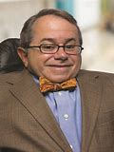
The Gregory S. Fehribach Center
Mission is to promote equitable employment outcomes and full civic engagement for college graduates with physical disabilities
Has provided 536 internships to 266 students attending 46 colleges or universities in Indiana, Kentucky, Michigan, Ohio, and Illinois
Has partnered with 46 Indiana employers, including Eli Lilly and Company, Republic Airlines, Ascend Indiana, BraunAbility, Cummins Inc., Eskenazi Health and the Indiana Pacers
Recipient of the 2024 NACE Chevron Innovation Award
Gregory S. Fehribach
Founder
Notes:
LARRY reads
Next slide: Larry

Slide 8
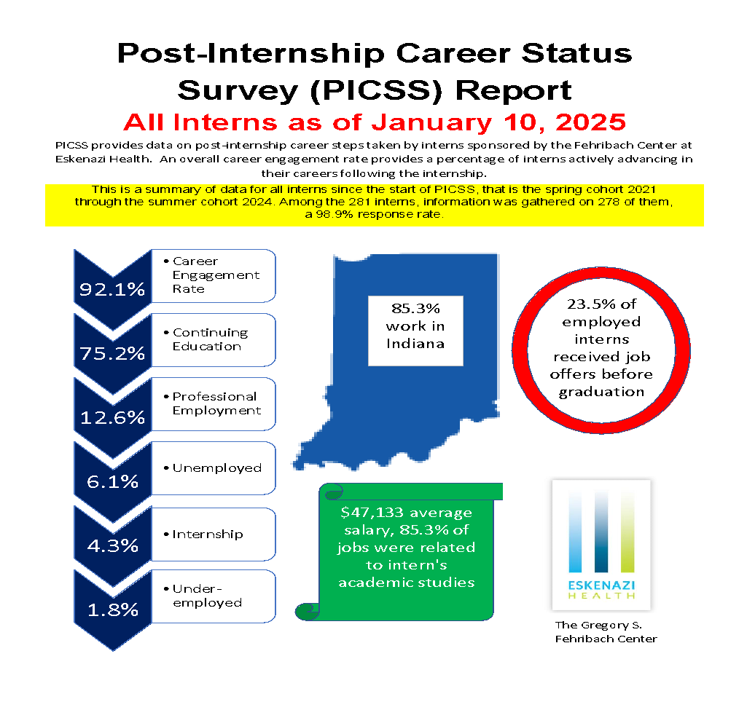
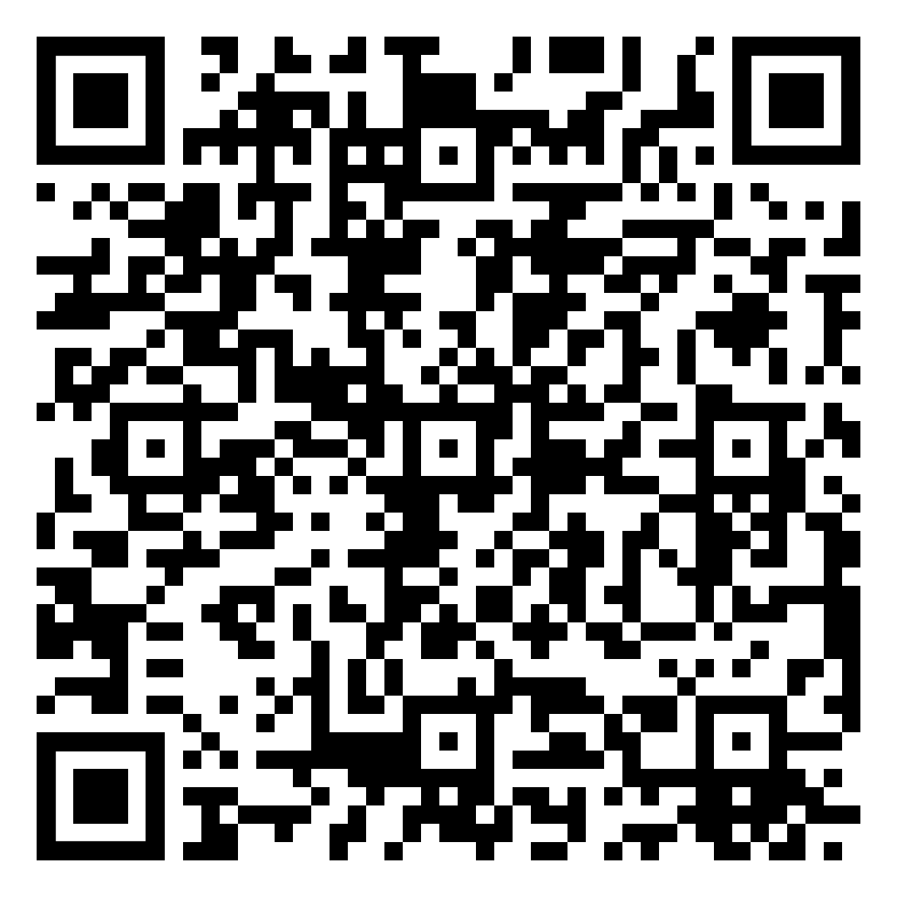
Our Research
JPED 37(3)
Promising Outcomes
Notes:
LARRY reads
Next slide: Larry

Slide 9
DS and CS Professionals Working Together:
What the Data Say
“Cross training” between Disability Services and Career Services offices to create meaningful career preparation to undergraduates with disabilities (Madaus 2006; Pilette 2019)
Career services are more helpful when those professionals are knowledgeable about the unique needs of job-seekers with disabilities (DiYenno et al. 2019)
Partnerships between these two campus resources create opportunities for students with disabilities to obtain field-related internships, resulting in greater self-advocacy skills and a clearer understanding of one’s strengths and needs as an employee (Mamun et al. 2018)
Notes:
LARRY reads
Next slide: Heather

Slide 10
Campus Connections:
The Fehribach Center’s CoP Partnership
Representatives from Disability Services and Career Services from campuses in Midwest region
Quarterly virtual meetings facilitated by Fehribach Center staff
At each meeting, one campus takes the lead in presenting its programming, challenges and successes
Google site used to share resources and materials
Each campus creates a summary report (successes, evaluation reflections, next steps, artifacts) at end of year
A new twist: piloting a CoP with out-of-region campus
Notes:
HEATHER reads
Next slide: Heather

Slide 11
CoP Pilot: The Fehribach Center & UW
University of Washington located in Seattle
Large, research university (R1)
40,754 undergraduates
6,313 graduate students
Disability Resources for Students (DRS) coordinates accommodations for ~7,000 students (approximately 7% of UW Seattle students)
Notes:
HEATHER reads
Next slide: Heather
DRS serves ~7,000 students across all three campuses; however,

Slide 12
UW Career & Internship Center
Served 10,052 students (AY 2023-2024)
3,966 1:1 coaching sessions
3,505 Workshop attendees; 6,128 Career Fair attendees
Outcomes for CS users after graduation:
  62.3% employed full time
  85% ‘positive outcome’ (employed full time, employed part time, employed in volunteer service, and continuing education)
Notes:
HEATHER reads
Next slide: Travis

Slide 13
Reflection: Ever Been Asked?
How many of you have had questions about jobs or internships from students?
Did you have the answer(s)?
Were you aware of experts or resources immediately available on/around your campus?
Notes:
TRAVIS reads
Next slide: Travis
- invite folks to respond however they can - call out, raise hands, jot things down
- ask folks to reflect on these questions;
- everyone take a breath
- invite folks to share any opinions

Slide 14
Initial Concerns about Joining CoP...
DRS office already feeling stretched thin
Will this be a lot more work?
Not sure if these are the right people to work with on a project like this
My supervisor will never sign off on another project for me…
Notes:
TRAVIS reads
Next slide: Travis

Slide 15
Buying In: the ‘Aha!’ Moment
You don’t need to have all the answers!
Benefit from combined expertise of colleagues
There is a plan (no need to start from scratch)
This doesn’t involve you taking everything on at once nor doing this alone
Notes:
TRAVIS reads
Next slide: Travis

Slide 16
It starts with one internship for one student
Take it slow
Minimize individual effort, maximize collaborative impact
Realized that this is truly a continuation of what we already encourage across campus
Once I understood that we could start small and then scale up, this project started to roll
Notes:
TRAVIS reads
Next slide: Travis

Slide 17
Student Concerns at Onset
Worried about positioning or “optics”
Unsure how much agency student would be given in the process
Will this be a meaningful, relevant internship experience?
Did not want to feel “like a guinea pig”
Notes:
TRAVIS reads
Next slide: Heather

Slide 18
Pilot CoP Outcomes at a Glance
Administered student survey on career fair accessibility
Fleshed out disability “identity” page on CS website
Student education: Zoom panel on internship and job search with disabled UW alumni (41 registered, 20 attended synchronously)
Employer education: webinar on accessible hiring and onboarding practices (80 registered, 48 attended synchronously)
Growing list of “ideas not yet implemented” document
Coordinated paid, 2025 summer internships for two disabled students with employers related to academic majors (!!)
Notes:
HEATHER reads
Next slide: Heather

Slide 19
Example 1: Career Services ‘Identity’ Webpage for Students with Disabilities
“At the UW Career & Internship Center, we are committed to helping all disabled, D/deaf, and neurodivergent-identifying students find satisfying experiential learning opportunities and gainful employment” webpage link
Resources include disability employment articles, videos, tips, strategies for disclosure, interview prep materials, etc.
Features “testimonials” from current and former disabled students
Provides “alumni profiles” with current job title, location, and link to connect with the alumni
Notes:
HEATHER reads
Next slide: Heather

Slide 20
Example 2: “Succeed in the Internship & Job Search as a Student with a Disability” Panel
Recruited 4 UW alumni to talk about internship experience or transition to full time employment
  Variety of self-reported disabilities: visual impairment, achondroplasia, Deaf, ADHD, Bipolar Disorder
  Mix of college majors: Engineering, Sociology, Public Health, MBA
  Mix of gender identities, race/ethnicities, employment organizations
41 students registered, 20 attended synchronously
At least one panelist reported being contacted by students afterwards for follow up advice
Notes:
HEATHER reads
Next slide: Heather & Travis

Slide 21
Example 3: Two Paid Summer Internships
Internship aligned with academic interest: one student placed in tech company, other student placed in inclusive healthcare practice
Interns to complete bi-weekly reflection journal
Mid internship check in scheduled with both intern and manager
Opportunity to attend 8 professional development webinars with other Fehribach interns
Interns and managers to complete end of internship evaluations
Notes:
HEATHER & TRAVIS
--include quote from Vic??

Slide 22
Other Impacts: the ‘Ripple’ Effect
Students working inside DS office, getting services from DS office, and even prospective students have expressed increasing interest & appreciation for this project
This CoP has been helpful for multiple other objectives for DS office, from staff development to campus engagement
Notes:
HEATHER reads
Next slide: Heather

Slide 23
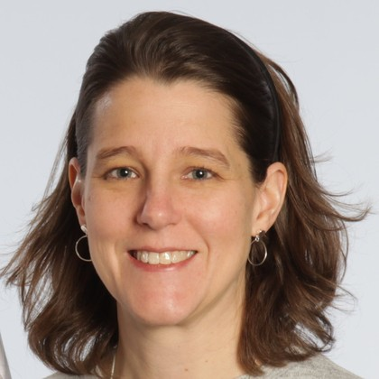
Briana Randall, Executive Director of UW Career & Internship Center
“It's been a personal privilege and delight to work with this group. It's also been really rewarding just to see some of the tangible things that have already occurred, and I have immensely enjoyed and been humbled learning more about this space, learning more about disabilities and how to be accessible in all the different ways. …I am so glad and privileged to be part of this community of practice and to be improving our work in this area.”
Quote from AccessUW Podcast, Ep 17: Career Services (link)
Notes:
HEATHER reads
Next slide: Larry

Slide 24
Reflection:
What is Your Low Hanging Fruit?
Who do you know at your campus that you might network with to develop a connection with your campus Career Services?
What are some concrete things you can work with others to do to increase access to career services or internships for disabled students on your campus?
What are the most important resources you would need to take action?
Notes:
LARRY reads:
Next slide: Larry (thank you)
-discussion for 7 mins

Slide 25
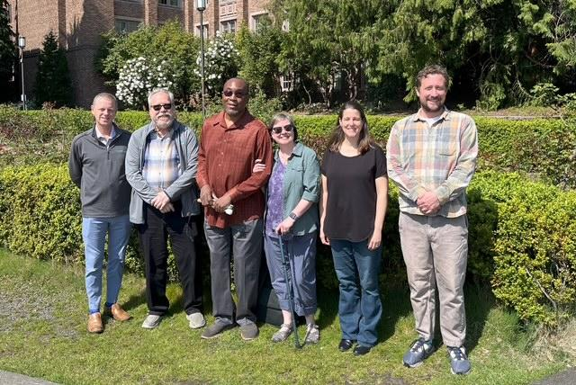
Thank You & Please Take a Handout!!
Left to right:
Larry Markle
David Parker
Carlos Taylor
Heather Evans
Briana Randall
Travis Hyde
Seattle, April 2025
Notes:
LARRY reads:
Next slide: Larry &David (AHEAD evaluation)

Slide 26
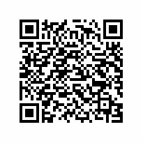
Session Evaluation
tinyurl.com/AHEADFeedback
Your feedback helps shape future programming.
Thank you for attending!
Notes:
DAVID

