Slide 1

A Comparison of Student Use of Closed Captioning and Interactive Transcripts in Online Courses
Lyman Dukes III
Karla Kmetz-Morris
University of South Florida St. Petersburg
Presentation at
AHEAD, July, 2017
Notes:
Trey
Who is our audience today? We did a session in 2014, was anyone here today at that session? Are there professionals here who have registered students requesting captions? As we move thru the session, please ask questions and share your experiences with your session partners. While we have knowledge leading this specific project at our institution, neither Dr. Frechette nor myself lead an OSD, so your experiences can help helpful to other institute attendees.

Slide 2
Or - what might be better titled -
Beyond Compliance:
An Examination of the Use of Distance Learning Accessibility Features for All Students
Notes:
So, after taking a look back at the conference proposal we submitted some months ago, I realized the title we’d provided for this session didn’t effectively capture what the session content actually addresses. So, I’ve taken another shot at titling the session and included it here – Really what we’re talking about are accessibility features that go beyond what institutions of higher education are currently obliged to provide.

Slide 3
Session Objectives
Discuss legislation and relevant literature
Discuss study results and the potential benefits of interactive transcripts particularly in comparison to closed captioning
Share rationale for use of interactive transcripts and/or closed captioning in online courses given study outcomes
Share conclusions and next steps
Notes:
This slide spells out our session objectives or, better said, our road map for the next 60 minutes or so.
We’ll look at legislation and relevant literature, discuss the pilot study results and potential benefits of the use of interactive transcripts and closed captioning, and a rationale for the use of these online accessibility tools as well as conclusion and next steps -

Slide 4
USFSP Accessibility Committee
The Institution’s ‘Accessibility Committee’ conducted a pilot study to examine the cost and benefit of captioning all online course video content
Next, the ‘Committee’ conducted a pilot study on the benefits of interactive transcript use including a comparison to closed captioning
Notes:
Our institution convened an ‘accessibility committee’ about 7 or so years ago. Its comprised primarily of OSD staff, myself a special education professor, a number of distance learning staff, and Dr. Frechette who serves in our institution’s digital journalism program. We’ve been given relative freedom to address accessibility concerns campus-wide – particularly with regard to online instruction – and a portion of what we’ve chosen to do is take a closer, scientific look at various online instructional practices we believe will benefit not only students with disabilities, but, instead, all students. About 4 years ago we examined the use of captions in the videos used in a two of our larger online courses and more recently, and the focus of the presentation today, we’ve looked at the use of interactive transcripts in – again – two of our larger enrollment online courses.

Slide 5
Project Background
Learner (Input)
  Voice recognition
  Keyboard navigation
  Gesture navigation
  Customized mouse behavior
Technology (Output)
  Captioning
  Interactive transcripts
  High contrast
  Large type
  Alt text
Notes:
KARLA (OR DELETE?)

Slide 6
What is Closed Captioning?
Text version of the audio portion of a presentation displayed synchronously with the audio
Notes:
While, I suspect most, if not everyone in the session today knows what closed captioning is – We’ll take a moment and just review its definition -

Slide 7
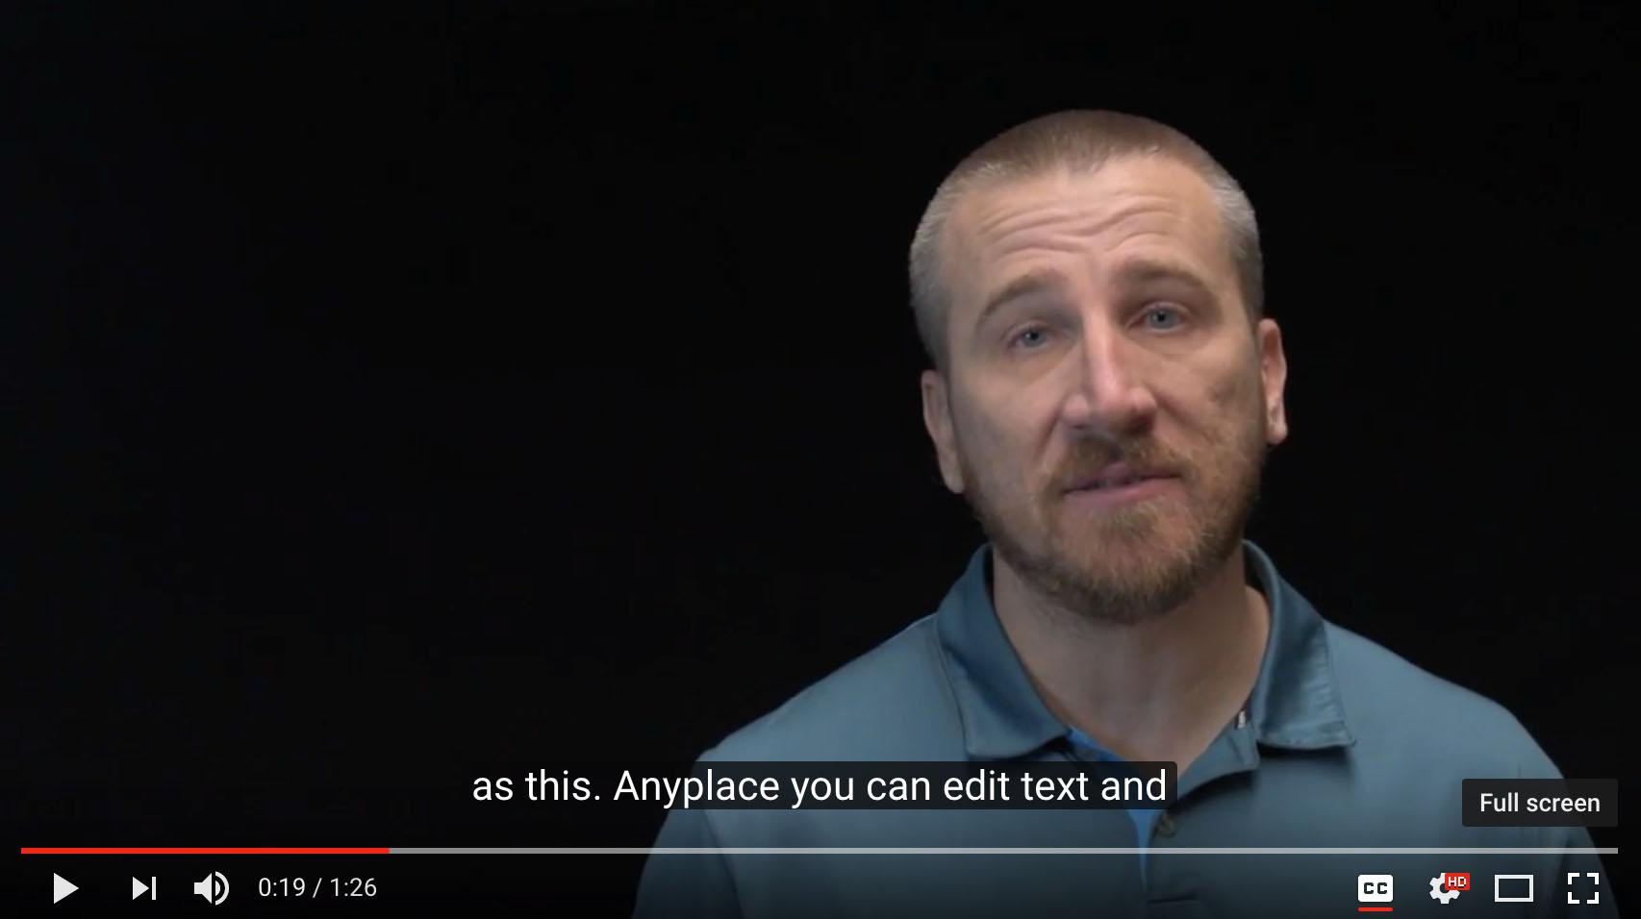
Closed Captioning:
An Example
Text of audio in concert with spoken word
1976 - FCC approves closed captioning
Distance Education faces a journey similar to that of TV with regard to captioning, though it is being widely adopted more quickly
Notes:
Here we see a screen grab of precisely what would an online video would look like with captions.
As you know captioning the tv environment is standard today, and there are laws governing its use.
Distance education faces a similar journey as TV with laws governing its use in place. The challenge is that there are thousands of educational videos made each year. They are typically not closed captioned at the outset.

Slide 8
What is an Interactive Transcript?
Interactive transcripts provide viewers with an auto-scrolling script
  Words highlight as they’re spoken
  Viewers can search, navigate, and print the text
Notes:
A more pertinent topic for discussion is – What is an interactive transcript – Interactive Transcripts are a new tool for media consumption. Similar to subtitles in many ways, an Interactive Transcript is displayed beside the audio or video source. As the user hears the words being spoken, the matching words in the transcript are underlined or highlighted. Interactive Transcripts allows users to interact with video in an entirely new way. Users can search the transcript of the video and navigate to an exact point by clicking on any word.

Slide 9
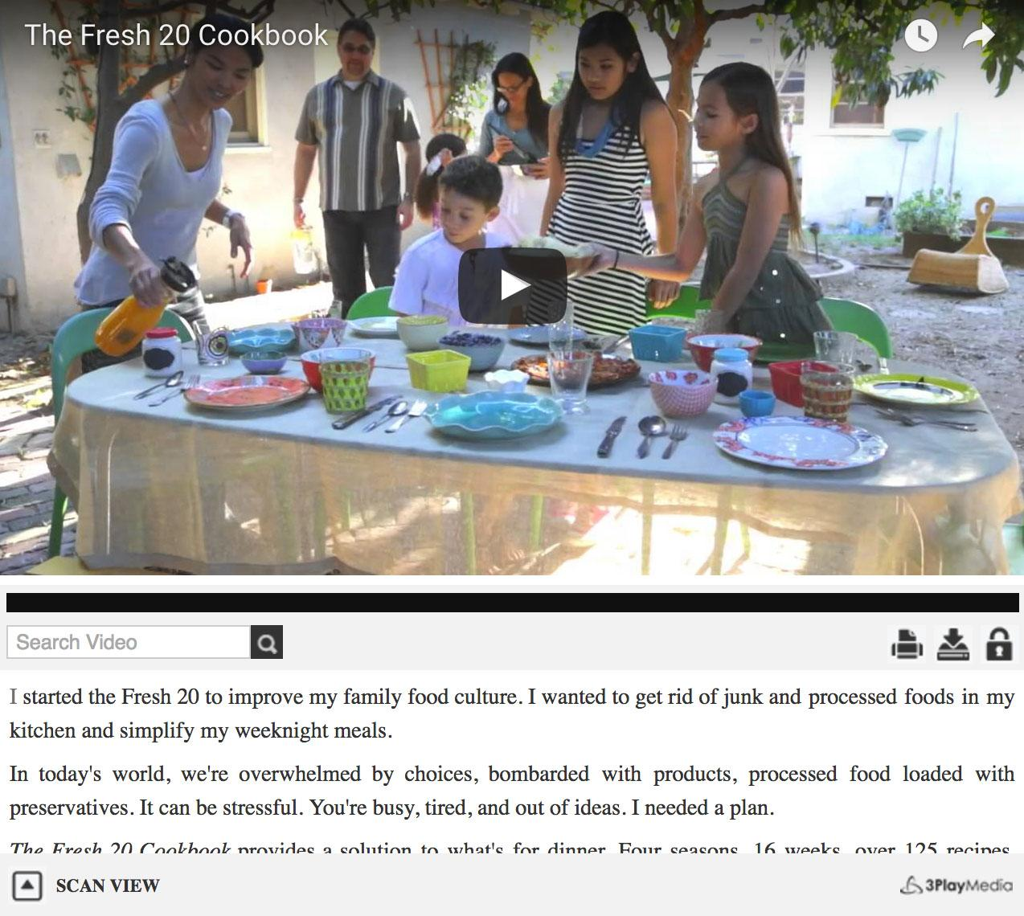
Interactive Transcripts:
An Example
Auto-Scrolling Script
Words Highlight as Spoken
Search, Navigate, and Print Text
Example Video
Notes:
We’ve included an example here that you can check out on your own. In the interest of expense to the institute, we did not request wi-fi access for the session today.
DO WE HAVE NET ACCESS??

Slide 10
Legislation
Online Communication / Access
  Section 508 of the Rehabilitation Act
  Title II of the ADA
  The DOJ and OCR have taken positions
Numerous court rulings in regard to captioning
None for interactive transcripts at this time
Notes:
Online communication and access have been addressed legislatively in a number of ways – section 508 indicated electronic communications be accessible if institutions receive federal funds, the ADA states communications be equally effective for persons with or without disabilities, the DOJ has noted that the ADA applies to online communication, and OCR has indicated that public entities may be out of compliance if they are responding to accommodation requests on an ad-hoc basis – (Have a policy in advance of accommodation requests)

Slide 11
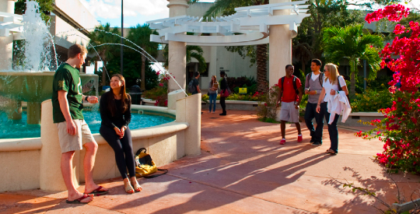
Institutional Policy
USF System Policy (USF / USFSP / USFSM)
  All online and face to face media must be captioned by 2021
Notes:
USF policy: http://regulationspolicies.usf.edu/policies-and-procedures/pdfs/policy-10-506.pdf
Our university system has determined that media used at our institution be captioned no later than 2021 – Faculty who would like to receive stipends for the development of online courses must be in compliance with the quality matters guidelines for online instruction and one of the guidelines references the captioning of online courses.

Slide 12
Our Position
(not necessarily the position of the Institution)
Closed captioning improves accessibility
Interactive transcript use moves us further along the universal design continuum
Access does not equal compliance, but effectiveness of the access - timeliness, accuracy, and appropriateness - must be addressed (Carnevale, 1999)
Notes:
The bottom line is that merely providing access does not mean that institution’s have met their compliance obligation.
That access must be effective – specifically, the timeliness, accuracy, and appropriateness of the information provided electronically must be addressed. Only then may we be meeting the spirit of our legal obligation. We believe interactive transcripts move us closer to that place – A course experience should be the same for students with or without a disability.

Slide 13
Literature Says …
Closed Captioning
For Students Diagnosed
Students with hearing impairments most often report issues with the inaccessibility of audio/video material
Second digital divide …
Adds another level of complexity but does help …
For Students not Diagnosed
‘Provides an additional level of comprehensive input when learning a new language’
‘Yielded more positive attitudes and improved vocabulary’
‘Improved vocabulary, reading comprehension, word analysis skills, and increased motivation in a remedial reading course’
Notes:
While not a comprehensive look at the literature on captioning, we would like to share a few highlights.
Students with hearing impairments have issues with audio / video inaccessibility and also note in this study that the issues are typically resolved at the instructor level. Another study noted that students with disabilities experience a second digital divide due to accessibility issues with technology. (the first technology digital divide speaks to the idea that tech is less available to certain groups of individuals, including persons with disabilities – accessibility issues exacerbate this). An additional study noted here reported that students with hearing impairments on average had an 8th to 9th grade reading level and visual text alternatives and complex sentence structures resulted in an additional level of complexity for these individuals.
For students without a diagnosis – captions have helped students learn a new language, improve attitudes toward courses, and improved vocabulary knowledge, reading comprehension, and so on.

Slide 14
Literature Says …
Interactive Transcripts
In one study:
  97% of students
    Said interactive transcripts enhanced their learning experience
    Found the interactive transcript interface easy to use
    Found transcript-based navigation useful
  95% of students
    Recommended that interactive transcripts be used more widely
    Were able to find the desired content
Notes:
http://www.3playmedia.com/customers/case-studies/mit-opencourseware/
While we didn’t conduct an exhaustive review of literature, we did make a reasonable effort to determine what does exist with regard to the examination of online course use of interactive transcripts.
A study completed by an online media organization found that almost all students in the study believed the use of the interactive transcript enhanced their learning, and found the interface easy to use. They also found the content they were seeking and would recommend that the technology be used more widely.

Slide 15
Interactive Transcript Study:
How Students Used It
Move at their own pace
Learn in a multi-sensory mode
Create study guides
Improve comprehension of complex scientific concepts
Understand English as a second language
Stay focused on 60-minute lectures
Notes:
In the same study students were asked how they used the technology and they indicated that it allowed them to move at their own pace, it enhanced their multi-sensory learning ability, they used the transcript to develop study guides, it improved focus and with respect to content it improved their comprehension of scientific concepts and their ability to understand english in the case of students for whom english is a second language -

Slide 16
Goals of the Current Study
Do students find an interactive transcript useful?
How do students use the interactive transcript?
  Searching, navigating, and so on.
Is there a significant benefit - that is observed and reported - to interactive transcripts versus closed captioning?
Notes:
In the current study we wanted to determine the following: Do students find an interactive transcript useful?
How do students use the interactive transcript?
Searching, navigating, and so on.
Is there a significant benefit - that is observed and reported - to interactive transcripts versus closed captioning?

Slide 17
Method
The research setting
  USFSP, part of the USF System, with about 6,500 students
  An urban campus in downtown St. Petersburg
  In fall & spring, online courses generate about 30% of SCHs
  In summer, online courses generate about 60% of SCHs
Notes:
We’re a relatively small institution as our student body in total – both full and part-time – is approximately 6,500.
We are an urban campus with most of our students coming from our region though that is slowly changing. Many of our local students are choosing online courses over face to face course sections.
Online course offerings – like many places – are on the increase and currently nearly a third of our student credit hours are generated thru online courses.

Slide 18
Method
The course
  Online, upper-level course on Developmental Psychology taught in fall 2016
  Primary content: Full-length lecture capture videos
    Instructor and on-screen presentation materials
    Filmed in distance learning studio with a live audience of 32 students
Notes:
The pilot study was completed through a fully online psychology course – Students completing the course accessed full-length lecture capture videos in which they were able to view both the instructor giving a traditional lecture and the presentation materials used by the faculty member. The course had been filmed with an earlier set of students who participated in a live version of the course.

Slide 19
Method
The course
  25 video lessons totaling 27 hours and 17 minutes of content
  Each week, one or two videos were delivered
  The average length was just over one hour
Notes:
Ultimately, the course included 25 video lessons that totaled better than 27 hours of course content. – With a 16 week course, this meant that sometimes students were required to view more than one video per week and with 25 videos resulting in 27 hours of content, the average length was just north of one hour.

Slide 20
Method
The research design
  Students who opted in were randomly assigned to one of two groups:
    Videos with closed captioning (CC)
    Videos with CC and interactive transcripts (IT)
  Students received a short orientation video about each feature
  All other aspects of the course were identical
Notes:
Students, when beginning the course, had to agree to participate. Those who chose to do so, which included the vast majority of the students, were then randomly assigned to either a closed captioning group – which was the business as usual group – or instead were assigned to a group that viewed videos with closed captioning and the interactive transcript.
Because the transcript, in particular, was going to be a novel experience, we provided both groups with a short orientation video describing what each feature was and how to employ them. Otherwise the two groups taking the course had an identical experience.

Slide 21
Method
All videos delivered via VideoJS, an open-source HTML5 video player
Advantages
  Place captions below videos
  Customize font for maximum readability
  Provide option to turn captions off
  Provide other playback controls
  Option to track student interactions with controls
Notes:
KARLA

Slide 22
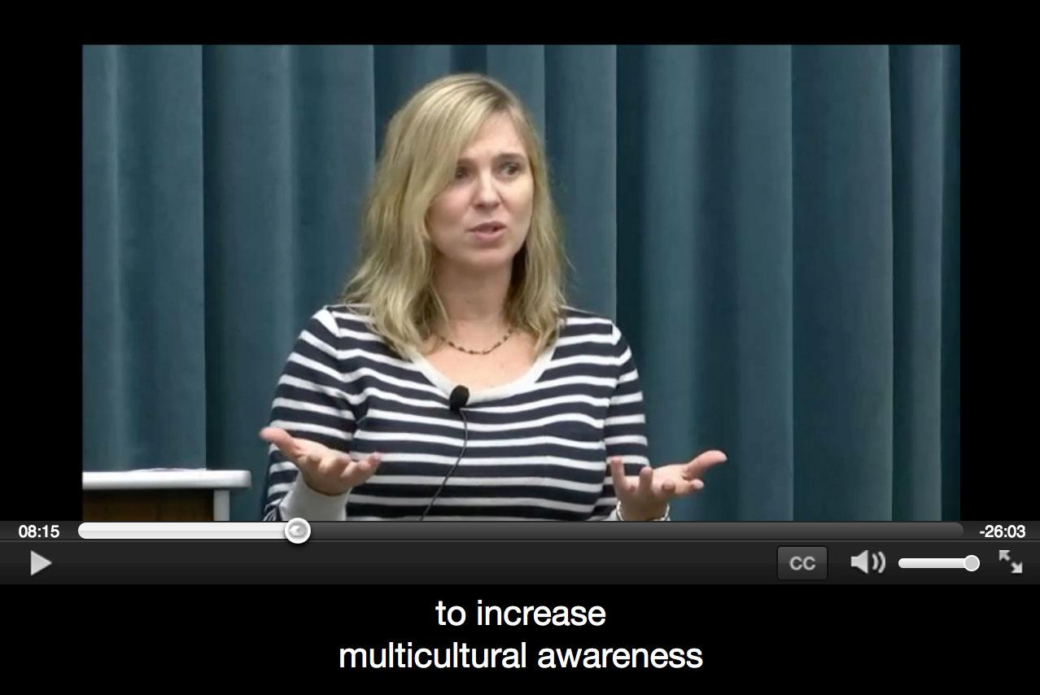
Notes:
So, what we’ve done here is share a screen grab of what the closed captioning group would have seen during one of the course lectures – As you can see it is essentially identical to the captioning example we shared earlier.

Slide 23
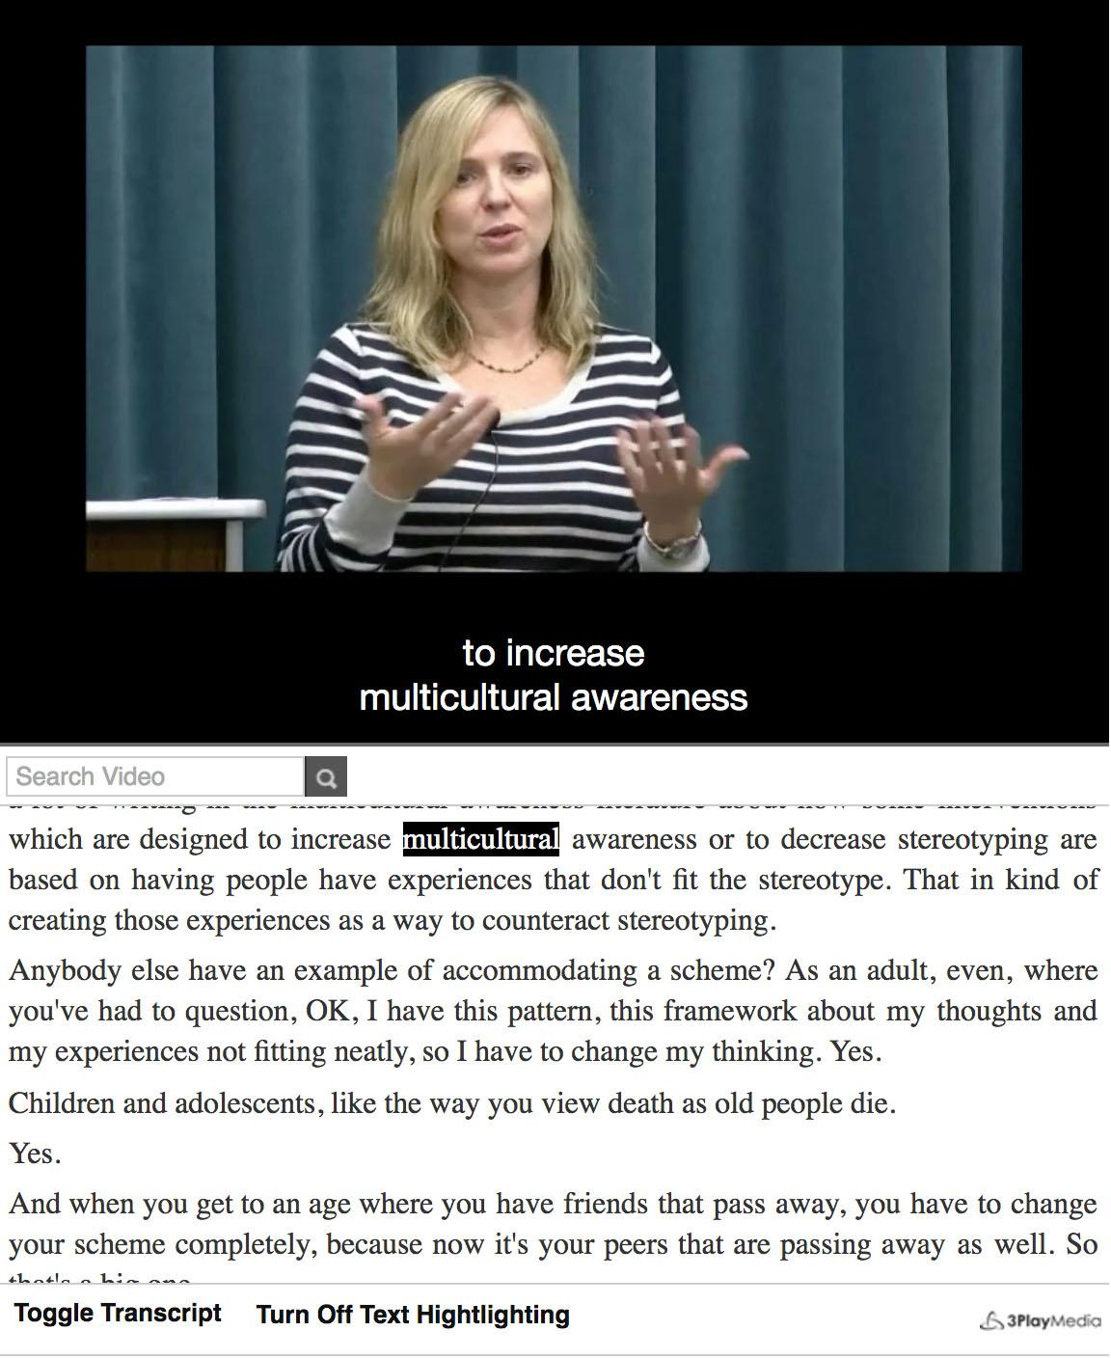
Notes:
Next, this is what the captioning plus interactive transcript group saw as they viewed the online lecture content. This particular example shows the faculty member stating the word ‘multicultural’ at this moment – And the reason we know this is that it is the term highlighted at the moment the screen grab was taken. You can also see a couple of tabs at the bottom, which are tools available to the viewer. One is toggle transcript an the other is allows the viewer to turn off text highlighting.

Slide 24
Method
CC was enabled by default and could be turned off
ITs were enabled by default and could be turned off, CC was disabled by default for this group but could be turned on
Notes:
For the captioning only group the captions were activated by default and could be turned off the student, while the transcript group had the transcript on by default and the captioning off by default. Both could be modified either on or off by the student.

Slide 25
Method
The participants
  Over 80 students agreed to participate in the study and completed the pre test
  37 students completed the post-test and are included in this analysis
  Of those, 32 watched one or more videos throughout the semester
Notes:
In total, a little more than 80 students agreed to participate and completed the course pre-test – which we’ll refer to later when we discuss results. A smaller number complete the post-test with a slightly smaller number having viewed two or more videos.
Is anyone considering completing a study of this nature? CAVEAT!

Slide 26
Method
The participants
  Gender
    27 female
    9 male
    1 unidentified
  Classification
    2 freshmen
    2 sophomores
    16 juniors
    15 seniors
    2 grad students
Notes:
Here we provide a breakdown of the demographic data by gender and student classification from freshman to graduate student.

Slide 27
Method
The participants
  Disability status
    Six participants indicated having a disability
    Four in the CC group
      Chronic Medical Disorder
      Learning Disability
      Physical Disability
      Other
    Two in the IT group
      Mental Illness
      Learning Disability
    One student registered with Disability Services
Notes:
Of course, we also asked students about disability status – We had 4 in the captioning section and 2 in the transcript group. A follow up question was asked about whether they were registered with the OSD – Only 1 was, thus further highlighting the value of accessibility tools in our courses campus wide.

Slide 28
Method
Pre-test
  Content questions based on course objectives
Post-test
  Content questions based on course objectives
  Perceived extent of usage
  Other experiences with CC/IT
  Disability status
  Demographic information
Notes:
CASEY GOING FORWARD

Slide 29
Quantitative Analysis
Were captions helpful?
  CC (n=15):
    Slightly: 20%
    Moderately: 33%
    Very: 27%
    Extremely: 33%
  IT (n=13):
    Slightly: 31%
    Moderately: 23%
    Very: 15%
    Extremely: 31%

Slide 30
Quantitative Analysis
Was the interactive transcript helpful?
  IT (n=18):
    Not at all: 6%
    Slightly: 11%
    Moderately: 11%
    Very: 28%
    Extremely: 44%

Slide 31
Quantitative Analysis
Would you always want the option for captions?
  CC: 14 of 18 (78%)
  IT: 15 of 19 (79%)
  Overall: 29 of 37 (78%)

Slide 32
Quantitative Analysis
Pre/Post performance
  Overall, among those who watched at least one video (n=32), scores improved from 60% to 70% from pre- to post-test, or one letter grade.
  CC group (n=15) improved by six points
    from 69% to 75%.
  IT group (n=17) improved by 13 points
    from 53% to 66%
Notes:
(the average post test score factoring those five participants who watched no videos was slightly lower, or 67 percent.)

Slide 33
Quantitative Analysis
Video viewing habits
  Participants in the CC group spent an average of 11 hours and 14 minutes watching videos
    40% of all content
  Participants in the IT group spent somewhat longer -- 11 hours and 52 minutes on average -- watching videos
    44% of all content

Slide 34
Quantitative Analysis
Video viewing habits
  In the CC group:
    Seven participants watched 37 percent of less of the content
    Eight participants watched 50 percent or more of the content
    Three participants did not watch any content

Slide 35
Quantitative Analysis
Video viewing habits
  In the IT group:
    Nine participants watched 26 percent or less of the content
    Eight participants watched 67 percent or more of the content
    Two participants did not watch any content

Slide 36
Quantitative Analysis
Sessions per video
  CC group:
    4.92 sessions per video
    About 5 minutes per session
  IT group:
    3.63 sessions per video
    About 8 minutes per session

Slide 37
Quantitative Analysis
Turning assistive technology off
  CC group:
    13 participants never turned captions off
    One participant turned them off just once
    Four participants disabled them multiple times
      3, 5, 6, 16
  IT group:
    Four participants turned captions off once
    Three participants turned them off twice

Slide 38
Quantitative Analysis
Using IT tools
  IT group:
    Searched for 8.95 words on average
      Seven participants used this capability
      Four participants searched for at least 22 words, and one searched for 68 words
    Clicked on 19.74 words on average
      10 participants made use of this feature, with one participant clicking on 277 words
      The remaining nine participants clicked on an average of 10.89 words each

Slide 39
Qualitative Analysis
If closed captioning was distracting, why?
  Because it makes listening harder
    “Only because I caught myself reading instead of listening.”
  Because of errors in the captions
    “They were often incorrect.”
  Because of technical problems
    “In full screen mode the captions would block portions of the powerpoint presentation.”

Slide 40
Discussion/Conclusions
Finding #1: Students want closed captioning and find it helpful
  93% of participants found closed captioning at least moderately helpful
  Nearly 80% always want the option of closed captioning

Slide 41
Discussion/Conclusions
Finding #2: Students who worked with interactive transcripts found them particularly helpful
  44% said interactive transcripts were extremely beneficial

Slide 42
Discussion/Conclusions
Finding #3: Both closed captioning and interactive transcripts made a difference in student learning
  Overall, scores increased a letter grade
  The IT group showed twice as much improvement, with scores ranging from 53% on the pre-test to 66% on the post-test

Slide 43
Discussion/Conclusions
Finding #4: Students may not be watching recorded lessons as much as we think
  On average, participants watched 11 hours and 14 minutes of video -- just 40% of the available content
  Interactive transcripts seemed to encourage slightly more watching
  About half of participants watched very little, and the rest watched quite a bit. But few are in the middle

Slide 44
Discussion/Conclusions
Finding #5: Students watched videos in spurts
  Students watch in brief sessions. The average video was viewed in about five distinct sessions for the closed captioning group, with each session lasting about five minutes in length
  The IT group watched videos for longer in fewer sessions

Slide 45
Discussion/Conclusions
Finding #6: Students tended to leave captions on
  The majority never turned them off
  A handful turned them off just a few times across dozens of viewing sessions
  Only one participant regularly turned them off

Slide 46
Discussion/Conclusions
Finding #7: IT tools aren't used by everyone, but some students were heavy users
  One student searched for 68 terms
  Another clicked 277 words

Slide 47
Discussion/Conclusions
Finding #8: For those who find closed captioning distracting, it's mainly because it takes their focus away from what's being said
  Some students felt they could not read and listen at the same time

Slide 48
Discussion / Conclusions
Educate Administrators
Educate and Train Faculty
Educate and Train Students
Develop and Adopt e-learning / accessibility Guidelines
Convene a campus accessibility committee
Look for ‘friends’ doing similar work and share
Further Research
Notes:
In summary what are some takeaways from the presentation today – 1. we undertook this project at our institution with the goal of educating administrators on our campus about the value of both captioning and interactive transcripts - Given that administration on our campus are especially focused upon state defined performance metrics tied to institutional budget, it is important that we communicate the value of captioning and interactive transcripts for student academic success. 2. we recommend educating and training faculty about the value of online accessibility features. Look for well respected department champions who can share their positive accessibility experiences with their colleagues. Also look for opportunities to share this kind of information at department, college, and campus-wide meetings. Work to develop a culture that values UD / accessibility methods and attempt to tie these to issues that matter to each academic audience 3. Train students how to best use the accessibility tools. Consider a module that describes how to best use the tools. Communicate that this is campus-wide responsibility, not just an OSD job. 4. Consider accessibility guidelines that can be shared / promoted campus-wide – If you have not already done so. 5. Consider a standing committee such as ours – If you have not already done so.

Slide 49
Looking Forward
This research can be expanded by:
  Recruiting more students
  Testing in different courses
  Testing with videos produced solely for online students

Slide 50
Thank You
Please share your experiences with captioning at your institution and ask any questions you may have.

Slide 51
References
Carnevale, D. (1999, October 29). Colleges strive to give disabled students access to on-line courses. Chronicle of Higher Education, 46(10), Retrieved May 22, 2014, from http://chronicle.com/article/Colleges-Strive-to-Give/13474

Slide 52
Thank you very much for
sharing your time with us.
ldukes@usfsp.edu
kmetz1@mail.usf.edu

