Slide 1

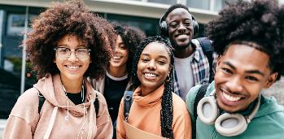


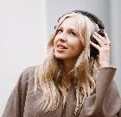
Swimming Upstream
Navigating the Shift from Compliance to Proactive Inclusion

Slide 2

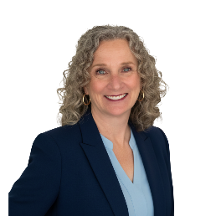
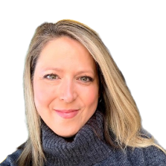
Meet the Team
Colleen Sandquist
Strategic Partner Manager
ReadSpeaker
Erin Martin
Director of NA Education
ReadSpeaker

Slide 3

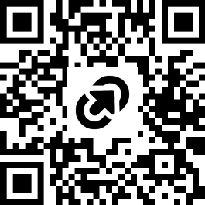
Access the Presentation
https://tinyurl.com/mw5dcz3n

Slide 4


ReadSpeaker Beliefs
At ReadSpeaker We Believe
At the heart of every student is a learner who wants to thrive.
In proactively breaking down barriers through innovation and technology making education accessible to all.
By supporting faculty & educational leaders, we are creating a brighter tomorrow for all learners.
Notes:
Brief talk through our session
Audience participation -
How do we address these challenges or meet them head on

Slide 5

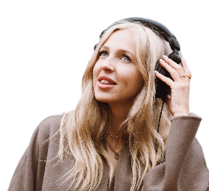
Today’s Discussion
The inspiration
Under the sea: Supporting diverse learners
Just keep swimming: moving towards inclusion
The life preserver: ReadSpeaker

Slide 6


Upstream
By Dan Heath

Slide 7


The Data Tells Us
National study of over 23,000 9th grade students with identified disabilities, surveyed between 2009 and 2016. Among students who responded that they did have a disability while attending college, about one-third of students (37 percent) informed their college. Source

Slide 8

Under the Sea

Slide 9
The New Majority Learner
  Working students
  Veterans
  Students caring for elderly parents
  1st generation college students
  English language learners
  Low income
  Neurodiverse
source

Slide 10

Just keep swimming

Slide 11
A Move Toward Inclusion
Reactive
Proactive
Potential grievances
One by one support
Costly - time and resources
Set apart / feeling “othered”
Missed opportunities for social & academic inclusion
ADA Compliance - coming soon!
Removing Stigma - students feel seen
Improved academic performance
for ALL
Increase in course retention & graduation rates
Enhanced reputation, enrollment & diversity of student populations

Slide 12




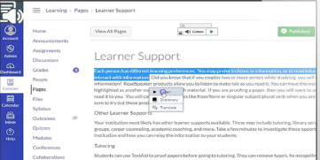


ReadSpeaker in the LMS
v. Browser Extension
Browser Extension
Limited to plain text on webpages
Inconsistent
Potential security risks
Requires internet access
Natively Embedded
Access to content across the LMS
Seamless user experience
Secure and consistent
Offline access with MP3 download
Notes:
MASTER _ reading order correct!

Slide 13

The Learner
  Documented need
  Preferred
  Occasional
  Situational

Slide 14
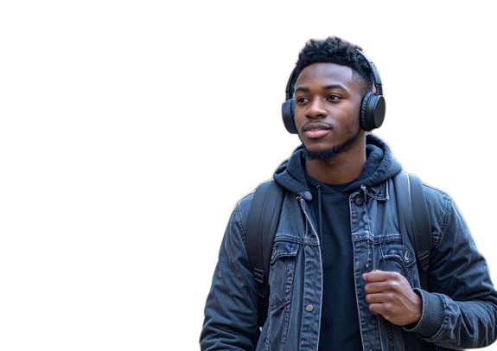
The Multimodal Edge
Dual Coding Theory source
Reduces cognitive load
Better retention of material
Boost Accessibility & Focus
Eyes & Ears working together
Supports neurodiversity
Accelerated Language Mastery
Word Mapping
Supports English language learners

Slide 15




Universal Design for Learning (UDL)
The goal of UDL is to support learner agency
Multiple Means of:
  Engagement
  Representation
  Action & Expression
UDL Guidelines

Slide 16


The ReadSpeaker Advantage
1
2
3
4
5
Seamless Integration
Alternative Formats
A11Y/Inclusive Tools
Quizzes/
Proctoring Solutions
Human-Like Voices
Certified integrations into ALL major LMS platforms
Straight forward instructions to support the ease of implementation
Streaming
MP3 download
OCR
Enlarged Text
Multimodal learning
Highlighters with collection for notes
Text Mode
Translation
Dictionary
Respondus
Honorlock
All majoring proctoring platforms
Over 200 voice options
50+ Languages
Customization available
Access for your website

Slide 17


Time for a demo of

Slide 18

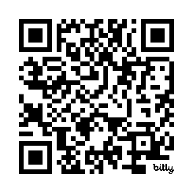
Resources
bit.ly/4xLn0qA

Slide 19
THANK YOU!

