Slide 1
Presentation Title
Presenters

Slide 2
Conference Civility Statement
We ask you to join us in creating a culture that reflects…
Access and Inclusion
and
Civility and Respect
…this week and in all aspects of our organization.

Slide 4
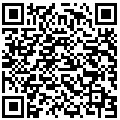
Session Evaluation
tinyurl.com/AHEADFeedback
Your feedback helps shape future programming.
Thank you for attending!

