Slide 1
AHEAD Business Meeting 2020

Slide 2
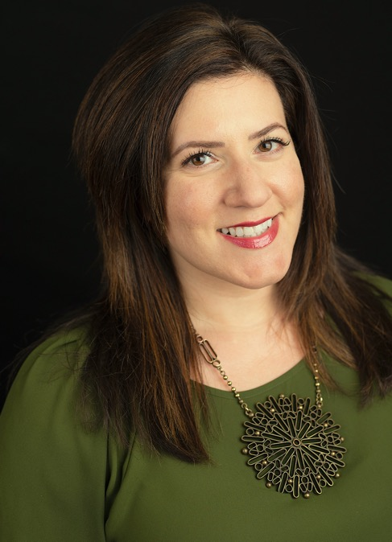
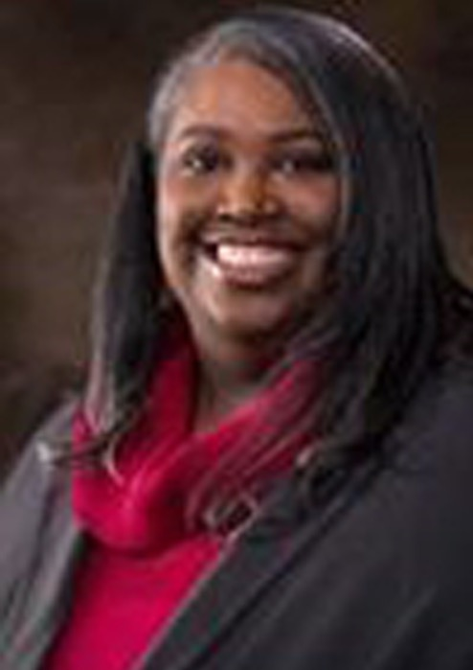
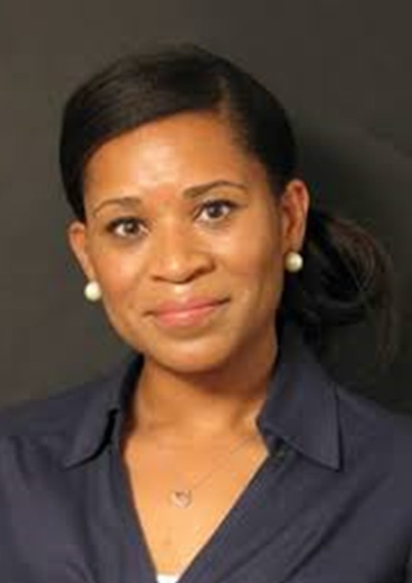
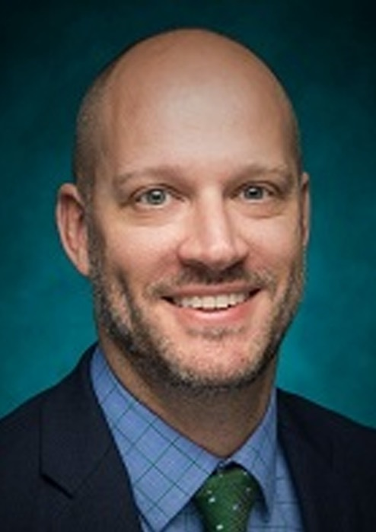
Amanda Kraus
AHEAD President
The University of Arizona
Katy Washington
President-Elect
University of North Texas
Crystal Hill
Director at Large
Texas Woman’s University
Chris Stone
Director at Large
Washington University
in St. Louis
AHEAD Board of Directors: Returning Members

Slide 3
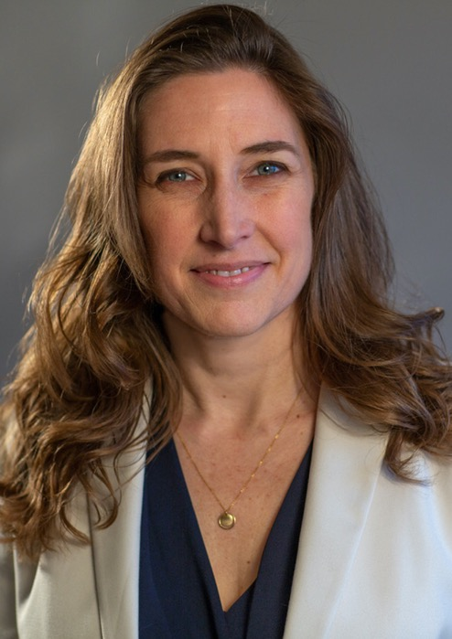
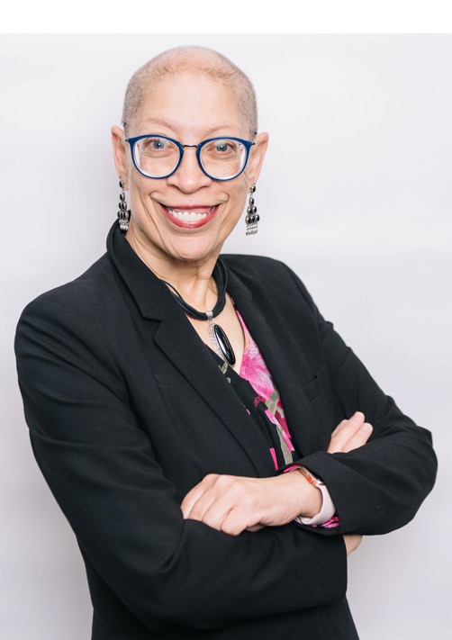
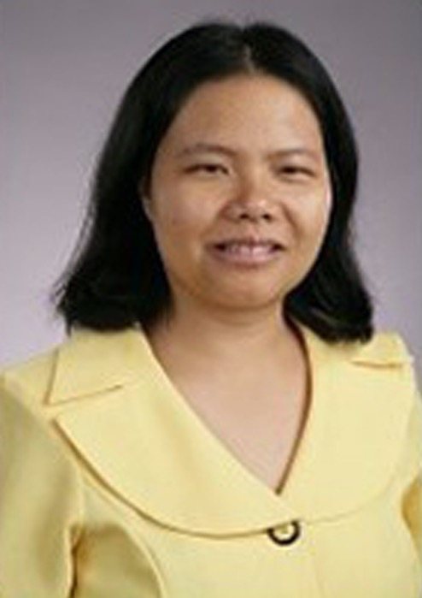
Elisa Laird-Metke
Director at Large
Samuel Merritt University
Karen Andrews
Director at Large
University of California - Irvine
Enjie Hall
Director at Large
The University of Toledo
AHEAD Board of Directors: Returning Members

Slide 4
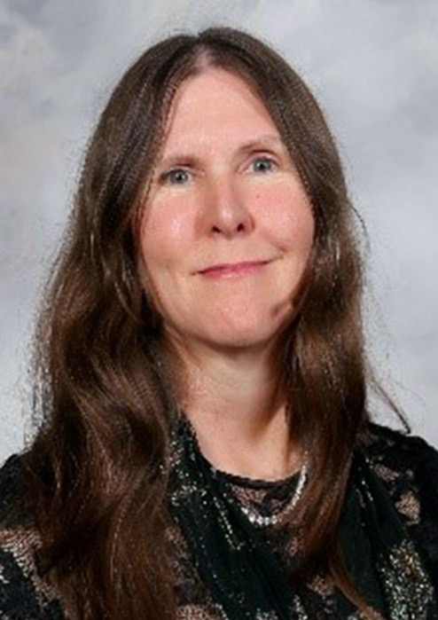
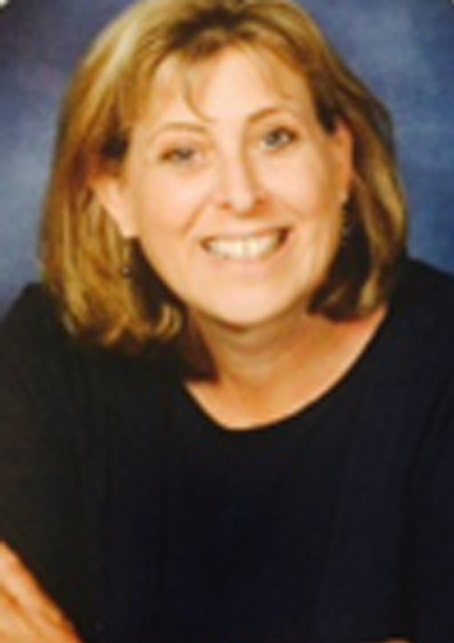
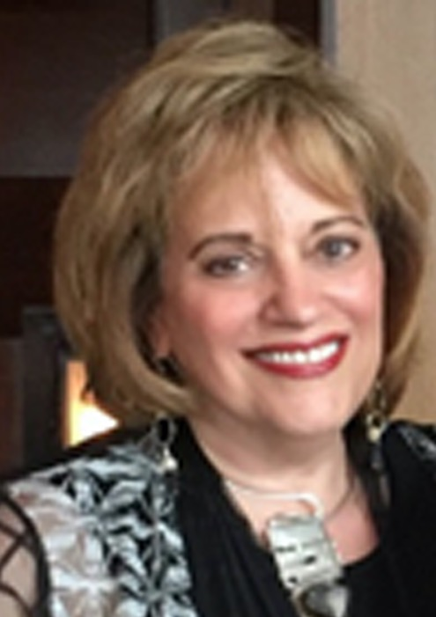
Gaeir Dietrich
AHEAD Treasurer
Access Specialist
Donna Johnson
Director at Large
University of Minnesota - Twin Cities
Linda Nissenbaum
Director at Large
Jen Dugger
Acting Equity Officer
Portland State University
AHEAD Board of Directors: Retiring Members

Slide 5
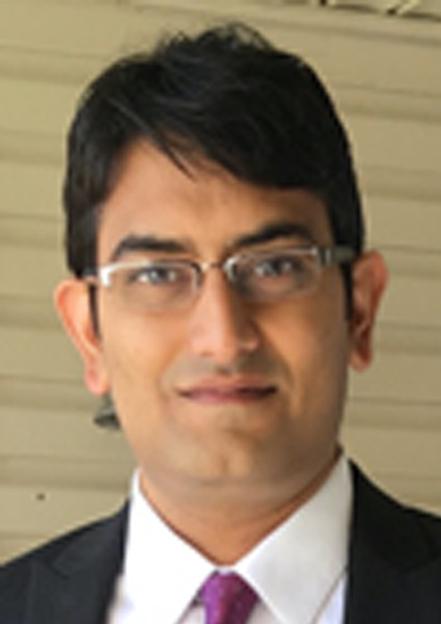

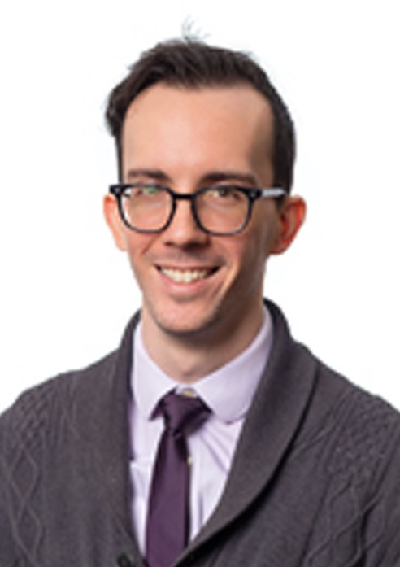
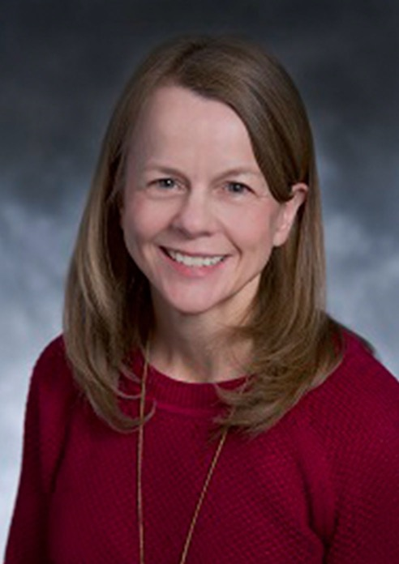
Darshan Shah
Director at Large
Farleigh Dickinson University
Michelle Rigler
Director at Large
The University of Tennessee - Chattanooga
Adam Crawford
Director at Large
The Ohio State University
Kristie Orr
President
Texas A & M University
AHEAD Board of Directors: Retiring Members

Slide 6
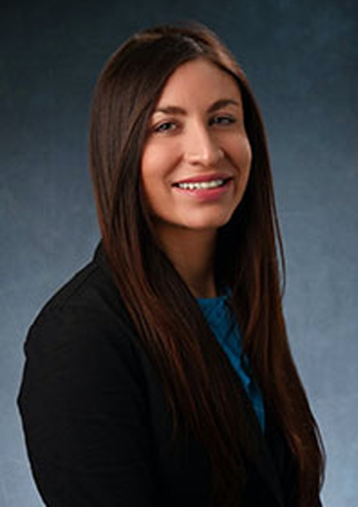
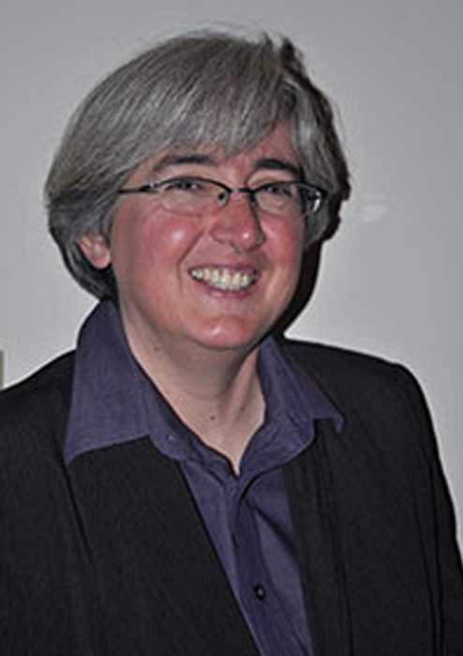
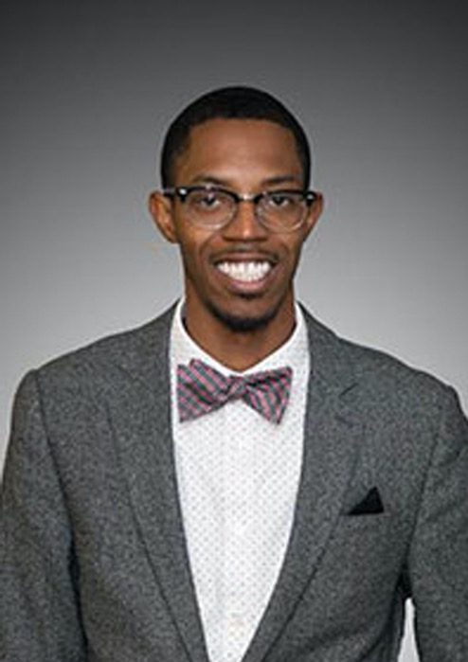
Katy Washington
President-Elect
University of North Texas
Jill Sieben-Schneider
Secretary
Northwestern University
Melanie Thornton
Treasurer
University of Arkansas – Partners for Inclusive Communities
Zebadiah Hall
Equity Officer
Cornell University
AHEAD Board of Directors: Newly-Elected Members

Slide 7
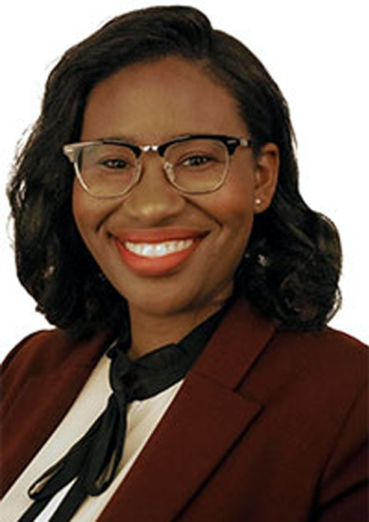
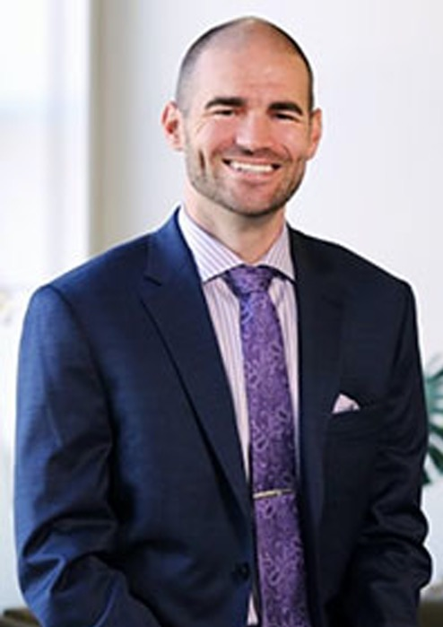
Chinwendu Okoronkwo Burns
Director at Large
University of Arkansas
Allen Sheffield
Director at Large
Rutgers University - Newark
AHEAD Board of Directors: Newly-Elected Members

Slide 8
AHEAD Highlights 2019-2020
AHEAD ended 2019 with record membership of over 4,000 people (approximately 12% growth)
Record attendance and revenues in AHEAD professional development offerings
Pivoting to a virtual conference with over 650 registrants
Secured an additional $500,000 funding for the NCCSD to continue working through December of 2020.
Behind the scenes- negotiated out of hotel contracts for several professional development opportunities

Slide 9
AHEAD Challenges 2020-2021
Managing the impacts of COVID-19 on the Association while keeping all of the essential work and priorities moving forward
Developing and growing in the areas of social justice and equity
Continuing to provide excellent professional development in a time where in-person meetings may not be possible
Negotiating out of contracts if in person gatherings are not possible

Slide 10

AHEAD Membership Continues to Grow!
And these are only mid-year numbers…
Year | Membership | # Growth Year to Year | % Growth Year to Year | # Growth 5 Year Cumulative | % Growth 5 Year Cumulative
2015 | 2790 | 171 | 6.53%
2016 | 2863 | 73 | 2.61%
2017 | 2974 | 111 | 3.90%
2018 | 3155 | 181 | 6.10%
2019 | 3705 | 550 | 17.4%
2020 | 3814 | 109 | 2.94% | 1024 | 36.70%

Slide 11
AHEAD Remains Fiscally Sound… while investing in growth.
2019 Fiscal Year Revenues and Expenses Compared to 2018
(October 1 – September 30).
 | Fiscal 2019 | Fiscal 2018
Total Revenues | $3,625,726.00 | $3,331,912.00
Total Expenses | $3,300,546.00 | $2,995,979.00
Other Revenues (Gaines/Losses) | $0.00 | $0.00
Net Income/Deficit | $325,180.00 | $335,933.00

Slide 12
Remaining Strong –
Statement of Asset Position June 30, 2019 and
June 30, 2020
ASSETS | June 30, 2020 | June 30, 2019
Current Assets (reflects loss of conference revenues) | $1,073,596.00 | $1,314,771.00
Property and Equipment (fully depreciated) | $0.00 | $3,087.00
Other Assets | $394,194.00 | $391,249.00
Total Assets | $1,467,790.00 | $1,706,021.00
Add your first bullet point here
Add your second bullet point here
Add your third bulleAudited Statement of Asset Position December 31, 2014 and 2013t point here
AHEAD is 100% transparent. View all financial details at www.guidestar.com from anywhere, anytime!

Slide 13
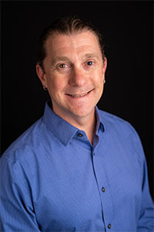
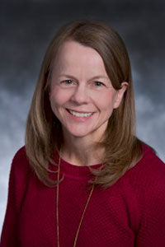
2020 Ronald E. Blosser Award Recipients
Jamie Axelrod
Northern Arizona University
Dr. Kristie Orr
Texas A&M University

Slide 14
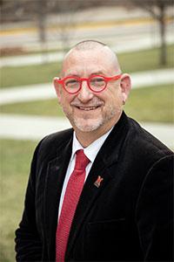
2020 AHEAD Honor for Meritorious Contribution Award
Andrew Zeisler
Miami University, Emeritus

Slide 15
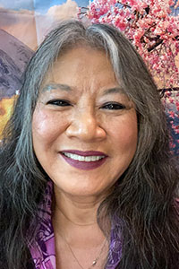
2020 Duraese Hall Excellence in Diversity & Inclusion Award
Mary Lee Vance
California State Sacramento

Slide 16
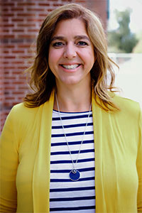
2020 AHEAD Professional Recognition Award
Michelle Rigler
University of Tennessee, Chattanooga

Slide 17
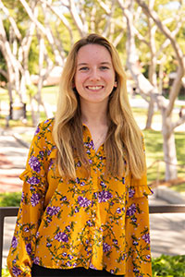
2020 AHEAD Student Recognition Award
Heather Schmoll
Cal State Long Beach

Slide 18
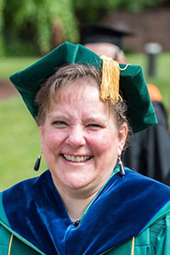
2020 JPED Reviewer of the Year Award
Melinda Burchard
Messiah University

Slide 19
2020 Evidence-Based Practices Exemplars Competition Winners
Using Data to Develop our New Student Disability Resource Center. Karen Pettus, University of South Carolina
When Access Goes Viral: Considering the Impact of Resource Sharing. Melanie Thornton, University of Arkansas
Centering Race in Self-Advocacy Resources within University Disability Services. Julia Karpicz, UCLA
Complex Accommodations: Fundamental Alteration, Undue Burden. Tom Thompson.

Slide 20
2020 Evidence-Based Practices Exemplars- Honorable Mention
Evidence-Based Practices to Assess, Advocate, and Improve. Tawny Rigsby, The University of Tulsa
Artworks Creative Community Outreach Project. Casey Cline, Midlands Technical College

Slide 21
AHEAD Remembers
Retirees 2019-2020
Matthew Mattingly- University of Massachusetts: Amherst
Ruth Loew- Educational Testing Services (ETS)
Bill Dethlefs- University of Texas El Paso (UTEP)
Anne Lynch- Augsburg University
Janet Lockhart, El Paso Community College

Slide 22
AHEAD Remembers
Retirees 2019-2020
Rhonda Rapp- St. Mary’s University
Rosemary Kreston, Colorado State University- Ft. Collins
Anne Sherman, Grand Rapids Community College
Loring Brinckerhoff, Educational Testing Services (ETS)

Slide 23
AHEAD Remembers
In Memoriam
Kathleen Maxson, Fashion Institute of Technology. December 9, 1989- August 8, 2019
Louise H. Russell, Harvard University, Emeritus September 18, 1945 – April 14, 2020
A moment to honor

