Slide 1
Reaching Your Maximum Potential Through Discomfort

Slide 2
Is the ultimate goal comfort?

Slide 3
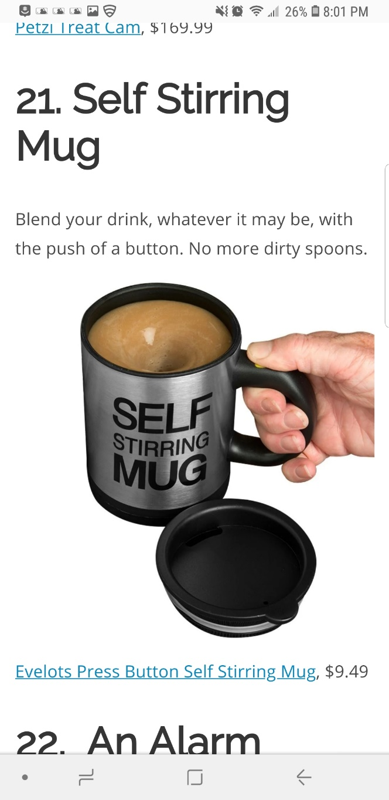



Slide 4
Western culture has things a little backwards right now. We think that if we had every comfort available to us, we’d be happy. We equate comfort with happiness. And now we’re so comfortable we’re miserable. There’s no struggle in our lives. No sense of adventure. We get in a car, we get in an elevator, it all comes easy. What I’ve found is that I’m never more alive than when I’m pushing and I’m in pain, and I’m struggling for high achievement, and in that struggle I think there’s a magic.
-- Dean Karnazes (The Road to Sparta)

Slide 5
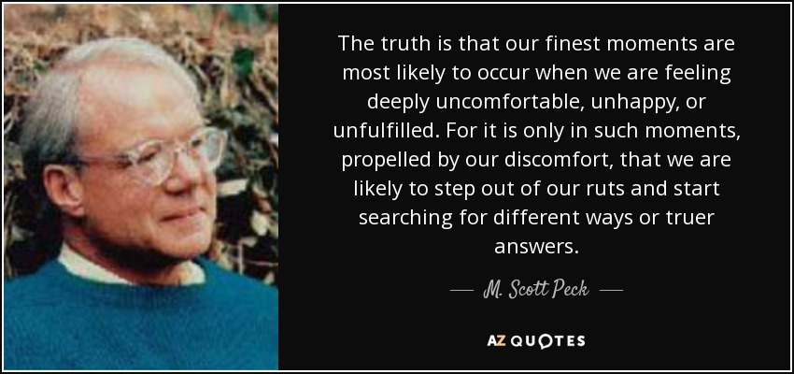

Slide 6
Know Your Why

Slide 7
WHY:
What is your life mission?
Cause?
Belief?
Passions?
Ideals?
What drives WHAT you on a daily basis?
Why do you get out of bed every day?
What can be your unique contribution to this world?
What is your vision for your life 5, 10, and 20 – 30 years from now?
What legacy do you want to leave behind?

Slide 8
Four Experiences of Discomfort in My Story

Slide 9
Adoption

Slide 10
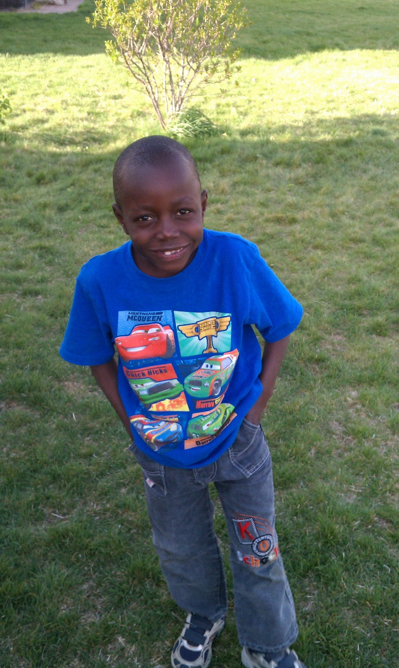
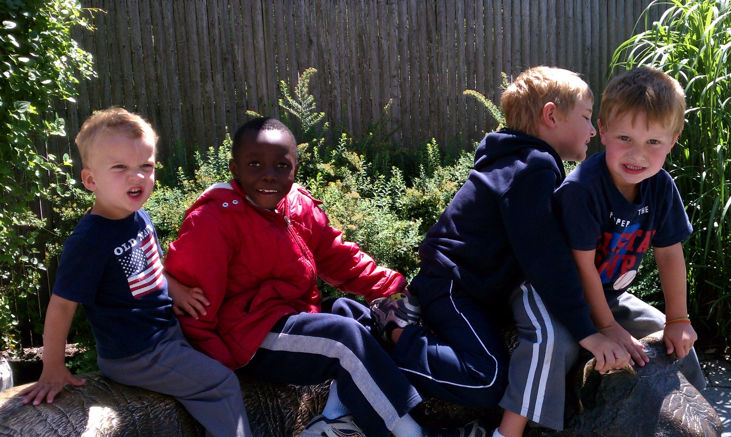

Slide 11
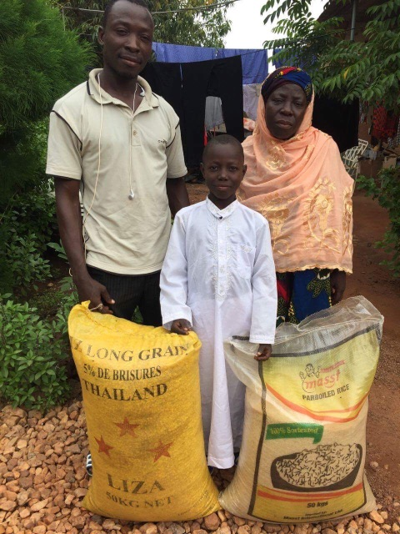
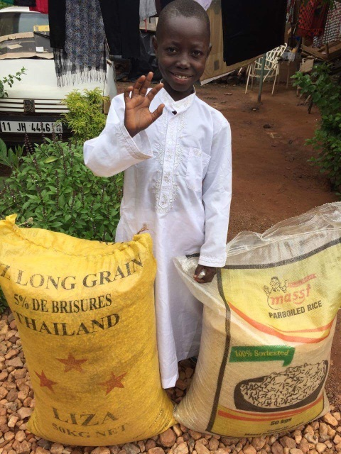

Slide 12
Transition

Slide 13



Slide 14
Adoption

Slide 15
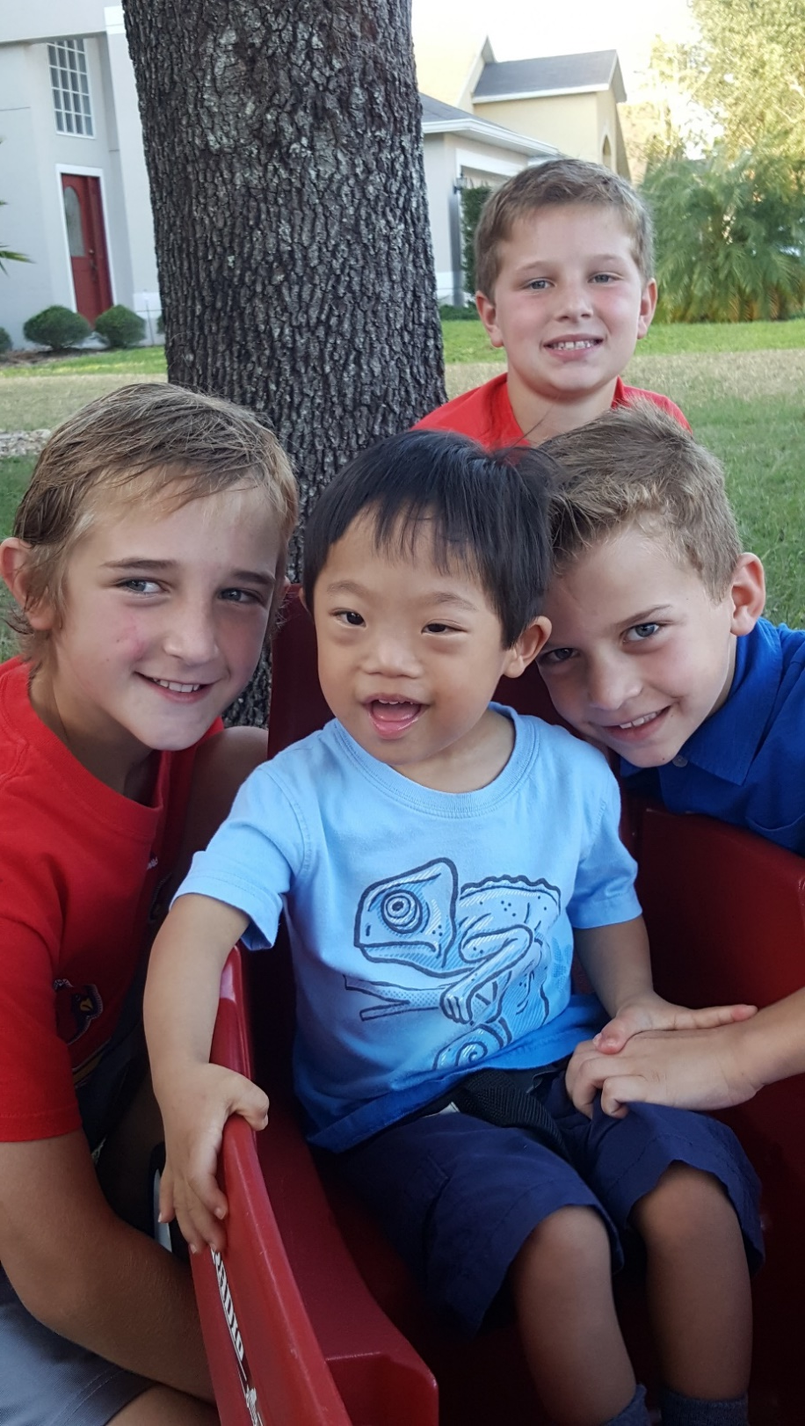
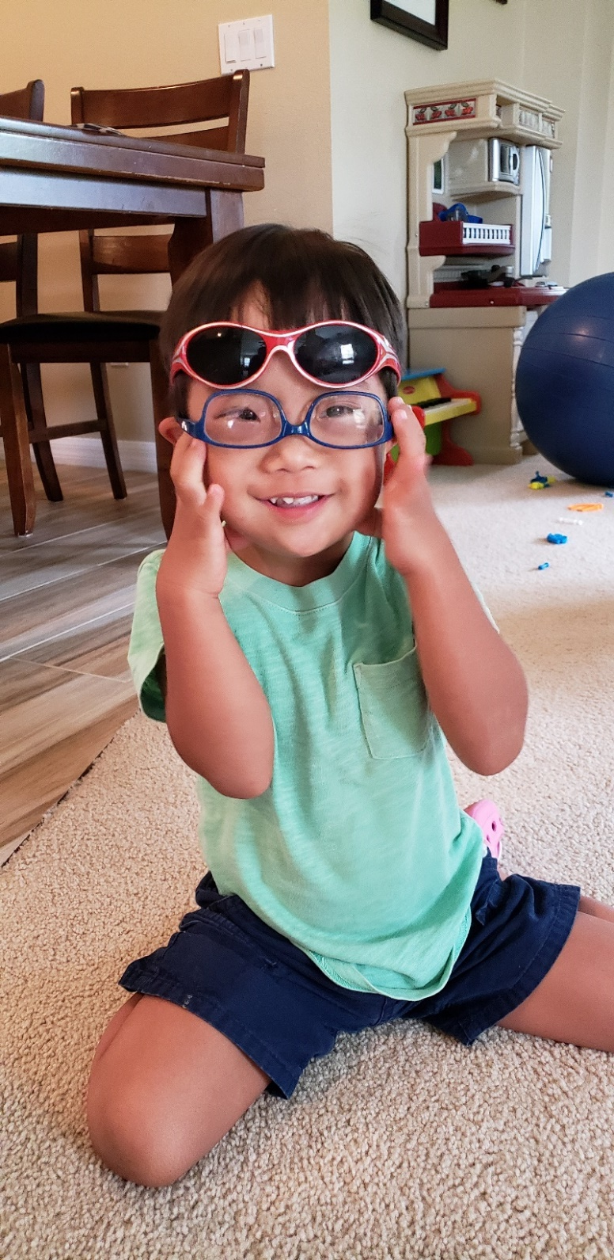

Slide 16
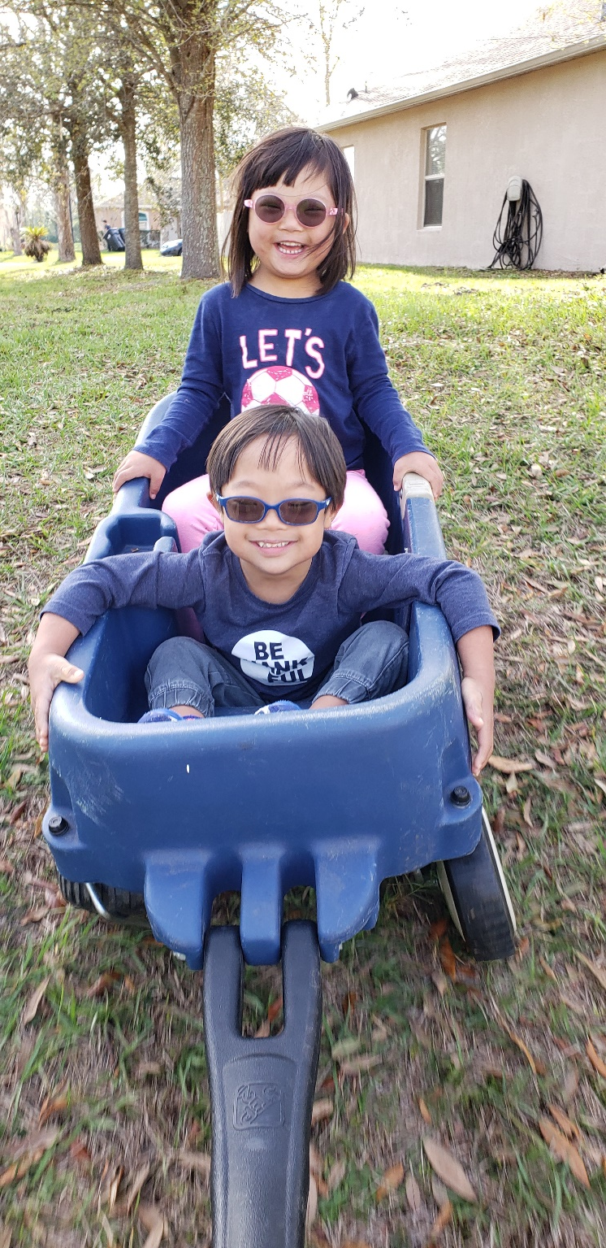


Slide 17
So what have I learned?

Slide 18
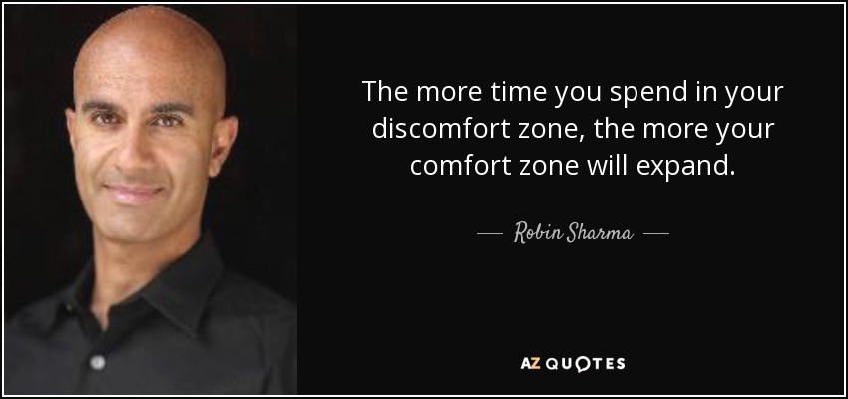

Slide 19
Benefits of Discomfort
(and working through it)
Creativity
Confidence
Easier to embrace change
Satisfaction with achieving goals or conquering challenges
Enhanced cognitive functioning and mental health
Experience adventures
Potential to experience greater joy and fulfillment
More energy
More life satisfaction

Slide 20

Six Cages that Hold Us Back
Cage of Responsibility
Cage of Routine
Cage of Assumptions
Cage of Guilt
Cage of Failure
Cage of Fear

Slide 21
What holds you back?
What holds the students we work with back?

Slide 22
Discomfort from Expected vs. Unexpected Circumstances

Slide 23
Small Steps

Slide 24
It is the small things that people do that no one sees that lead to the big things that everyone sees and wants.
-- Craig Groeschel
Notes:
Mention when a student graduates from college and we see them walking across stage. That is success but we do not see all of the work that went into that moment

Slide 25
What could be your small step of discomfort?
Notes:
Ask question. Pause to allow people to think of something

Slide 26
What could be your small step of discomfort?
Less time on social media and risk “missing out”; use time otherwise
Silent time
Exercising
Reading
Volunteering once a week somewhere out of comfort zone but aligned with skills and interests
Waking up earlier than normal to do something that facilitates growth
Have an over-do conversation with someone
Notes:
Ask question. Pause to allow people to think of something

Slide 27
