Slide 1
The Accessibility Scavenger Hunt: Empowering Students to Advocate for Campus Change
Chris Lanterman
Lauren Copeland-Glenn
AHEAD 2018 conference
July 20, 2018

Slide 2
Literature
Burgstahler & Doe (2014)
Flower, Burns, & Bottsford-Miller (2007)
Lalvani & Broderick (2013)
Silverman, Gwinn, & Van Boven (2015)
Leo & Goodwin (2016)
Singer (2016)
Nario-Redman, Gospodinov, & Cobb (2017)
VanPuymbrouck, Heffron, Sheth, The, & Lee (2017)

Slide 3
Simulations
Pros
Increase empathy
Demonstrate barriers
Cons
Perpetuate pity
Promotes distress
Fails to offer authenticity
Identify barriers, not solutions

Slide 4
History and Context
Commission on Disability Access and Design (CDAD)
Disability advocacy
Intersectional representation
Staff, Students, and Faculty

Slide 5
NAU 4 All
Departure from “disabled students organization”
Advocates for institutional inclusion and universal design
Strong leadership

Slide 6
Evolution of Strategies
Evolution of our scavenger hunt
From small checkpoints to experiences
With a group of people with and without disabilities

Slide 7
Comparison of Scavenger Hunt and Simulation
Empathy
From pity to power
Advocacy
Sympathy
From power to pity
Awareness

Slide 8
From Student-Focused to Facilities Focused
Problem focused
Focused on accessibility (ADA)
More UD and highlighting both successes and opportunities
More of a scavenger hunt
Evolution of partnership between N4A and CDAD
The reality of personality and expertise
Facility Services

Slide 9
Sustainability of the Event
Student voice and passion
Developing a culture
Develop a team of staff, faculty, and empowered individuals

Slide 10
The Rules
NO stairs
NO stepping off of or onto curbs
Everyone must get to the destination in the same way
All groups must follow stated campus rules (i.e. use crosswalks)

Slide 11
Questions to Consider
Who is, and who is not, able to use this? Why?
Who is, and who may not be, considered in this design? Why?
Who is, and who is not, able to participate in an activity here? Why?
Who do you think was involved in the design decision here and who might not have been? What makes you think this?
What does this design enable and what does it constrain? Why?

Slide 12

Tasks
Group 1: Task 1
(Text pictures to: 999-999-9999)
Start at the French Fries
Go to the Learning Resource Center (LRC) (15 minutes)
  How did you get there? Describe the path of travel and entrance. Can everyone travel together?
  Describe the ease of access.
  How do you access the building if you drove?
  Find the parking lot and your next task. Describe how you got here. What else do you notice about ADA access in this area?
Proceed to your next task

Slide 13
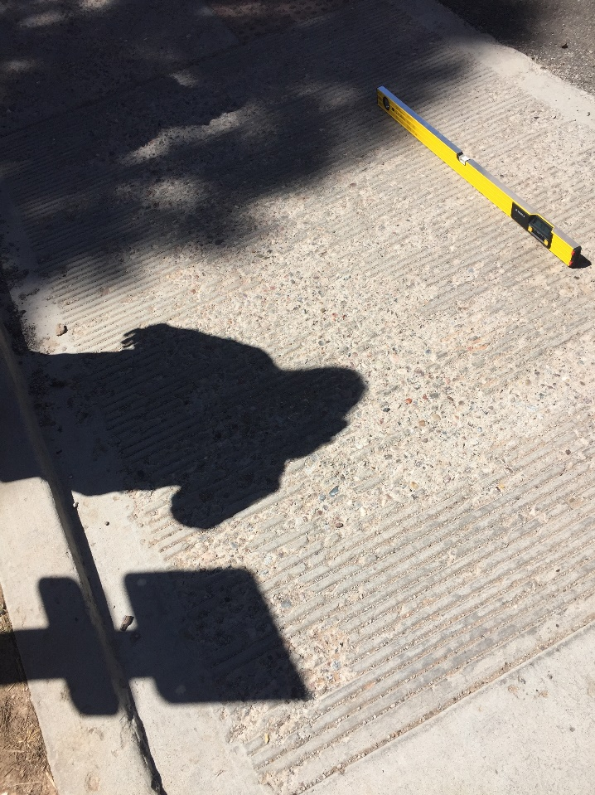
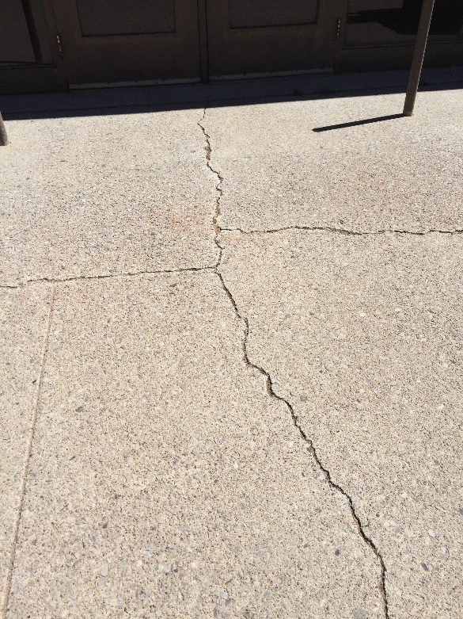
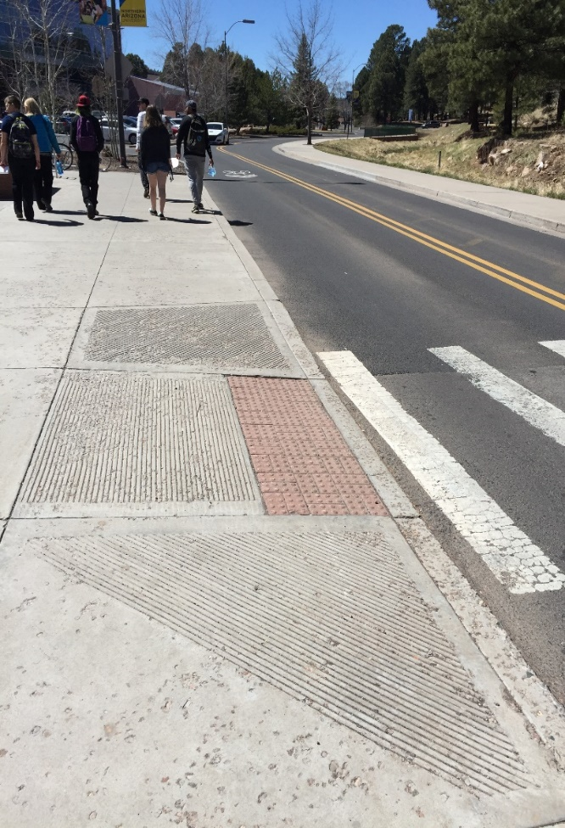

Slide 14
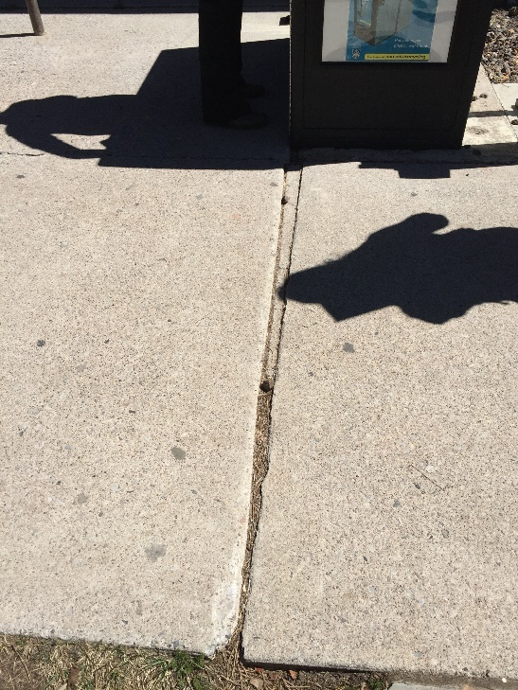
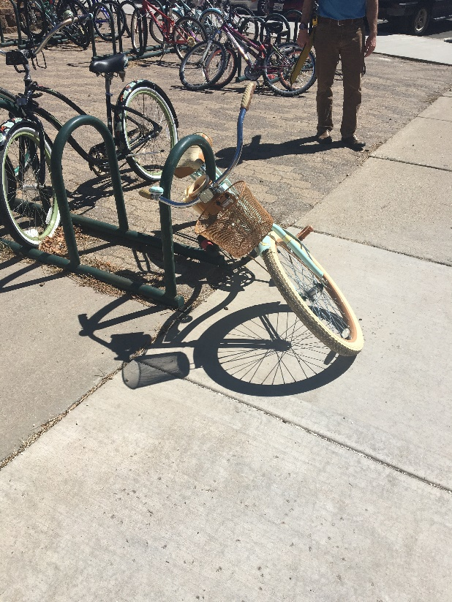
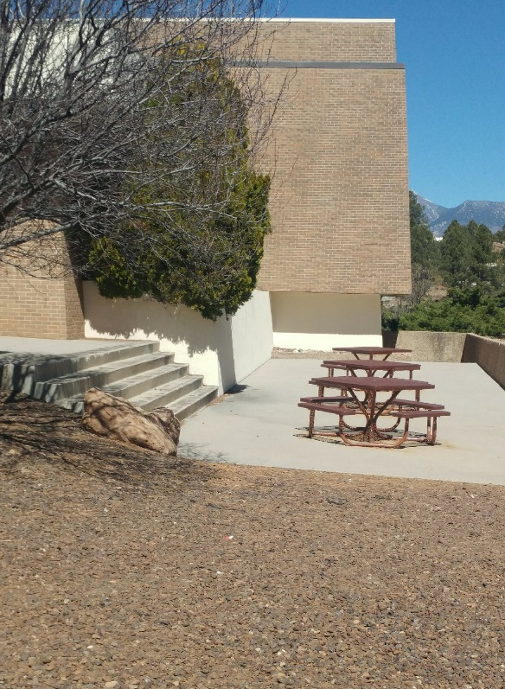

Slide 15
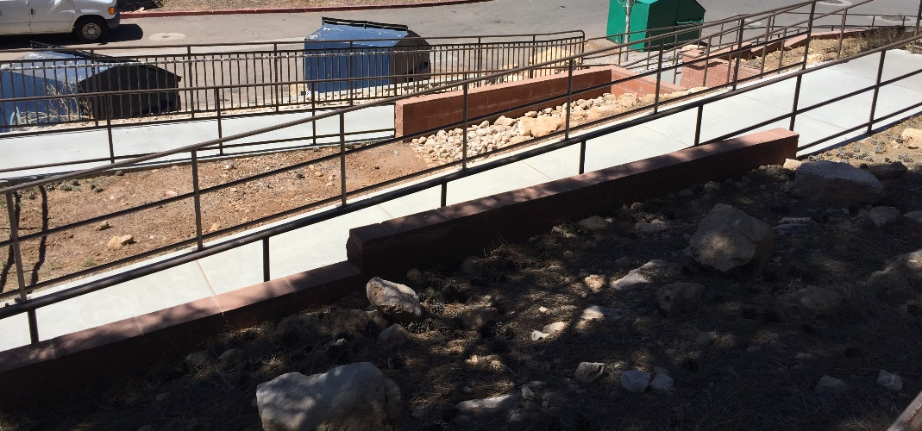

Slide 16
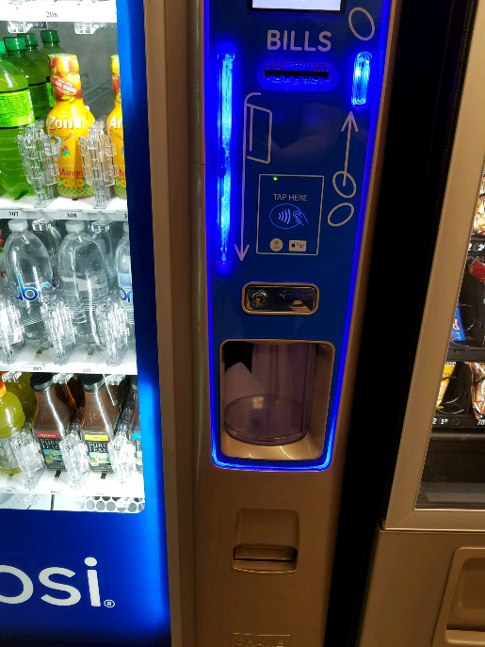
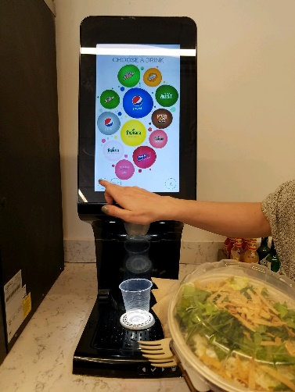
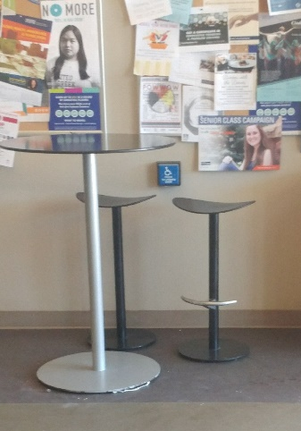

Slide 17
Environmental Outcomes
Universal Design incorporated into all new buildings and substantial remodels
Campus is more welcoming to individuals with disabilities through better design
Barriers are eliminated reducing the need for accommodations
Innovative design and collaboration

Slide 18
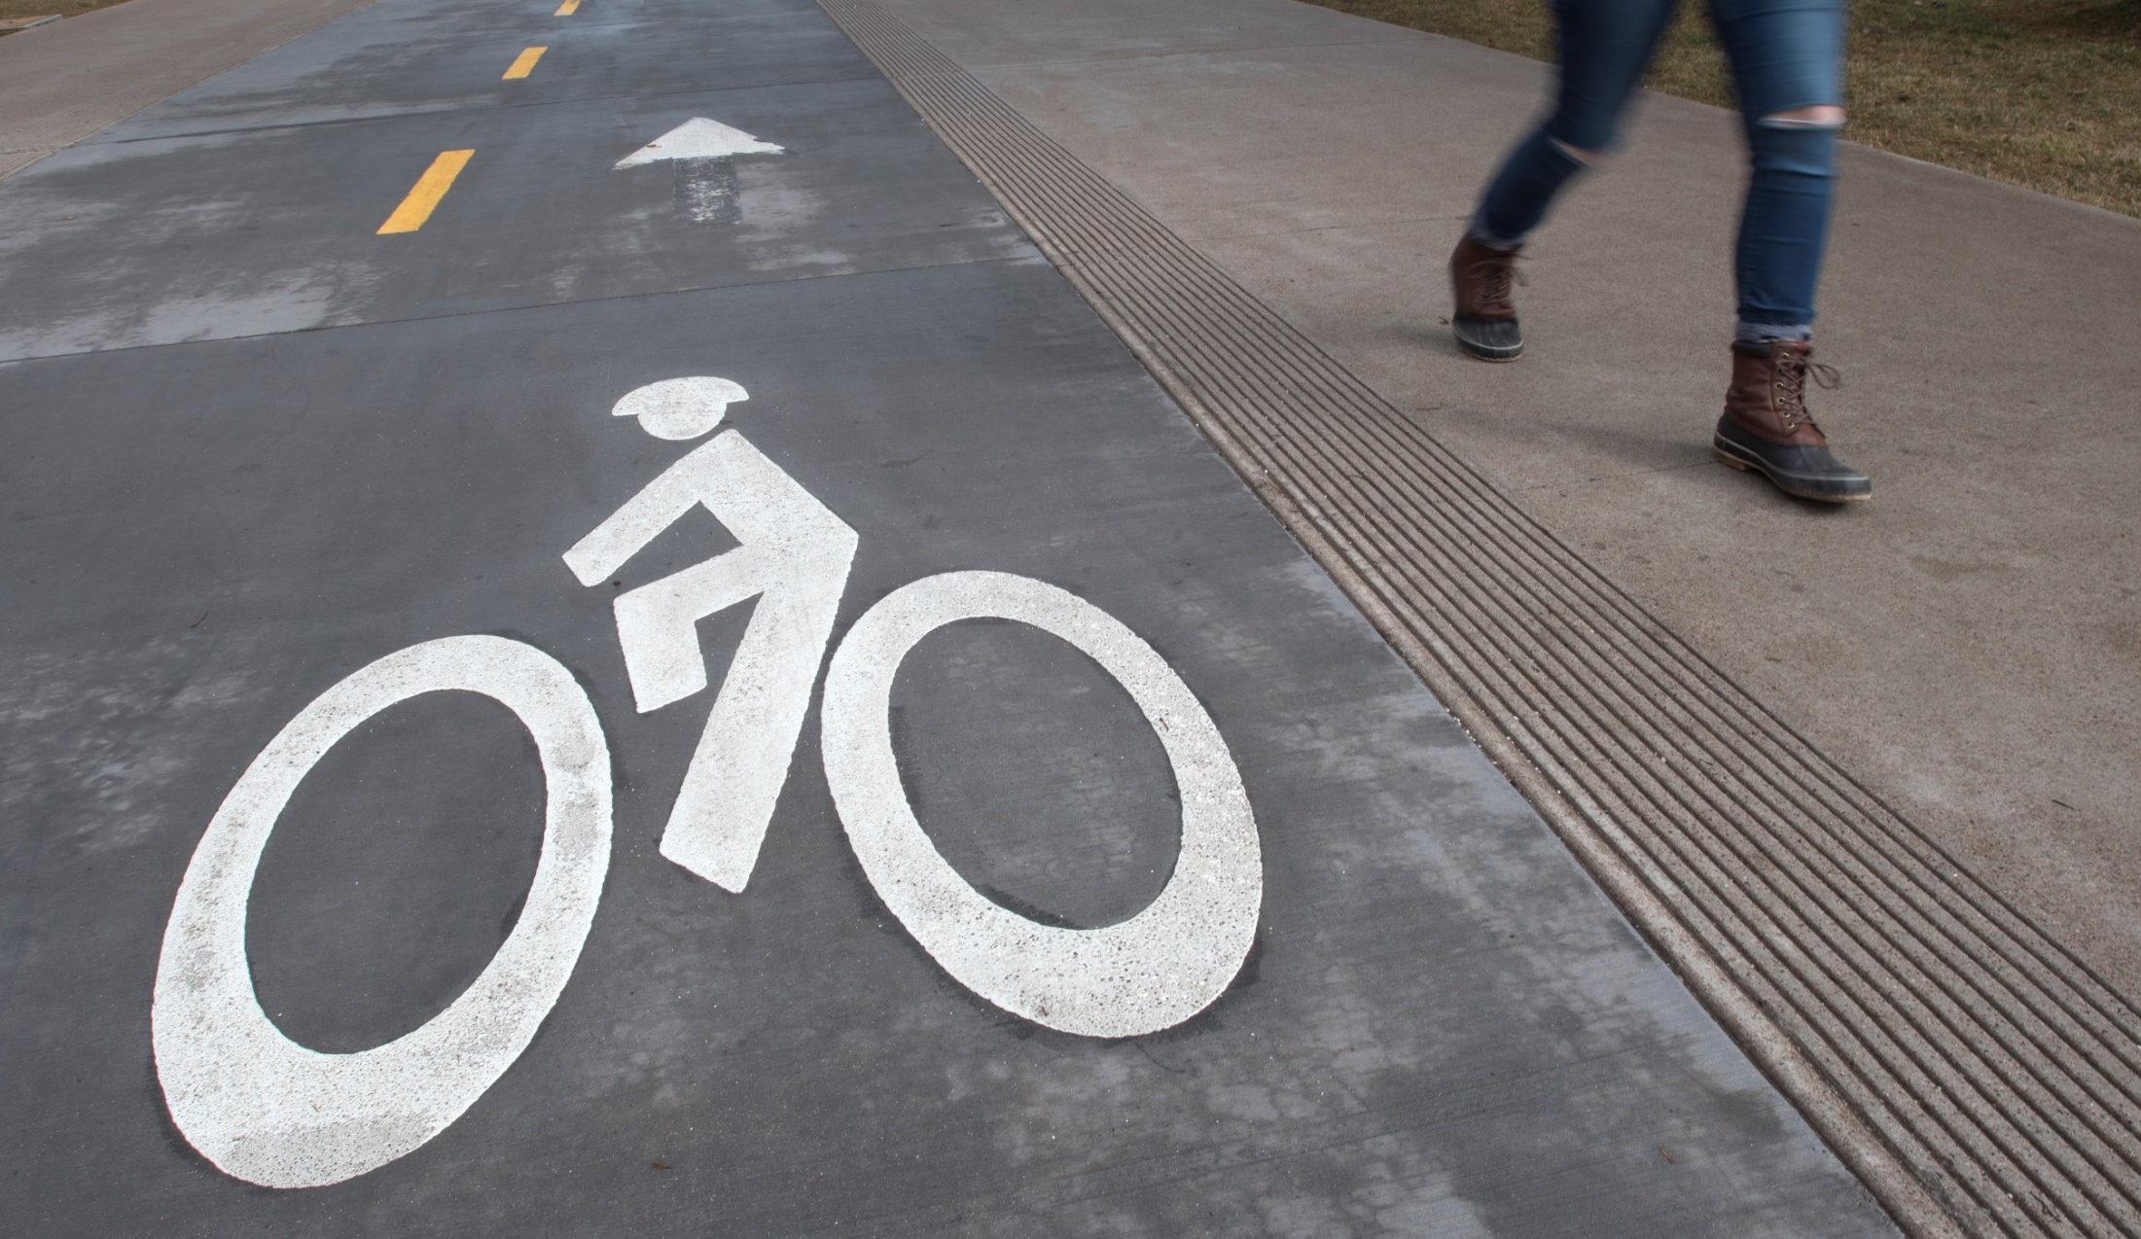

Slide 19
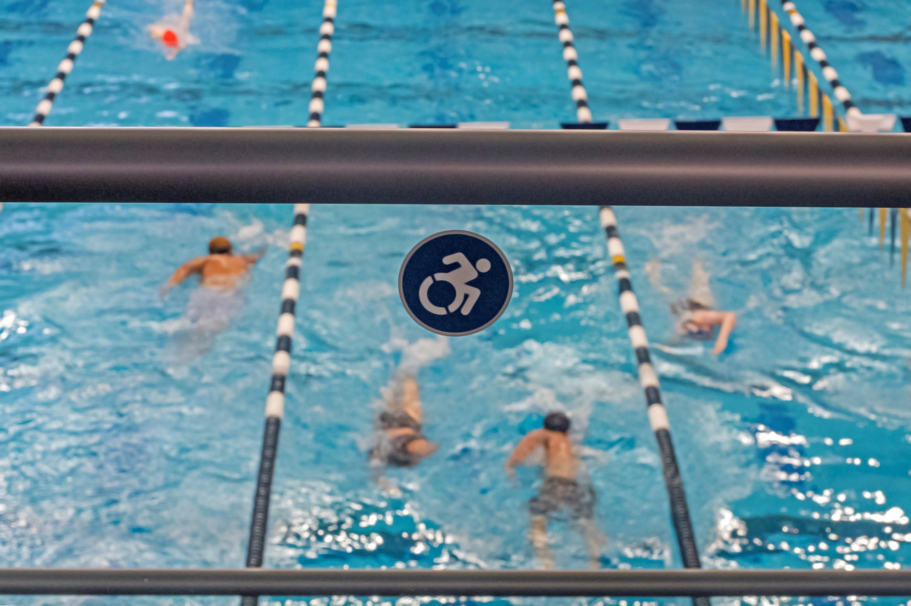

Slide 20
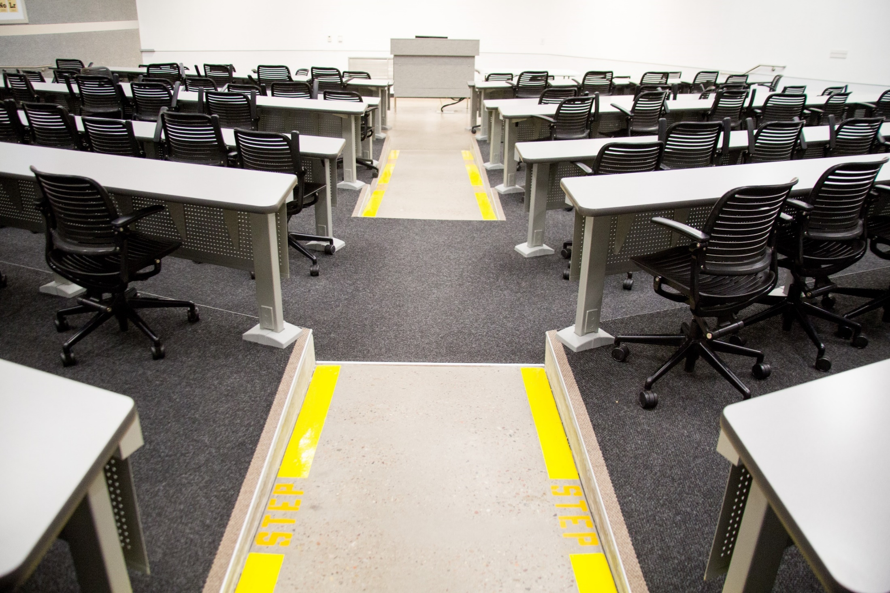

Slide 21
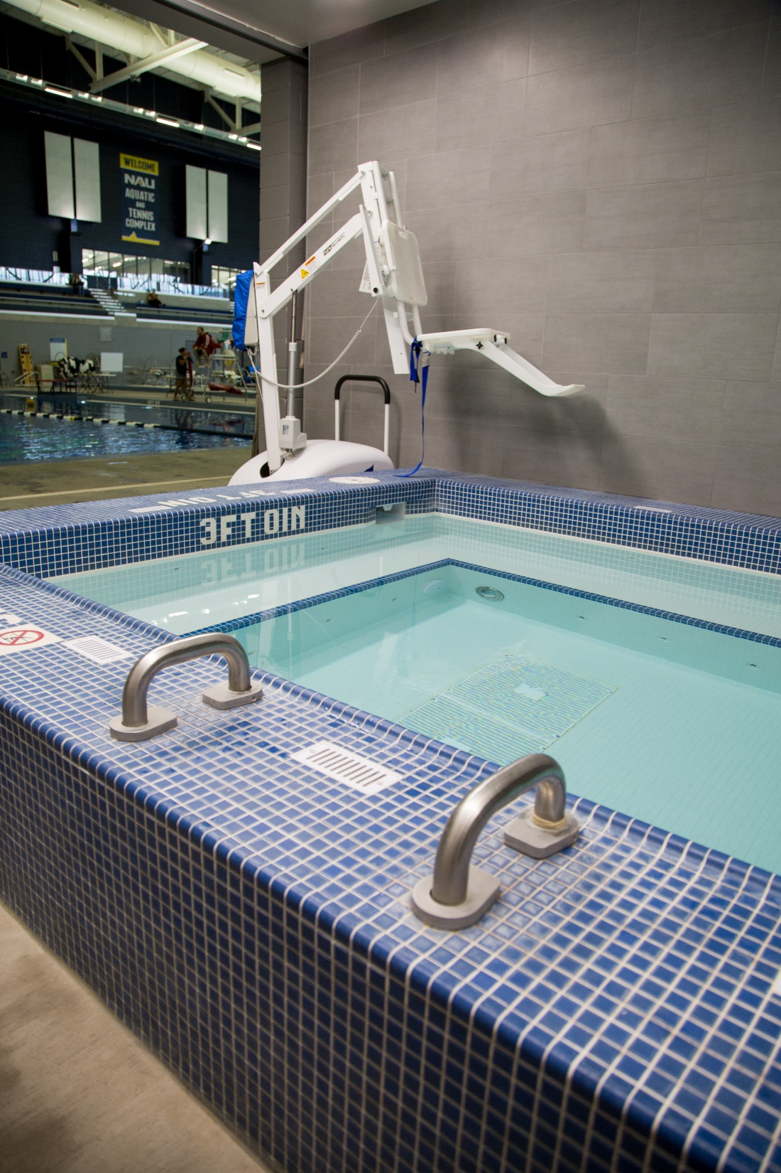
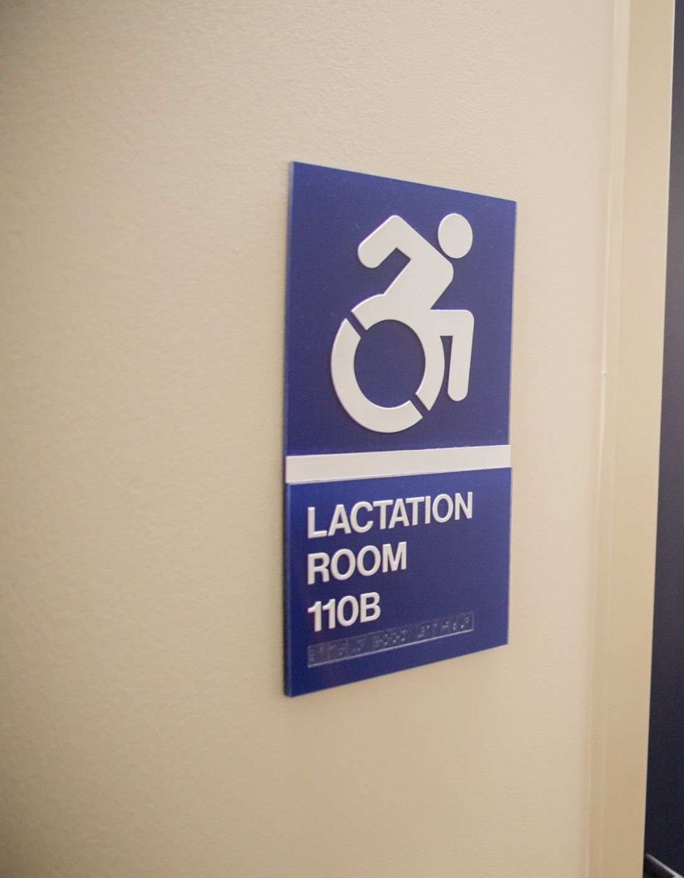

Slide 22
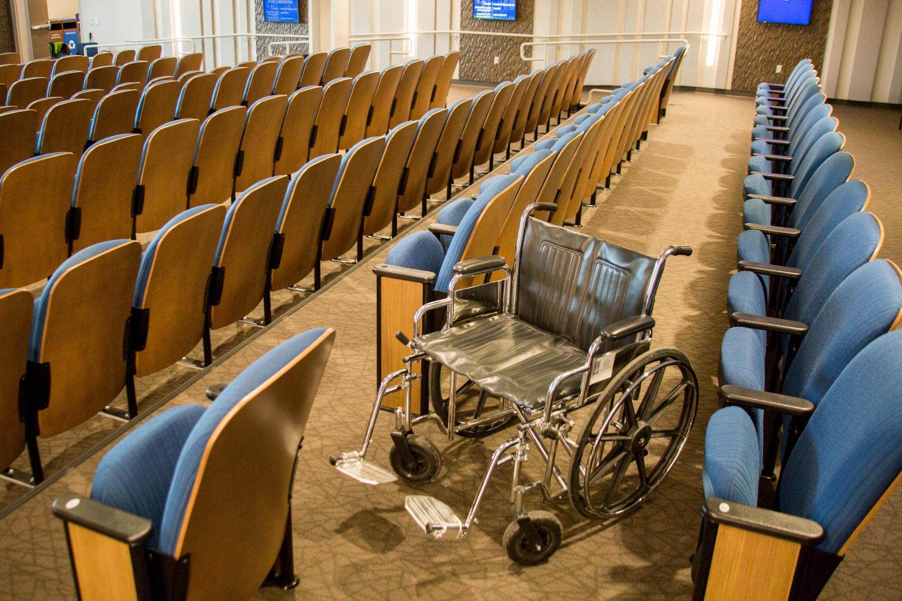

Slide 23
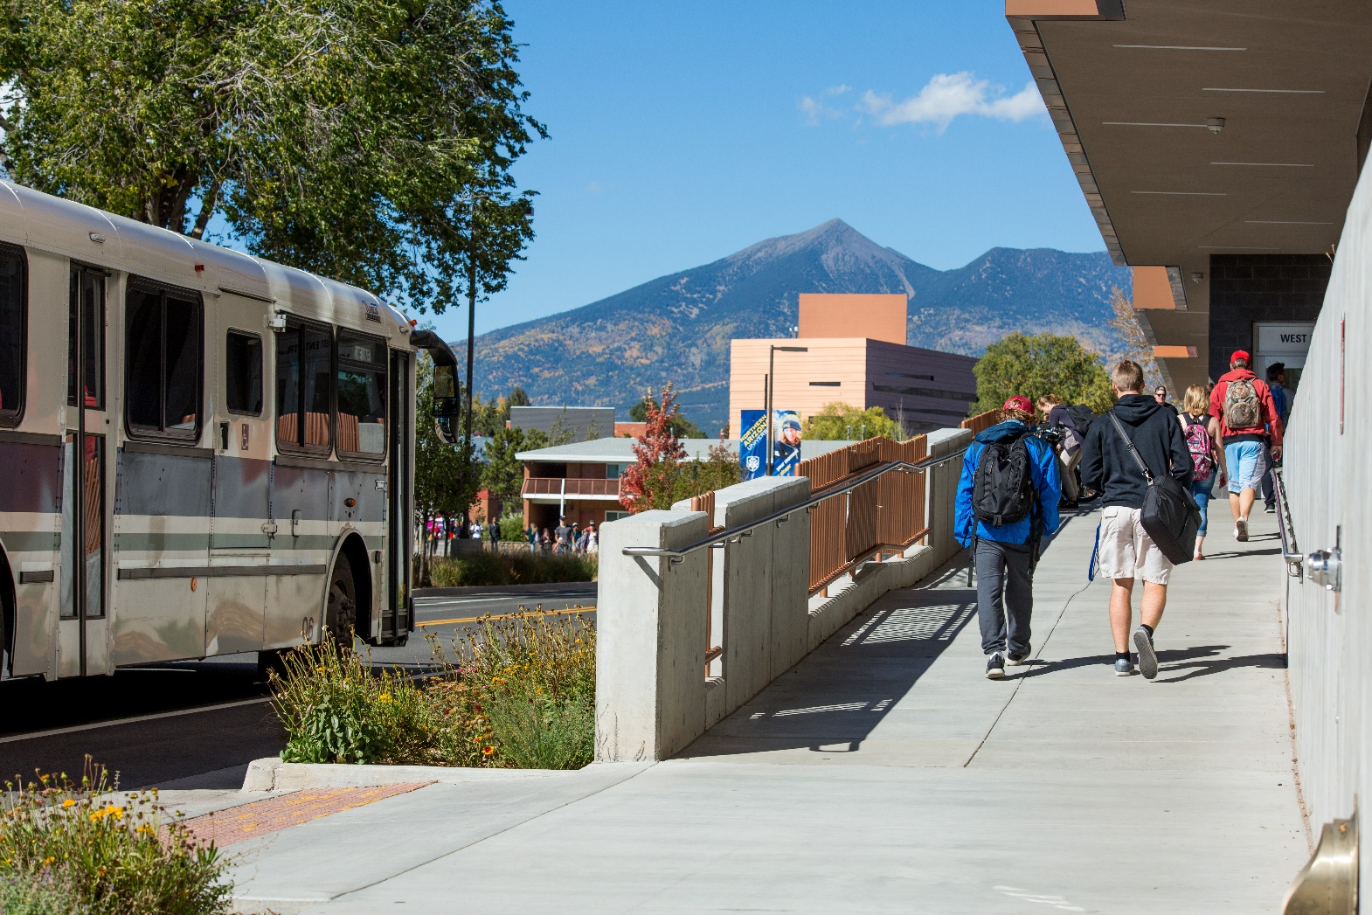

Slide 24
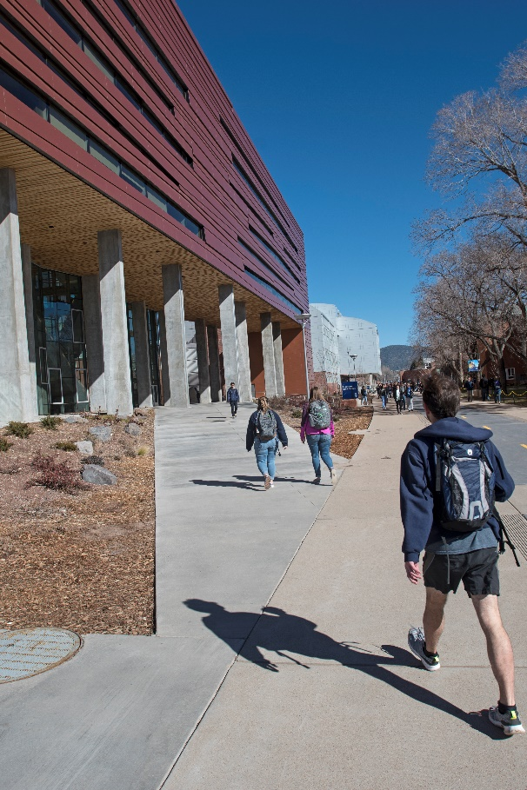
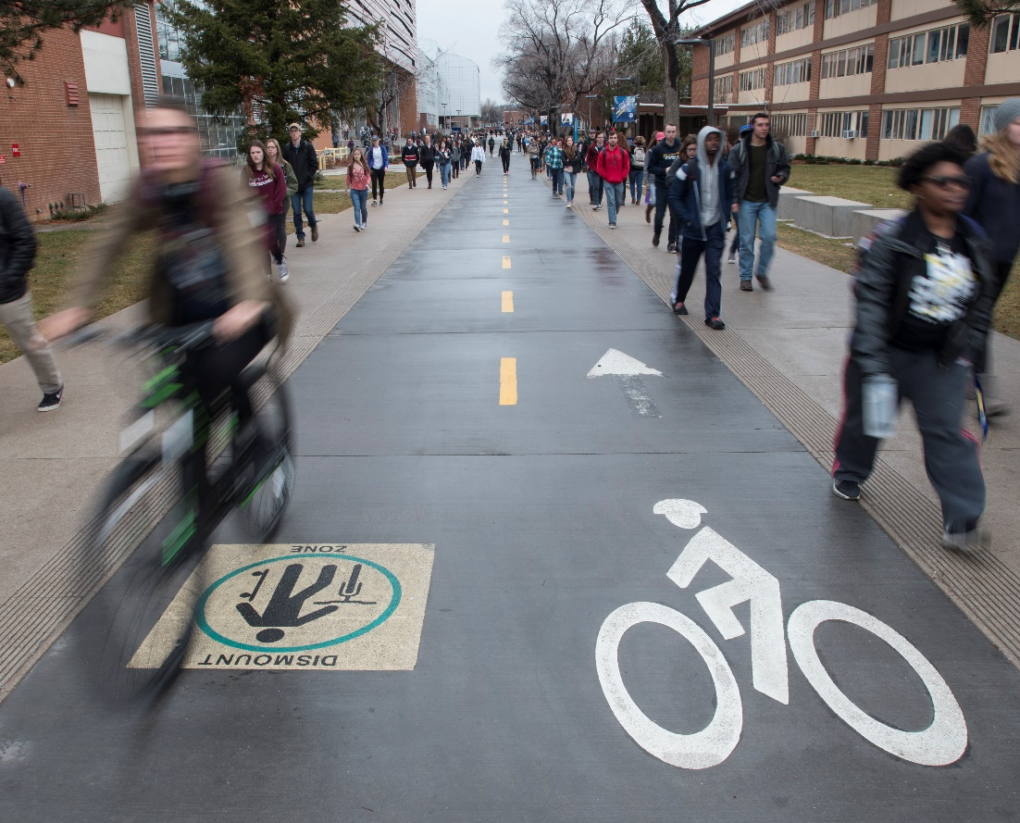

Slide 25
Attitudinal Outcomes
Cultural shift within institutional stakeholders (e.g., Facility Services)
Attitudinal shifts among participants (e.g., global responsibility for addressing barriers)
Implications for future professional practices
Awareness, Empathy, and advocacy
From medical model to social model

Slide 26
Brainstorming opportunities

Slide 27
Let’s Give It A Go!

Slide 28
References
Burgstahler, S., & Doe, T. (2004). Disability-related simulations: If, when, and how to use them. Review of Disability Studies, 1, 4–17.
Flowers, A., Burns, M. K., & Bottsford-Miller, N. A. (2007). Meta-analysis of disability simulation research. Remedial and Special Education, 28, 72–79.
Lalvani, P., & Broderick, A. (2013). Institutionalized ableism and the misguided disability awareness day. Equity and Excellence in Education, 46, 468-483.
Silverman, A. M., Gwinn, J. D. & Van Boven, L. (2015). Stumbling in their shoes: Disability simulations reduce judged capacities of disabled people. Social Psychological and Personality Science, 6, 464-471. doi: 10:1177/1948550614559650
Leo, J., & Goodwin, D. (2016). Simulating others' realities: Insiders reflect on disability simulations. Adapted Physical Activity Quarterly, 33, 156-75.
Singer, S. (2016). Transforming transformative disability experiential learning. Issues in Teacher Education, 25, 23.
Nario-Redmond, M. R., Gospodinov, D., & Cobb, A. (2017). Crip for a day: The unintended negative consequences of disability simulations. Rehabilitation Psychology (Epub), 62, 324-333. Doi: 10.1037/rep0000127 National ADAPT (2017). Category archives: I was there. Retrieved from

