Slide 1


Self-Advocacy
for Individuals
with Hidden Disabilities
Debra G. Holzberg, Ph.D.
University of North Carolina at Greensboro
Latacha Hamilton, Ph.D.
St. Jude Children’s Research Hospital

Slide 2
Agenda
Roll call
Barriers to accessing accommodations in postsecondary education
Self-advocacy
Relevant research
Learning Activity 1
Learning Activity 2
Resources to teach self-advocacy
Questions

Slide 3
Outcomes
Participants will …
  Explore the concepts of invisible disability, disability identity, academic self-efficacy, and self-advocacy
  Review research aimed at exploring impact of these concepts on university students’ disclosure behavior
  Consider the effect of the Self-Advocacy and Conflict Resolution (SACR) instruction on students’ accommodations requests

Slide 4
What We Already Know:
Students with disabilities may represent one of the fastest growing population of students at post-secondary institutions across the nation (Reinschmiedt, Sprong, Dallas, Buono, & Upton, 2013).
This population of students may be at a greater risk of non-persistence than their nondisabled peers (Mamiseishvili et. al., 2011).
Colleges and universities provide support and accommodations for individuals with disabilities, but services are widely underused (Reinschmiedt et al., 2013; Lombardi et. al. 2010)
Only 0.7 percent of enrolled students had identified themselves to institutional staff as having a disability.

Slide 5
Key Terms:
Invisible disability (ID) – refers to conditions that are not obvious to the onlooker
  Can limit daily activities
  Can range from mild challenges to severe limitations
  Can vary from person to person (Invisible Disabilities Association, 2013)
Academic self-efficacy – one’s belief about him/herself regarding his/her ability to perform academic tasks (Chemers, Hu, & Garcia, 2001)
Self-disclosure - “any message about the self that a person [verbally] communicates to another” (Wheeless & Grotz, 1976, p. 338)

Slide 6
Comparison of Students with High Incidence Disabilities Attending Postsecondary Institutions
Category | NLTS-2 2005 | NLTS-2 2011
ADHD (served under other health impairments [OHI]) | 5.9% | 19.6%
ED (emotional and/or behavioral disorders [EBD]) | 4.0% | 10.8%
High-functioning autism (HFA) | .9% | 17.4%
Learning disabilities (LD) | 9.7% | 21.2%
Mild mental retardation (Mild intellectual disability [MID]) | 0.0% | 6.7%
Source: NLTS-2, 2005; NLTS-2, 2011

Slide 7
Disability Identity:
Students may be apprehensive when requesting accommodations due to their stance regarding ownership of disability, perceptions of support services, and choice.
Students disclose based on perceptions of a need for assistance and/or understanding balanced by desire to maintain autonomy and positive self-image (Blockmans, 2015).
Students may not perceive themselves to be “disabled” and as a result, may not see any benefit or may not believe adjustments will be valuable enough to employ this support (Jacklin, 2011).
Students experience of “negotiating” identity
Social Model of Disability (Miskovic & Gabel, 2012)
Notes:
Barnard-Brak, Sulak, Tate, and Lechtenberger (2010)

Slide 8
Self-Efficacy Theory (Bandura, 1994)
Self-efficacy beliefs determine how people feel, think, motivate themselves and behave.
Much of human behavior is purposive, thus regulated by forethought and will.
Provides positive supports for choosing actions to assist in attaining goals in those with high levels of efficacy
Creating doubt and failure predictions in those with low self-efficacy.
A major function of thought is to enable people to predict events and to develop ways to control those that affect their lives.
Judgments may result in increased/decreased quality of performance, leading to completion/termination behavior.

Slide 9
Self-Advocacy Intervention Literature
One - quasi-experimental, post-test only control group (Palmer & Roessler, 2000)
Four - single-subject, multiple probe across participants (Bethune, 2015; Holzberg, McAllister, & Harrington (in preparation); Holzberg, Test, & Rusher, (2018); Walker & Test, 2011)
One - single-subject multiple baseline across participants (Roessler, Brown, & Rumrill, 1998)

Slide 10

Barriers to Accessing Accommodations
Students may not be accessing available resources (Barnard-Brak, Lechtenberger, & Lan, 2010)
Students registered with Disability Support at one university:
  7.9% were freshmen
  18.6% were sophomores
  24.6% were juniors
  39% were seniors

Slide 11
Barriers to Accessing Accommodations
Changes in the way students access accommodations
  High school
  Individuals with Disabilities Education Act (IDEA; 2004) and Section 504 of the Rehabilitation Act (1973)
College
  Students must actively seek their accommodations
  Must provide adequate documentation of need for services
  Services are provided under the Americans with Disabilities Act (ADA) and Section 504
    Level or intensity of services is at the discretion of the institution
  Emphasis is on access as opposed to success
(Cawthon & Cole, 2010)

Slide 12
Barriers to Accessing Accommodations
Awareness of one’s disability
Understanding of the disability and its impact
Unprepared to disclose disability
Knowledge of rights and accommodations
Janiga and Costenbader (2002)
  Found that students with disabilities who matriculate to college often do not understand the differences in the advocacy process when they transition from IDEA to ADA
(Cole & Cawthon, 2015; Getzel & Thoma, 2008; Summers, White, Zhang, & Gordon, 2014)

Slide 13
Self-Advocacy
Many definitions:
  Overarching theme – an individual’s ability to effectively recognize and articulate one’s needs and rights
Self-advocacy strategies
  Equip students with a set of tools to facilitate transition
  Help students access their accommodations
  Include conflict resolution
(Test, Fowler, Wood, Brewer, & Eddy, 2005)

Slide 14
LEARNING ACTIVITY 1

Slide 15
Disability Disclosure:
Factors that influence the likelihood and extent of disclosure
  Severity of the impairment
  Perceived abnormality status of the impairment
  Prominence of the disability in one’s identity
  Emotional implications of one’s physical condition
  Consideration of the needs/goals of disclosure
  Shared views on what is necessary and socially appropriate to disclose at university (Blockmans, 2015, pp. 176-77).
The time of disclosure is highly subjective

Slide 16
Research Questions:
What academic self-efficacy (ASE) beliefs contribute to the motivation of students with invisible disabilities in higher education to disclose to disability support services?
What beliefs about coping capabilities influence persistence in educational pursuits by students with invisible disabilities in higher education? What role does disability identity play in reinforcing ideas about competency for students with invisible disabilities in higher education?

Slide 17
Methodology:
Utilized qualitative research design, specifically phenomenological research since it considered the “lived experiences” of college students with invisible disabilities
Data was collected from a single public, coeducational institution in the southern region of the United States
Specifically chosen because it reports high percentage of students accessing disability support services
Purposeful sampling
  Current college student
  Diagnosis of a disability
  Completion of disclosure process (receiving support services through DSS)

Slide 18
Data Collection and Analysis:
An informational flyer was shared with the director for distribution to potential participants via email and face-to-face.
After initial contact by the director and with the permission of the student, potential participants were called and interviews were scheduled, if appropriate.
Semi-structured interviews were conducted individually.

Slide 19
Data Collection and Analysis:
After completion, participants were provided compensation in the form of a Starbucks e-gift card ($5 value).
After completing interviews, participants’ responses were transcribed and coded.
The investigator conducted thematic analyses of each interview transcript and develop a summary of the information based on comprehensive data analysis.

Slide 20
Demographic Information:
Participants | Classification | Diagnosis | Major | Gender
A | Senior | Dyslexia | Nursing | Female
B | Graduate | Autism Spec DO | Engineering | Male
C | Graduate | ADD/Dyslexia | Engineering | Female
D | Graduate | Learning DO | Mathematics | Male
E | Senior | Learning DO | Disability/Rehab | Female
F | Senior | Arthrogryposis | Paralegal | Female
G | Sophomore | Reading DO | Radio/TV/Film | Female
H | Senior | Learning DO | Communications | Female
I | Junior | Visual Imp | Music | Male

Slide 21
Demographic Information Continued:
Participants | Classification | Diagnosis | Major | Gender
J | Senior | Leaning DO | Social Work | Female
K | Sophomore | ADHD | Criminal Justice | Female
L | Junior | Dyscalculia | Exercise Manag | Male
M | Junior | ADD | Psychology | Female
N | Graduate | Learning DO | Social Work | Female
O | Junior | Learning DO | Music | Female
P | Senior | Dyslexia | Education | Female
Q | Sophomore | Speech DO | Undecided | Female
R | Graduate | Math DO | Communication | Female

Slide 22
Research Question 1:
What academic self-efficacy (ASE) beliefs contribute to the motivation of students with invisible disabilities in higher education to disclose to disability support services?
Theme 1: Belief of being smarter than others
  Subtheme 1. Better development of academic skills
  Subtheme 2. Categorization as a different type of learner

Slide 23
Research Question 2:
What beliefs about coping capabilities influence persistence in educational pursuits by students with invisible disabilities in higher education?
Theme 2: External support systems
Theme 3: Internal motivation
Theme 4: Need to “prove” normalcy to others

Slide 24
Research Question 3:
What role does disability identity play in reinforcing ideas about competency for students with invisible disabilities in higher education?
Theme 5: Integrating self-perception and social perception

Slide 25
Significance of the Results:
Pooley et al. (2012) established that the existence of high levels of self-efficacy skills was linked to problem-focused coping skills.
  Students utilize support systems as a way to assist with potential difficulties.
Persistence is more consistent among students with disabilities that disclose to disability support services in comparison to students with disability who do not choose to utilize this resource.

Slide 26
Significance of the Results Continued...
Students with disabilities that sought support services tended to persist and graduate, according to Newman et al. (2011), it stands to reason that the current participants have developed the necessary skills to persist.
Appropriate academic self-advocacy (ASE) skills motivate them to make decisions that impact their efforts to continue to graduation.

Slide 27
Policy and Social Implications:
Policy Amendment?
The Workforce Innovation and Opportunity Act (WIOA) of 2014
  Research and funding
Higher Education Opportunity Act (2008)
  Universal Design for Learning (UDL)
More collaboration with other departments to identify students earlier
Increased awareness about Disability Support Services

Slide 28
LEARNING ACTIVITY 2

Slide 29
Self-Advocacy as a Life Skill – SACR Instruction
Recognized as a key skill in facilitating transition for individuals with disabilities
  Self-Advocacy and Conflict Resolution Training (SACR; Rumrill, Palmer, Roessler, & Brown, 1999)
  Two-part module
  Module 1: Self-Advocacy Skills
    Goal to teach students to appropriately request academic accommodations
    Seven targeted self-advocacy behaviors (e.g., greeting, disclosure, solution)
    Explicitly taught through scripted lesson plans
      Modeling and role-play

Slide 30
SACR
Module II:
  Conflict Resolution Skills
  Seven targeted conflict resolution behaviors (e.g., reflecting, mutualizing, collaborating)
  Designed to help students have the dialogue to resolve conflicts which might arise when requesting or implementing accommodations
Shown to be an effective intervention on students’ ability to request academic accommodations (e.g., Bethune & Test, in preparation; Holzberg, 2017; Holzberg, Test, & Rusher, 2018; Palmer & Roessler, 2000; Walker & Test, 2011)

Slide 31
SACR - Module I
Self-Advocacy and Conflict Resolution Training: Strategies for Classroom Accommodations Request (SACR; Rumrill, Palmer, Roessler, & Brown, 1999)
Two modules
  Module I: Seven self-advocacy lessons:
    Introduction
    Disclosure
    Solution
    Resources
    Agreement
    Summary
    Closure

Slide 32
SACR - Module II
Module II: Seven conflict resolution lessons
  Specifying
  Reflecting
  Mutualizing
  Collaborating
  Inventing
  Summarizing
  Selecting

Slide 33
Purpose
The purpose of this Study 1 was to evaluate the effect of Self-advocacy and Conflict Resolution (SACR) instruction on the ability of four college students with hidden disabilities (e.g., anxiety, attention deficit hyperactivity disorder, autism spectrum disorder, and depression) to request and negotiate academic accommodations in role-play and in-situ conditions.
The purpose of Study 2 was to evaluate the effect of Self-advocacy instruction (i.e., Module I) on the ability of four college students with intellectual and developmental disabilities (ID/D) to request academic accommodations in role-play and in-situ conditions.

Slide 34
Research Questions - Study 1
What are the effects of a self-advocacy and conflict resolution intervention on knowledge of skills to request and negotiate academic accommodations with postsecondary level students with hidden disabilities in a role-play setting?
What are the effects of a self-advocacy and conflict resolution intervention on the students’ generalization of accommodations-requesting and negotiating skills to an in-situ setting?

Slide 35
Research Questions - Study 1
3. What are the university instructors’ perspectives on the usefulness of using the self-advocacy and conflict resolution intervention to assist students with requesting and negotiating academic accommodations?
4. What are the students’ perspectives about the effects of the intervention on their use of self-advocacy and conflict resolution skills and its success in acquiring and negotiating academic accommodations?

Slide 36
Method - Design
Multiple probe across participants (Gast, 2010; Horner & Baer, 1978)
Primary DV
  Participants’ correct use of the 19 steps in SACR instruction of the target behaviors
Second DV
  Participants’ ability to generalize the target behaviors to an in-situ condition
Criteria for mastery
  89% of target behaviors at the end of intervention
Generalization
  Preintervention and postintervention

Slide 37
Method - Setting
Urban, public university in the Southeastern United States
Undergraduate enrollment: ≈22,000
  ≈3,300 freshmen
Student to faculty ratio: 19:1
Average class size: 35
Male: 51%; Female: 49%
Minority students: 36%

Slide 38
Participants - Study 1
Student* | Age | Class Year | Gen. | Disability | Race/ Ethnicity | Requested Accommodations
Daniela | 19 | Jr. | F | ADHD; Anxiety | Latina | Extended time testing; distraction free setting; note-taker; record class lectures
Marcus | 27 | Sr. | M | ASD | African American | Extended time testing; separate setting; copy of class notes; record class lectures
Sam | 19 | Fr. | F | Depression; Anxiety | Asian | Copy of class notes; flexibility with attendance policy; short breaks due to fatigue
Tiki | 22 | Sr. | M | Depression | White | Separate setting, extended time, copy of class notes
*Note: Pseudonyms were assigned

Slide 39
Procedures
Prebaseline
  Students viewed a multimedia presentation including information from the Office of Civil Rights document, The Civil Rights of Students with Hidden Disabilities Under Section 504 of the Rehabilitation Act of 1973
  Selected accommodation(s) to request from instructor
Baseline
  Role-play requesting an accommodation(s) from an instructor

Slide 40
Procedures
Intervention
  Explicit instruction on the 19 SACR target behaviors
  Four lessons/sessions per student
  Approximately 20-30 minutes per session
  Model, lead, test

Slide 41
Scripted Notecards
Example: #1
Hi, Dr. Taylor, I’m Noah Lott from your Tuesday/Thursday Linear Algebra class.
I wanted to talk to you about my accommodations from the Office of Disability Services (ODS).
It takes me longer to finish tests, so I would like to take my tests at Disability Services.

Slide 42
Scripted Notecards - Self-Advocacy
Example: #2
4. Last year, I had extra time for tests and quizzes.
5. It helps me think about what is being asked.
6. I think extra time for quizzes and tests in your class would be extremely helpful as well.
7. I’m registered with the Office of Disability Services (ODS) in order to get accommodations in my classes.
8. I will let ODS know I have asked you for extended time for quizzes and tests.
9. Does that sound like a good plan?

Slide 43
Scripted Notecards - Conflict Resolution
Example: #3
10. I understand you have some concerns about this accommodation, may I ask what bothers you?
11. So, giving me extended time for my quizzes and tests would be an unfair advantage over other students and it is extra work for you?
12. From what we’ve discussed, I can tell that we both want me to do well in your class.
13. Maybe we can come up with some possible solutions that work for both of us.

Slide 44
Scripted Notecards - Conflict Resolution
Example: #3
14. Extra time is something I have used in the past that has been very helpful. I understand you are not comfortable with me having extra time. What if I were to take quizzes and tests in your office during office hours? That way you would be able to supervise me and you wouldn’t have to deal with getting the test materials to ODS?
15. So, I can either take my quizzes and tests at ODS or in your office during your office hours.

Slide 45
Scripted Notecards - Conflict Resolution
Example: #4
16. Of the two choices we discussed, which is your preference?
17. Great, I will take my quizzes and tests in your office during your office hours.
18. I will let ODS know that we have made these arrangements and that you agree to administer the tests and quizzes during your office hours.
19. Thank you so much for working with me; I appreciate your time and help with this. I am really looking forward to your class! Thanks again!

Slide 46
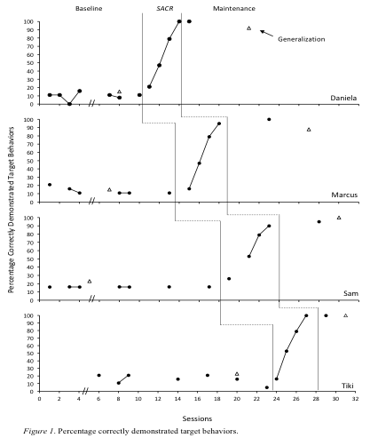
Results

Slide 47
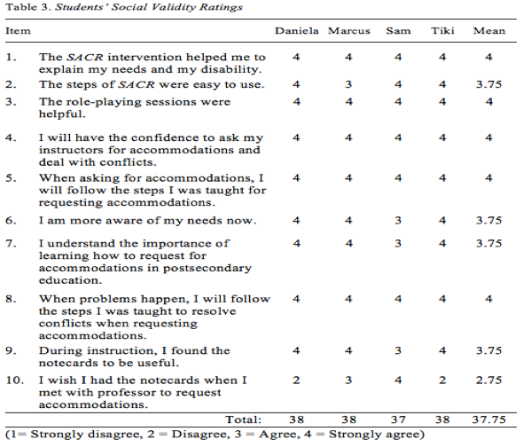

Slide 48
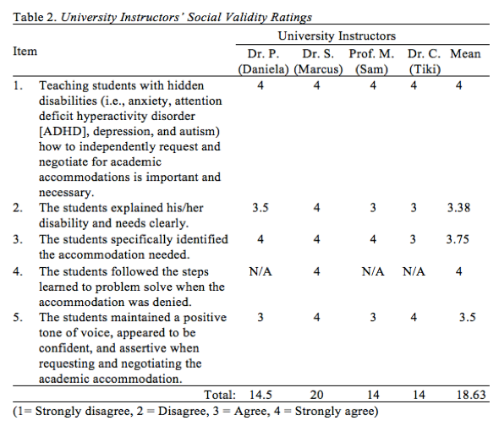

Slide 49
Significance of the Results
Results were consistent with similar studies (i.e., Bethune & Test, 2015; Palmer & Roessler, 2000; Holzberg et al., 2018; Walker & Test, 2011)
Contributions
  Added to the literature on the use of the SACR:
  In an in-situ setting
  Students with hidden disabilities
  Created a “streamlined” version of SACR instruction for use with students with hidden disabilities

Slide 50
Study 2 - Purpose
The purpose of this study was to evaluate the effect of Module I (i.e., self-advocacy) of Self-advocacy and Conflict Resolution (SACR) instruction on the ability of four college students with intellectual and developmental disabilities and/ or autism spectrum disorder to request academic accommodations in role-play and in-situ conditions.

Slide 51
Research Questions - Study 2
What are the effects of a self-advocacy intervention on knowledge of skills to request academic accommodations with postsecondary level students with I/DD in a role-play setting?
What are the effects of a self-advocacy intervention on the students’ generalization of accommodations-requesting skills to an in-situ setting?

Slide 52
Research Questions - Study 2
3. What are the university instructors’ perspectives on the usefulness of using the self-advocacy intervention to assist students with requesting academic accommodations?
4. What are the students’ perspectives about the effects of the intervention on their use of self-advocacy skills and its success in acquiring academic accommodations?

Slide 53
Method - Design
Multiple probe across participants (Gast, 2010)
Primary DV
  Participants’ correct use of the 12 steps in SACR instruction of the target behaviors
Second DV
  Participants’ ability to generalize the target behaviors to an in-situ condition
Criteria for mastery
  85% of target behaviors at the end of intervention
Generalization
  Preintervention and postintervention
Maintenance

Slide 54
Method - Setting
Urban, public university in the Southeastern United States
Undergraduate enrollment: ≈16,000
  ≈3,600 freshmen
Student to faculty ratio: 20:1
Average class size: 25
Female: 66%; Male: 34%
Minority students:
  26.2% Black
  8.3% Hispanic
  9.6% Other Minorities

Slide 55
Participants - Study II
Student* | Age | Year | Gen. | Disability | Race/ Ethnicity | Requested Accommodations
William | 23 | So. | M | MI* | African Am. | Read aloud
Levi | 21 | So. | M | MI* | African Am. | Read aloud
James | 20 | Fr. | M | AU* | African Am. | Extended time
Haris | 20 | Fr. | M | AU* | White | Read aloud
*Note: Pseudonyms were assigned; AU = autism spectrum disorder; MI = mild intellectual disability

Slide 56
Method - Procedures
Prebaseline
  Students met with the interventionist who described the study and selected accommodation(s) to request from instructor
Baseline
  Role-play requesting an accommodation(s) from a mock instructor (i.e., the interventionist)

Slide 57
Method - Procedures
Intervention
  Explicit instruction on the 12 SACR target behaviors (i.e., Module I)
Four lessons/sessions per student
  Approximately 20-30 minutes per session
  Model, lead, test

Slide 58
Intervention
Component 1:
  Conference with the student to select the accommodation(s)
Component 2:
  Specific lessons for each target behavior
Taught using explicit instruction and role play scenarios
  Broken into four lessons (covering 12 target behaviors; e.g., greet instructor, explain benefits of past accommodations, request the use of accommodations)
Mastery criteria set at 85% (10 of 12 targeted behaviors)

Slide 59
Scripted Notecards - Self-Advocacy
Example: #1
Hi Professor Plum, I’m Anne Teaque from your Monday/Wednesday History 101 class.
I wanted to talk to you about my accommodations.
I have trouble reading the tests and it makes it hard for me to know what you are asking.

Slide 60
Scripted Notecards - Self-Advocacy
Example: #2
4. Last year, I had read aloud in my classes.
5. It helped me understand the test questions better.
6. I think read aloud in your class would be extremely helpful as well.

Slide 61
Scripted Notecards - Self-Advocacy
Example: #3
7. Before the semester, I registered with the Office of Accessibility and Resources (OARS) to get accommodations in my classes.
8. I will let OARS know I asked you for read aloud.
9. Does that sound like a good plan?

Slide 62
Scripted Notecards - Self-Advocacy
Example: #4
10. Great, I will let OARS know I asked for read aloud.
11. I will let OARS know that we have made these arrangements and that you agree.
12. Thank you so much for working with me; I appreciate your time and help with this. I am really looking forward to your class! Thanks again!

Slide 63
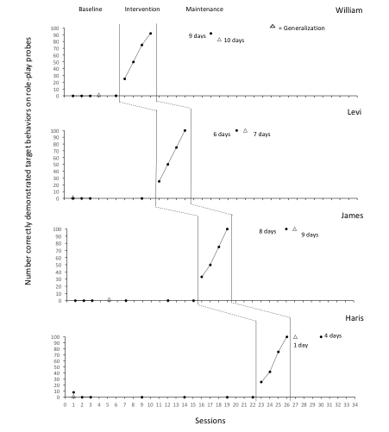
Results

Slide 64
Social Validity - Students
Students were given a questionnaire and asked to answer questions using a 4-point Likert-like scale
Students all agreed or strongly agreed:
  Role-playing sessions were helpful (M = 3.75)
  SACR instruction helped them gain the confidence to ask instructors for accommodations (M = 3.5)
  The importance of asking for accommodations in college (M = 3.75)
  The notecards helped them learn the steps (M = 4.0)

Slide 65
Social Validity - Instructors
Instructors were given a questionnaire and asked to answer questions using a 4-point Likert-like scale
Instructors all agreed or strongly agreed:
  Teaching students with disabilities how to independently request academic accommodations is important and necessary (M = 4.0)
  The student explained their learning/ accommodation needs clearly (M = 4.0)
  The student identified the specific accommodation need (M = 4.0)

Slide 66
Significance
Results were consistent with similar studies (i.e., Holzberg, 2017; Holzberg, Test, & Rusher 2018; Walker & Test, 2011)
Contributions:
  Added to the literature on the use of the SACR:
  In an in situ condition
  Students with IDD

Slide 67
Significance
This could be “packaged” and scaled up for use in universities’ Offices of Disability Services
  For example, mentors could teach SACR to students new to a university
  SACR instruction could be a part of orientation programs prior to students beginning classes or during the first weeks of class

Slide 68
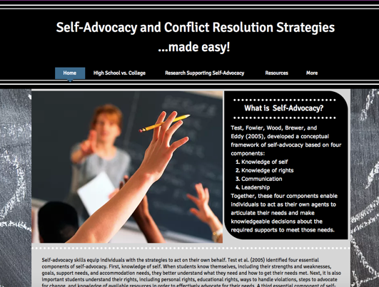
Resources for Teaching Self-Advocacy Skills
Links to: http://dholzberg.wixsite.com/sacrinstruction

Slide 69
Acknowledgments:
Research Site University
  Students
  DRS Staff
Jackson State University
  Dissertation committee
St. Jude Children’s Research Hospital
  Department of Hematology
UNC Greensboro
  Beyond Academics - Office of Comprehensive Transition and Post-Secondary Education
UNC Charlotte
  Office of Disability Services

Slide 70
Contact Information:
Latacha Hamilton, PhD
St. Jude Children’s Research Hospital; Memphis, TN
latacha.hamilton@stjude.org
901.595.5775
Debra G. Holzbreg, Ph.D.
University of North Carolina at Greensboro
Department of Specialized Education Services
Beyond Academics - Office of Comprehensive Transition and Post-Secondary Education
dgholzbe@uncg.edu
http://dholzberg.wixsite.com/sacrinstruction

