Slide 1
7.6: Dispute Resolution – A Response to “No!”
L. Scott Lissner, The Ohio State University
A student requests an accommodation for a test in two days that you don’t believe is appropriate, you say, “no,” and the student appeals. An instructor says, “no, that is not reasonable in my course” to an accommodation request you believe is supported. This session will use brief case studies to explore formal and informal tools for dispute resolution. Defining roles and responsibilities, balancing advocacy and compliance, and identifying decision-makers of “first” and “last” resort will define the boundary between the interactive process and complaints. We will identify best practice models and resources for framing the interactive process, considering “effective” and “essential,” and developing policy and process for appeals.

Slide 2

Dispute Resolution
A Response to “No!”
Presented by L. Scott Lissner, ADA Coordinator, The Ohio State University
7/20/2018

Slide 3
Disability Services Provider
Ongoing relationship with student
Expertize in accommodations
Facilitator, advisor, mentor, advocate and decision maker of first resort
Potential respondent or witness
Faculty
Ongoing relationship with student
Expertize in discipline; course and program goals and structures
Instructor, academic advisor
As an evaluator assigning grades is in a power up position
Potential respondent or witness
ADA Coordinator
Neutral and Objective
Expertize in relevant institutional policies and practices, law, and disability
Policy developer, mediator, arbitrator, and decision maker of last resort
Investigator for complaints of disability discrimination or harassment

Slide 4
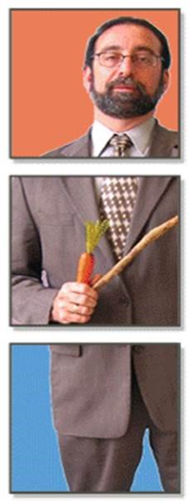
Designation of responsible employee and adoption of grievance procedures
In US law both Section 504 and the ADA require:
Non Discrimination
Facilities Access
Reasonable Accommodation
Designated Employee (504 Compliance Officer; ADA Coordinator)
Grievance Process
Notice
Good organizational practice suggests:
Policy owner
Dispute resolution process with authourity
Notes:
The ADA Complaint Investigation Process at the University of Michigan includes:
Receive written allegation(s) from Complainant
Interview Complainant, named Respondents (usually faculty), and Witnesses (including the disability services provider)
Insure that all relevant documentation is collected and reviewed
Write interview summaries. Complainant and Respondent have 10 days to review their summaries for accuracy
4

Slide 5
Section 504 of the Rehabilitation Act
(34 CFR § 104.7)
Designation of responsible employee. A recipient that employs fifteen or more persons shall designate at least one person to coordinate its efforts to comply with this part.
(b) Adoption of grievance procedures. A recipient that employs fifteen or more persons shall adopt grievance procedures that incorporate appropriate due process standards and that provide for the prompt and equitable resolution of complaints alleging any action prohibited by this part. Such procedures need not be established with respect to complaints from applicants for employment or from applicants for admission to postsecondary educational institutions
Notes:
The ADA Complaint Investigation Process at the University of Michigan includes:
Receive written allegation(s) from Complainant
Interview Complainant, named Respondents (usually faculty), and Witnesses (including the disability services provider)
Insure that all relevant documentation is collected and reviewed
Write interview summaries. Complainant and Respondent have 10 days to review their summaries for accuracy
5

Slide 6
Title II of the ADA (28 CFR § 35.107)
Designation of responsible employee. A public entity that employs 50 or more persons shall designate at least one employee to coordinate its efforts to comply with and carry out its responsibilities under this part, including any investigation of any complaint communicated to it alleging its noncompliance with this part or alleging any actions that would be prohibited by this part. The public entity shall make available to all interested individuals the name, office address, and telephone number of the employee or employees designated pursuant to this paragraph.
(b) Complaint procedure. A public entity that employs 50 or more persons shall adopt and publish grievance procedures providing for prompt and equitable resolution of complaints alleging any action that would be prohibited by this part.
Notes:
6

Slide 7
A model for the role of ADA Coordinator
Primary role is to insure compliance with Federal and State non-discrimination laws (neither advocate nor adversary).
Develop, review and refine policy and practice as they relate to access and accommodations
Provide training and consultation to deans, chairs and program directors, faculty, human resources and supervisors,, and staff
Dispute resolution
Initiate, encourage and support disability related initiatives.

Slide 8
Student Complaint Resolution Options
Defining a Path
Office for Disability Services (ODS); Office of Services for Students with Disabilities (SSD)
Faculty and/or Chair of the Department
Department Review or Appeal Process
Dean’s Office (Associate or Assistant Deans)
Student Advocacy Office; Office of Student Conflict Resolution
ADA Coordinator (Provost’s Office; Office of Institutional Equity)
Notes:
8

Slide 9
Typical Complaint Categories
  Discrimination/prejudicial treatment/exclusion
  Harassment/hostile environment
  Disability status
  Facilities access
  Accommodation request refused
  Accommodation not implemented

Slide 10
Essential Elements for the Complaint Process
Notice of how, when, and where to file a complaint;
Clear distinction between informal and formal processes;
Prompt timeframes for each stage of the complaint process;
Hearing officer/investigator has relevant knowledge/training;
Hearing officer/investigator is free of conflict of interest;
Accommodations provided for grievance procedures, if needed;
Investigation of the allegation(s) is thorough and objective, and includes the opportunity to present evidence;
Written notice to the parties of the finding.

Slide 11
Standards of Evidence
Substantial
  reasonable mind might accept as adequate to support a conclusion; not the result speculation or conjecture
Preponderance
  must be persuaded that the facts more probably support the position asserted
Clear and Convincing
  must be persuaded that it is highly probable that facts support the position asserted
Beyond a Reasonable Doubt
  must be all but certain of the position asserted

Slide 12
A model for ADA Complaint Investigation
Receive allegation(s) from the complainant
Interview all parties: complainant, respondent (usually faculty), and witnesses (may include the Disability Services provider)
Collect and review all relevant policies, communications, files, and other documentation.
Written summaries of interviews are reviewed for accuracy by complainant and respondent(s). Typically five to ten days.

Slide 13
A model for ADA Complaint Investigation
All information is evaluated using the preponderance of the evidence standard.
A finding of ‘Cause’ or ‘No Cause’ is made. A finding of ‘Cause’ requires a discussion of remedy.
A written report is issued to the complainant, respondent(s), and the appropriate University officials including any remedies or actions that are recommended.

Slide 14
Effective Strategies
Widely distribute clear and concise information to students
Provide clear explanations for the difference between recommendations, decisions, and rights to appeal
Consistently apply policies, follow all procedures
Maintain complete documentation
Insure an impartial but knowledgeable individual presides over the grievance or completes the institution’s internal investigation

Slide 15
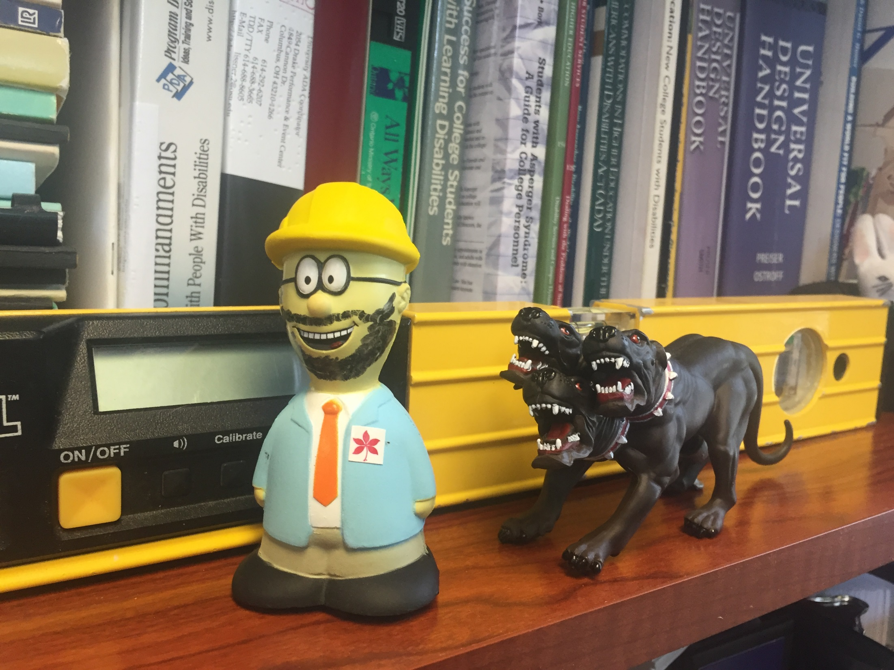
Notes:
Photo: close view of a shelf of books; in front of the books is a digital level; in front of the level is a soft rubber figure of a man in a blue jacket with a buckeye on it, a tie, a safety glasses and hard hat. A beard has been added with a marker making him look like your presenter. He is being chased by a figure of cerberus

