Slide 1
Wayfinding in a Digital World:
Providing Accessible Campus Maps
Jim Kessler
AHEAD
Lauren Copland-Glenn
Northern Arizona University

Slide 2
Word Maps
y
Jim Kessler
AHEAD

Slide 3
“We have a student who is blind who, over the years, has come to expect us to bring him to and from class. In the past, he has also asked us to take him to the restroom and help him purchase coffee.

Slide 4
He has wandered into the parking lot trying to get to our office from the trolley. Usually, a maintenance employee or police office finds him and brings him to us. He also refuses to work with an O&M specialist to learn the campus.

Slide 5
What is our responsibility?

Slide 6
Campus Way-Finding Information
Campus Maps
Print
On-line
Interactive
Virtual Tours

Slide 7
Buildings
Exterior
Marquee (Banner)
Post and Panel
Lawn Signs
Destination Arrow Posts
Temporary Event

Slide 8
Interior
Banner
Shingle – pictographs
Kiosk Maps
Information Desks
Door numbers
Placards

Slide 9
No campus ‘maps’ for the blind

Slide 10
Braille
Standards for dots and code (2013)*
Lack of Standards for maps
Inflexibility
Limited information presentation
*Braille Authority of North America (BANA)
‘Guidelines and Standards for Tactile Graphics 2010”
http://www.brailleauthority.org/tg/web-manual/index.html

Slide 11
Understanding Tactile Graphic
…need to be introduced early in the process of learning braille. The ability to read graphics will be required for the understanding of concepts such as diagrams, graphs, and maps, and to be able to participate in standardized testing.”

Slide 12
OCR has defined accessibility as:
A person with a disability is afforded the opportunity to: acquire the same information, engage in the same interactions, and enjoy the same services as a person without a disability in an equally effective and equally integrated manner, with substantially equivalent ease of use.
OCR – DOJ Dear Colleague Letter June 2010 (para 4)

Slide 13
lack of access to orientation information
Responsibility to defer to the blind/visually impaired student to get information

Slide 14
Orientation
the understanding of where you are, that is dependent on knowing
where you have come from, and
where you are going

Slide 15
Controlling the Environment

Slide 16
Word Maps

Slide 17
Word document in an accessible .pdf
Utilizing the constructs of Orientation*
Presented in hyperlinks
In an Excel format
sort by building, department, advance search
*Does not depend on specific cane techniques (Mobility)

Slide 18
Making ‘Word’ Maps

Slide 19
Essential Information
Cardinal Directions
North
West East
South
RIGHT / LEFT
UP / DOWN

Slide 20
Fundamental Information
Building
Entrances
Path(s) of travel
Door(s)
Floor covering
Signage
Elevator and Stairs
Restrooms (including service animal relief area)

Slide 21
BUILDINGS
Where – what is adjacent (left/right, front/back)
Macro –
What is the basic floor pattern
How may floors (including ground/basement)
Main features (offices, functions) on each floor

Slide 22
Building
Micro –
Systematically describe each floor
Entrance(s) –
How many
Where they (paths of travel) come from – does the surface change

Slide 23
Doors
Types
Hinged – manual (knobbed/pushed), automatic
Sliding - automatic
Revolving – automatic
Offices/classrooms
Inset
How many/location

Slide 24
Path of Travel
Lobby/Hallways
Floor Covering
Carpet, tile, concrete/terrazzo, wood
Obstacles
Number Sequence

Slide 25
Rooms
Office
Classrooms
Seats
Resident Hall
Auxiliary/Service areas
Conference Rooms

Slide 26
Signage
Types
Shingle, Banner, Placard
Braille
Pictograph

Slide 27
Elevator/Stairs
Elevator
Specific location
How many cars
“Call’ button
Floor Buttons (top down)
Which side

Slide 28
Stairs
Types
Straight w/o landing
Half Turn (Switchback)
Quarter Turn (Perimeter)
Bifurcated
Circular (Spiral, Curved

Slide 29
Emergency Stairs
Descent side from landing/area of safe rescue
Emergency Stairs exit where?

Slide 30
Restrooms
Signage
Inside path of Travel
Location
Stalls/urinals - Flush mechanism (auto/manual)
Sinks, soap (location),towels/blower
manual/motion activated
Trash

Slide 31
Animal Relief Area
Location in relationship to ‘door’ and
trash receptacle location
Courtesy ‘bags”

Slide 32
Sidewalks
THE connectors to all parts of campus
hard surfaces, concrete – smooth, pressed concrete (imprinted brick pattern), or textured (embedded stones) or brick.
Off path ` crushed gravel or compacted dirt
Intersection – dimpled or etched lines
Intersecting sidewalks/paths ????

Slide 33
Streets
One way
Two-way
Number of Lanes
plus parking
turning (specify at intersection)

Slide 34
Streets
Intersections
4-way, “T” (or 3-way), Round-about
Controls
Stop Sign, traffic light –sequence
Walk/wait lights (control location) - duration, audible signal
Crosswalks – textured? Color?

Slide 35
Landmarks
anything that has an auditory, aromatic, textural, kinesthetic, thermal or sensational impact that provides a reference to place.

Slide 36
Auditory – airplanes (airport), trains, automobiles, air handling units, fountains (water features), escalators, buildings, paths between buildings, overhands (canopies), objects (trees/posts… i.e. ‘sound shadows”), intersecting hallways, wide-open spaces.
Aromatic - cafeteria/coffee shops, swimming pools, mildew, trash containers (dumpsters), laboratories, gyms

Slide 37
Textural - carpet, bricks, asphalt, service covers, grass, dimpled curb cuts…
Kinesthetic - ups/downs – steps, sidewalk undulations, uphill/downhill, curbs (driveways), curb cuts, surface changes
Thermal - Air condition, hallways, foliage (shade from trees)

Slide 38
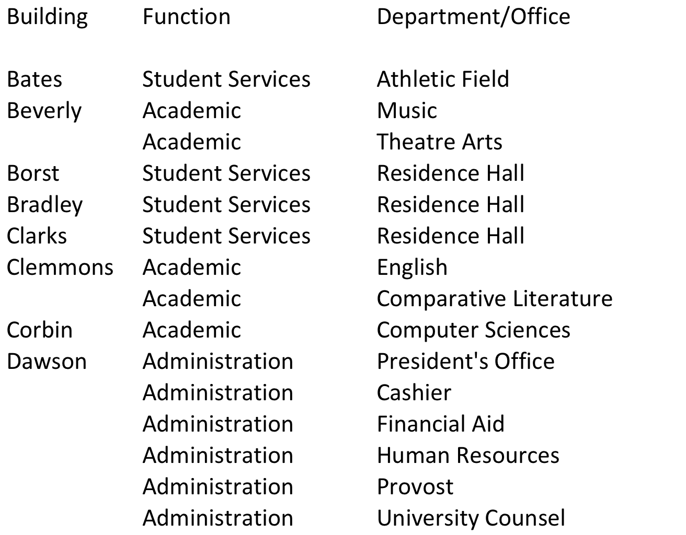

Slide 39
General Information
First Floor
Second Floor
Third Floor
Elevators
Stairs
Restrooms

Slide 40
Dawson Hall
Administration
Dawson Hall - Named in honor of Raymond H. Dawson (1929 -), Professor of Political Sciences, Dean of the College of Arts and Sciences, and first Senior Vice-President of the University system. Dr. Dawson - pioneer of equal rights and access to education.
Dawson Hall is located on the north side of Middle Campus facing Washington Street. To the east of Dawson Hall is a Visitor/Guest Parking Lot. To the West of Dawson Hall is Schroeder Building. South of Dawson Hall is ‘The Lawn’.
Dawson Hall has three floors (no basement)
First Floor – Main entrance, Reception, Registrar, Financial Aid, University Cashier
Second Floor – Human Resources, University Counsel, Vending and Break Room
Third Floor – President, Provost, Business and Finance

Slide 41
The basic design of the hallways in Dawson Hall is a ‘T” shape with a ‘central lobby’ on each floor and a hallway going east and west and south from the lobby. In each of the hallways are offices. Each hallway has a set of ‘fire doors’ that are held open with electro magnets that ‘release’ the doors to close automatically when the fire alarm is activated.

Slide 42
Lobby and hallways
West Hallway
East Hallway
South Hallway
Exits
Elevators (lobbies)
Restrooms
Water fountains
Trash/Recycling
Emergency Exits

Slide 43
Questions

Slide 44
Lauren Copeland-Glenn

