Slide 1
Bridging the Crossroads:
The Intersection of
Trans* and Autism Identities
Tay McEdwards, M.S.Ed., Oregon State University
Cynthia Konrad, M.A., Oregon State University
Teryn J. Robinson, M.A., M.S.Ed, Lake Forest College

Slide 2
Spectrums
Transgender (Trans)- An umbrella term that describes individuals whose gender identity does not match their sex assigned at birth.
Autism (ASD) - is a neurological and developmental disorder characterized by social-interaction difficulties, communication challenges and a tendency to engage in repetitive behaviors.

Slide 3
Research on the intersections of trans identities and autism

Slide 4
Terminology used in the research
DSM-IV used Gender Identity Disorder as a diagnostic category
DSM-V uses Gender Dysphoria as a diagnostic category
Most of the research defaults to
Gender Dysphoria (GD)

Slide 5
Terminology used in the research
Some assessment tools use “opposite gender” language, which is not encompassing of non-binary gender identities
Some research mentions “gender non-conformity”
Discussion of the research will use ”gender dysphoria” or “GD” because that’s what the research itself uses

Slide 6
Research looking for
A causal relationship
Biological
Prenatal hormone levels and ASD
Extreme Male Brain
Birth weight
as summarized by Van Der Miesen, Hurley, and De Vries (2016)

Slide 7
Research looking for
A causal relationship
Social
Forming social relationships
Deficits in social communication
as summarized by Van Der Miesen, Hurley, and De Vries (2016)

Slide 8
Research looking for
A causal relationship
Psychological
Obsessive interests
Rigid thinking
Theory of Mind
as summarized by Van Der Miesen, Hurley, and De Vries (2016)

Slide 9
Research methods
Some of the instruments used
CSBQ: Children’s Social Behavior Questionnaire
DISCD: Diagnostic Interview for Social Communication Disorders
ASQ: Autism Spectrum Quotient
SRS: Social Responsiveness Scale
CBCL: Child Behavior Checklist, item 110
see van der Miesen et al. (2018a)

Slide 10
Research methods
Cross-sectional analysis of patient files
Some research done from gender clinics looking at occurrences of ASD
Some research done from ASD diagnoses looking at occurrences of GD
see van der Miesen et al. (2018a)

Slide 11
What is the co-occurrence of GD and ASD?
Estimates of GD in overall population
Individuals labeled male at birth:
1 in 10,000-20,000
Individuals labeled female at birth:
1 in 30,000-50,000
See Zucker et al. (2009)

Slide 12
What is the co-occurrence of GD and ASD?
Estimates of ASD in overall population
1% overall
Individuals labeled male at birth: 1 in 42
Individuals labeled female at birth: 1 in 189
See Lai et al. (2014)

Slide 13
What is the co-occurrence of GD and ASD?
Most of the research comes to a correlation between 3-5 percent of individuals with ASD also with GD

Slide 14
Limitations of the research
Symptoms versus diagnosis:
  CSBQ: Children’s Social Behavior Questionnaire
Who completes the instrument?
  CBCL, item 110: parents identify if child’s “wishing to be of the other gender”
Limited choices
  CBCL,, item 110: “wishing to be of the other gender” is answered on a scale of “never,” “sometimes,” or “often”
see van der Miesen et al. (2018a)

Slide 15
Limitations of the research
Difficulty for someone with ASD to be able to self-report because of the introspection required, and many of the measures are all or part self-report — see van der Miesen et al. (2018a)
Most research done since 2000, so this area of research is evolving right now.
Most research done outside the US — What are the implications of this on the research?
  Differing societal norms and legal protections

Slide 16
ASD, GD, and mental health
Depression, anxiety and somatic issues were found to be higher in people with ASD and GD than with the general population — see van der Miesen et al. (2018a)
Symptoms of depression and anxiety weren’t just found to correlate with obsessive interests among people with ASD who also demonstrated GD, they correlate with other sub-features of ASD — see van der Miesen, de Vries, Steensma, and Hartman (2018)

Slide 17
Important implications
We don’t have an accurate measure of the co-occurrence of ASD and GD — perhaps a new assessment tool is in order
Multiple research studies identify increased levels of mental health distress among people identifying with ASD and GD

Slide 18
Considerations for us from the research
We need to be aware that we’re more likely to see our students with ASD also identifying as trans*
We need to create a supportive environment for students with these intersecting identities.
We need to be attuned to the mental health of these students and be able to make appropriate referrals for students who need support beyond what we can provide.

Slide 19
Risks for Trans People Dealing with Oppression
Increased psychological distress and suicide attempts
39% of respondents to the US Transgender Survey experienced serious psychological distress in the month before completing the survey
40% have attempted suicide in their lifetime, nearly nine times the U.S. population
7% attempted suicide in the past year, nearly 12 times the rate in the U.S. population
Report of the 2015 U.S. Transgender Survey, Executive Summary, 2016.

Slide 20
Risks for Trans People Dealing with Oppression
Increased risk of victimization
46% or respondents were verbally harassed in the past year because of being transgender
9% of respondents were physically attacked in the past year because of being transgender
47% of respondents were sexually assaulted at some point in their lives, and 10% were sexually assaulted in the past year
54% experienced some form of intimate partner violence
Report of the 2015 U.S. Transgender Survey, Executive Summary, 2016.

Slide 21
Challenges for Trans
People with Autism
Difficulty finding educational and medical professionals who support them holistically
Difficulty finding knowledgeable and accepting staff and peers in LGBTQ+ and disability service spaces
Dependence on unsupportive family
Compounded risks of violence, economic struggles, discrimination, etc.
What challenges have you seen trans people with ASD face?

Slide 22
Supporting Trans People with ASD
Educational Resources and Ideas

Slide 23
Understanding Fluidity
Assigned Sex
Man |  | Woman
Gender Identity
Male |  | Female
Gender Expression
Masculine |  | Feminine
Sexual Orientation
Attracted to Men |  | Attracted to Women

Slide 24
Genderbread Activity
Sex Assigned at Birth: the sex a person is assigned at birth based on their genitalia, chromosomes, hormones, etc.
Gender: a person’s internal sense of having a gender or being a gendered person
Gender Expression: the ways people express their gender externally

Slide 25
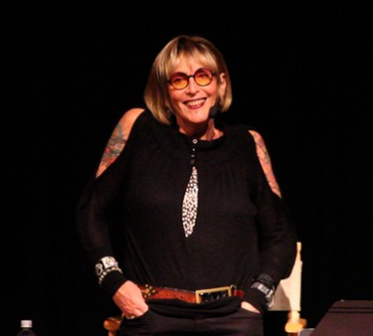
Kate Bornstein
Gender:
Kate Bornstein identifies as nonbinary, as neither a woman or a man.
Gender expression:
Kate’s gender expression varies and is sometimes masculine, feminine, or androgynous.

Slide 26
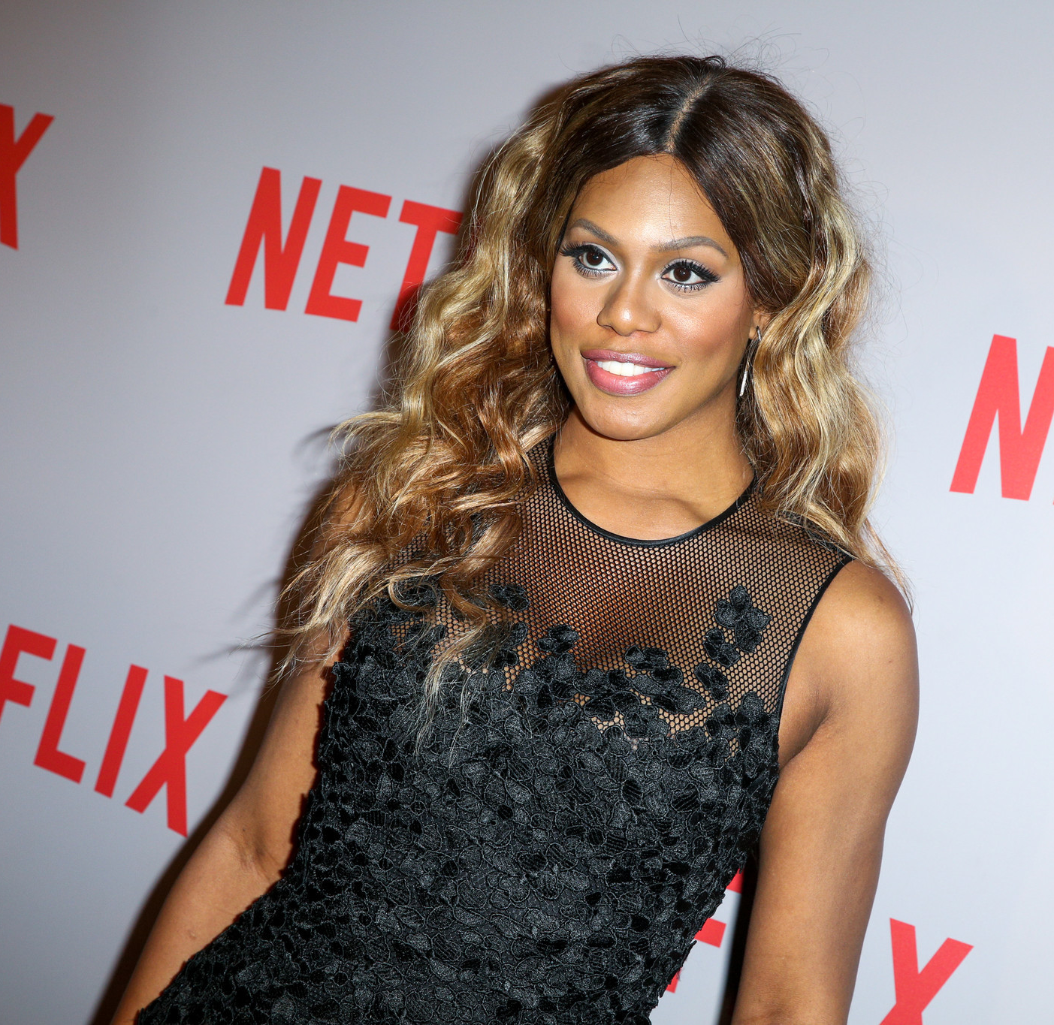
Laverne Cox
Gender:
Laverne Cox identifies as transgender and as a woman.
Gender expression:
She usually has a feminine gender expression.

Slide 27
Genderbread Activity
Where do you fall within the spheres of gender and gender expression?
If you are comfortable, share your answers and thoughts in a group of 2-3 people.

Slide 28
Understanding Pronouns
Pronoun
a word that replaces a noun or noun phrase.
Gendered pronoun
signifies the gender identity or, in many languages other than English, the grammatical gender or a person or object.
Gender inclusive pronoun
one that does not specify a gender identity or grammatical gender of a person or object.
can be used by people of any gender identity, including people who are agender or don’t identify with a gender.

Slide 29
Examples of Pronoun Usage
 | Nominative (subject) | Objective (object) | Possessive determiner | Possessive Pronoun | Reflexive
He/him/his | He danced. | I texted him. | His smile is beautiful. | That book is his. | He is proud of himself.
She/her/hers | She danced. | I texted her. | Her smile is beautiful. | That book is hers. | She is proud of herself.
They/them/ theirs (singular) | They danced. | I texted them. | Their smile is beautiful. | That book is theirs. | They are proud of themself.
Ze/zie, hir/zir, hirs/ zirs | Ze/zie danced. | I texted hir/zir. | Hir/zir smile is beautiful. | That book is hirs/zirs. | Ze/zie is proud of hirself/zirself.
No pronouns, use name instead | Sam danced. | I texted Sam. | Sam’s smile is beautiful. | That book is Sam’s. | Sam is proud.

Slide 30
Universal Design
Words have power
Name in use
Pronouns
Correct ASD terms
Document audit
Safe spaces/non-verbal cues
Gender inclusive housing
Gender inclusive restrooms
Low sensory areas
Ability to be one’s whole self in LGBTQ+ and disability access spaces

Slide 31
Accommodations
Accommodations based on the secondary impact of gender dysphoria impacting the individual in the learning environments (depression, anxiety, insomnia, etc.) not the diagnosis
Depending upon the individual accommodations, may be needed long-term or only for short-term transition
Housing should have gender-inclusive, family, and LGBTQ+ spaces with low sensory options

Slide 32
Best Practices
Empower trans students and staff
Recruit and retain trans staff
Trans students with autism in leadership roles, paid positions, and decision making
Build inclusive environments
Use correct language, pronouns, names, signage, etc.
Positive cues in spaces that might impact students on these spectrums
Serve as a resource for colleagues
Reach out and offer--don’t wait to be asked!
When students consent, share feedback with colleagues

Slide 33
Best Practices
Collaborate on development for all students
Work on ways to interact with others in classrooms and living spaces
Discuss methods for approaching and talking to new people and about personal boundaries
Communicate in ways that meet people where they are
Faculty, staff, and RA trainings to help engage students with diverse abilities
Reduce student conduct complaints due to expected behavior norms
Build inclusive student groups and programming for events, with trans students with ASD in on planning

Slide 34
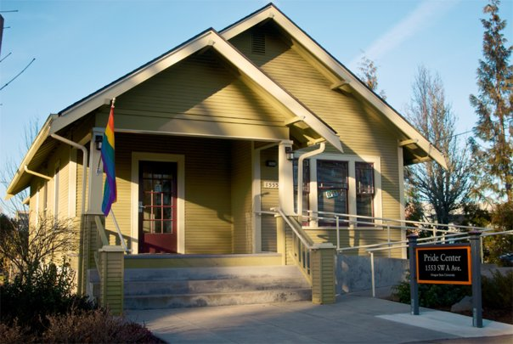
Scenario
Student staff at the LGBTQ+ center on your campus express frustration to their supervisor about a guest who asks very personal questions, gets distracted during events, and doesn’t give others a chance to talk in discussions.
The LGBTQ+ center director knows that the student has ASD and reaches out to you for help.
What advice would you offer your colleague?
What tools or resources would you share with them?

Slide 35
Scenario
A student you serve tells you they are questioning their gender and think they might be nonbinary. They ask you to use a name other than the one on their student record and use they/them pronouns to refer to them.
They ask you where they can learn more about nonbinary identity and meet other people who identify this way.
How do you respond to the student?
What resources do you suggest?

Slide 36
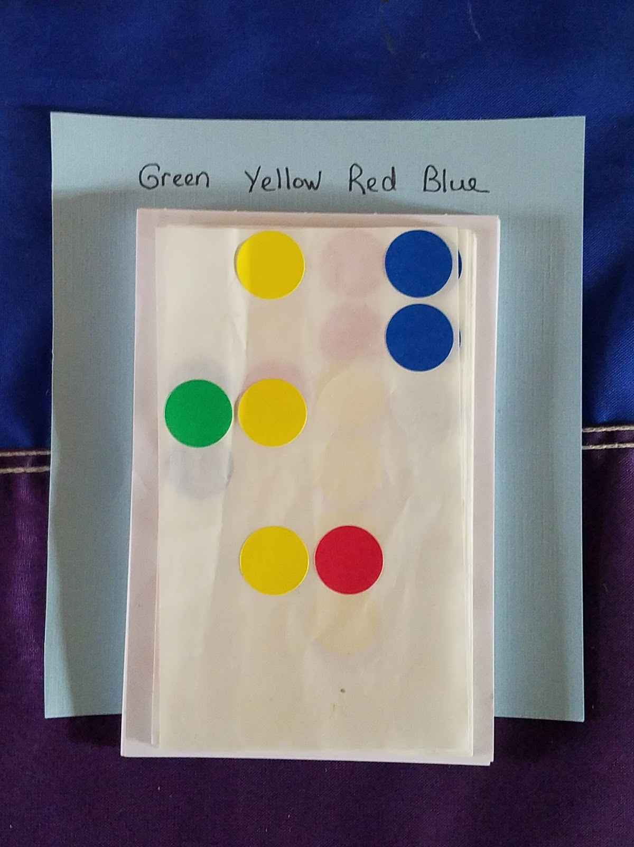
Tools used at the OSU Pride Center
Color-Coded Communication
Sometimes communicating our needs can be difficult. To help ease the way, here are some stickers to help you communicate your needs for the day
Green: I have a question or want to chat!
Yellow: I’m feeling shy today. I’ll let you know if I want to chat.
Red: I can’t or don’t want to talk. Give me some space, please.
Blue: I’m having a difficult day and need support.
Feel free to mix and match! This is something we’re trying out. Let us know what you think!

Slide 37
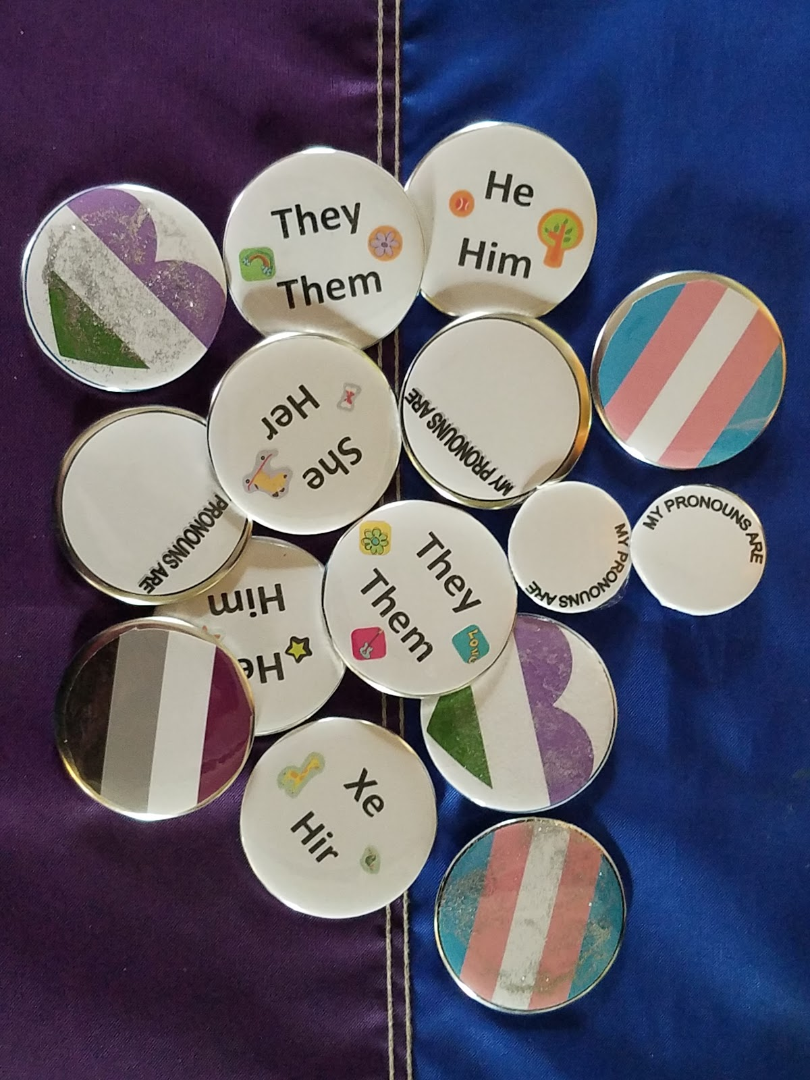
Tools used at the OSU Pride Center
Quiet space and space for large, noisy, or social events
Social and knowledge-sharing events for LGBTQ+ students with disabilities
Buttons to share pronouns and celebrate identities

Slide 38
Systemic Change
Cultural Center collaborations
DS Office liaison – attend events to meet students where they are at
Inclusive programing/events – consider sensory impact and social cues
Campus wide collaborations
Trans Task Force – Collaboration of Trans faculty and staff, graduate teaching assistants, students, and allies
  Allows students and employees to meet individuals with identities similar to themselves
  Influences policies and procedures to create a more inclusive campus

Slide 39
What best practices have you found effective?

Slide 40
Four Ways That You
Can Make A Difference
Pronouns - sharing yours/ask others to share
  If unsure, use individuals name or gender neutral pronouns (you, they, them)
Use a safe space cue to let people know it is OK to be their whole self in this environment
Learn about LGBTQ+ resources in the campus and community and refer others to them
Take on the responsibility to educate others--share knowledge with colleagues and students.
Make a commitment! What will you do?

Slide 41
questions?
Thank you for Being here today.

Slide 42
References
James, S.E., Herman, J.L., Rankin, S., Keisling, M., Mottet, L.’ & Anafi, M. (2016). Executive Summary of the Report of the 2015 U.S. Transgender Survey. Washington, DC: National Center for Transgender Equality.
Lai, M.; Lombardo, M. V.; & Baron-Cohen, S. (2014). Autism. Lancet, 383(9920), 896-910.
van der Miesen, A. I. R.; de Vries, A. L. C.; Steensma, T. D.; & Hartman, C. A. (2018). Autistic symptoms in children and adolescents with gender dysphoria. Journal of Autism and Developmental Disorders, 48, 1537-1548.
van der Miesen, A. I. R.; Hurley, H.; Bal, A. M.; & de Vries, A. L. C. (2018). Prevalence of the wish to be of the opposite gender in adolescents and adults with autism spectrum disorder. Archives of Sexual Behavior, Online.
van der Miesen, A. I. R.; Hurley, H.; & de Vries, A. L. C. (2016). Gender dysphoria and autism spectrum disorder: A narrative review. International Review of Psychiatry, 28(1), 70-80.
Zucker, K. J. & Lawrence, A. A. (2009). Epidemiology of gender identity disorder: Recommendations for the standards of care of the world professional association of transgender health. International Journal of Transgenderism, 11(1), 8-18.

