Slide 1
Key collaborations: working with faculty for accessible distance & online education
Dr. Courtney Jarrett

Slide 2
The BSU Model
Collaboration is KEY!

Slide 3
Key partners
DS office
Assistive Tech Specialist
Caption Writer
Instructional Designers
Educational Excellence (Faculty Support)
Faculty!

Slide 4
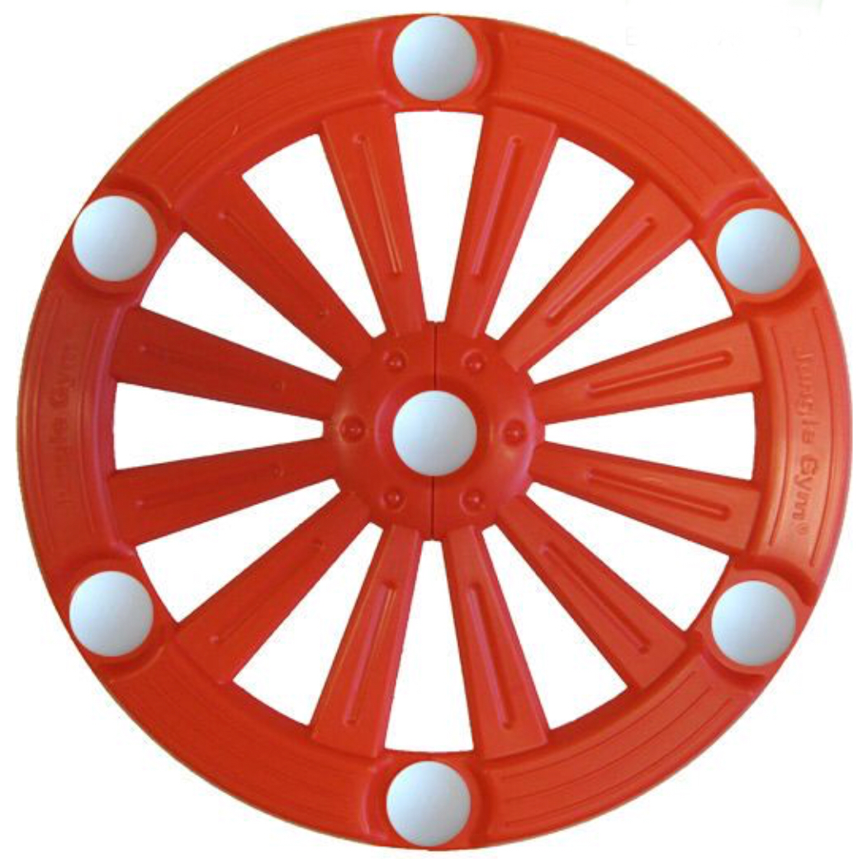
DS as starting point…
-expertise
-referral to appropriate resource

Slide 5
Collaboration Examples
DS staff as Faculty
Training with Online & Distance Ed staff
ILS workshops
Accessible Technology Task Force
Faculty Mentorship Program

Slide 6
Other Tips & goals
Incentivize accessibility
Ease of use
Indicate efficiency
Alleviate worry/fear
Find ambassadors

Slide 7
Problem Areas
Decision-making power
Lack of knowledge
Faculty mindset

Slide 8
Future collaborations
Campus climate
Strategic plan
Resources
New innovation

Slide 9
Questions?
Thank you!
Thanks!!!!
Dr. Courtney Jarrett
cjjarrett@bsu.edu

