Slide 1
Audio Description: Collaboration, Implementation, and Evaluation
AHEAD National Conference 2018
Albuquerque, NM
Elizabeth (liz) Anh Thomson, PhD Candidate
Disability Studies, University of Illinois at Chicago

Slide 2
Session Agenda
Positionality
General Overview of Audio Description
Collaboration Theory
Case Study
Discussion of Implementing Audio Description

Slide 3
Accessibility
Will read all text on slides
Will use the microphone
Will insert alt text in Powerpoint; will describe all images or graphics
Will be aware of my rate of speaking
Will have large print access copies
Slides are numbered
Powerpoint design is black and white without background color
Will use plain, simple language
Did Accessibility Check with Microsoft Office
Anything else?

Slide 4
Positionality
Identify as a middle class, disabled, Vietnamese adoptee, bi/queer, dark-skinned, gender non-conforming, cisgender female
Do not have a visual impairment
Appreciate arts and culture
Documentary photography and photojournalist
Fifth year, PhD candidate in Disability Studies, at the University of Illinois at Chicago
Studying disability cultural centers in higher education

Slide 5
Collaboration Theory
Used Gajda’s (2003) principles of collaboration theory to guide this project.
The five principles are:
Collaboration is an imperative.
Collaboration is known by many names.
Collaboration is a journey not a destination.
With collaboration, the personal is as important as the procedural.
Collaboration develops in stages.

Slide 6
General Overview of Audio Description
An accommodation primarily for those who are blind and/or have low vision
Audio Description can be used anytime where describing a person’s or people’s gestures is helpful and effective to understanding the situation.
Audio Description is being more commonly available in movie theaters, Netflix Original shows, theater, dance, and sporting events.
Early conversations on the “professionalization” of audio describers
Audio Description is different than 1) an art label, 2) photo caption, or 3) an audio guide.

Slide 7
Basic Standards to Writing Descriptive Text
From Snyder (2014)
Go from general to specific
Use color
Use directional information
Be clear, concise, and conversational (accessible language)
Use metaphors or similes
Be mindful of adverbs, which usually equals interpretation
Prioritize the most essential
  Who
  What
  When
  Where

Slide 8
Intro to Descriptive Text, cont’d
Acknowledge your own sighted privilege
Consult people who are blind or have low vision as AD specialists
Consider race, ethnicity, and skin color
Don’t use whiteness as a default

Slide 9
Case Study
Myself and MUSE graduate student Jonathan Kelley
Art exhibit at one of the cultural centers at UIC
Goal: To work collaboratively with the participating artists in writing the descriptions and voicing the descriptive text to create a unique and meaningful experience for all of the guests
10 artists participated
Ask of the artists –
  work collaboratively to write the descriptions, and
  voice the descriptions

Slide 10
Implementation
Worked early with the exhibit curator and artists
Explained why AD was needed
Set deadlines
Worked one-on-one with the artists
Myself and Kelley did finishing touches
Got audio files online and on devices; also, printed text in large print

Slide 11
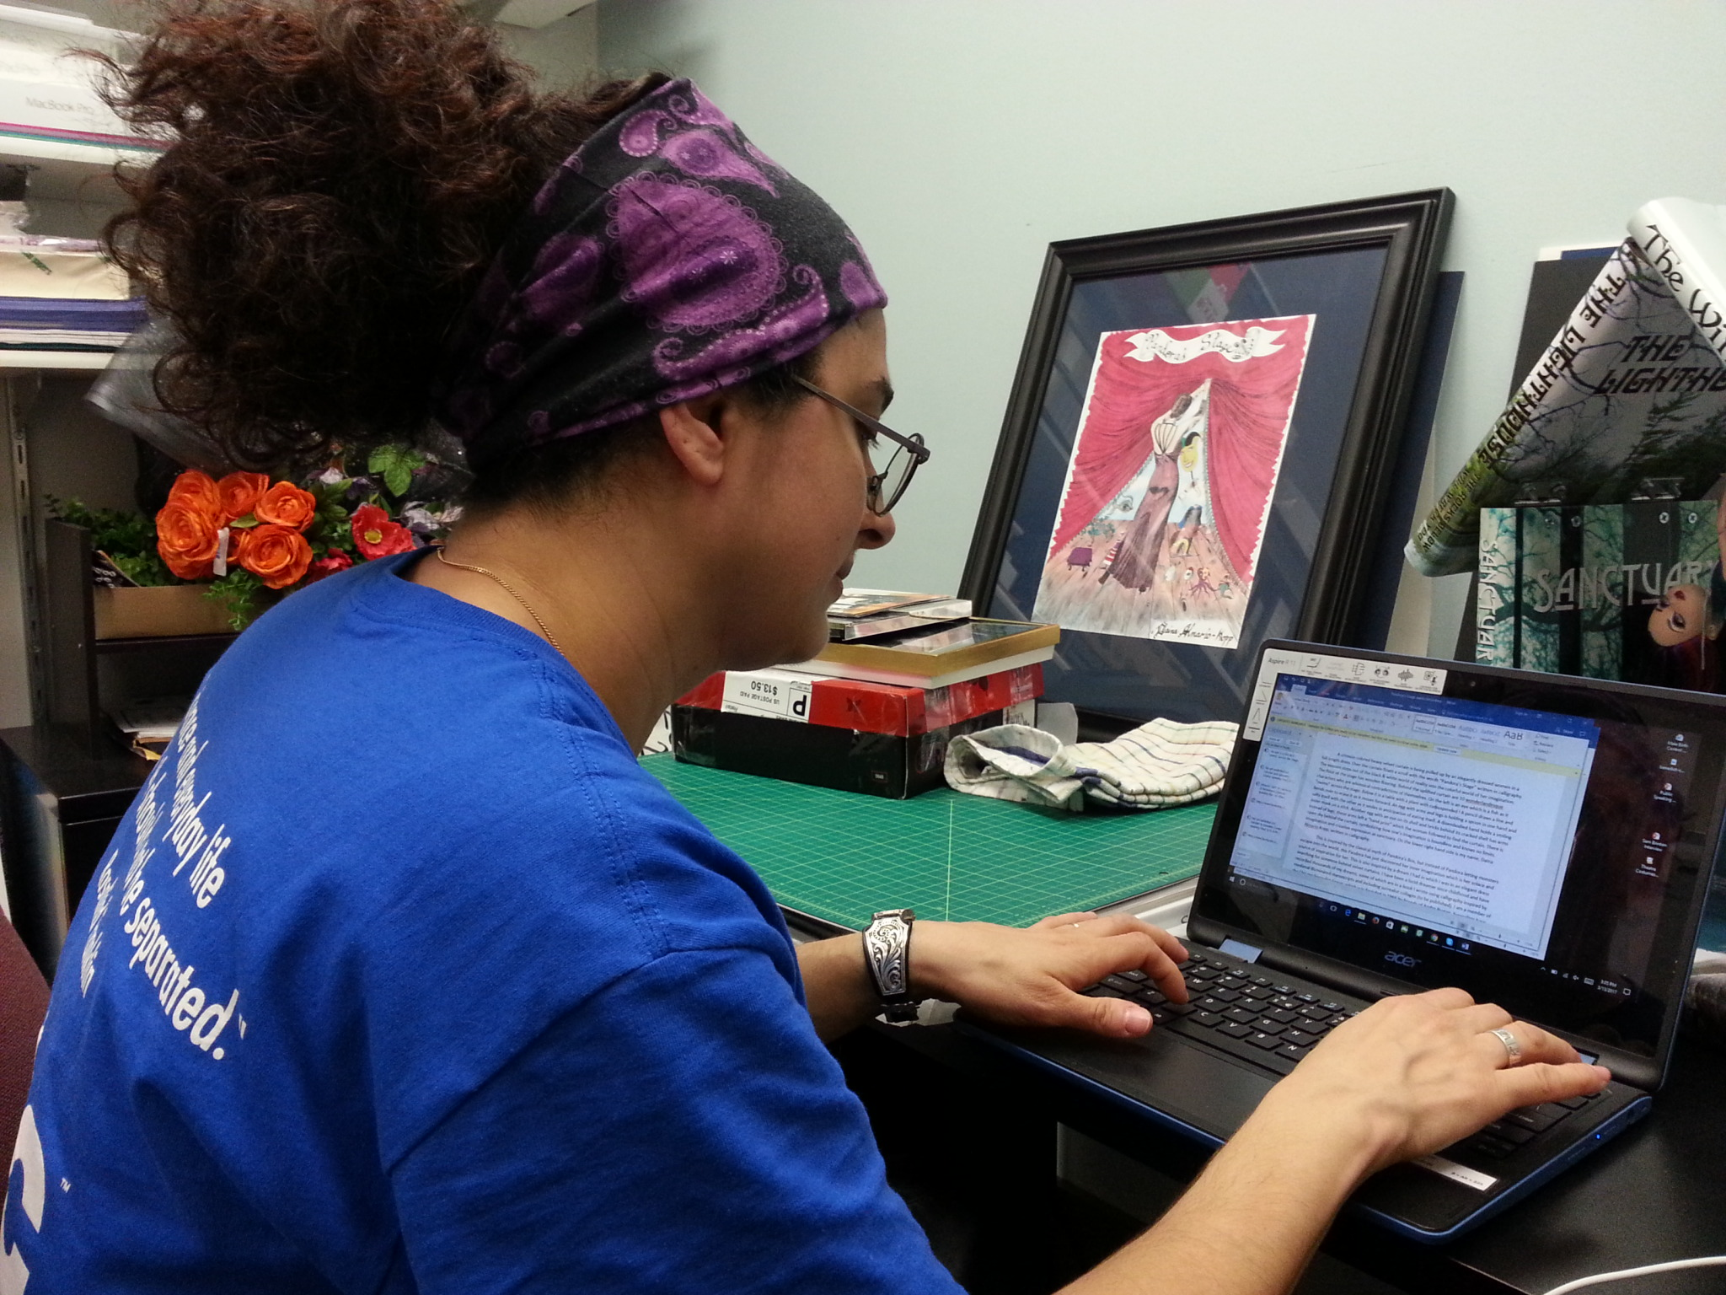

Slide 12
Evaluation
Created short anonymous survey for guest users
Created short anonymous survey for artists
  Results – overall positive
  Quotes

Slide 13
Discussion of Implementing AD

Slide 14
Contact Information
Liz Thomson
E-mail: lthomson@uic.edu
Cell: (773) 330-6878

