Slide 1
AHEAD Session #4.8 Get Hands-On with Information at the NCCSD Clearinghouse
Welcome to
#4.8 Get Hands-On with Information
at the NCCSD Clearinghouse
Richard Allegra, Associate Director, Education and Outreach
richard@ahead.org

Slide 2
Agenda for Today
NCCSD Introduction
What we have available to you from:
  Technical Assistance
  NCCSD Clearinghouse & Training Center
  Research Activities
  DREAM Student Organization
Tour of Resources
Q & A
Session Evaluation

Slide 3

Where We Came From
Higher Education Opportunity Act of 2008
Competitive grant competition in Summer 2015. Awarded to AHEAD in October 2015.
A four-year federal project funded through the Fund for the Improvement of Postsecondary Education (FIPSE), now OPE.
U.S. Department of Education
(P116D150005)

Slide 4

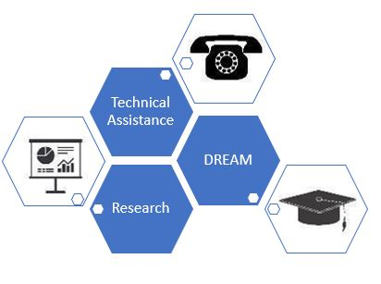
Who We Are
homepage: nccsdonline.org

Slide 5
Our Team – From Across the U.S.
STAFF
Shedita Alston– Project Office, OPE (DC)
Stephan Smith – Co-PI/PD (NC)
Wendy Harbour – Co-PI/Director (MN)
Richard Allegra – Education and Outreach (CA)
Kim Elmore – DREAM Coordinator (VA)
Sally Scott – Research and Information (VA)
Graduate Students & Interns
PARTNERS AND AFFILIATES
University of Massachusetts – Boston (MA)
University of Minnesota (MN)
Virginia Commonwealth University (VA)

Slide 6
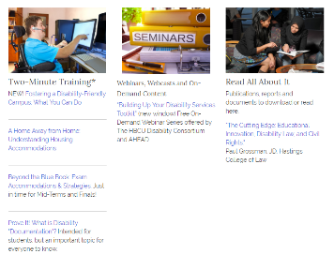

Technical Assistance and Outreach
Contacts. Training Center. Clearinghouse.
Calls and emails from students, parents, others. Disability Resources staff (24%) Undergrads (11%) Faculty (14%)
Avg 450 contacts/year to date
Referral to Resources (41% of requests)
NCCSD Training Center – Two-Minute Training, links to webinars, videos, references
Social Media presence

Slide 7
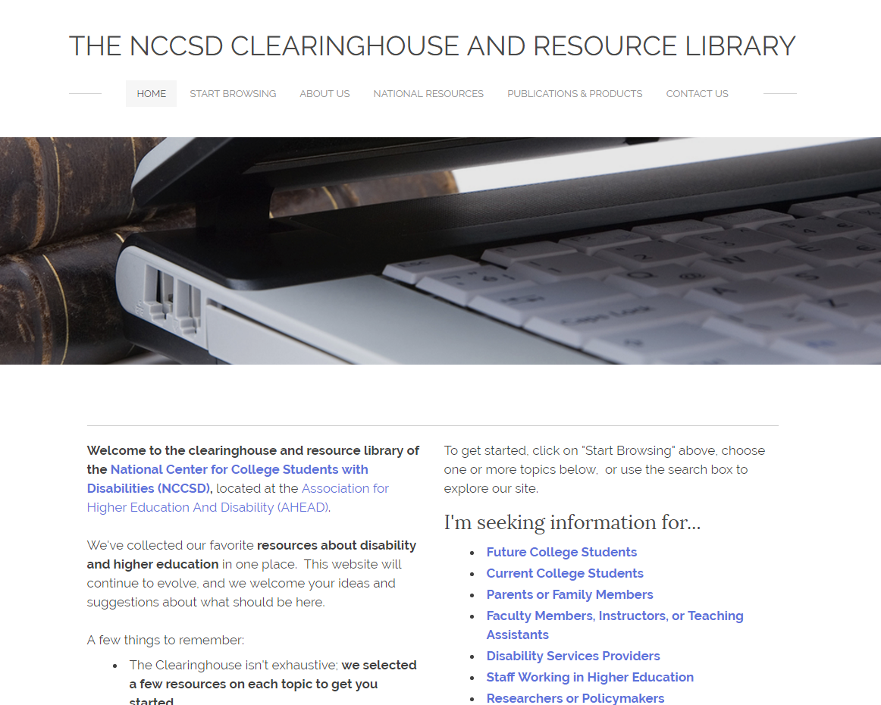
The NCCSD Clearinghouse: A Tool for Students & You
Average Unique Visitors = 8,000/month (Year 2, full-year data)
Content developed in-house, plus links to ”best” external resources
Material developed in response to students and others who contact us
nccsdclearinghouse.org

Slide 8

Research & Reporting
Determine needs of students with disabilities in higher education and priorities for work of the NCCSD through:
Literature Review
Needs Assessment – Focus Groups
Products:
Research Briefs & Highlights
Database of Disability Resource Centers at all US campuses
Photo source Bigstock.com

Slide 9
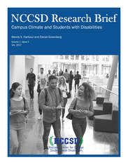
Research & Reporting
NCCSD Research Brief on Campus Climate
Cited 2017 Studies:
  disabled students less comfortable on campus than non-disabled students
  23% of disabled students witnessed discrimination
  22% experienced offensive verbal comments
  Bias second only to African-American students

Slide 10

Mission & Goals
DREAM is an acronym of our 4 major areas of programming interest: Disability Rights, Education, Activism, and Mentoring.
Building a communications network to promote peer support and disability pride as well as disseminate information relevant to disabled students.
Advance the interests of postsecondary students with disabilities.
Advocating for student rights, increased accessibility, and social and policy change.
Developing ways to support local campus groups and expanding the depth and breadth of mentoring activities.

Slide 11

Current DREAM Activities
Monthly DREAM Mentor Mondays
Digital Care Packages for DREAM Chapters and Affiliates
Community-Building Through Social Media
Resources and Publications, including “College While Disabled” blog and Weekly “DREAM Weekly News in Higher Education and Disability”
Individualized Support of Emerging Student Leaders on U.S. Campuses
Disabled & Proud Online Conference, October 11 – 13, 2018 https://www.disabledandproud.org/

Slide 12

Take a Tour

Slide 13
Contact, Visit and Follow Us!
Our email is NCCSD@ahead.org
Our toll-free number is 844-730-8048
Websites:
www.NCCSDonline.org
www.NCCSDClearinghouse.org
www.DREAMCollegeDisability.org
FB, Twitter & Instagram: @nccsdonline
Tumblr & Pinterest: yesdisabledcollege

Slide 14
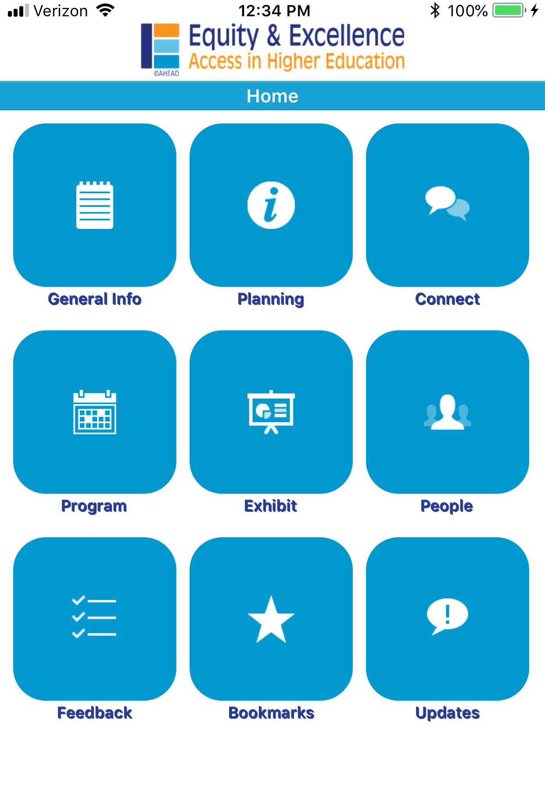
SESSION EVALUATION
Thank you for participating in this session.
The AHEAD Conference Committees appreciate your thoughts on the program.
Please take a few minutes now to complete the session evaluation available from the Moderator or the AHEAD app

