Slide 1
welcome everyone (we)
PLANNING EVENTS
Jim Kessler
AHEAD (WE)

Slide 2
Guidance
Rehabilitation Act [29 U.S.C. § 701 et seq]
Section 504: prohibits federal agencies, programs or activities from discriminating and requires reasonable accommodations for qualified individuals with disabilities.
http://www2.edu.gob/about/offices/lists/ocr/know.html?scr+ft

Slide 3
Americans with Disabilities Act (ADA – [42 U.S.C. ch. 126 § 12101 et seq.])
Title II - public institutions that receive federal funding
Title III – private institutions that receive federal funding
… no qualified individual with a disability shall, because a public entity's facilities are inaccessible to or unusable by individuals with disabilities, be excluded from participation in, or be denied the benefits of the services, programs, or activities of a public entity, or be subjected to discrimination by any public entity.
http://www.ada.gov/ada_intro.htm

Slide 4
What do we do?
Remember – both 504 and the ADA (Titles II & III)
Are Outcome Oriented

Slide 5
What is required
A Process
Interactive – if at all possible!

Slide 6
Institutional Commitment
Anywhere State University prohibits discrimination against qualified individuals
based on their status as protected veterans or individuals with disabilities,
and prohibits discrimination against all individuals
based on their age, race, color, creed, religion, sex, sexual orientation, gender identity, genetic information, genetic expression, or national origin
in respect to employment opportunities or educational programs or activities.

Slide 7
Who is Otherwise Qualified?

Slide 8
If it is a public free event -
everyone
If it is a public event with a fee,
anyone who pays the fee

Slide 9
If it is an invitation only event,
all invited attendees
If it is based on specific qualifications
then otherwise qualified are limited
(Class Reunion)

Slide 10
Who has the responsibility
Anywhere State University prohibits discrimination….
Faculty
Staff
Students
Contracted Vendors
Welcome Everyone = WE issue
THE VERY TOP ADMINISTRATOR

Slide 11
Threshold

Slide 12
What event(s)/activities are we talking about?

Slide 13
In the Beginning
Orientation – Undergraduate/Graduate/Professional
Housing/Food
Tours
Placement Exams
Individual/Group advising
Move-in
Week of Welcome
Convocation
Fraternity/Sorority Rush

Slide 14
Around Campus
Award Events
Chancellor/Presidential Installations
Retirement – Memorials
Divisional/Departmental Celebrations
Film Festivals
Speaker’s Series
Job Fairs
Movie Nights

Slide 15
Public Performances (Plays, Musicals, Concerts)
Art Galleries - Museums
Open House (Institutional – Departmental)
University (Founder’s) Day
Home-Coming
Conferences

Slide 16
Athletics
Stadiums, pools, gymnasiums
Summer Camps
University sponsored
Outside Contractor
Housing, lockers/showers, food service

Slide 17
End of Year
Commencement
Main
Departmental
Class Reunions

Slide 18
What are the Access issues to consider
Communication
Physical Access
Facilities
Meeting areas
Way-Finding - Path of Travel
Transportation/Parking
Restrooms
Amenities

Slide 19
Accommodations
Participation
Communication: visual, hearing
Printed materials
Streaming (websites, overflow)
Interpreters/CART
Assistive Listening
Amenities – food/beverage

Slide 20
#1 Cause of Complaints/Problems

Slide 21


Slide 22
“ What we’ve got here is a failure to communicate”
The Captain (Strother Martin)
‘Cool Hand Luke’ 1967

Slide 23
COMMUNICATIONS

Slide 24
ELECTRONIC
Emails
Websites (links)
What is the institutional ‘policy’
INFORAMTION TECHNOLOGY VP
COMPLIANCE COMMITTEE

Slide 25
(TEXT ONLY)

Slide 26
(text Only) (link)

Slide 27
Ticketmaster®
Music – Sports – Arts – Family
Summer Picks Just For You
The Book of Mormon (Touring)
Get Tickets (link)
Just Days Away!
North Carolina Symphony Orchestra
North Carolina Symphony – Glenn Miller To Gershwin: Jump, Jive & Swing
Get Tickets (link)

Slide 28
Syllabus Accessibility Statement
Federal law requires the university to accommodate students with documented learning, physical, chronic health, psychological, visual or hearing disabilities
To receive accommodations students must make a formal request and must supply documentation from a qualified professional to support that request.
Students who believe they qualify must contact DEPARTMENT, LOCATION, PHONE to begin the accommodation process. All discussions are confidential
Accommodations cannot be provided retroactively.
More information may be found at: (Links)

Slide 29
Public Event statement
If you require assistance to attend and participate in this event/activity, please contact
NAME
PHONE NUMBER (and RELAY)
EMAIL OR LINK (to complete accessible form)
By: Due Date
Contracted activities
EVENT MANAGERS
DEPARTMENTAL COORDINATORS

Slide 30
Printed Advertisements
Are all poster advertisements required to be posted electronically?
e.g. student organizations
Institutional Policy

Slide 31
Costs
Parking
Accessible publications
Programs - (large print, braille [alternative - word document])
Interpreters/CART
MUST have guaranteed parking
Paid for rehearsals/

Slide 32
costs
What office is responsible for ‘accommodation’ costs for public event?
ADA Office
Sponsoring Departments/Units
Written into contract with special events
Traveling Performances
Summer ‘camps’
BUSINESS OFFICE
DIRECTOR OF CONTRACTS

Slide 33
In the event of…...
Emergency
Does the evacuation plan address persons with disabilities?
….and who knows this??
CAMPUS HEALTH & SAFETY
FIRST RESPONDERS
EVENT PERSONNEL

Slide 34
Programs
Anything ‘printed’ originated in an accessible document (to go to the printers)
Why can there not be a ‘link’ that allows electronic access to the program information

Slide 35
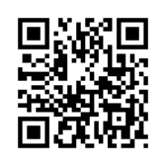
QR Code

Slide 36
Performing Arts Center
App (refreshing/updating for various programs/performances
Branding Opportunity

Slide 37


Slide 38
Equipment
Assistive Listening Systems
Checkout (explained in literature)
Multiple locations e.g. Orientation, Open Houses, etc..)

Slide 39
Planning
FACILITIES REVIEW

Slide 40
Campus Inventory
Where are the common places for ‘events’

Slide 41
Auditoriums
Stage – access
Seating – line of sight to interpreters
Wheelchair and companion access
Limited mobility access
Podium access
Standing
Table seating
Causal ‘discussion’

Slide 42
Arenas - Stadiums
Ground/floor seating
Wheelchair and companion access
Limited mobility access
Sightline to interpreters on stage
Large Screen (CART)
Sporting Events

Slide 43
Transportation/Parking
Accessible spaces must connect to the shortest accessible route to the accessible building entrance or facility they serve.
https://adata.org/factsheet/parking

Slide 44
Multiple Lots
Stadium/Arenas
Adjacent lot – 1000 spaces = 20 accessible (4 van accessible)
Remote lot – 1500 spaces = 25 accessible (5 van accessible)
shortest accessible route to the accessible building entrance or facility they serve…
Adjacent lot = 45 accessible spaces (9 van accessible)
Accessible Shuttle Service
PARKING/TRANSPORTATION COORDINATOR

Slide 45
Way-finding
Maps
Signage
Buildings
Accessible Entrances
Room Access
COORIDINATOR OF SPONSORING UNIT
FACILITY SERVICES

Slide 46
Room set-up

Slide 47
Room Set-up
Theater Seating (movable seats)
XXXX __ XXXXXX XXXXXXXXXX __ __
XXXXXXXXXXXX XXXXXXXXXXXXX
__ XXXXXXXXXX XXXXXXXXXXX __
XXXXXXXXXX __ __ XXXXXXXXXXX
XXXXXXXXXXXX XXXXXXXXXXXXX
FACILITY MANAGER (Building)

Slide 48
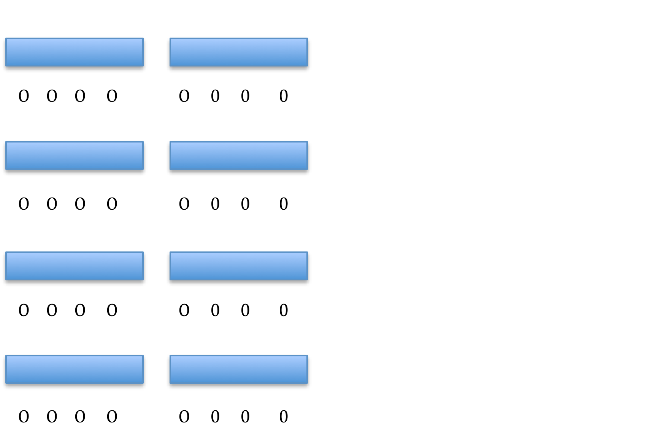
Classroom seating (movable seats)

Slide 49

Banquets

Slide 50
Amenities
Restrooms
Non-Gender
Aromas – Fragrance Free

Slide 51
Food
Is there an option for everyone?
Food allergies – nut, seafood, gluten, lactose intolerant
Food preferences – vegetarian/vegan
How is the food presented/served?
Roving servers, banquet,
Buffet – accessible?
DIRECTOR OF FOOD SERVICS

