Slide 1
Resilience Isn’t Just for Students! We Need It, Too
Elizabeth Harrison
University of Dayton
elizabeth.harrison@udayton.edu

Slide 2
Agenda
On work-life balance
What is resilience?
How can we grow our resilience?
How can we build a work environment that fosters resilience?

Slide 3

On work-life balance
What is “work-life balance”?
Let’s model it: handout
  Keep the strip flat
  Join and hold the two ends together
  to make a ring

Slide 4

On work-life balance
Work
Life
What do you see?
What does this model say about the relationship
between “work” and “life”?
How does this mirror your experience?

Slide 5
On work-life balance
A different model
  Hold the strip by one end, let it hang down
  At the bottom end, twist the strip 180°
  (a half twist)
  Join and hold the two ends to make a ring with a difference

Slide 6

Work
Life
mobius strip

Slide 7
Work
Life
What do you see? What does this model say about the relationship between work and life?

Slide 8
On work-life balance
“Work” & “Life” =
  Two aspects of the same person’s experience
  Inextricably connected
  Resilience at work ←→ resilience in one’s life

Slide 9
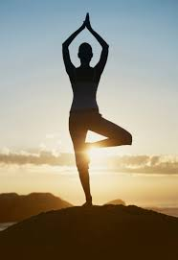

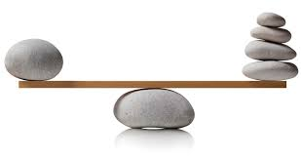
On work-life balance
Balance
  Keep or put (something)
  in a steady position
  Different elements are equal
  or in the correct proportions
★ Goal: stasis

Slide 10
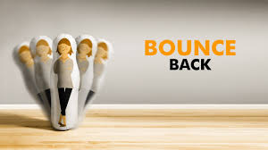
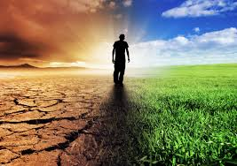
What is “resilience”?
Ability to bounce back from
adversity, challenge: recovery
Ability to adjust to
changes in
circumstances:
continuity
★ Goal: maintenance, get back to where we were

Slide 11
On resilience & work-life balance
Recognize and maintain . . .
continuous relationship of life with work, work
with life . . .
in proper proportion . . .
using ability to recover from adversity

Slide 12

Transformative resilience
“The ability to learn, grow, and spring forward”
  Change, improve, transform from struggle with
    Change
    Stressful life events
  Embrace imbalance, unbalance
  because “uncertainty is a
  condition of life”

Slide 13
Balance / Resilience
Struggle with uncertainty, change, events
Find balance
Bounce back
Assumption: Adversity, challenges are bad

Slide 14
Balance / Resilience | Transformative Resilience
Struggle with uncertainty, change, events | Find meaning in challenges
Find balance | Embrace imbalance, unbalance
Bounce back | Change, improve, transform
Assumption: Adversity, challenges are bad | Reframe: Opportunity

Slide 15
Transformative resilience
Positive reframing of the stories we tell
ourselves
  Post-traumatic growth
  Dweck’s growth mindset

Slide 16
A shoe factory sends two marketing scouts to a region of Africa to study the prospects for expanding business.
One sends back a telegram saying,
SITUATION HOPELESS STOP NO ONE WEARS SHOES
The other writes back triumphantly,
GLORIOUS BUSINESS OPPORTUNITY STOP
THEY HAVE NO SHOES
(Zander & Zander)

Slide 17
6 Characteristics
of Transformational
Resilience
Adaptability
Continual learning
Healthy relationship to control
Leveraging support
Sense of purpose
Active engagement
(Marston & Marston)

Slide 18
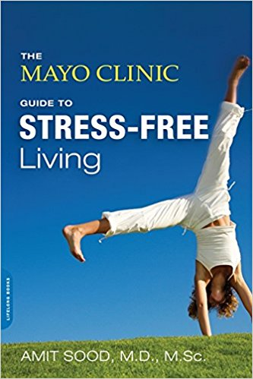
How can we grow our resilience?
Dr. Amit Sood, Mayo Clinic
  Resilience → stress-free living
Our brains/minds are:
  Restless (mind-wandering)
  Sticky (rumination on “open files”)
  Storytellers (narratives)

Slide 19
How can we grow our resilience?
Sood’s solution: Focus on training –
  Attention
  Interpretation

Slide 20
How can we grow our resilience?
Attention
  Trained attention = focused, relaxed, nonjudgmental, compassionate, sustained, deep, intentional
  Choose what you attend to** ( vs. letting thinking just happen)
  ** mindfulness

Slide 21
How can we grow our resilience?
Attention training
  Start the day with gratitude
  Journal: 5 things in the past week that you’re grateful for
  Kind attention (compassion)

Slide 22
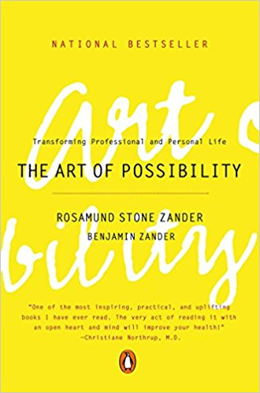
How can we grow our resilience?
Interpretation
  Notice the stories you tell yourself
  Intervene
    The Art of Possibility

Slide 23
How can we grow our resilience?
Interpretation training
  Change your inner dialogue **
    Acceptance
    Higher meaning
    Forgiveness
    Celebration
    Reflection/prayer
  ** positive reframing

Slide 24
How can we build a work environment
that fosters resilience?
Adaptability
Healthy relationship to control
Sense of purpose
Continual learning
Leveraging support
Active engagement
⬇ ATTENTION
⬇ INTERPRETATION

Slide 25
Some ideas
Practice –
  Gratitude
  Mindfulness
  Mindful collaboration
  Positive reframing
  Creativity (inspiration, deliberate risk, discovery)

Slide 26
Resources
Marston, A., & Marston, S. (2018). Type R: Transformative
resilience for thriving in a turbulent world. New York:
PublicAffairs.
Palmer, Parker (2004). A hidden wholeness: The journey
toward an undivided life. San Francisco, CA: Jossey-
Bass.
Sood, A. (2013). The Mayo Clinic guide to stress-free living.
Boston, MA: Da Capo Press/Lifelong Books.

Slide 27
Resources
Zander, R. S., & Zander, B. (2002). The art of possibility:
Transforming personal and professional life. New York:
Penguin.
Zolli, A., & Healy, A. M. (2012). Resilience: Why things
bounce back. New York: Simon & Schuster.

