Slide 1

Tightening the Leash:
Policies and Processes for Handling the Increasing Number of Service/Assistance Animals on Campus
Presenters:
Leslie Johnson, Ability Access Specialist, Michigan State University
John Pedraza, Ability Access Specialist, Michigan State University
Michelle Shaw, Director, Student Accessibility Services, Florida Atlantic University
MSU Resource Center for Persons with Disabilities (RCPD) www.rcpd.msu.edu
FAU Student Accessibility Services (SAS) http://www.fau.edu/sas/

Slide 2
Michigan State University
Resource Center for Persons with Disabilities (RCPD)
MSU: 50,019 students RCPD: 2,200 students (4.4%)
5,200 acre campus (East Lansing), 557 buildings
27 resident halls, 2 apartment communities
15,000 campus residents annually
Large public institution, Big Ten Conference
All Accommodations for students & employees
    12 Full Time Ability Access Specialists in 9 Disability Populations
42 registered animals
  11 Service Animals (not required to register with RCPD)
  31 Assistance Animals

Slide 3
Background Information
# students
# on campus residents
Large public institutions
Campus size
SAS – accommodations for students not employees
Dynamics of disability office- what are role is with animals
Student Accessibility Services
Notes:
2017-2018 Academic Year
Six campuses across three counties (SAS has offices on three campuses) Davie, Dania Beach, Down Town Fort Lauderdale, Boca Raton (Main campus), Jupiter and Harbor Branch
# of FAU Students 29,139
# Students registered with SAS 1,145
Number of Housing Beds 4,459
# of student needing Housing accommodations 149
#of Service Dogs 5
# of Service Dogs in Training 2
# of ESA’s 38
Service Animals is ADAAA
Many different names for ESA animals - HUD Fair Housing Act

Slide 4
Relevant Legislation
ADA (1990)/ADA Amendments Act (2008 & 2010): https://www.ada.gov/service_animals_2010.htm
Section 504:
MI Civil Rights Act for Persons with Disabilities
Fair Housing Act (HUD): https://portal.hud.gov/hudportal/documents/huddoc?id=servanimals_ntcfheo2013-01.pdf
Florida State Laws:
    413.08 (6b) Vaccinations
    413.08 (8) Service Animal in Training
    413.08 (9) Misrepresentation of a Service Animal
      http://www.leg.state.fl.us/Statutes/index.cfm?App_mode=Display_Statute&Search_String=&URL=0400-0499/0413/Sections/0413.08.html
    (828.30), Required Vaccinations for dogs, cats, & ferrets
      http://www.leg.state.fl.us/statutes/index.cfm?App_mode=Display_Statute&URL=0800-0899/0828/Sections/0828.30.html

Slide 5
Definition of a Service Animal
Any dog that is individually trained to do work or perform tasks for the benefit of an individual with a disability, including a physical, sensory, psychiatric, intellectual, or other mental disability. Other species of animals, whether wild or domestic, trained or untrained, are not service animals for the purposes of this definition. The work or tasks performed by a service animal must be directly related to the handler's disability. The crime deterrent effects of an animal's presence and the provision of emotional support, well-being, comfort, or companionship do not constitute work or tasks for the purposes of this definition.
* Miniature Horses

Slide 6
MSU Service Dogs in Training
Under Michigan Law (2016) & the ADAAA, Service Dogs in Training, no longer have rights of access to public spaces.
However, some States and local laws/policies cover animals in training.
MSU Policy regarding Service Dogs in Training:
  Adult dogs only (12 months of age or older) or w/BOT exception
  Request for access in private spaces or for canines under 12 months of age via the MSU Board of Trustee Office
1. Proof of canine age/vet record
2. Good Citizenship/Obedience Training Cert.
3. Proof Housebroken (vet record/trainer record)
  No puppies allowed in Housing

Slide 7
FAU Service Animals in Training
Under Florida law Service Dogs in Training, have rights to access to public spaces where pets are not allowed.
FAU Policy regarding Service Dogs in Training:
  Students must meet with SAS Director/Associate Director to discuss the service animal in training (verification)
  Provide a Veterinarian Verification form
  Review policies and procedures - animal must be under control, not disruptive, etc.
Student Accessibility Services

Slide 8

Service Dog in Training Scenarios
Student brought “Puppy Service Dog in Training” on Campus to advising appointment
Handler of Service Dog in Training is not a person with a disability

Slide 9
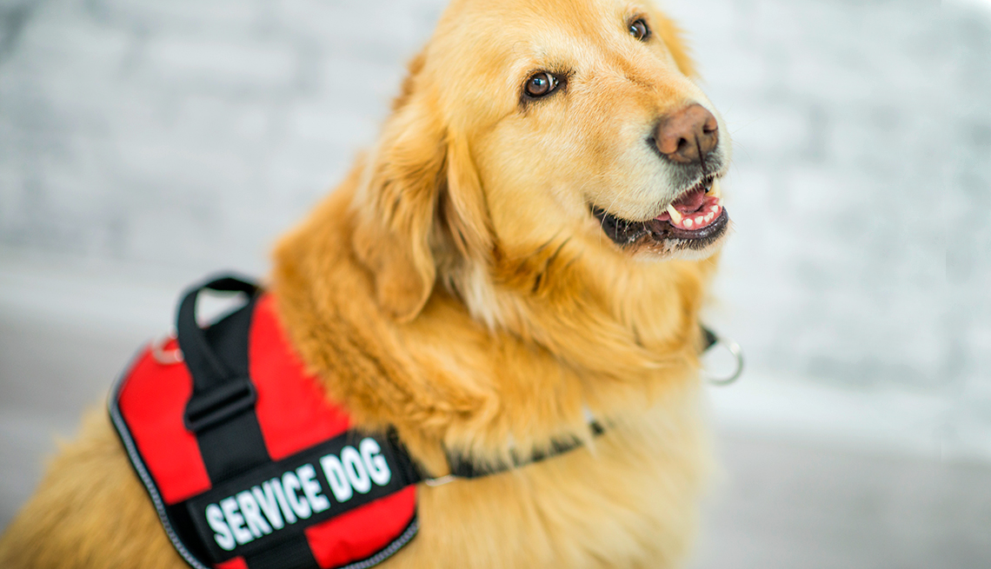
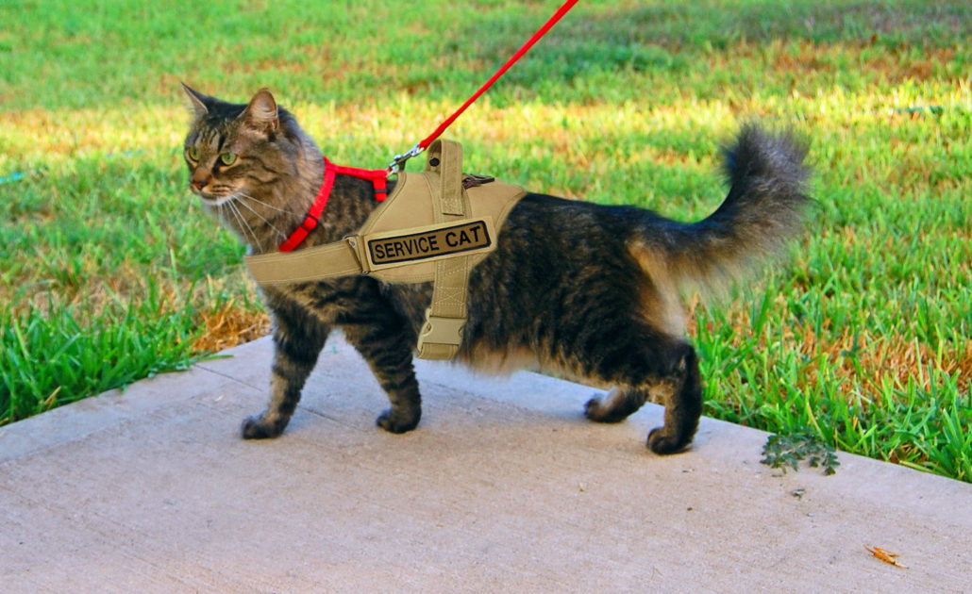
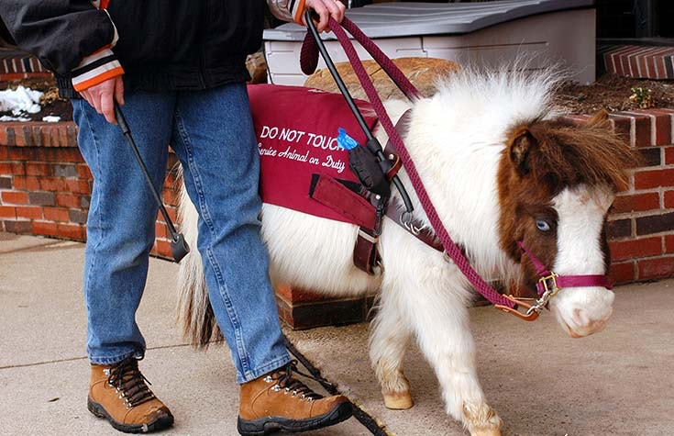
Clarifying Animal Status
Is the animal required because of a disability?
What work or task has the dog been trained to perform?
** If disability is readily apparent & animal is dog or miniature horse – No inquiry needed.

Slide 10
MSU Service Animal Policy
https://www.rcpd.msu.edu/services/serviceanimal
Restricted Areas
  Research Labs, Classrooms w/demo/research animals, Med/Vet/Clinical Areas, Nuclear Research Areas.
  ** Individual assessment **
  ** Appeal Process **
Conflicting Disabilities
  Respiratory, allergies, psychological conditions, etc.
** Contact Disability Services for Assistance **

Slide 11

Flow Chart for Animals in Public Venues
Guest
Dog or Miniature Horse
Other (Ex. Cat, hamster)
Is the disability readily apparent?
(Ex. Wheelchair, white cane)
Is the disability not readily apparent?
(Cannot see the disability)
Not Permitted – Only Exception is MINIATURE HORSE
Approved
ASK: Is the animal required because of a disability?
Yes
No
Dog in Training
Ask: What is the dog’s Age?
ASK: What work or task is the animal trained to perform?
Not Approved
12 Months or Older
Under 12 Months of Age
Signals, alerts, guides, etc.
Emotional support, therapy, comfort pet, etc.
Ask for Documentation of Trainer Status or Animal Training Status
Ask for Letter from BOT/RCPD
Yes
No
Approved
Yes
No
Not Approved
Approved
Not Approved
Approved
Not Approved
V1-1116

Slide 12
FAU Animal Policy
Possession of animals, other than fish as defined below, are prohibited.
Any cost associated with the possession of an illegal animal will be charged to the responsible resident(s) or to all residents of the room/apartment, (damaged furniture, cleaning, pest control, etc.).
This policy shall not effect the verification process of service animals or approval process of emotional support animals by Student Accessibility Services.
Failure to comply with this process as outlined by SAS regarding services animals and emotional support animals may result in a Code of Conduct Violation and/or a breach of the Housing Contract.
Student Accessibility Services

Slide 13
Definition of an Assistance Animal
“Assistance Animals” under the Fair Housing Act provide physical and/or emotional support to individuals with disabilities. “Assistance Animals” are defined as a category of animals that may work, provide assistance, or perform physical tasks for an individual with a disability and/or provide necessary emotional support to an individual with a mental or psychiatric disability, but which are not considered Service Animals under the ADAAA.
Assistance Animals are not pets, nor individually trained or certified.

Slide 14
MSU Campus Housing
Service Animal
No Pre-Authorization once animal status is clarified.
The Service Animal is permitted to accompany the resident to all areas of housing where residents are normally permitted to go.
Assistance Animal
Requires Pre-authorization for Access to Campus Housing.
Student must register with RCPD & request assistance animal accommodation.
Only authorized for resident’s privately assigned individual living quarters (room, suite, apartment) **except to the extent the resident is taking the animal out for natural relief.**

Slide 15
Flow Chart for Animals in University Housing
MSU STUDENT
Dog
Other (Ex. Cat, hamster)
Is the disability readily apparent?
(Ex. Wheelchair, white cane)
Is the disability not readily apparent?
(Cannot see the disability)
Ask student for VISA from RCPD
Approved
ASK: Is the animal required because of a disability?
VISA Accommodation lists Animal
No VISA
Yes
No
Unapproved
(Refer to RCPD)
Approved
ASK: What work or task is the animal trained to perform?
Unapproved
(Refer to RCPD)
Signals, alerts, guides, etc.
Emotional support, therapy, comfort pet, etc.
Approved
Ask student for VISA from RCPD
VISA Accommodation lists Animal
No VISA
Approved
Unapproved
(Refer to RCPD)
V1-1116

Slide 16
Flow Chart for Animals in University Housing
NON-MSU STUDENT
Dog
Other (Ex. Cat, hamster)
Is the disability readily apparent?
(Ex. Wheelchair, white cane)
Is the disability not readily apparent?
(Cannot see the disability)
Ask individual for approval form from U Physician
ASK: Is the animal required because of a disability?
U Phys approval form lists Animal
No approval form
Approved
Yes
No
Approved
Unapproved
(Refer to U Physician)
ASK: What work or task is the animal trained to perform?
Unapproved
(Refer to U Physician)
Signals, alerts, guides, etc.
Emotional support, therapy, comfort pet, etc.
Approved
Ask individual for UPhys approval form
UPhys approval form lists Animal
No approval form
Approved
Unapproved
(Refer to U Phys)
V1-1116

Slide 17
FAU Campus Housing
Service Animal
Emotional Support Animals
No pre-authorization once the service animals has been verified by SAS
Service animal is permitted to accompany the resident in all areas of housing and the university
Requires pre-authorization for access to campus housing
Student must apply for services (SAS)
Only authorized for residents residential hall (room/suite/open areas)
Verification is completed yearly with Housing Contract
Student Accessibility Services

Slide 18
MSU - Assistance Animals in Campus Housing
A person may reside with an assistance animal in housing as a reasonable accommodation, if….
The person has a disability;
The animal is necessary to afford the person with a disability an equal opportunity to use and enjoy a dwelling; and
There is an identifiable relationship or nexus between the disability and the assistance the animal provides.
Service/Assistance Animal in University Housing Policy: https://www.rcpd.msu.edu/download/97

Slide 19
MSU - Assistance Animals in Campus Housing
Process for Approval:
Identify & Register with Disability Services in Advance (i.e., 45 days).
Treating professional completes the Service/Assistance Animal in University Housing Documentation Form
University resident completes the Service/Assistance Animal Request Form
Student meets with specialist for Needs Assessment.
Specialist presents documentation to RCPD Animal Committee for determination
Additional documentation may be requested
When Approved, RCPD notifies student, housing community director, and facilities manager.
Housing notifies roommate & makes room changes if needed
Student meets with Housing Staff to review animal in housing checklist

Slide 20
Emotional Support Animal in Campus Housing
Process for Approval:
Students must register with SAS in advance of moving in (Housing deadlines for Housing accommodation June 1 and November 1)
Submit an ESA Verification from their treating medical provider
Submit a Veterinarian Verification Form – required shots, wellness, & safety of animal
Intake interview: accommodation
Review ESA Contract going over rules and expectations for an ESA in Housing
Letter sent to Housing to verify accommodation of ESA
Email notification sent to suitemates to notify of ESA
Room assignment changes made if necessary

Slide 21
Reasons for Denying Animal
MSU
If the presence of the animal….
Poses a direct threat to the health and safety of others;
Would cause substantial physical damage to the property of others;
Would pose an undue financial and administrative burden; or
Would fundamentally alter the nature of housing operations.
FAU
Insufficient documentation
No Disability Diagnosis
Animal is not house broken
No verification of required vaccinations
Animal poses a direct threat to the health and safety of others
  SAS does have an appeal process

Slide 22
Considerations for Approval
MSU
Animal’s size
Animal’s presence would force another individual from individual housing (e.g., serious allergies)
Animal’s presence would otherwise violate individuals’ right to peace and quiet enjoyment of their dwelling
Animal is housebroken and able to live with others in a reasonable manner
Animal’s vaccinations are up to date
Animal poses or has posed in the past a direct threat to the individual or others, such as injuring or acting aggressively; and
Animal causes or has caused excessive damage to housing beyond reasonable wear and tear.
FAU
Documentation verifies individuals disability
Identified relationship or nexus between the disability and the ESA provides
Animal’s size
Animal’s presence would otherwise violate individuals’ right to peace and quiet enjoyment of their dwelling
Animal is housebroken and able to live with others in a reasonable manner
Animal’s vaccinations are up to date

Slide 23

Unique Animals Requested
Approve or Deny?
Turtle
White’s Tree Frog
2 Rats
Tarantula
12 week Kitten
Gecko
Pineapple Green-Cheeked Conure Parrot
Cat that requires use of toilet

Slide 24
MSU - Assistance Animals in Campus Housing - Requirements
Owner Requirements:
  Comply with state, local laws, and regulations pertaining to licensing & vaccination.
  Clean up after & properly dispose of the animal’s waste
  Financially responsible for any damage caused by the animal
  The animal must be properly housed, restrained, and under the owner’s control at all times. If animal is found loose or unattended outside the owner’s private living quarters, the animal is subject to immediate removal.
  May not leave the animal overnight to be cared for by any individual other than the owner. If the owner is absent overnight, the animal must accompany them or other arrangements to board animal off campus. Animal control will be notified to remove any animal left overnight in housing without its owner present.

Slide 25
FAU - ESA in Campus Housing (1)
Owner Responsibilities:
Must stay in the students assigned residence hall
Must be under control at all times
Limit the ESA interaction with others
Abide by FAU, county and state laws and policies
ESA must be well cared for
Understand that staff, entities or emergency responders are not responsible to feed, care or remove an ESA in an emergency situation
Responsible for property damage by ESA (university/suitemates)
Notify SAS if and ESA is no longer needed or if an ESA has changed
Student Accessibility Services

Slide 26
FAU - ESA in Campus Housing (2)
ESA’s may be removed from University Housing for any of the following reasons:
Risk. direct threat
Damage. Health / hygiene. Behavior.
Toileting - not housebroken
Programming. My ESA’s presence fundamentally alters an FAU program
Responsibilities - ESA Contract
Disturbance.
Expired vaccinations
Student Accessibility Services
Notes:
Risk. My ESA poses a direct threat to the health or safety of others.
Damage. My ESA causes substantial property damage to University property or the property of others.
Health / hygiene. If my ESA displays poor hygiene or consistent ill health, I may be required to remove my ESA from campus until the situation is remedied.
Behavior. If my ESA’s behavior is disruptive, threatening, aggressive, or not under control.
Toileting. If my ESA not housebroken.
Programming. My ESA’s presence fundamentally alters an FAU program.
Responsibilities. If I do not comply with my responsibilities as set forth above.
Disturbance. My ESA or its presence causes an unreasonable disturbance or interferes with the FAU community.
Expired vaccinations. I do not provide proof of updated vaccinations within one week of my ESA’s rabies vaccination expiration date.

Slide 27

Other Things to Consider
How to handle emergencies
    Natural Disasters
    Medical Emergency
Conflicting Animals
  Student vs. Student
  Student vs. Employee
Animals in Family Housing
  Family Member utilizes service/assistance animal
Multiple Animals
  Multiple Service or Assistance Animals
  Service and Assistance Animal
Notes:
ESA’s and Shelters:
I spoke with Andrew and Bill this morning, which was quite educational, so here is what I’ve found out regarding ESA’s and emergency shelters. Currently, the state policy is only service animals are allowed into regular shelters, not ESA’s. The reason is that shelters are last resort and a temporary place for individuals to be placed. They do not see changing this policy at time soon.
The choices for students with ESA’s are as follows:
Go home to be with family with their animals
Stay with family or friends locally with their animals
Find a local vet office that they can board their animal (at their expense)
Go to a hotel at their expense
Last resort- students can pre-register for the pet friendly shelter (only one in the county) Park Vista Community Center in Boynton Beach – West Boynton Recreation Center, 6000 Northtree Boulevard, Lake Worth, FL 33463
https://www.rightservicefl.org/palm%20beach/node/18867 Website to pre-register their animal at the pet friendly shelter
http://discover.pbcgov.org/publicsafety/animalcare/pdf/pet_friendly_shelter.pdf
If the student does pre-register only one person and pet are allowed and they must bring their supplies for their animal these will not be provided. Animals need to be crated or in a pet carrier.
The Pet Friendly Shelter is available to Palm Beach County residents residing in a mandatory evacuation zone or in mobile homes. Proof of residency is required. Space is limited and restrictions apply. Pet owners are required to stay at the shelter. The shelter can accommodate approximately 300 people, 400 cats, 250 birds and small pocket pets, and 240 small and large dogs. Livestock and reptiles will not be accepted. Pets will be housed in separate area from people. Pet owners will be given a schedule to attend to their animal’s needs. Please call for more information.
PET FRIENDLY SHELTER PRE-REGISTRATION INSTRUCTIONS
To pre-register for the Pet Friendly Shelter (disaster shelter for pets and people), complete the application and waiver forms. Please send a copy of your proof of Palm Beach County residency, which is required (driver’s license, utility bill, etc.).
Once completed, mail to: PBC Animal Care and Control Pet Friendly Shelter 7100 Belvedere Road West Palm Beach, FL 33411
If you have questions, please call 561-233-1200, ext. 0 and reference the Pet Friendly Shelter or e-mail pbcacc@pbcgov.org.
The Pet Friendly Shelter is for pets and people living in mandatory evacuation zones or in mobile homes.
Pet owners are required to bring a kennel or carrier, food for five days, bedding, bowls, toys, and any special medications for their pet(s).
Livestock and reptiles will be NOT accepted.
Aggressive animals or animals classified as dangerous or potentially dangerous will NOT be accepted.
All dogs and cats must have a current rabies vaccination, County license tag, microchip, and be current on flea and tick preventative.
I hope this is helpful, Michelle
State of Florida Emergency Management
https://www.floridadisaster.org/contact-us/
Andrew Susman 850-815-4110
http://discover.pbcgov.org/publicsafety/dem/Pages/default.aspx
Palm Beach County Emergency Management
561-712-6400 main number
561-712-6321 Bill Johnson
561-712-6269 Keith Wall
Other resources:
https://www.ready.gov/animals
https://www.aspca.org/pet-care/general-pet-care/disaster-preparedness
http://www.redcross.org/get-help/how-to-prepare-for-emergencies/pet-disaster-preparedness#Pet-Emergency-Plan
https://www.cdc.gov/features/petsanddisasters/index.html
https://www.fema.gov/media-library-data/1392389819026-75460345a2f4adcc5418a1da7cb25eef/2014_PrinterFriendly_PetOwners.pdf
Great overview of understanding the law regarding ESA’s in hotels or other temporary housing (not main dwelling)
The Fair Housing Act obligates ESA accommodations for a singular purpose -- to assure an occupant with a disability "an equal opportunity to use and enjoy a
dwelling." 42 U.S.C. 3604(f)(3)(B). Nothing in the Fair Housing Act extends the right to keep an ESA beyond the dwelling; under the FHA, an ESA is a housing accommodation, not an all-purpose disability accommodation. The key word limiting the coverage of the Fair Housing Act is "dwelling, "defined in 42 U.S.C. 3602(b) as a facility "occupied as, or designed or intended for occupancy as, a residence by one or more families."
By contrast, Title Three of the ADA, applicable to public accommodations, defines public accommodations to include "an inn, hotel, motel, or other place of lodging...." 42 U.S.C. 12181(7)(A). The distinction between dwelling (occupancy) and motel (lodging) is important and deeply rooted in American law; motels and hotels that provide short stay lodging (as distinct from long term occupancy) are public accommodations governed by the ADA but are not "dwellings" within the meaning of the Fair Housing Act.(Similarly, landlord-tenant law does not apply to motels; motel customers are business licensees, not tenants).
Stated simply, the ADA, but not the Fair Housing Act, governs the rights of individuals with disabilities who stay in a motel or hotel. Under DoJ's ADA service animal regulations applicable to public accommodations, individuals with a disability have a right to bring service animals, but not ESAs, into motels and hotels. Because, under DoJ regulations enacted with the force of law, ESAs are not service animals, a person with a disability who has an ESA has no right under the ADA to bring an ESA into a motel. Because a motel is not a dwelling, that person also has no rights under the Fair Housing Act to bring the ESA into a motel this includes emergency shelters.
Michael R. Masinter
Professor of Law
Nova Southeastern University
3305 College Avenue
Fort Lauderdale, FL 33314
954.262.6151
masinter@nova.edu

Slide 28
MSU’s Unique Strategies (1)
Continual Updates & Revisions to Policies
Utilize documentation/request forms
    https://www.rcpd.msu.edu/services/documentation
Utilize a committee to review requests
  Other DSS staff
  College/university physician
  General Counsel
  Colleagues in other departments
Three disability specialist experts that field all animal related inquiries

Slide 29
MSU’s Unique Strategies (2)
Educate and train departments on campus
  Lead specialists conduct all trainings:
  Created presentations geared towards different audiences
  Recent trainings include:
    Campus Police
    Housing
    Library
    Campus Dining
  As questions arise, we offer departmental trainings
Partner with Community Resources

Slide 30
MSU’s Unique Strategies (3)
Partner with Campus Resources
  College of Veterinary Medicine faculty and animal behaviorist
  General Counsel
  University Physician
  Campus housing liaison, community directors and facilities managers
Partner with Community Resources
  Local animal shelters
  Local animal trainers
  MI-AHEAD colleges and universities

Slide 31
FAU’s Unique Strategy
Housing and SAS Collaboration:
Housing and SAS work closely together to review policies and procedures
Make changes as needed
Address issues and concerns as they arise
Communicate weekly on new students requesting ESA’s
Student Accessibility Services

Slide 32

Questions???

Slide 33
Case 1: Conflicting Service Dogs
Student w/Service Dog in Housing
Self-report of dog acting out
Involved Trainer
Assessment Re: behavior ($$)
Training/re-training ($$)
Employee w/Service Dog in Housing
Report of dog barking
Summary of intervention taken w/student
Offer of employment accommodations.

Slide 34
Case 2: Assistance Animal Request
(Gecko, Turtle, Tarantula, Bird/Parrot)
Documentation of Disability
Necessary to Enjoy Dwelling
Nexus between Disability & Animal
Considerations for Approval
  Size
  Force another from individual housing
  Violate individuals’ right to peace and quiet
  Direct threat to the health and safety of others

Slide 35
Animals in Campus Housing Issues
ESA biting a student
ESA with Fleas infecting residential suite
ESA attacking a service dog
Student not taking care of ESA
  leaving it unattended
  crying and barking
Student leaving ESA behind

