Slide 1


Student Perspectives on Disability Resources
AHEAD Session 3.8 – July 19, 2018
Student Panel with Izzie Bullock, Jimmy Cong, Kim Elmore,
Andrew Gomez, Toni Saia, and Kevin Thomas
Notes:
Slide titled “Student Perspective on Disability Services” includes logos for DREAM and the NCCSD. The DREAM logo includes three triangular and two curved shapes arranged closely together next the words “DREAM” and “Disability Rights, Education, Activism and Mentoring.” The NCCSD logo includes two green laurel sprigs on either side of “NCCSD” with “National Center for College Students with Disabilities” underneath.

Slide 2
Session Outline
In addition to accommodations, how can DR professionals better outreach to students, enhance services, and help create a more welcoming campus for students with disabilities?
Panelist Self-introductions
Accommodations + Audience Q & A
DREAM Student Video
Identity, Community, and Mentoring + Audience Q & A
Final Thoughts from Panelists

Slide 3


Questions for the Audience 1
During your years as a college student, did you identify as a student who was Deaf, disabled, or chronically ill?
1
Notes:
The slide titled “Questions for the Audience 1” includes a simplified drawing of a stick figure raising their hand in front of a large screen with the number 1 on it.

Slide 4
Questions for the Audience 2
During your years as a college student, did you identify as an ally of people with disabilities?
2
Notes:
The slide titled “Questions for the Audience 2” includes a simplified drawing of a stick figure raising their hand in front of a large screen with the number 2 on it.

Slide 5
Panel Goals
to share our perspectives of living as college students with disabilities, including experiences of using disability resources for accommodations and access and developing disability identity and community
to suggest how DR professionals can better outreach to students, enhance services, and help create a more welcoming campus for students with disabilities

Slide 6
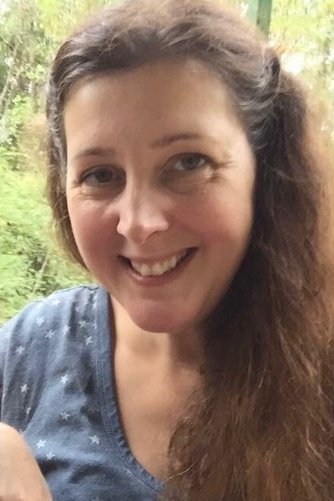
Kim Elmore, Moderator
Texas Tech University doctoral candidate in Technical Communication and Rhetoric studying inclusion and accessibility of science and tech
Coordinator of DREAM, a U.S. organization by and for college students with disabilities, who started as a board member in 2012
Did not publicly identify as disabled or know about disability community until taking a graduate course on Disability and Accessibility
Notes:
Moderator introduction slide titled “Kim Elmore” includes her headshot. Kim is a white woman with medium-length brown hair. She is wearing a blue t-shirt and smiling in this headshot.

Slide 7
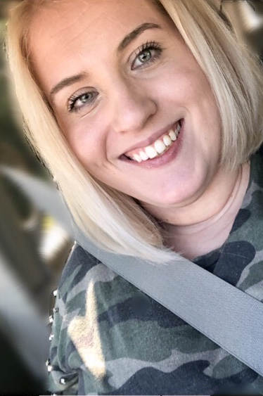
Isabella “Izzie” Bullock, Panelist
M.A. candidate in Educational Leadership/Higher Education and Student Affairs at Eastern Michigan University (EMU)
Graduate Assistant for EMU’s Disability Resource Center
Firmly believes that student involvement is a key to a student’s success
Notes:
Panelist introduction slide titled “Isabella (Izzie) Bullock” includes her headshot. Izzie presents as a young white woman with medium-length blonde hair. She is wearing a green, grey, and black camo-style t-shirt and smiling.

Slide 8
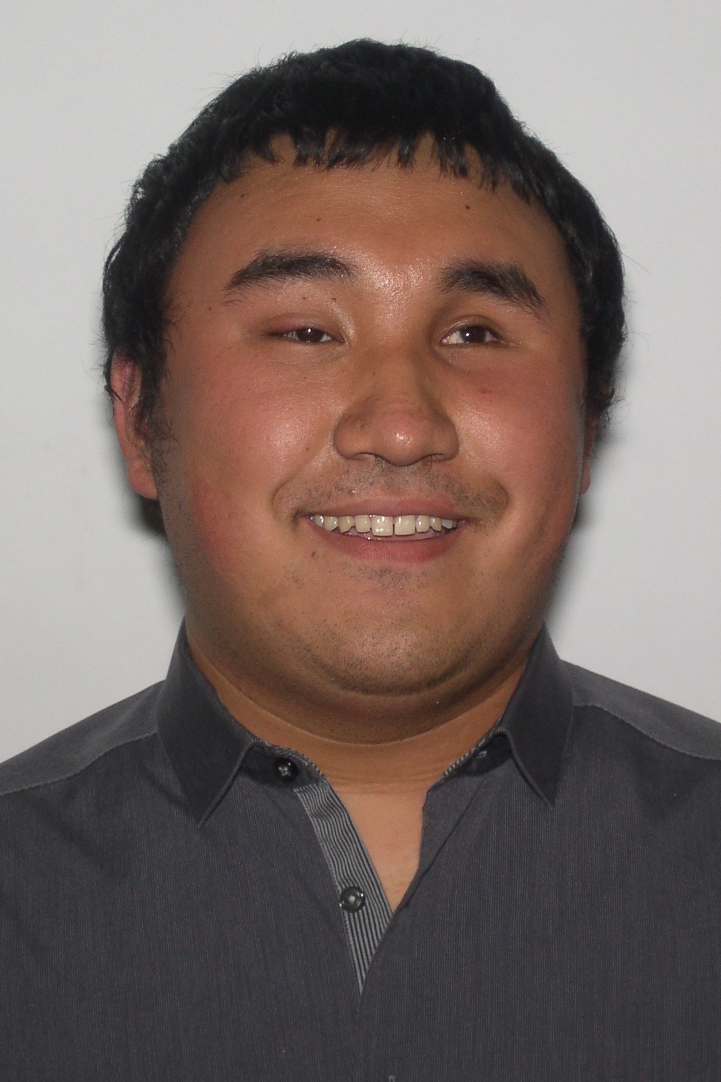
Jimmy Cong, Panelist
University of California San Diego senior who will receive a B.A. in Visual Arts, Digital Media and Music Composition in December
Plans to attend graduate school to study film scoring
Enjoys DJing for all sorts of events from house parties to weddings
Notes:
Panelist introduction slide titled “Jimmy Cong” includes Jimmy’s headshot. Jimmy is a young brown man with short black hair. He is wearing a black button-up shirt and smiling.

Slide 9
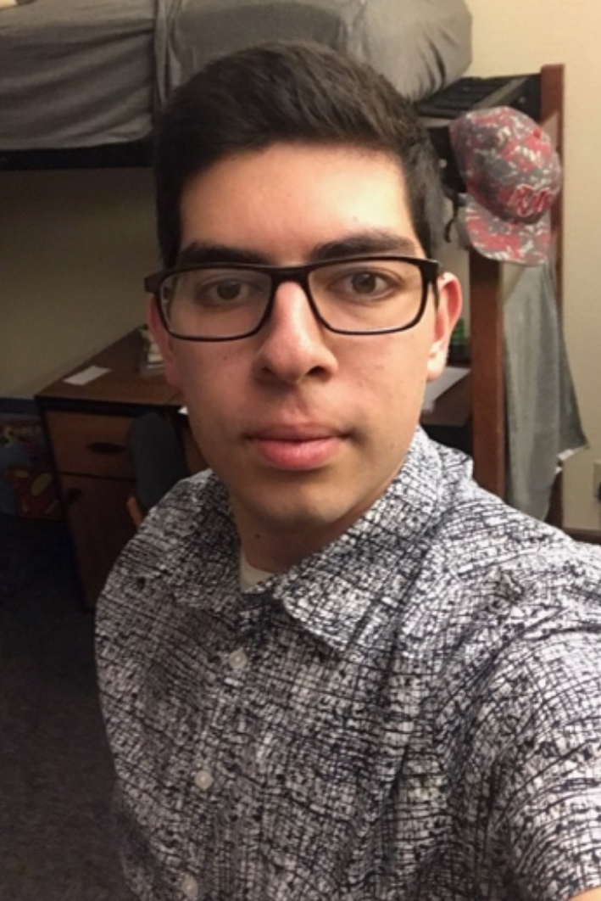
Andrew Gomez, Panelist
Senior at the University of New Mexico (UNM) double majoring in English and Psychology who is preparing for a career in occupational therapy
Works at the UNM LGBTQ Resource Center to provide support, education, advocacy, & safety to students, faculty, and staff of all gender identities & sexual orientations
Andrew travels around the world, surrounds himself with a diverse friend group, and always actively tries to learn about the world
Notes:
Panelist introduction slide titled “Andrew Gomez” includes his headshot. Andrew is a young, light brown man with dark-rimmed eyeglasses and short dark hair. He is wearing a black-and-white patterned button-down shirt in this headshot.

Slide 10
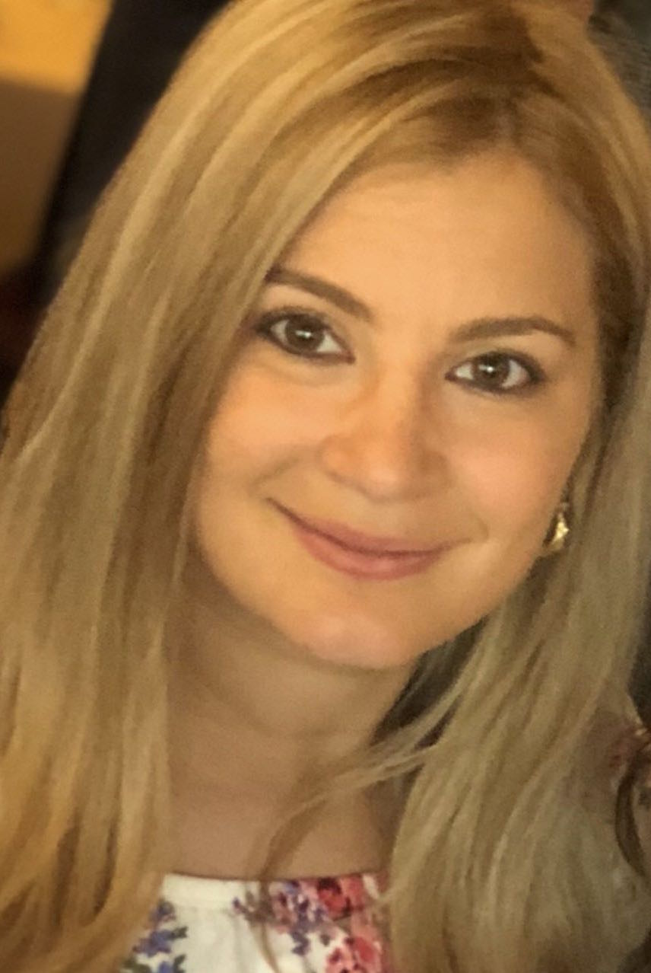
Toni Saia, Panelist
Ph.D. candidate at the University of Arizona studying Counseling Education and Supervision with a minor in Higher Education
Works as the first coordinator of the Disability Cultural Center at the University of Arizona
Toni was born and raised in Staten Island, NY, but then decided to give life in the desert a try
Notes:
Panelist introduction slide titled “Toni Saia” includes her headshot. Toni is a young white woman with medium-length straight, blonde hair. She is wearing a floral blouse and smiling in this headshot.

Slide 11
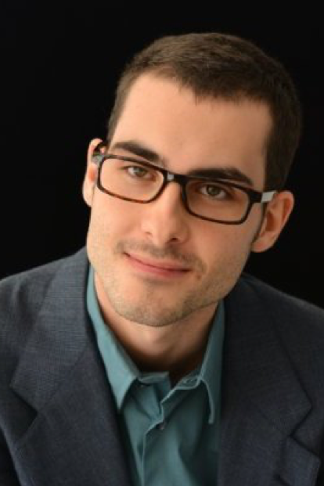
Kevin Thomas, Panelist
Recent graduate from Mercyhurst University (PA) with a B.A. in English and a Minor in Communications
At 10, began writing film reviews for The Citizen Newspaper in Georgia and started publishing reviews at KevintheCritic.com in 2015
Approaches life with a sense of human and hopes to find work in the writing, publishing, or entertainment industries
Notes:
Panelist introduction slide titled “Kevin Thomas” includes her headshot. Kevin presents as a young white man with dark-rimmed, tinted glasses and short, black hair. He is wearing a teal button-down shirt and dark suit jacket and smiling in this headshot.

Slide 12
Prompt 1: College Transition
Did you know how to access disability services at your university during your transition into college?
How did your school’s disability resources office support you during your college transition?

Slide 13
Prompt 2: Accommodations
Briefly describe disability resources at your university.
How did the disability resources staff help you access your class space and activities through accommodations?

Slide 14
Prompt 3: Beyond Accommodations
Did the disability resources office help you with more than classroom accommodations?
How did they support you during college beyond providing access to classroom activities?

Slide 15

Audience Q and A
Pass your written questions to the end of your row
Please wait for the microphone before asking your oral questions
Thank you!
1
Notes:
The slide titled “Audience Q and A” includes a simplified drawing of a speech bubble with a Q in it and a speech bubble with an A in it along with the number 1.

Slide 16
The National Center for College Students with Disabilities (NCCSD)
A four-year federal project funded by the Fund for Improvement of Postsecondary Education (FIPSE) and started in December 2015
Based at the Association for Higher Education and Disability (AHEAD)
Serving postsecondary students with disabilities and those who work with them (e.g. faculty, disability service professionals, parents, researchers, higher education administration)
Divided into 3 parts: Outreach, Research, DREAM

Slide 17
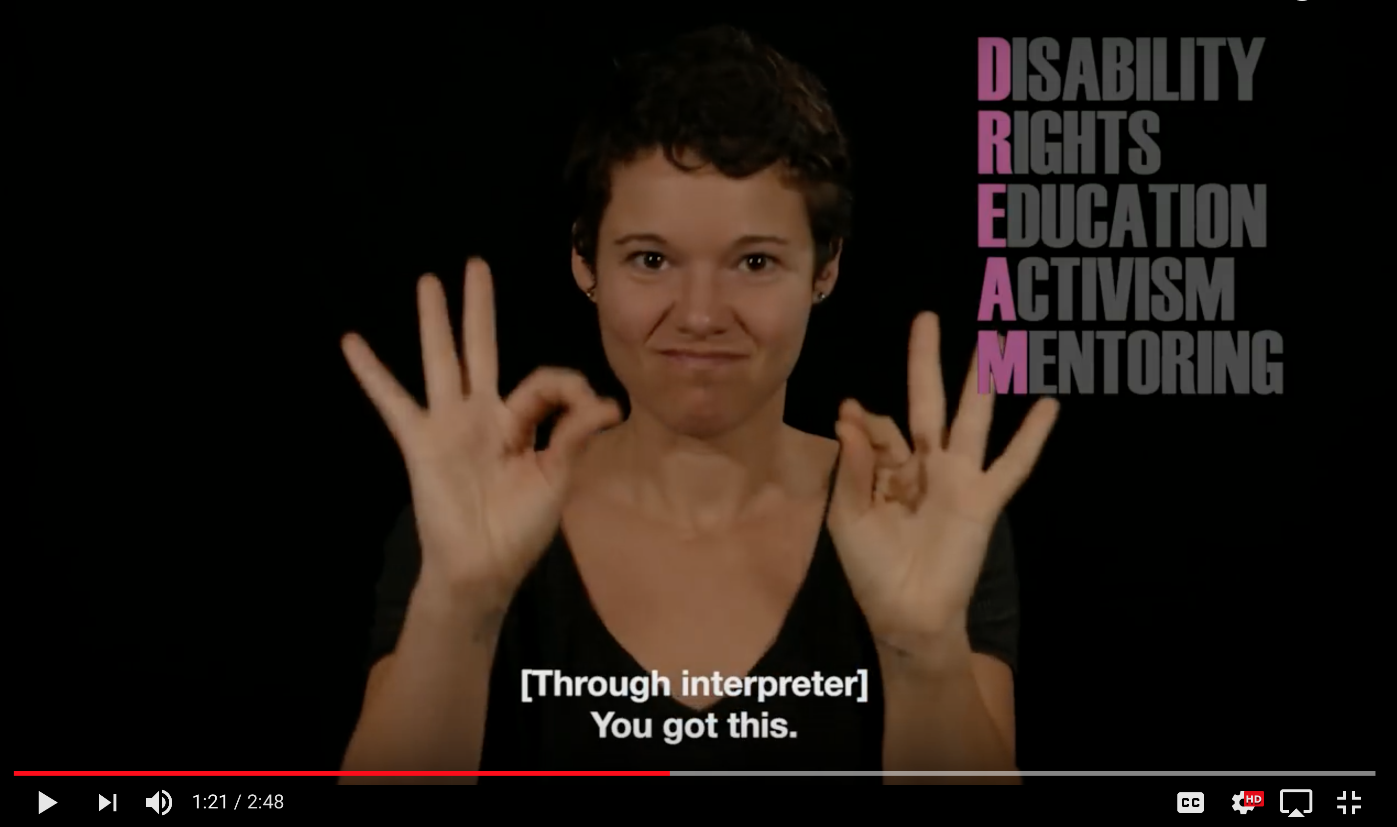
DREAM Video (https://youtu.be/PUmopJ8Y-9w)
Notes:
The slide titled “DREAM Video (https://youtu.be/PUmopJ8Y-9w) includes a thumbnail image from the DREAM promo video. The image shows a young, white woman making the ASL sign for “You got this.” On the black background behind her are listed the words Disability, Rights, Education, Activism, Mentoring. The first letter of each word is purple revealing the word DREAM. An audio-described and captioned version of this video is available at https://youtu.be/PUmopJ8Y-9w. Video produced by independent filmmaker Reid Davenport at Through My Lens.

Slide 18
Experience of Campus Isolation
About 11% of undergraduate and 8% of graduate students enrolled in U.S. colleges and universities have disabilities (1, 2).
“I’m on campus with like 30,000 other people, and I know there has to be other students with disabilities. But it’s like we’re invisible, and it’s hard to find each other” (3).
Only a third of students with disabilities enrolled in a four-year college or university and 41% of those in two-year schools graduate within 8 years, according to a 2017 Hechinger Report (4).
We at DREAM want students to know that they are not alone in facing ableism, struggling to reach their college goals, or wanting community.

Slide 19
Early History of DREAM
Founded by three college students 2011 through disability listserv discussions looking for student disability groups in U.S.
DREAM is an acronym of our 4 major areas of programming interest: Disability Rights, Education, Activism, and Mentoring
Initial focus: Building a communications network to provide information and promote peer support and disability pride
Current focus: Developing ways to support local campus groups and expand our mentoring activities, including peer networking between campuses

Slide 20
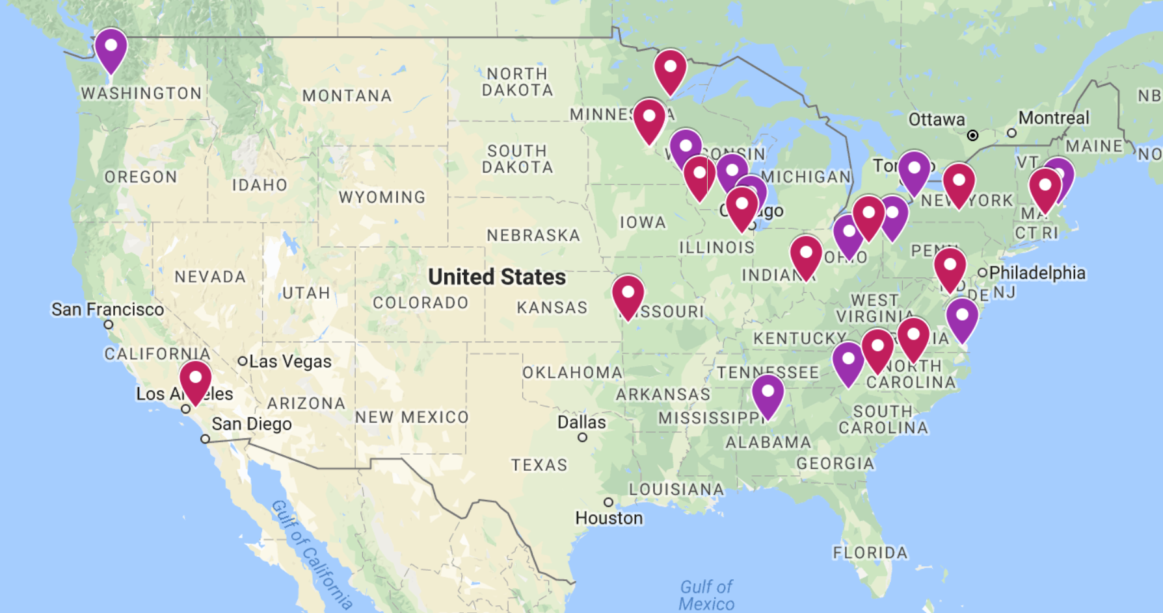
Current DREAM Activities
Resources, publications, and social media
Monthly DREAM Mentor Monday webinars
Monthly Digital Care Packages for DREAM Chapters and Affiliates
Disabled & Proud: Leading Change online student conference
Notes:
The slide titled “Current DREAM activities” includes a map of the mid 48 states with many of the states and a half dozen major cities shown. 13 purple pins mark the locations of DREAM Chapters and 13 red pins mark the locations of DREAM Affiliates.

Slide 21
Prompt 4: College Community
How did you find friends and community in college?
Are other college students with disabilities part of your community?
Do you consider other campus members with disabilities—such as staff and faculty—part of your community?

Slide 22
Prompt 5: Disability Identity
Did you value disability as a part of your self identity when you arrived at college?
How has your disability identity developed during college?
Did your disability resources office play any role in helping your develop disability identity or community?

Slide 23
Prompt 6: Identity, Intersectionality & Community
Did an organization, project, or event you participated in improve awareness and appreciation of disability and/or intersectional identities on your campus?
Did it help develop community for you and other students with disabilities? How so?

Slide 24
Prompt 7: College and Career Decisions
How has disability affected your academic and/or career choices in college?

Slide 25
Prompt 8: Mentoring
Have you had a mentor with a disability or a mentor with your disability?
Did you have a mentor that shared other identities with you?
Is sharing an identity important? Why?

Slide 26
Audience Q and A
Pass your written questions to the end of your row
Please wait for the microphone before asking your oral questions
Thank you!
2
Notes:
The slide titled “Audience Q and A” includes a simplified drawing of a speech bubble with a Q in it and a speech bubble with an A in it along with the number 2.

Slide 27
Beyond Accommodations:
Student Ideas for Disability Resources
What could we add or change on this list based on today’s discussion?
Introduce students to the basics of disability studies as well as to self advocacy skills
Provide opportunities for students to develop a positive disability identity
Empower students to seek out disability community that embraces those with intersectional identities
Support collaboration between marginalized identity groups on campus
Network with offices and departments to promote the inclusion and acceptance of disability community in activities and decision-making

Slide 28
Prompt 9: Advice for Disability Resources
What advice would you give to disability resources professionals about how to help students with disabilities find success in college?

Slide 29
Sources Cited
U.S. Department of Education, National Center for Education Statistics. (2016). Digest of Education Statistics, 2015 (NCES 2016-014), Table 311.10. Retrieved from https://nces.ed.gov/fastfacts/display.asp?id=60
Bell, N. E. (2011, July). Data Sources: Graduate Students with Disabilities. Retrieved from the Council of Graduate Schools at http://cgsnet.org/data-sources-graduate-students-disabilities
National Center for College Students with Disabilities. (2018, January 16). DREAM [Video file]. Retrieved from https://youtu.be/R-mq-24A66A
Vader, J., & Butrymowicz, S. (2017, November). The vast majority of students with disabilities don’t get a college degree. From the Hechinger Report, Willing, able and forgotten: How high schools fail special ed students. Retrieved from http://hechingerreport.org/vast-majority-students-disabilities-dont-get-college-degree/

Slide 30
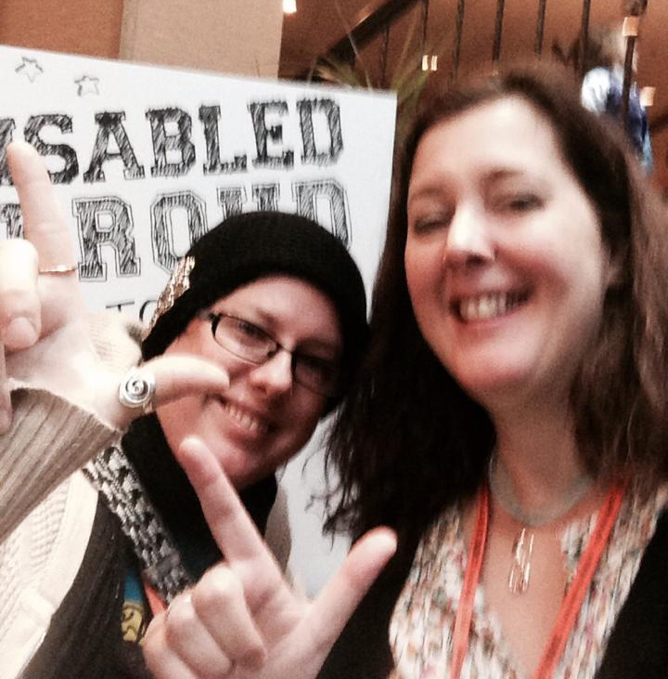
Contact
Kim Elmore, DREAM Coordinator, DREAM@ahead.org
DREAM website: www.DREAMcollegedisability.org
DREAM Twitter: www.twitter.com/DREAMdisability
DREAM Facebook: www.facebook.com/DreamOnlineCommunity
You can also find DREAM on YouTube, Instagram, and LinkedIn
Notes:
The “contact us” slide includes a personal photo of the speaker, Kim Elmore, and her fellow Texas Tech University grad student, Jeannie Bennett, posing together at the 2014 Disabled and Proud student conference, holding up their index fingers and thumbs to imitate guns for the Texas Tech “guns up” salute.

