Slide 1
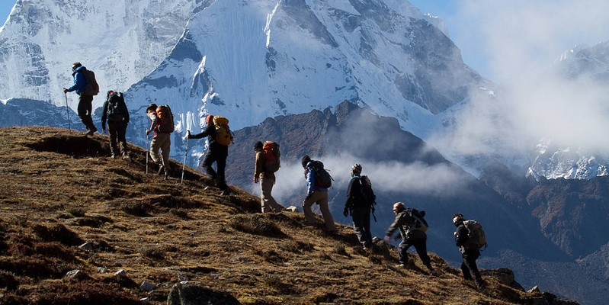
HIKER’S GUIDE
Engaging Administrators, Faculty and Staff
with ADA Policy, Procedures and Practices

Slide 2
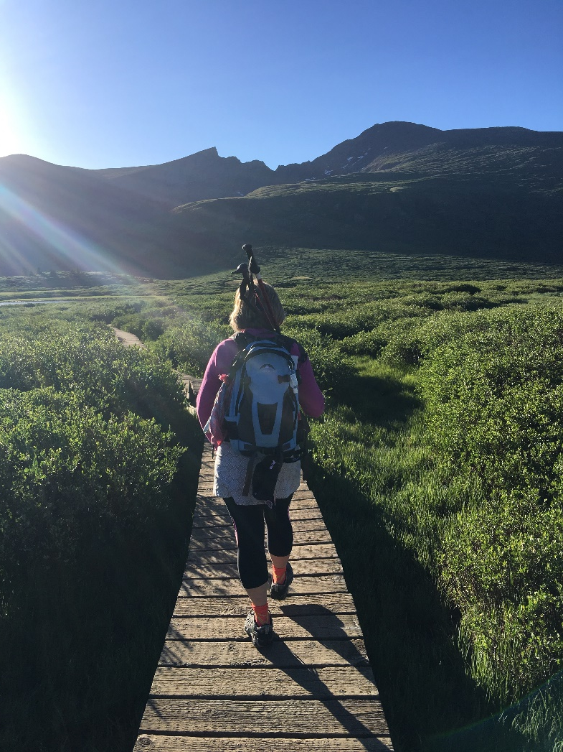
"The journey of a thousand miles begins beneath one's feet." Lao-tzu

Slide 3
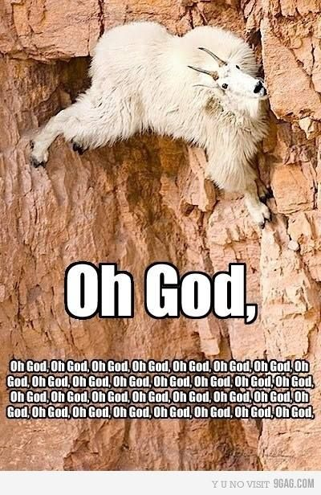

Slide 4
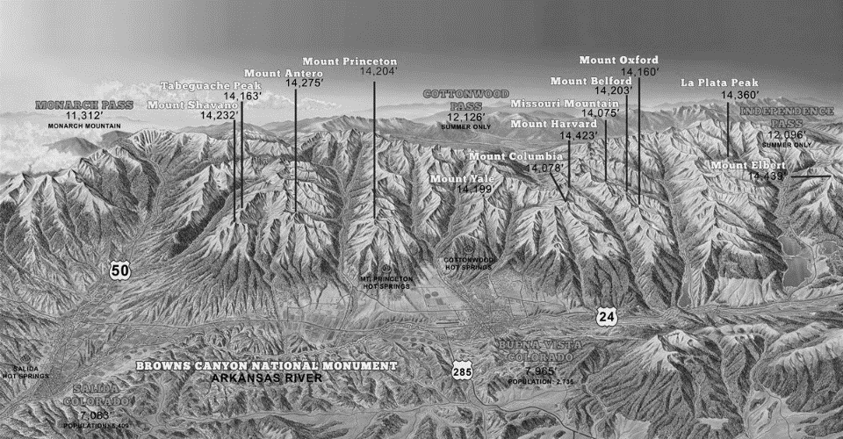
What is the Collegiate ADA Wilderness?
Put series of pictures here

Slide 5
Plan the Journey
Activity 1: Where do you want to go?
Identify major goals for your institution related to access and ADA.
Name the biggest challenges.
  (not the people! – be nice ☺)

Slide 6

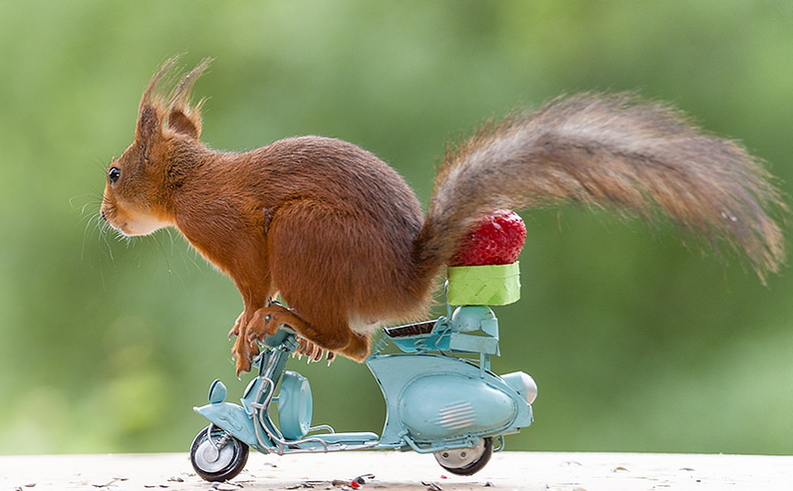
The Basic Principles of Hiking
    Plan the journey.
    Gear up for survival.
    Practice.
    Enjoy the trip.
    Tell Tales of survival.

Slide 7
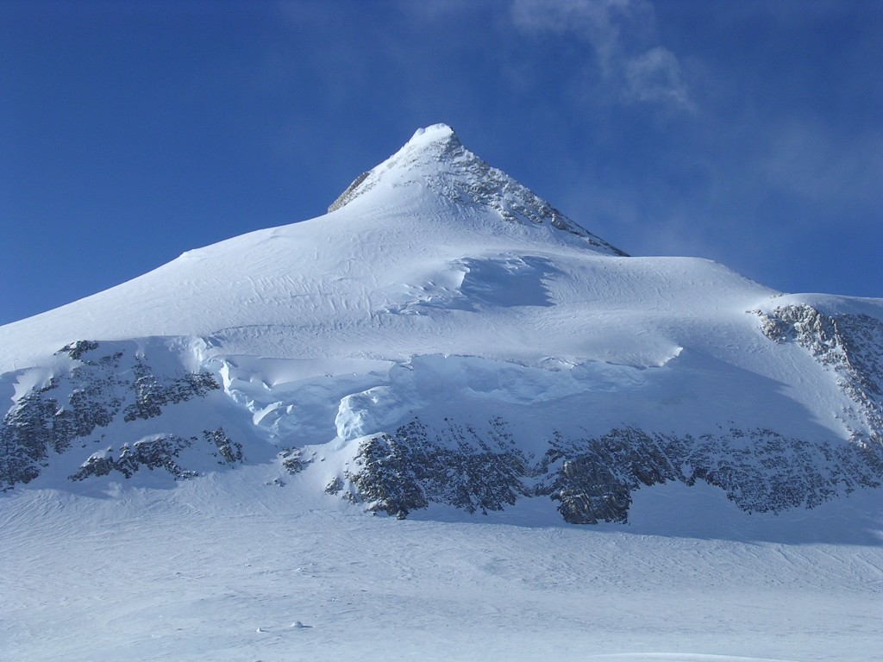
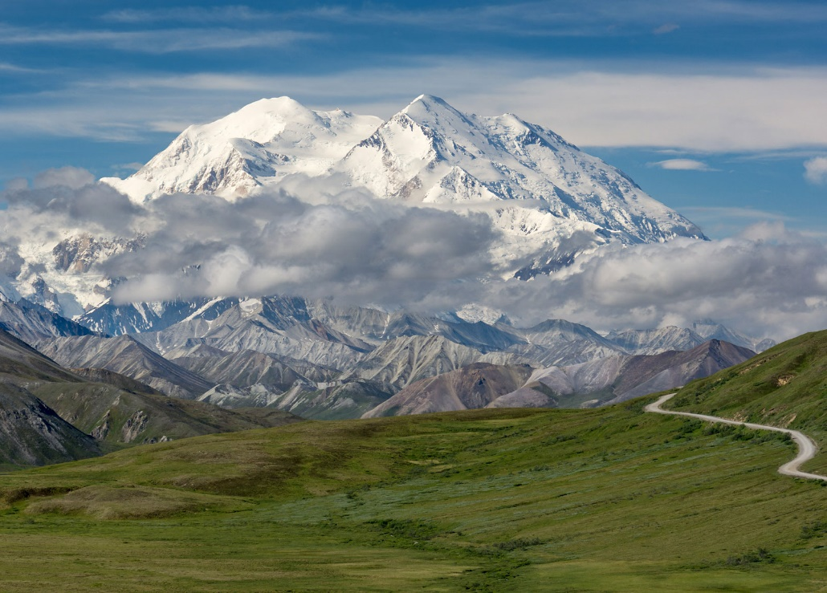
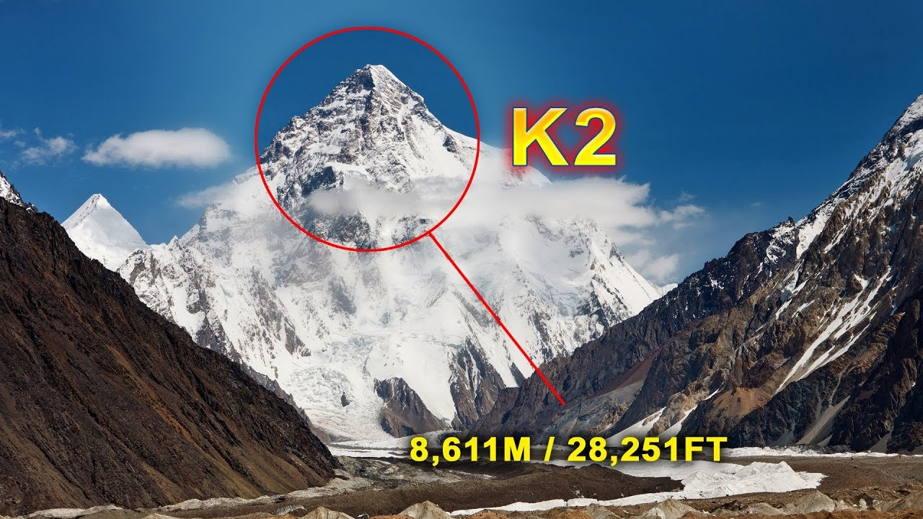
Challenges to implementing ADA…..

Slide 8
The Scruff of the Neck Incident and the
Conditional ADA Leadership Map

Slide 9
Questions | Increasing Favorability | Decreasing Favorability
What are the consequences….. For whom? | Minor | Major
Number and types of “dangers”…. | Few | Many
Individuals who need to adopt the change… | Knowledgeable | Untrained
Leadership… | Supportive | Uninformed
Group…. | Unified | Divided
Cost… | No/Low | High

Slide 10
Goal: Change the referral process for disability services at CMC
Question | Increase | Decrease
Consequences: very minor to improve referral process; major if they are not changed | X
Dangers: if not changed significant dangers of law suits but the improvement poses few dangers; might ruffle a few feathers | X | !
Individuals want to know how to recognize and refer appropriately but have never been trained | + | X
Leadership at campus level and central level supportive of improvements, need to be trained | + | X
Group cohesion – have no idea how well they play together at other campuses by SV is unified in staff, divided in faculty | ??? | ???
Cost – not a lot of cost generally except training time | X | X?

Slide 11
Activity 2
Where do you want to go? Choose 1 goal from Activity 1
Use the CALM Chart to answer critical questions about the conditions for change.
What can we learn from each other?

Slide 12
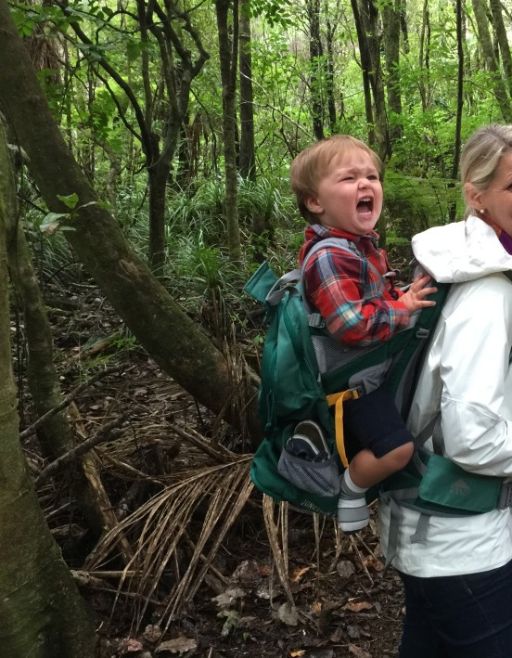

Activity 3
B. Who are the best hikers?
Who has the most experience or can be most influential with the goal?
Should I start with an individual, small group or large group?
Should I recruit an individual or a group for the goal?

Slide 13
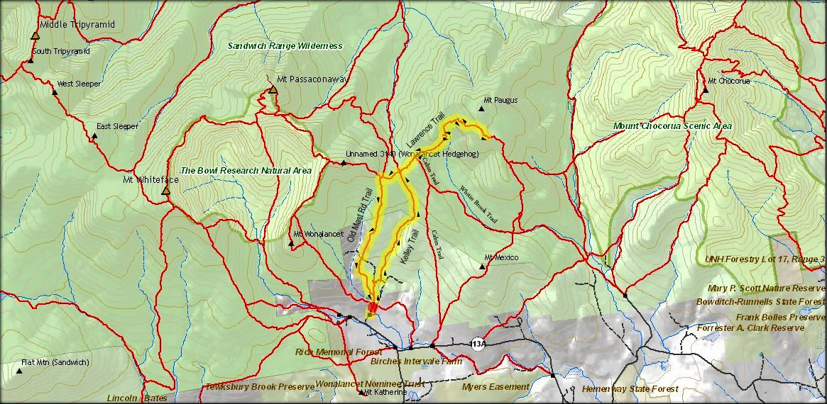
There are many paths to the summit.

Slide 14
3. How do I choose the best route?
What contemporary guide books, agencies and regulations can give me the information?
  www.ada.gov; https://adata.org; https://www2.ed.gov
Who has been on this journey and lived to tell about it?
  https://www.ahead.org/home
  https://www.nccsdclearinghouse.org/ds-professionals.html
Where can I see this successfully in action?

Slide 15
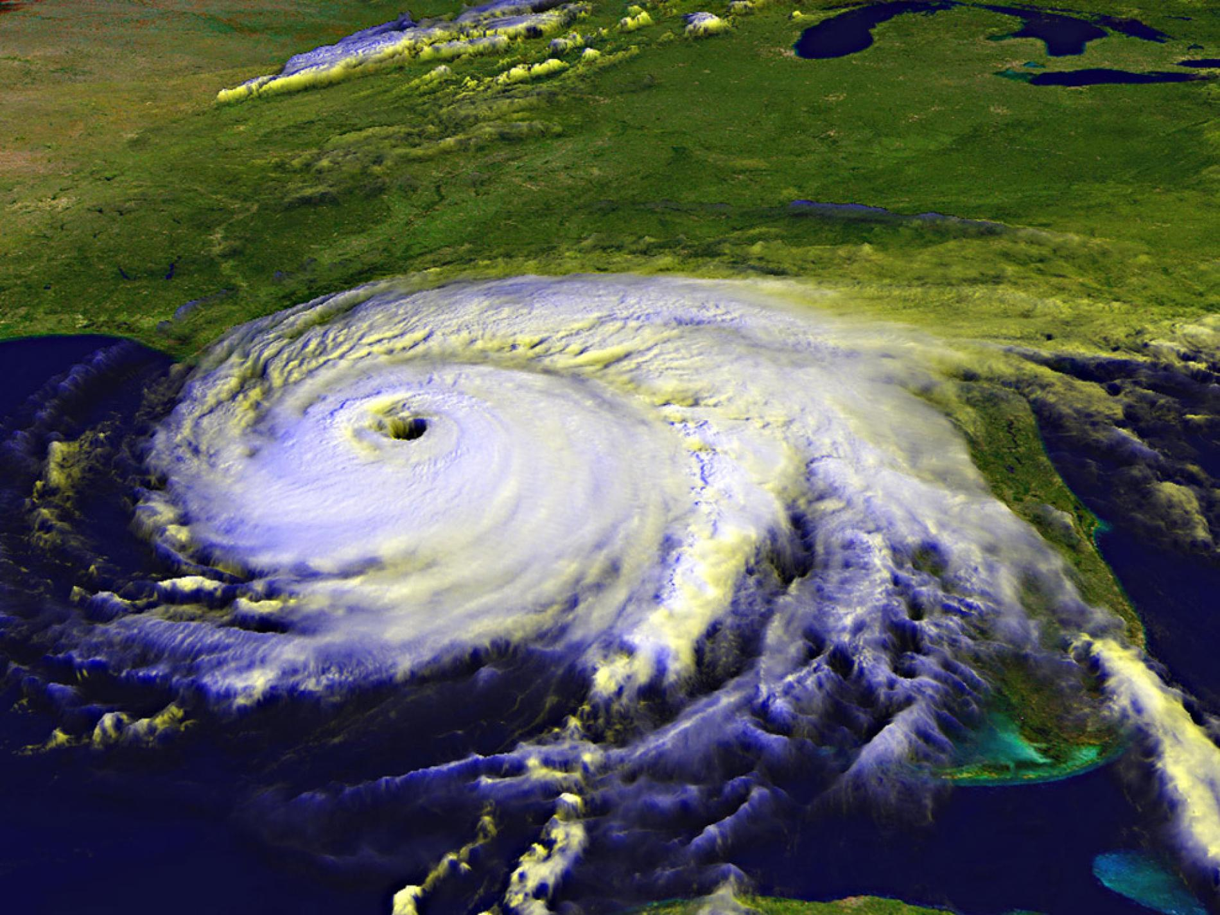

Activity 4
D. When is the best time for change?
How is the climate at the institution?
What is the window of opportunity?
Is there a seasonal opportunity?

Slide 16
Gear up for Survival
Navigation Sun protection
Insulation Illumination
First aid supplies The Shovel
Waterproof fire Rescue Beacon
Repair kit and tools
Nutrition & Hydration
Emergency shelter
Stabilizers

Slide 17
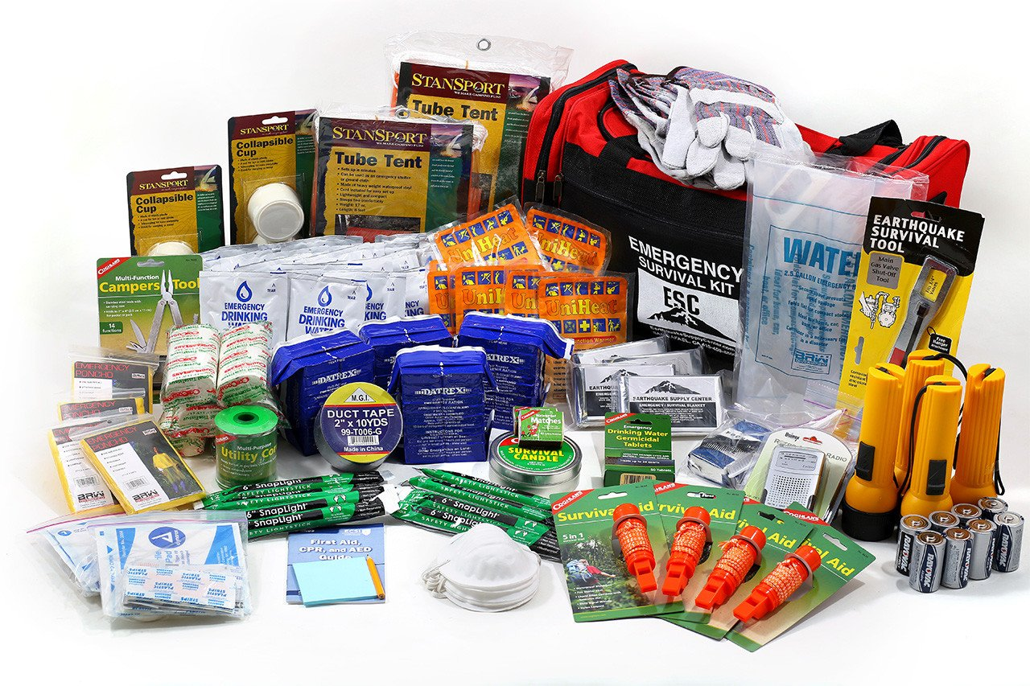
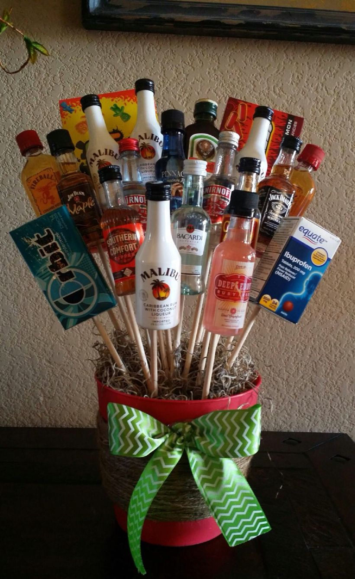

Navigation
Insulation
First aid supplies
Waterproof fire
Repair kit and tools
Nutrition & Hydration
Emergency shelter
Stabilizers

Slide 18
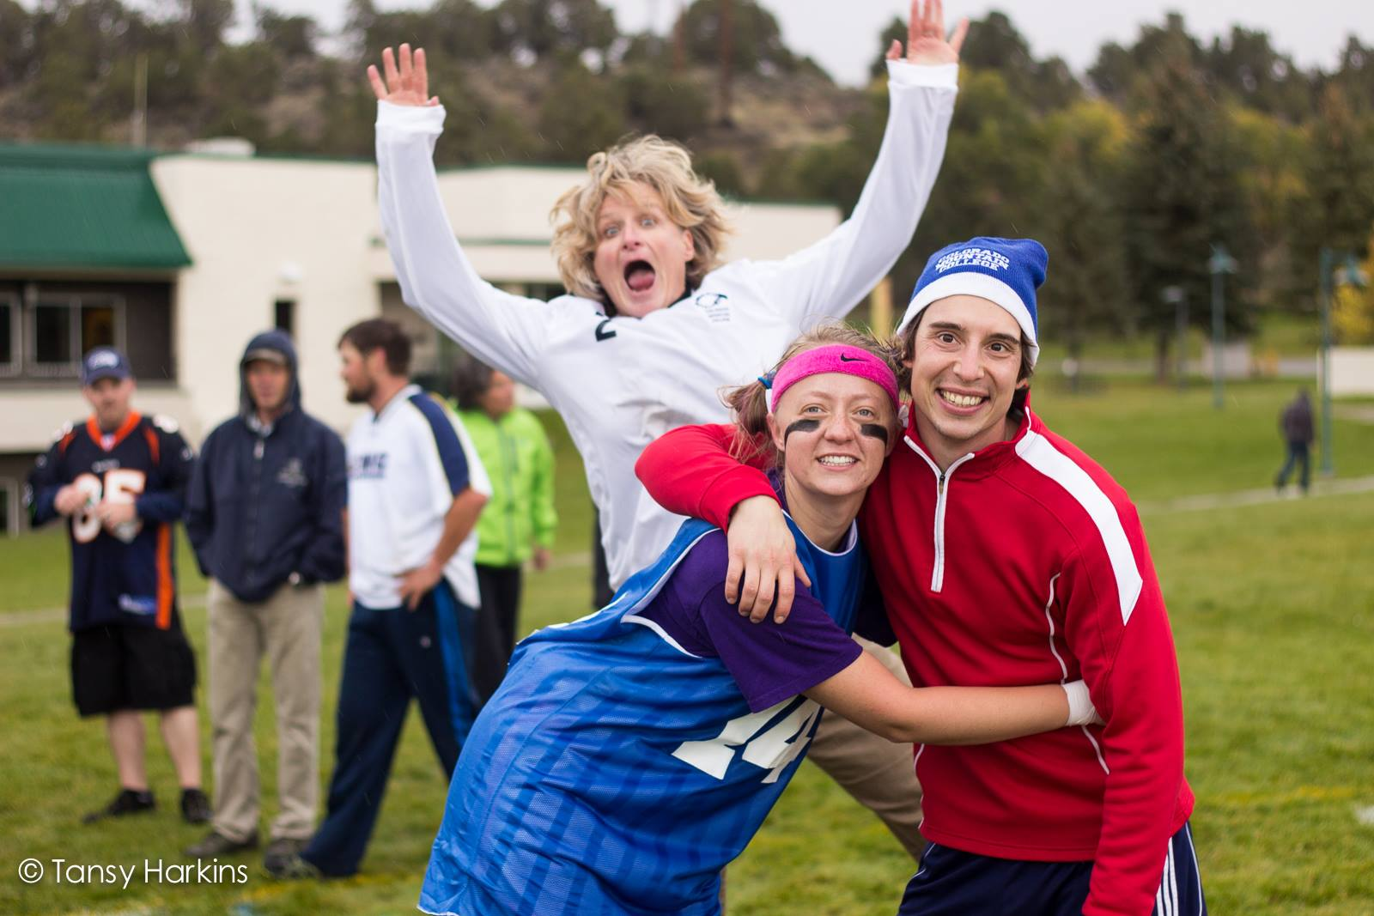
Illumination
Be the one to shine light on the pathway
Be HIGHLY visible – in every aspect of the college – safety teams, building committees, mental health issues, student activities, faculty meetings,

Slide 19
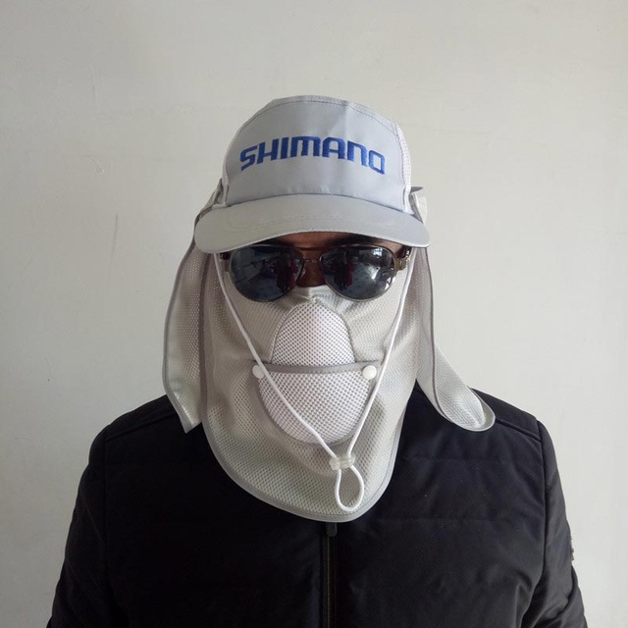

Sun Protection
Keep records
Know the law but don’t’ hide behind it

Slide 20

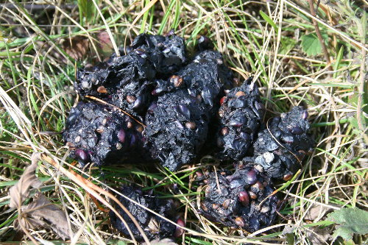
The Shovel
We all make mistakes!

Slide 21
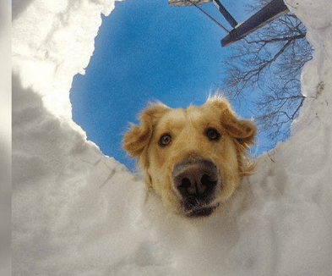
Rescue Beacon
Have someone who knows
To come looking for you
If you get lost in the
Wilderness

Slide 22
3. Practice

Slide 23
4. Make the journey
Mark and celebrate/document junctions, milestones and data
Keep the group together If you get knee deep in snow mud or fog, think like the trail… the easiest terrain
If you need to, go back and find the path you started on and begin again.

Slide 24
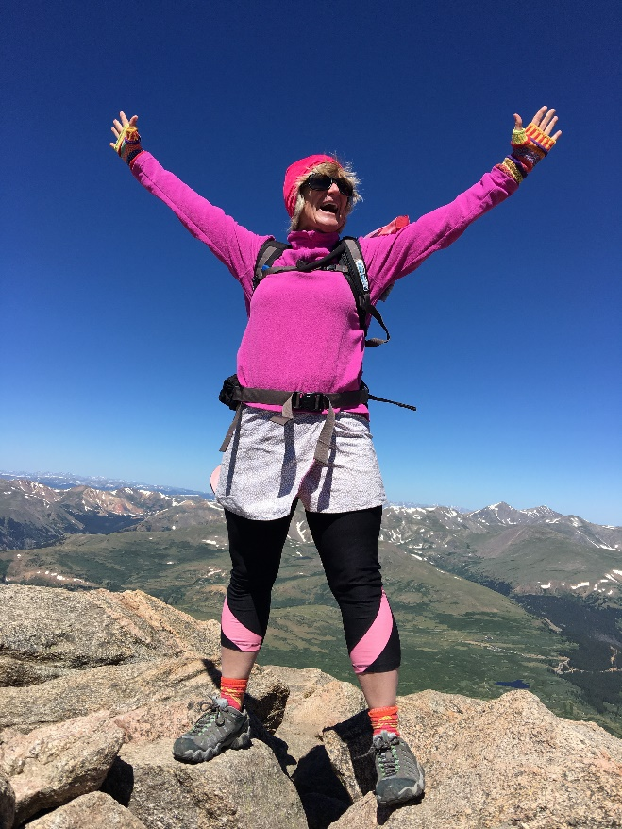
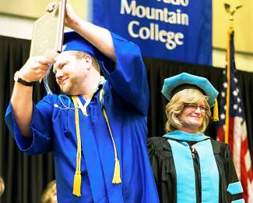
5. Tell the Story
The Story of Brent and Alex

Slide 25
To Evaluate this presentation go to:
https://www.surveygizmo.com/s3/4374072/2018-AHEAD-Conference-Session-Evaluation

