Slide 1
Access for All: Creating a campus culture of disability inclusion
Presented by UAB Disability Support Services:
Valerie DuBose, M.Ed., CRC
Allison Solomon, M.S., CRC

Slide 2
Learning Outcomes
Identify effective campus partnerships in order to garner support for disability inclusion initiatives
Describe the impact that DS offices can have on creating a campus culture of inclusion
Recognize several programming initiatives that can be implemented with a very low to no budget

Slide 3
University of Alabama at Birmingham (UAB)
20,902 students
Public Urban Research University
Located in Birmingham (spans 100 city blocks)
#1 young U.S. university
Top 10 worldwide
(Times Higher Education)
Largest employer in the state

Slide 4
UAB Disability Support Services
Vice President
Division of Student Affairs
  AVP Student Health and Wellbeing
  AVP Student Experience
  AVP Student Services
  Development & Giving
  Finance & Administration
  Title IX
Assistant VP
Student Health and Wellbeing
  Disability Support Services
  Campus Recreation
  Student Health
  Student Counseling
  Veteran Recruitment & Support Services
  Wellness Promotion
Disability Support Services

Slide 5
UAB DSS at a Glance
Number of active students: 674
Students registered: 12% increase from AY17
Applications submitted: 38% increase from AY 17
Students in Progress: 72% increase from AY 17
Interactions: 11% increase from AY 17
Internal Presentations & Trainings: 5,780 people within UAB community reached (265% increase)

Slide 6
Campus Strategic Goals: Diversity woven throughout
UAB continues to promote its core value of diversity and build on its reputation as
one of the most diverse universities in the nation.
UAB University-Wide Strategic Plan (2018—2023) includes:
  Shared Values: Integrity, Respect, Diversity and Inclusiveness, Collaboration, Excellence and Achievement, Stewardship, Accountability
  Strategic Goal 1: Offer a world-class, socially conscious education to diverse students to prepare the next generation of citizens and leaders
UAB Division of Student Affairs Strategic Plan (2016-2020):
    Strategic Priority 2: Supportive and Inclusive Communities
      Cultivate and demonstrate an atmosphere of inclusion and social justice
      Highlight and celebrate UAB’s uniqueness
      Establish a culture of civic responsibility
      Foster a welcoming, supportive and affirming community

Slide 7

Establishment of Access for All Campaign
Intended to promote and increase campus awareness
Partnered with campus Marketing to create a logo
Ramped up marketing efforts surrounding this theme
  Tabling events on Campus Green and Student Center
  Invested in swag for giveaways at various events
Notes:
First attempt at a campaign (beyond a program, single event). Became the foundation of other initiatives, events, etc.
Started this push/campaign in 2016
Will Hopper – access for all button at Highlands CDC (off campus)

Slide 8
IDENTIFYING & DEVELOPING STRATEGIC PARTNERSHIPS

Slide 9
Who are potential partners?
Faculty
Staff
Administrators
Campus Departments/Organizations
Student Groups
Community Businesses, Agencies

Slide 10
Developing Strategic Partnerships: Faculty/ Staff
  Visit departmental meetings
  Center for Teaching & Learning
  Human Resources (AWARE Program)
  Faculty resource page
  Recognition/Awards
    DSS Outstanding Faculty Award (nominated by students)
    DSS Staff Outstanding Recognition Award (nominated by DSS staff)

Slide 11
Developing Strategic Partnerships and Increasing Engagement : Students
Survey and assess to identify specific interests
Partner with student groups
  Greek Organizations
  Registered Student Organizations
Utilize Student Assistants for help with programming
To increase participation, provide giveaways
  Donations from Community Businesses (No Cost to You!)

Slide 12
Additional Strategic Partnerships & Outreach
Collaboration with campus departments
  Office of Diversity, Equity and Inclusion
  Marketing (for promoting events)
  Academic Success Center
  Trio
  Athletics
  Campus Recreation
Local organizations/agencies
Committee Involvement
Seek out Campus/Division-wide Involvement
  Ex: Student Affairs Innovation Grant

Slide 13
PROMOTING A CULTURE OF INCLUSION

Slide 14
Establish clear expectations for campus community
  Campus Messaging of Shared Responsibility: EVERYONE is responsible for accessibility
  Leadership support and involvement
    Gather supportive quotes from areas such as: Provost, Legal Counsel, University Compliance, Risk Management, Human Resources, Vice President of Office of Diversity, Equity, and Inclusion
    Opportunities to set expectations
      Provost support for mandated DSS syllabus statement
      VP of Student Affairs mandated DSS online training for all Student Affairs employees

Slide 15
“What sets UAB apart is its charge to all community members not only to comply with laws and regulations, but always to conduct our actions in the spirit of our core values of respect and equal access to education. Students with disabilities are an essential part of our diverse campus community, and we are committed to working closely with Disability Support Services to support all UAB students and the faculty and staff serving them. UAB’s continued excellence depends upon going above and beyond compliance with minimum legal standards to sustain a campus culture of equity and inclusiveness.”
Teresa Bragg, University Compliance Officer ​

Slide 16
Additional Opportunities for promoting a culture of inclusion:
Orientation involvement and presentations
Monthly Disability Posters
“Commitment to Captioning”
Involvement with on-campus committees/working groups
  Staff Council, Campus Master Planning, Commencement, Campus Climate, Digital Strategy and Communication, Equity Leadership Council
Utilization of various methods for outward communication
  Campus newsletters (student, faculty, staff)
  Student media (newspapers, magazines, TV stations, radio)
  Social media

Slide 17


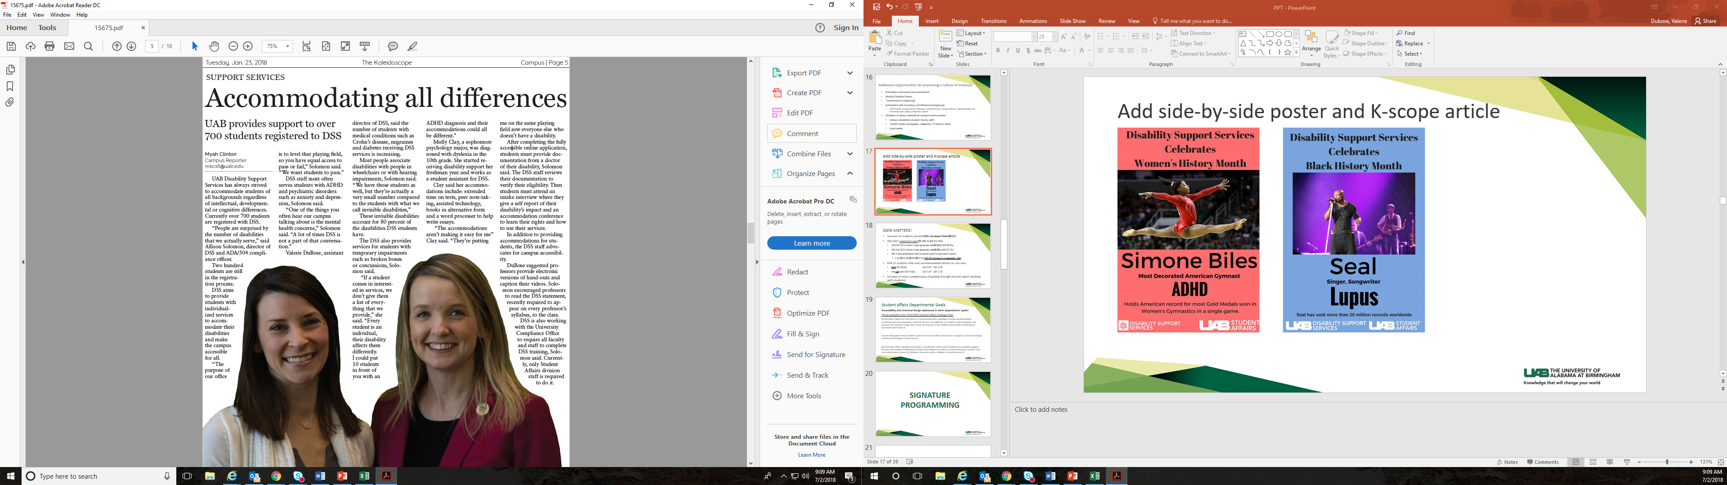

Slide 18
DATA MATTERS!
Increase in students served (12% increase from AY17)
DSS 2017 retention rate 97.1% (UAB 93.9%)
  DSS Fall 2013 cohort 4 year graduate rate 37.5% (UAB 39.9%)
  DSS Fall 2011 cohort 6 year graduate rate 42.9% (UAB 52.7%)
  DSS 4 year graduation rate increases (year to year- past 4 years)
    2.2%→14.3%→25%→37.5% (35.3% increase in graduation rate)
GPA of students that sent accommodation letters vs. did not send
  Sent (SP 2018): UG=3.03 GR: 3.49
  Did not send (SP 2018): UG=2.87 GR= 2.72
Increase in more complex cases (tracking through minutes spent working with students)

Slide 19
Student Affairs Departmental Goals
Accessibility and Universal Design addressed in other departments’ goals!
Three examples from 2016-2020 Student Affairs Strategic Plan :
By fall 2016, implement and enforce a Division-wide policy regarding creating and distributing marketing and communications materials that are accessible for our students with disabilities and demonstrate inclusive images that mirror the diversity of our student body (Student Marketing & Communications Goal 2)
Ensure Hill Student Center facilities and series are accessible and inclusive in regards to Universal Design standards (Hill Student Center Goal 3)
By December 2018, schedule and conduct consultations with recommendations by Disability Support Services and Student Multicultural and Diversity Programs in order to create welcoming, inclusive and accessible physical spaces for Wellness Promotion areas. (Wellness Promotion Goal 2)

Slide 20
“The Office of the Vice President for Diversity, Equity and Inclusion is an advocate and proud partner with Disability Support Services at UAB. Our goal is to work collaboratively with DSS to ensure that the focus of our education and training will increase the level of awareness among all members of the UAB community so that our students with disabilities reach their educational potential. I encourage all faculty and staff to participate in the education and training opportunities offered by DSS to further support our efforts to make UAB an accessible, inclusive and welcoming community for people with disabilities.”
Dr. Paulette Dilworth, Vice President for Diversity Equity and Inclusion

Slide 21
SIGNATURE PROGRAMMING

Slide 22
Challenge the Stigma: Details
(adopted from Stella Young’s TED Talk: “I’m not your inspiration, thank you very much”)
Overview: Campus community was invited to participate in a month long event to gain an understanding of the unique additional identities of individuals with disabilities.
Purpose: Dispel stereotypes of students and staff who are more than their disability. This event was created to highlight an individual’s achievements both academic and social.
Structure: Tabling event held throughout the month of October where participants would complete the following statement: I am not my ___(disability)___, I am ____.
Participation: To encourage participation, those who completed a statement card were submitted into a drawing for a gift card to a local business.
Campus/Community Partners:
  Campus Dining
  Hill Student Center
  Student Affairs Marketing Department
  Various community businesses (gift card donations)

Slide 23
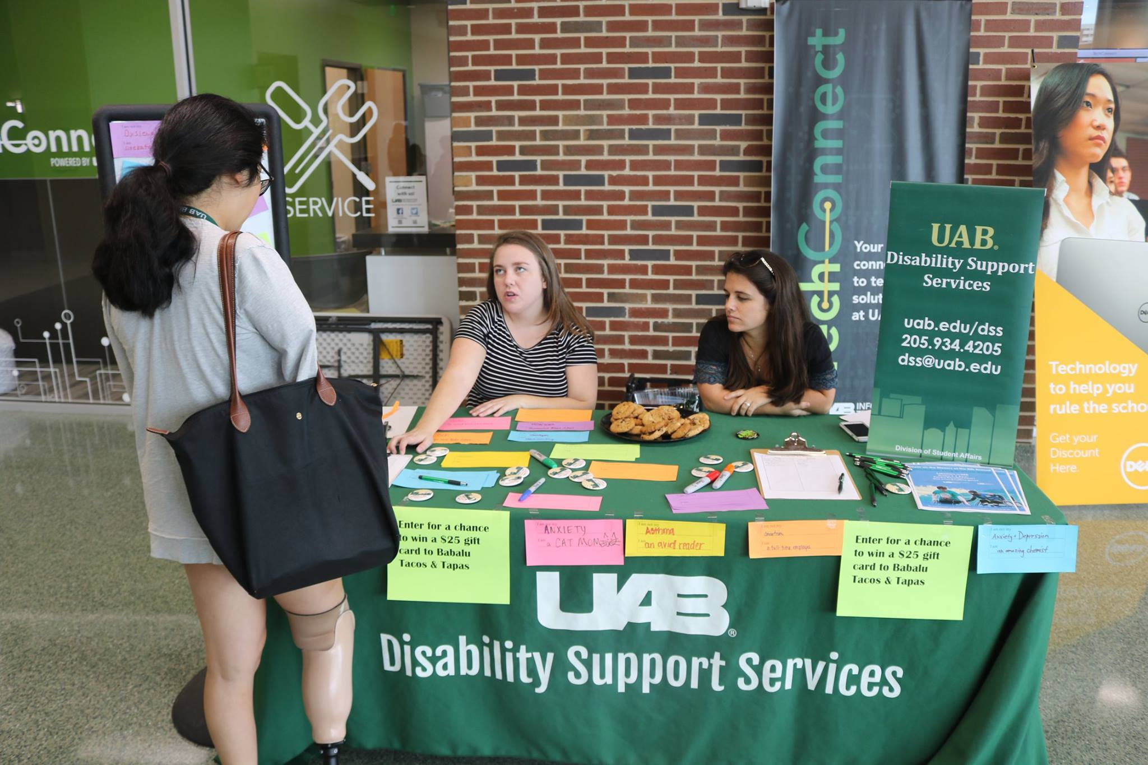
Challenge the Stigma
I am not my Autism
I am UAB Anime Club’s President
I am not my Traumatic Brain Injury
I am a Biomedical Engineer
I am not my Anxiety & Depression
I am an amazing chemist
I am not my Dyslexia
I am an Alpha Xi Delta
I am not my Migraines
I am a Boss
I am not my OCD
I am a traveler of 143 countries and counting
I am not my Hearing Impairment
I am a student, a writer, a tutor, a friend and an advocate

Slide 24
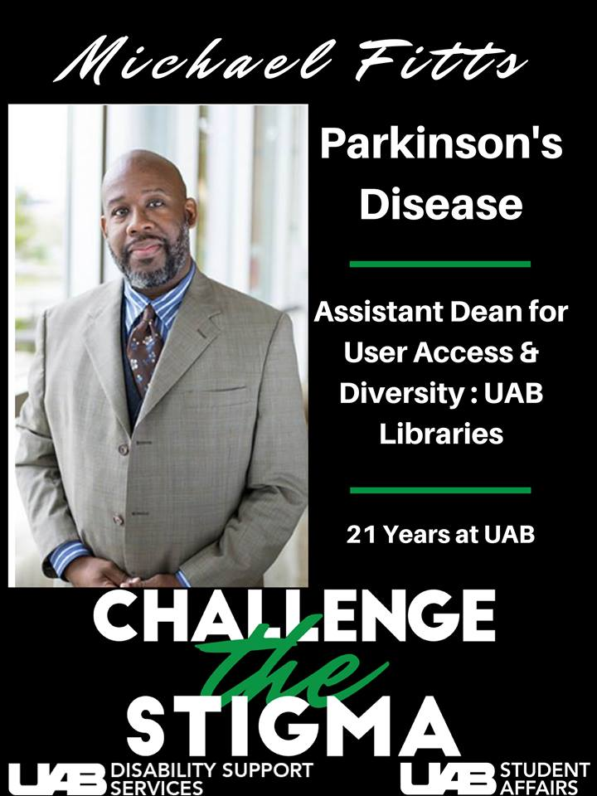
Challenge the Stigma: Impact
Direct Results:
Marketing Video
  Published online
  Added to faculty training
  https://www.youtube.com/watch?time_continue=1&v=1_sN7p_bwIw
Student Media Attention
  Kaleidoscope Article: “Accommodating All Differences”
  UAB TV: The Sit Down
  https://www.youtube.com/watch?v=5Yr5uLDMStY
140 students

Slide 25
Challenge the Stigma Video
https://www.youtube.com/watch?v=1_sN7p_bwIw

Slide 26
“The University of Alabama at Birmingham is committed to providing a quality educational experience for all of our students. UAB is enriched by the diversity of the student population and disability is a component of that diversity. Faculty are critically important to facilitating a quality learning experience and to insuring that students with disabilities have every opportunity for success.”
Dr. Pam Benoit, Senior Vice President-Academic Affairs & Provost

Slide 27
All In: A Commitment to Accessibility & Inclusion
Overview: A follow up to the “Challenge the Stigma” campaign with “All In” program and Inclusivity Fair.
Purpose: Encouraged participants to pledge how they can help promote access. During “Challenge the Stigma,” individuals shared their own success stories and identities. The “All In” event provided a platform for UAB community to show support with a commitment to accessibility and inclusion.
Structure: Tabling set up throughout the week where participants complete the following statement, “I, ___, am committed to help provide accessibility and inclusion at/by _____.” At the end of the week, the Inclusion Fair included a running loop of the “Challenge the Stigma” video and various campus/community partners were available to provide additional information on their organizations.
Campus/Community Partners:
  UAB Disability Advocates Club
  Autism Society
  Crisis Center
  National Alliance on Mental Illness
  Vocational Rehabilitation
  Lakeshore Foundation
  USGA
  UAB Student Counseling Services
  Alabama School for the Deaf & Blind
  UAB Student Multicultural and Diversity Programs
  Disability Rights & Resources
Notes:
.

Slide 28
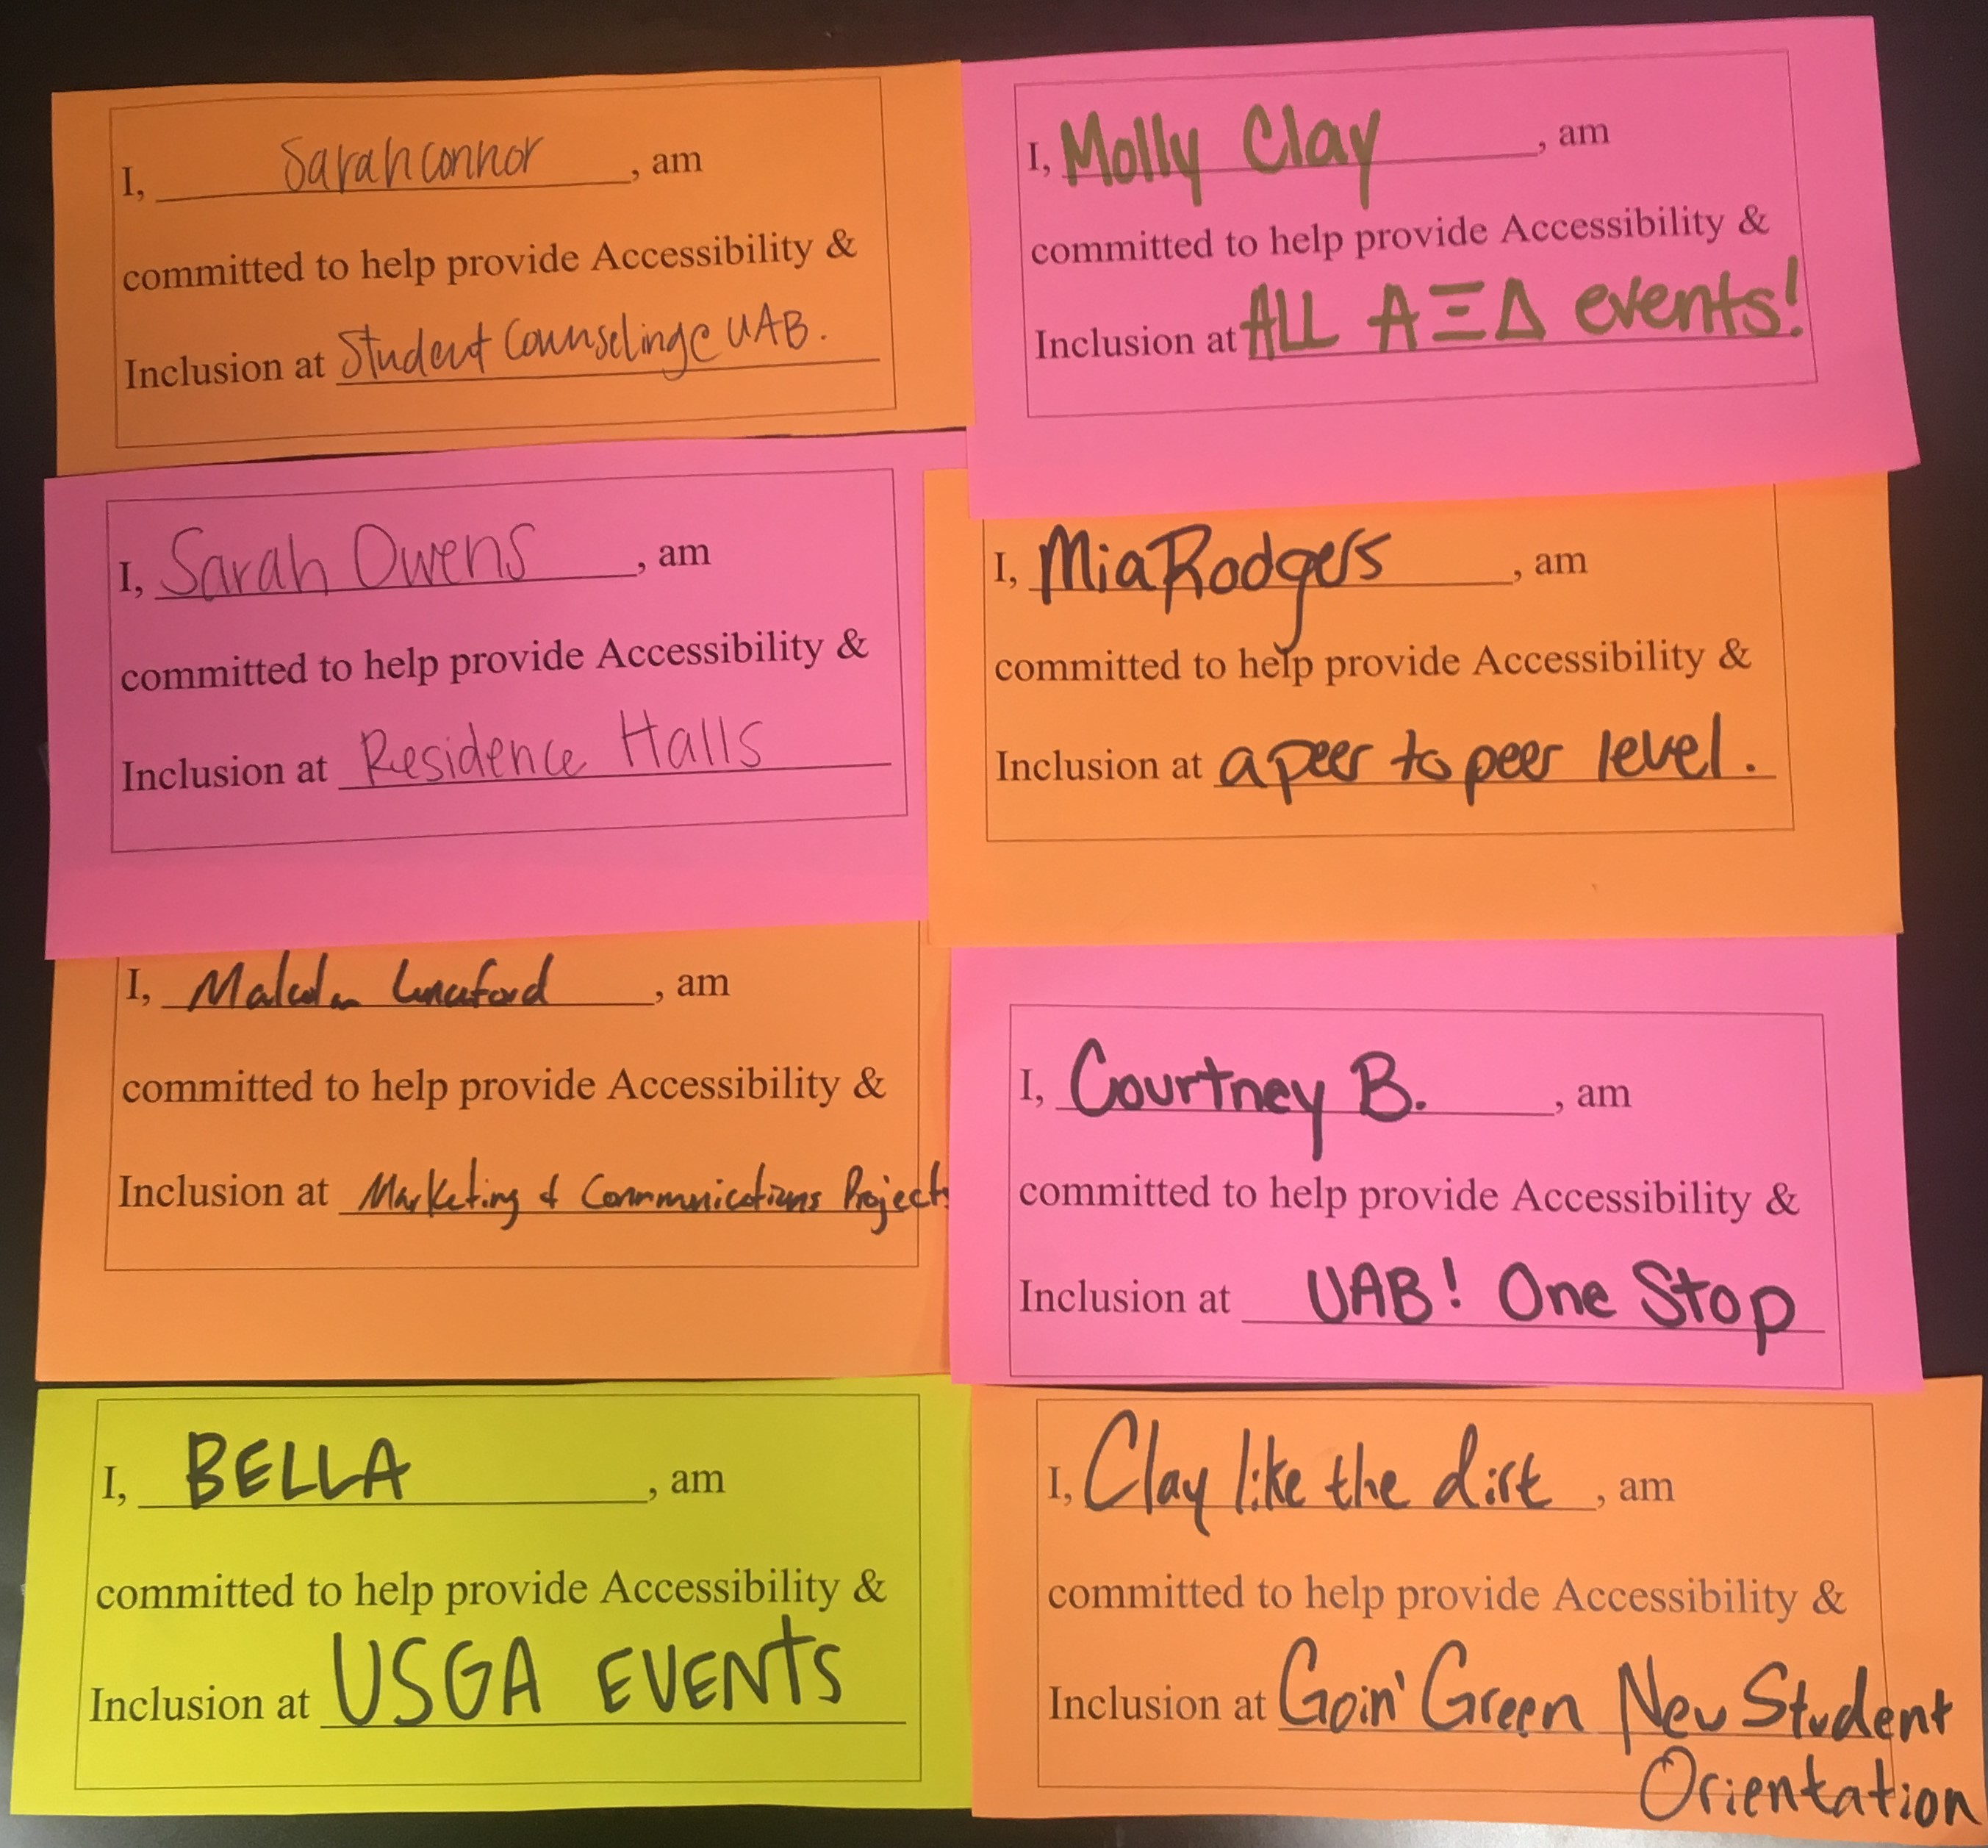
Direct Results:
Increased exposure
Interviewed by Student Media
172 participants

Slide 29
The Disability Experience: Details
Overview: UAB students, faculty, staff and administrators were invited to participate in an accessibility “experience.”
Purpose: To make the campus community aware of the importance of accessibility for all.
Structure: Participants experienced a brief activity demonstrating a possible barrier(s) for an individual with a learning disability, mobility impairment, hearing impairment, ADHD or a visual impairment. After the “experience,” facilitators led a group discussion for each activity focusing on specific barriers and potential solutions for accommodations. At the end of the week, a post-discussion/debrief was held with all participants from each activity for a final wrap-up.
Campus Partners:
  UAB Blazing Start Program
  Department of Occupational Therapy
  Alabama Department of Rehabilitation Services (Vocational Rehabilitation Services)
  UAB Student Affairs Marketing Department

Slide 30
The Disability Experience: Impact
Direct Results:
"Accommodation Statement" on Student Affairs Marketing materials
Re-evaluation of UAB Captioning software
Greater understanding of importance of accessibility
Increased discussion of disability as diversity
93%
Felt that this program changed the way they think about accessibility
84%
Felt that this program enhanced their knowledge of what it means to be accessible
100%
Indicated that they would re-evaluate accessibility within their positions in the coming months

Slide 31
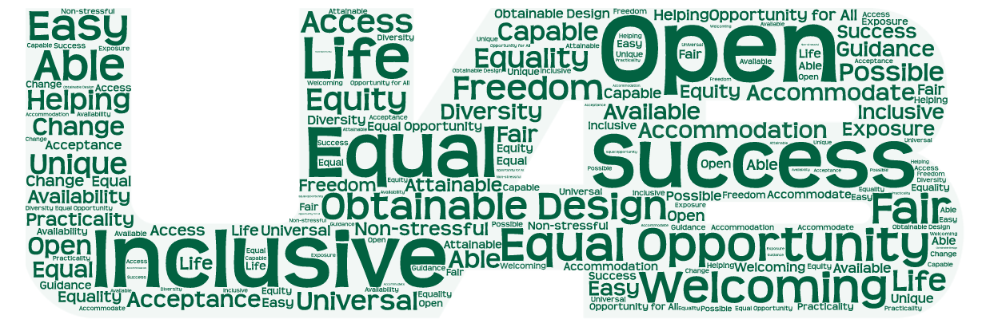
Use one word to describe accessible...

Slide 32
Comments from Participants:
"Good experience. Reminded me how important it is to create processes that are visible by people within a wide range of abilities."
"We can ALL change accessibility on campus."
"Made me stop and think about what I can do to help my students within the [residence] hall be more successful."
"Very enlightening and very needed. I want to follow up with DSS to see about running this with our senior leadership!"
"Count me as a partner!"
"This will certainly help in my execution of lesson plans."

Slide 33
“A major tenet of Human Resources is removing barriers wherever they may exists. This extends to everyone in the UAB Community including students and more specifically, students with disabilities. It is with this principle in mind, that I strongly encourage all employees to complete the Online Disability Support Services (DSS) Faculty and Staff Training Course. This course includes information that is beneficial to students with disabilities, and as such, provides safeguards for faculty and staff by revealing important, need-to-know facts and useful recommendations that may be unknown to employees. Department leaders should also consider inviting DSS to regular meetings or special sessions to conduct live training. Because UAB is a large educational institution, encounters with students and students with disabilities are inevitable regardless of where on campus or in the hospital an employee works and despite what that employee’s responsibilities are. As representatives of UAB, all faculty and staff have an obligation to make the University more accessible for everyone and to ensure compliance with guidelines designed to enhance the quality of academic life.”
Alesia M. Jones, UAB Chief Human Resources Officer

Slide 34
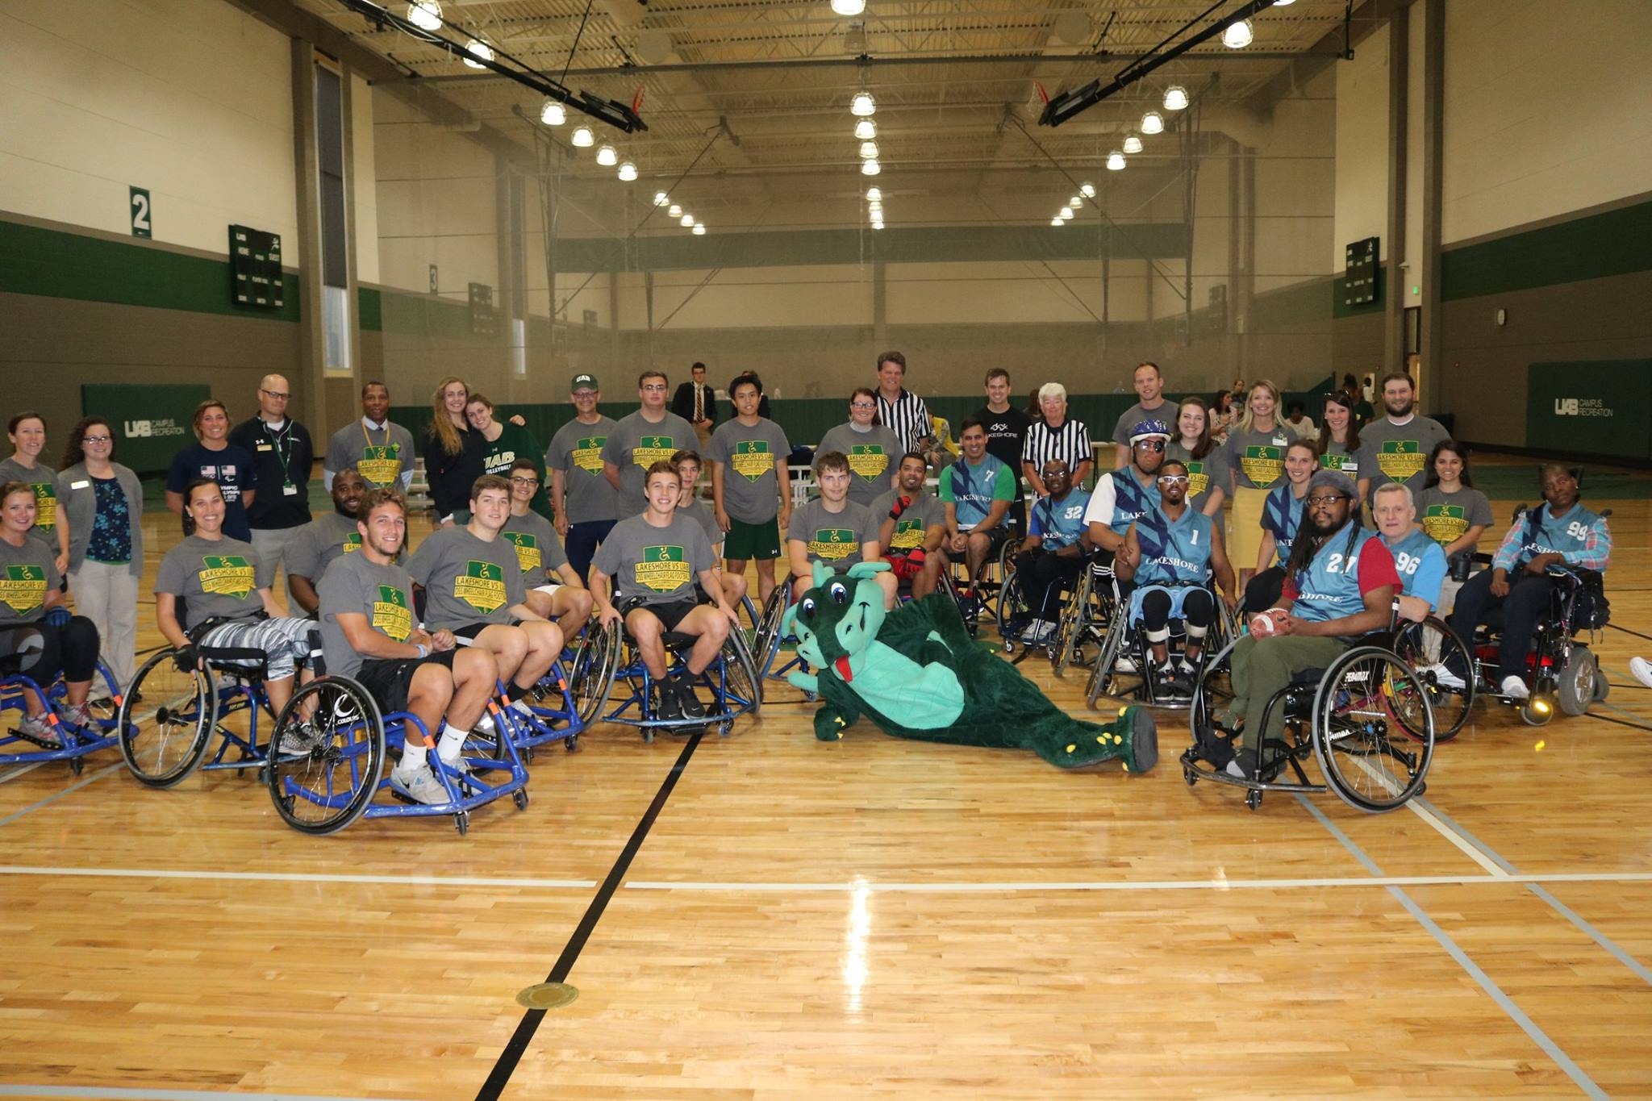
Annual Wheelchair Flag Football Game
Overview: An annual event where UAB students, faculty and staff compete against Lakeshore’s recreational wheelchair flag football team
Purpose: To provide an opportunity for UAB and a community partner (Lakeshore) to come together for some fun, friendly competition! And, of course, raise awareness and an appreciation of the athleticism and ability of the opponents.
Structure: A 7-on-7 wheelchair flag football game. Lakeshore provides wheelchairs for UAB participants. Additional activities throughout the event include half-time games complete with raffle items. Vice President of Student Affairs is head coach for Team UAB.
Community/Campus Partners:
UAB Campus Recreation
Vice President of Student Affairs
AVP Student Health and Wellbeing
NEW! This year, Wheelchair Basketball!
Overview: An annual event where UAB students, faculty and staff compete against Lakeshore’s recreational wheelchair flag football team
Purpose: To provide an opportunity for UAB and a community partner (Lakeshore) to come together for some fun, friendly competition! And, of course, raise awareness and an appreciation of the athleticism and ability of the opponents.
Structure: A 7-on-7 wheelchair flag football game. Additional activities throughout the event include half-time games complete with raffle items.

Slide 35
Student Affairs Innovation Grant: Kurzweil Pilot Project
Description: Kurzweil 3000 provides students with accessible tools that allow organizing notes, creating outlines, essays and study guides. Includes: text-to-speech, optical character recognition, dictionary, and more!
Purpose:
Provide targeted students with an all-in-one educational software solution designed based on the principles of Universal Design for Learning (UDL).
High impact student populations include DSS, TRIO, and INTO UAB
  Ultimate goal: to supply data based conclusions that might pave the way for all UAB students to enjoy access to Kurzweil
  Campus Partners:
    Vulcan Materials Academic Success Center
    Athletics
    INTO UAB
    TRIO
    University Writing Center
    Institutional Effectiveness and Analysis (data)

Slide 36
Key Accomplishments resulting from campus support
New Positions: ADA Investigator/Faculty Advisor & Graduate Associate
Reclassification of current position (OM to Program Coord. II)
Extended Test Proctoring Hours
Awarded the inaugural SA Strategic Innovation Grant: Kurzweil Firefly 3000
Awards/Recognition: UAB Employee of the Month, Student Affairs Employee of the Month (3), Student Affairs Employee of the Year, Student Affairs Legacy Award, Student Assistant: Inclusive Campus Commitment Award, Student Assistant: Student Employee of the Year, Disability Advocates Organization- Outstanding New Organization

Slide 37
“One of the many responsibilities of Disability Support Services (DSS) is to ensure that all UAB faculty and staff are well educated about working with students with disabilities. Their efforts protect faculty and staff, as well as the institution and provide a more accessible, open campus for UAB’s students with disabilities. In an effort to ensure university-wide compliance, I strongly encourage all employees to complete the DSS Faculty and Staff Online Training Course or to reach out to DSS to request an in-person training for your unit. It is appropriate for all full-time and part-time staff and should be incorporated into the departmental onboarding processes. Help us ensure an accessible, inclusive experience at UAB by participating in this important educational opportunity.”
Dr. John Jones, Vice President for Student Affairs

Slide 38
Let’s hear from you!
How does your campus promote a culture of disability inclusion?
At what level does your campus view the idea of disability as diversity?
What is something your department can do to further advance toward a culture of disability inclusion/access?
What are some of the potential challenges for accomplishing your goal?
Are there any strategies that might work on your campus to overcome those challenges?

Slide 39
Questions / Contact Information
Allison Solomon, Director/ADA Compliance Officer asolomon@uab.edu
Valerie DuBose, Assistant Director
vdubose@uab.edu
UAB Disability Support Services
uab.edu/dss
dss@uab.edu
205.934-4205

