Slide 1
Serving Students on the Autism Spectrum and Intellectual Disabilities at Community Colleges
Michael W. Duggan, LCPC, CRC, Ed.D.
Counselor for Students with Disabilities/Professor
Counseling Services
duggan@cod.edu
630-942-2845

Slide 2
Unique challenges of community colleges:
Open admissions
Levels of intellectual functioning can go anywhere from 1st to graduate level
Levels of maturational functioning can go anywhere from the 1st to graduate level
Funding
Staffing
Faculty pushback
Time!

Slide 3
What we’re doing for Autism Spectrum Students:
Autismerica
Education 1110 for Spectrum Students

Slide 4
What we’re doing for Students with Intellectual Disabilities:
Vocational Skills Program
Project COACH
Best Buddies

Slide 5


Claire and Jason

Slide 6
Perspective: Starting Off

Slide 7

History
Social group for students and community members on the autism spectrum
No age limit, but most students age 16-30
Includes short educational programming, and then social time, including video games, ping-pong, pool and more
Separate meeting area for parents
Mentoring Program
Facebook Page
Official website

Slide 8
Articles:
  Daily Herald
  Chicago Sun Times
  COD Courier
  West Suburban Living

Slide 9
Autismerica Video

Slide 10
Education 1110—Interpersonal Skills for Life and Work for Autism Spectrum Students
Small cohort of 15 students
Targets unique interpersonal challenges for students on the spectrum
  Making friends
  Developing relationships
  Managing anxiety and stress
  Developing coping skills
  Asking for help
  Expressing and recognizing emotions
  Many more topics

Slide 11
What works:
Students love socializing without the heavy therapeutic component
Eases the transition from high school to college
Long term relationships form from both the class and the group
Parents benefit as much as the students

Slide 12
Challenges
Some parents feel once a month isn’t enough
Staffing levels can be low if someone is out
Varying functioning levels in the class

Slide 13
Students with Intellectual and/or Developmental Disabilities
Vocational Skills Program--
  Job Skill Development
Project COACH
  --Cohort focused, internship based program

Slide 14
Vocational Skills Program
Classes focusing on vocational skills development including:
  Horticulture Skills
  Computer Skills
  Office Skills
  Hospitality Skills
  Communication Skills
  Keyboarding Skills

Slide 15
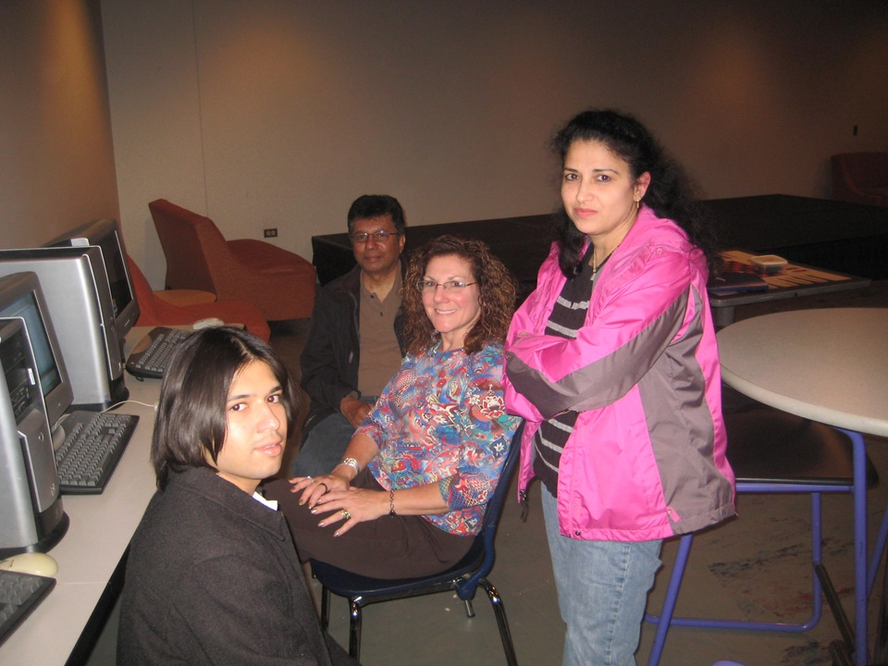
Vocational Skills Program (cont.)
Classes also offered in
  Independent Living Skills
  Money Management Skills
  Literacy

Slide 16
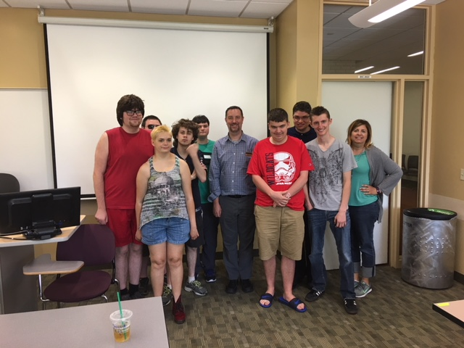
Project COACH
Cohort structured program for students with intellectual disabilities over 2 years.
Accepts 15 students per year
Year 1: classwork
Year 2: Work Experience

Slide 17
Project COACH (cont).
Competitive admissions
Scholarship assistance available
Students take credit classes as well
Students participate in COD Best Buddies

Slide 18

COD Buddies
Mentoring of Project COACH Students by COD Human Service and Special Education Students
Students meet weekly and also plan celebrations

Slide 19
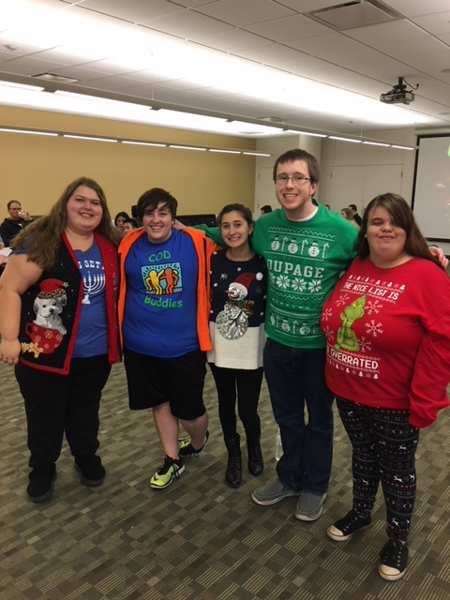

Slide 20
What works:
Students love the cohort model
Students are learning life-long skills for employment and life
Faculty are wonderful
An affordable option is now available.

Slide 21
Challenges & What We Learned
Some parents feel once a month isn’t enough
Staffing levels can be low if someone is out
Varying functioning levels in the class

Slide 22
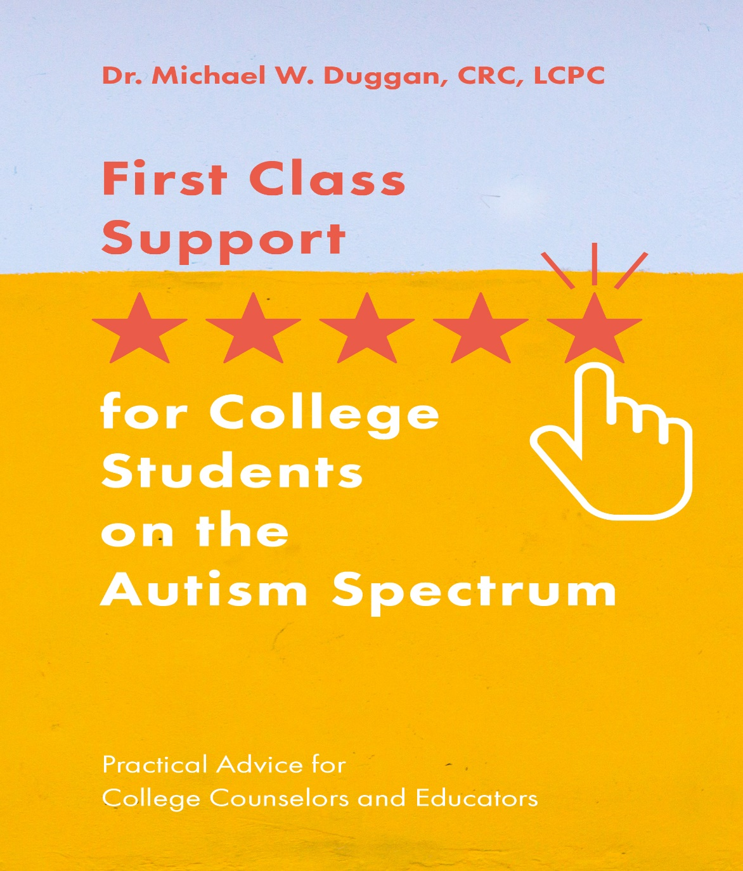
Shameless Plug

Slide 23
Your Experiences/Questions?

