Slide 1
Investigating the
ADA Complaint
Kristin Malloy, Lone Star College, tx – Kristin.a.Malloy@lonestar.edu
Tina Vires, Winthrop University, sc – virest@Winthrop.edu
Including consultation with additional members of the Ahead ada sig
Notes:
This session is an overall review to offer investigators a starting point

Slide 2
Purpose:
Through an actual, redacted complaint, walk through an investigation process
Follow Flow Chart
Use Templates
Review Process
Share Policies and Forms

Slide 3
Informal Complaint Procedure
Whenever possible, students are encouraged to speak directly with:
The person/department with whom or wherein the complaint refers
Accessibility/Disability Services Offices
In these discussions, a satisfactory resolution may be readily found.
Notes:
Today, we are mainly focusing on the FORMAL ADA complaint, within our institutions.

Slide 4
Complaint Forms
SAMPLE FORMS:
Winthrop ADA Complaint Form
Lone Star College ADA Appeals Form
Sample Form to Document ADA Requests and Responses to Requests

Slide 5
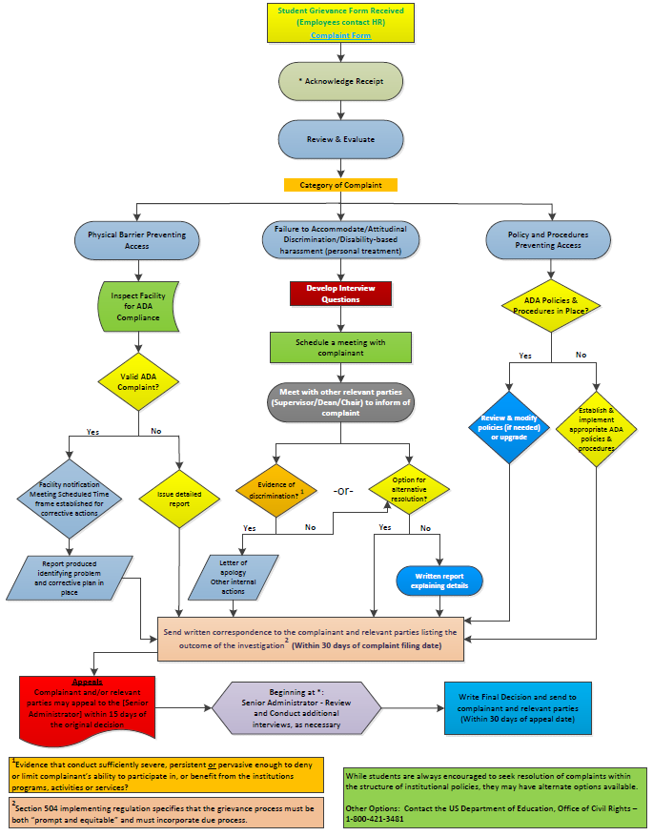
Grievance Procedure
Flow Chart
(Outline in Word document included in handouts)
Notes:
This is what a grievance procedure might look like in a flow chart. We will be addressing separate sections of this chart throughout this presentation and a full size attachment as well as a Word outline was included in the handouts available online.

Slide 6
Amalgam Complaint (LSC)
The technical standards for the EMS program require that a student be able to “manage stressful situations.” The student must be able to respond accurately and appropriately in emergency situations.
William has filed a complaint because he was recently dismissed by the internship site.

Slide 7
Amalgam – Event Summary
William was at the internship site, but on lunch break when he experienced a seizure. The program director found him lying down outside on a picnic table bench. The program director learned that other students saw the seizure happen and noted that William was not fully recovered for at least 35 minutes. Internship site leadership discussed the situation and determined that William was potentially a threat to others during an emergency situation. They dismissed him that day.

Slide 8
Amalgam – Process
The DS Provider consulted with campus leadership and reviewed the MOU with the site location. The location has the ability to terminate an internship without due process in situations where they have a safety concern.
Instructional team is now questioning whether or not the student meets the technical standards for the EMS program.

Slide 9
Amalgam – Appeal
The student has appealed and asked to be allowed to return to the internship next semester. The student wants the grade for this semester to be “wiped” from his transcript and his money returned.
What steps must the DS Provider complete next?

Slide 10
Accommodation and/or resolution requested:
To be allowed to return to the internship next semester.
To have the grade for this semester “wiped” from his transcript.
Return of tuition/fees for the current semester.

Slide 11
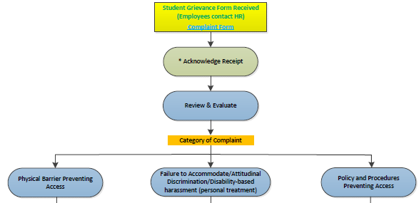
Getting Started
Student Grievance Form Received
Acknowledge Receipt and Begin Log (actual log in handouts)
Review and Evaluate to
Determine Category of Complaint
  Physical Barrier Preventing Access – go to IV
  Failure to Accommodate/Attitudinal Discrimination/disability-based harassment (personal treatment) -- [Most Complex] – go to V
  Policy and Procedures Preventing Access – go to VI

Slide 12
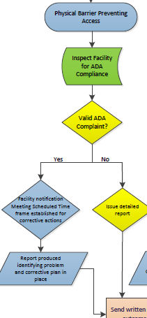
A. Physical Barrier?
IV. Inspect Facility for ADA Compliance and determine – Is this a valid ADA complaint?
  If yes, notify facility, schedule meeting within established time frame to take corrective actions and generate report identifying problem and corrective plan in place - go to VII
  If no, issue detailed report - go to VII

Slide 13
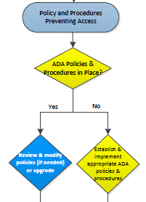
C. Are Policies/Procedures Preventing Access?
VI. ADA Policies and Procedures in Place?
  If yes, review and modify policies (if needed) or upgrade – go to VII
  If no, establish and implement appropriate ADA policies and procedures (working with relevant department heads) – go to VII
Notes:
Skipping B for the moment… E.g. Is a tight “no pets” policy preventing a student from having an ESA? Are the policies/procedures required for documentation so onerous that many are unable to comply (documentation older than requested, etc.)?

Slide 14
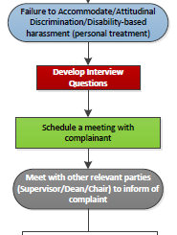
B. Accommodation/Attitudinal (Most Common/Complex)
V. Develop Interview Questions
  Schedule a meeting with complainant – add to log
  Meet with other relevant parties (Supervisor/Dean/Chair) to inform of complaint – add to log
Notes:
Come back to B

Slide 15
Determining Accommodations Was the Interactive Process Properly Engaged?
The Office of Civil Rights (OCR) requires disability services personnel to engage in an interactive process to determine if reasonable accommodations are warranted. Includes:
Never say never
Always – Case-by-case
Student self-report
History of accommodations
Supportive documentation
These items help provide a nexus between accommodations and their potential for mitigating effects of the disability.
Notes:
Fundamental basics of accommodations

Slide 16
REVIEW
Three ways to accommodate
Reasonable accommodation
Provision/allowance of auxiliary aids and services
Alteration to policy/procedures
Notes:
Basics

Slide 17
REVIEW
When not to accommodate
There are three reasons to legally deny any accommodation:
Is the accommodation a fundamental alteration of program requirements? (know program admissions criteria and technical standards - be able to defend rationale)
Would the accommodation constitute an undue burden/hardship? (Rare; again, must be able to defend)
Does the accommodation result in a direct threat? (e.g., Categorical exclusion of an assistance animal by breed or species is not permissible.)
Notes:
Basics

Slide 18
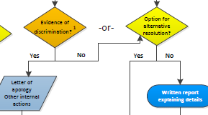
Determination:
Evidence of Discrimination?
Note: Is there evidence that the alleged conduct was sufficiently severe, persistent, or pervasive enough to deny or limit complainant’s ability to participate in, or benefit from the institution’s programs, activities or services?
If yes, issue letter of apology, including remedies/other internal actions – go to VII
If not, is there an option for alternative resolution?
If yes, go to VII
If no, issue written report explaining details – go to VII

Slide 19

VII. Response
Send written correspondence to the complainant and relevant parties listing the outcome of the investigation (Within 30 days of complaint filing date).
2) Note: Section 504 implementing regulation specifies that the grievance process must be both “prompt and equitable” and must incorporate due process.
Notes:
Institutions should set reasonable deadlines.

Slide 20



VIII. Appeals
  Complainant and/or relevant parties may appeal to the [Appeals Administrator] within 15 days of the original decision
  Beginning with Acknowledgement, Appeals Administrator – Review and conduct additional interviews, as necessary
  Write final decision and send to complainant and relevant parties within 30 days of appeal date
  Note: While students are always encouraged to seek resolution of complaints within the structure of institutional policies, they may have alternative options available, including contacting the US Department of Education, Office of Civil Rights – 1-800-421-3481.

Slide 21
Retaliation forbidden
Negative/derogatory remarks may be considered retaliation.
I don’t believe you have a disability.
You’re using disability as an excuse.
You don’t look like you have a disability.
ADHD, depression, anxiety, etc. are all in your mind.
http://askjan.org/bulletins/adaaa1.htm#IIID
Notes:
Retaliation is not permissible at any time. All investigations and decisions must be treated confidentially.
These types of remarks may result in an attitudinal discrimination complaint.

Slide 22
Accreditation
Notes
SACS – During Winthrop’s last 5-year review, SACS requested a full report on student complaints over a five year period and has asked that such a report be maintained henceforth.
Other agencies may also require this information for scholarship and/or grant purposes
Notes:
TV: SACS – Southern Association of Colleges and Schools; Equal Opportunity Office for Grants; etc.

Slide 23
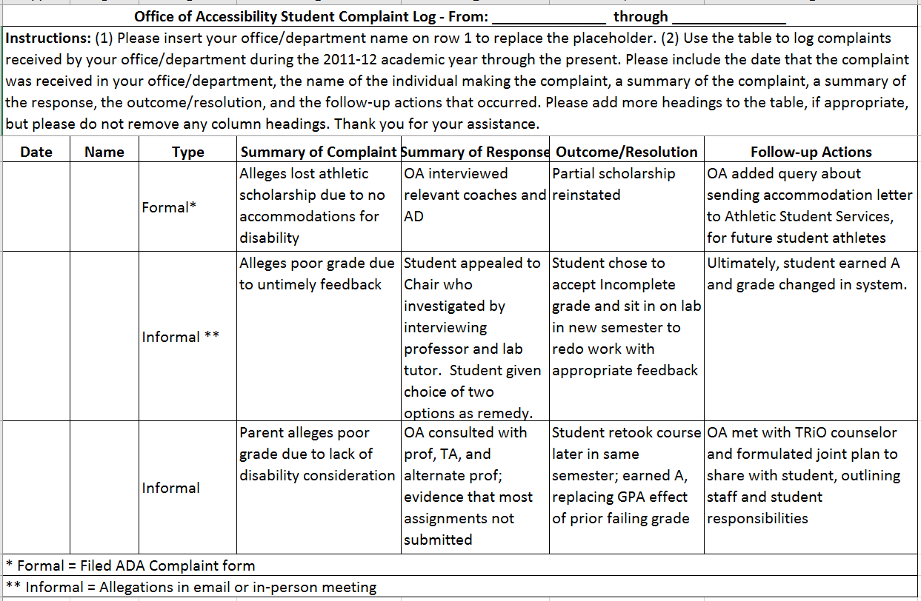

Slide 24
“Gray Areas”
Who conducts the grievance investigation? What is your role if you are not the lead investigator? (LSC Example)
Identifying conflict of interest during an investigation?
At what point is it ok to share student disability information if someone else is handling the complaint investigation, and how do you know what / how much to share?
What happens when the person filing a disability discrimination is a witness and does not have a disability?
Notes:
Kristin

Slide 25
“Gray Areas” (Continued…)
Modifying the grievance process if the head of DS is also the ADA compliance officer
Establishing boundaries for handling disability concerns versus situations involving someone with a disability
Being proactive to prevent situations from intensifying
Mitigating measures under Title IX and/or DS accommodations
Meeting compliance versus fostering inclusion
Meeting accommodation needs and balancing this with academic integrity/essential requirements
The role of Student responsibility versus processes/procedures
Notes:
TV – differing roles will be discussed during the panel presentation in the following session.

Slide 26
Resources
Following are documents used by the presenting institutions. These items are fluid in nature and are constantly being tweaked/revised as experience and need dictates.
Policies:
Lone Star College Policy: Students with Disability Rights
Winthrop ADA Complaint Policy for Students
Forms:
Lone Star Civil Rights Complaint Form
Lone Star College ADA Appeals Form
Winthrop ADA Complaint Form
Other Sample Forms Included at the presentation link on the AHEAD Website:
ADA Grievance Procedures Flow Chart and Word document, ADA Grievance Investigation Log Template, Student Complaint Log for Accrediting Bodies and Template, Investigative Report Template, Complaint Worksheet
Notes:
TV? – summarize, Q & A, and - The presentation feedback/evaluation form is available directly through the app or online (the URL is in the program book). Please remind participants in your sessions to share their feedback at the end of your session. It’s very helpful to AHEAD in planning further professional development events.

