Slide 1


WELCOME
Staff Forum 2022
Notes:
Welcome
Invite cameras, questions

Slide 2

Get the AGRiP Conference App
Read full session descriptions
Search speakers, attendees and QEI Patrons
Filter by session type or role
Find session handouts and resources
www.agrip.org/app

Slide 3

GET CONNECTED
Wi-Fi Network Name:
AGRiP
Access Code:
AGRiP2022

Slide 4
Special thanks to QEI Patrons!
Quality Education Initiative (QEI) Patrons invest in AGRiP education.
Collaborative • Trusted • Effective
www.agrip.org/qei

Slide 5

QEI Legacy Level Patron
Contributing at the highest level of support to pooling

Slide 6

QEI Legacy Level Patron
Contributing at the highest level of support to pooling

Slide 7




QEI CEO Level Patrons
Contributing a high level of support to pooling
Notes:
Ambridge
AON
AP Keenan
BusinessSolver

Slide 8



QEI CEO Level Patrons
Contributing a high level of support to pooling
Notes:
Chubb
Gallagher
Genesis
Guy Carpenter

Slide 9




QEI CEO Level Patrons
Contributing a high level of support to pooling
Notes:
Lexipol
Markel Global Resources
Risk Program Administrators
STOPit Solutions
WTW

Slide 10








QEI VP Level Patrons
Notes:
PwC Safety National Segal Select Actuarial Services Strategic Asset Alliance Vimly Benefit Solutions

Slide 11







QEI VP Level Patrons

Slide 12
QEI Executive Level Patrons
AAM Insurance Investment Management
Amwins Specialty Casualty Solutions
AssetWorks
Davies
Eide Bailly
Euclid Public Sector
Independent Consulting & Risk Management Services
Insight Investment
Johnson Lambert
Kroll
Midwest Employers Casualty
Milliman
Origami Risk
Paul Davis Restoration
PowerDMS
Redhand Advisors
TRISTAR
Vector Solutions
Ventiv Technology

Slide 13


Governance Conference 2023
Mar. 5-8 • Orlando, FL

Slide 14

CEO Institute 2023
Aug. 6-9 • Chesapeake Bay (Cambridge, MA)

Slide 15
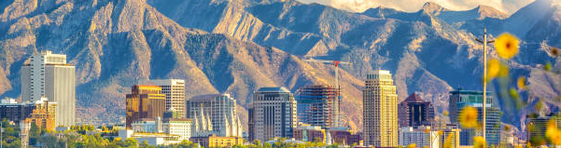
Staff Forum 2023
Oct. 1-3 • Salt Lake City, UT

Slide 16

Interactive, online learning that’s built by the pooling community, for the pooling community.
www.poolingacademy.org

Slide 17
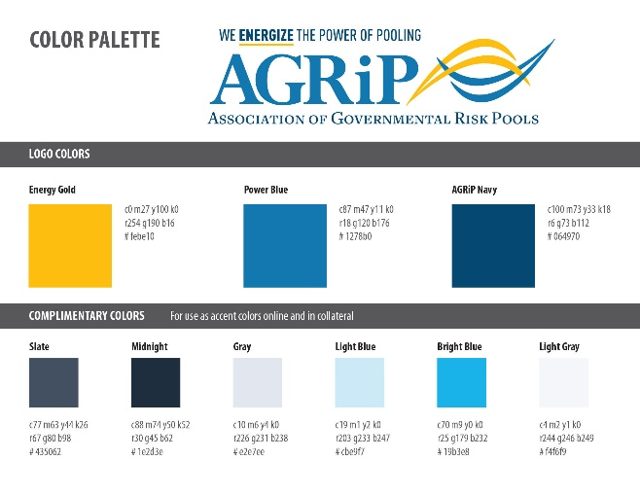


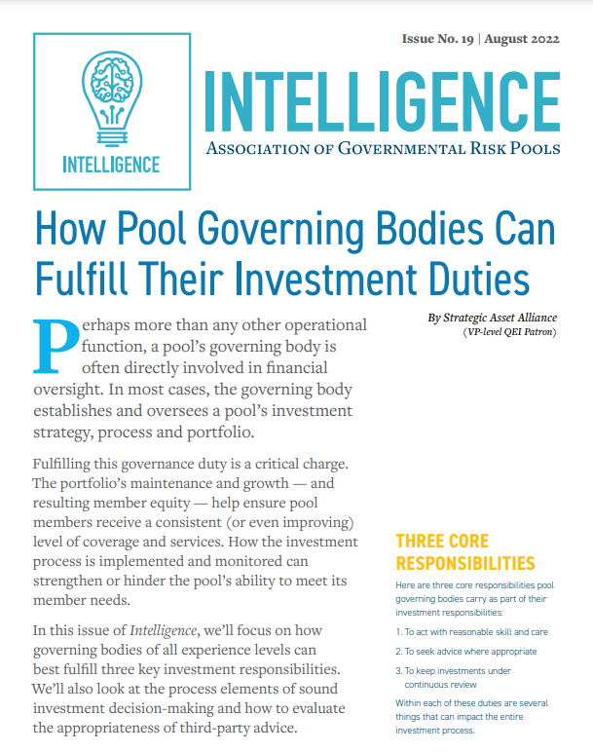

Explore Intelligence publications
Navigating the future of public entity pooling through in-depth commentary and though leadership.
www.agrip.org/intelligence

Slide 18



Join a committee or workgroup
General Counsel Peer Forum
Technology Peer Forum
New CEO Peer Forum
AGRiP Health Pool Resource Group (AHPRG)
Membership Practices Committee (MCP)
www.agrip.org/networking/workgroups

Slide 19



Visit the Cybrary
Search AGRiP member websites and other trusted web resources.
www.agrip.org/intelligence/cybrary

Slide 20
Meet the Advisory Standards
for Recognition
AGRiP Recognition is a method for pool members to conduct a comprehensive self-assessment of internal operational procedures against industry standards.
www.agrip.org/best-practices/advisory-standards
Notes:
Advisory Standards for Recognition

Slide 21
Recognize outstanding individuals, pools and other groups with the Awards for Excellence
The 2023 nominations are open Oct. 10-Nov. 30
www.agrip.org/networking/awards-for-excellence
Notes:
Advisory Standards for Recognition

Slide 22
Recognize outstanding individuals, pools and other groups with the Awards for Excellence
The 2023 nominations are open Oct. 10-Nov. 30
www.agrip.org/networking/awards-for-excellence
Notes:
Advisory Standards for Recognition

Slide 23
Recognize outstanding individuals, pools and other groups with the Awards for Excellence
The 2023 nominations are open Oct. 10-Nov. 30
www.agrip.org/networking/awards-for-excellence
Notes:
Advisory Standards for Recognition

Slide 24


www.linkedin.com/company/powerofpooling
www.twitter.com/powerofpooling
Notes:
Advisory Standards for Recognition

