Slide 1
Residency Selection Improvement Initiative
AFMRD/AFMA Webinar
October 1, 2025
Karen Mitchell, MD, FAAFP
Vice President For National Residency and Academic Partnerships
Notes:
Thank you for inviting me. I am Dr. Karen Mitchell, former program director, and now AAFP VP for National Residency and Academic Partnerships.
Thank you to AFMRD and AFMA for being involved in this initiative, led by AAFP, to improve the systems and processes of residency selection and recruitment in family medicine.

Slide 2
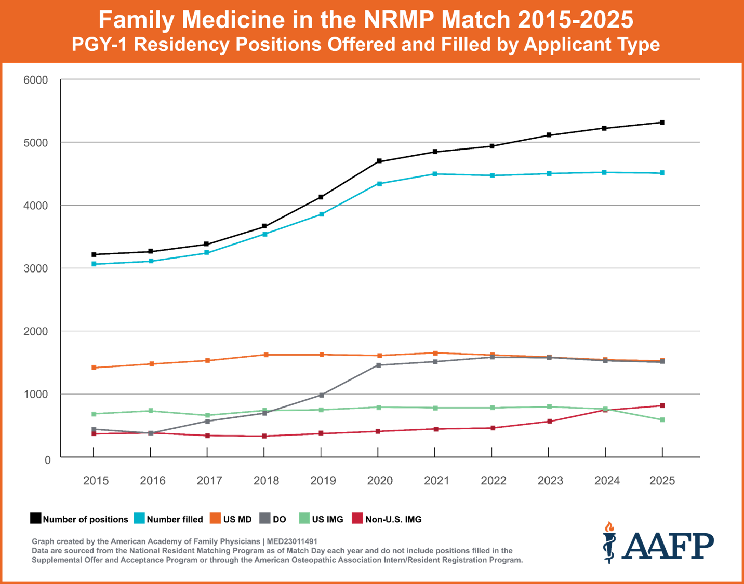
Why?
Notes:
-Growing number of geographically distributed residency programs in community settings—ideal for primary care training. More family medicine residencies than any other specialty (>800).
-To meet U.S. primary care needs, family medicine residencies need to continue expanding.
-The number of students choosing family medicine in the Main Match is not increasing.
-Both residency programs and applicants going unmatched.
-Current application, interview and matching system takes significant time and resources. Hard for applicant find programs they want, hard for programs to find their best applicants who whose values and interests align.
-Addressing only one aspect of the application, interview and match process won’t be enough to create the systemic change.
-Urgent action is critical to prevent further loss in the future family medicine workforce.

Slide 3
Goal: Fill all family medicine residency positions in the most effective, efficient and economical way possible
Help residency applicants find family medicine programs that align with their values and interests
Help residency programs find the best possible applicants for their program
3

Slide 4
Focus on Residency Selection Process
4
Notes:
We believe we can create change in the coming 12-24 months using a “focused by design” approach.

Slide 5

Important factors
Broader factors influencing students’ specialty choice.
Pathways to medical school (except as related to early residency commitment).
Family physician practice and payment issues.
…being worked on by other initiatives and organizations, including other divisions of AAFP
5
Notes:
These are all being worked on by other initiatives and organizations (including people on this webinar and other divisions of AAFP)

Slide 6
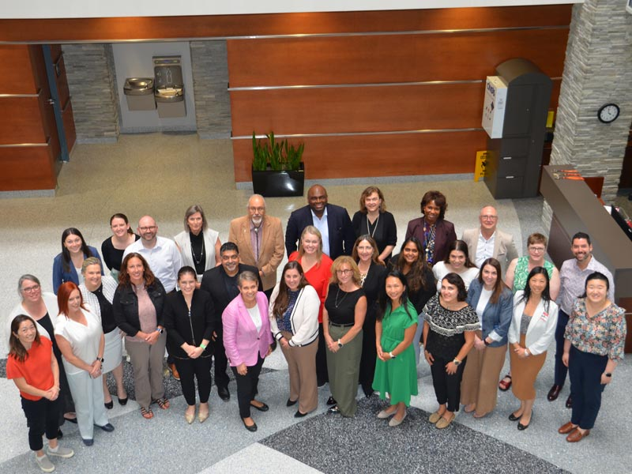
AAFP convened stakeholders in August 2025 representing the entire Match process to identify a focused number of impactful, rapid residency selection system changes over the next 1-2 years that will better serve family medicine.
6
Notes:
Meeting objectives: Coalesce around and identify 2-5 major areas where we think if we make changes in those areas, it would have a significant positive impact on the system. Develop priority action areas and action plans.
Define the problem we’re trying to solve.
Thank you AFMRD leaders Sarah Cole, Raj Woolever and Grace Yu and to AFMA leaders Emmalyn Dyer and Melissa Keller for participating!
It generated a lot of momentum

Slide 7

Convening Overview:
Data and information about residency selection to establish common knowledge
Personal experiences from applicants and program directors to animate the data
Analysis of Journey Maps to identify areas of friction and inefficiency
Brainstorming solutions
Evaluating solutions for feasibility, impact
Selection of 4 priority areas
Action planning for each of the 4 priorities
  Stakeholder mapping
  Models/precedents/info to draw on
  Impact potential for applicants and programsrs
Word cloud of participant takeaways
7

Slide 8
Four Priority Areas
Creating a Centralized Program Information Tool
Re-Imagining the Interview Process
Improving the Residency Selection and Match for International Medical Graduates (IMGs) and Multi-Specialty Applicants
Exploring Multi-Phase Match Options
8

Slide 9
Creating a Centralized Program Information Tool
A centralized program tool provides a “one-stop shop” for learners and advisors to obtain information about residency programs and for residency programs to update their data and unique characteristics.
Goal: Provide additional search capabilities to help learners find and filter key information
Proposed approach:
Define a set of key information to feed into a “one stop shop” and an implementation timeline
Convene with key stakeholders, including AFMRD, to identify family medicine specific items to include in the tool.
Validate the information needs through focus groups and surveys and include perspectives from program directors, applicants, and learners
Assess if the desired information can be reliably gathered
Collaborate with key stakeholders on the specific elements that would improve existing program information and propose an infrastructure/plan for a “one stop shop” interface
9

Slide 10
Re-Imagining the Interview Process
A phased interview process would provide transparency, clarity, and a more seamless experience for both applicants and residency programs. It would provide the opportunity to plan ahead, devote the appropriate amount of time, and clarify expectations around issues such as post-interview communications.
Goal: Enable applicants to choose the program that would be best for them, and residency programs would choose the best applicant for them, increasing likelihood that interviewees select the residency program.
Proposed approach:
Develop recommendations for concrete ways to make the interview process easier and equitable, effective and efficient for key stakeholders (residency directors, students)
Convene with key stakeholders, including AFMRD, and review the inputs from the RSII Convening
Develop a set of recommendations to improve the interview process
Explore any unintended consequences with key stakeholders and ensure there is input from learners and medical school advisors
10

Slide 11
Improving the Residency Selection and Match for IMGs and Multi-Specialty Applicants
A set of possible strategies for improving the residency selection and Match for IMG and multi-specialty applicants would benefit both learners and residency programs. There is a likely pool of candidates who are IMGs or multi-specialty that might be a good fit for family medicine that are not being selected for interviews.
Goal: Develop guidance for residency programs on how to best draw from the pool of well qualified IMG applicants, as well as how to encourage multi-specialty applicants to see family medicine as a good fit for them.
Proposed approach:
Collect data and information to highlight opportunities that are being missed and why
Interview key association leaders to help identify specific issues and define questions worth probing further.
Gather data on characteristics of IMGs and multi-specialty applicants, and criteria that residency programs use to assess these applicants via surveys and focus groups.
Create guidance on:
  How to search for and find strong IMG applicants for residency programs
  How to help multi-specialty applicants see the value and fit within family medicine
  How to help residency programs frame the value of family medicine by highlighting the experiences their program offer
11

Slide 12
Exploring Multi-Phase Match Options
A multi-phased match option or set of options which would allow early commitment between applicants and programs. This would allow programs to focus more resources on undecided applicants later in the process and potentially draw more applicants into the specialty.
Goal: Make the matching process more efficient and economical for both programs and applicants and reduce the number of applicants in the SOAP process.
Proposed approach:
Collaborate with key stakeholders to analyze and explore a range of options (e.g., “early decision” option, accelerated pathways, and other phased approaches)
Create models to inform how and whether to operationalize multi-phase Match options
Understand the implications and impact for both residency programs and applicants
12

Slide 13
Audience Poll
Which of these priority areas are likely to have the biggest positive impact on your program?
Creating a Centralized Program Information Tool
Re-Imagining the Interview Process
Improving the Residency Selection and Match for IMGs and Multi-Specialty Applicants
Exploring Multi-Phase Match Options
13

Slide 14
Q&A and Discussion
What factors or considerations not yet mentioned could accelerate our impact? Or stand in the way?
What partners or resources have we not thought of that could help move these priority areas forward?
14

Slide 15
Thank you
15
Notes:
Thank you, Planning Committee: AAFP, AFMRD, AFMA, STFM, ADFM, ABFM, ACOFP, AAFP Foundation.
Thank you AAFP staff.
Thank you X4.

