Slide 1

Interview Guidance for Recruitment 2026-2027

Slide 2
Today’s Panelists:
Grace Yu, AFMRD President
Melissa Keller, AFMA Immediate Past President
Raj Woolever, AFMRD Immediate Past President
Karen Mitchell, AAFP Residency Selection
Improvement Initiative
Sarah Cole, AFMRD Representative to OPDA

Slide 3






































Residency Selection and Improvement Initiative (RSII)
Goal: Fill all family medicine residency positions in the most effective, efficient and
economical way possible.
Help applicants find FM programs that align with their values and interests | Help residencies find the best applicants for their programs
Create a One-stop Information Tool
Re-imagine the
Interview Process
Improve Residency Selection and Match for International Medical Graduates and Multi-specialty Applicants
Support FM Dedicated Applicants
Streamline the process of finding FM residency information for applicants.
Because of RSII: FM-specific changes will be incorporated into 2026 Residency Explorer, Careers in Medicine and GME Track Survey.
Make the interview process easier, equitable, effective and efficient for residencies and applicants.
Because of RSII: A multi-stakeholder workgroup developed six recommendations for timing of interview offers and acceptance. Being incorporated into the Program Directors Association Guide for Applicants for FM.
Increase the number of high-quality IMG and multi-specialty applicants who are selected for interview.
Because of RSII: Creating residency resource list for IMG applicant consideration based upon survey and key stakeholder collaboration. Input into the creation of a FM-specific indicator that highlights an applicant’s interest in family medicine.
Make the matching process more efficient and economical for programs and applicants.
Overall Strategy: Explore ways to support FM-dedicated applicants on their residency selection pathway. Work with AAMC and NRMP on dedicated pathway opportunities.
RSII North Star Leadership Group: Strategic support and guidance provided by residency program directors, program coordinators/administrators, medical school advisors and students/residents.
May 2026

Slide 4
Interview Guidelines for Family Medicine
01 | Number of Interview Invitations | Programs offer only as many invitations as interview spots available. This is in accordance with the NRMP Match participation agreement.
02 | Interview Offer Release | Programs release initial interview invitations no sooner than one week after applications are released to programs to allow for mission-aligned application review.
03 | Applicant Response Time | Programs provide applicants at least 2 business days to accept or reject an interview invitation before releasing the spot to another applicant.
04 | Applicant Withdrawal Notice | Applicants who plan to withdraw from an accepted interview should provide at least 2 weeks notice to the program.
05 | Applicant Status Notice | Programs notify current applicants of their application status by December 1st.
06 | Virtual/In-person Interviews | Programs may host interviews that are virtual and/or in-person and should clearly specify the available options on their website and applicant materials.

Slide 5
Recommendation 1:
Number of Interview Invitations​ | Programs offer only as many invitations as interview spots available. This is in accordance with the NRMP Match participation agreement.​

Slide 6
Recommendation 2:
Interview Offer Release ​ | Programs release initial interview invitations no sooner than one week after applications are released to programs to allow for mission-aligned application review.​

Slide 7
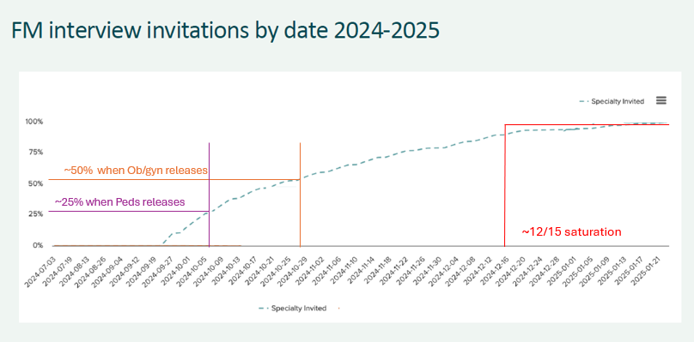
Slowing the process allows for mission-aligned review to occur without penalizing programs
FM "No Sooner Than" Release Date –
BEFORE Peds & OB offer releases
Source: Provided by Thalamus
7
Notes:
Streamlining the process can sometimes mean going more slowly, NOT going more quickly.
According to our annual meeting Quick Hoitter results, 77% felt delaying 1-3 weeks were reasonable (23% 1 week, 54% longer than 1 week))

Slide 8
Recommendation 3:
Applicant Response Time​ | Programs provide applicants at least 2 business days to accept or reject an interview invitation before releasing the spot to another applicant.​

Slide 9
Recommendation 4:
Applicant Withdrawal Notice​ | Applicants who plan to withdraw from an accepted interview should provide at least 2 weeks notice to the program.​

Slide 10
Recommendation 5:
Applicant Status Notice​ | Programs notify current applicants of their application status by December 1st.​

Slide 11
Recommendation 6:
Virtual / In-person Interviews​ | Programs may host interviews that are virtual and/or in-person and should clearly specify the available options on their website and applicant materials.

Slide 12

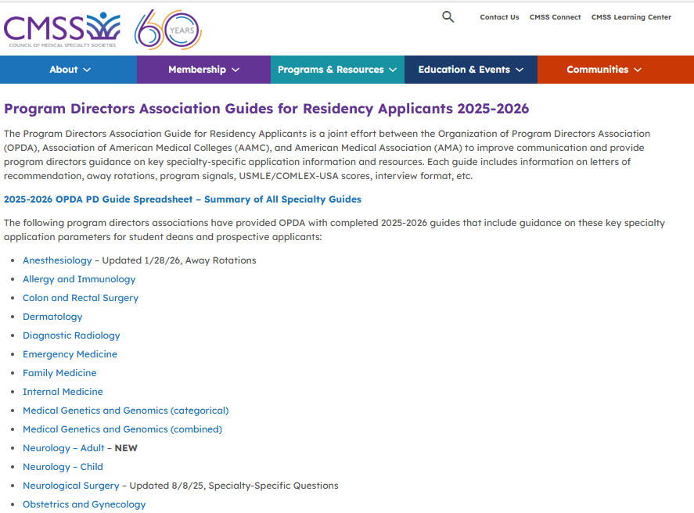
Can be viewed at: https://cmss.org/program-directors-association-guides-for-residency-applicants/
Notes:
The Program Directors Association Guide for Residency Applicants is a collaborative effort between the Organization of Program Directors Association (OPDA), Association of American Medical Colleges (AAMC), and American Medical Association (AMA). Its purpose is to provide specialtyspecific guidance, application information, and resources.

Slide 13
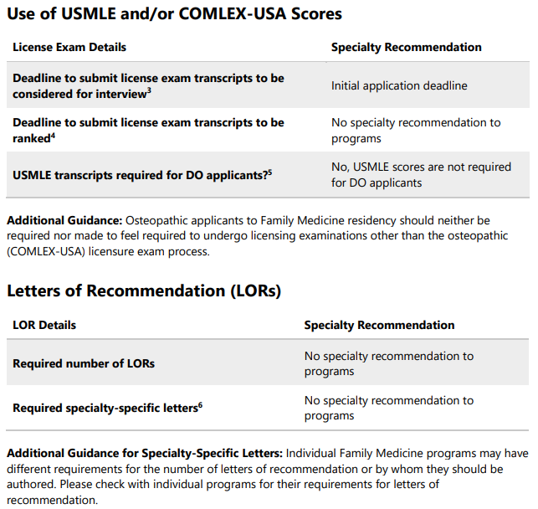
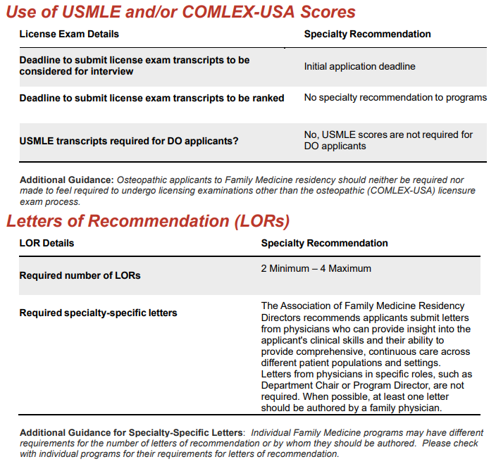
Family Medicine Specialty Guidance
2025-26
2026-27 NOT YET PUBLISHED
Notes:
This guide outlines specialty-level guidance and policies for applicants to Family Medicine programs. This year’s guide was updated to a) provide more specificity to programs, applicants, and their advisors and b) align with RSII initiatives. For example, AFMRD’s historic guidance to applicants was that FM programs may have different requirements for LORs and placed the onus on the applicants to discern this. This year, AFMRD set guidance listing the typical range of 2-4 LORs as the required number and recommend that at least one be authored by a family doc if possible while retaining the disclaimer that individual programs may have different requirements.

Slide 14
The Family Medicine Specialty Guidance for the 2026-27 Interview Cycle will be posted to the OPDA website in mid-June for applicants, their advisees, and programs.
It will subsequently be posted to the AFMRD website for members as well!

Slide 15
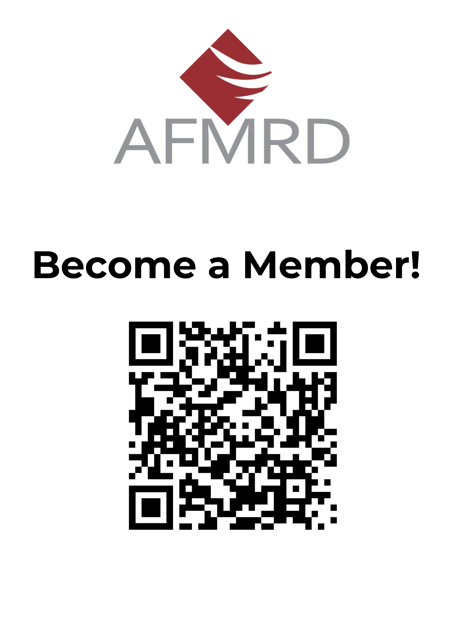

Welcoming all FM Program Directors and
Associate Program Directors

Slide 16
Questions?
Please enter your questions in the Q&A, found near the bottom of your screen. Attendees can upvote
or comment on questions currently in Q&A.

