Slide 1

Recommended Practices for
Assessing Procedural Competency
The Procedure Workgroup
Notes:
Welcome! My heart is full to see in real life so many of my AFMRD colleagues. So often we see each other just as names on our listserve or faces on webinars. It is a joy to share fellowship at RLS and especially during this next hour together, as we share a meal, celebrate successes from the year, and still get to Warren Newton's udpate from the ABFM on time!

Slide 2
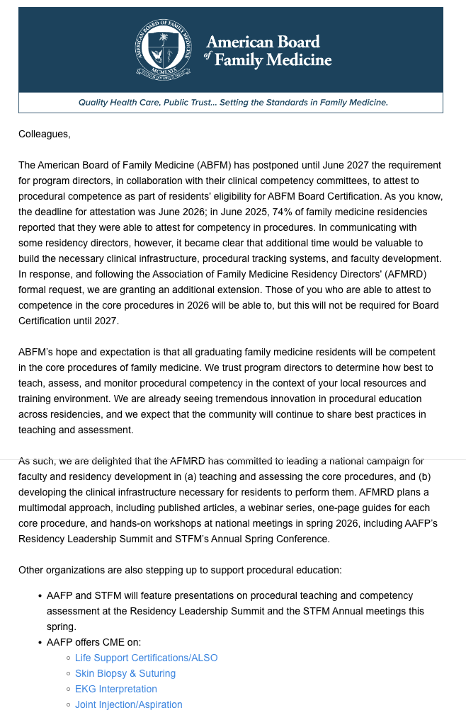
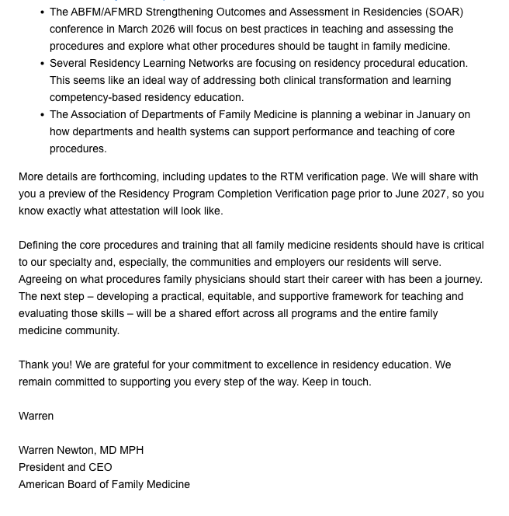
Postponement to 2027

Slide 3
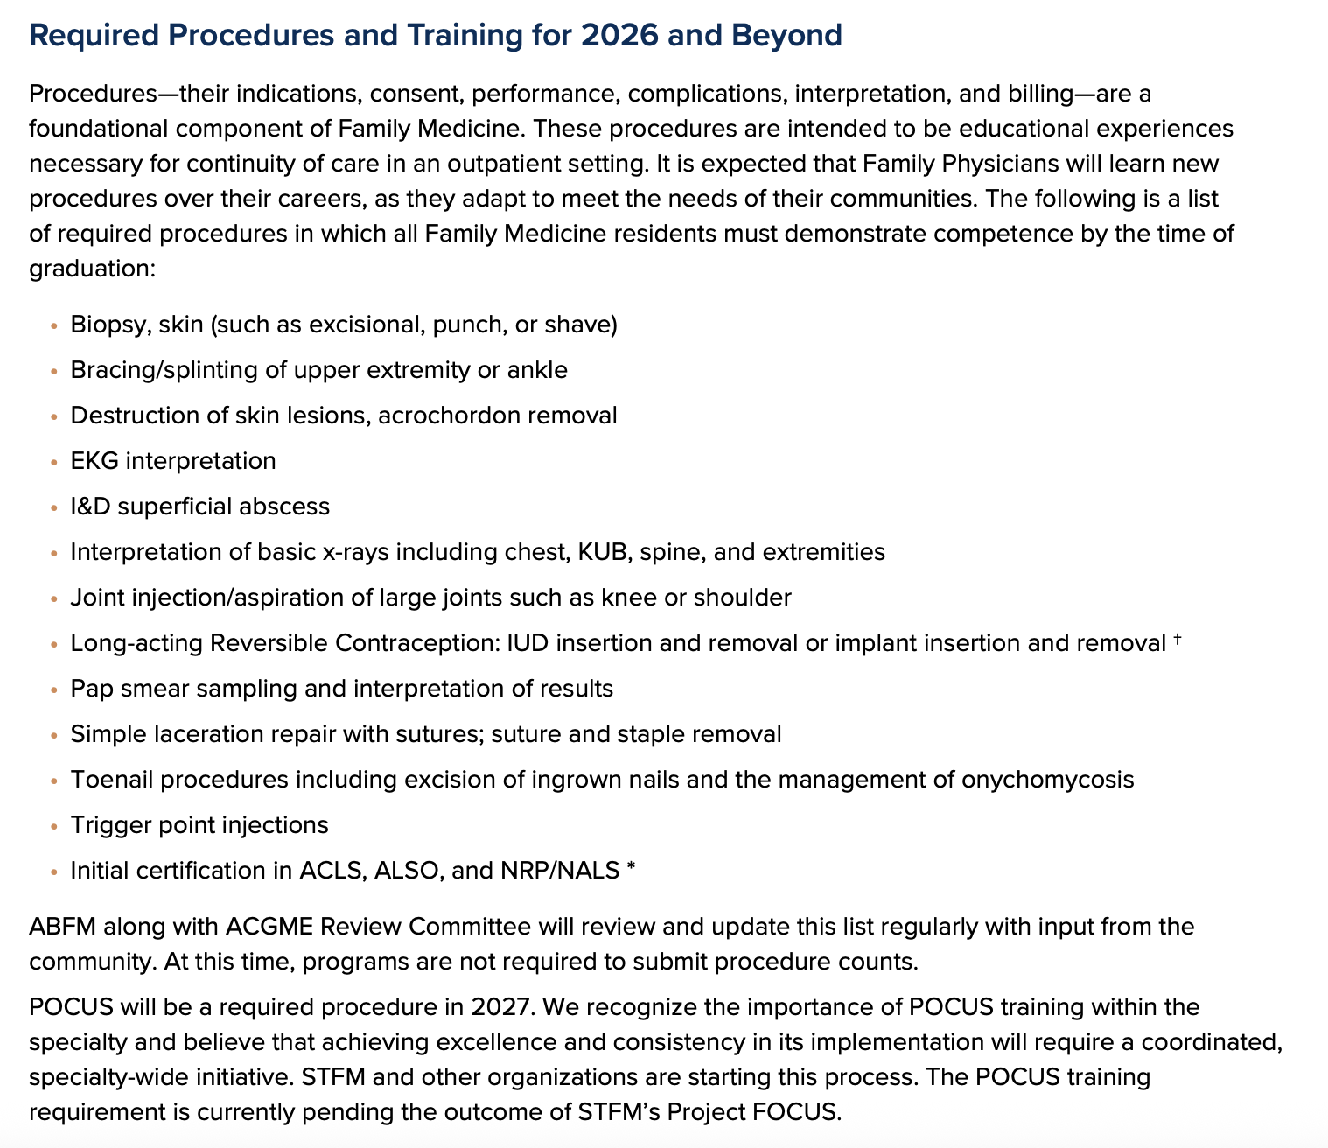
List of procedures

Slide 4
Why Procedural Competency Matters
Family physicians must perform procedures safely and autonomously.
Competency ≠ mastery; focus is on readiness, not perfection.
Aligns with lifelong learning and community-responsive care.
Notes:
Procedural competency is essential for family physicians. It ensures they can safely and autonomously perform procedures relevant to their practice, without needing to reach mastery during residency.

Slide 5
Understanding Competency
Includes judgment, autonomy, and help-seeking.
Mastery may come later through continued practice.
Learn to discern what to perform vs. refer.
Notes:
Competency involves more than technical skill—it includes judgment, autonomy, and knowing when to seek help. Residents must learn to decide which procedures to perform and which to refer.

Slide 6
Individualized Pathways to Competency
No fixed number of procedures guarantees competency.
Each resident progresses at a different pace.
Assess confidence in each procedural step.
Notes:
Each resident learns at a different pace. Competency can't be measured by a fixed number of procedures. We must assess confidence and skill in each step of the procedure.

Slide 7
Core Foundational Skills
Competency involves more than technical skill—it includes judgment, autonomy, and knowing when to seek help
Knowledge: indications, risks, complications.
Communication: education, consent.
Performance: technique, asepsis, teamwork.
Skills are transferable across procedures
Notes:
Foundational skills are the building blocks of procedural competency. These include knowledge, communication, and performance. Many skills are transferable across procedures.

Slide 8
Structured Individualized Pathways to Competency
No fixed number of procedures guarantees competency.
Each resident progresses at a different pace.
Assess confidence in each procedural step.
Combination of numbers (simulation and live), BSQs or other scales
Notes:
Each resident learns at a different pace. Competency can't be measured by a fixed number of procedures. We must assess confidence and skill in each step of the procedure.

Slide 9
Curricular Approaches
Traditional methods might not always work
Map where residents are exposed to procedures or procedural skills, and where supplements are needed
Use simulation, workshops, supervised practice.
Deliberate practice improves skill acquisition.
Notes:
Curricula must evolve beyond traditional methods. Simulation, workshops, and supervised practice provide structured opportunities for skill development and deliberate practice.
Simulation doesn’t have to be expensive – this is an opportunity to become creative in collaboratives with low fidelity models. It is also an opportunity to study what works when and how we get our faculty to the same place

Slide 10
Assessment Tools
Use PCAT, BSQ, and other structured tools.
Ensure objective criteria and consistency – requires a system.
Invest in faculty development and calibration.
Notes:
Assessment tools like PCAT and BSQ help standardize evaluations The workgroup has gathered some and we plan to hold a place in the PD toolbox that you can add additional or take and adapt for your settings. Faculty must be trained to use these tools consistently and objectively. What matters is your team knows how to use them and will judge the procedure the same way

Slide 11
Program Strategies
Ensure exposure via clinics, rotations, scheduling.
Combine didactics with clinical practice.
Support faculty development.
Notes:
Programs must create opportunities for residents to gain procedural experience. This may involve new rotations, procedure clinics, or creative scheduling solutions, additionaly simulation opportunities.
This is going to depend on your unique program – if you spend a lot of time in the OR, procedures with surgical subspecialties and with labor and delivery – you will find that you may need fewer of certain procedures to be
This
.

Slide 12
CAFM Consensus Statement 2019
Procedure Cluster | Procedure | Minimum Number
Anesthesia | Digital block | 3
Musculoskeletal | Upper and lower extremity splints/casts | 2 (including at least 1 upper and 1 lower extremity splint)
 | Injection/aspiration of joint, bursa, ganglion cyst, tendon sheath, or trigger point | 5 (including at least 1 knee and 1 subacromial/ subdeltoid bursa)
Skin | Removal of skin tags | 1 (or skin biopsy competency)
 | Biopsies (punch, shave) | 2
 | Excisional biopsy Destruction of skin lesion (including warts) | 3
 | using cryosurgery, RF/electrocautery, | 3 (each method)
 | chemical ablation, or intralesional injection | 3
 | Remove ingrown nail, or full toenail Incision and drainage of abscess, including paronychia | 3
 | Simple laceration repair with sutures | 3
Women's Health | Contraceptive implant insertion and removal | 1 following manufacturer training
 | Intrauterine device insertion | 3

Slide 13
Tools to Help
Collaboration across Organizations
Focused presentations/discussions at National Conferences
  RLS Preconference with expanded capacity for 175
AFMRD → PD Toolkit → Procedural Competencies 2027
  Standardized Summaries to help you craft your curricula

Slide 14
Purpose
Definition
Resources
Policy
Supervised Experience
Assessment of Competence
Faculty Role/ Sign- Off
PD Review and Documentation

Slide 15
Skin Biopsy Procedures
Purpose: to ensure residents develop procedural competency in skin biopsies-shave, punch and excisional through structured training, supervised practice and competency-based evaluation.
Definition: Skin biopsy is a diagnostic procedure involving removal of skin tissue for histopathologic analysis. Techniques include:
Shave biopsy: superficial sampling
Punch Biopsy: full thickness cylindrical sample
Excisional Biopsy: complete lesion removal with margins
Resource: American Family Physician Article with videos on shave and punch biopsy for skin lesions Shave and Punch Biopsy for Skin Lesions | AAFP
Policy: residents must complete required training and supervised procedures before performing independently. Competency is defined by skill, judgment and consistency- not solely by procedure count. Faculty must document direct observation and evaluation.
Supervised Experience: Didactic training on biopsy indications, techniques, and complications
Observation of at least 2 procedures
Performance of at least 5 skin biopsies (mix of 2 punch/shave and 3 excisional)

Slide 16
Assessment of competence:
Faculty will evaluate:
informed consent and knowledge of indications
Procedural set up and sterile technique
Anesthesia administration
Tissue handling, instrument use, and specimen management
Suturing and complication management
Post procedure care and documentation
Follow up and pathology review
Faculty Role and Sign-off
Faculty must directly observe and assess each procedure using a procedure competency assessment tool.
Upon satisfactory performance, faculty completes the skin biopsy competency sign off form.
Program Director Review and Documentation
Completed forms and direct observations on New Innovations are submitted to Program Director for review.
Competency logged in resident’s portfolio and milestone evaluation.
Competency will be formally reviewed during the semi-annual evaluations and CCC meetings
All documentation will be maintained in the resident’s portfolio and used to support milestone reporting and graduation readiness.

Slide 17
Conclusion & Recommendations
Focus on foundational skills and individualized learning.
Use structured curricula and validated tools.
Share and refine assessment tools across institutions.
Notes:
To ensure competency, programs should focus on foundational skills, structured curricula, validated tools, and faculty development. Collaboration across institutions is key.

Slide 18
Questions?

