Slide 1



National Graduate Survey 2026
What It Means & How To Utilize
Lars Peterson, MD, PhD
Wendy Barr, MD, MPH, MSCE
Barbara Miller, MD, FAAFP
Grace Yu, MD
Melissa Keller, MS, MBA,C-TAGME

Slide 2
Disclosures
Dr. Peterson works for the American Board of Family Medicine, which administers the National Graduate Survey.
Dr. Barr is supported by the American Board of Family Medicine Foundation.

Slide 3
Objectives
Give an overview and history of the National Graduate Survey (NGS).
Demonstrate the NGS reports inside RTM.
Discuss how NGS data can be used for program evaluation, recruitment, and advocacy.
Review research highlights from the NGS data.
Discuss challenges the NGS is facing and how to increase its usefulness to residencies.

Slide 4
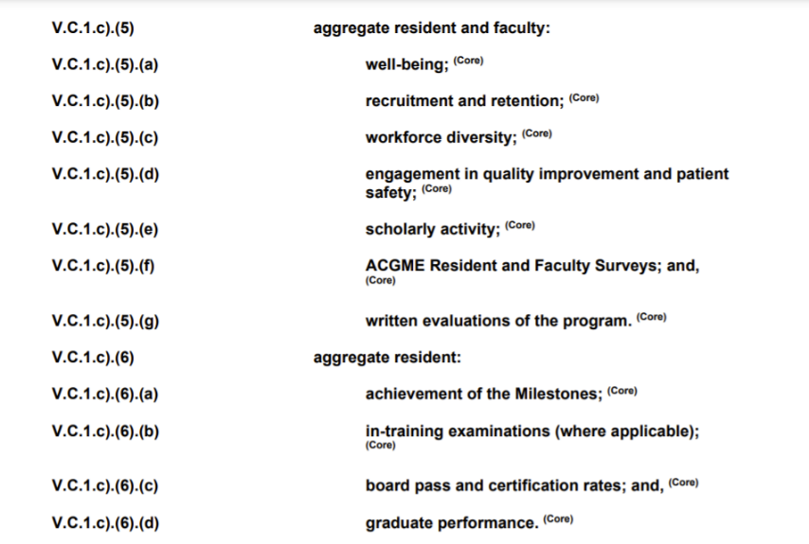
Notes:
Note the 2014 era ACGME requirements call out that resident should be surveyed.
2020 era requirements state that “graduate performance” must be used in annual program evaluation.
2024 requirements also state that “graduate performance” must be included in the APE.

Slide 5
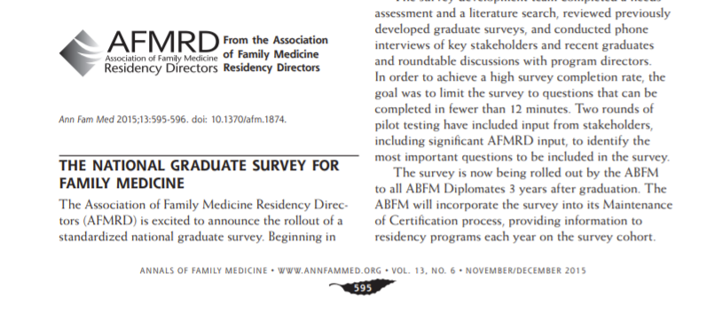
Notes:
After this paper came out, conversations lead to a meeting, of course in KC, of stakeholders including members of “the family” and the ACGME.
A steering committee created an RFP and the UW team won the contract and crated the survey in 2015.

Slide 6
Continued AFMRD and ABFM Partnership
AFMRD appointed advisory committee
Meets annually
  Usually at RLS
Reviews content and performance
Advises changes

Slide 7
NGS Limitations
ABFM privacy policy mandates that residency specific reports are censored unless there are ≥3 respondents in a year
  Small programs were disadvantaged
3 year lag until getting data from graduates
  New programs are disadvantaged
Until 2022 reports were an annual static PDF

Slide 8
Notes:
Increase response rate
National comparisons
Meet ACMGE program requirements
Hope data are used to help residencies improve training to meet their mission

Slide 9
NGS Response Rate and % Programs Getting Annual Reports

Slide 10
Many Programs Aren’t Accessing Their Reports
Notes:
As of Feb 6, 2024

Slide 11
Year | Responses | Eligible | Response Rate
2016 | 2,069 | 3,051 | 66.5%
2017 | 2,159 | 3,271 | 66.0%
2018 | 2,255 | 3,338 | 67.6%
2019 | 2,511 | 3,414 | 73.6%
2020 | 1,683 | 3,442 | 48.9%
2021 | 1,623 | 3,610 | 45.0%
2022 | 1,748 | 3,745 | 46.7%
2023 | 1,816 | 3,903 | 46.5%
2024 | 1,468 | 4,126 | 35.6%
2025 | 1,351 | 4,255 | 31.8%
YEAR | PROGRAMS WITH ELIGIBLE GRADUATES | PROGRAMS RECEIVING SPECIFIC REPORTS | PERCENT OF PROGRAMS RECEIVING SPECIFIC REPORTS
2016 | 439 | 376 | 85.6%
2017 | 441 | 376 | 85.2%
2018 | 457 | 394 | 86.2%
2019 | 460 | 418 | 90.9%
2020 | 474 | 328 | 69.2%
2021 | 513 | 305 | 59.5%
2022 | 495 | 320 | 64.6%
2023 | 537 | 344 | 60.0%
2024 | 592 | 274 | 46.3%
2025 | 620 | 229 | 36.9%

Slide 12
Efforts to Reverse the Trend
Promoting on AFMRD listserve
Workshops at RLS
Improved ABFM communications and email reminders
This webinar!
New (in 2026) Self-Assessment Activity available after completing NGS
  2.5 points

Slide 13
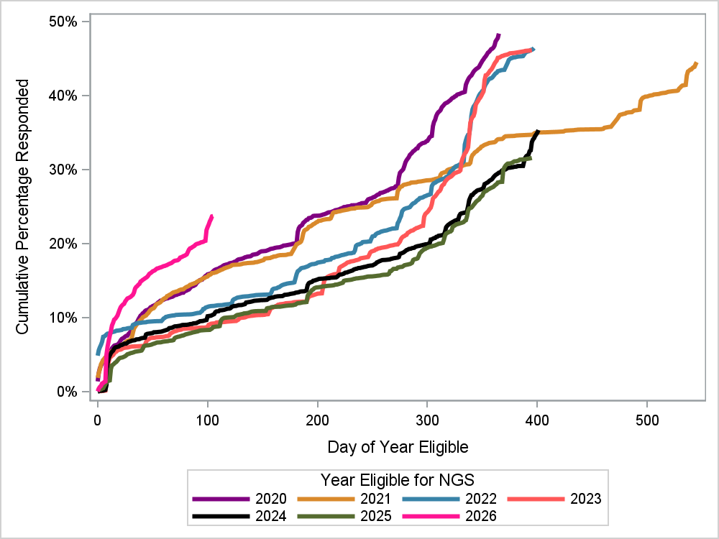
2026!!!!
Notes:
Already a 23% response rate! In April..
As of 6/4.. Now 27.9%

Slide 14
3 reports are available
2025 Annual report
  2025 (2022 residency graduates) data compared to national
2016 to 2025 program report
  All years collapsed together…
  ensures all programs get data
Trending Report
  Will only show data for years with ≥3 responses
Notes:
Diana..

Slide 15
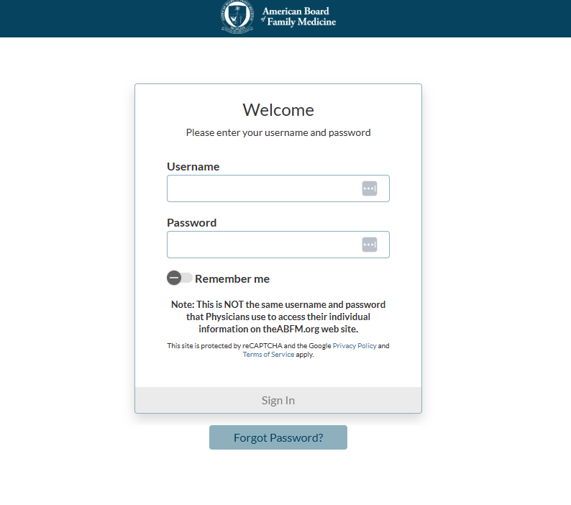
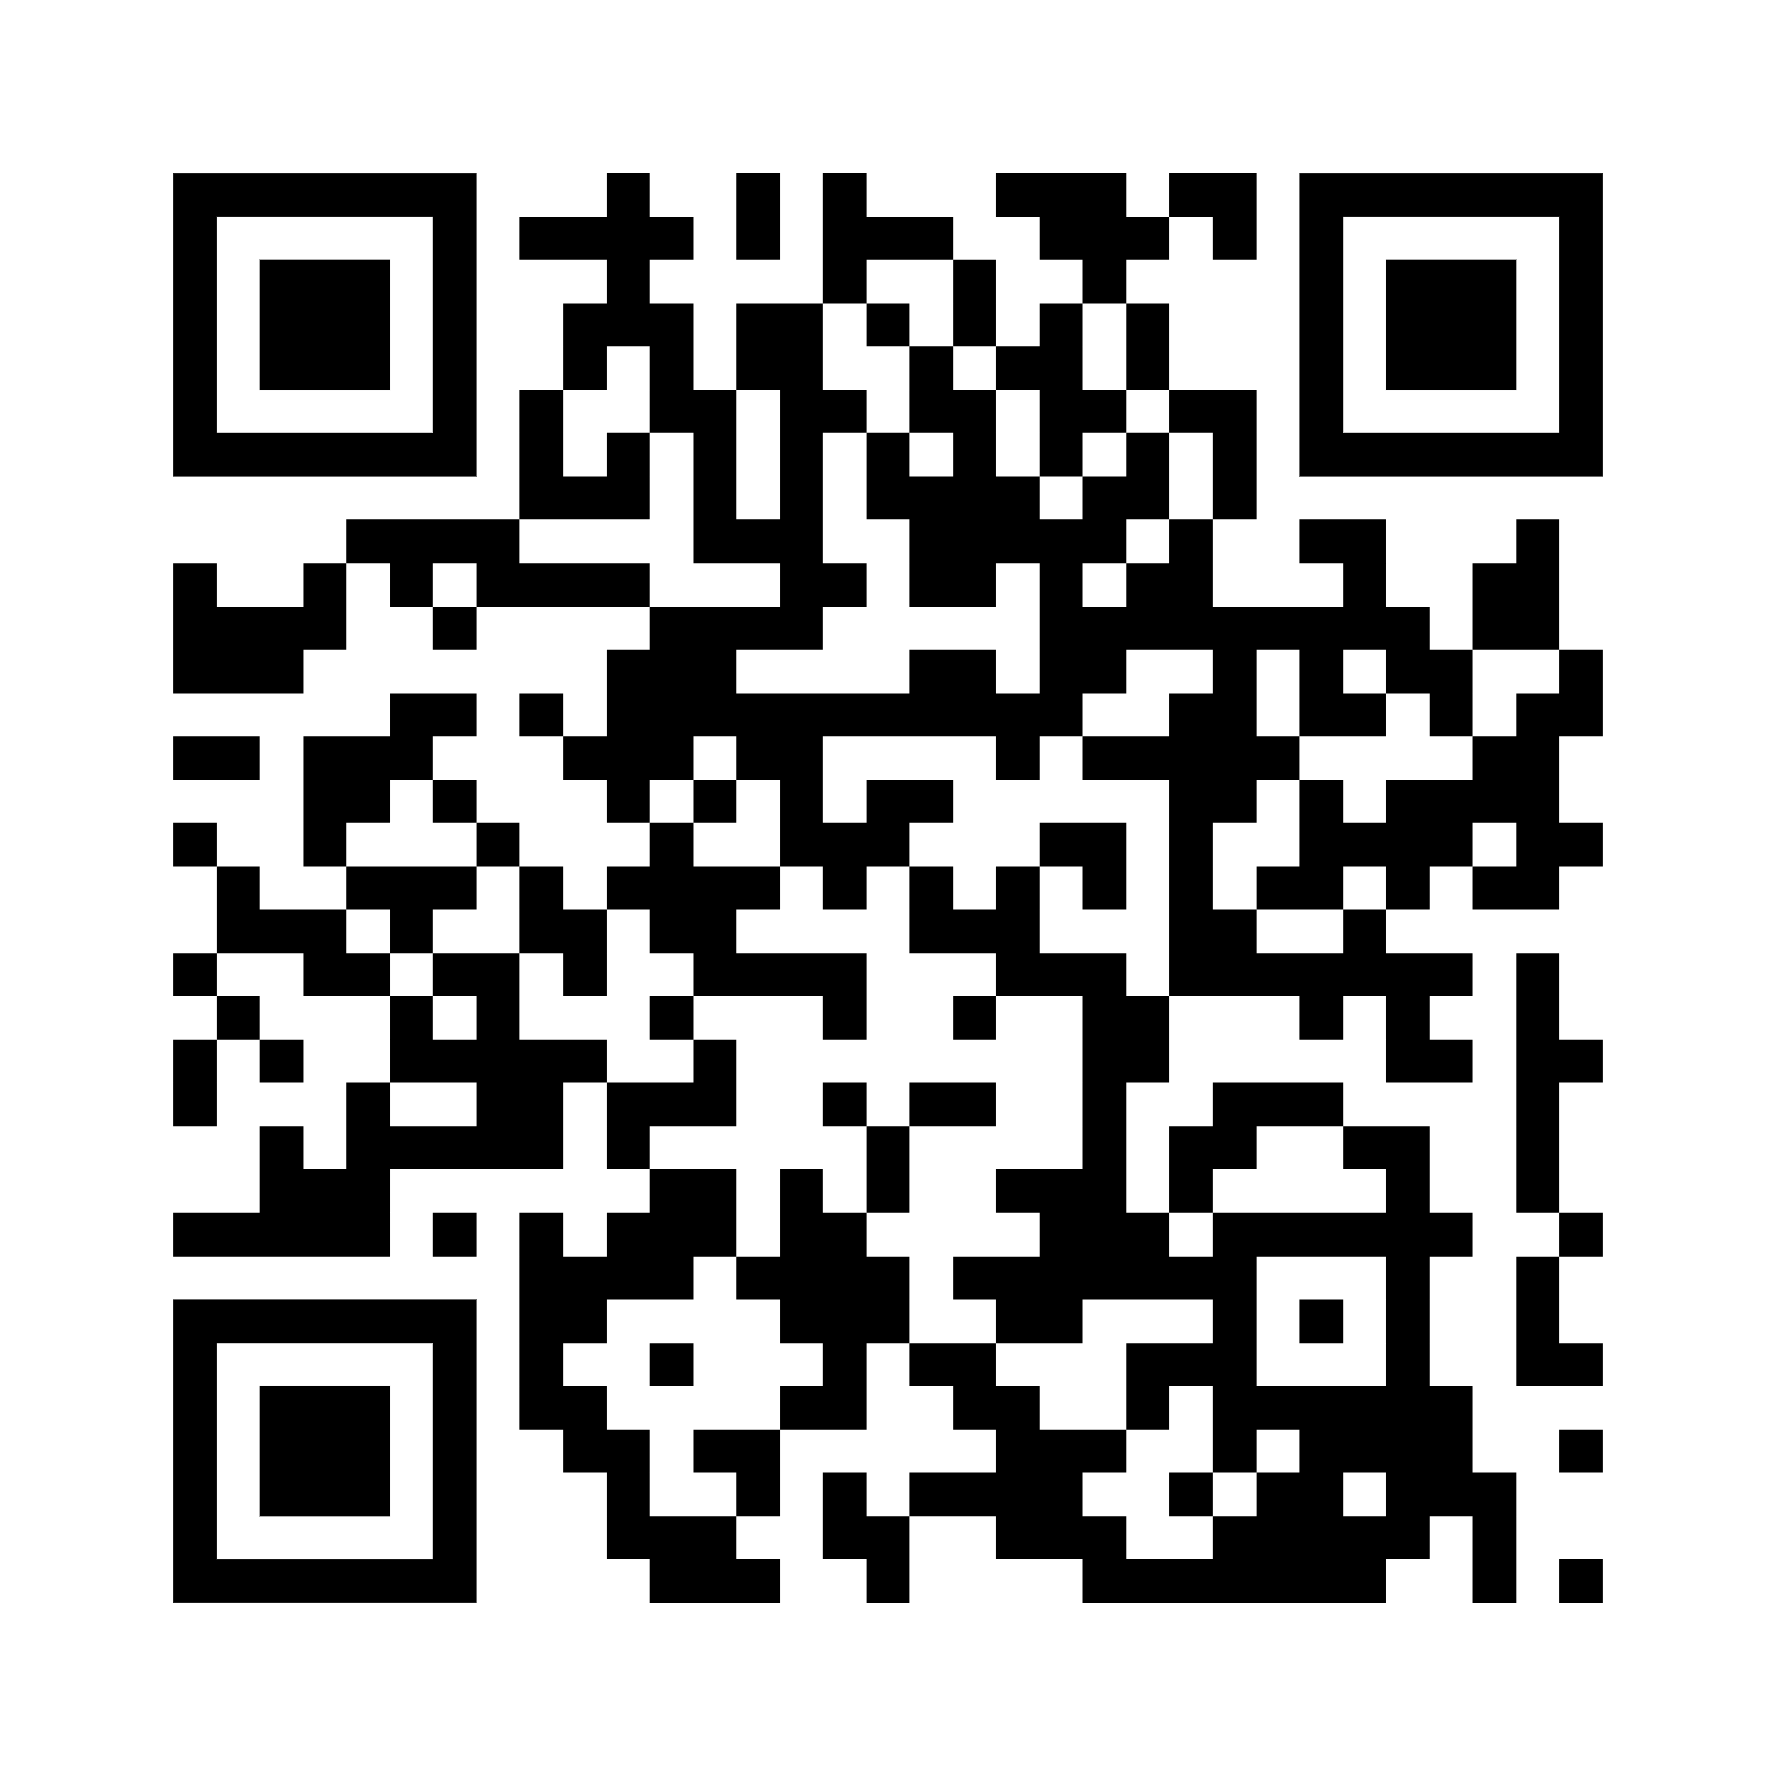
ABFM’s Resident Training Management System (RTM)
https://rtm.theabfm.org
Notes:
Diana..

Slide 16
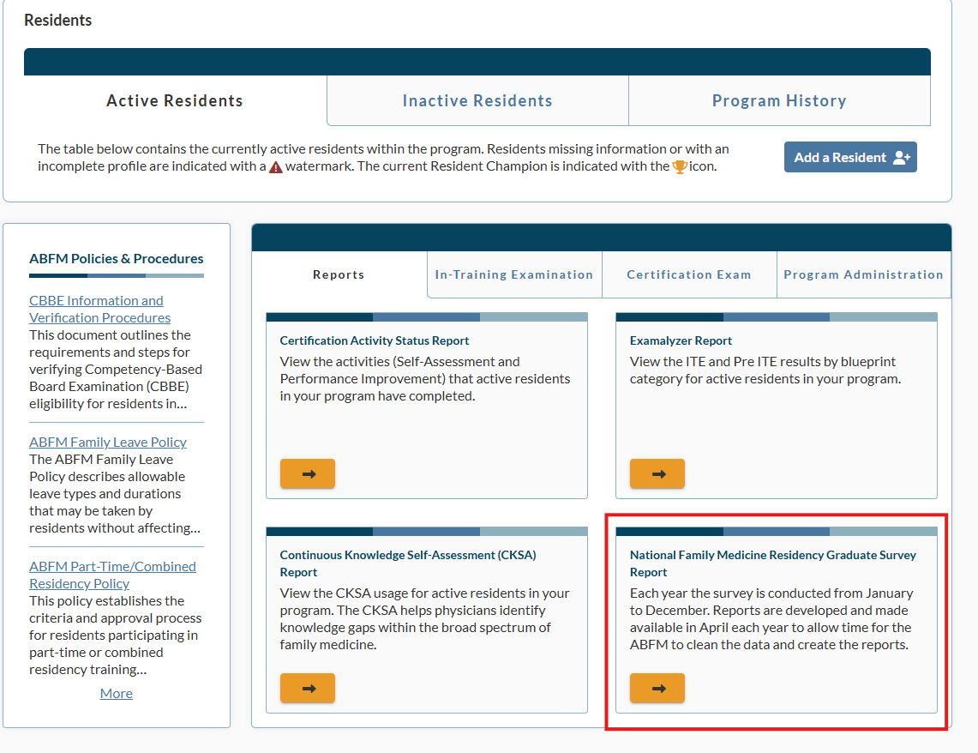
Where to get the reports….
Notes:
Diana..

Slide 17
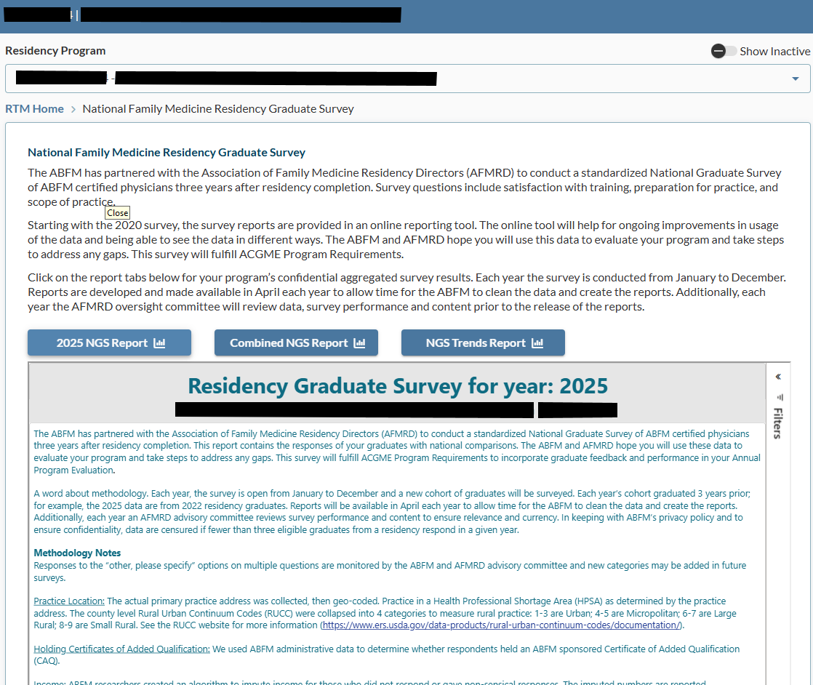

Slide 18
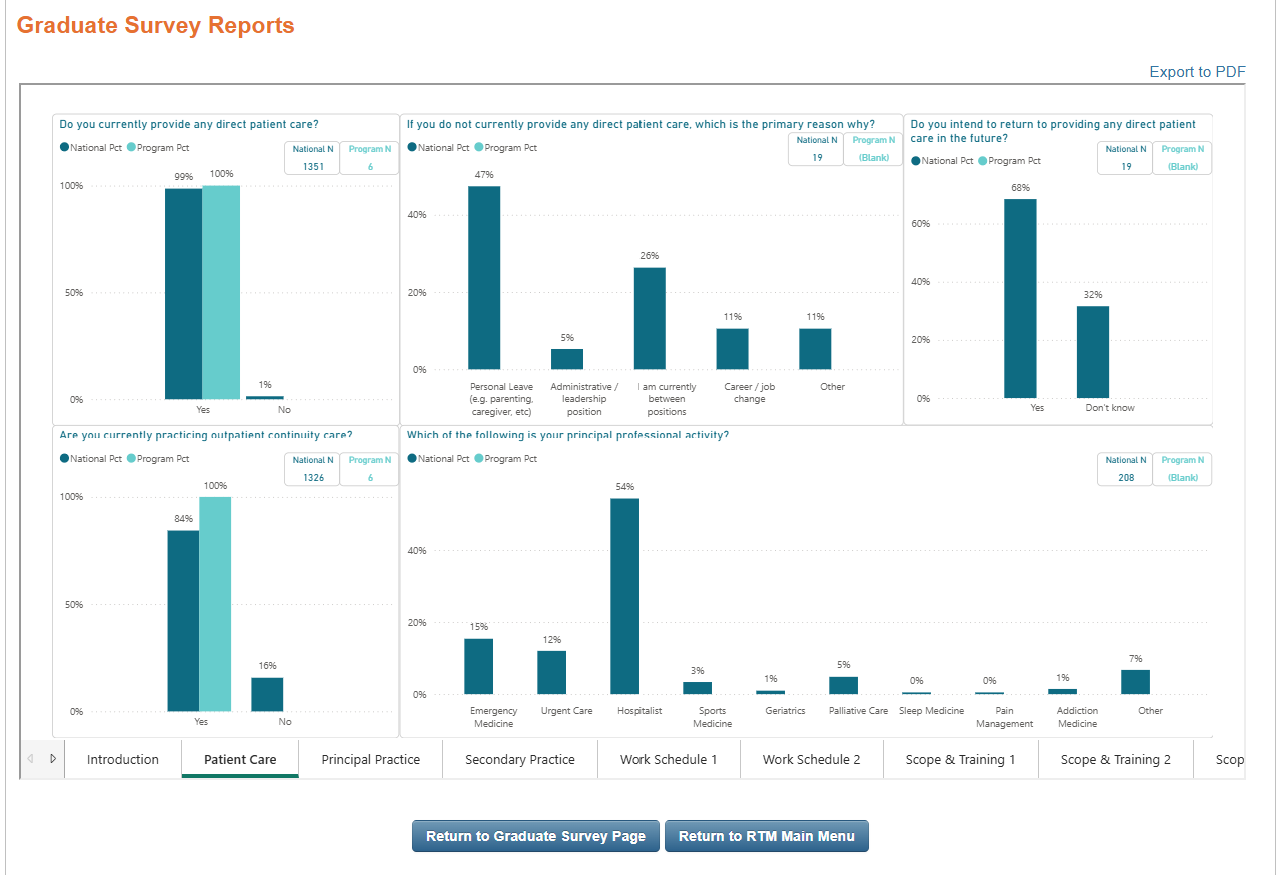
Annual Report

Slide 19
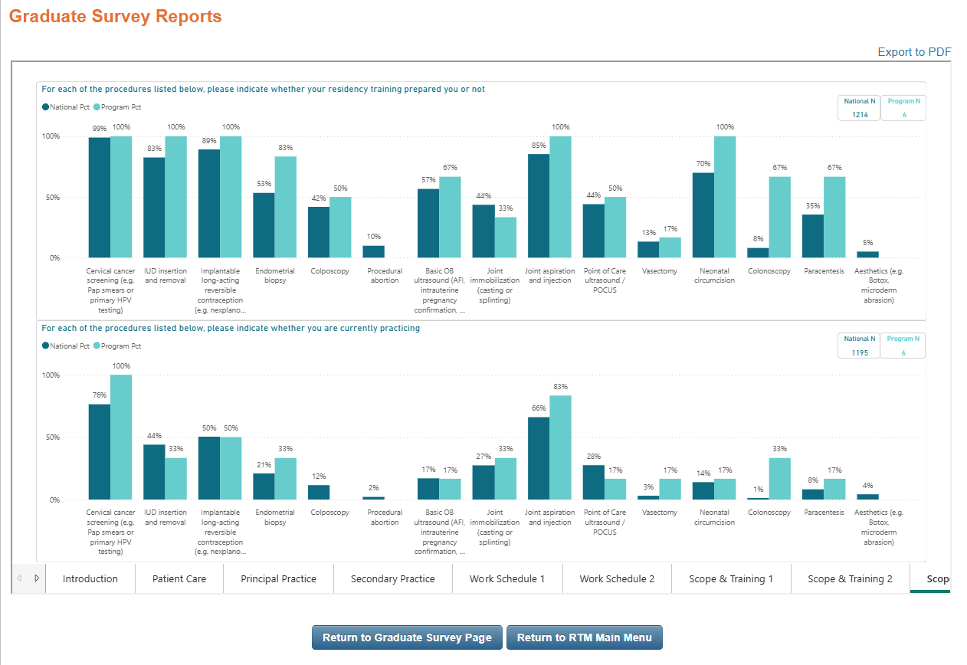
Annual Report

Slide 20
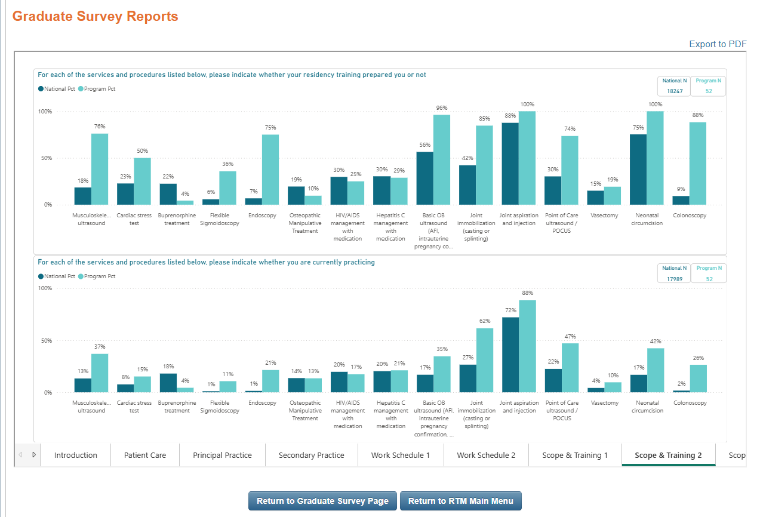
Combined Report

Slide 21
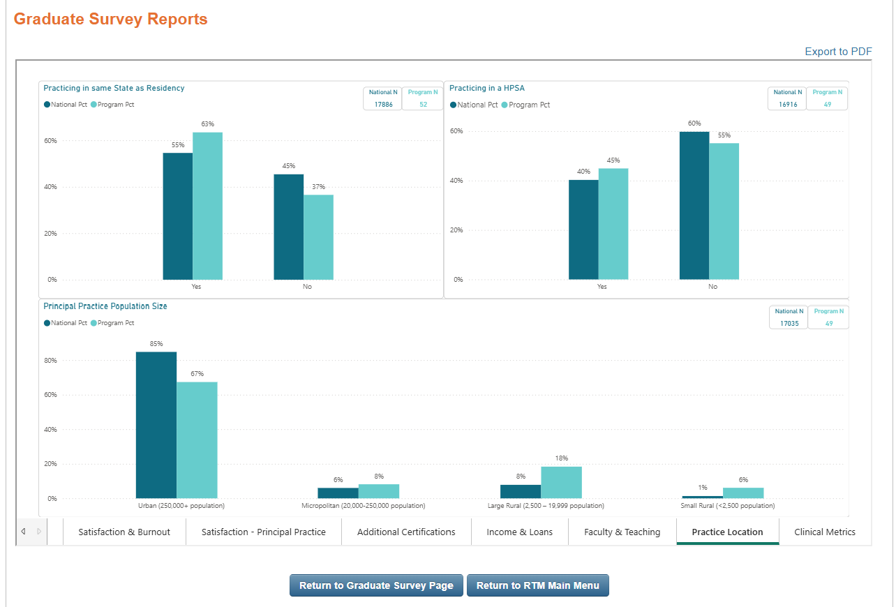
Combined Report

Slide 22
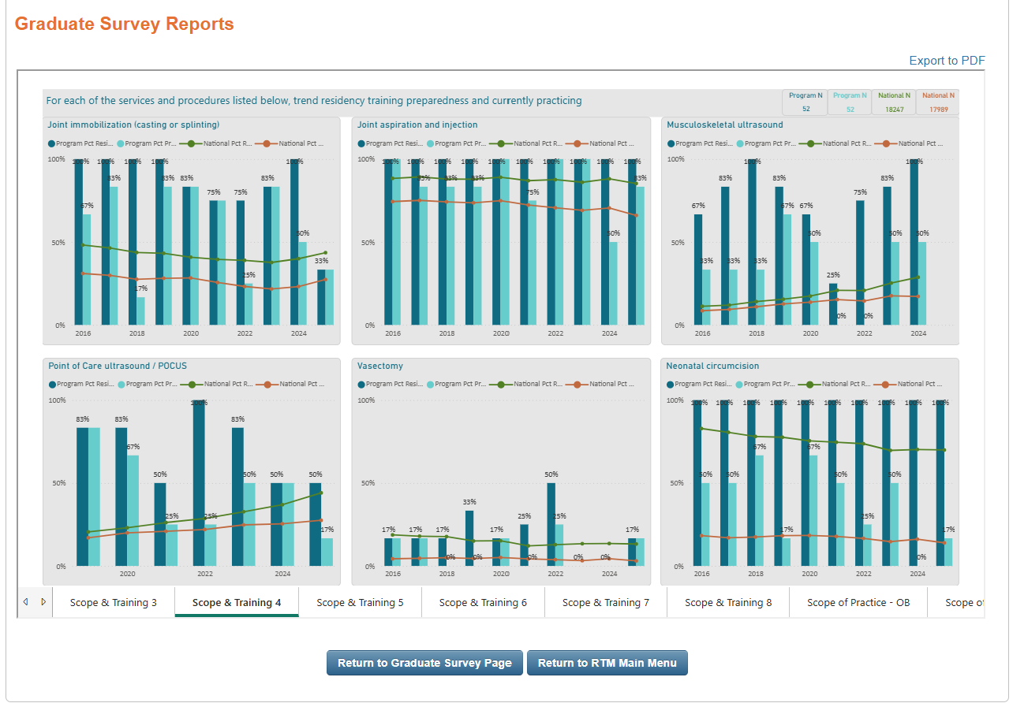
Trends
Report

Slide 23
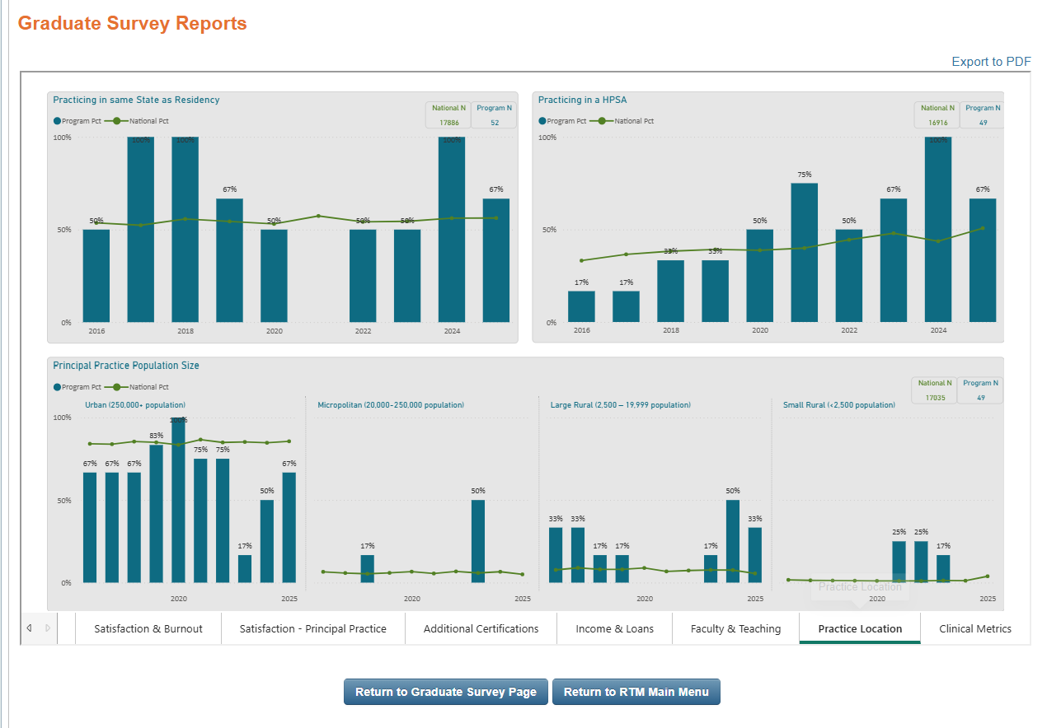
Trends
Report

Slide 24
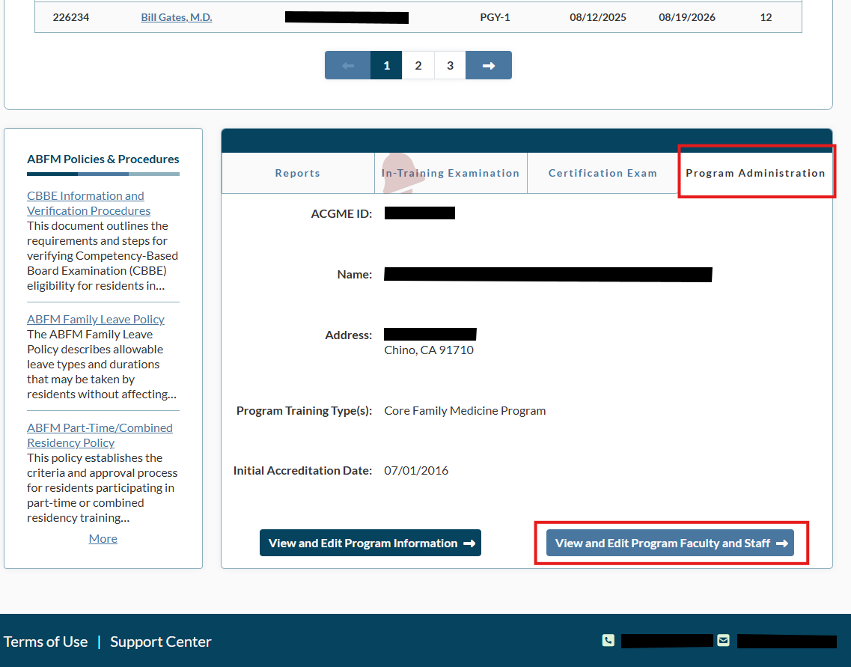
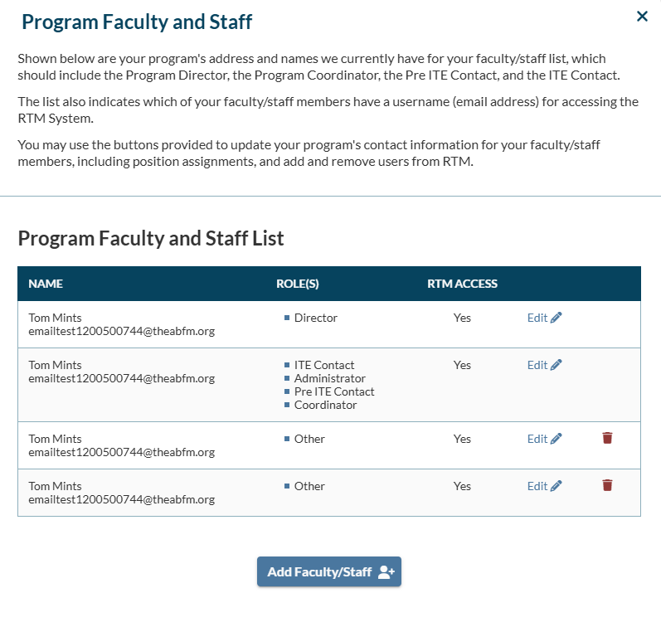
How to add additional people to access RTM

Slide 25
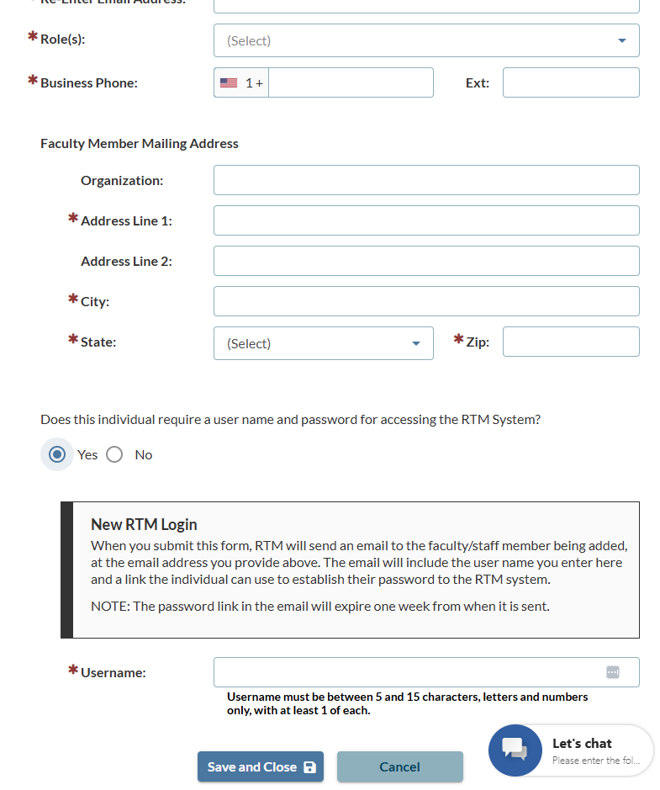
Enter their information, then be sure to create an individual login for each user.

Slide 26
How Can NGS Data Help My Program?

Slide 27
So Many Ways…….
Resident Recruitment
Program Improvement
Annual Program Evaluation (APE)
Advocacy for your program
Resident and Faculty Scholarship

Slide 28
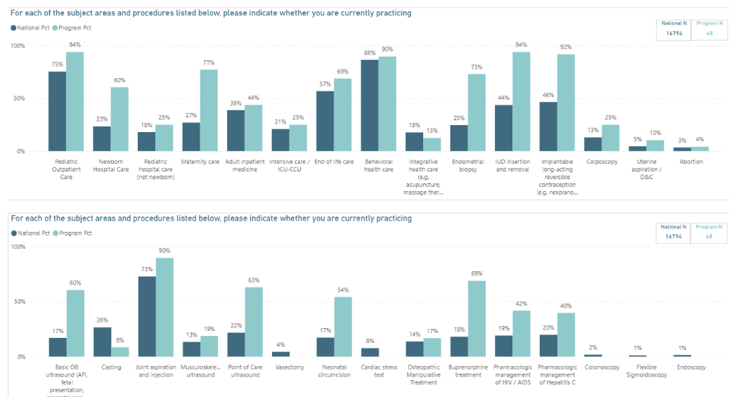
Resident Recruitment
Medical students want to know what your graduates are doing
NGS provides transparency
  Where do graduates practice
  Scope of Practice of graduates
  Satisfaction with training
  Reported salaries of graduates
Even place it on your website!
https://glfhc.org/alumni/

Slide 29
Using Graduate Data to Improve Your Program
Share the annual data with faculty and residents
Reflect on whether the results are consistent with your program aims and mission
Consider what was happening in program 3-5 years prior
Look at trends
Ways to use data in PEC
Reinforce things that are going well (having good outcomes)
Help prioritize areas for improvement

Slide 30
Theoretical Example
NGS shows that your program has
  High percentage of graduates deliver babies and provide maternity care
  High percentage of graduates who do inpatient adult medicine
  100% graduate satisfaction with training
Your residency curriculum for years has included 5 months of OB
A group of residents and faculty are advocating to decrease this by 2 months. This time would shift so 1 month goes to inpatient medicine to help with workload on this service. The other month to increase elective time from 6 to 7 months.
How can your NGS data help to inform this discussion?

Slide 31
Theoretical Example
NGS shows that your program has
  Low percentage of graduates caring for children
  Low percentage of graduates staying in the state
  A lower than national average satisfaction with your training program
Your residency curriculum meets ACGME minimums for block time in pediatrics. Your clinic has <5% of patient under the age of 10.
Most recent CHNA for your region identified need to increase access to pediatrics care. Several local pediatric practices are losing clinicians due to retirement.
How can your NGS data help to inform this discussion?

Slide 32

Incorporate in Your Annual Program Evaluation (APE)
Meets requirement to look at graduate performance and satisfaction
Align elements of NGS with program aims

Slide 33
Program Advocacy
Local Advocacy to Sponsoring Institution
Show where people are practicing
Scope of practice
Satisfaction with training
Legislative and Community
Scope of practice to meet specific community needs
Locations of practice (FQHCs and rural)
Primary care workforce
Notes:
Wendy..

Slide 34
Scholarship about Your Program
Evaluate the long-term impact of a curricular change
Evaluate the long-term impact of your program

Slide 35
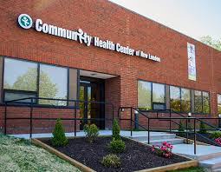
Theoretical Example
Program moved FMP from hospital-based clinic to and FQHC
Look for changes in the number of graduates working in FQHCs and underserved/rural clinics for graduating classes after the change

Slide 36
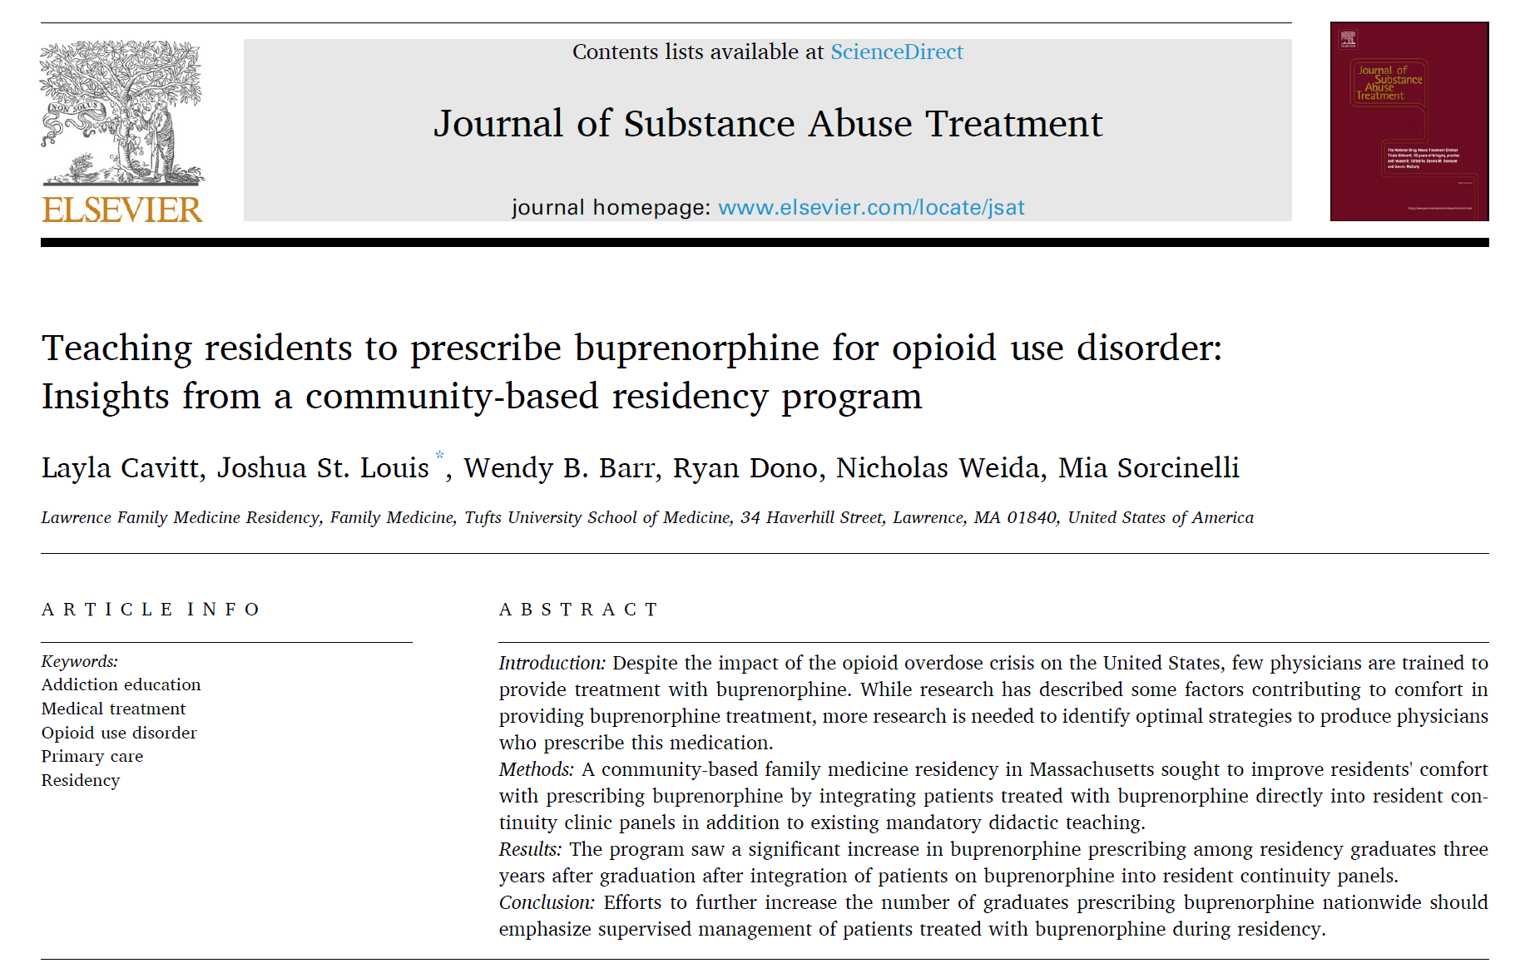
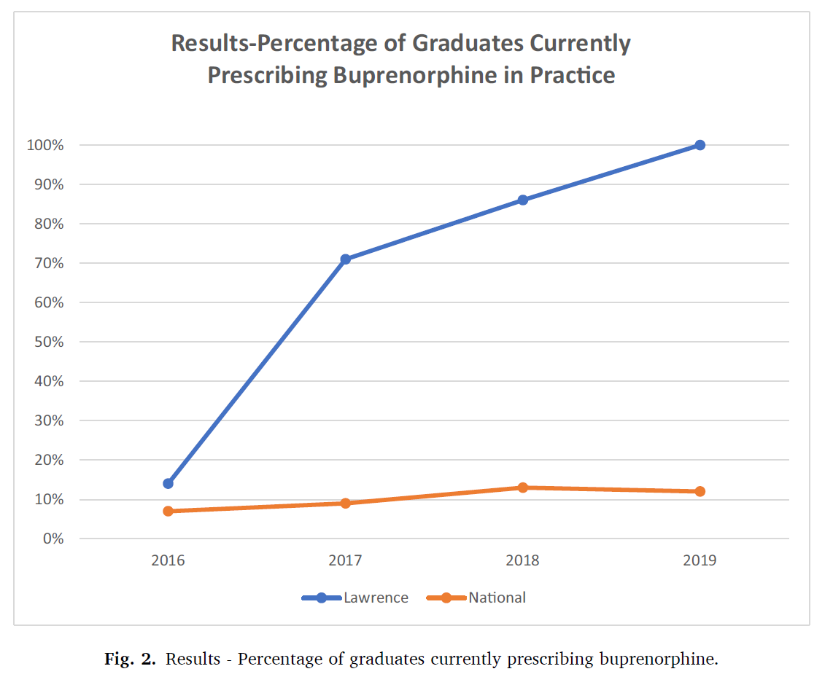
Scholarly Activity about Your Program
Notes:
Wendy..

Slide 37
Research Using the NGS

Slide 38
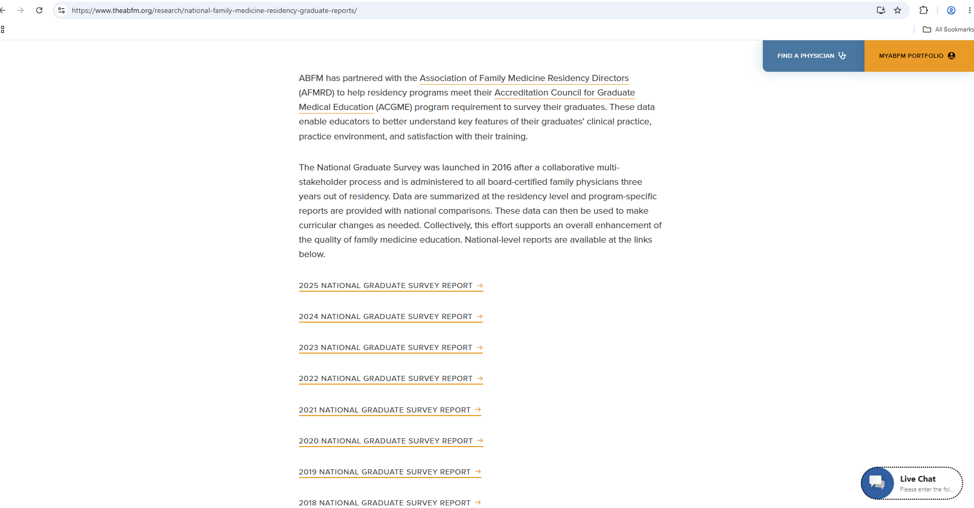
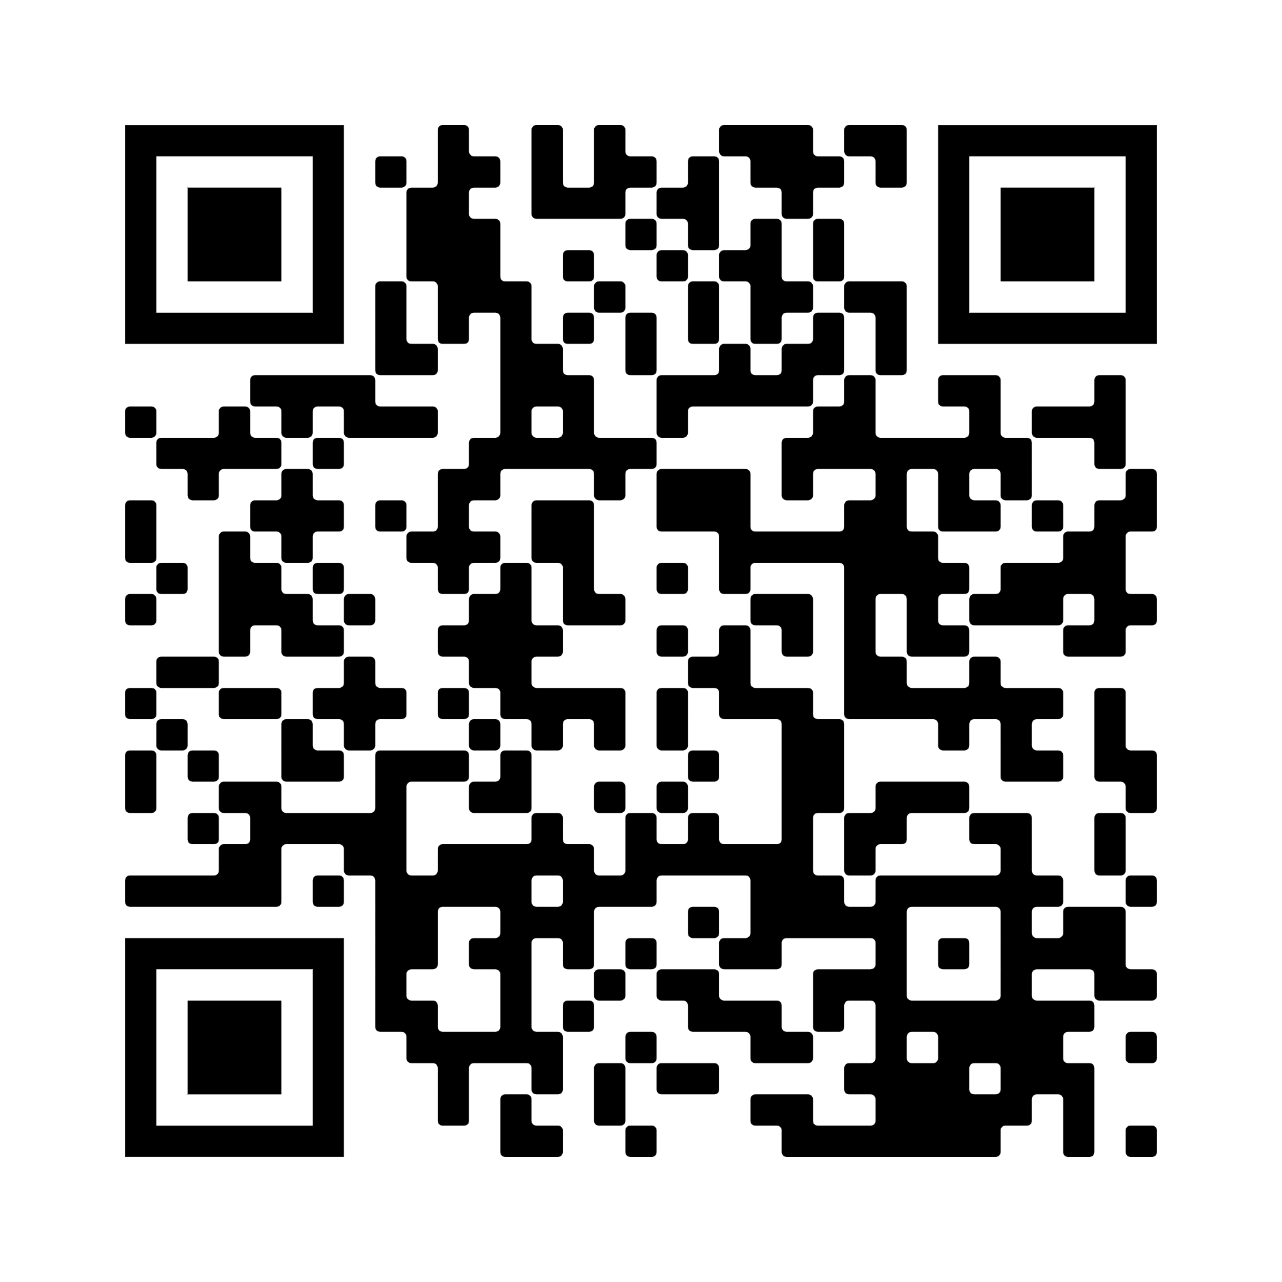
Notes:
National level reports have been made available on the ABFM website

Slide 39
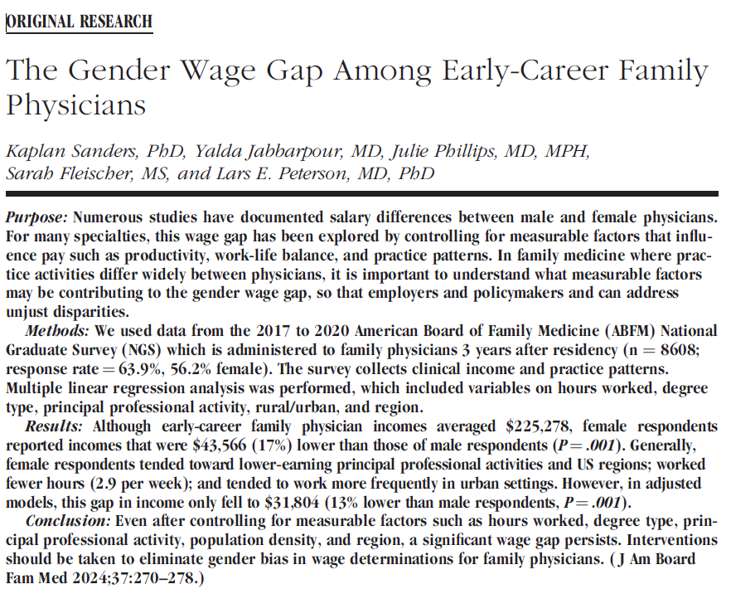
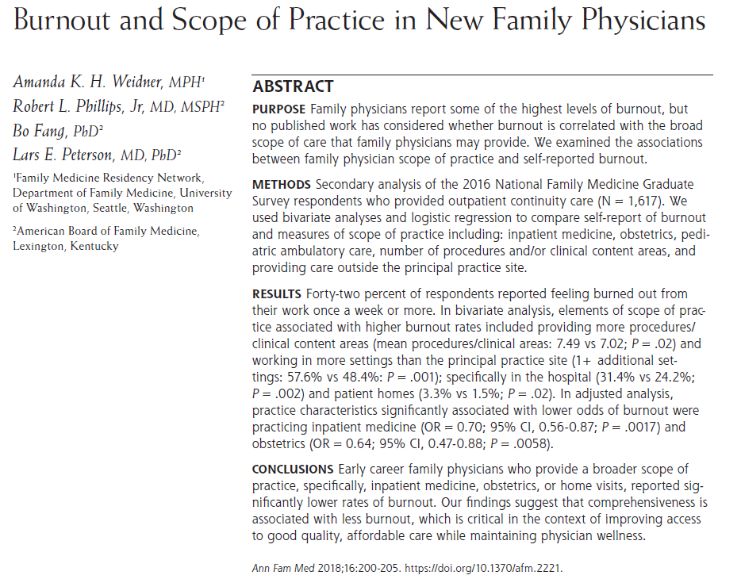
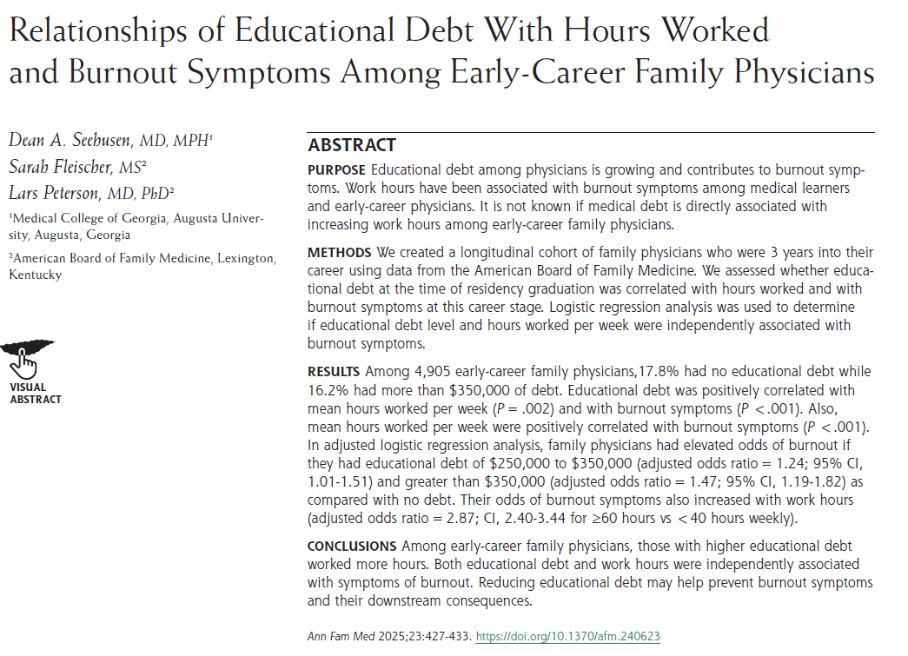

Slide 40
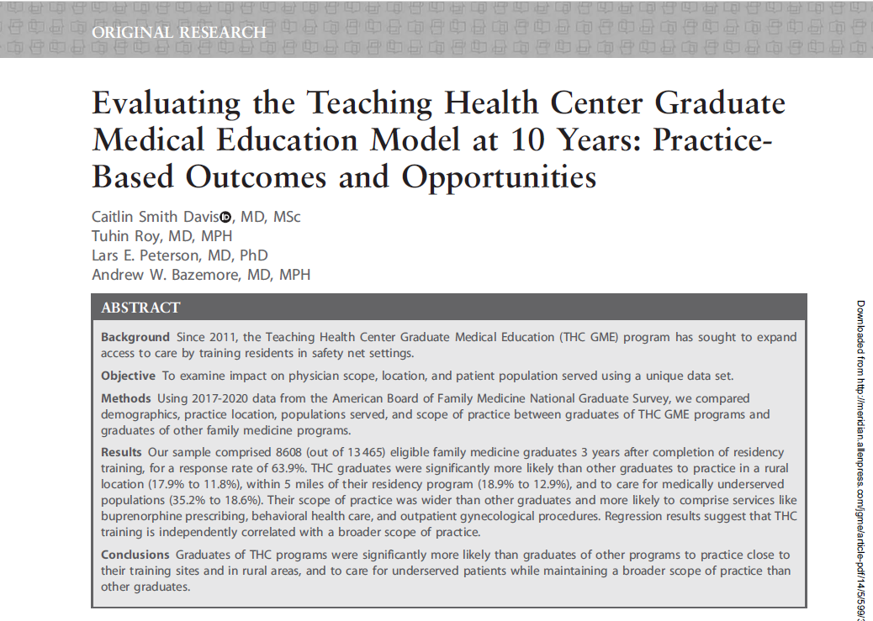
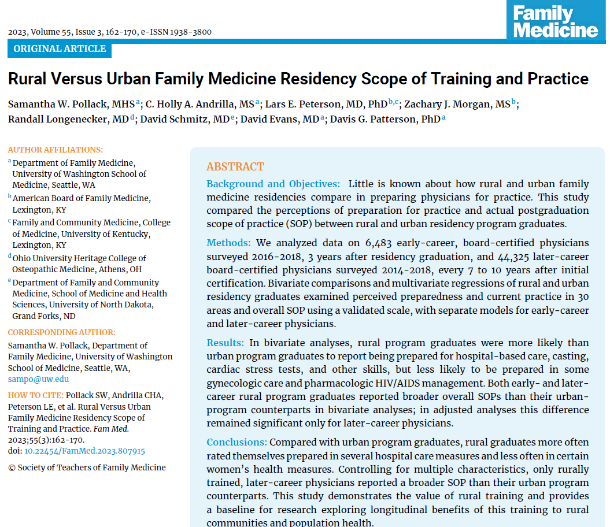
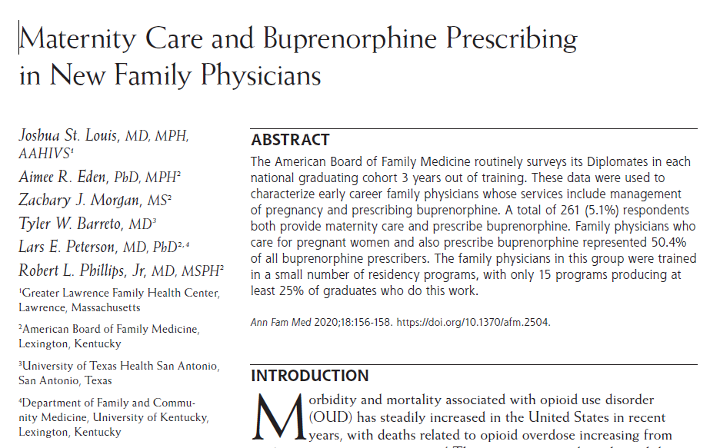

Slide 41

A first prospective study of residency outcomes in family medicine
Exposures =
Residency Program (2014/2015 – 2018)
Measure with CERA Program Director Survey with ACGME Program IDs in Summer/Fall of 2018 (frame questions for Class of 2018)
Outcomes =
Family Medicine Residency Graduate Outcomes
(3 years post residency)
Measure with National Graduate Survey of Class of 2018 (administered in 2021/2022)

Slide 42





Acknowledgements – The FM-ROP Team
Stephanie Rosener, MD, IBCLC – Pregnancy Care CERA Project
John Malaty, MD – Practice Management Curricula CERA Project
Amanda Weidner, MPH – Resident Wellness and Burnout CERA Projects
Brandon Brown, MD, FHM – Inpatient Adult Medicine CERA Project
Anastasia Coutinho, MD, MHS – Resident Wellness and Burnout CERA Projects
Wendy Barr, MD, MPH, MSCE– FMROP co-PI
Sarah Fleischer, MS – FMROP Data Analyst

Slide 43
FM-ROP High Level Positive Findings
Adult Inpatient Care
  + association; 9+ months inpatient
Burnout
  + intern workload > 60 hours / week
Buprenorphine
  + ≥6 faculty prescribing
Deliveries
  + Volume (80+ vaginal; 100+ cesarean); ≥6 faculty delivering
Care of Children
  + >10% of continuity clinic visits under age 10 years; 2+ faculty doing peds inpatient

Slide 44

SOAR Scholar Research Using NGS

Slide 45
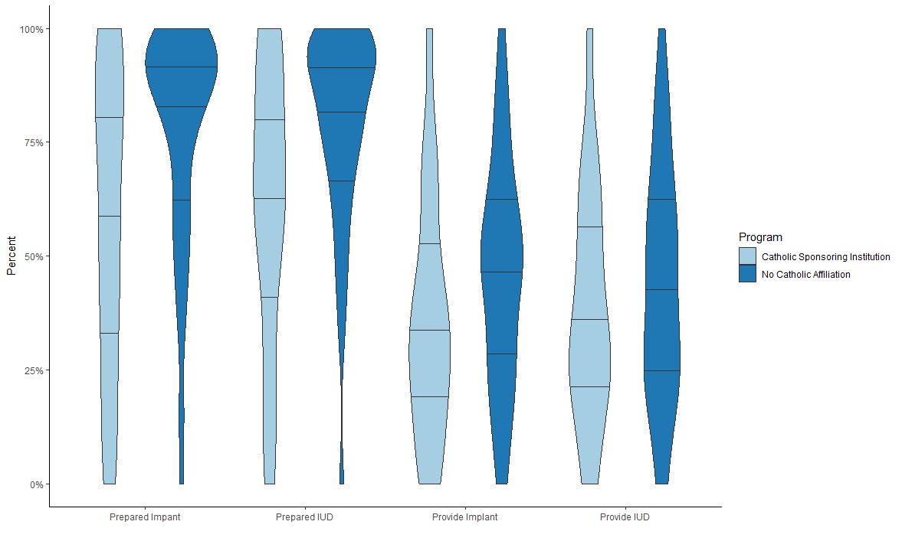
Bivariate Analysis
Prepare | Catholic Affiliation | No Catholic Affiliation
IUD | 64.9% | 82.8%
Implant | 55.9% | 81.2%
Provide | Catholic Affiliation | No Catholic Affiliation
IUD | 43.2% | 55.4%
Implant | 44.6% | 56.8%

Slide 46
Logistic Regression Results
 | Odds Ratio Provision of IUD | Confidence Interval | Odds Ratio Provision of Implant | Confidence Interval
Catholic Affiliation | 0.61 | 0.41 – 0.90 | 0.48 | 0.33 – 0.69
More likely to provide LARC if female, less than <38, not an IMG, working at an academic health center, FQHC, Rural health center
Less like to provide LARC if practicing in the South or West, or practicing in a metropolitan area

Slide 47
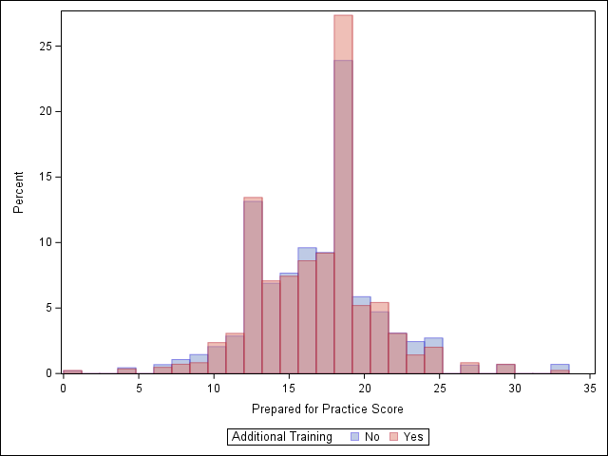
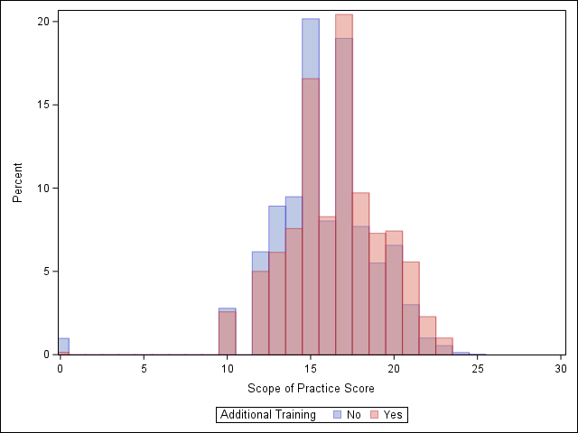
Variation in Scope Provision and Preparedness by Interest in Additional Training

Slide 48
Variation in Preparedness and Provision by Milestone Ratings

Slide 49
Q&A

Slide 50
Thanks!
Further questions?
Lars Peterson lpeterson@theabfm.org

