Slide 1
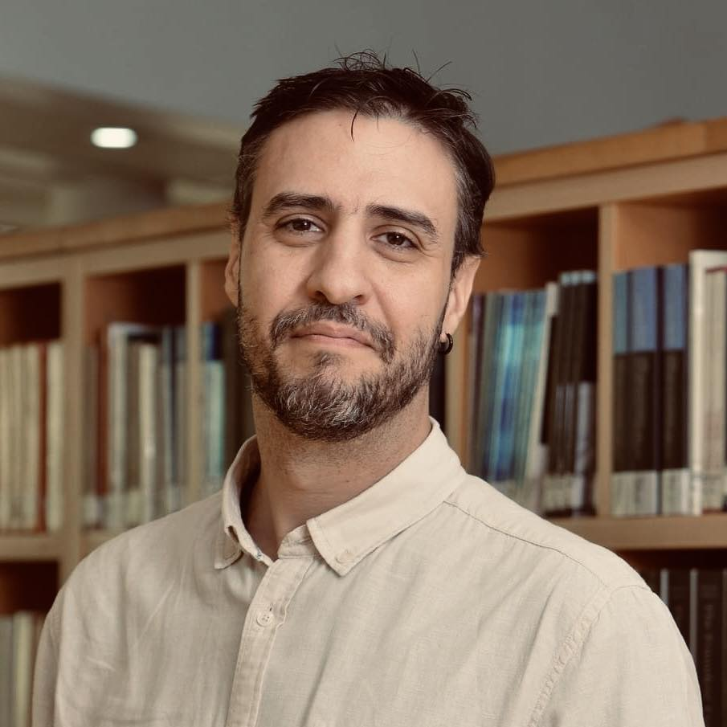
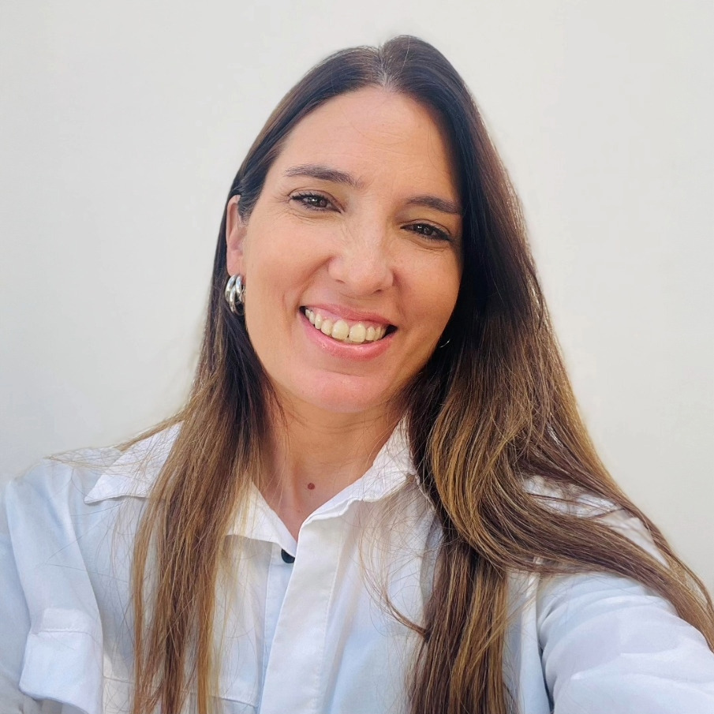
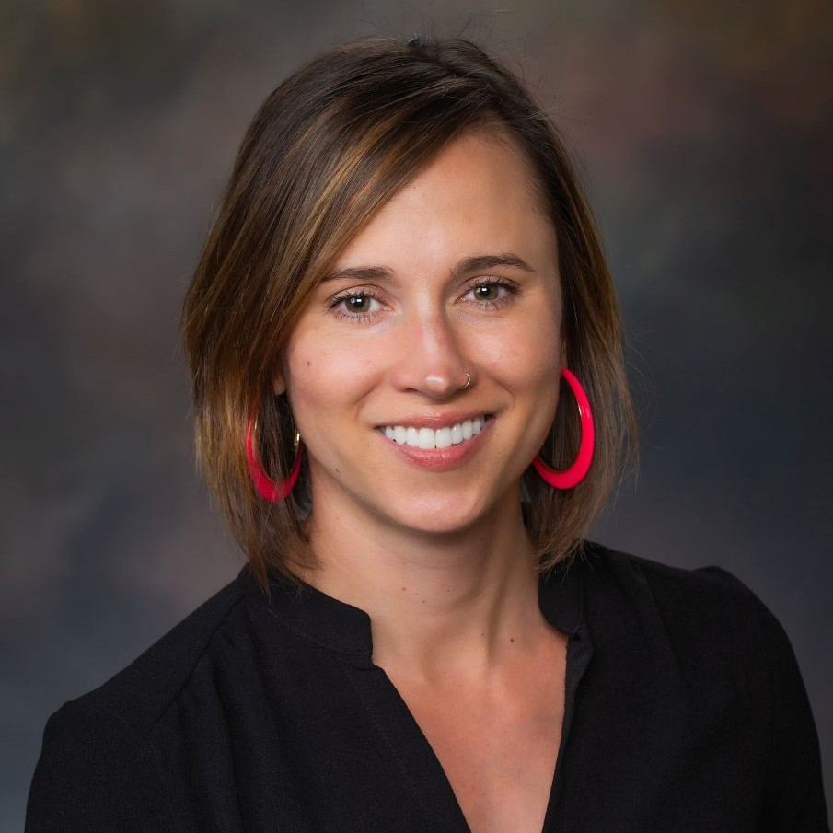
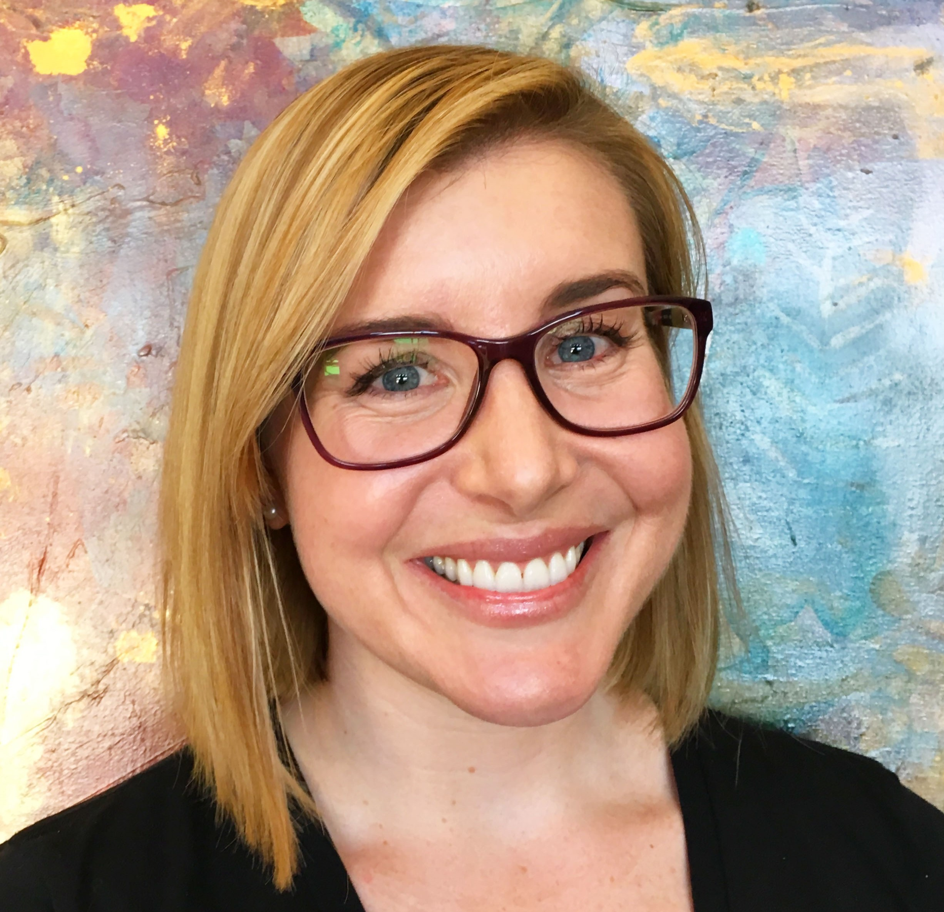
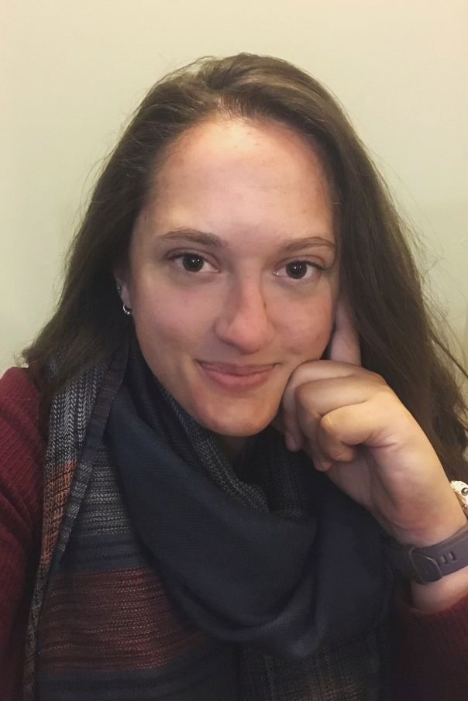
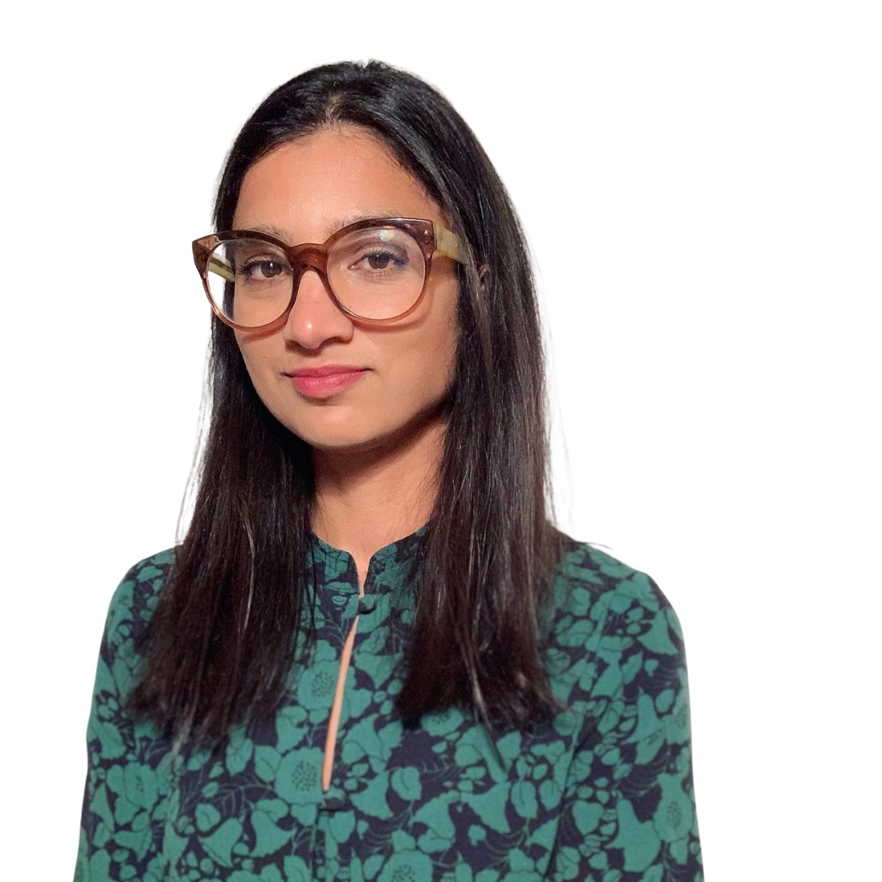
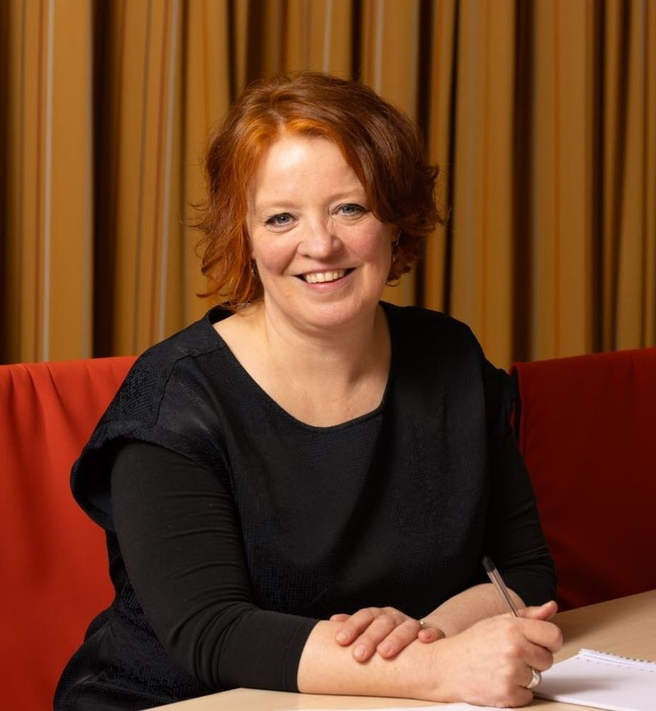
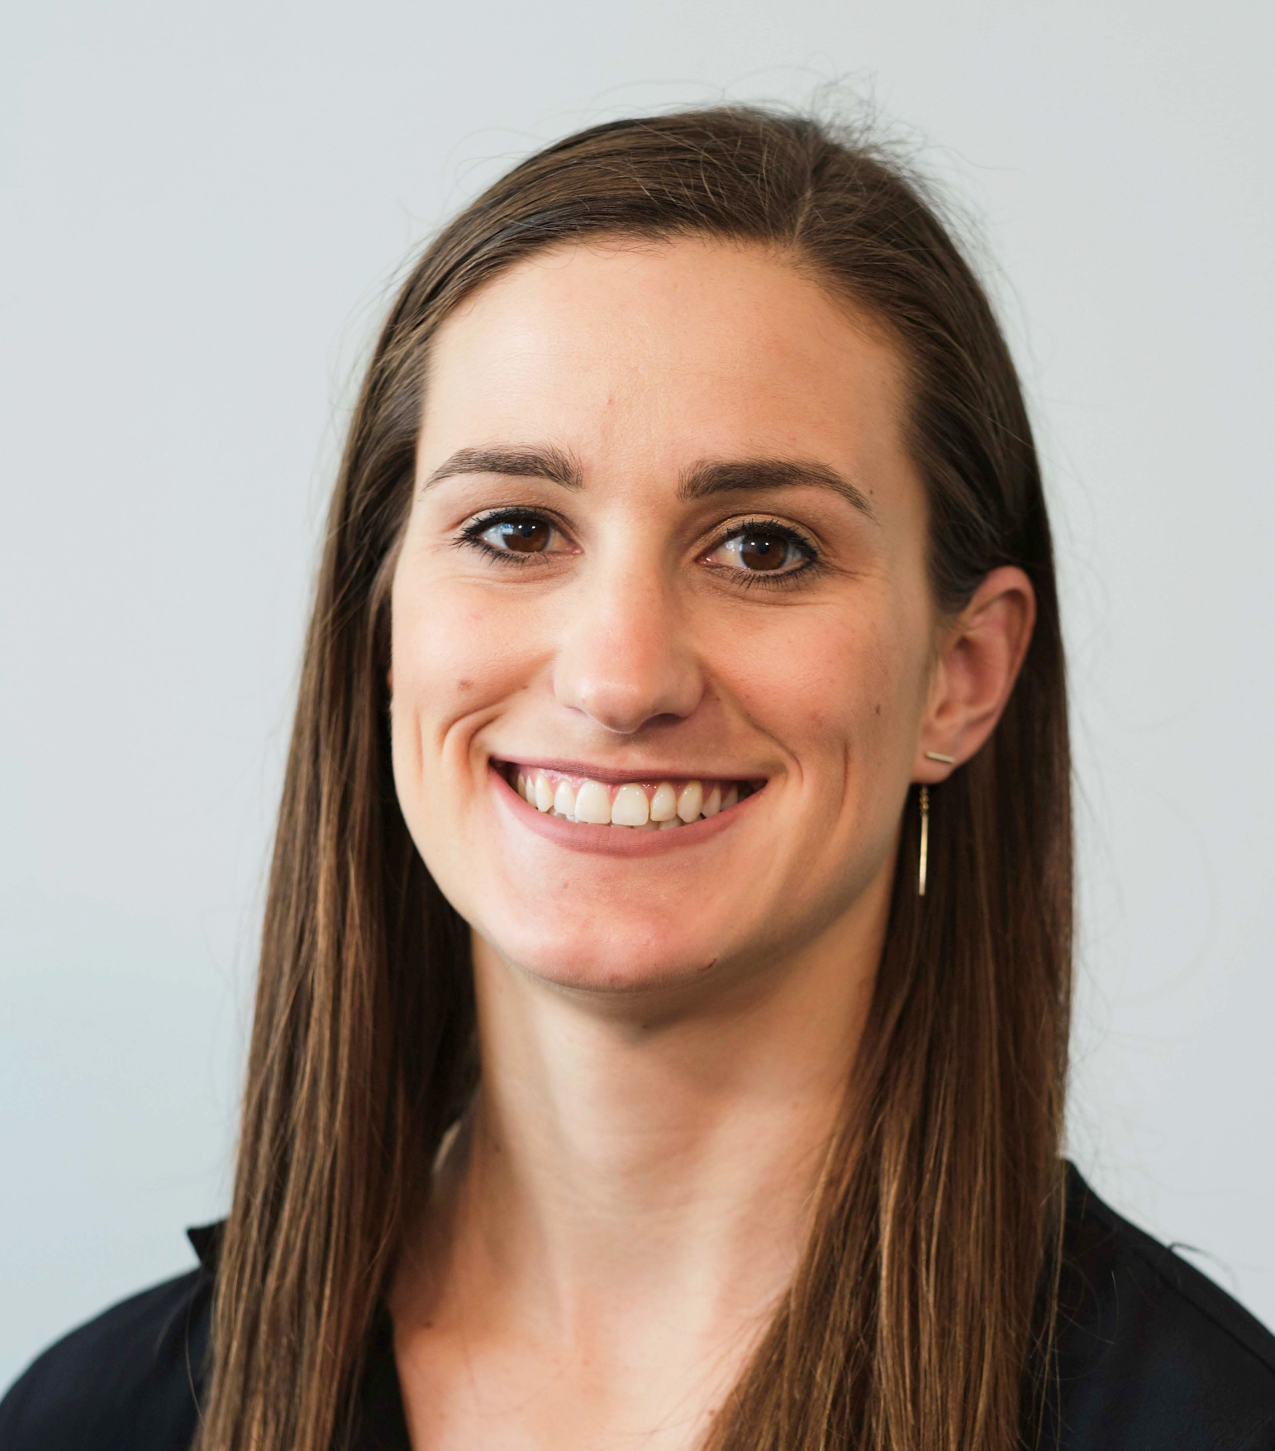
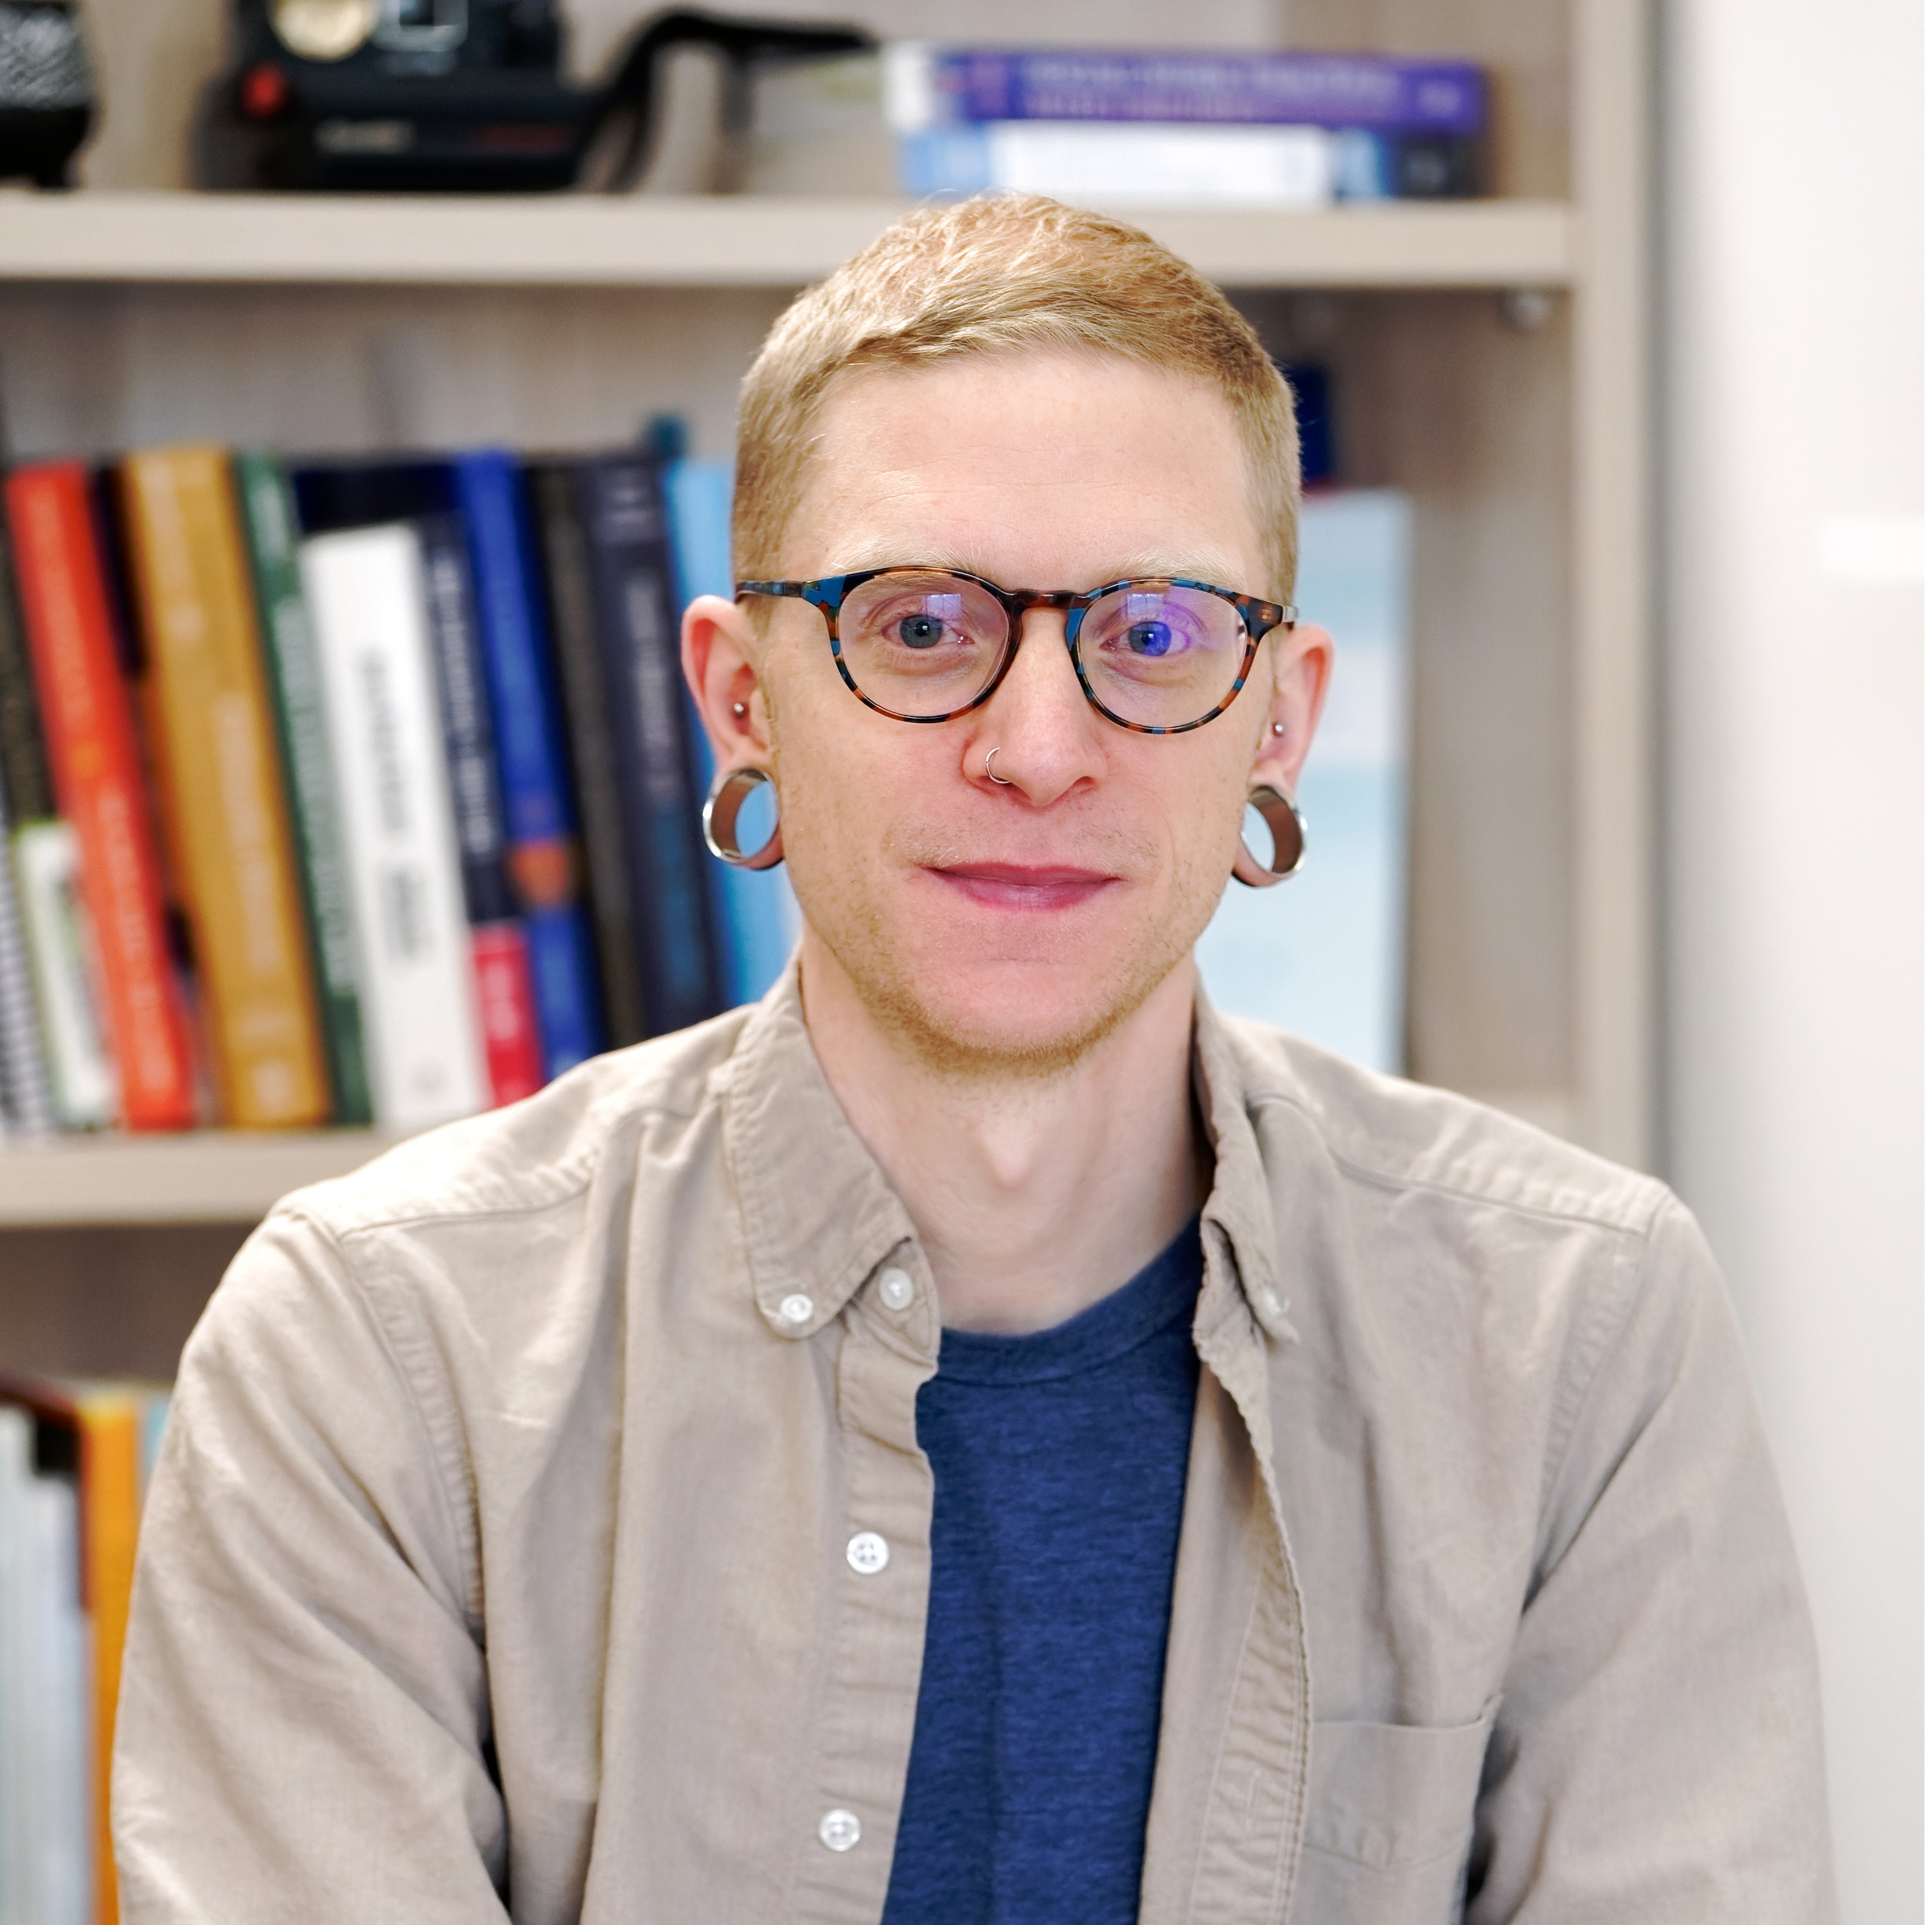
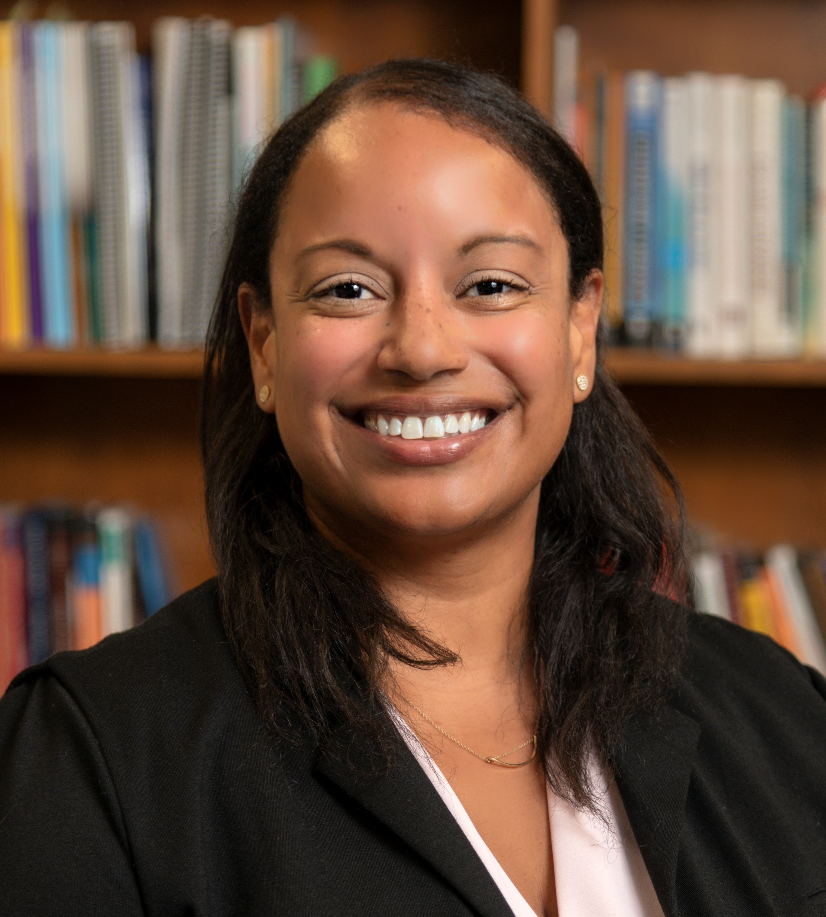
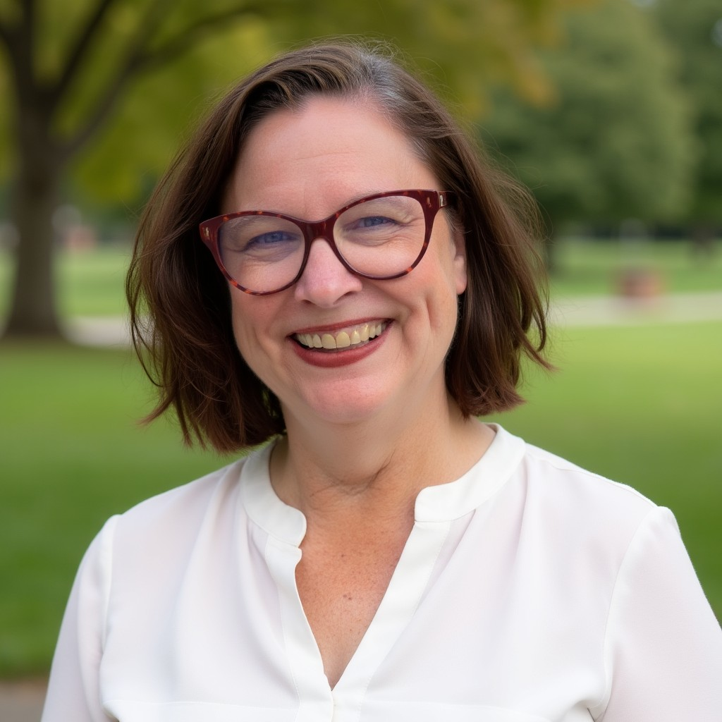
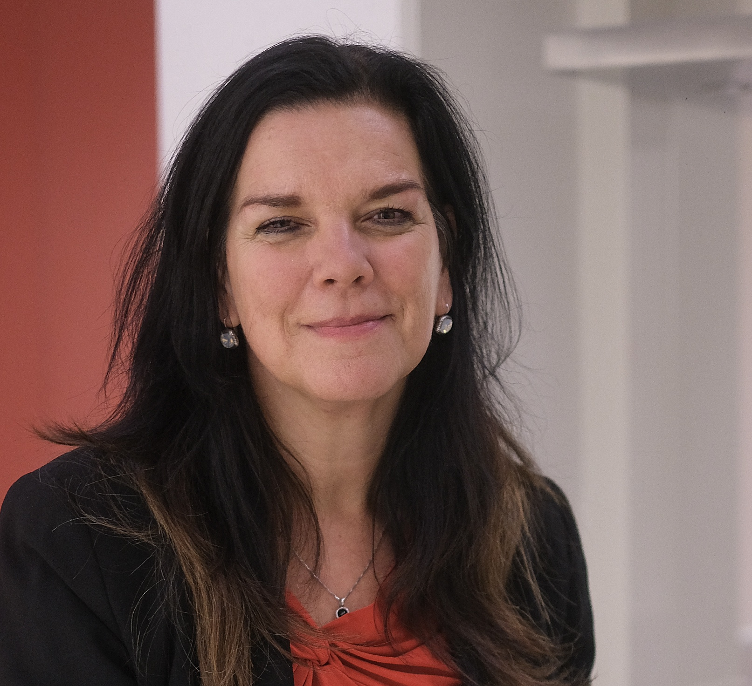
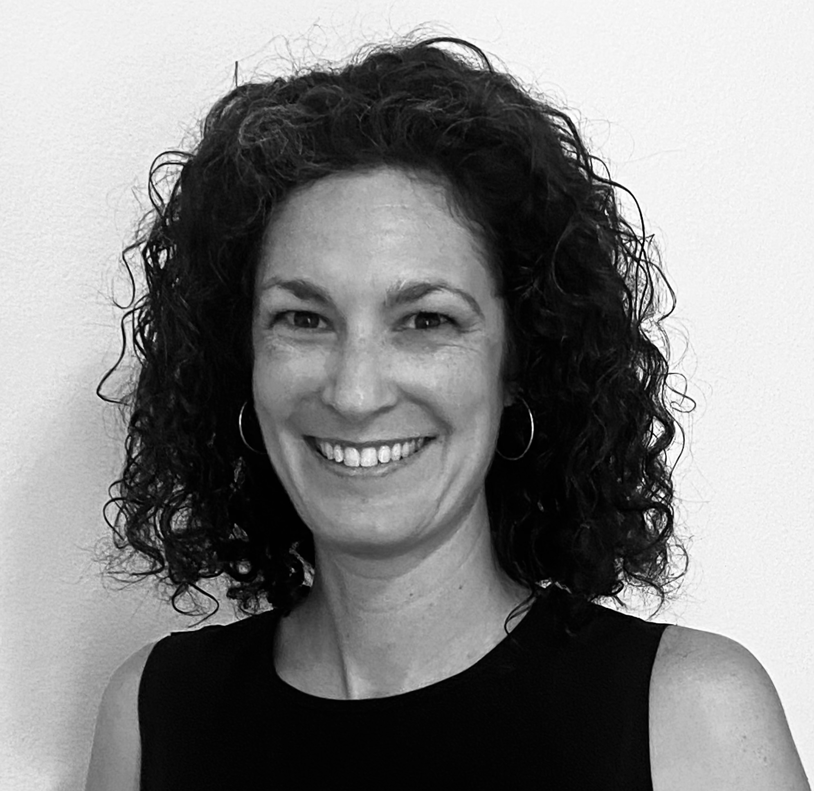
ICED 2025 Scientific Planning Committee
Emilio J. Compte, PhD
M. Luz Scappatura, PhD
April Smith, Ph.D
Tiffany A. Brown, PhD
Jennifer Campbell
LCSW, DBT-LBC
Dr. Nadia Craddock
PhD
Alexandra Dingemans
PhD
Lauren Forrest, PhD
Kyle T. Ganson, PhD
MSW
Not pictured:
Seena Grewal MD MSc FRCPC
Carolina López
Karen Jennings-Mathis, PhD, APRN, PMHNP-BC, FAED
Jenny Loudon, MPA
Sandra Mulkens, PhD
Diana Rancourt, PhD

Slide 2
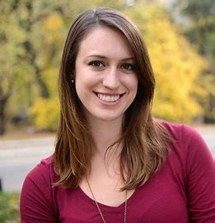
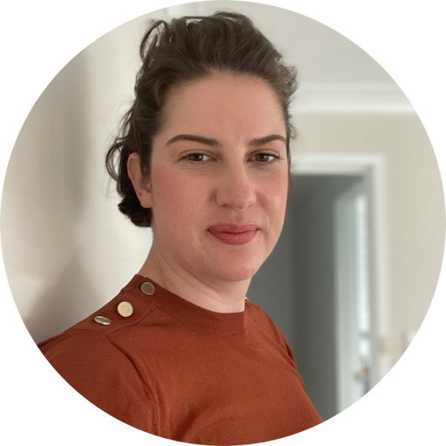
ICED 2024 Scientific Committee
Deborah Mitchison, NHMRC Research Fellow
Mae Lynn Reyes-Rodriguez, PhD, FAED
Helena Lewis-Smith, PhD
Andrea LaMarre, PhD
Kendra Becker, PhD
Erin Harrop, PhD
Caitlin Martin-Wagar, PhD
Claudia Pieper, MD, PhD
Luz Scappatura, PhD
Sandra Schlegl, PhD
Trevor Steward, PhD
Eva Trujillo, MD, FAED, FAAP, FIAEDP
Emilio Compte, PhD
Joanna Mercuri, MPMHC
Caitlin McMaster, PhD

