Slide 1


Orientation
Lifestyle Empowerment Approach for Diabetes Remission

Slide 2
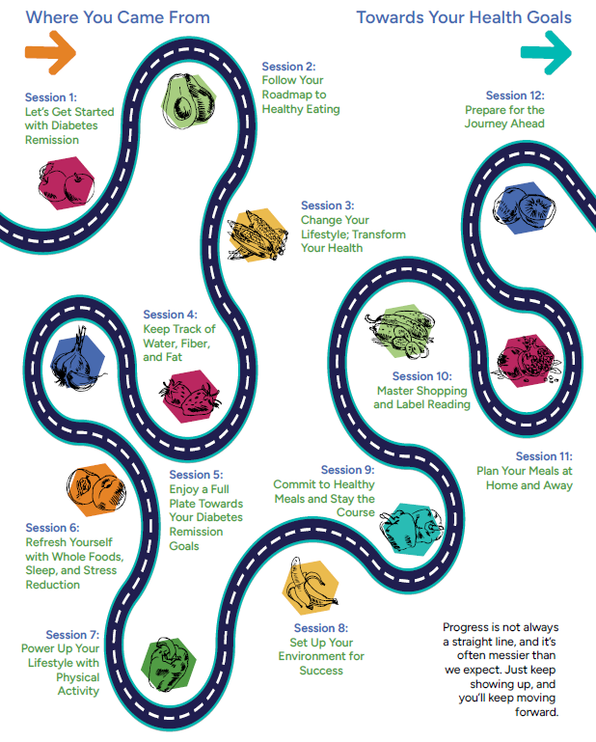
Welcome
We'll be taking a journey together, and it's helpful to remember that progress is not always a straight line. The group will be with you for support, feedback, accountability, and fun. The staff will be here to guide you.
And you will be here to participate and encourage yourself. When you have setbacks, it's totally okay. Just keep showing up and putting one foot in front of the other. We have a lot to cover in the coming weeks.

Slide 3
Let’s Get Inspired: Forks Over Knives
What are your thoughts about the movie?
What’s one thing you heard or saw that surprised you the most?
What did you like most in the movie? For example, a certain person’s story, something one of the people said that spoke to you, or a favorite scene?
Was there anything you saw that seemed scary or difficult when you think about your own life?
After watching the movie, how are you feeling about going through this program?
What did this make you think about your own life/ your own goals?

Slide 4
My Purpose
The search for absolute certainty
Waiting for the “magic moment”
Wishful thinking
Premature action
Looking at the wrong role models

Slide 5
My Goals for this Program:

