Slide 1


Session 12
Prepare for the Journey Ahead
pg. 201

Slide 2
Learning Objectives
Identify and review key strategies in putting diabetes into remission
Implement new strategies for following a WFPB after the program ends
Set long-term SMART goals
pg. 202

Slide 3
Diabetes Education: Remission Review
Flip through your workbook and jot down your most impactful strategies
pg. 203

Slide 4
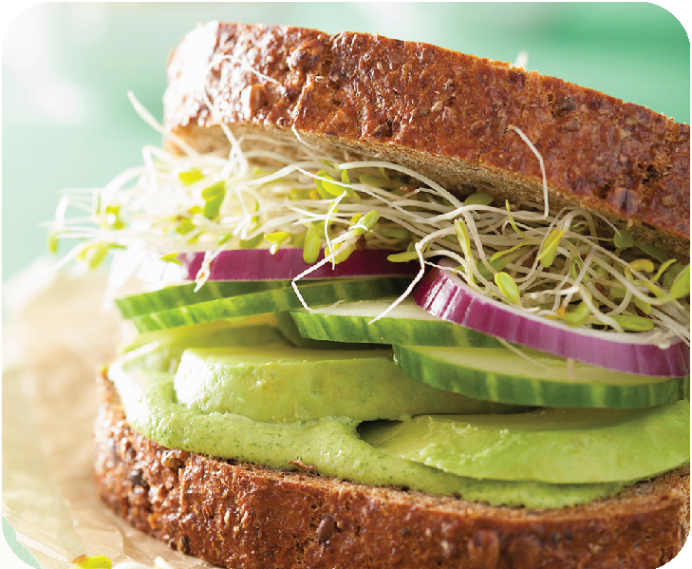
Teaching Kitchen: Loaded Veggie Sandwich
pg. 204

Slide 5
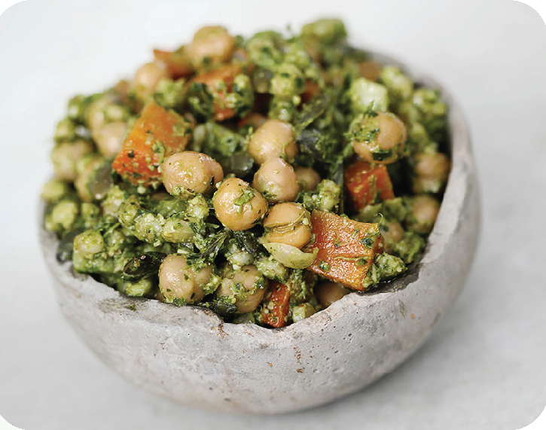
Teaching Kitchen: Chickpea Of The Sea
pg. 205

Slide 6

Teaching Kitchen:
Sweet Potato & Black Bean Quesadillas
pg. 206

Slide 7
Preparing for Your Journey Ahead
Make a list of your support allies, those you can call on to help you stay on your journey toward health and remission
pg. 207

Slide 8
Create a Safe Haven at Home
The environment we create around us heavily influences our behavior.
pg. 208

Slide 9
Create a Safe Haven at Work
If living a healthy lifestyle is important to you, making your home and work place as supportive as possible is also important.
pg. 209

Slide 10
Success Story: Vishnuku
pg. 210

Slide 11
What's Changed?
How much confidence do you have in your ability to eat a healthy diet, get healthy yourself, and stay healthy compared to when you first started the program?
Compared to when you first started the program, how much energy do you have?
Compared to the start of the program, how confident are you in your ability to make healthy food choices?
On a typical day, how clear is your thinking now compared to when you started the program?
How healthy do you feel now compared to when you first started the program?
Did you experience changes in your diabetes since beginning this program?
If so, what changed?
pg. 211

Slide 12
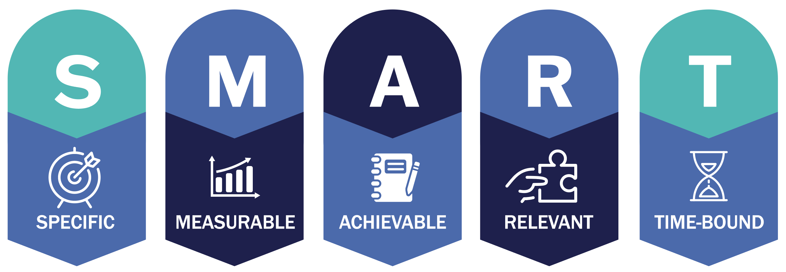
Set Your
SMART Goals
pg.212

Slide 13
Rate Your Goals and Strategize
pg. 213

Slide 14

In Closing
What strategies will you employ to create safe havens?
Congratulations on a course well done! What changes are you most proud of? You have come away with tools for optimal health for a lifetime of improvement.
May you continue on your fruitful journey towards diabetes remission and health.

