Slide 1


Session 11
Plan Your Meals at Home and Away
pg. 173

Slide 2
Learning Objectives
Identify meal planning and cooking strategies for eating at home and away
Summarize knowledge of a diabetes remission diet when eating in a restaurant
List 10 tips for holding your health when not at home
Set your SMART goals
pg. 174

Slide 3
Diabetes Education: Remission Meal Planning And Strategies
Plan ahead
Make the ‘healthy choice’ the easy choice
Game plan for eating away from home and traveling
pg. 175

Slide 4
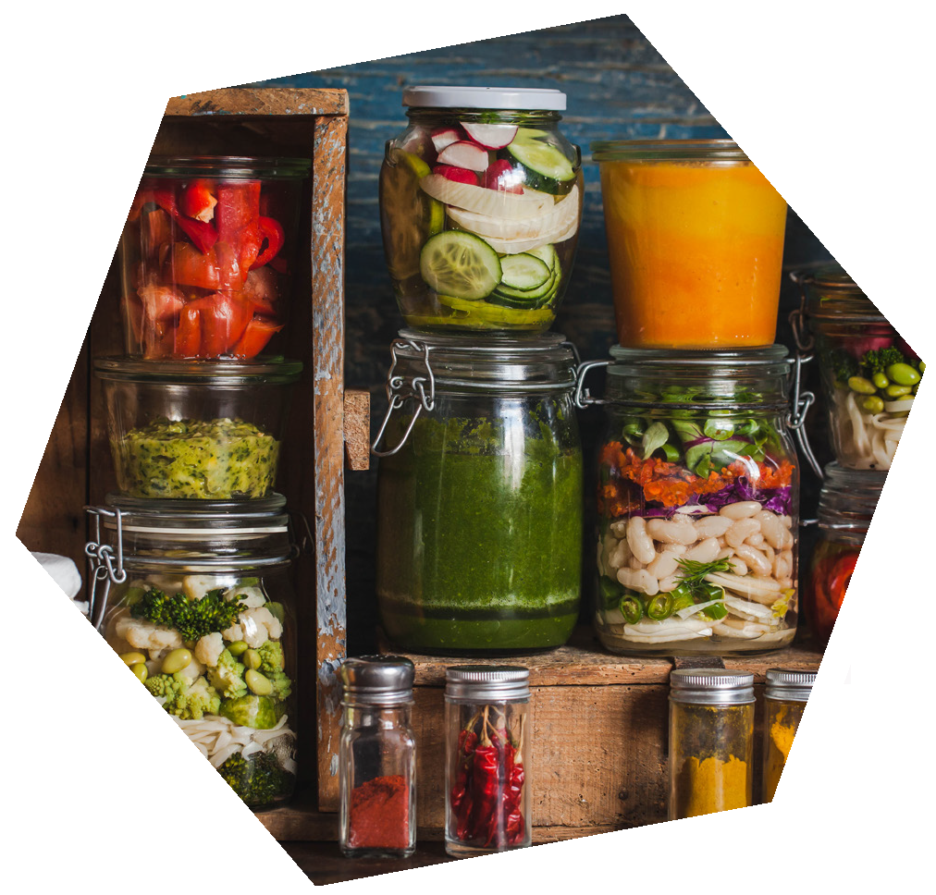
Diabetes Education: Remission Meal Planning And Strategies
Include the entire family
Set goals each week on your journey to improved nutrition
pg. 176

Slide 5
Hara Hachi Bu
Eating until you’re __________ and then __________.
pg. 177

Slide 6
Ten Tips for Eating Out
Select restaurants with fiber food options and avoid buffets.
Beware of the bar.
Watch out for liquid calories.
Drink water before your meal.
Split your entrée with someone at your table or use a to-go box to turn one meal into two.
Eat slowly so you’ll feel full faster and eat less.
Be creative. Use fiber foods you find anywhere on the menu to Power Up your meal.
Ask for whole grains—whole wheat pastas and breads, or brown rice.
Ask that your vegetables be steamed, baked, roasted, or grilled, not fried.
If you’d like dessert, order fresh fruit.
pg. 178

Slide 7
Maintain the Progress You’ve Made
Protect Your Progress
Stay Positive
Check Your Thinking
Help Someone Else
pg. 180

Slide 8
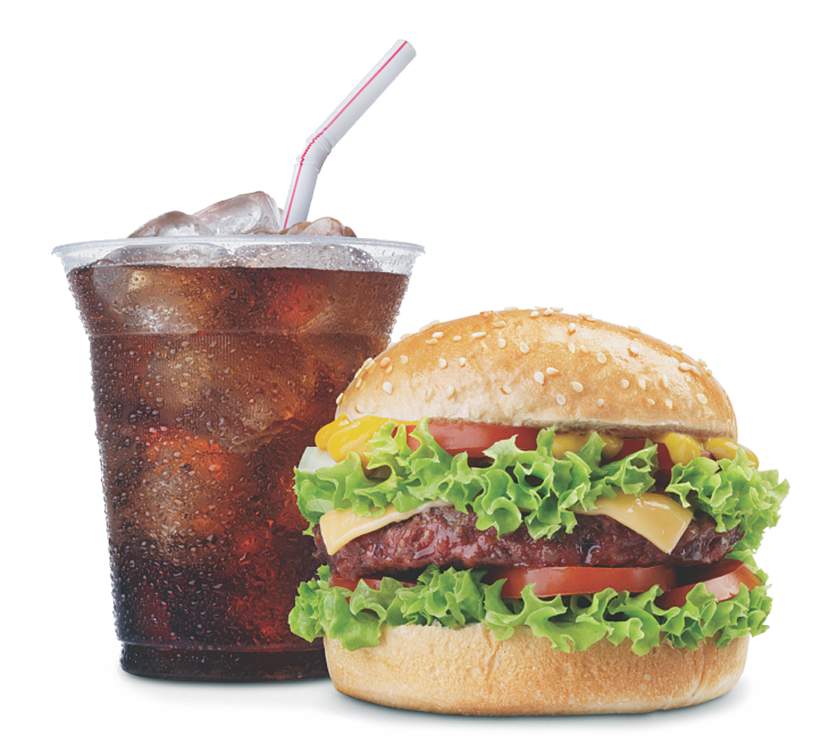
Eating Out by the Numbers
pg. 181

Slide 9
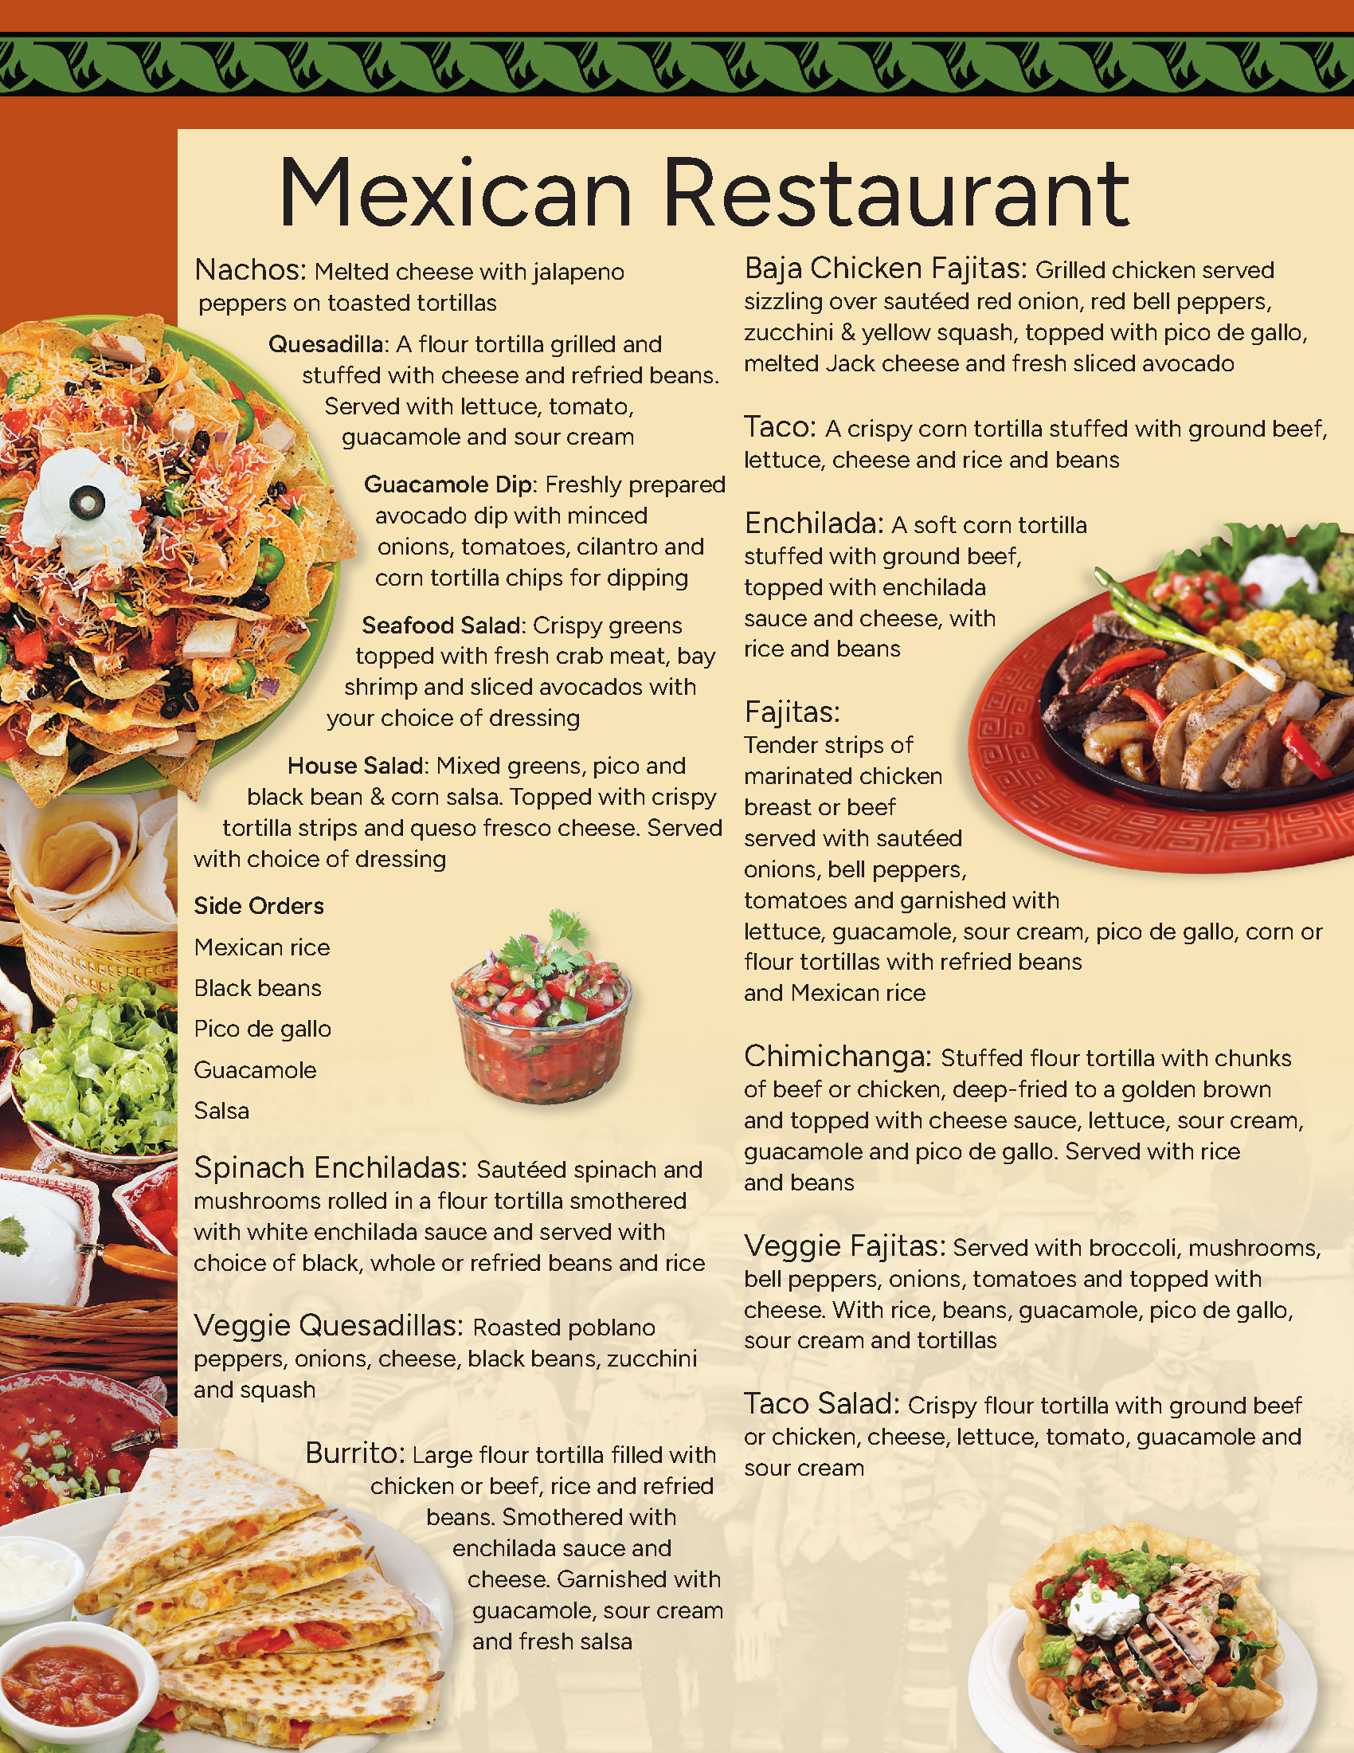
Mexican Restaurant
pg. 182

Slide 10
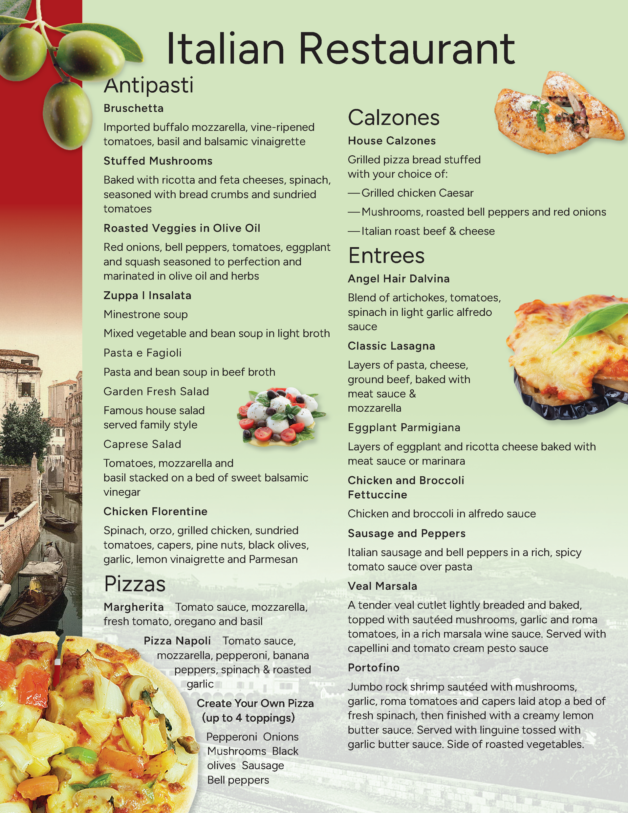
Italian Restaurant
pg. 184

Slide 11
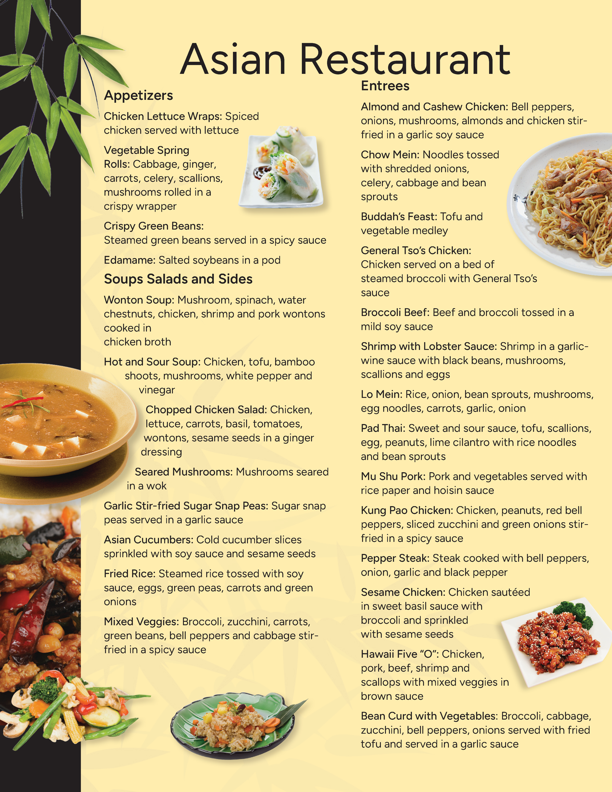
Asian Restaurant
pg. 186

Slide 12
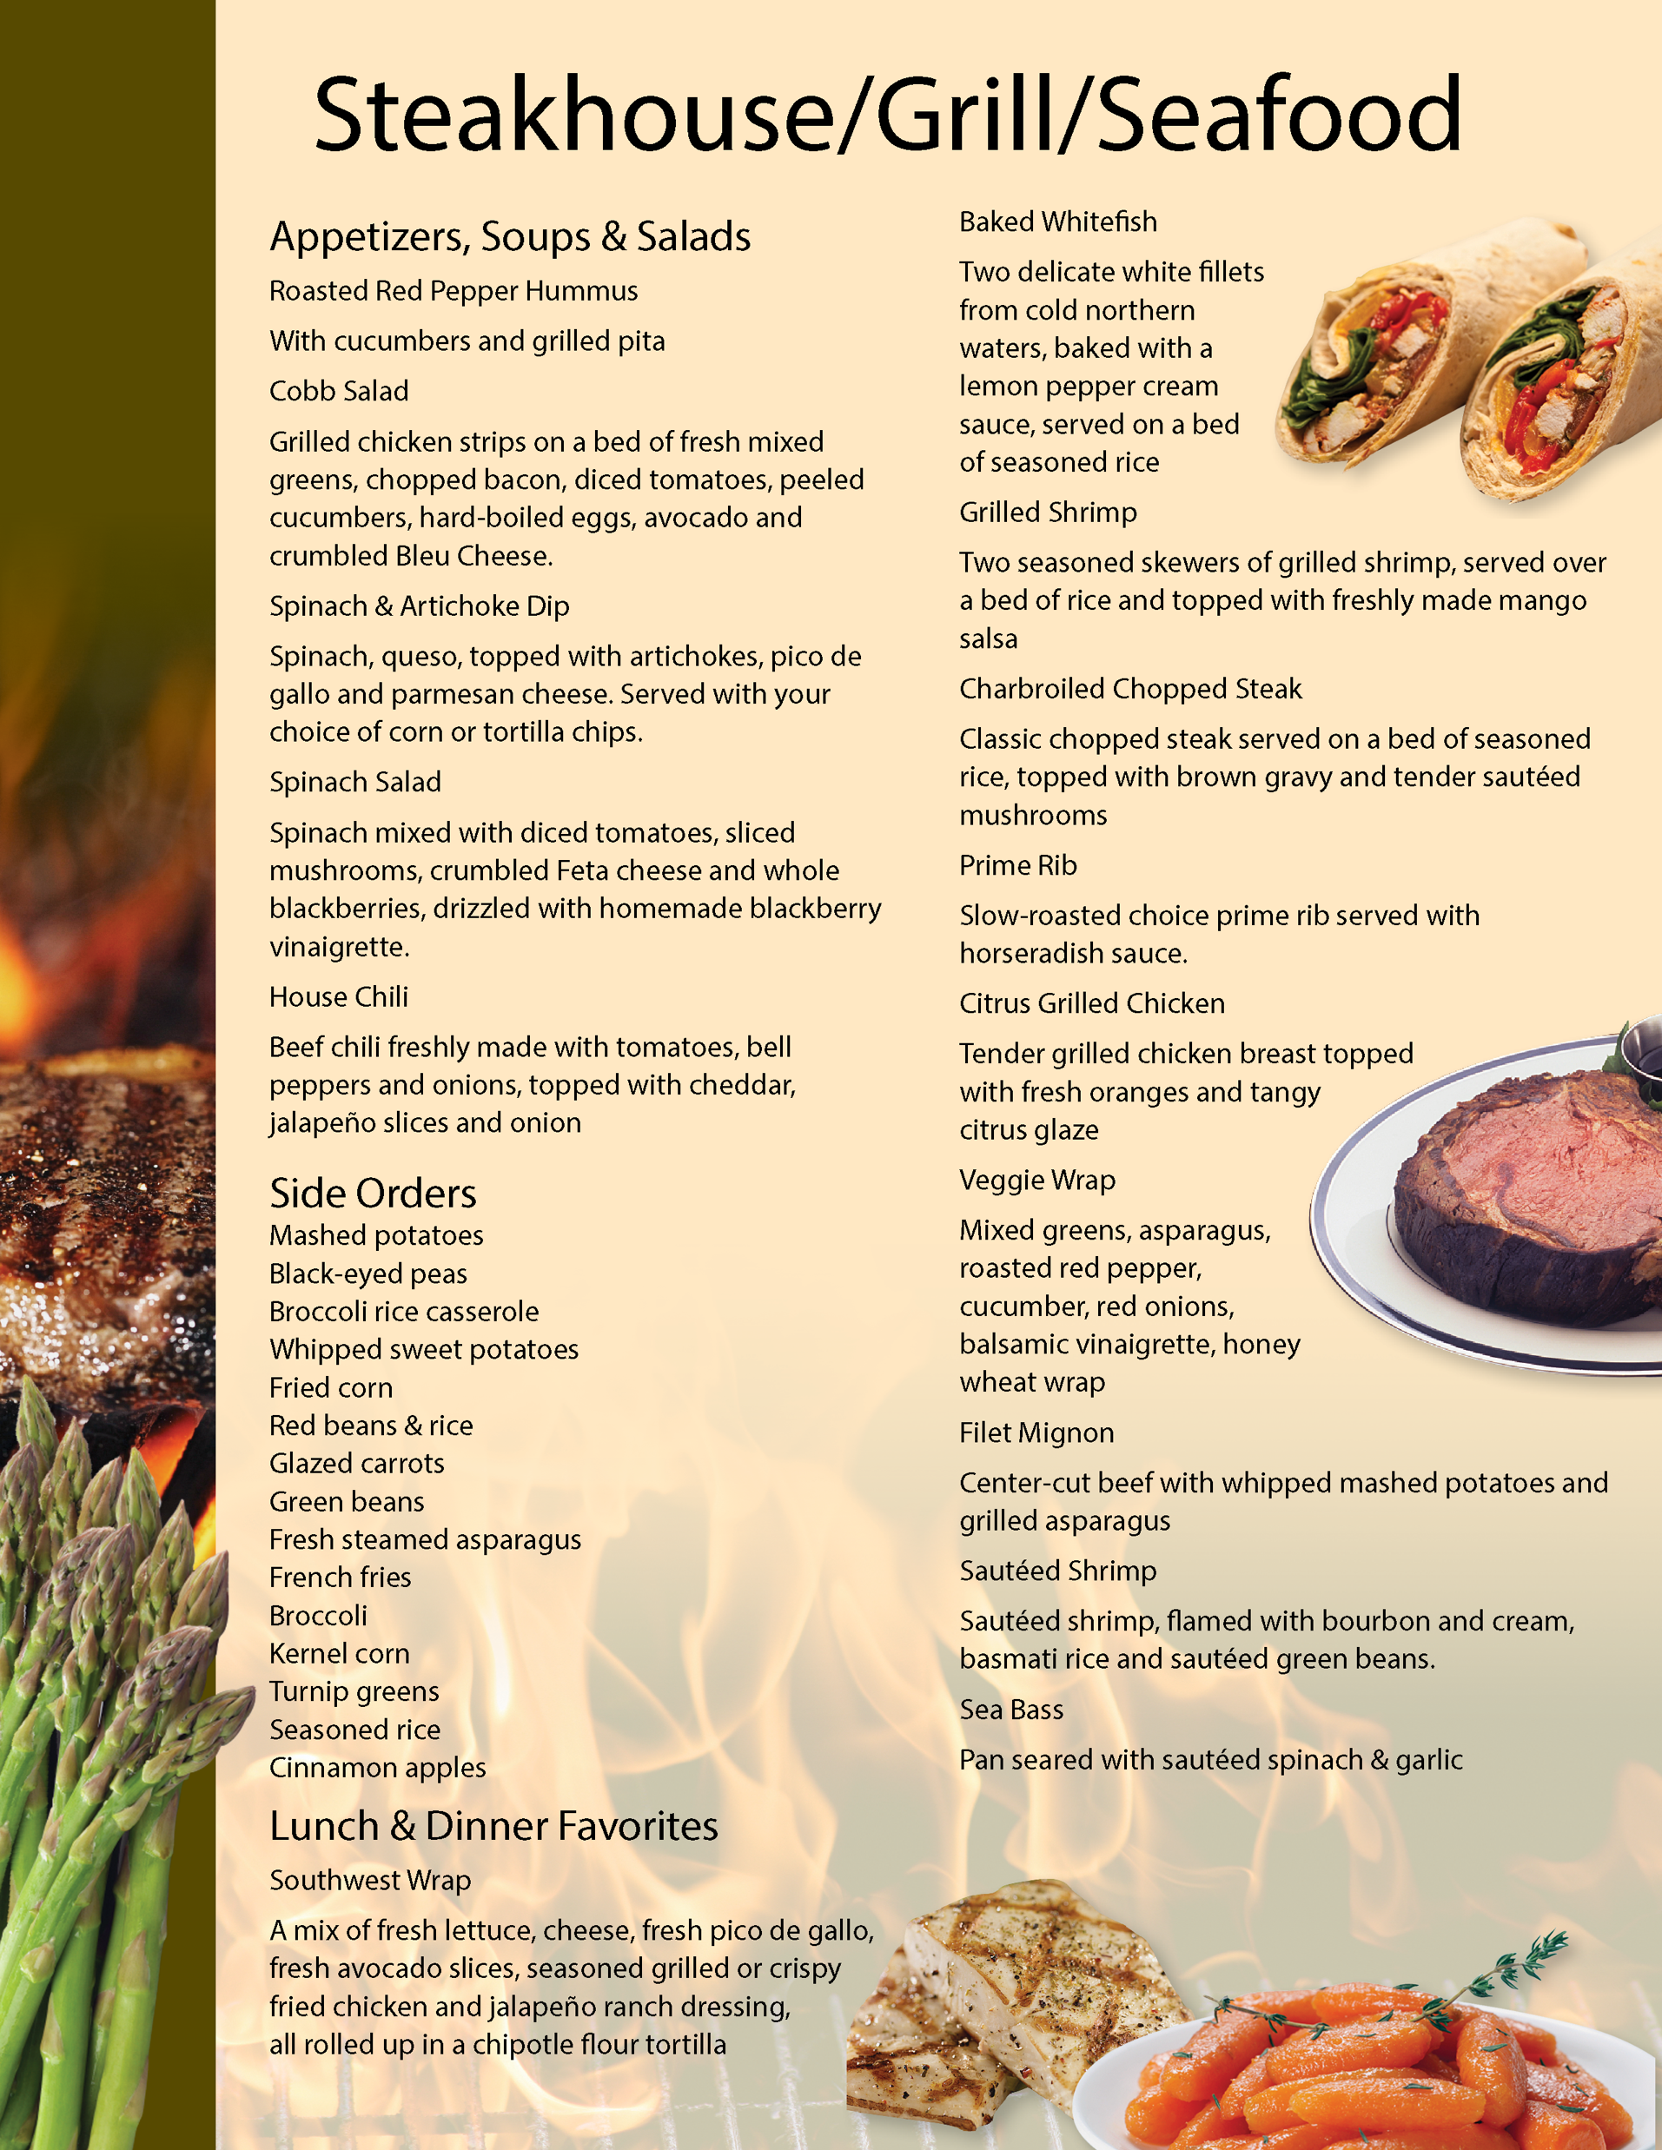
Steakhouse/Grill/Seafood Restaurant
pg. 188

Slide 13
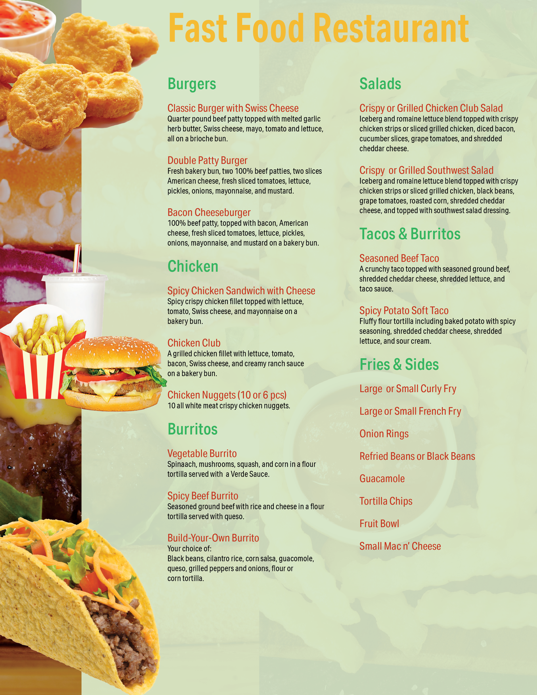
Fast Food Restaurant
pg. 190

Slide 14
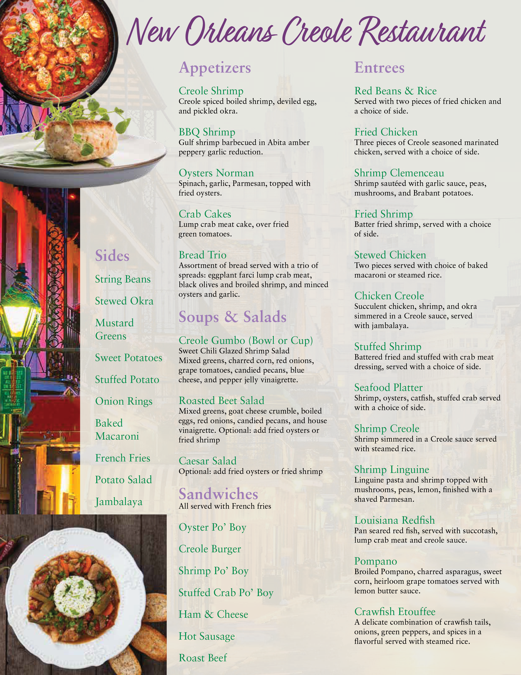
New Orleans Creole Restaurant
pg. 192

Slide 15

Haitian Restaurant
pg. 194

Slide 16
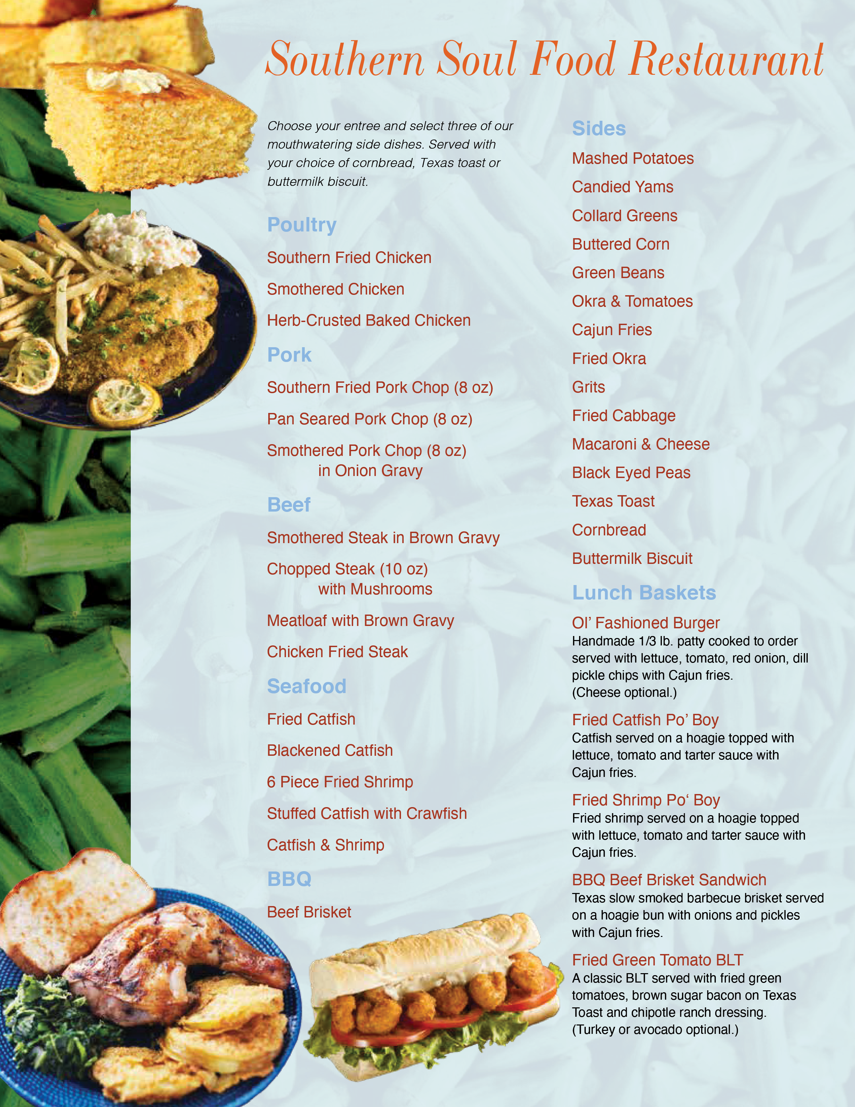
Southern Soul Food Restaurant
pg. 196

Slide 17

Set Your
SMART Goals
pg. 198

Slide 18
Rate Your Goals and Strategize
pg. 199

Slide 19

In Closing
Though eating out is a challenge, as we want to have an enjoyable and stress-free time with our friends and family, I think we see from today’s session how comfortable it can be to choose the best options available to support our remission goals, and have a satisfying meal as well. The more we practice these strategies, the easier it gets!

