Slide 1


Session 10
Master Shopping and Label Reading
pg. 161

Slide 2
Learning Objectives
Analyze food labels to determine if foods are appropriate for diabetes remission
Review strategies for successful shopping navigation and decisions
Set your SMART goals
pg. 162

Slide 3
Diabetes Education: Decoding Food Labels
Serving Size and Servings Per Container
Calories
Saturated Fat
Trans Fat
Fiber
Added Sugars
pg. 163

Slide 4
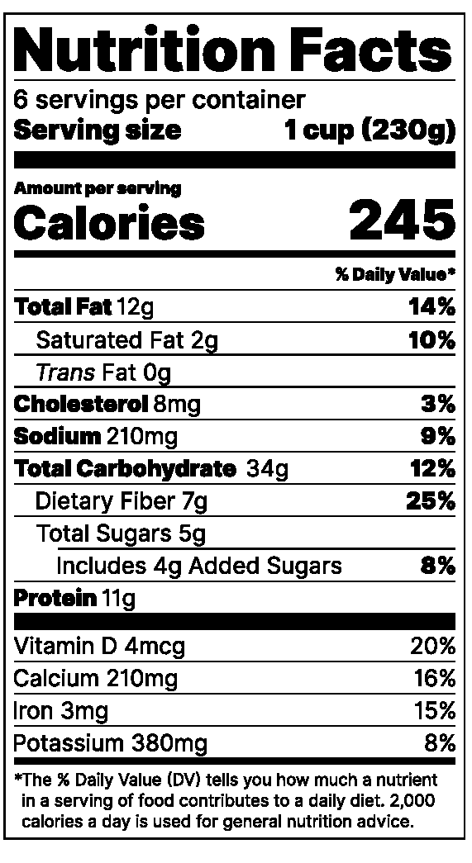
Diabetes Education: Decoding Food Labels
Sodium
Cholesterol
pg. 164

Slide 5
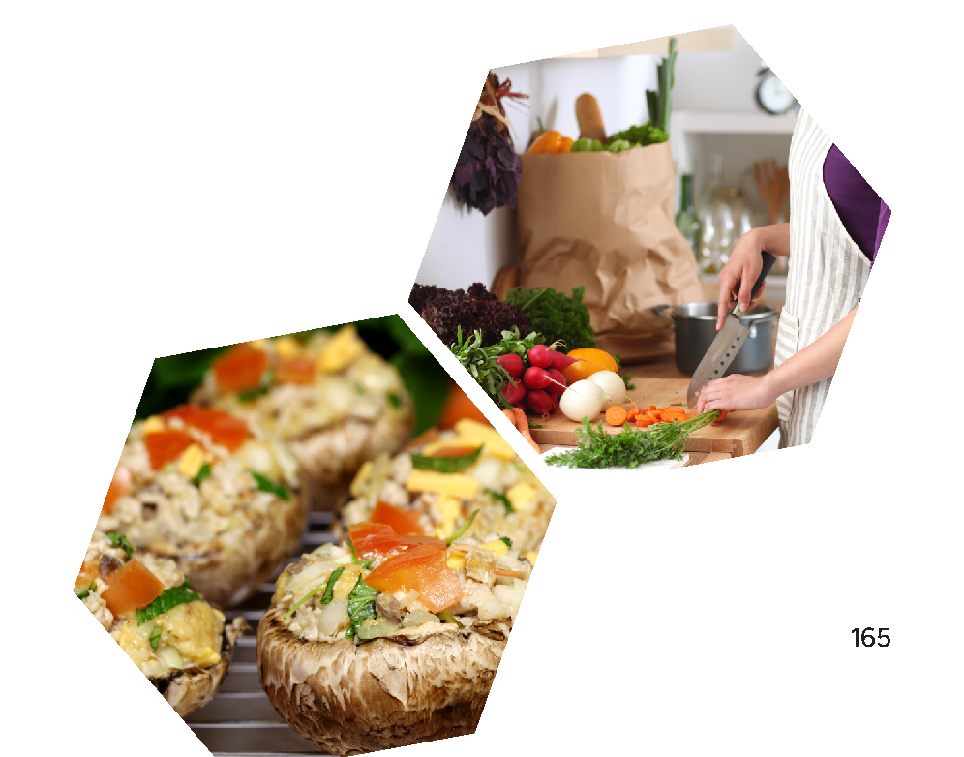
Full Plate Living: Smart Grocery Shopping
1. Select the Recipes
2. Shop for the Ingredients
3. Prepare Ingredients
pg. 165

Slide 6
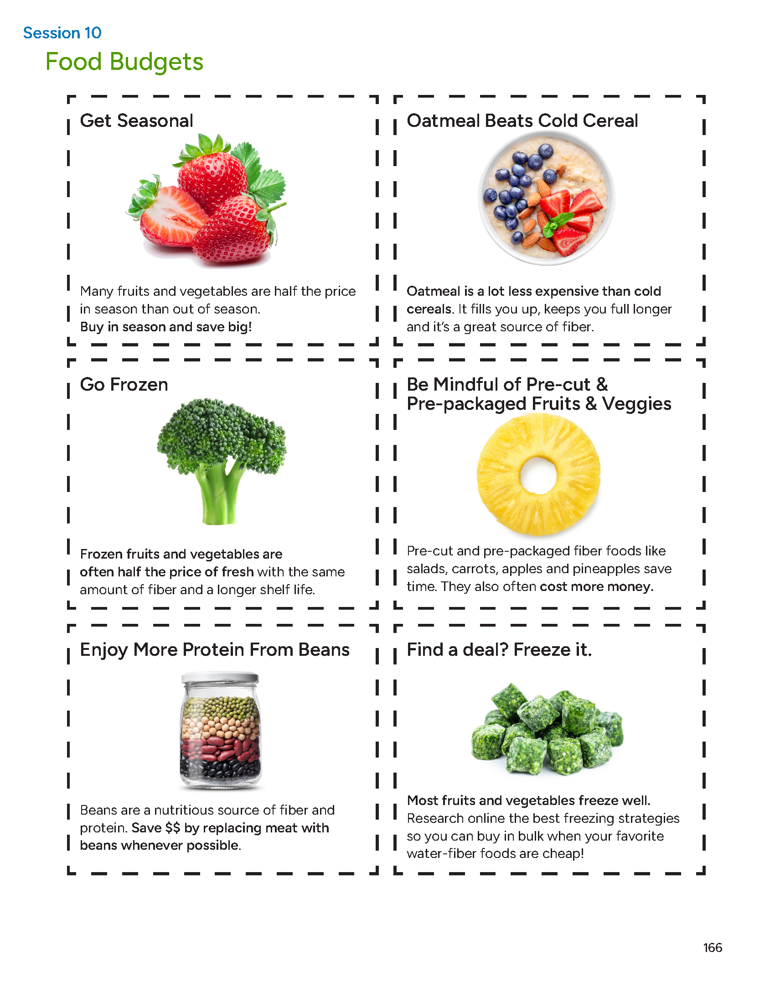
Food Budgets
pg. 166

Slide 7
Challenging Foods
What foods do you eat at home?
What are some healthy alternatives?
pg. 167

Slide 8

Where Are the 75% Plate Superfoods in Your Supermarket?
pg. 168

Slide 9
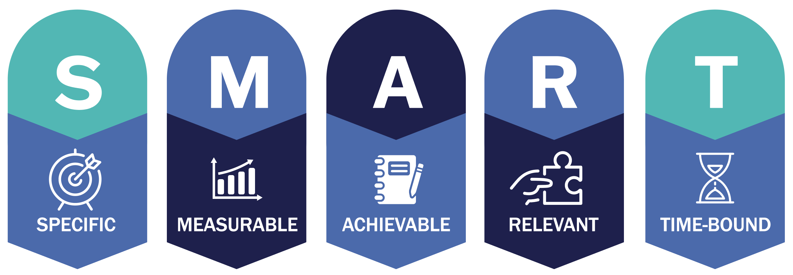
Set Your
SMART Goals
pg. 170

Slide 10
Rate Your Goals and Strategize
pg. 171

Slide 11

In Closing
Now we can consider how food labels can be helpful and not just confusing. Are you ready to go grocery shopping?

