Slide 1


Session 9
Commit to Healthy Meals and Stay the Course
pg. 147

Slide 2
Learning Objectives
Explain the benefits of eating a good breakfast for diabetes remission, and the pitfalls of skipping breakfast
Identify the need to make a commitment towards better health
Demonstrate the preparation of Cowboy Caviar and Tropical Fruit Salad
Set your SMART Goals
pg. 148

Slide 3
Full Plate Living: Making the Most of Your Mornings What's So Great About Breakfast?
Eating a good breakfast can help ___________________________ all day by jump starting your metabolism.
Eating a good breakfast can help you ___________________________ __________________
Eating a good breakfast can help keep ________________________ once you’ve lost it.
Eating a good breakfast can help
____________________________, so you can do more things you enjoy.
Eating a good breakfast can help increase _________________________ by improving concentration, memory, problem solving, and hand-eye coordination.
Eating a good breakfast can help to decrease your risk of three major killers: heart, __________________, and ___________________.
pg. 149

Slide 4
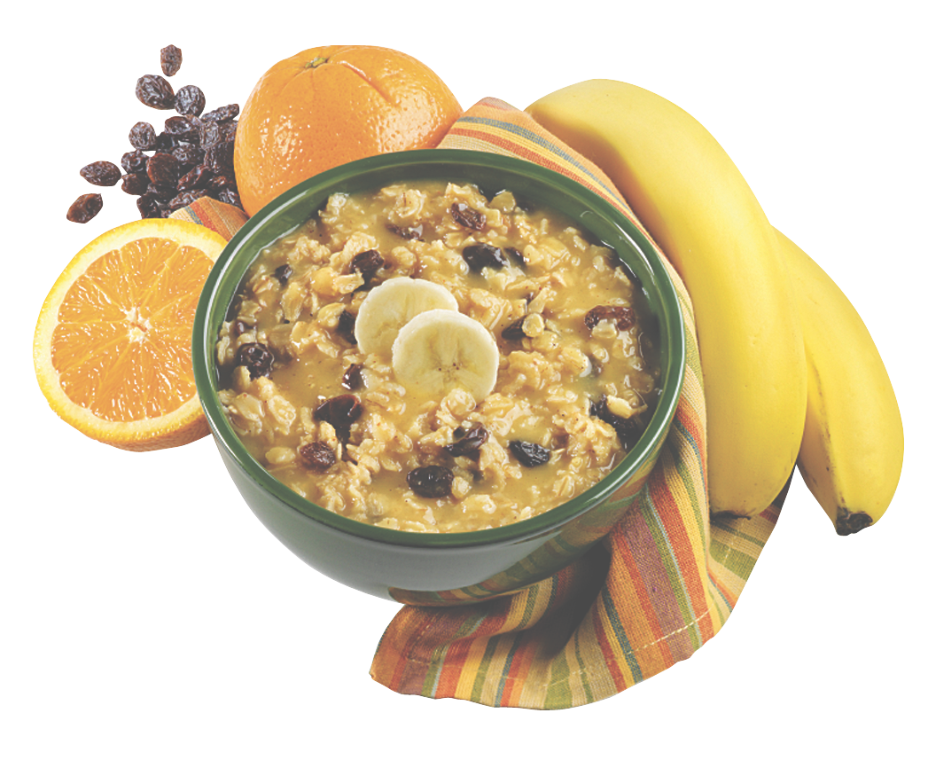
Why It's So Easy to Skip Breakfast
As a group, write in the space provided, one main reason people skip breakfast. Then brainstorm as many solutions as you can.
pg. 150

Slide 5
Breakfast Power Up Challenge
Breakfast 1
  Two pancakes
  Butter
  Syrup
  Sausage
  Orange juice
Breakfast 2
  Special K
  Milk
Breakfast 3
  Two eggs
  Two slices of turkey bacon
  White toast
  coffee
Breakfast 4
  Cheese omelet
pg. 151

Slide 6
You're Preparing to Live Healthier
How much time and energy are you willing to budget for health right now?
How is it going to fit into your daily schedule?
What are you willing to give up in order to achieve a healthy lifestyle?
What are the potential challenges that could throw you off?
pg. 152

Slide 7
Are Your Ready to Make a Commitment?
How much time and energy are you willing to budget for health?
How is it going to fit into your daily schedule?
What are you willing to give up?
What are the potential challenges?
How committed are you to this journey?
Rate your ability to reach a healthy weight.
pg. 153

Slide 8
Pantry Upgrade
What’s in your pantry now?
Which foods fit in with your new diabetes remission eating pattern?
pg. 154

Slide 9

Teaching Kitchen: Easy Veggie Stir Fry
pg. 155

Slide 10
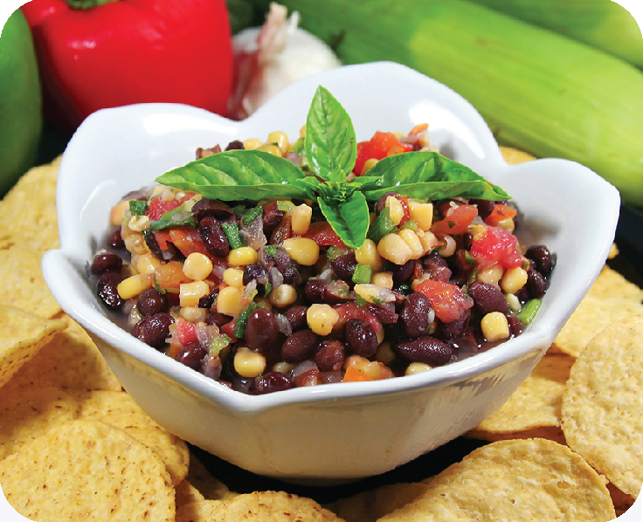
Teaching Kitchen: Cowboy Caviar
pg. 156

Slide 11
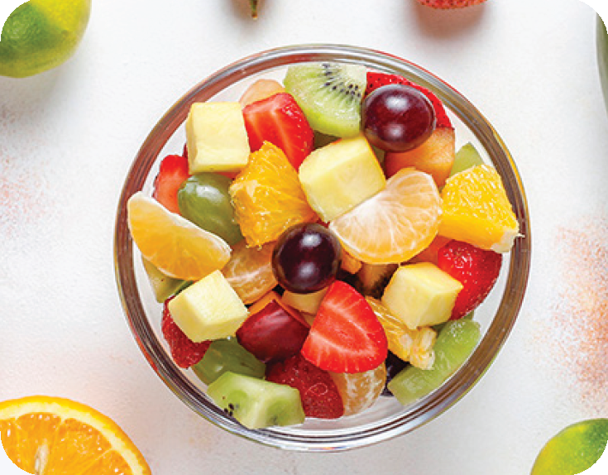
Teaching Kitchen: Fruit Salad
pg. 157

Slide 12
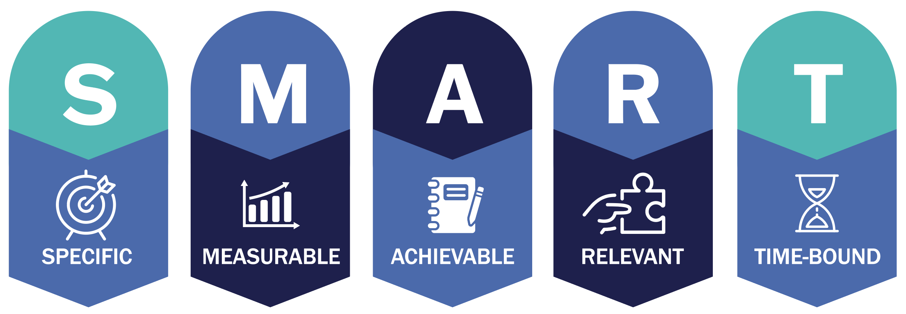
Set Your
SMART Goals
pg. 158

Slide 13
Rate Your Goals and Strategize
pg. 159

Slide 14

In Closing
Are you ready to make breakfast a part of your daily routine? How will you make it your morning using power food-friend? Remember that every meal counts, and is your new beginning. Until next time, thank you for making efforts toward better health - this is not easy work!

