Slide 1


Session 8
Set Up Your Environment for Success
pg. 135

Slide 2
Learning Objectives
Identify ways to make over eating habits and negative thoughts
Apply strategies to make adjustments to your environment that support diabetes remission
Set your SMART Goals
pg. 136

Slide 3
Full Plate Living: Make Over Your Negatives
Get the Facts
Get Inspired
Be a Role Model
Tap into Resources
Compare Your Actions to Your Values
Make a Commitment
Makeover Your Negatives
Drum Up Support
Create Safe Havens
Give Yourself Rewards
pg. 137

Slide 4
Make Over Your Negatives
Negative thoughts can prohibit progress. How can you replace negatives with more helpful thoughts?
pg. 138

Slide 5
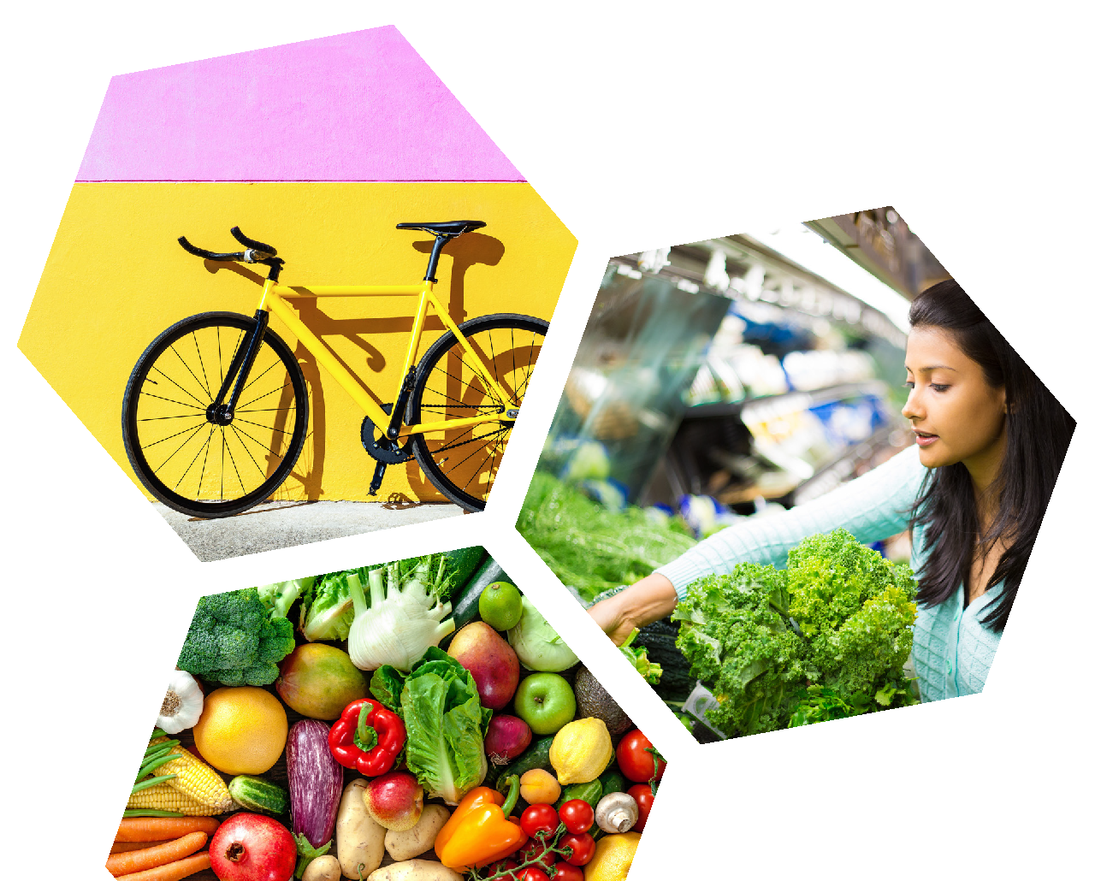
Diabetes Education: Set Up Your Environment to Support Your Goals
Your environment has a powerful effect on your eating habits. Enlist these strategies to set up your kitchen, workplace, and home to support your goals instead of sabotaging them.
pg. 140

Slide 6
Strategy #1: Out of sight, out of mind
pg. 140

Slide 7
Strategy #2: Change how you interact with your environment
pg. 141

Slide 8
Strategy #3: Change how you interact with the people in your environment
pg. 142

Slide 9
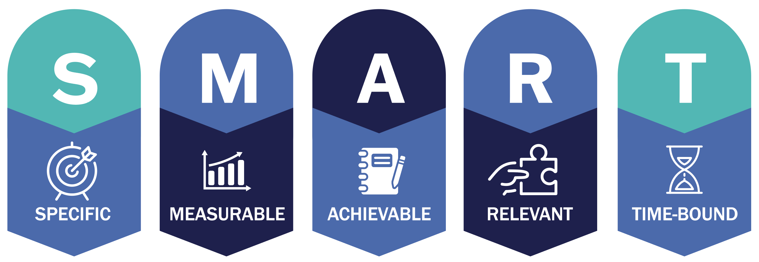
Set Your
SMART Goals
pg. 144

Slide 10
Rate Your Goals and Strategize
pg. 145

Slide 11

In Closing
Catch yourself thinking negative thoughts with a plan to change them into supportive thoughts.
What eating habit can you change to support your goals?
Congratulate yourself on your efforts thus far, big and small!

