Slide 1


Session 7
Power Up Your Lifestyle with Physical Activity
pg. 121

Slide 2
Learning Objectives
Understand the basic mechanisms of type 2 diabetes and the consequences of uncontrolled diabetes
Recognize the importance of incorporating physical activity into daily life
Recognize the personal fat threshold within genetic predisposition
Set your SMART Goals to incorporate more movement a daily routine
pg. 122

Slide 3
Diabetes Education: Remission Mechanics
____________ your portions of vegetables.
cut your portions of the foods that are considered “better” 25% choices in ____________
swap meat for ____________ .
keep ____________ in check in your diet.
be cautious with ____________ at the grocery store.
pg.123

Slide 4
Full Plate Living: Rev Up Your Healthy Life
Jog at 5 mph for ____________ hours.
Do high-impact aerobics for about ____________ hours.
Swim moderately for ____________ hours.
Walk briskly at 3 mph for ____________ hours.
Shop for about ____________ hours.
pg. 124

Slide 5
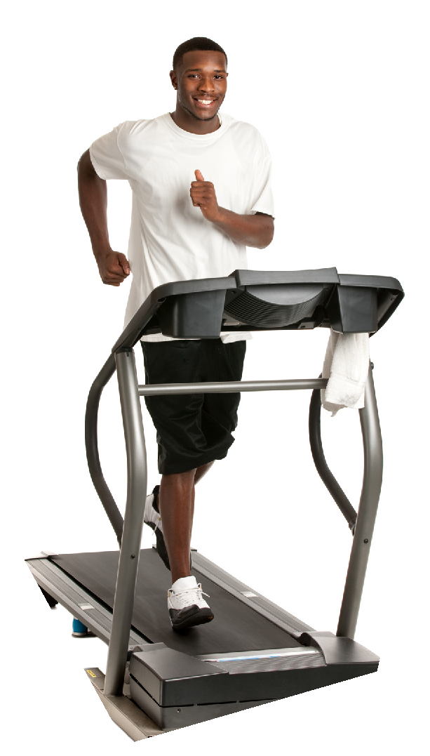
Benefits of Being Physically Active
What benefits are important to you?
pg. 125

Slide 6

Power Up Your Day
pg. 126

Slide 7

Power Up Your Evening
pg. 127

Slide 8
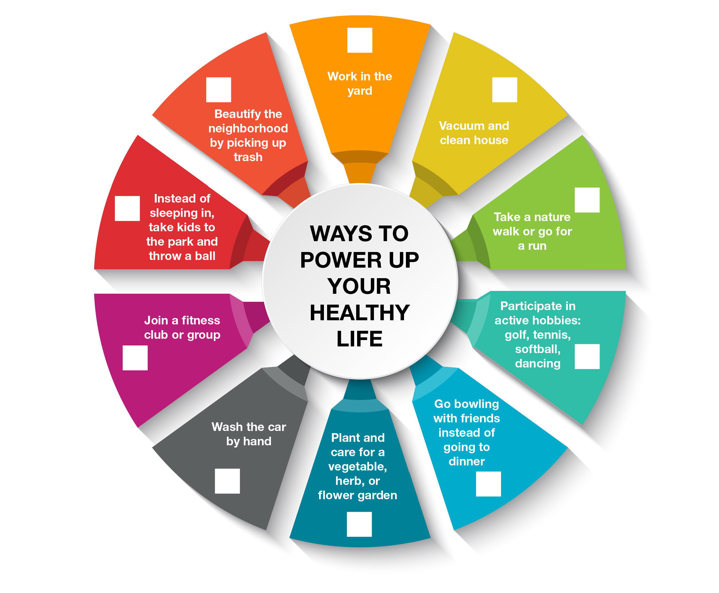
Power Up Your Weekend
pg. 128

Slide 9
Your Turn!
Do you currently exercise?
What kind of exercise do you do?
What prevents you from exercising?
What types of exercise have you enjoyed in the past?
Set a goal for this upcoming week!
pg. 129

Slide 10
Diabetes Education:
Exercise For Diabetes Remission
Go on a short walk or engage in any type of light physical activity immediately after every meal.
Avoid prolonged periods of sitting. Stand up for 3 minutes for every 30 minutes of sedentary activity.
Work up to at least 150–300 minutes a week of moderate-to-vigorous aerobic activity.
Fit in exercise whenever and however it is most sustainable for you.
Do at least 2-3 sessions of resistance exercises that work all major muscle groups per week.
pg. 130

Slide 11
Lessons from Setbacks
Achieving a healthy lifestyle usually requires more than one attempt
Achieving a healthy lifestyle requires an ongoing commitment
Some old habits die hard
But many slips do…
Distress can cause relapse
Seek Support
pg. 131

Slide 12
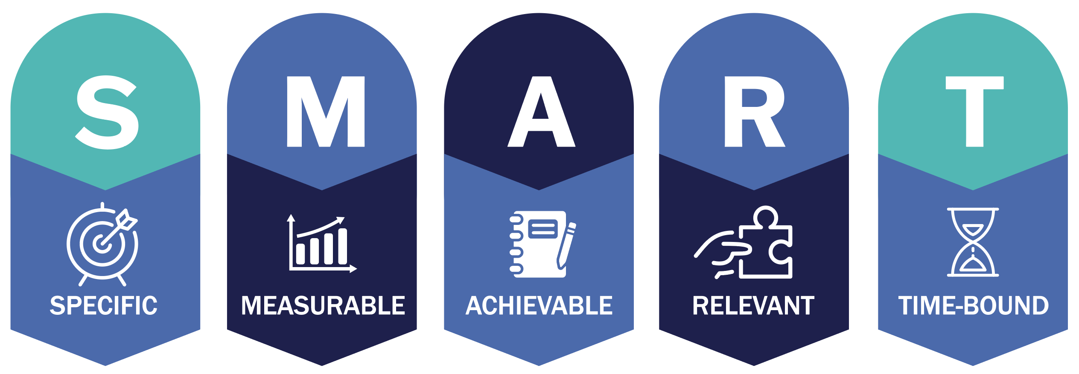
Set Your
SMART Goals
pg. 132

Slide 13
Rate Your Goals and Strategize
pg. 133

Slide 14

In Closing
We are as successful as the effort that we put in. We will make discoveries together. Thank you for being here!

