Slide 1


Session 6
Refresh Yourself with Whole Foods, Sleep, and Stress Reduction
pg.107

Slide 2
Learning Objectives
Identify the relationship between fiber and fat amounts in food
Describe the beneficial effects of both sleep and stress management in diabetes remission
Set Your SMART Goals
pg.108

Slide 3
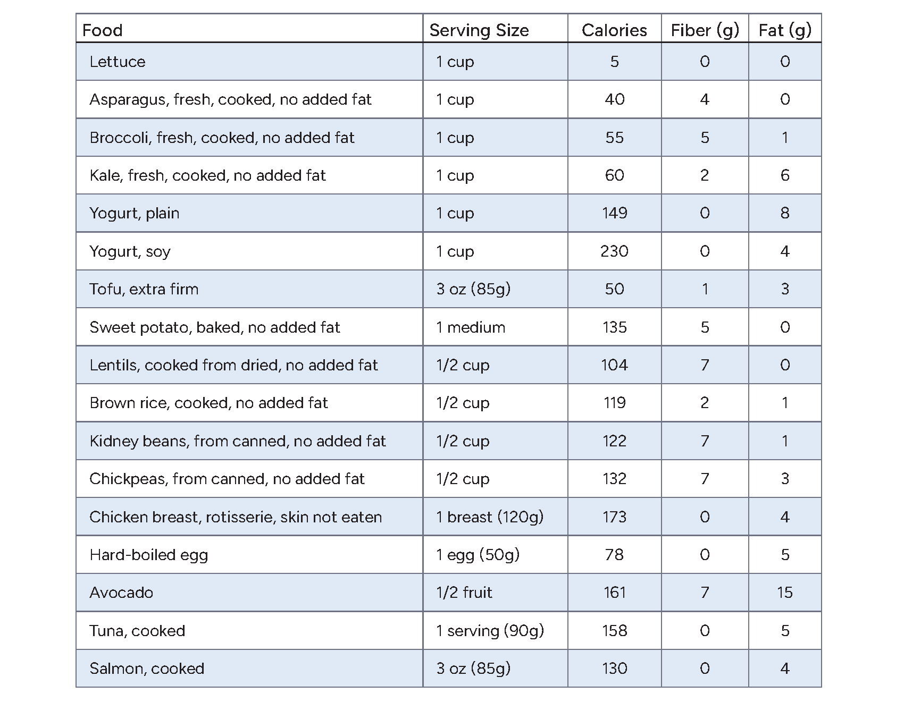
Diabetes Education: How Much Fat And Fiber Is In That Food?
pg. 109

Slide 4
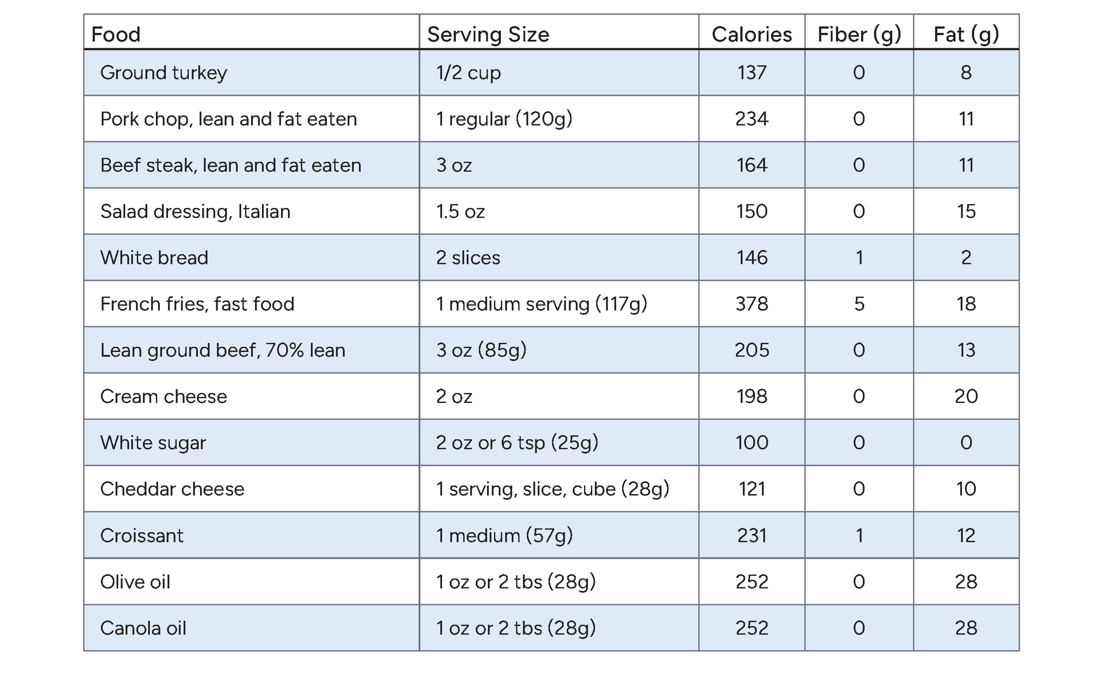
Diabetes Education: How Much Fat And Fiber Is In That Food?
pg. 110

Slide 5
Teaching Kitchen: Filling Salads Blueprint
Leafy greens
Vegetables
Smart carbs
Protein
Toppings
Dressing
pg. 111

Slide 6

Teaching Kitchen: Filling Salads Blueprint
What is a salad?
What vegetables, smart carbs, proteins, and toppings would you use?
pg. 112

Slide 7

Salad Topping Swaps
pg. 113

Slide 8
Simple & Satisfying Salad Dressings
Lemon Tahini Dressing
Balsamic Dressing
3-ingredient Hummus Dressing
Fresh Raspberry Dressing
Peanut Sauce
Cashew Ranch Dressing
pg. 114

Slide 9
Diabetes Education: Sleep and Diabetes
What healthy sleep habits are you doing well?
Which sleep habits do you find challenging?
pg. 116

Slide 10
Diabetes Education: Stress
Connection and involvement
Exercise
Breathing
Relaxation
Cognitive Behavioral Therapy
Health
Fun Activities
pg. 117

Slide 11
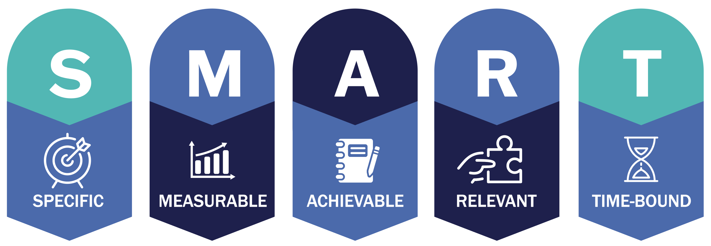
Set Your
SMART Goals
pg. 118

Slide 12
Rate Your Goals and Strategize
pg. 119

Slide 13

In Closing
Congratulations on completing half of your LEADR diabetes remission program!
What healthy sleep habits are you inspired to try?

