Slide 1

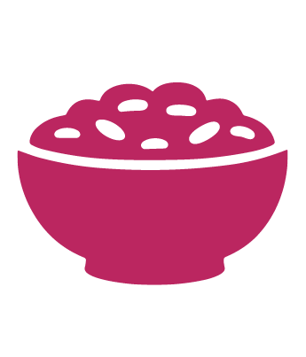
Session 5
Enjoy a Full Plate Towards Your Diabetes Remission Goals
pg. 83

Slide 2
Learning Objectives
Describe the mechanisms of type 2 diabetes
Apply an understanding of diabetes remission eating pattern through meal makeovers
Set your SMART Goals
pg. 84

Slide 3
Diabetes Education: The Basics
Glucose
Insulin
Pancreas
Body cell
Insulin sensitivity
Insulin resistance
pg. 85

Slide 4
Diabetes Education: The Basics
Type 1 diabetes
TYPE 2 diabetes
Diabetes remission
pg. 86

Slide 5
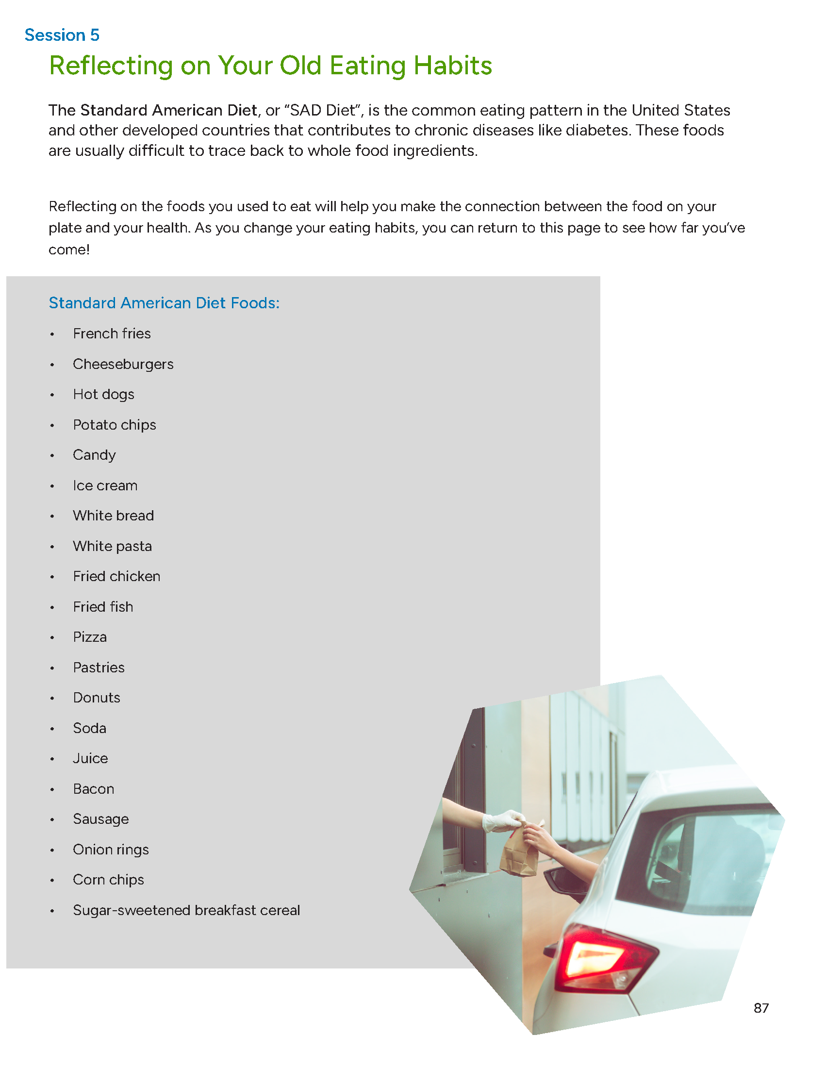
Reflecting on Your Old Eating Habits
The Standard American Diet, or “SAD Diet”
pg. 87

Slide 6
Reflecting on Your Old Eating Habits
What are some reasons why you ate these foods?
How did these foods make you feel while you’re eating them?
How did these foods make you feel after eating them?
If I keep eating these foods, what will my life look like?
If I stop eating these foods and replace them with diabetes remission foods, what will my life look like?
pg. 88

Slide 7
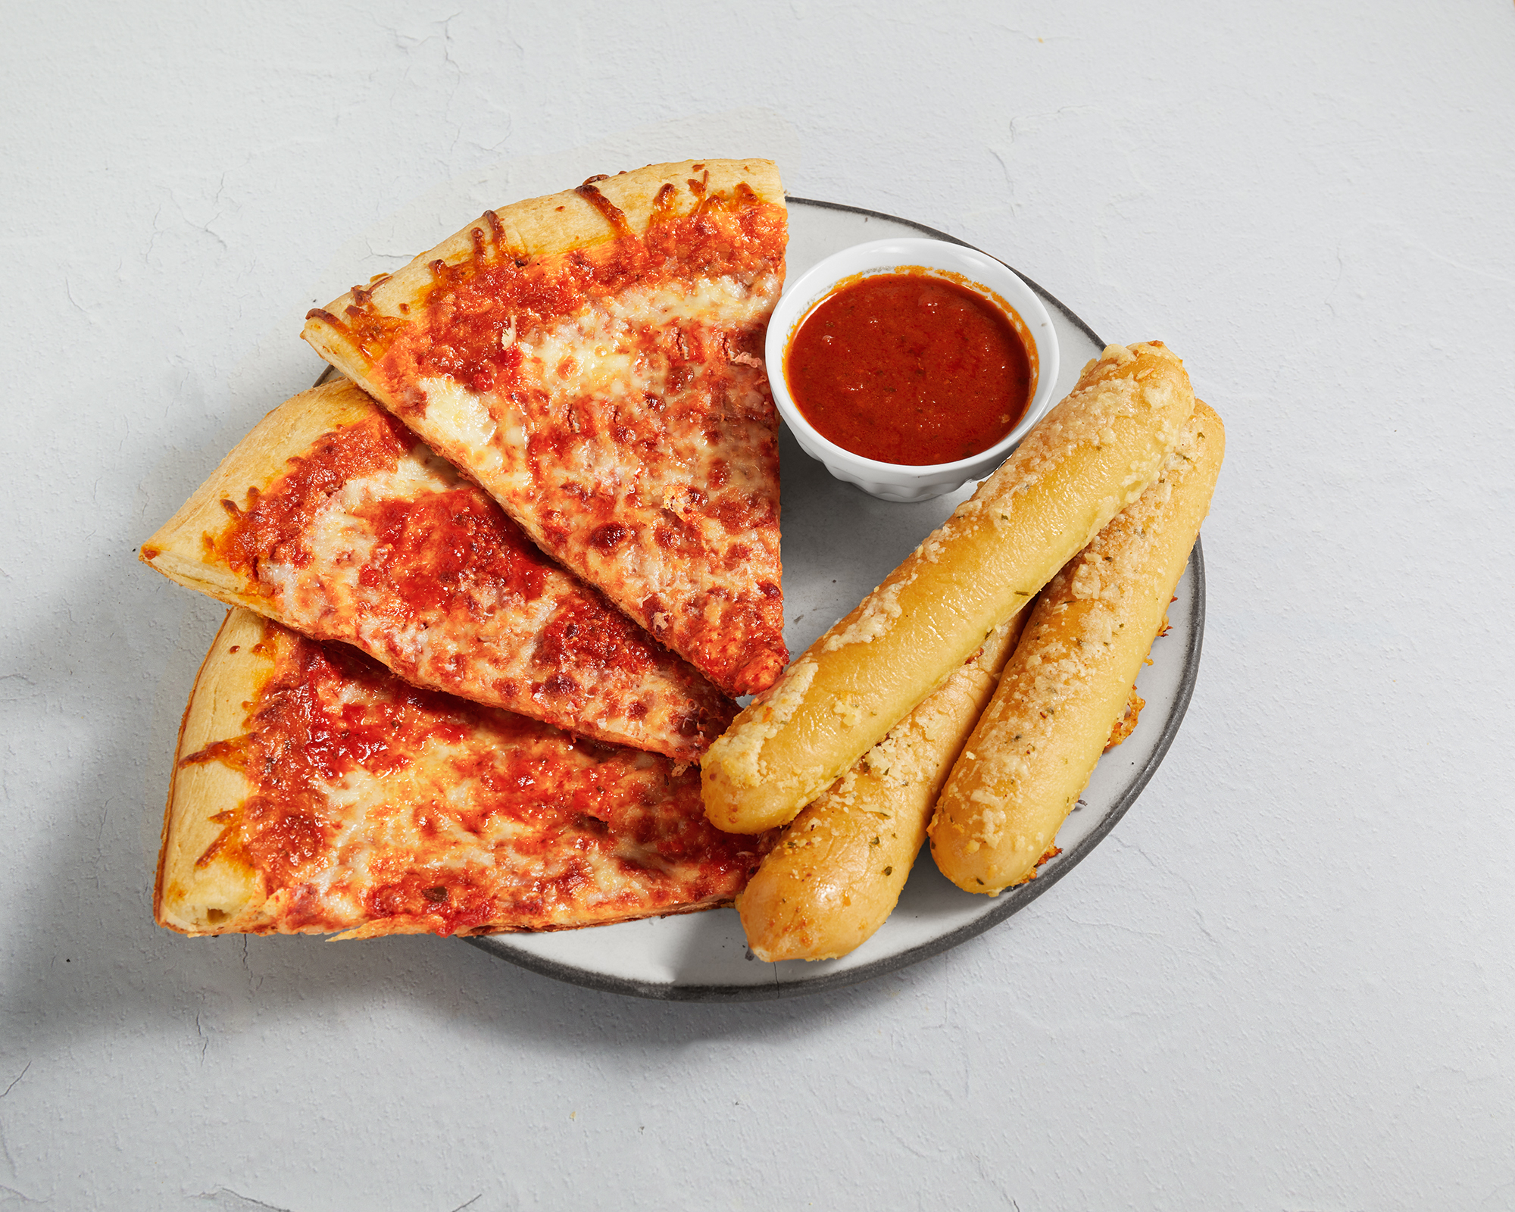
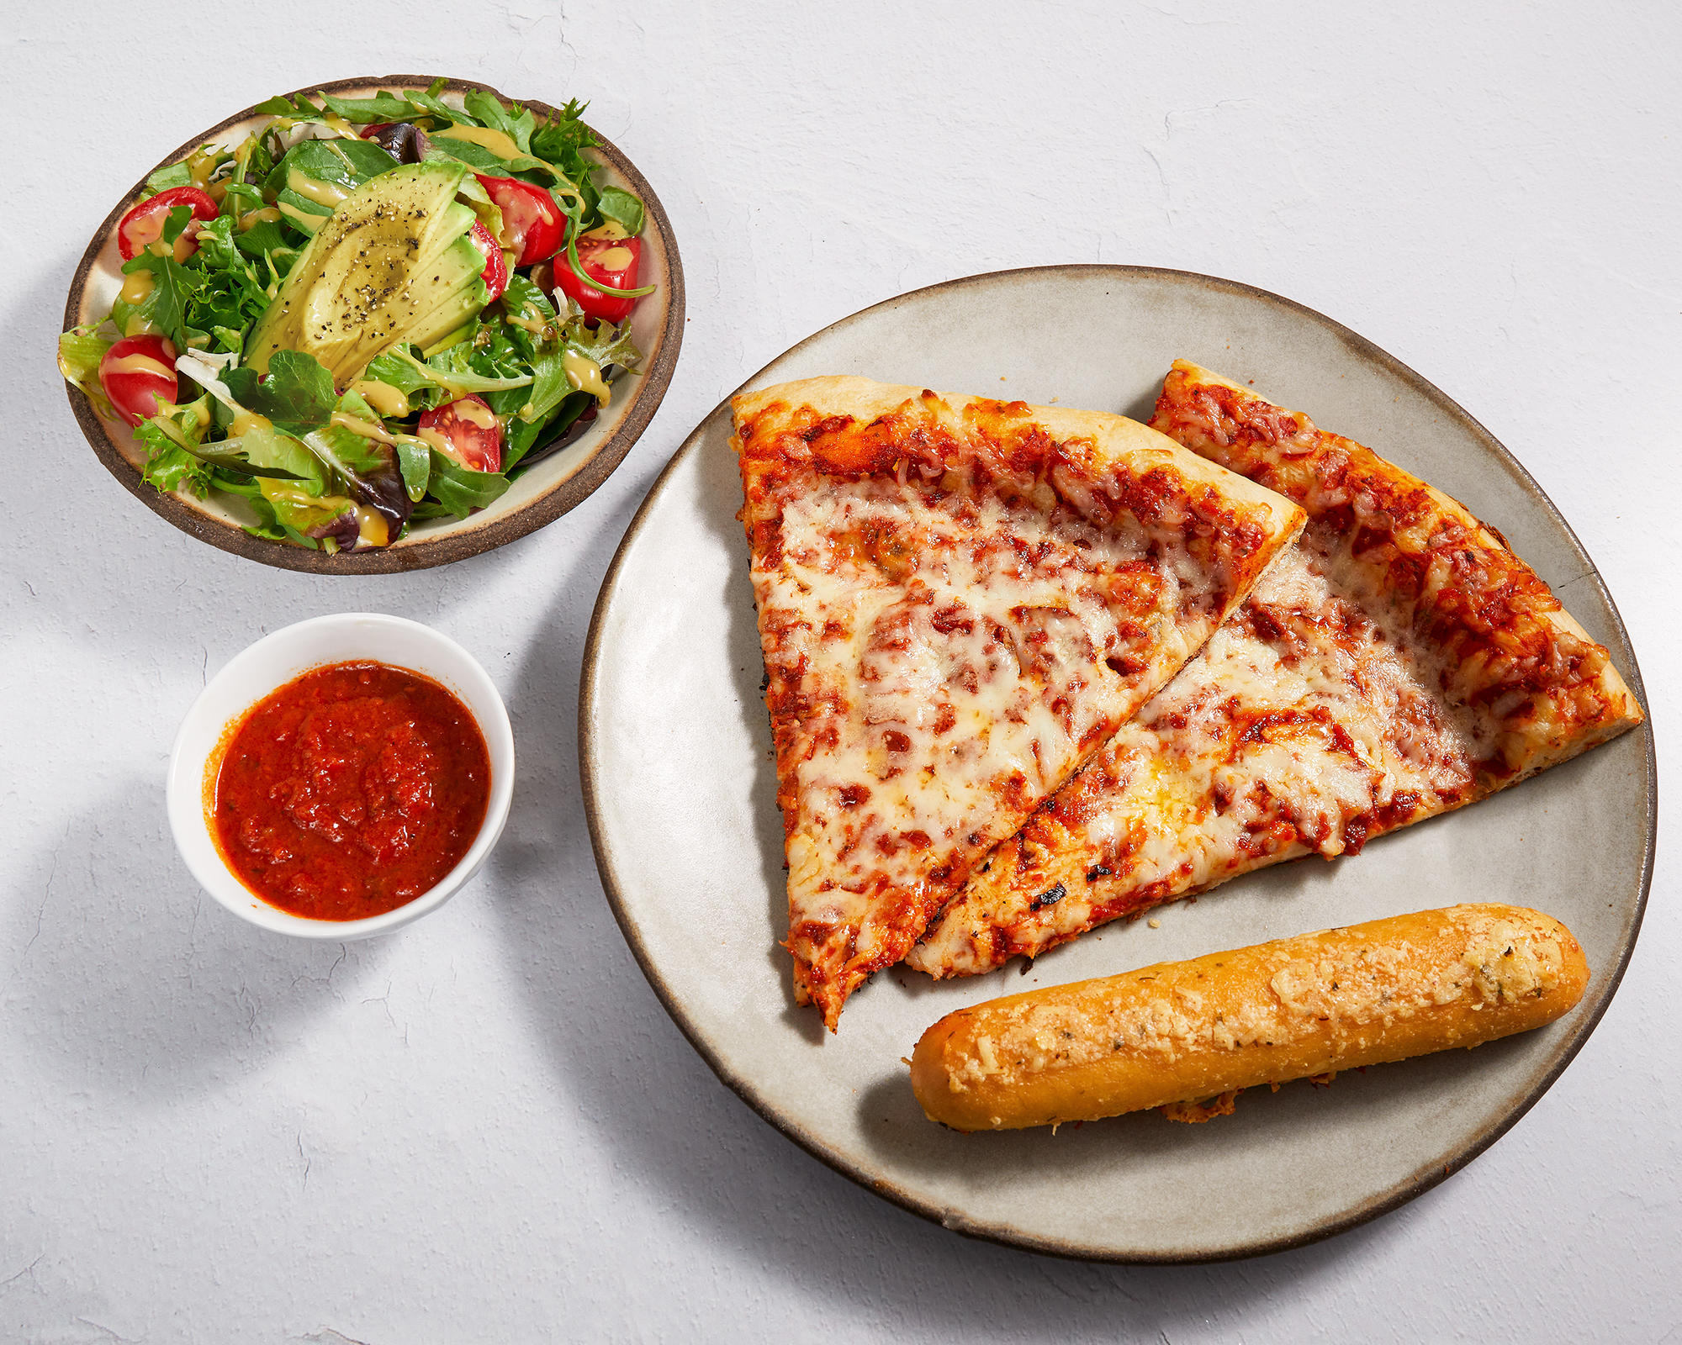
Meal Makeovers: Pizza
pg. 89

Slide 8
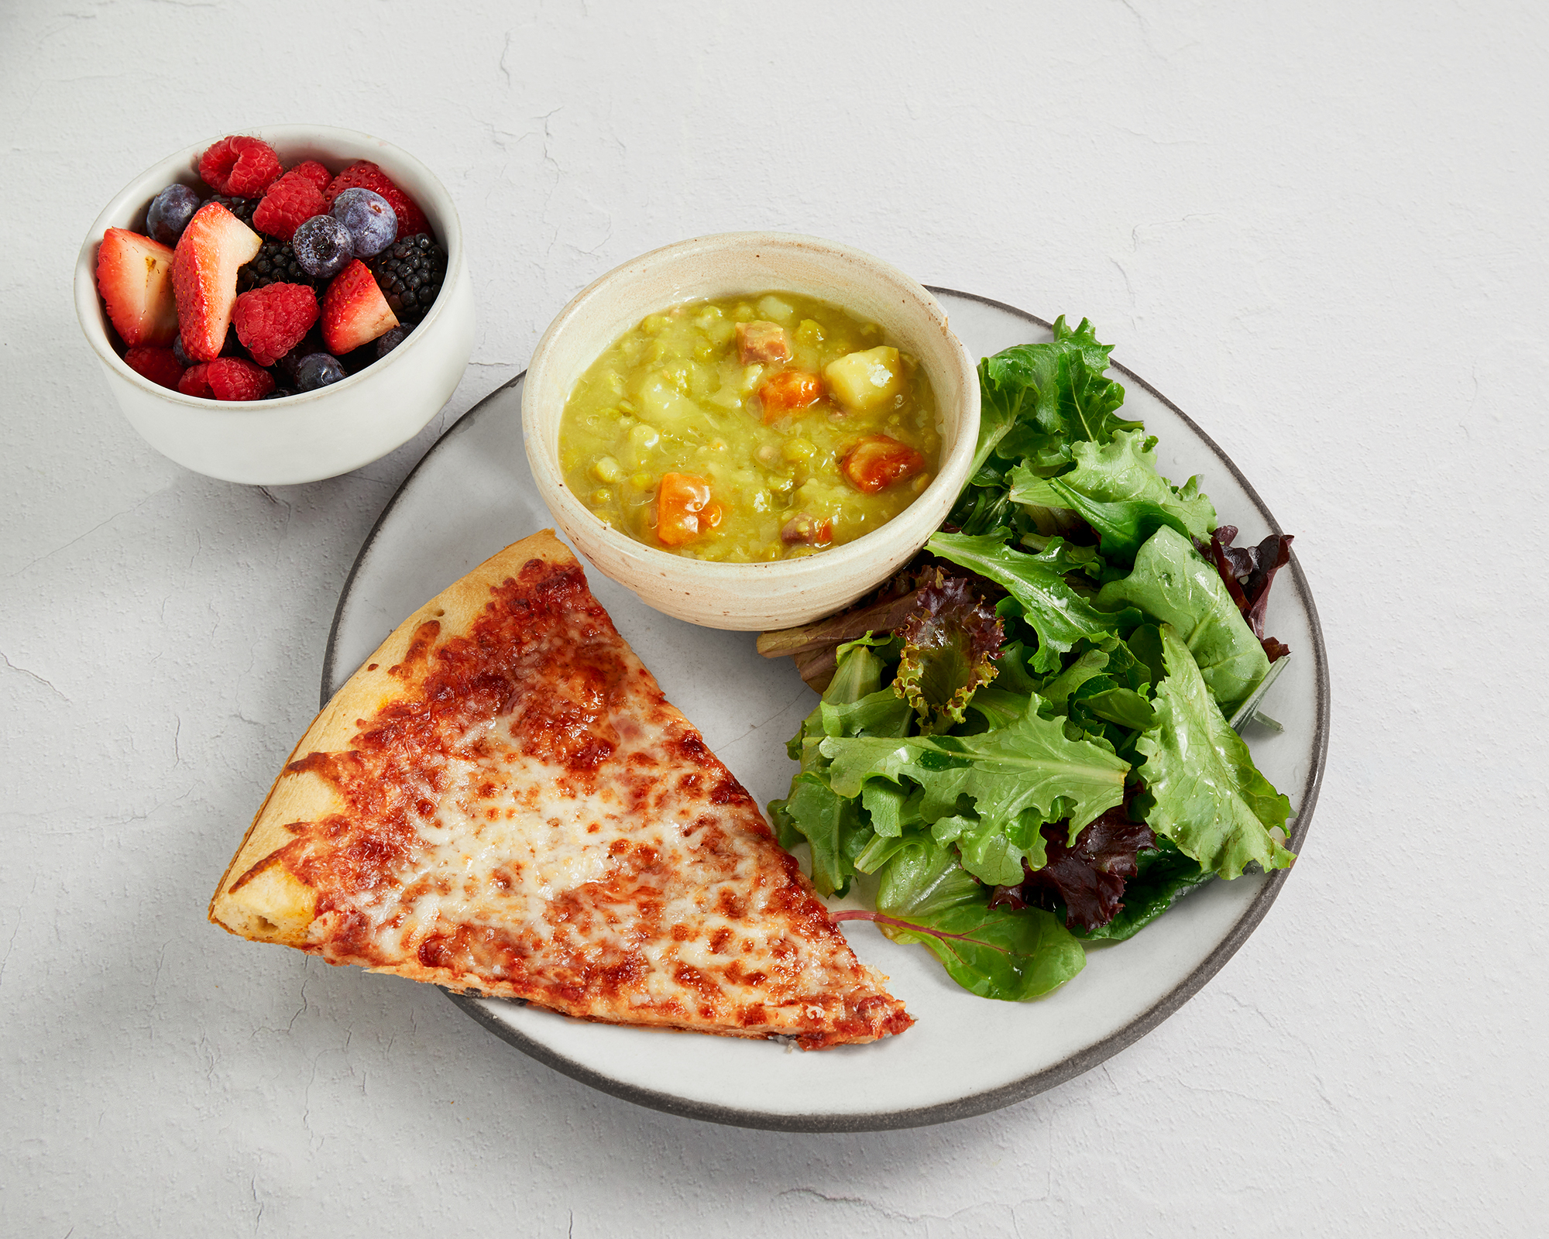
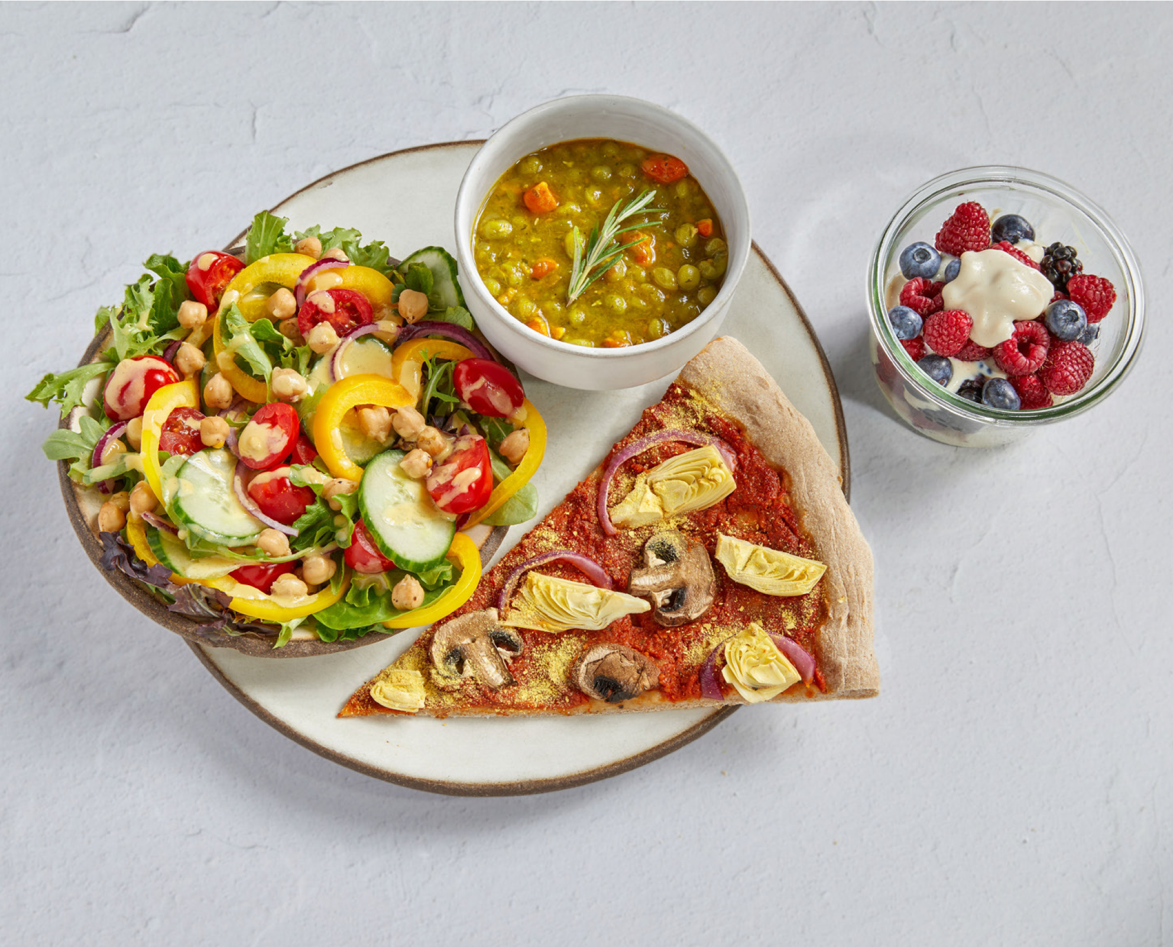
Meal Makeovers: Pizza
pg. 90

Slide 9
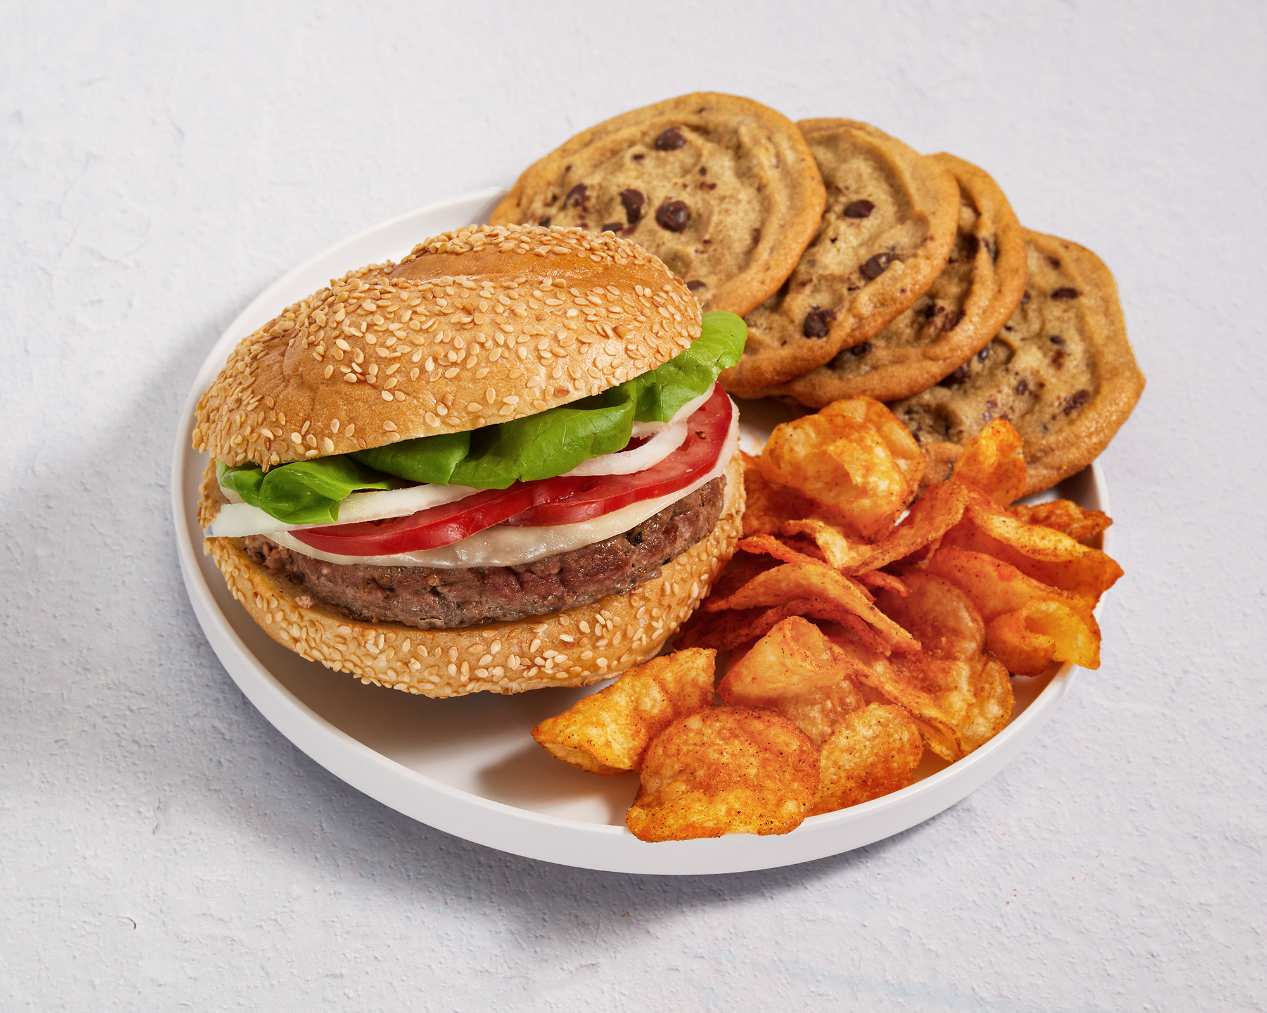
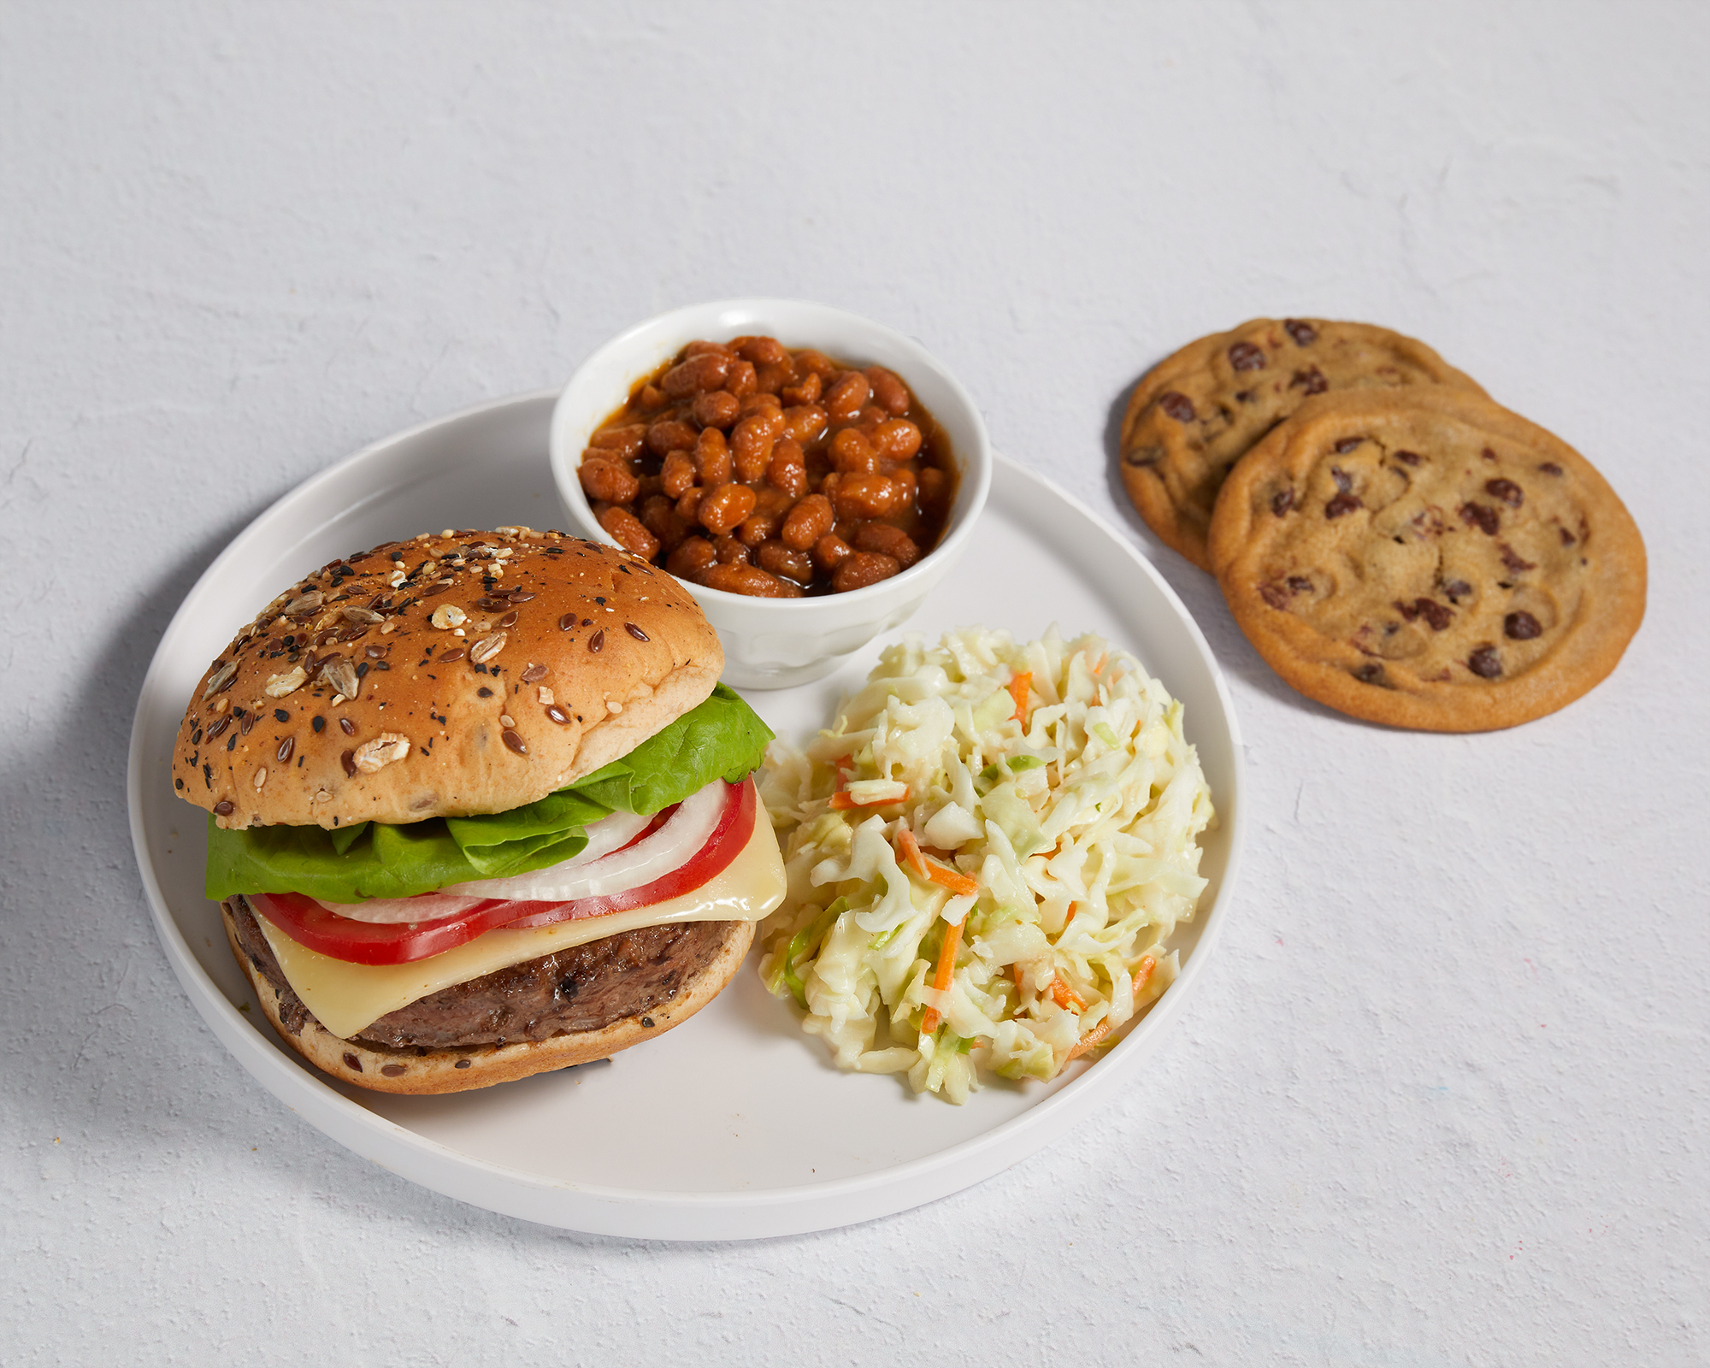
Meal Makeovers: Hamburgers
pg. 91

Slide 10
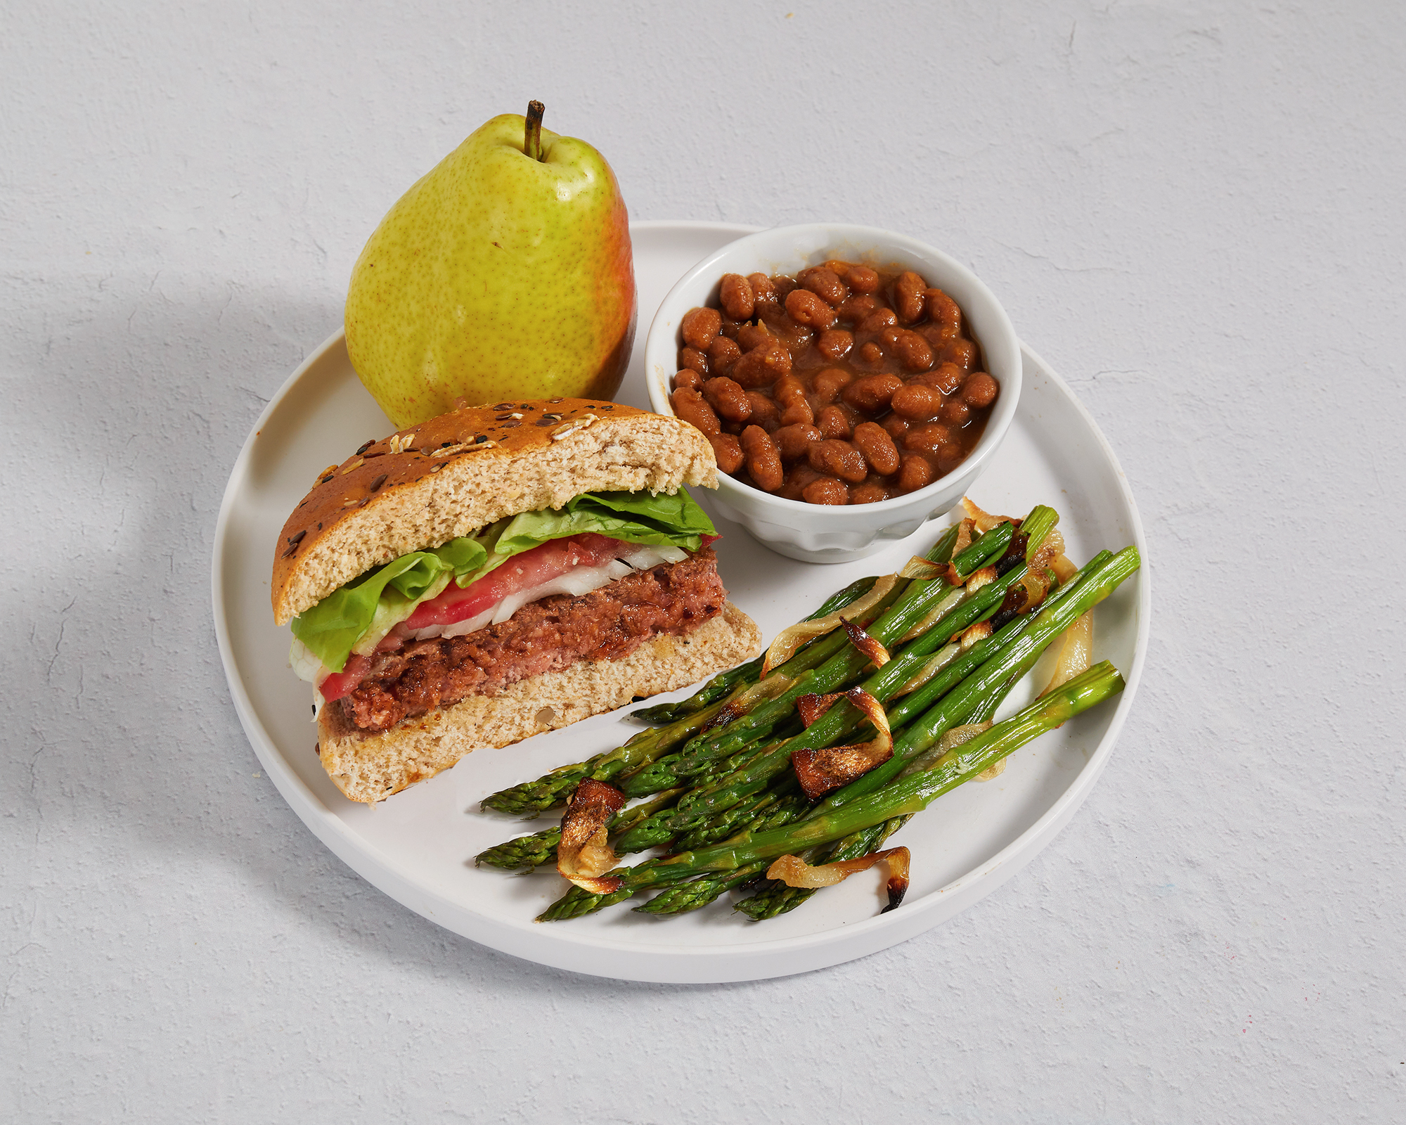
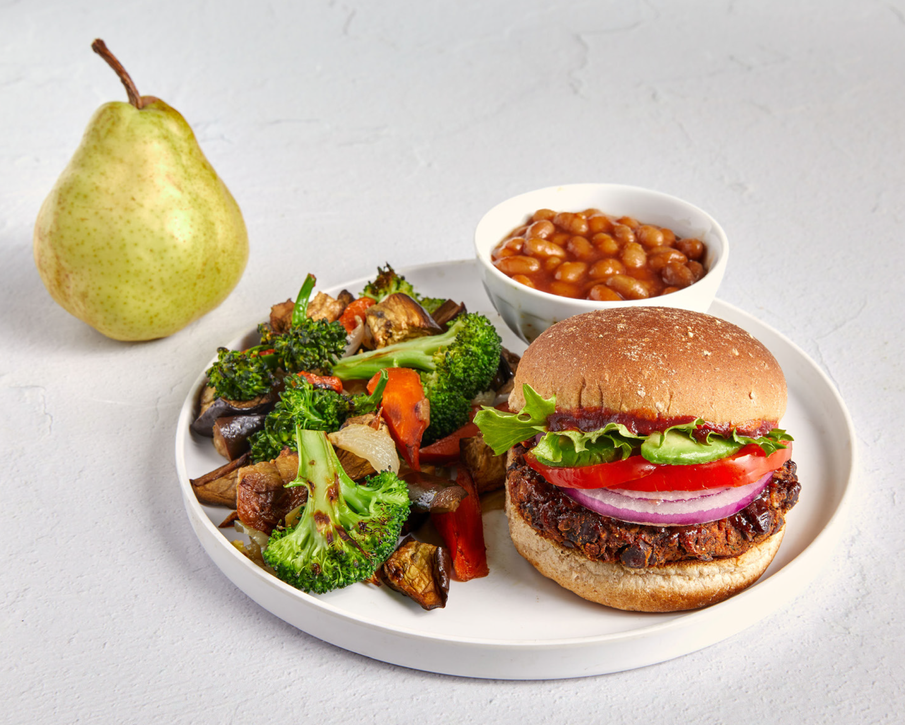
Meal Makeovers: Hamburgers
pg. 92

Slide 11
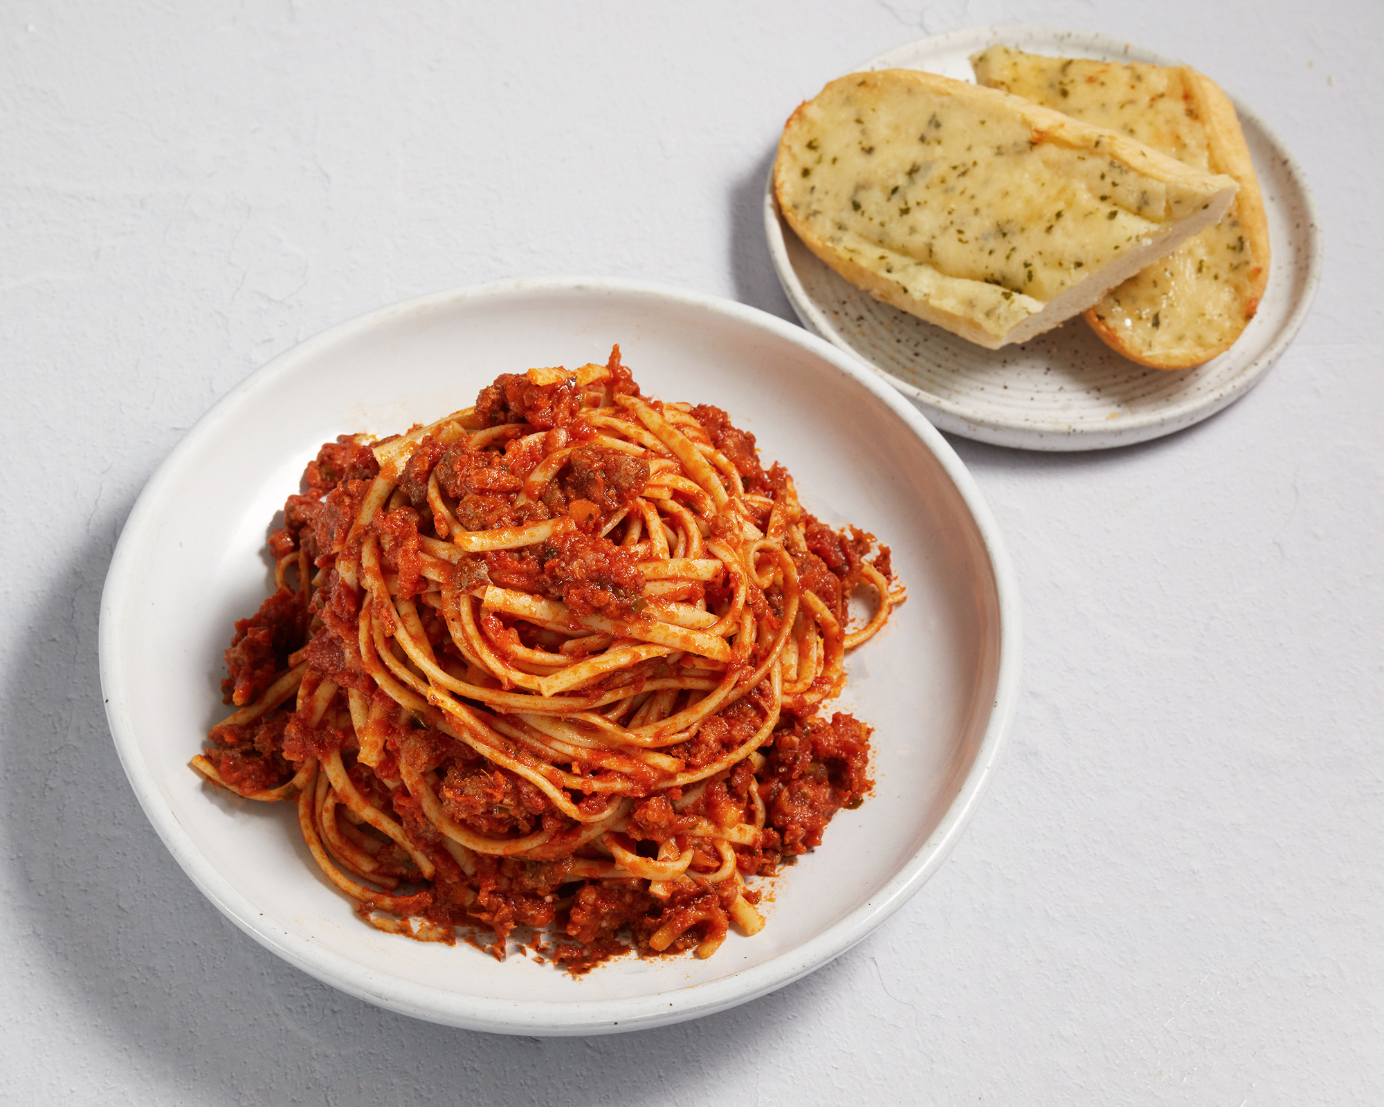
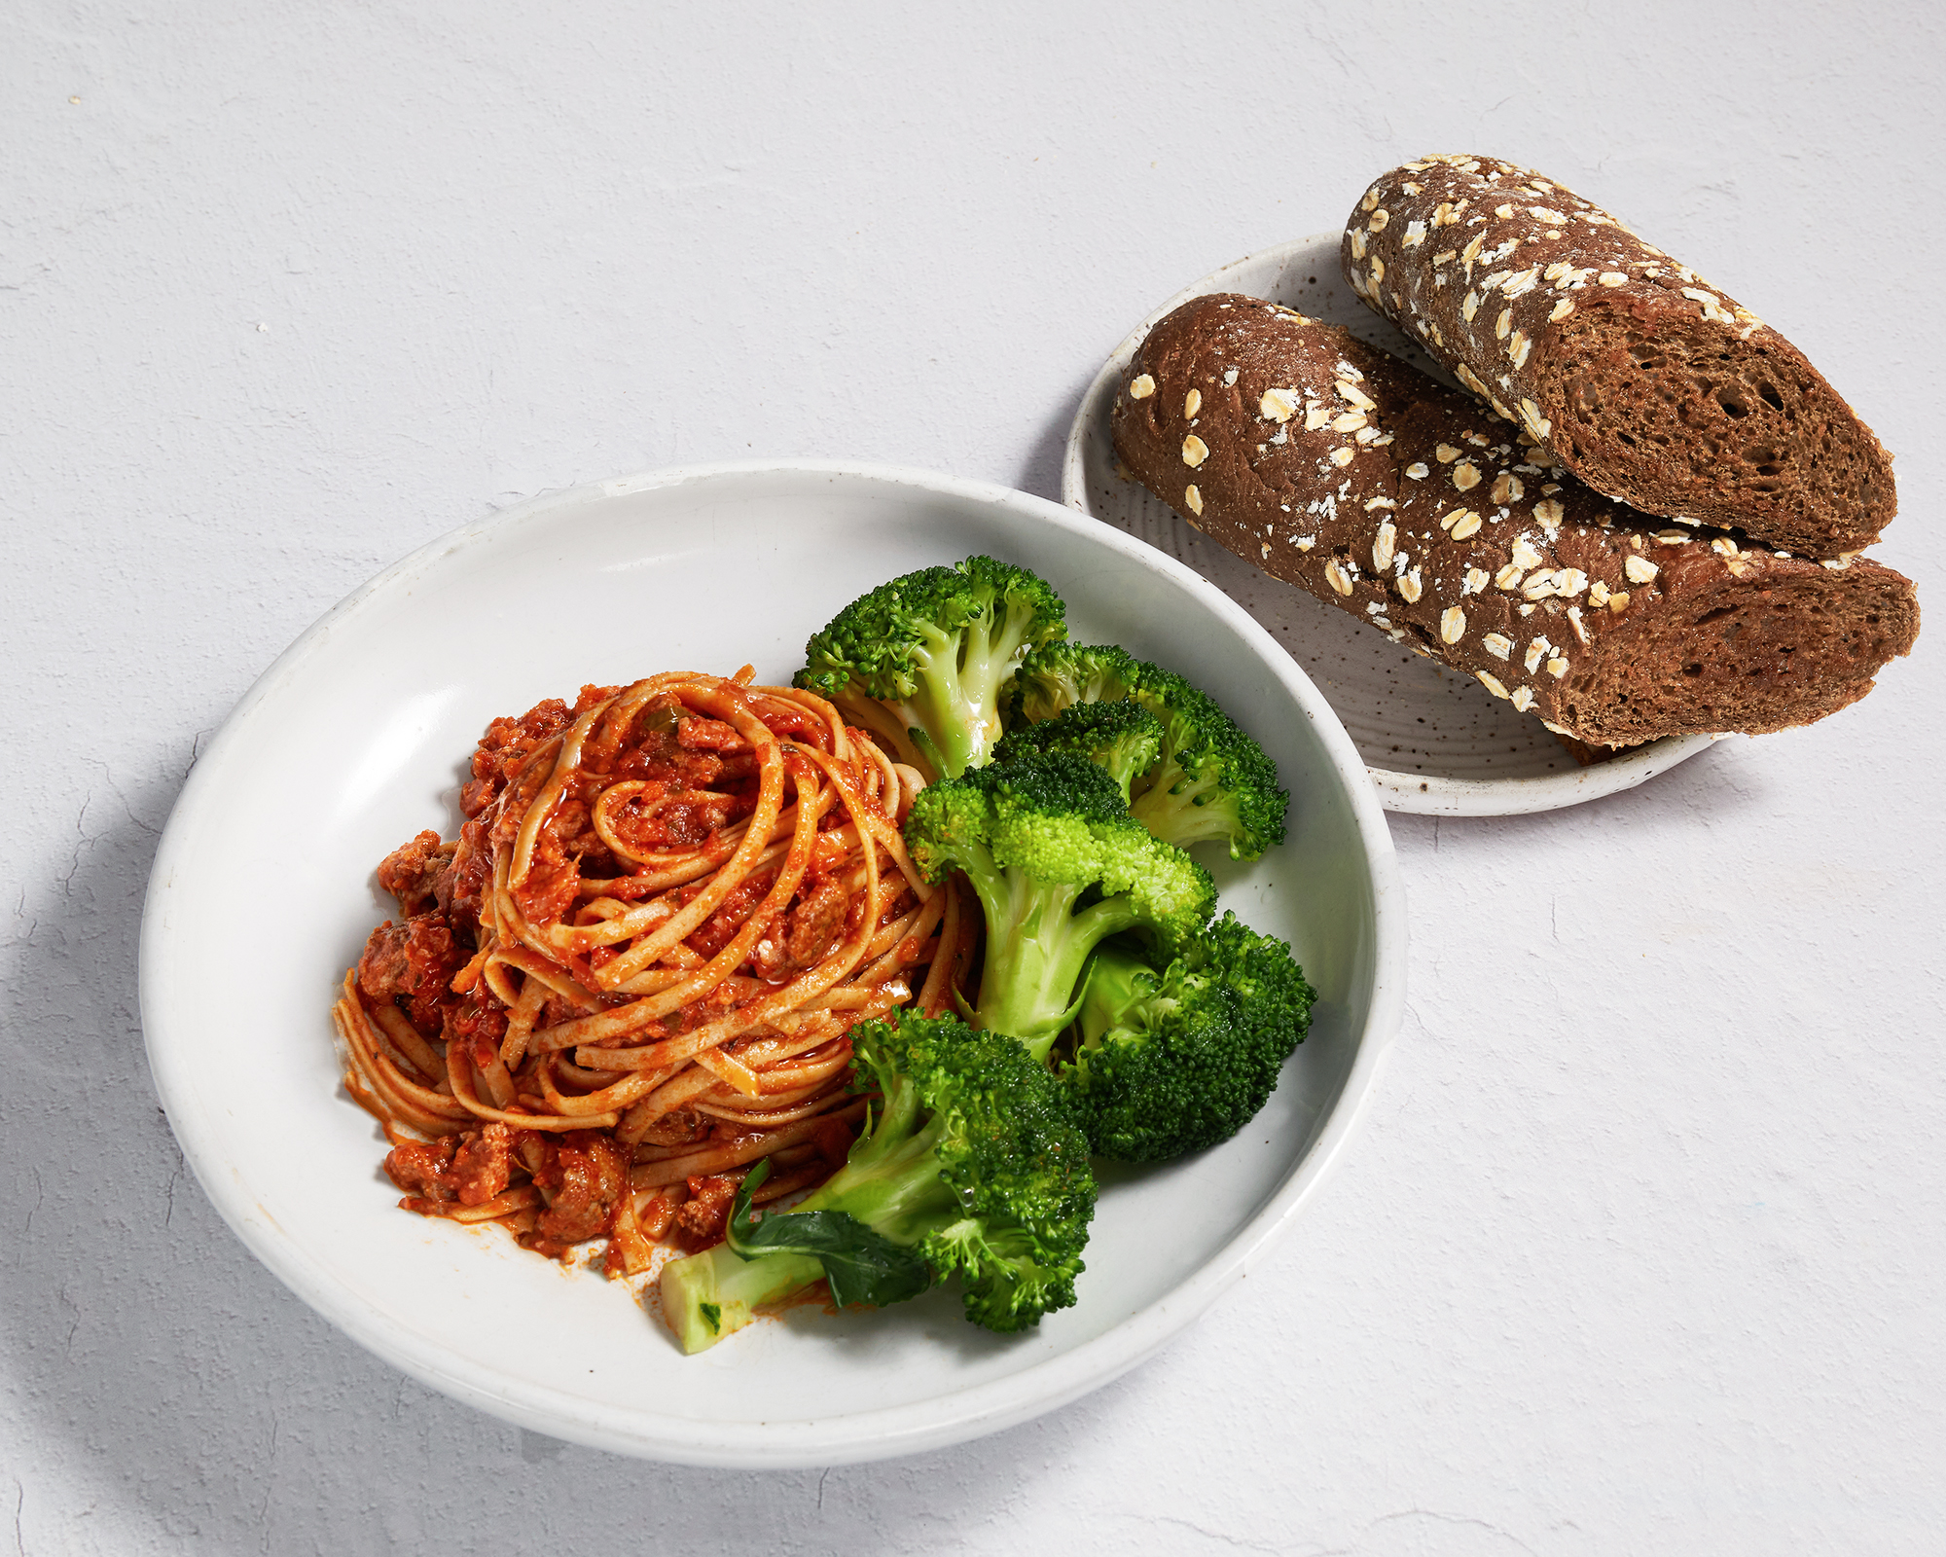
Meal Makeovers: Spaghetti
pg. 93

Slide 12
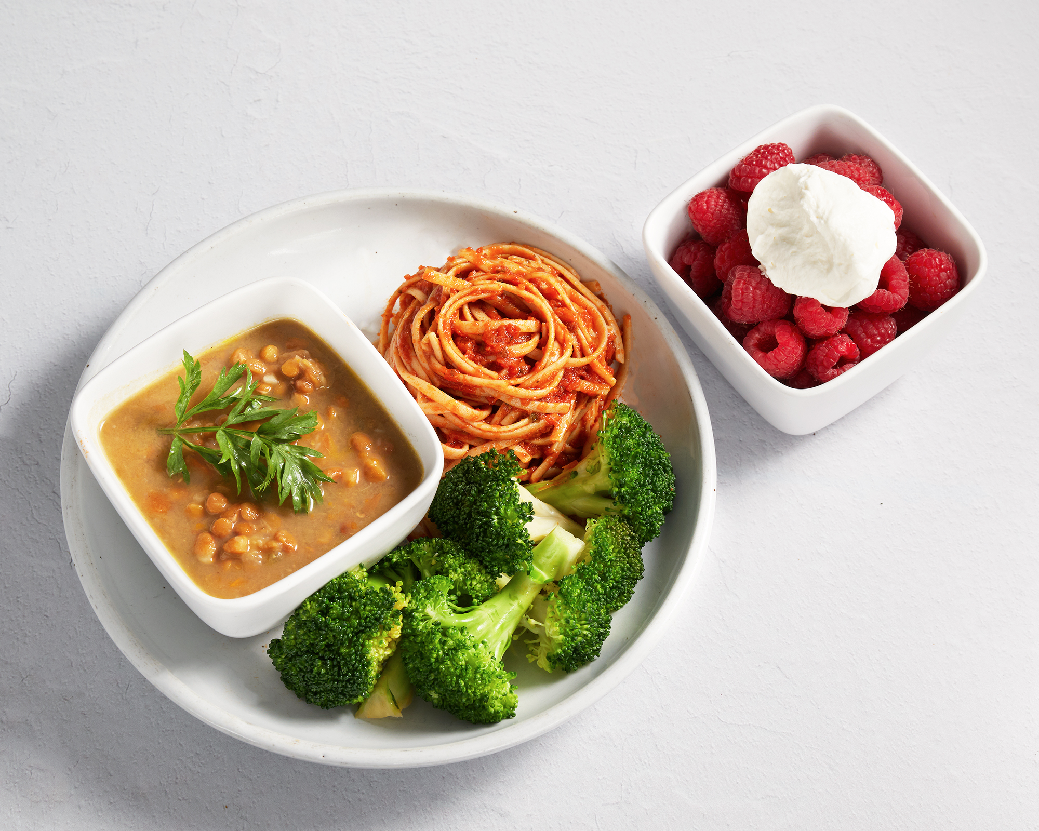
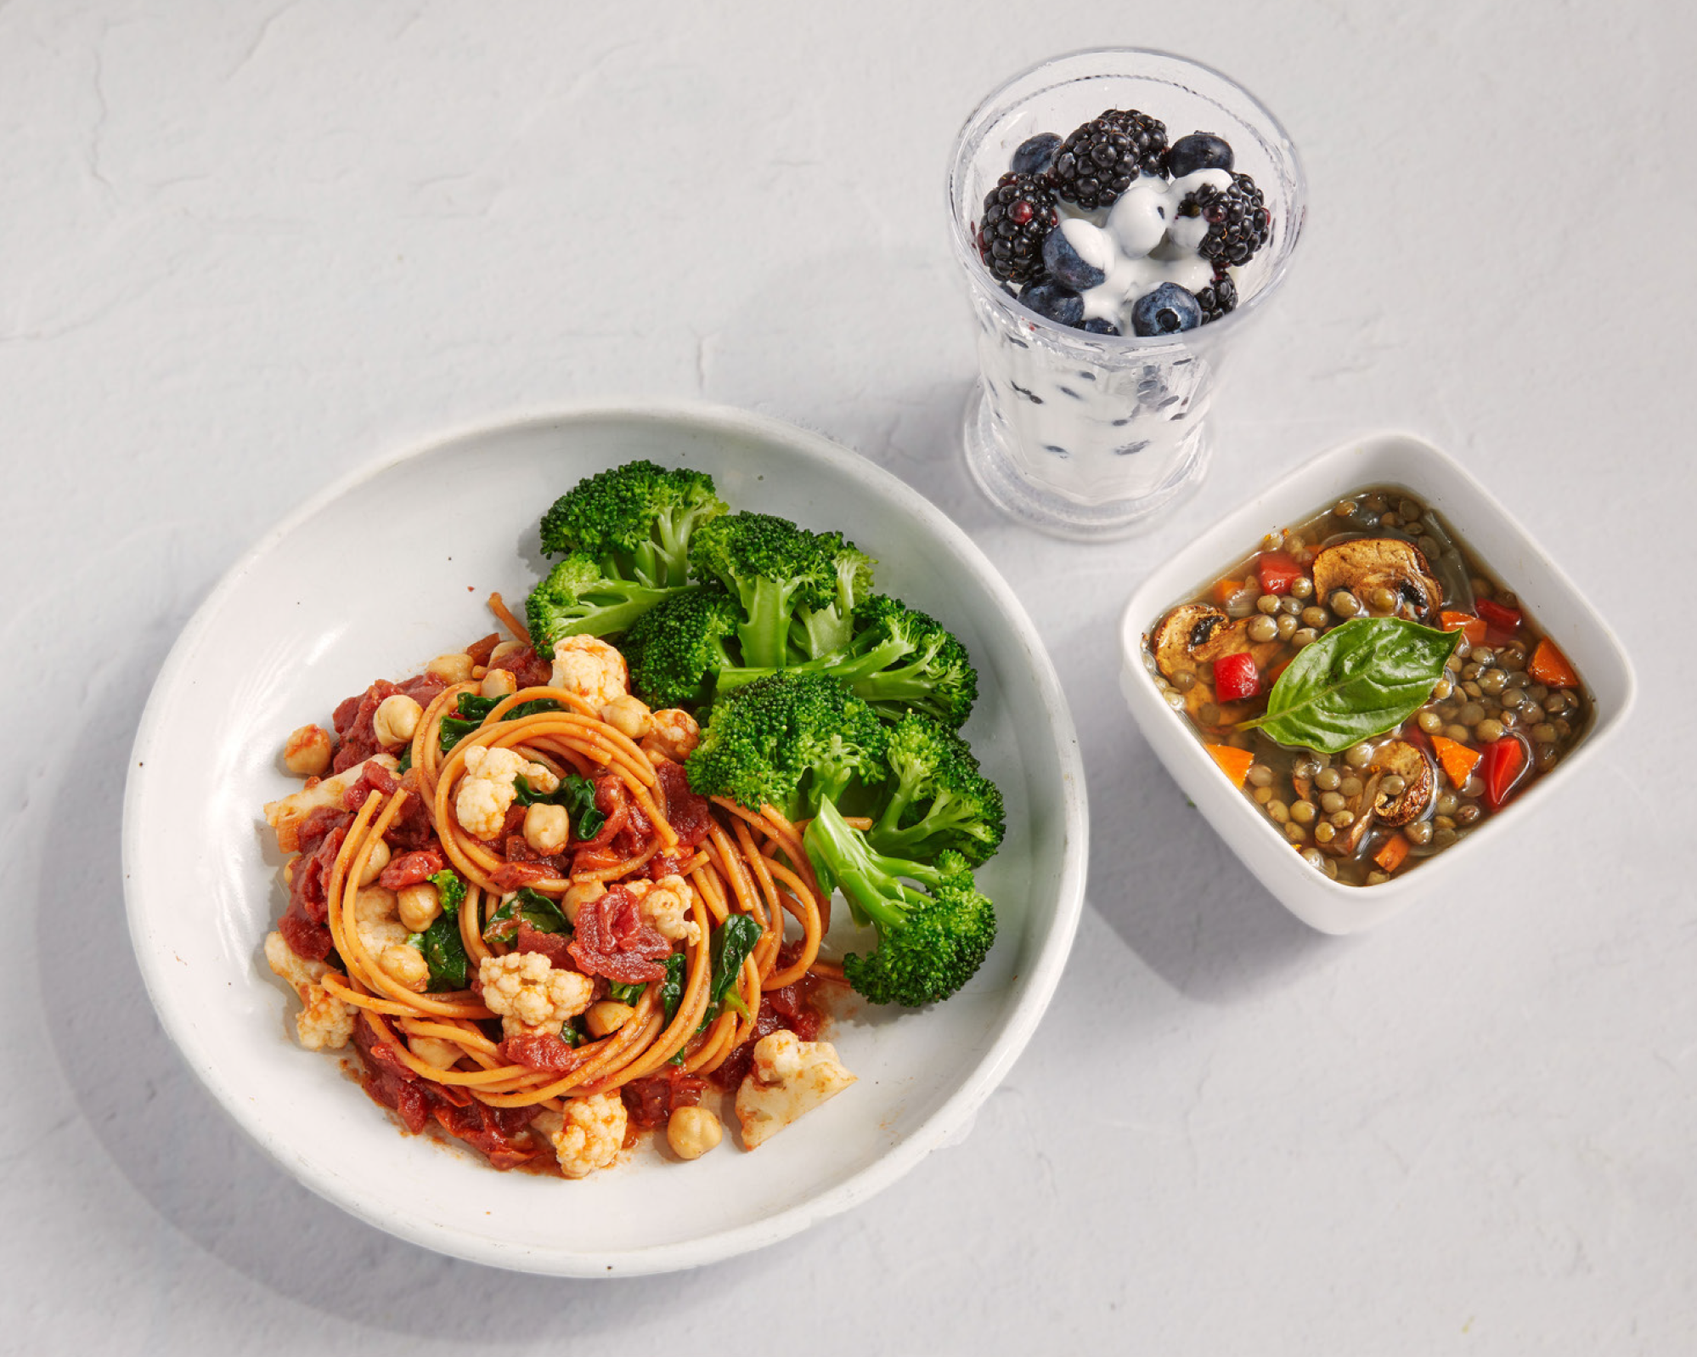
Meal Makeovers: Spaghetti
pg. 94

Slide 13
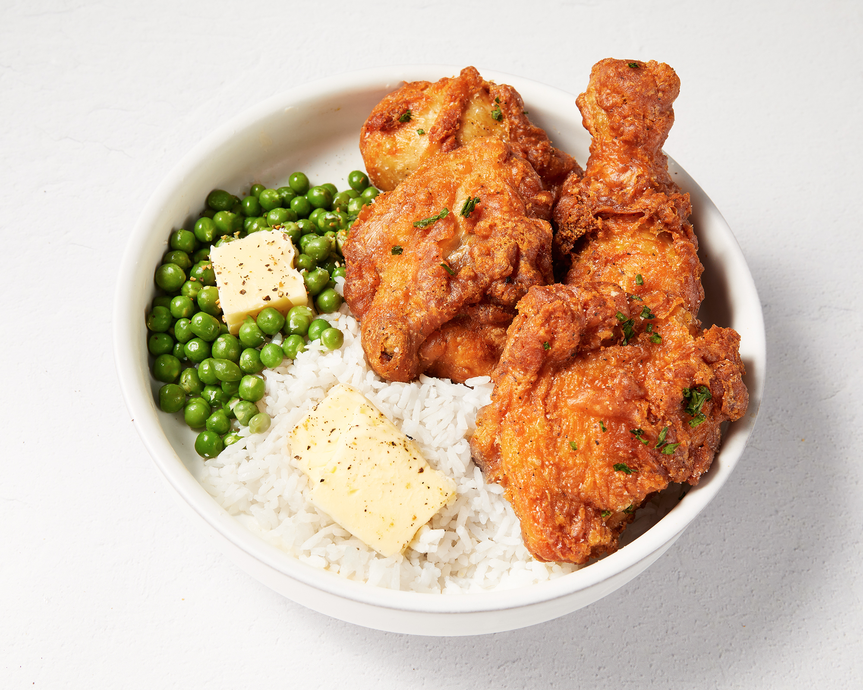
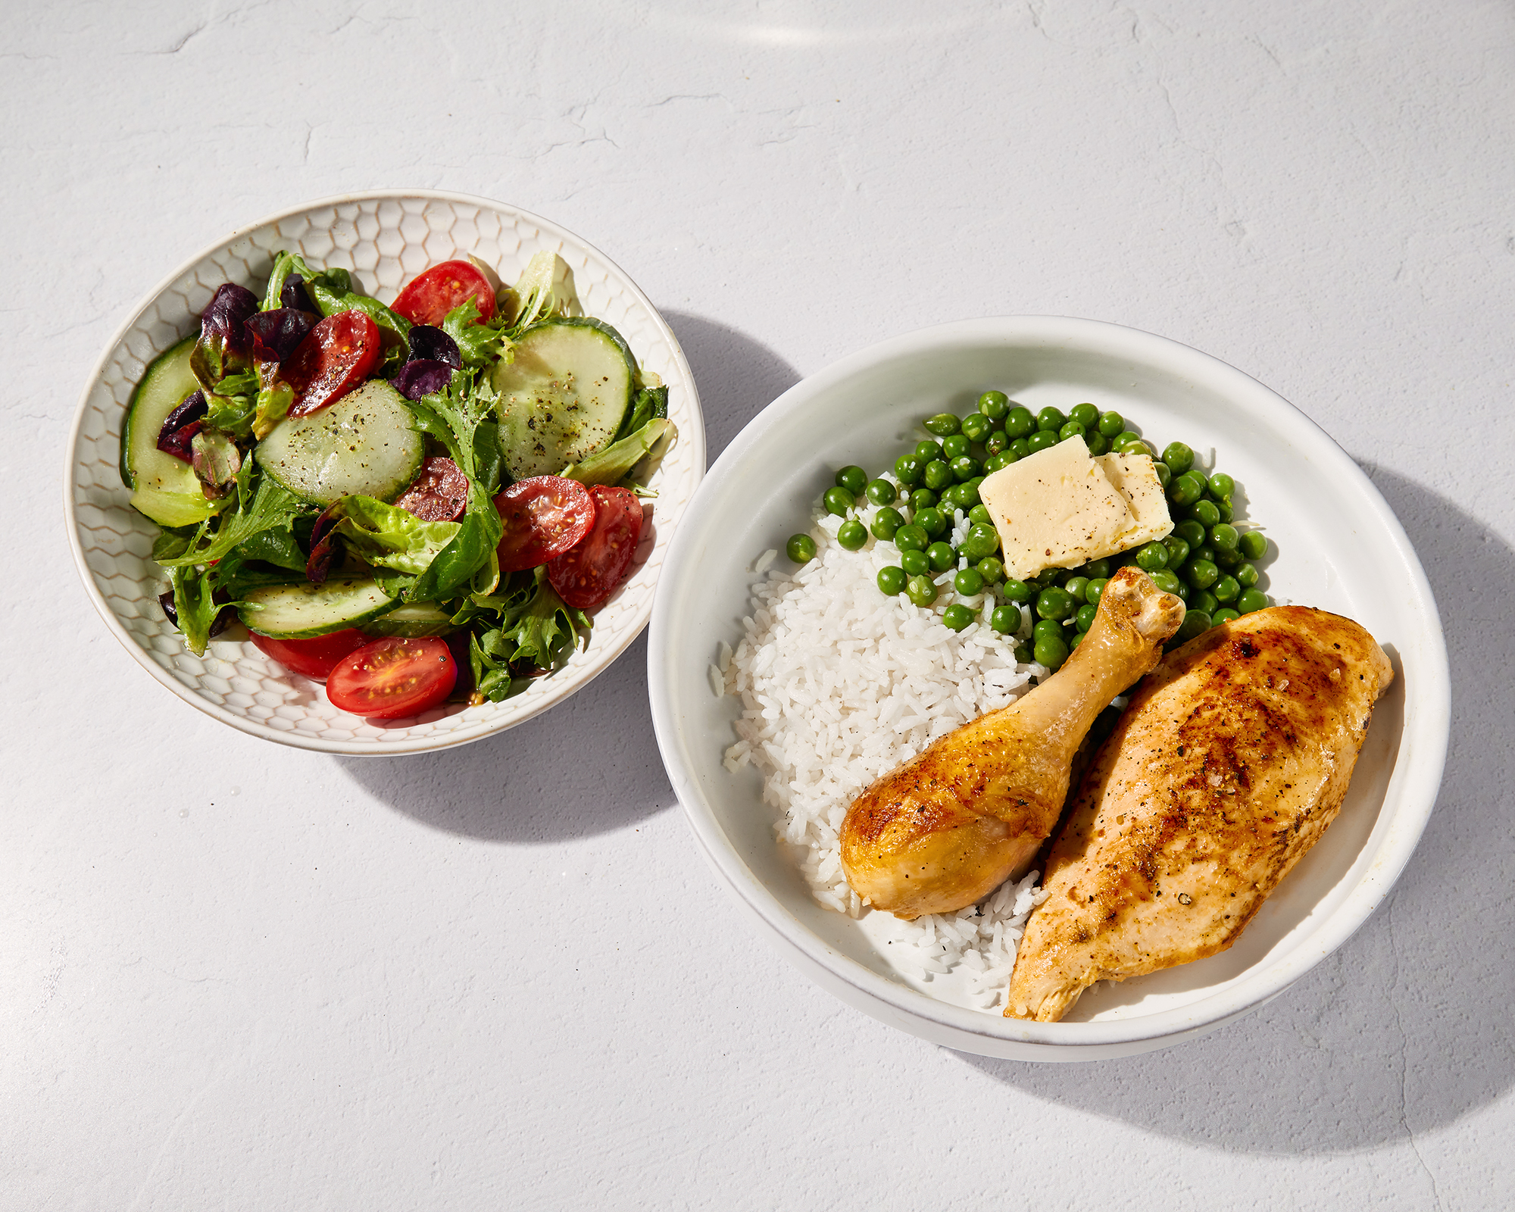
Meal Makeovers: Chicken
pg. 95

Slide 14
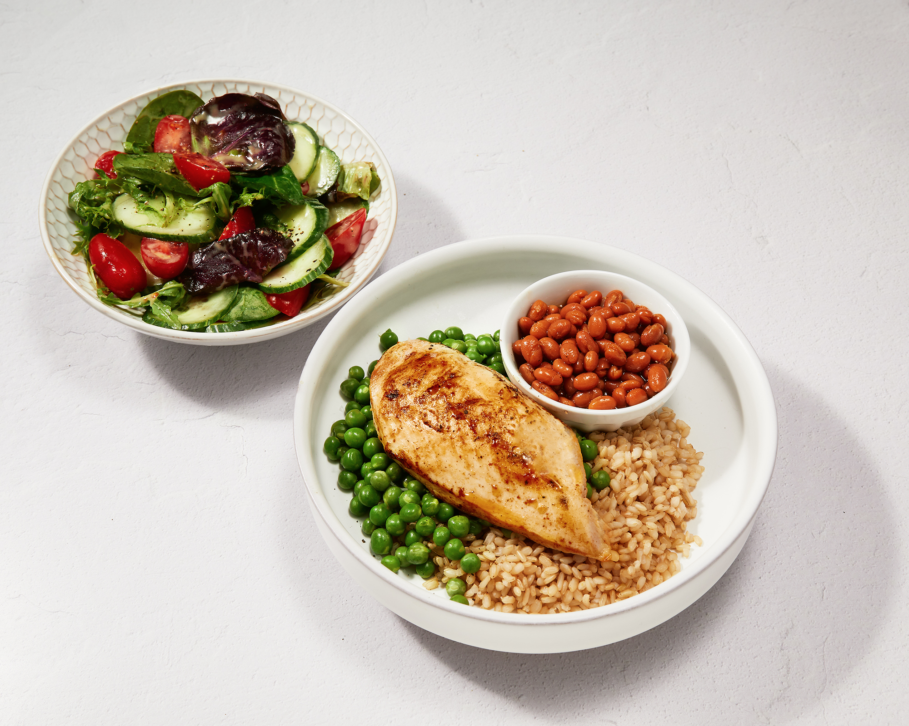
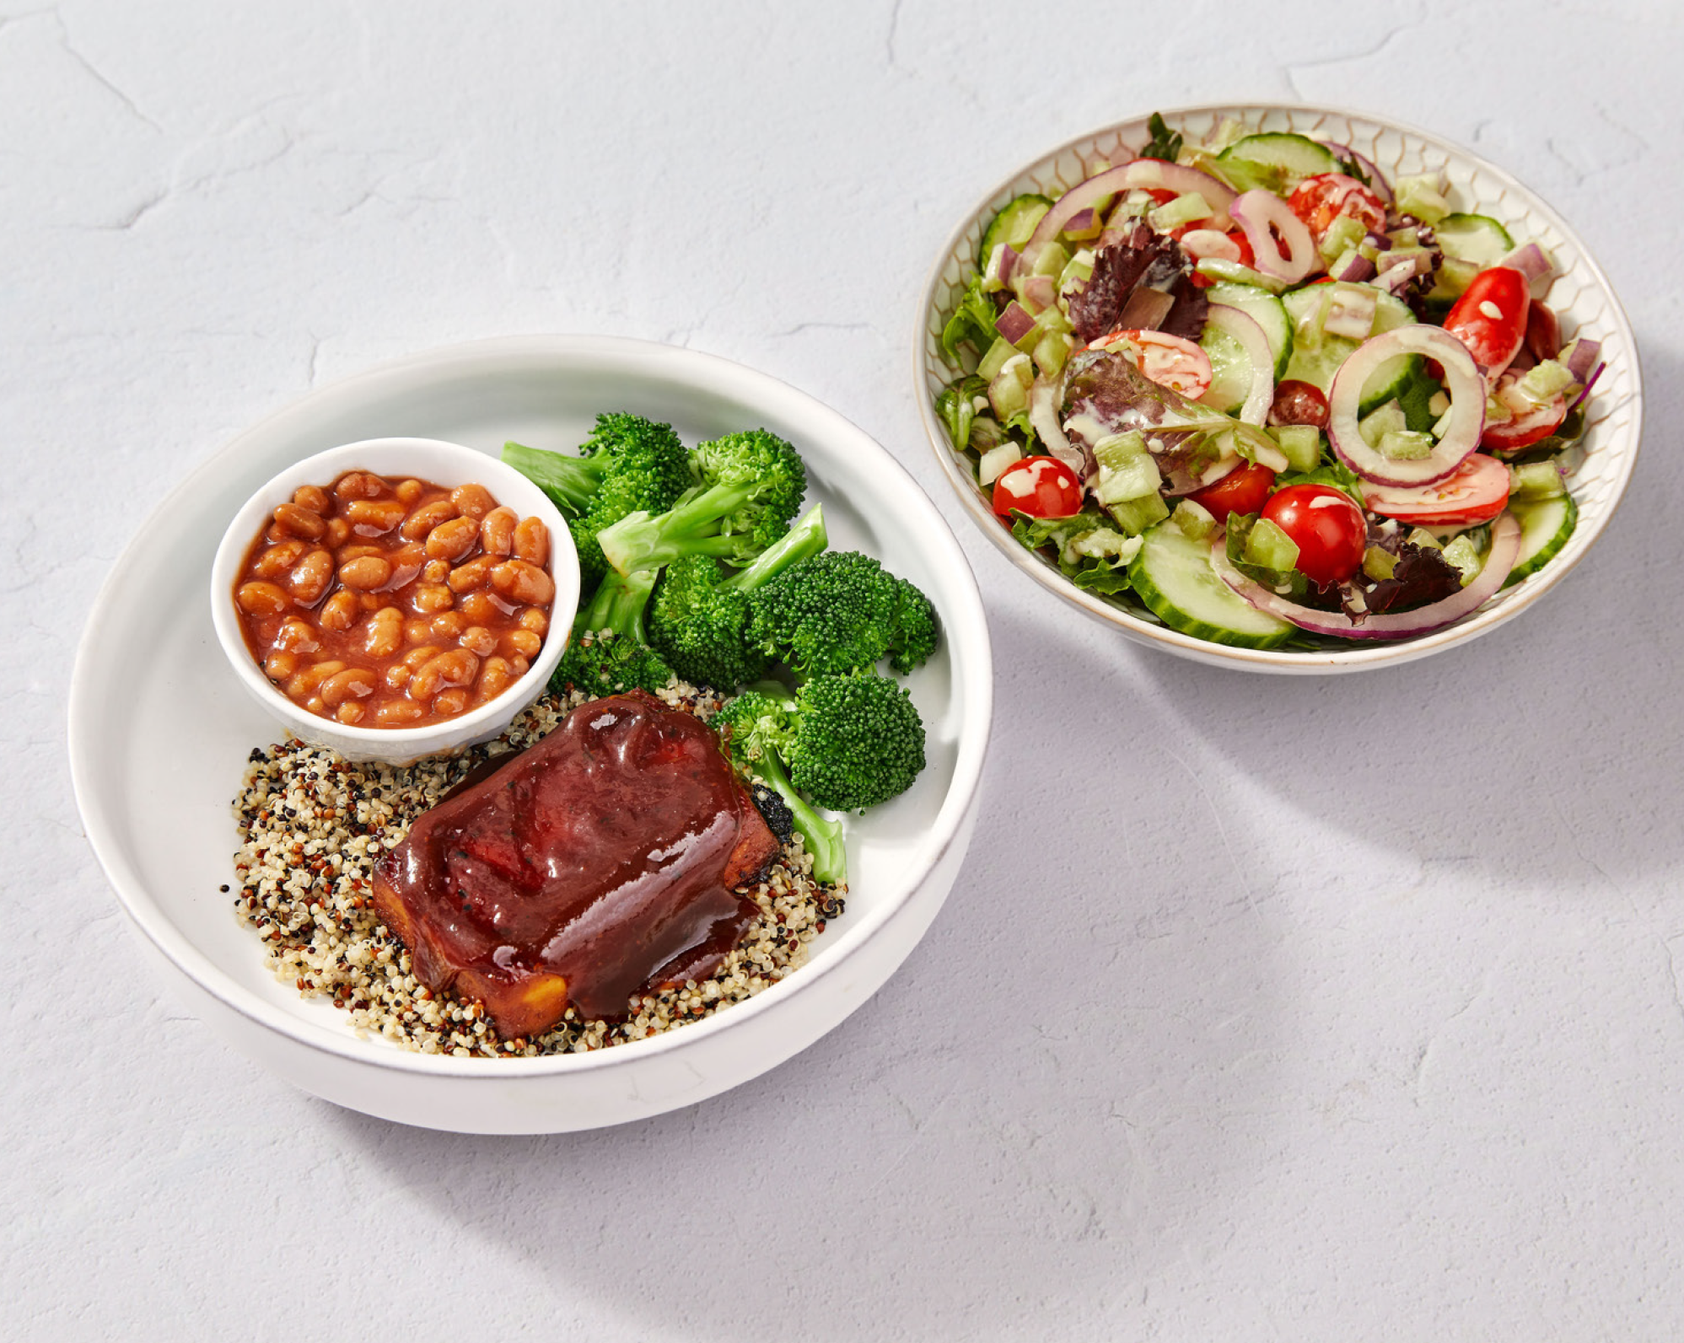
Meal Makeovers: Chicken
pg. 96

Slide 15
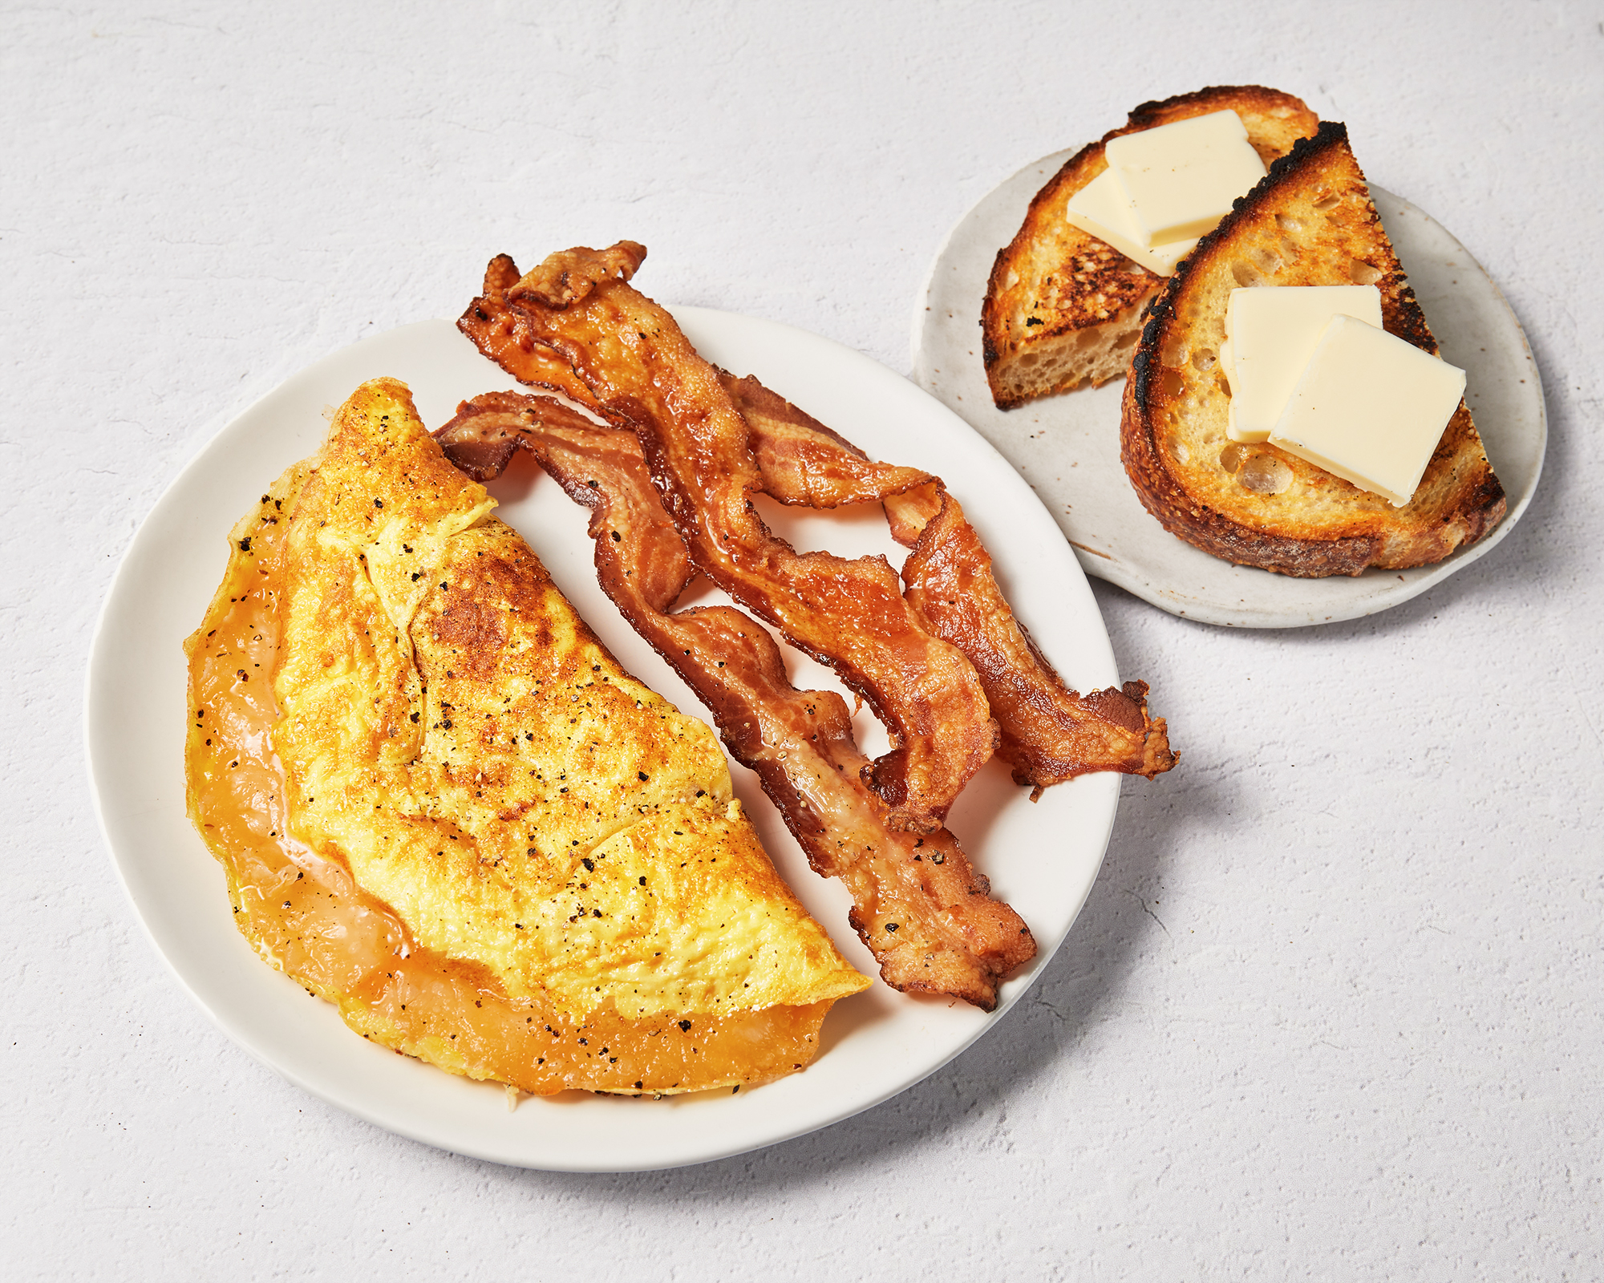
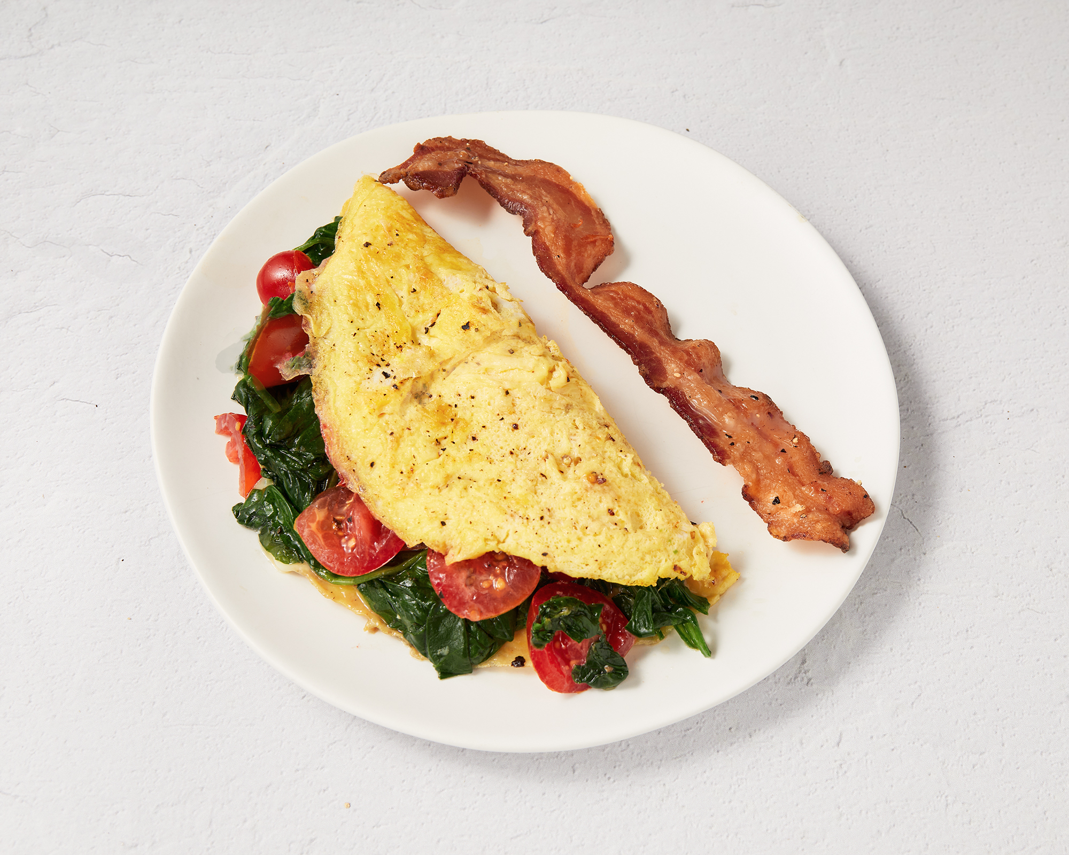
Meal Makeovers: Breakfast
pg. 97

Slide 16
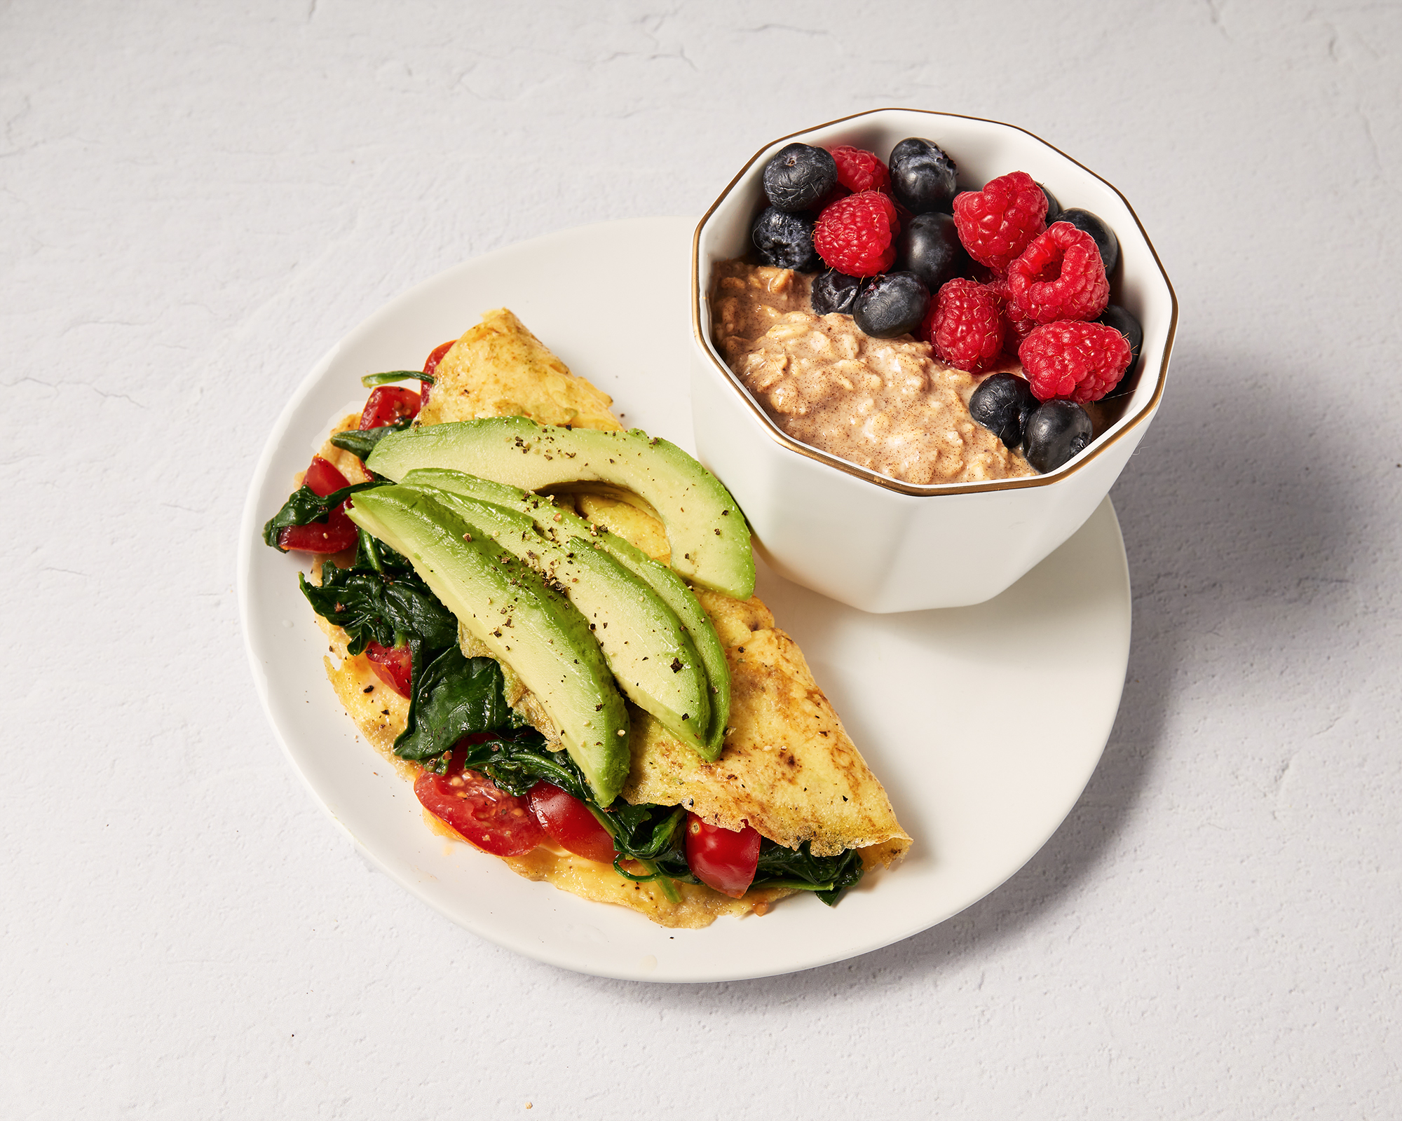
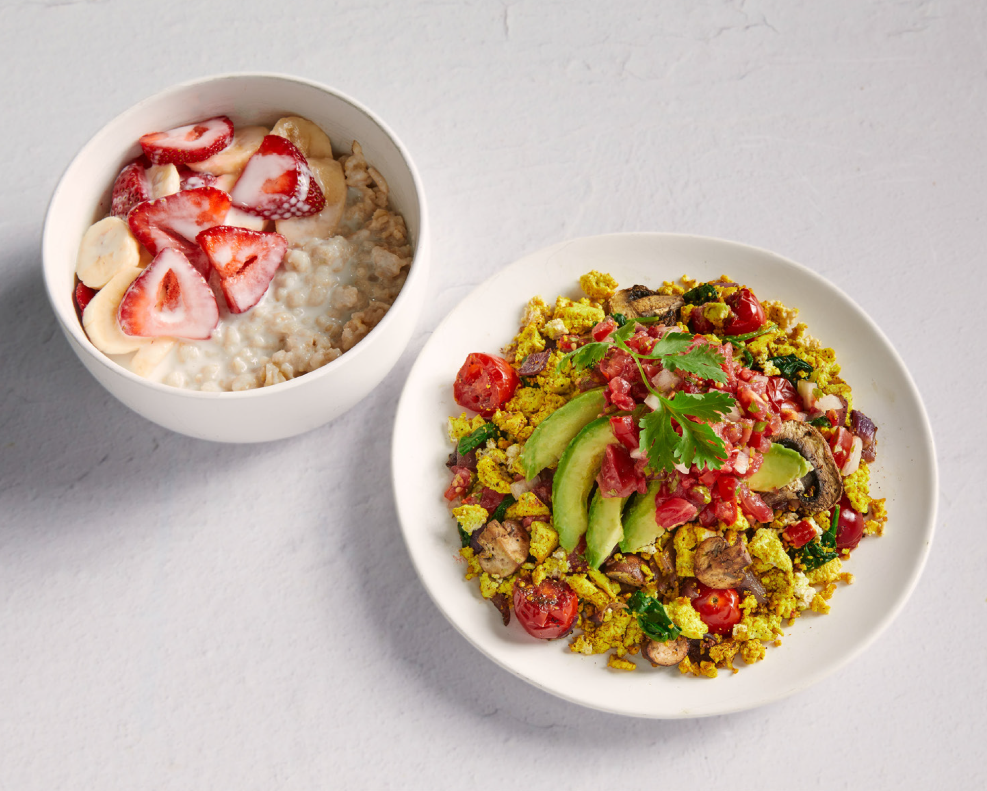
Meal Makeovers: Breakfast
pg. 98

Slide 17
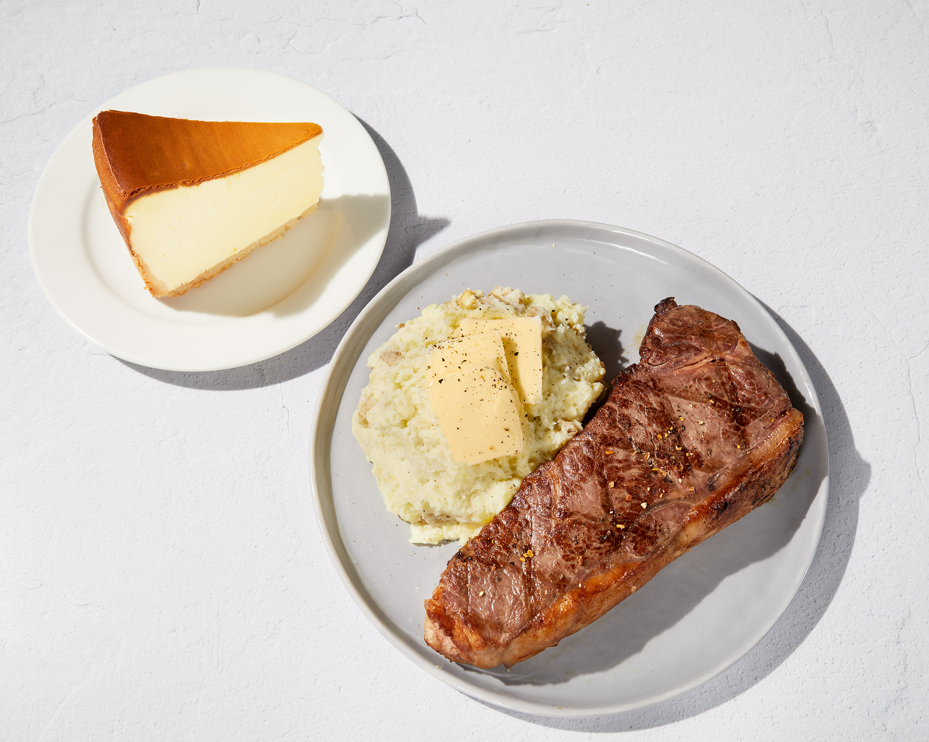
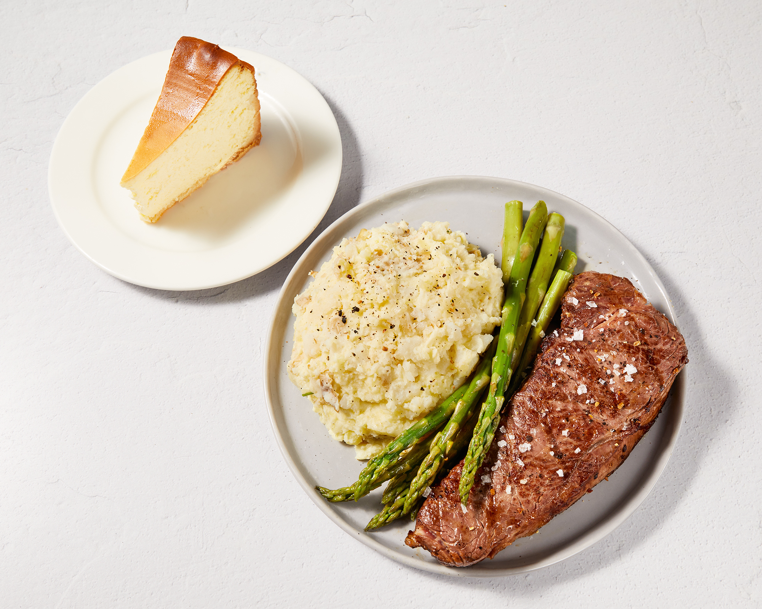
Meal Makeovers: Steak
pg. 99

Slide 18
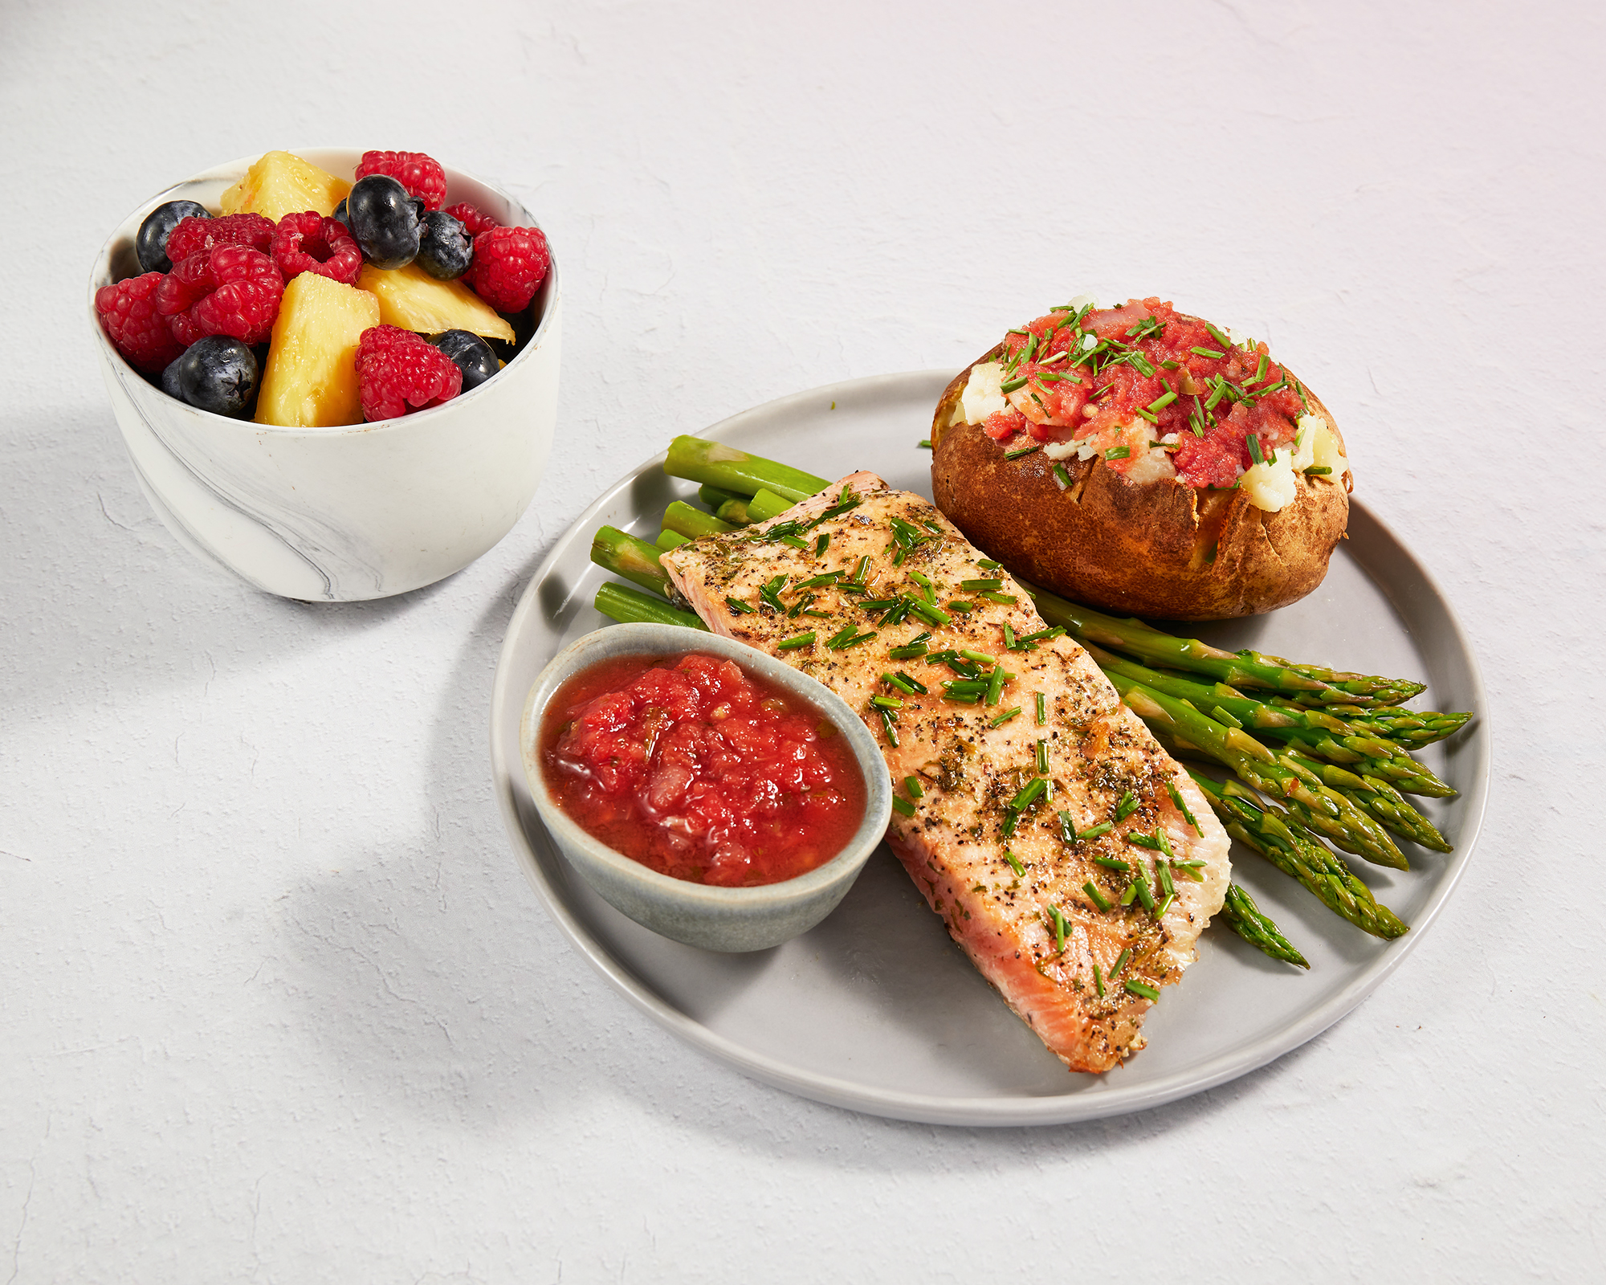
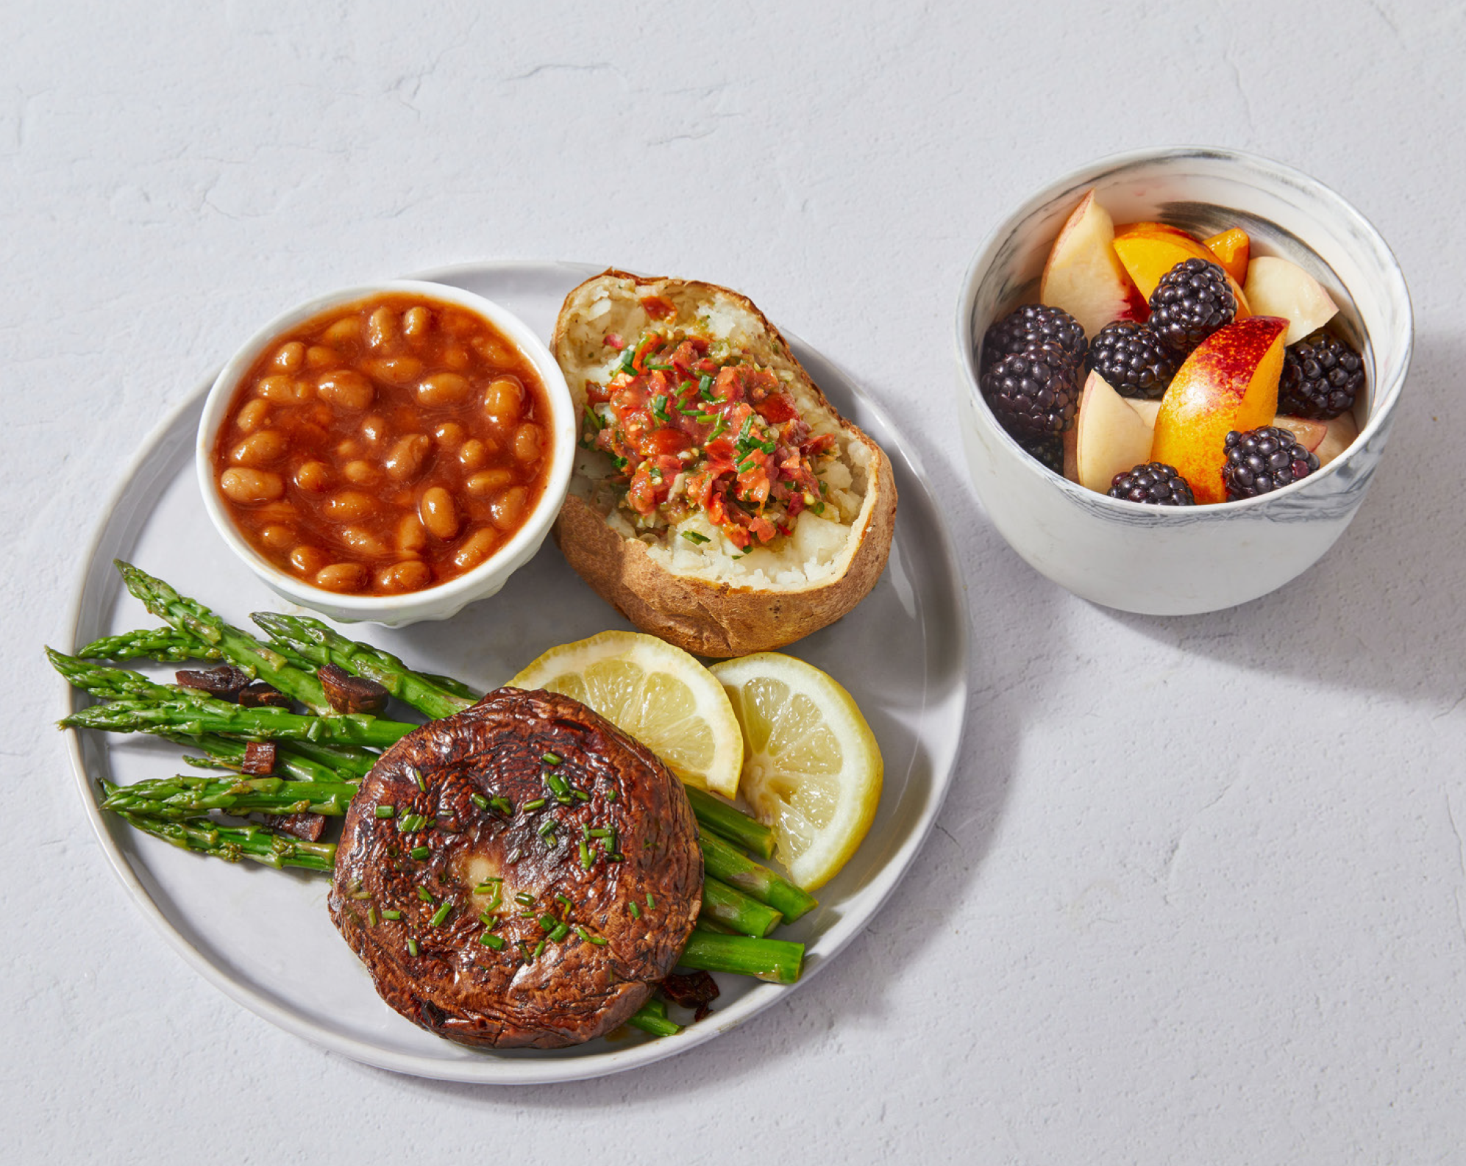
Meal Makeovers: Steak
pg. 100

Slide 19
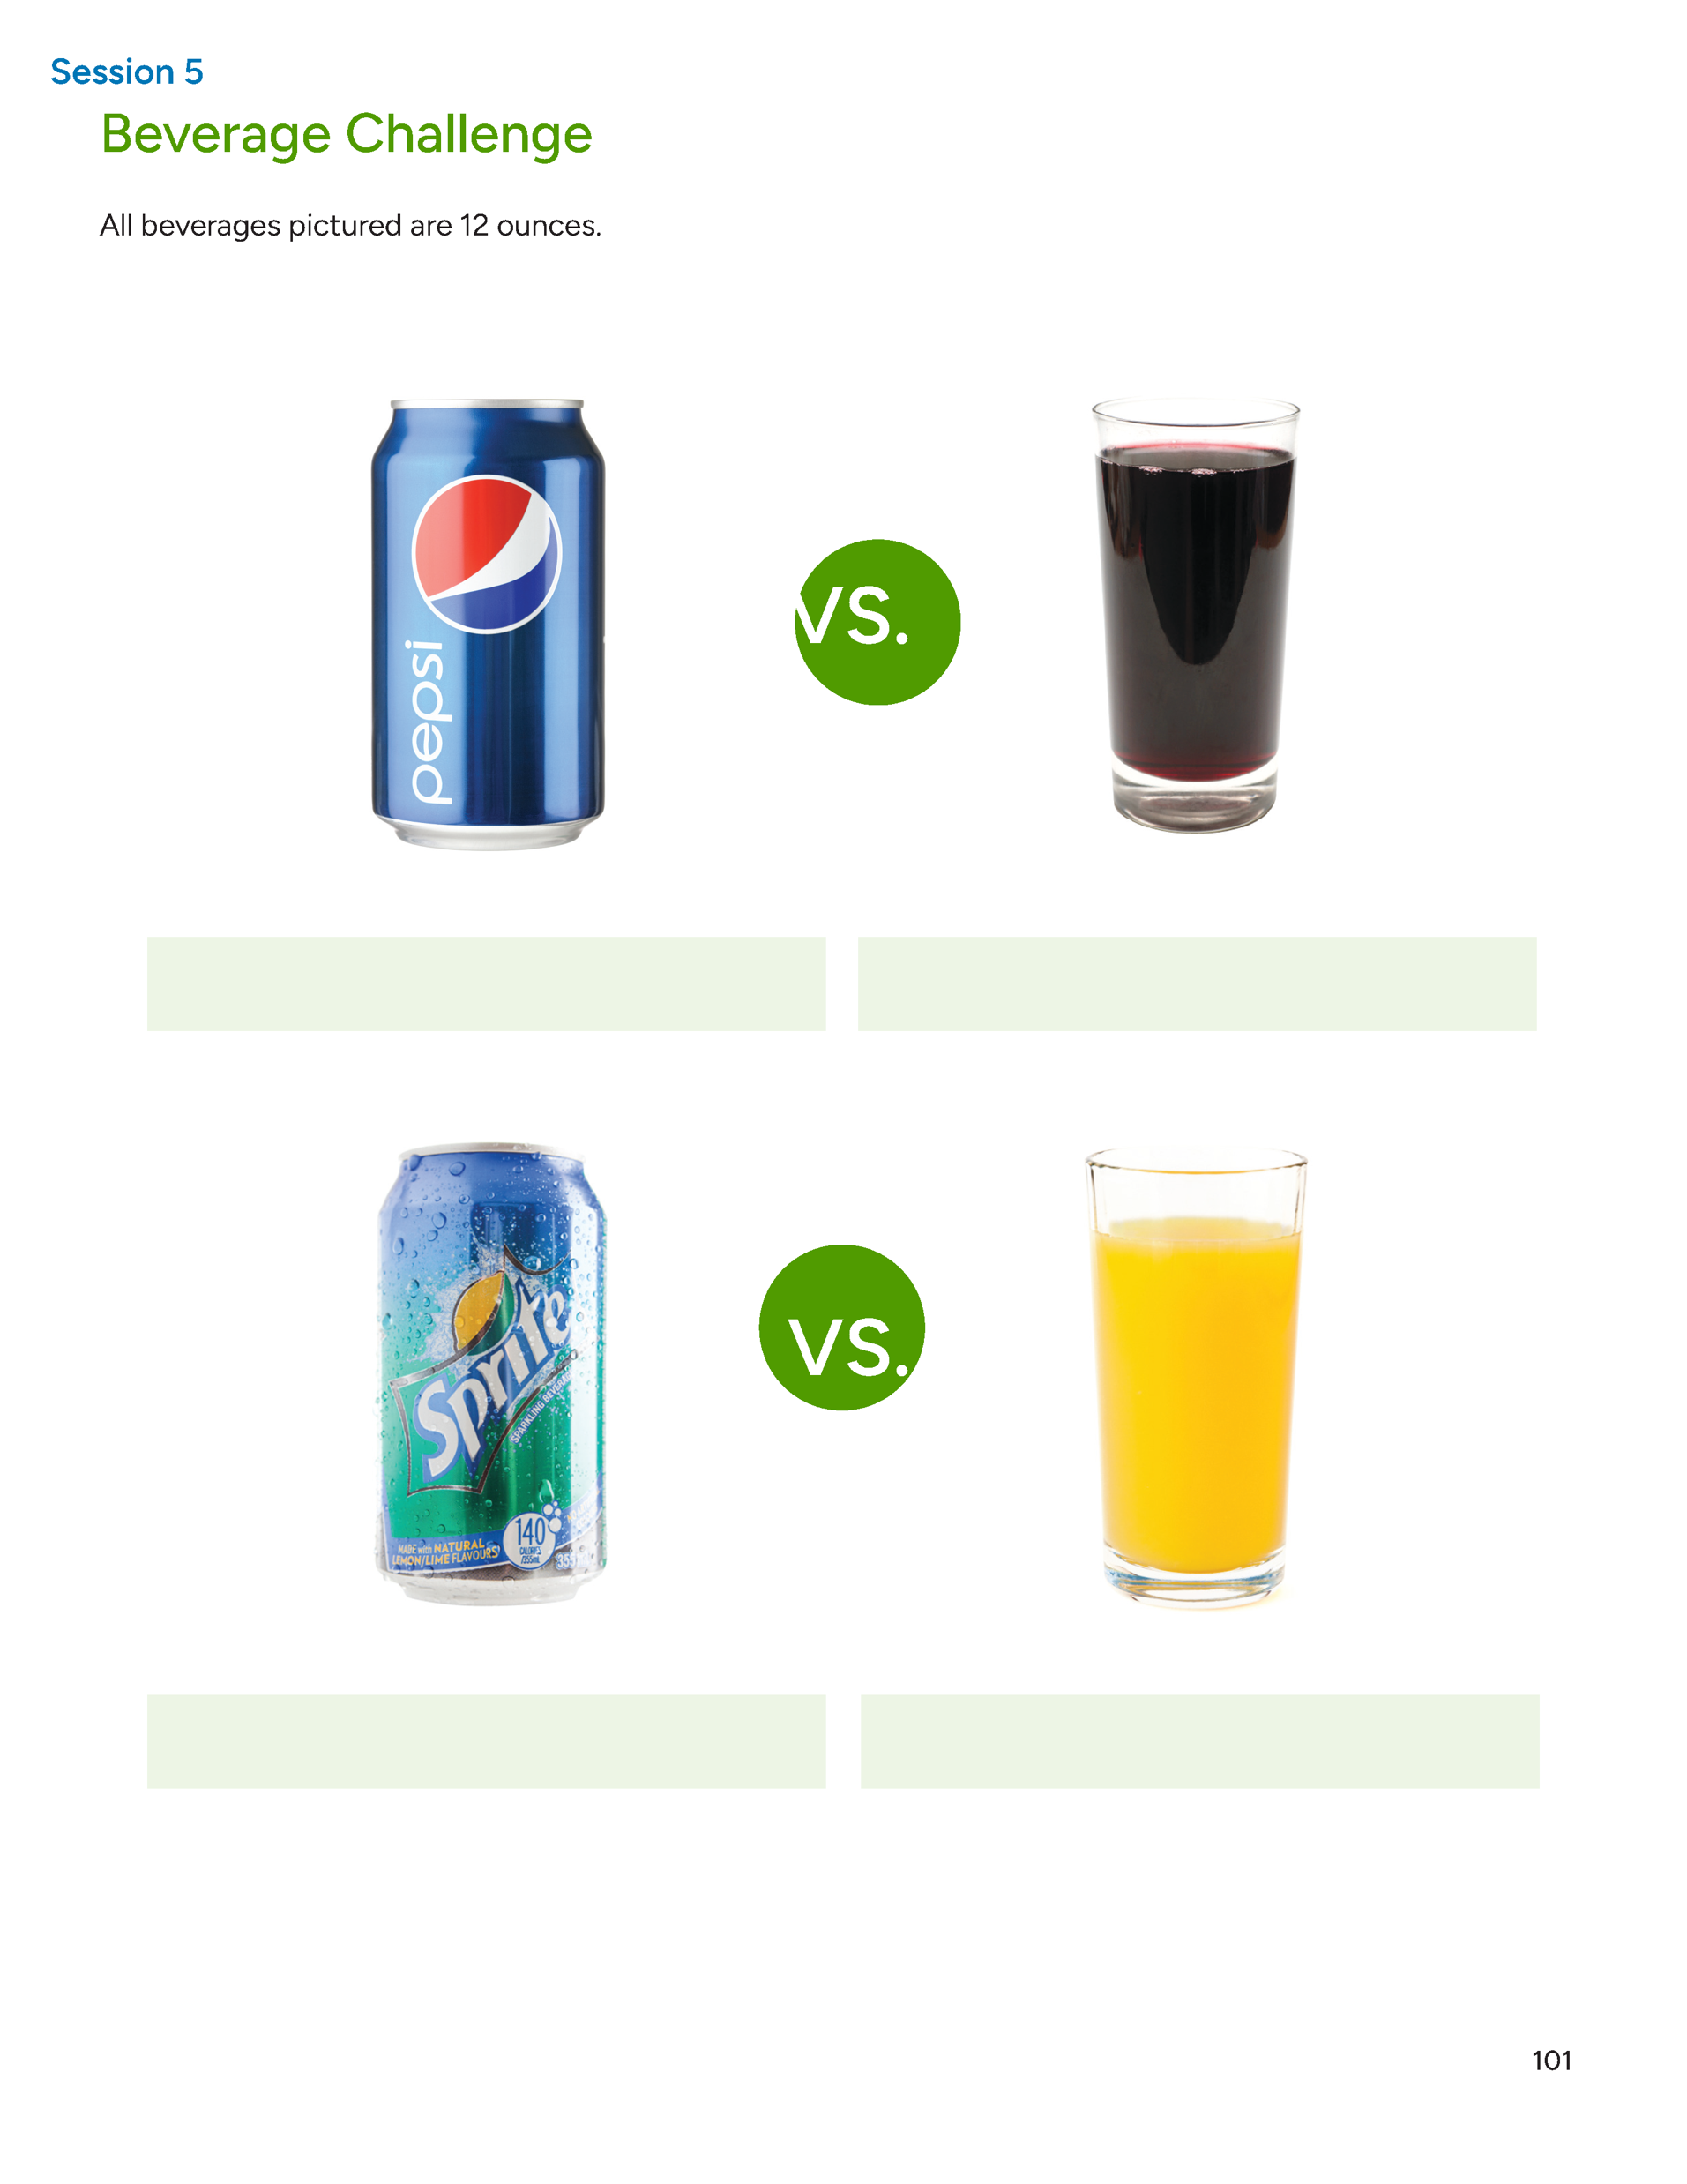
Beverage Challenge
pg. 101

Slide 20
Are you Drinking Pounds?
When you drink anything that has calories, you’re drinking your calories instead of chewing them. What’s the problem with that?
The problem is these liquid calories actually trick the brain by sneaking past its appetite control center
pg. 102

Slide 21
Brainstorm: How to Drink More Water
pg. 103

Slide 22
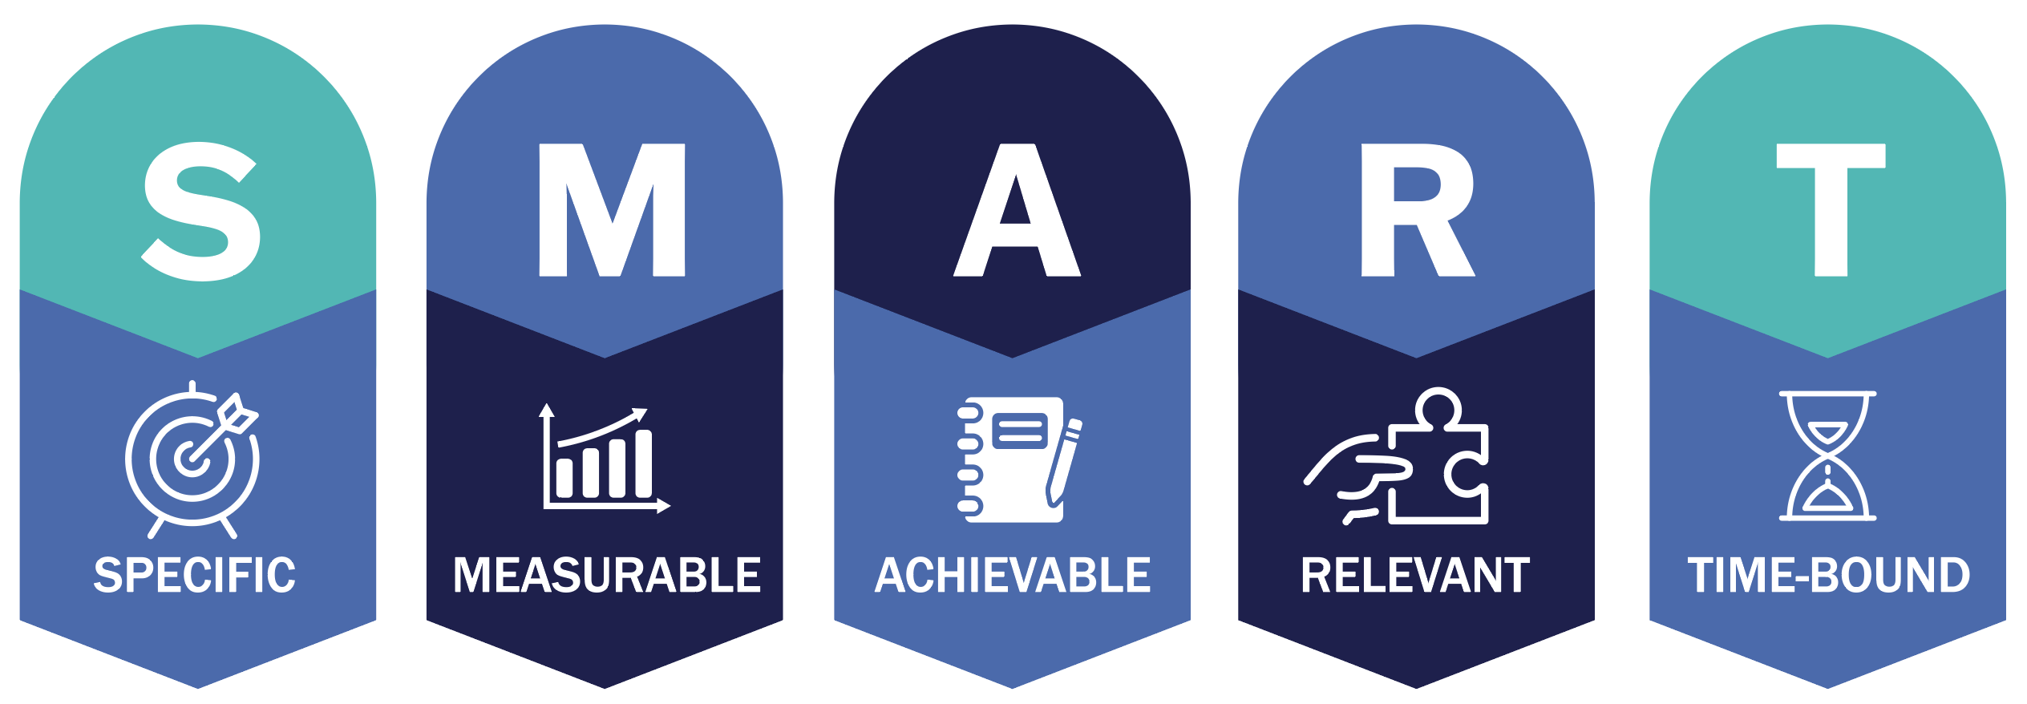
Set Your
SMART Goals
pg. 104

Slide 23
Rate Your Goals and Strategize
pg. 105

Slide 24
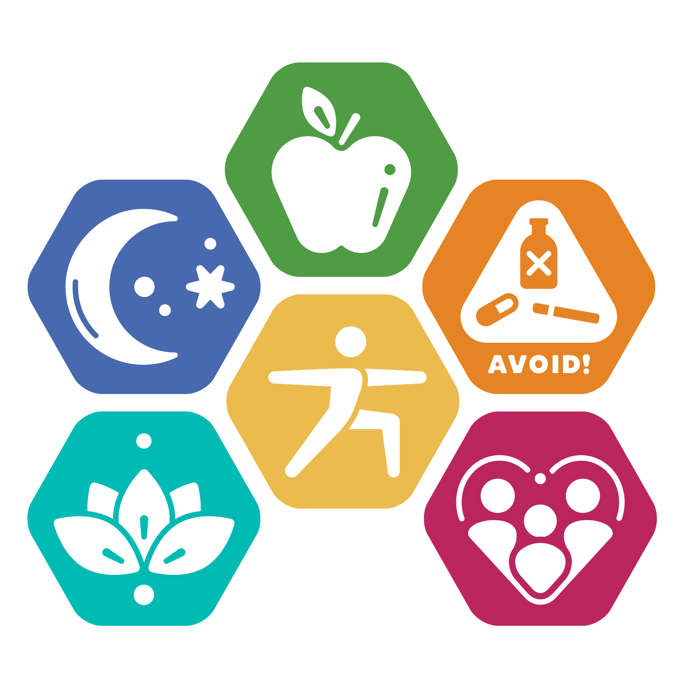
In Closing
What favorite meal are you inspired to make over this week?
Will it be one that we covered today, or another family favorite?
Try one, as every meal counts as they add up into healthy habits!

