Slide 1


Session 4
Keep Track of Water, Fiber, and Fat
pg. 59

Slide 2
Learning Objectives
Describe the benefits of water and fiber in foods
Identify the benefits of beans
Demonstrate two healthy recipe blueprints for bean and grains
Set your SMART Goals
pg. 60

Slide 3
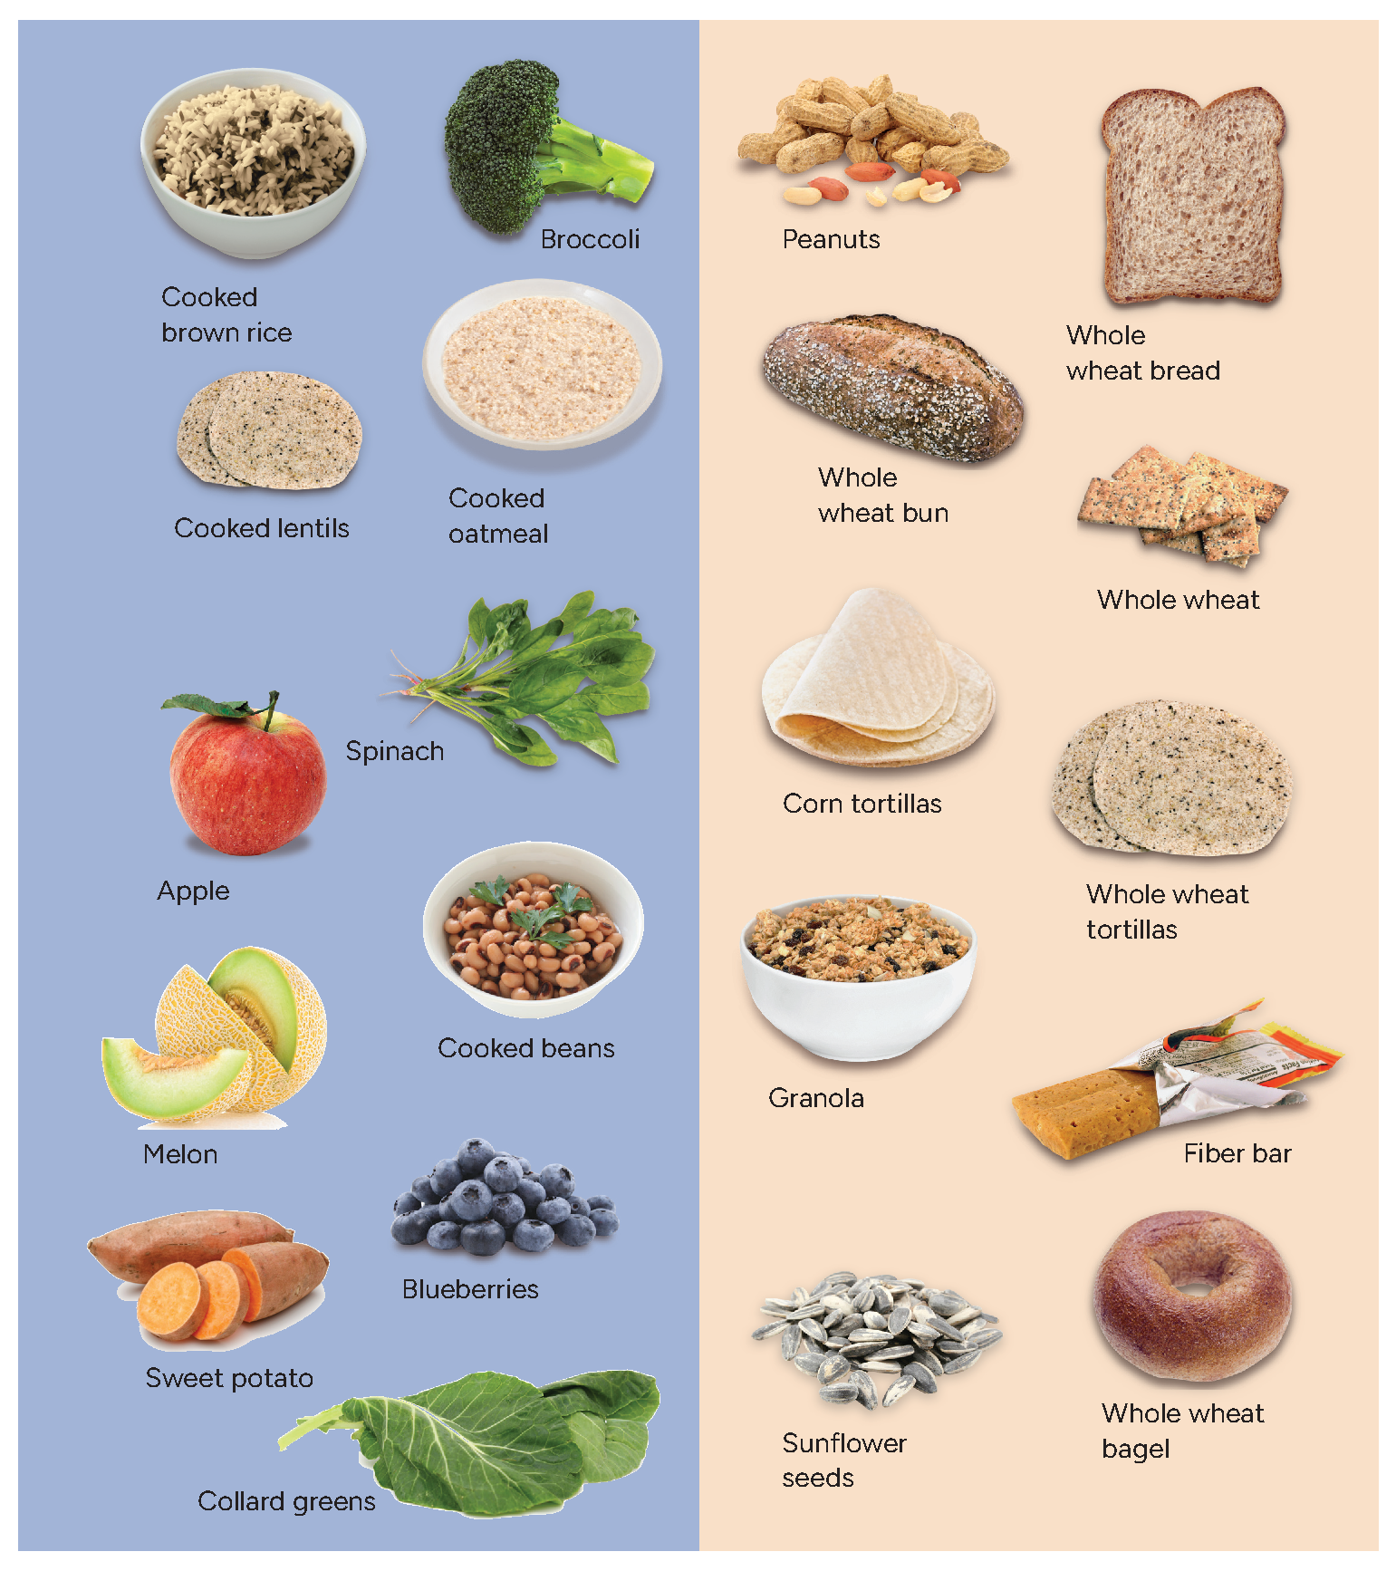
Full Plate Living: Water Fiber Principle
pg. 61

Slide 4
Full Plate Fiber Guide
How to use this fiber guide
Where did we get the numbers?
No decimals
Remember the serving sizes
pg. 62

Slide 5
The Full Plate Approach
What foods go in the 75% zone of my meal?
What about the 25% foods?
Why fiber foods for reaching a healthy weight?
Are you eating enough to reach a healthy weight?
Did you drink enough?
Beware of sabotaging your fiber foods
pg. 63

Slide 6
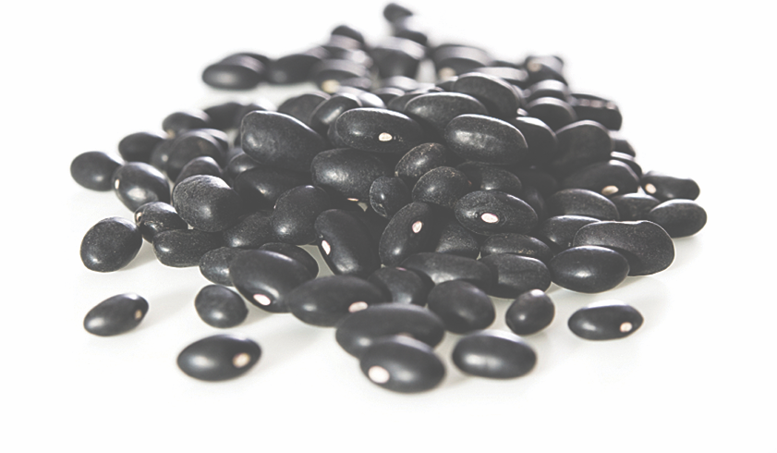
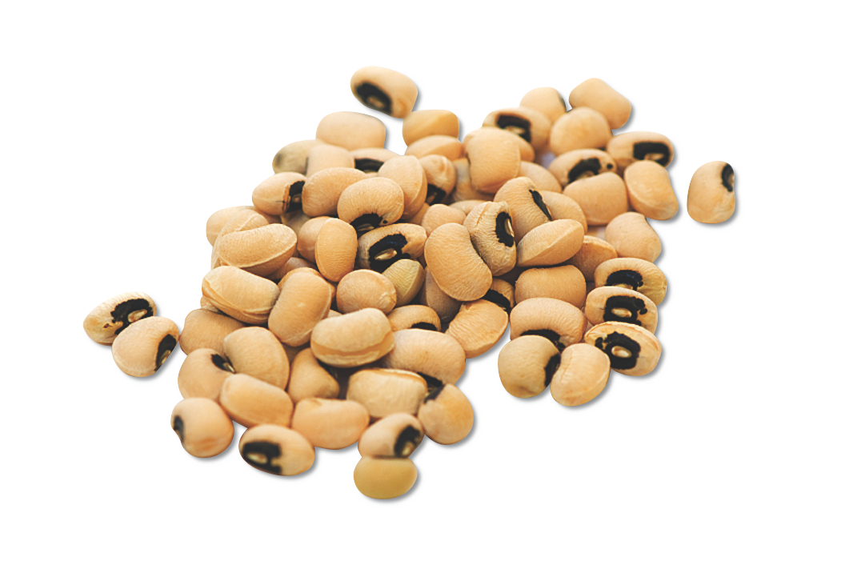
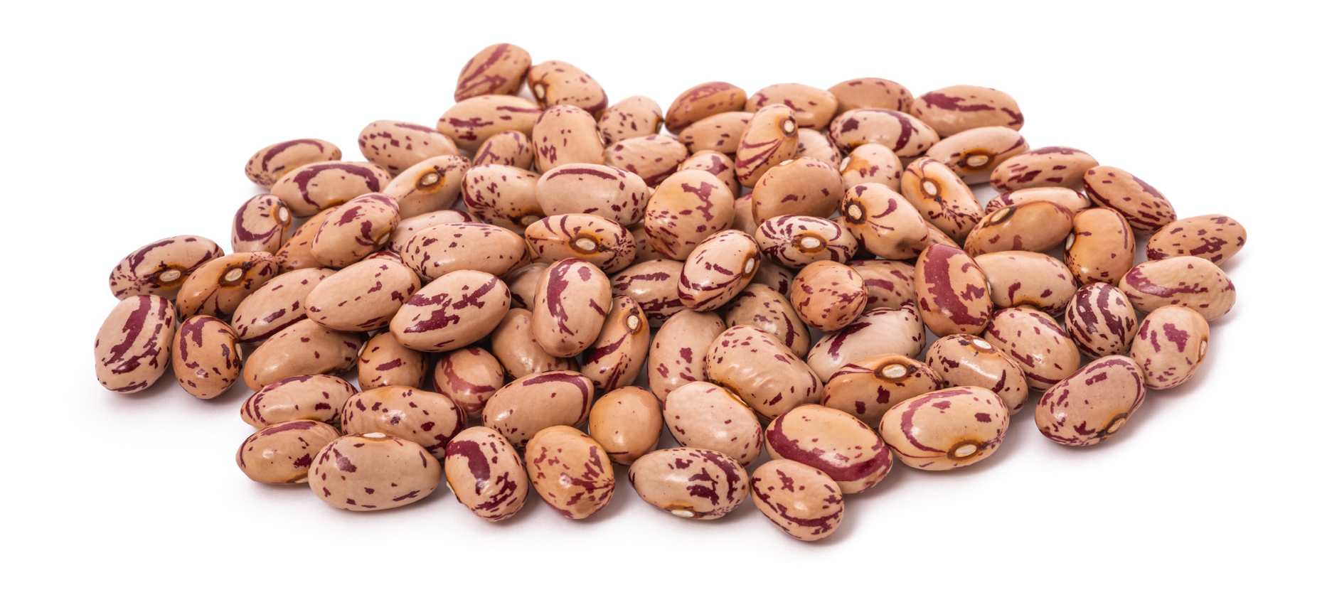
Beans & Peas
pg. 64

Slide 7
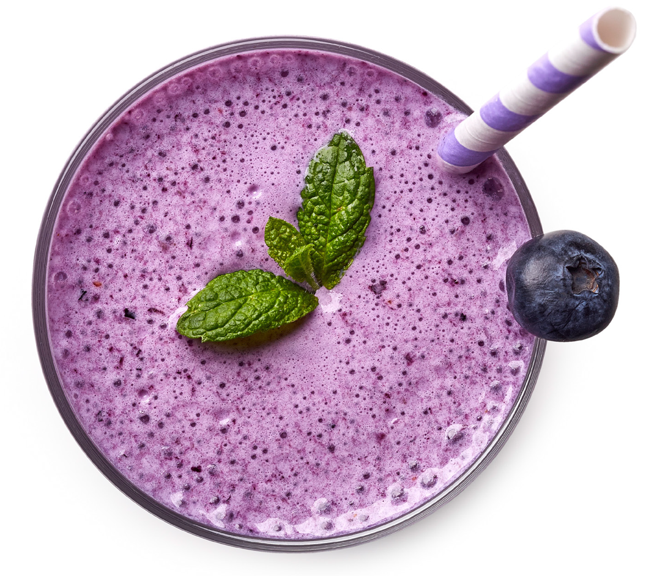
Beverages
pg. 66

Slide 8
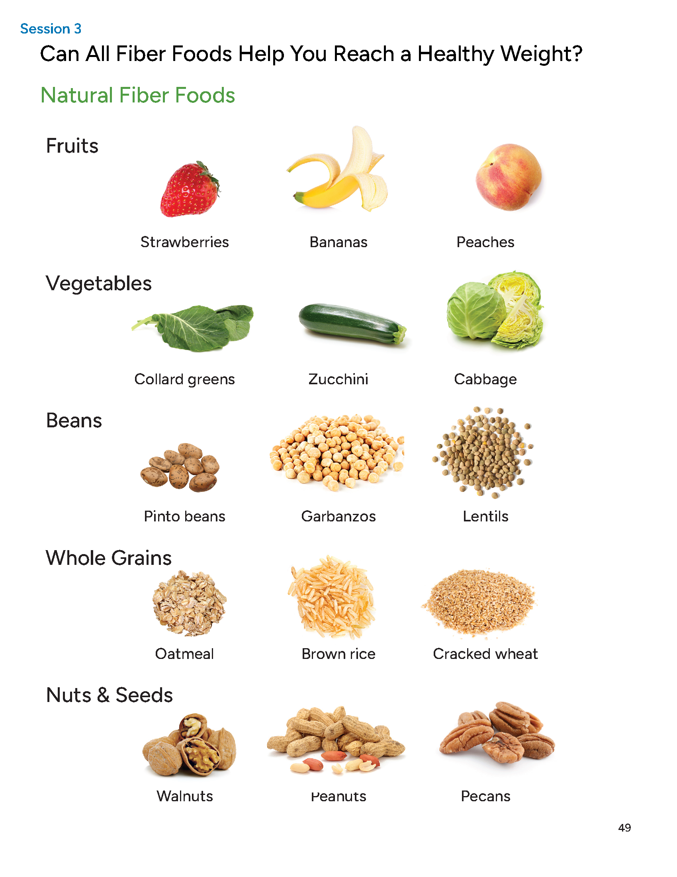
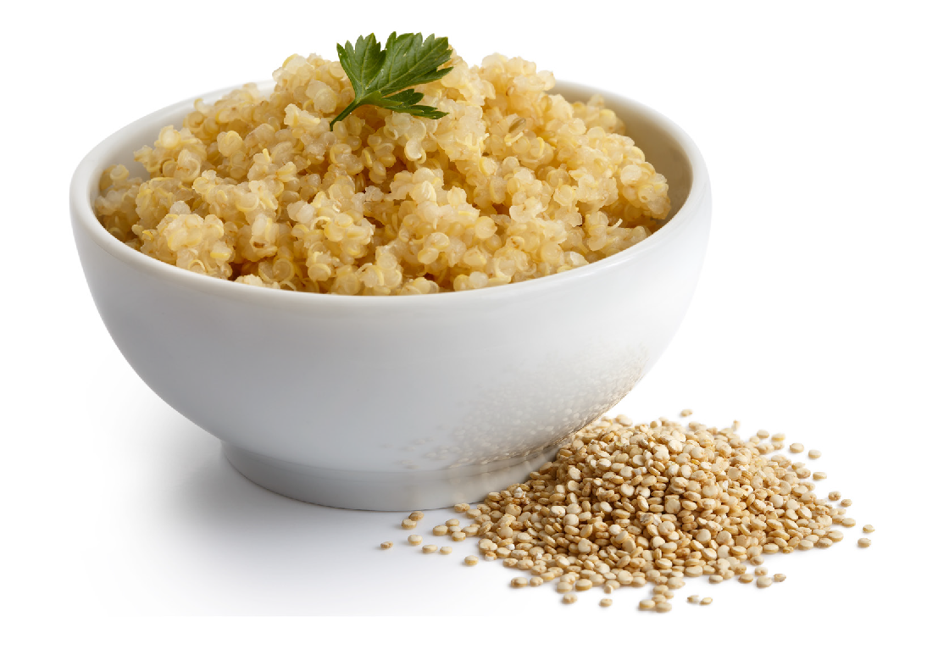
Grains
pg. 67

Slide 9
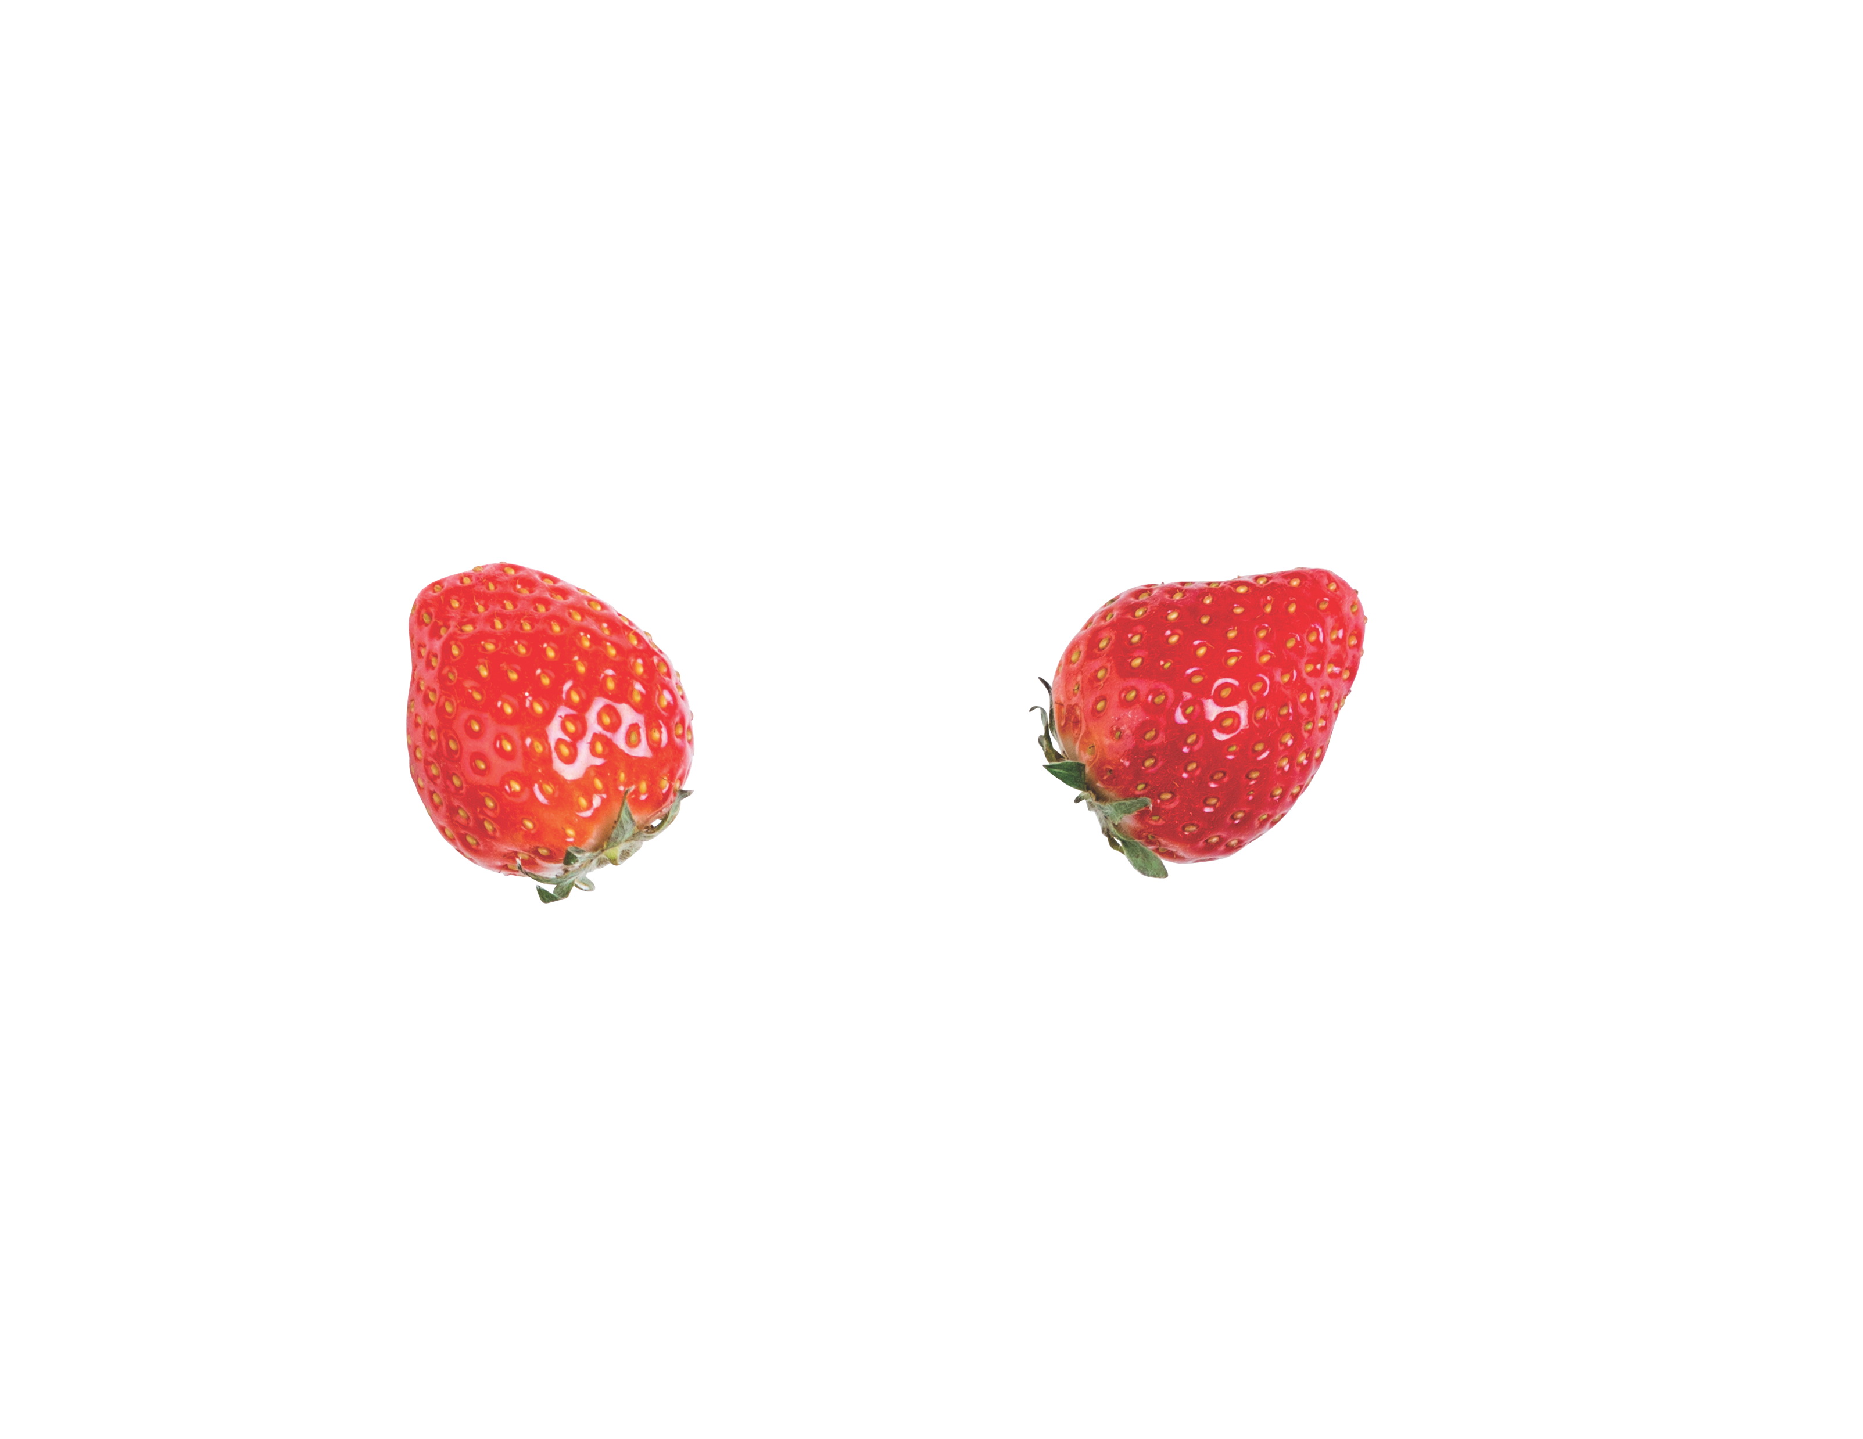
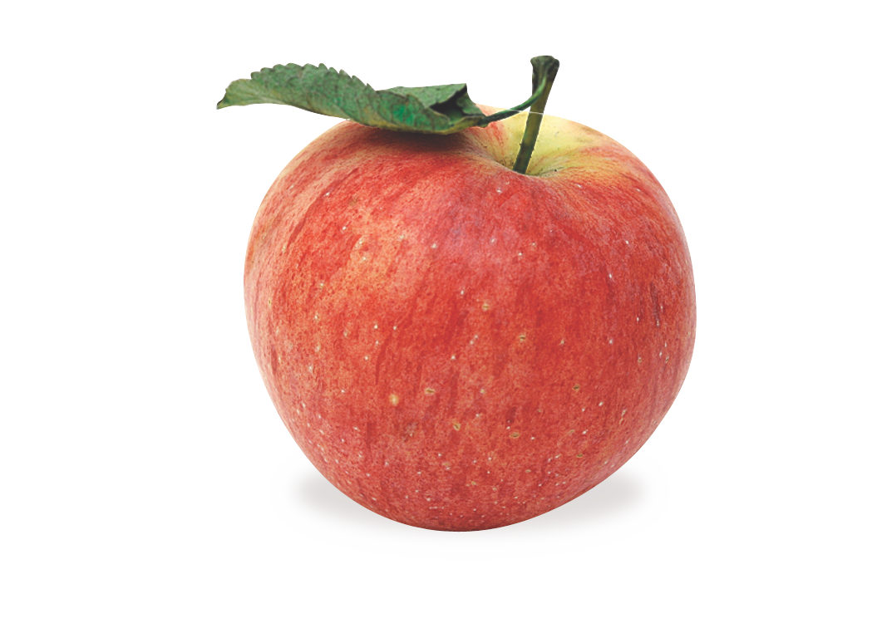
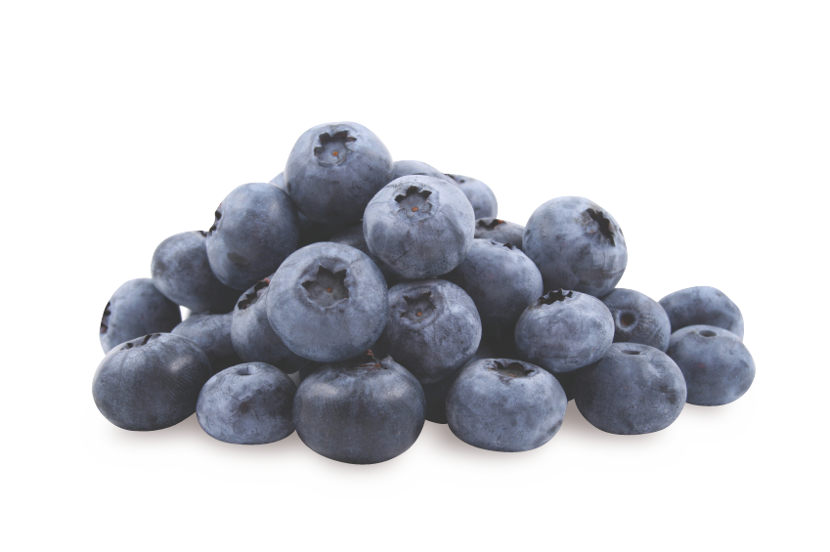
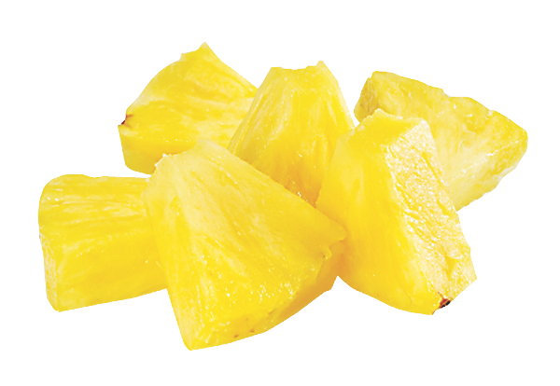
Fruit
pg. 68

Slide 10
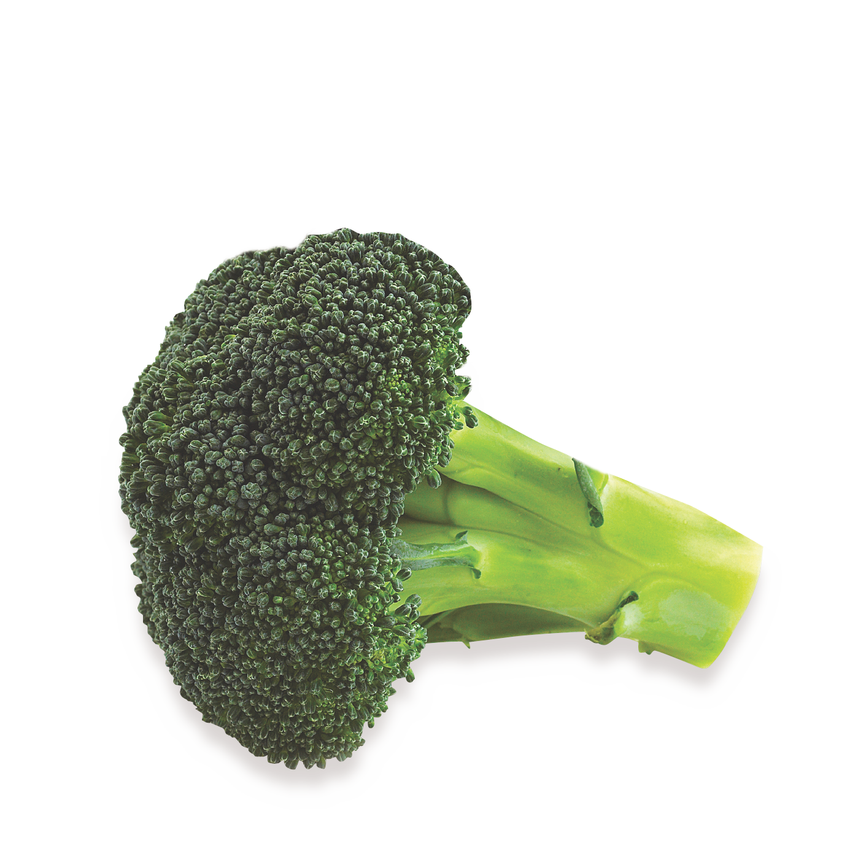
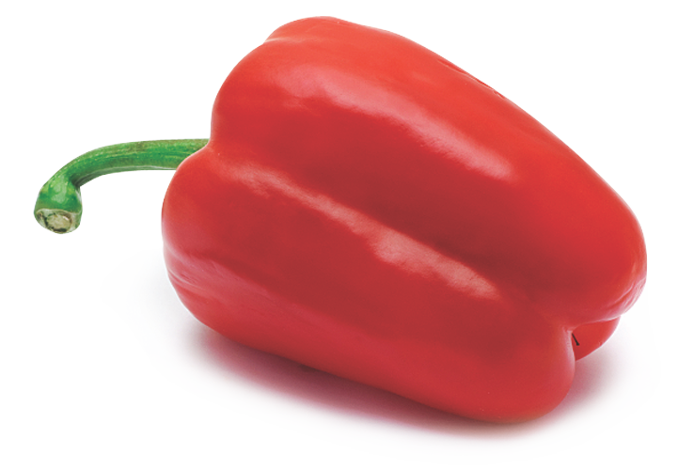
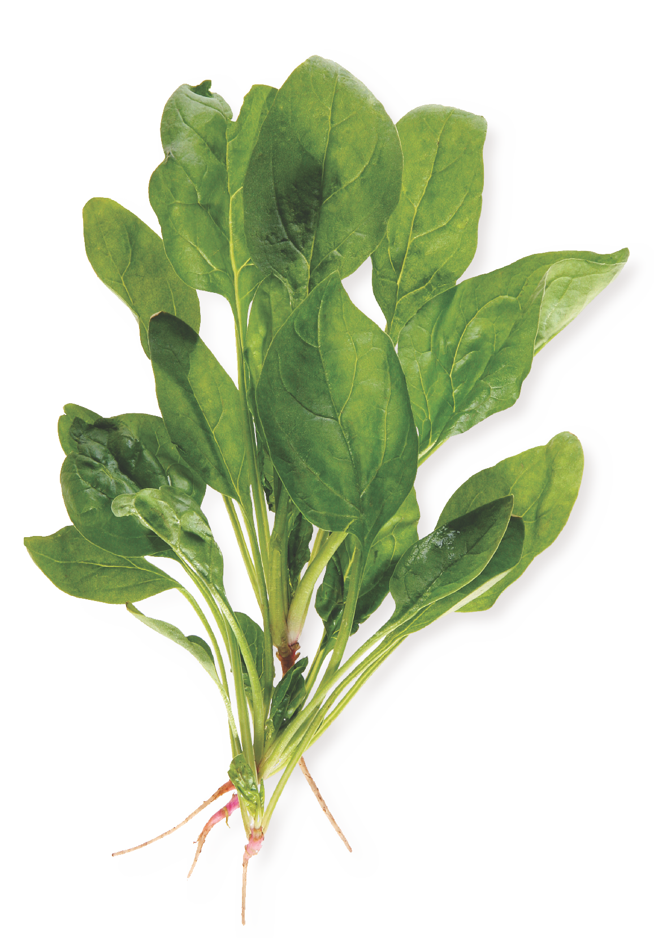
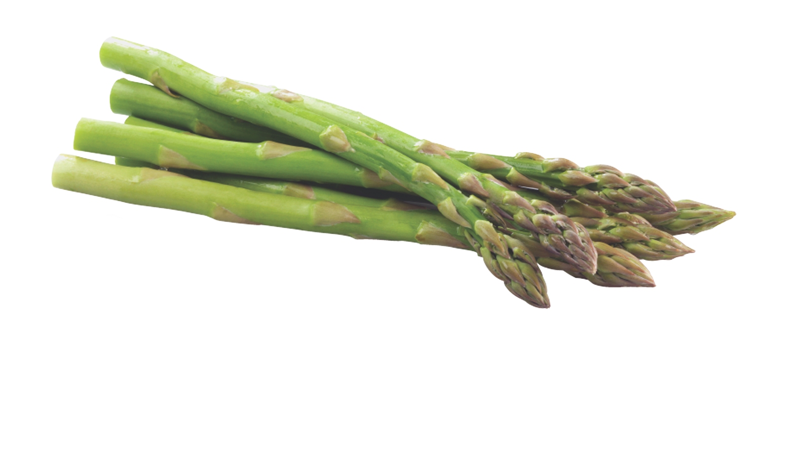
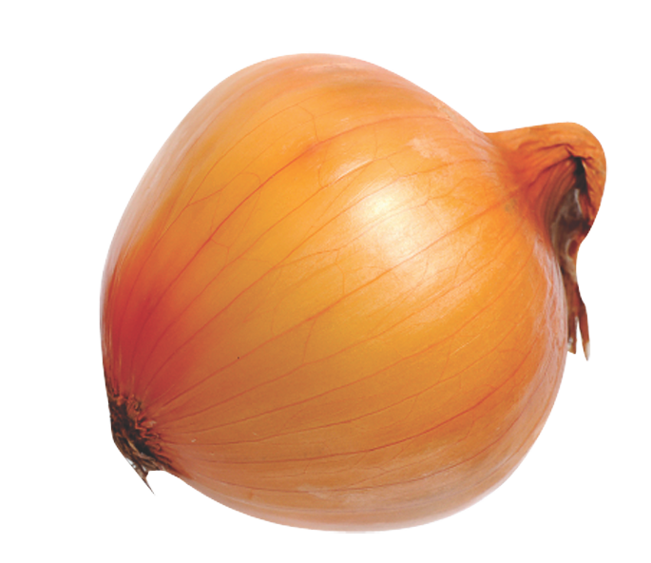
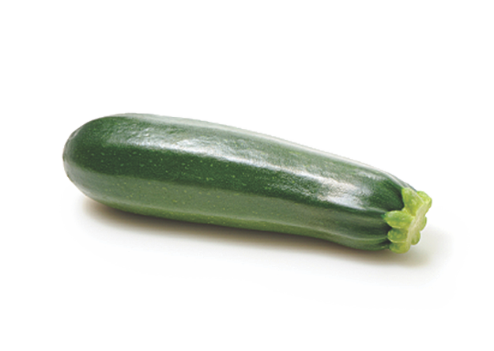
Vegetables
pg. 70

Slide 11
More than Just Fiber
There are many benefits from eating lots of fiber foods.
What is most important to you?
pg. 74

Slide 12
How to Cook Dried Beans
To Soak or Not to Soak
The Quick Soak Method
Cooking Method #1: Boiling on the Stove Top
Cooking Method #2: Slow Cooker
Cooking Method #3: Pressure Cooker or Instant Pot
How to tell when beans are done
pg. 75

Slide 13
How to Cook Dried Beans
Salting beans
Avoid adding acids early
How to amplify flavors
Food safety
Using dry beans in place of canned
Storing cooked beans and tips for later use
pg. 76

Slide 14
Teaching Kitchen: Nourish Bowls
Leafy greens
Vegetables
Protein
Fiber-rich carbs
Healthy fats
Toppers
pg. 77

Slide 15
Teaching Kitchen: Nourish Bowls
Burrito Bowl
Mediterranean Bowl
Asian Peanut Bowl
Tofu Nicoise
Tahini Bowl
pg. 78

Slide 16
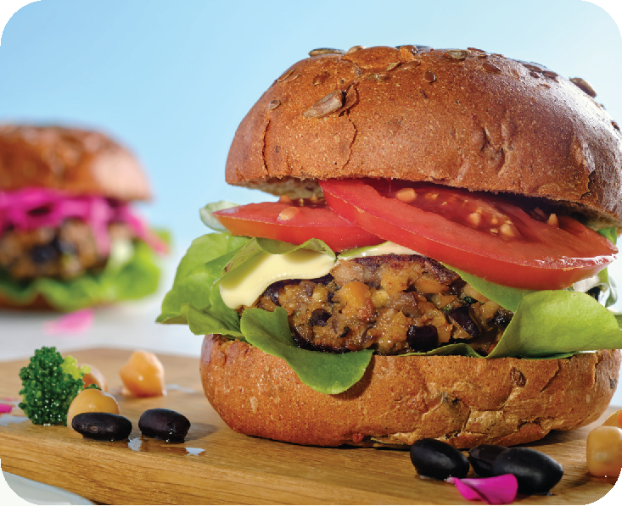
Teaching Kitchen:
Bean Burgers
pg. 79

Slide 17
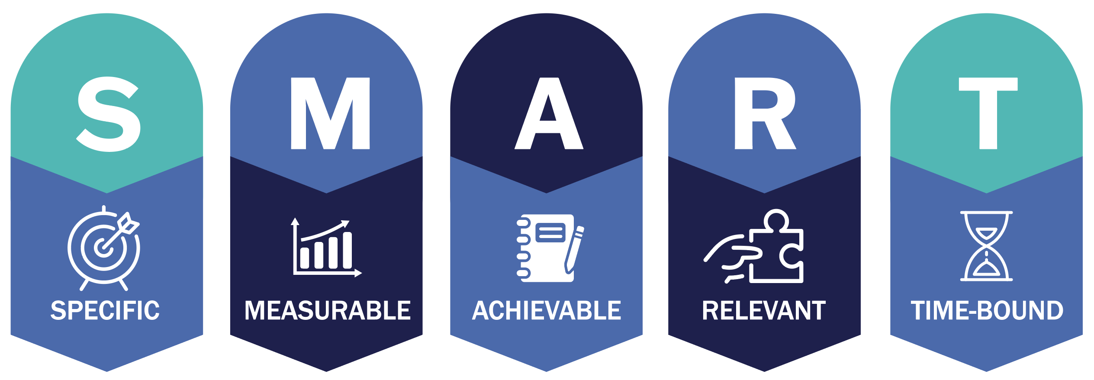
Set Your
SMART Goals
pg. 80

Slide 18
Rate Your Goals and Strategize
pg. 81

Slide 19

In Closing
What ingredients will you try in your next nourish bowl?
What new grain might you try this week?
Consider that quinoa only takes a few minutes to simmer on the stove top!

