Slide 1


Session 3
Change Your Lifestyle; Transform Your Health
pg. 45

Slide 2
Learning Objectives
Define fiber and identify fiber-rich foods
List whole grains
Set your SMART Goals
pg. 46

Slide 3
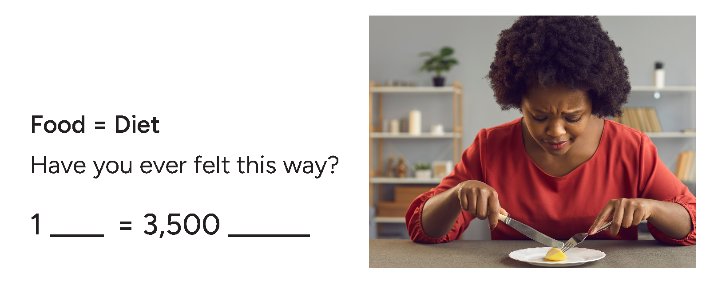
Full Plate Living:
Getting Whole Fiber Foods onto Your Plate
How can this program actually help me achieve my health goals?
pg. 47

Slide 4
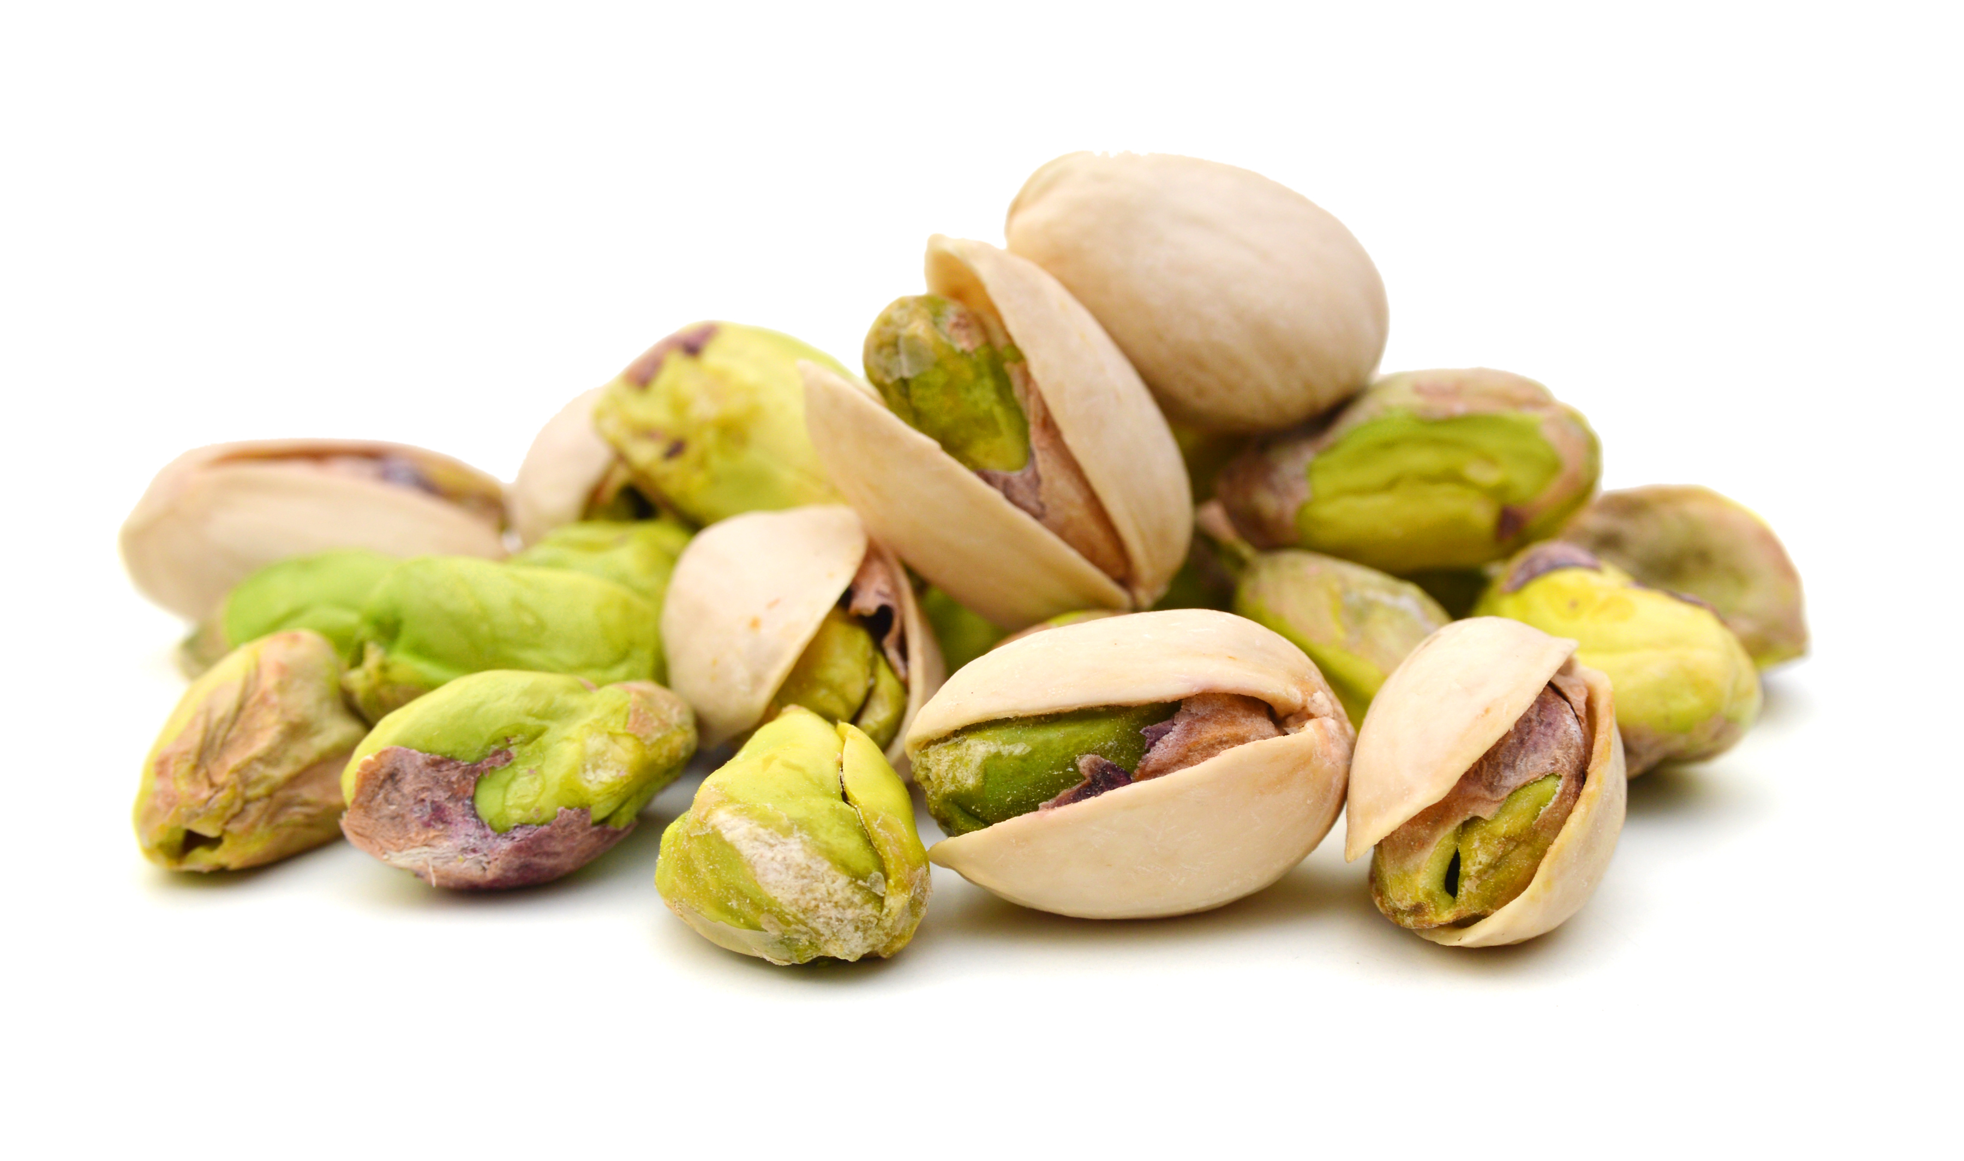
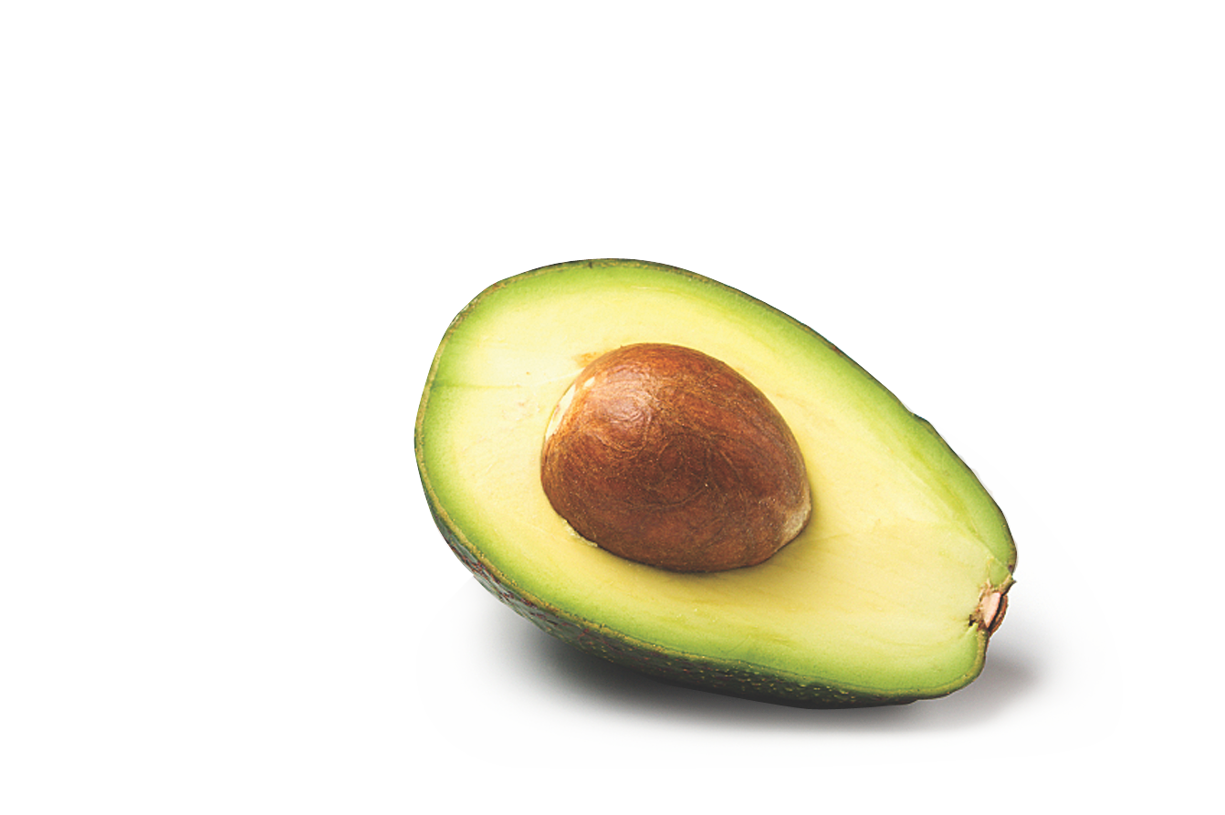
Natural Fiber Foods
Thousands of healthy choices fall within 5 food groups
Fruits
Beans and peas
Vegetables
Cooked whole grains
Nuts and seeds
pg. 48

Slide 5
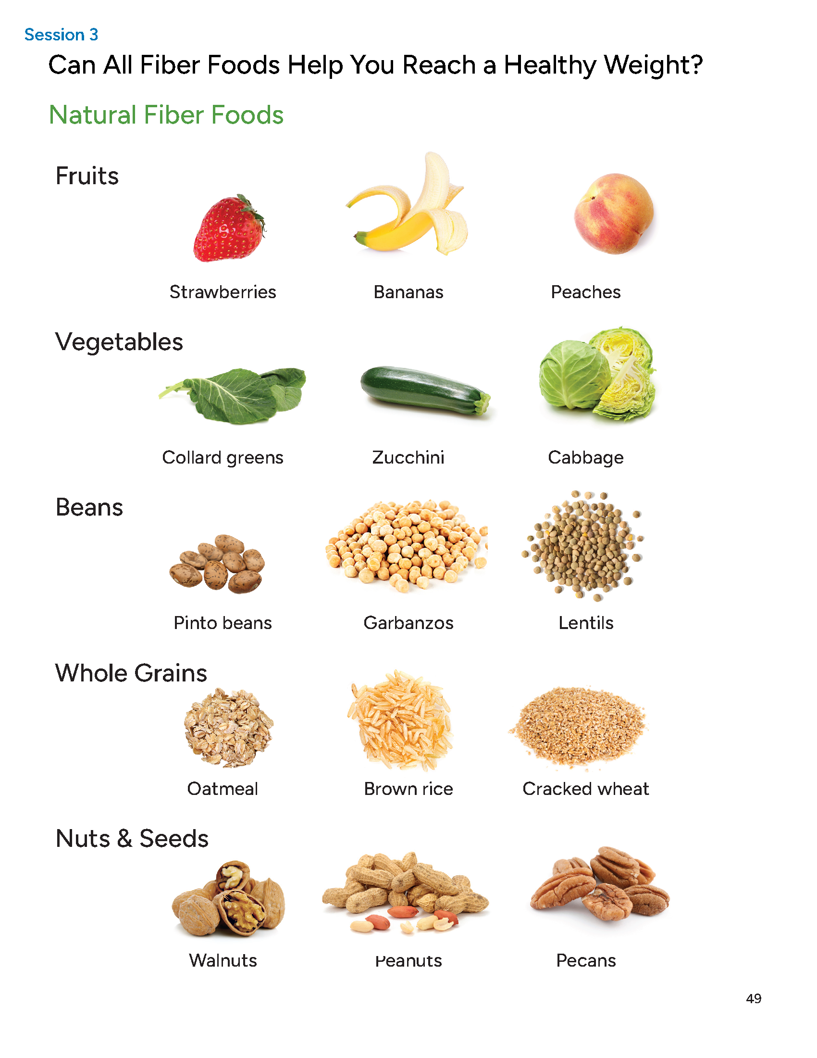
Can All Fiber Foods Help You Reach a Healthy Weight?
pg. 49

Slide 6
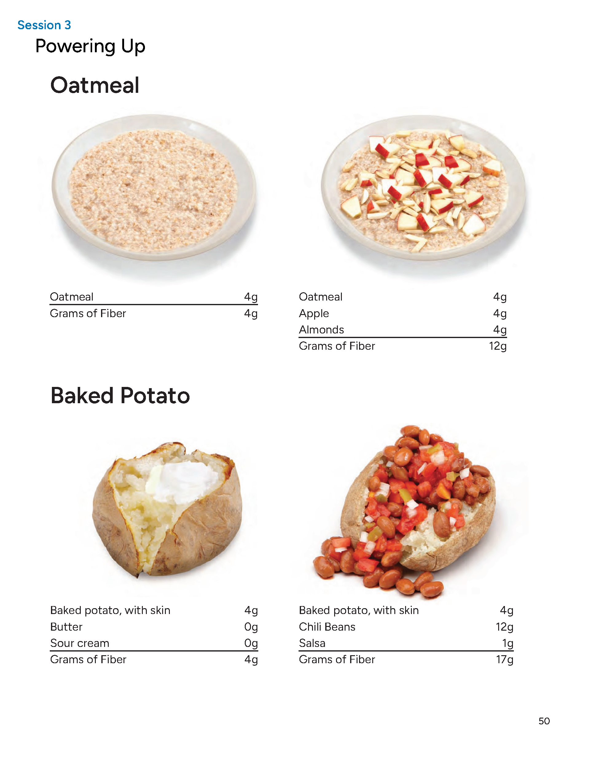
Powering Up
pg. 50

Slide 7
Powering Up Practice
pg. 51

Slide 8
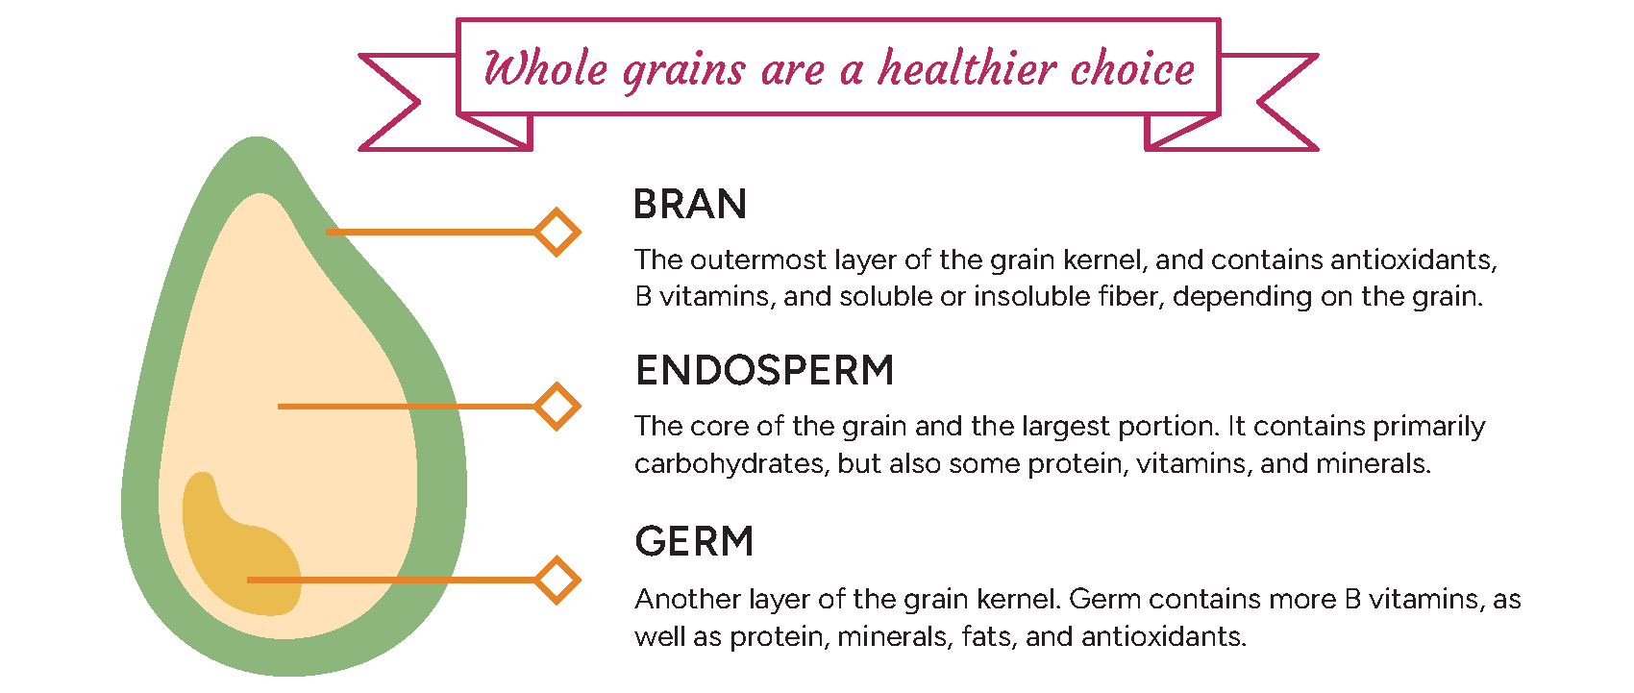
Whole Grains to Live By
pg. 52

Slide 9
Basic Method For Cooking Whole Grains
Rinse
Transfer
Add water & cook
Stand
Eat or store
pg. 53

Slide 10
Boiling Method For Whole Grains
Boiling can be an alternate method of cooking that works for whole grains that can keep their shape with cooking
  rice, quinoa, wheat berries, farro, or barley
This method works well if you want to serve whole grains in a salad rather than as a warm side
pg. 54

Slide 11
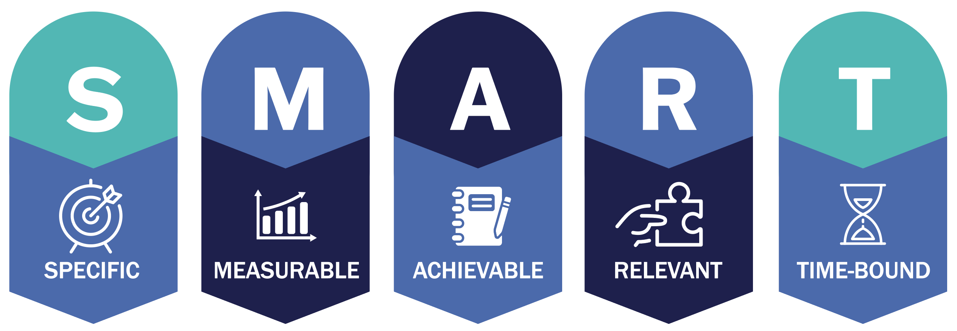
Set Your
SMART Goals
pg. 56

Slide 12
Rate Your Goals and Strategize
pg. 57

Slide 13

In Closing
Think about having a movie night with important people in your life.
Will this help to gain support you on your health journey? Will it reinforce what you’ve learned?

