Slide 1


Session 2
Follow Your Roadmap to Healthy Eating
pg. 25

Slide 2
Learning Objectives
Summarize the Diabetes Remission Roadmap
Demonstrate several remission-supporting breakfast dishes
List the benefits of soy and how to incorporate it into meals
Explain how to make a healthful diet affordable
Set first S.M.A.R.T. goals
pg. 26

Slide 3
The Diabetes Remission Roadmap
Enjoy
  Keep plant-based meals you already enjoy in your meal rotation
Adapt
  Give your favorite recipes a plant-based makeover
Explore
  Begin incorporating new plant-based foods into each week
pg. 27

Slide 4
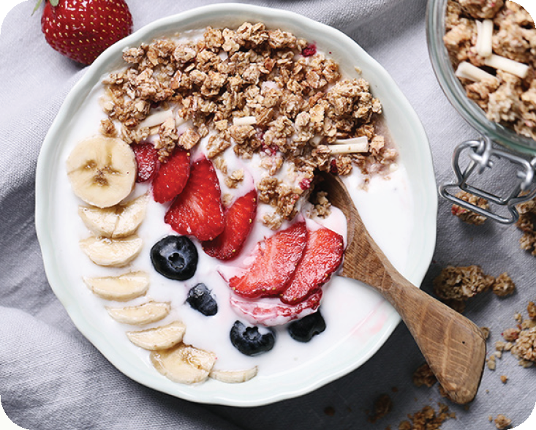
Teaching Kitchen: Oatmeal Two Ways
Strawberry Banana Oatmeal
pg. 28

Slide 5
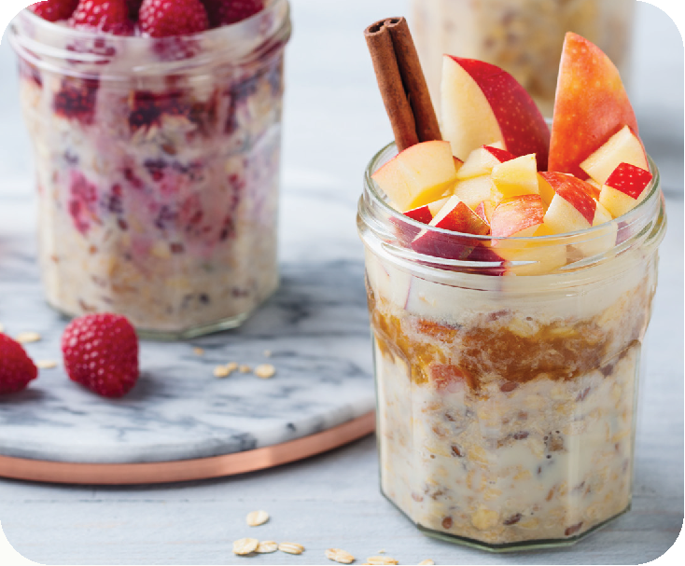
Teaching Kitchen: Oatmeal Two Ways
Overnight Oats
pg. 29

Slide 6
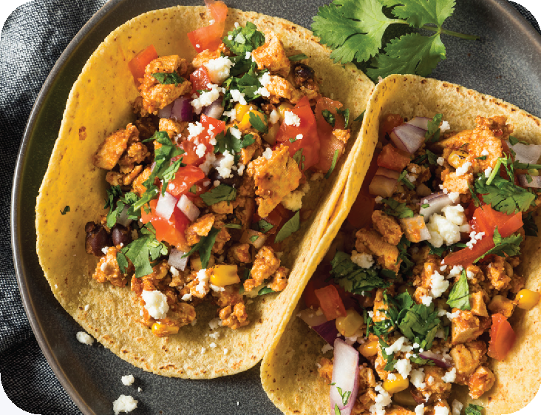
Teaching Kitchen: Tofu Scramble Tacos
pg. 30

Slide 7
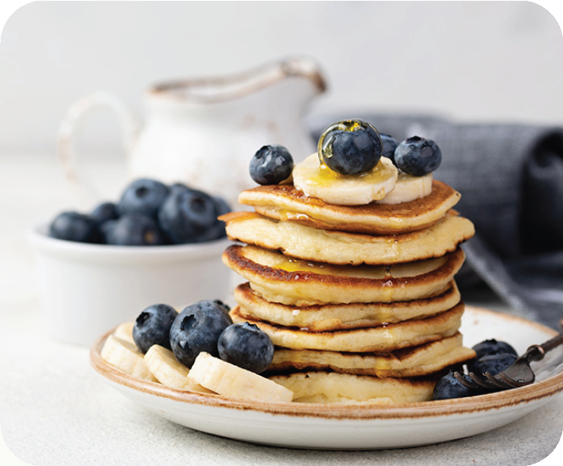
Teaching Kitchen: Fluffy Whole Grain Pancakes
pg. 31

Slide 8
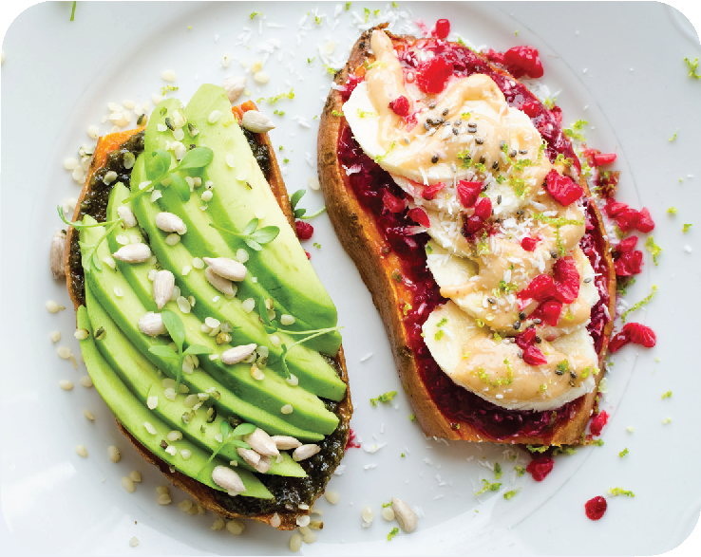
Teaching Kitchen: Sweet Potato Toast
pg. 33

Slide 9
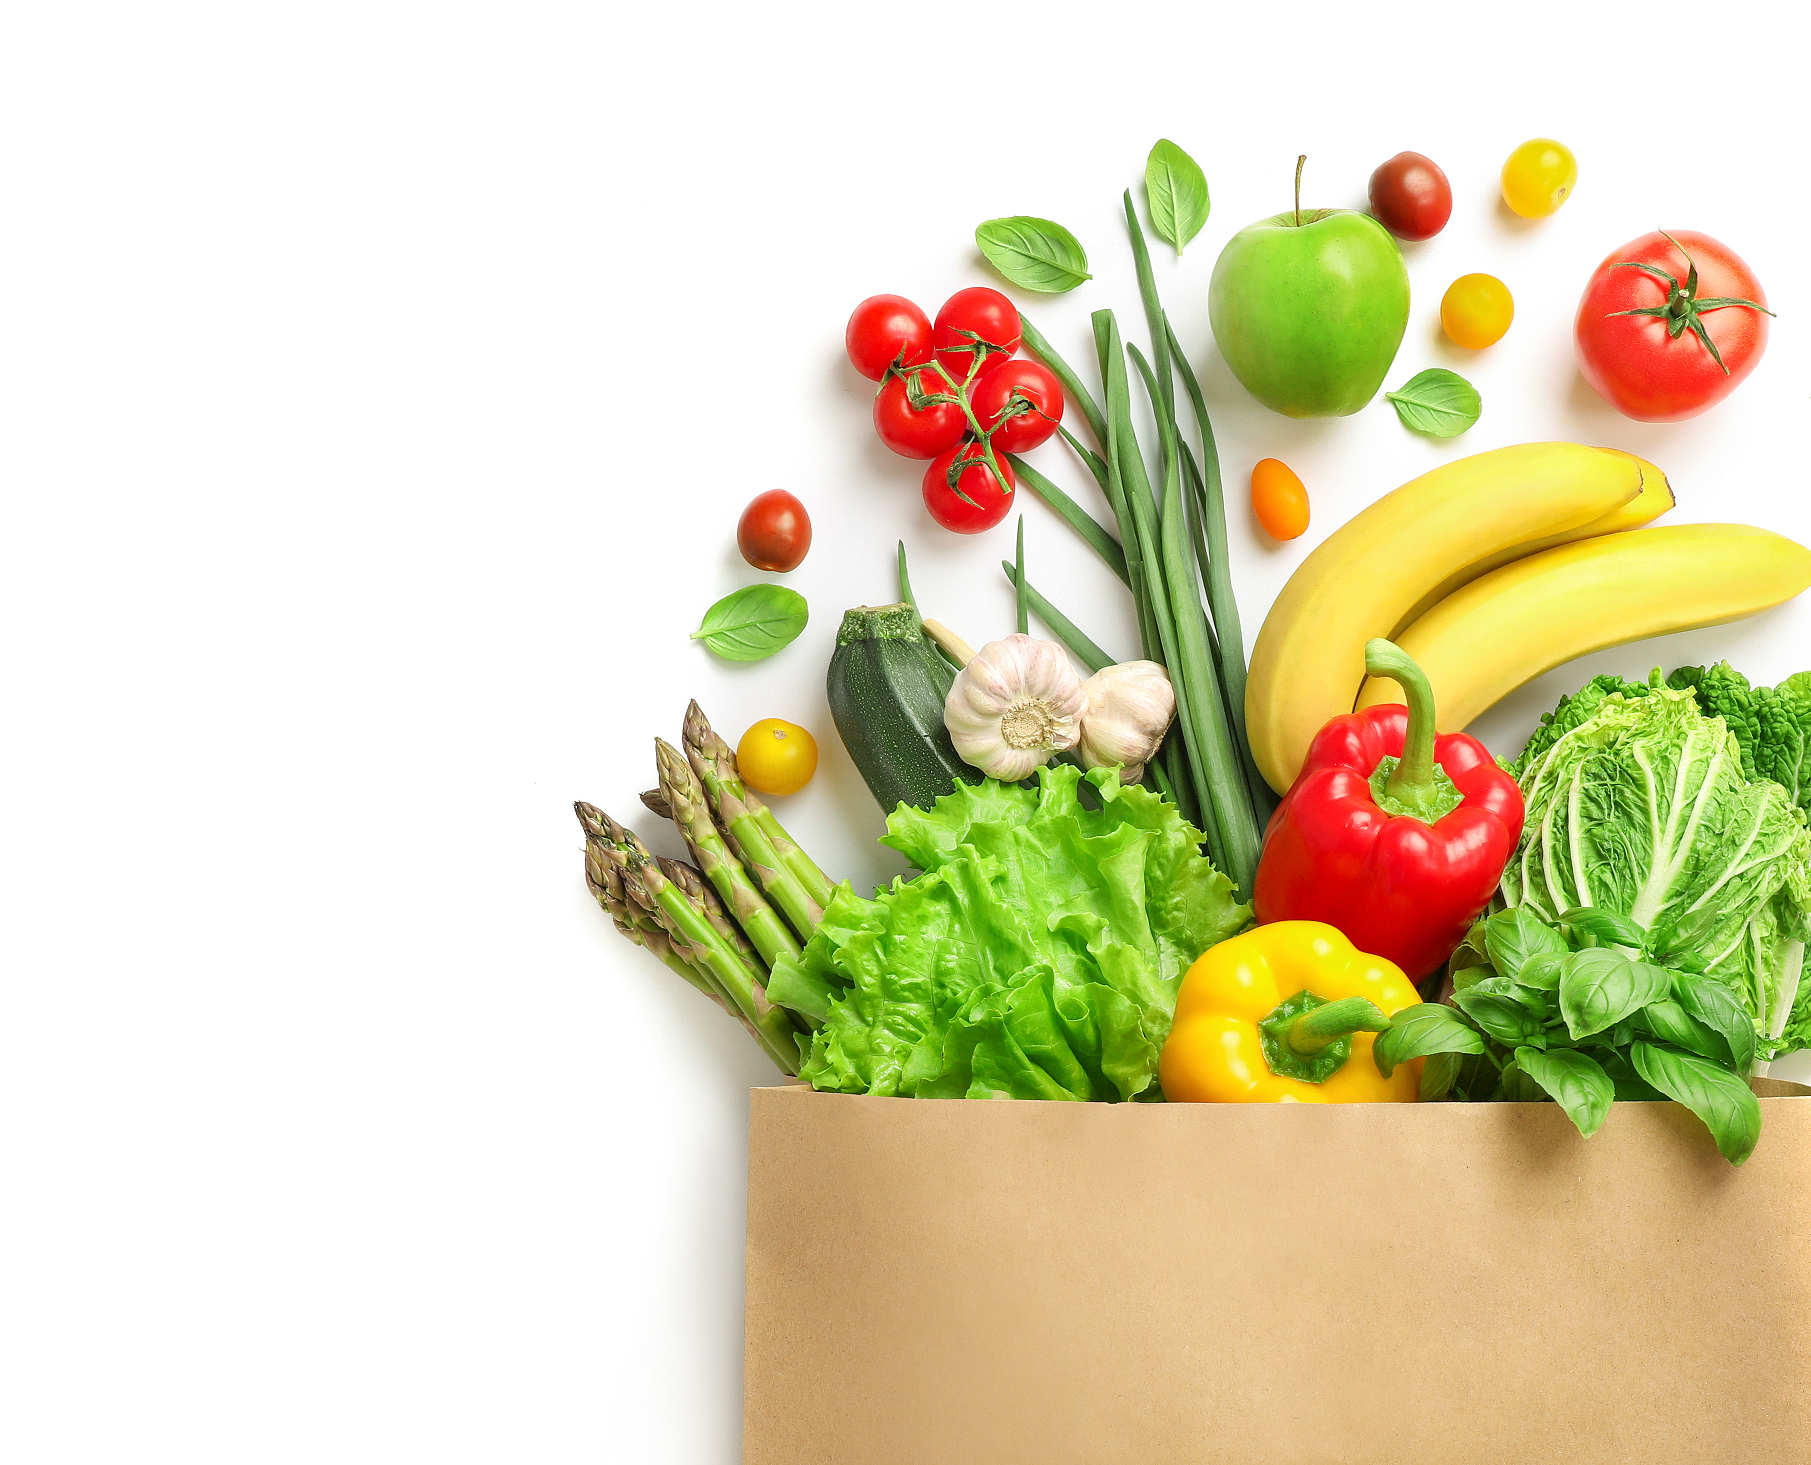
Remission on a Budget
There is an added benefit to our healthy dietary practice, which is that it can be cheap!
Generally note that the more processed, the more expensive a product becomes
pg. 34

Slide 10
Shopping Healthy on a Budget
Don’t buy prepared foods
Avoid purchasing empty calories
Don’t pay for beverages
Buy frozen vegetables and fruits
Avoid meat
Buy in-season and look for sales
pg. 35

Slide 11
Shopping Healthy on a Budget
Go back for ”seconds” at the farmer’s market
Go to the farmer’s market near closing time
Stretch your SNAP benefits at the farmer’s market
pg. 36

Slide 12
The Supplemental Nutrition Assistance Program (SNAP)
What is SNAP?
Maximizing SNAP Benefits
  What foods are eligible?
pg. 37

Slide 13
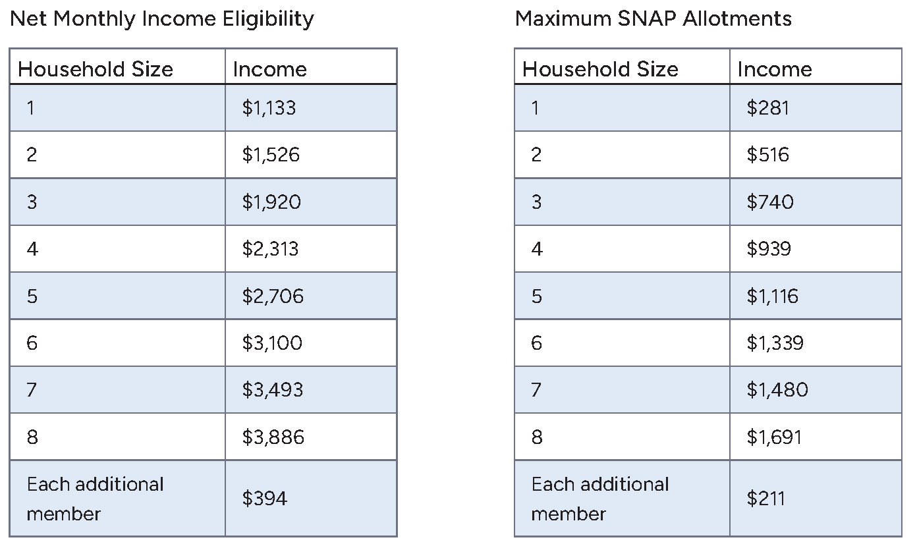
The Supplemental Nutrition Assistance Program (SNAP)
USDA SNAP Standards
pg. 38

Slide 14
Debbie’s Success Story
pg. 39

Slide 15
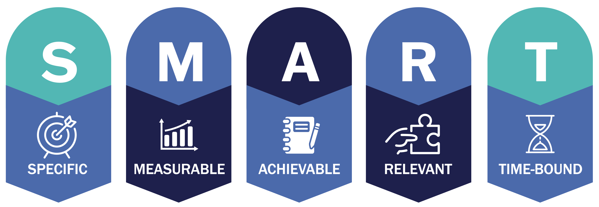
Commit to Your Health: Introducing SMART Goals
Set 3 goals each week
goal for nutrition
goal for physical activity
goal for other health habits
pg. 40

Slide 16
Set Your SMART Goals
pg. 42

Slide 17
Rate Your Goals and Strategize
pg. 43

Slide 18

In Closing
We are as successful as the effort that we put in. We will make discoveries together.

