Slide 1


Session 1
Let’s Get Started with Diabetes Remission

Slide 2
Whole food, plant-based plate
Focus on whole fruits & vegetables
Drink water for hydration
Eat a variety of plant protein
Choose whole grains

Slide 3
Your Health Vision Statement
What is the main goal you hope to achieve through this program?
Why do you want to achieve this goal? Think about how you imagine your life will change or improve after you achieve that goal. What things will you be able to do that you don’t do now? What things will you be able to have that you don’t have now?

Slide 4
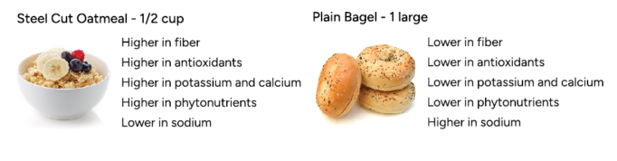
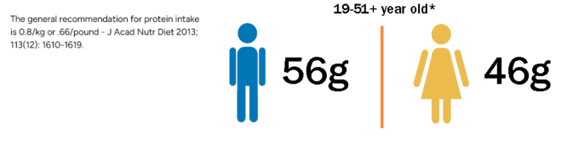
Common Nutrition Myths
Carbohydrates are bad for you
  FACT: Carbohydrates provide energy and essential nutrients.
Most people don’t get enough protein
  FACT: The average adult consumes far more than necessary.

Slide 5
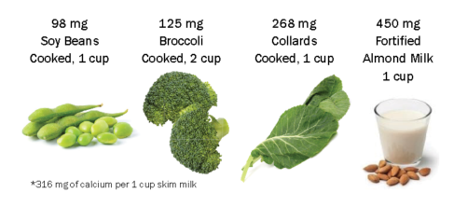
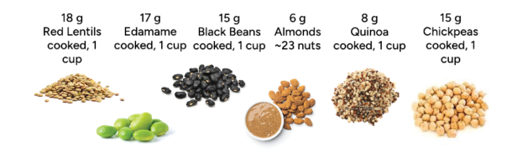
Common Nutrition Myths
You have to consume dairy to meet calcium needs
  FACT: Plants are the original source of calcium for the animals that provide dairy.
You need to eat animal protein to meet daily needs
  FACT: Plant foods can provide ample protein for all life stages.

Slide 6

Your Health Lifestyle
The Six Pillars of Lifestyle Medicine
  Nutrition
  Physical Activity
  Restorative Sleep
  Stress Management
  Social Connection
  Avoidance of Risky Substances

Slide 7
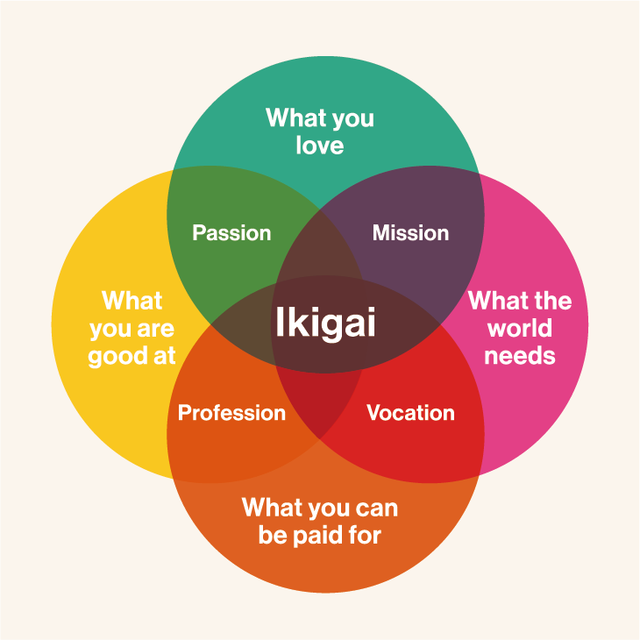
Ikigai
Passion that gives value and joy to life

Slide 8
Successes and Challenges

Slide 9
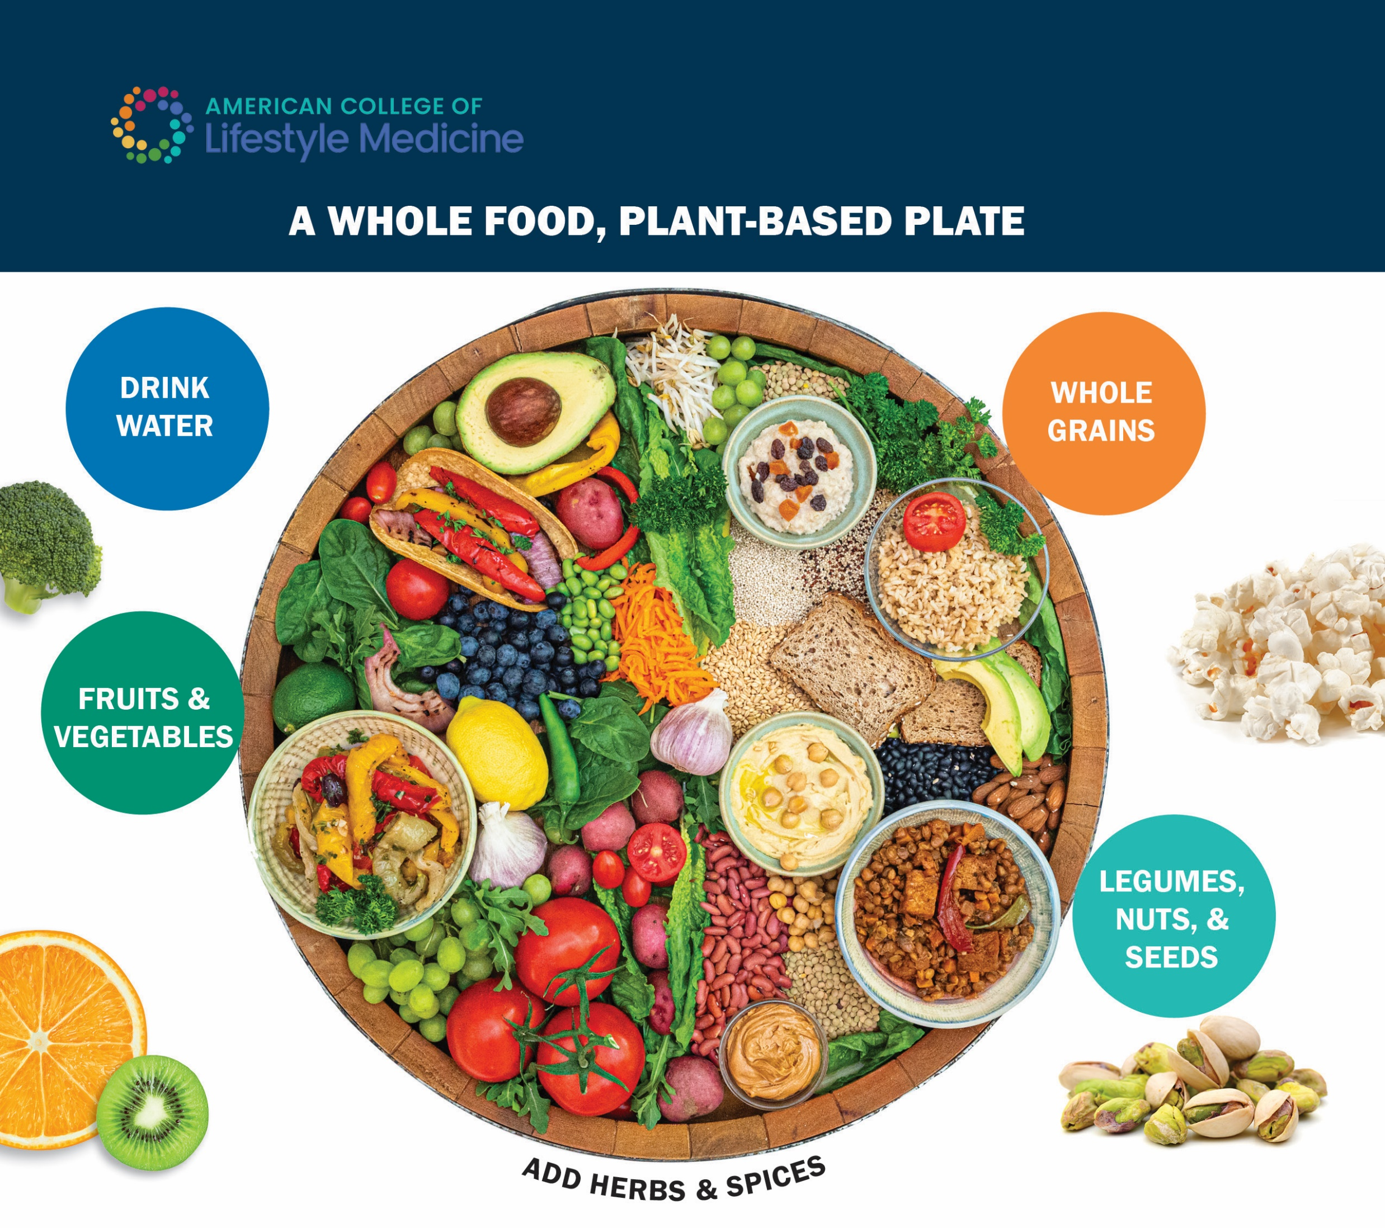
In Closing
Effort = Success
The First Step is the Hardest
Do your best

