Slide 1
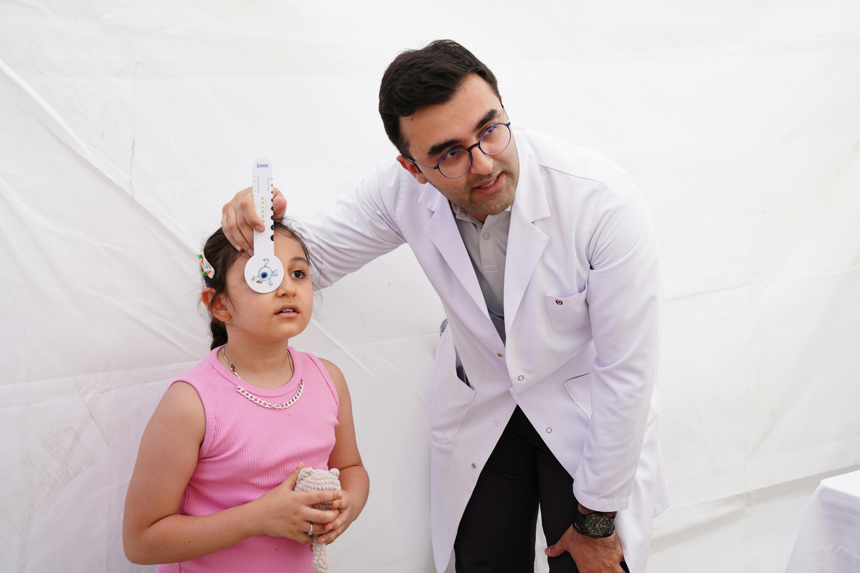
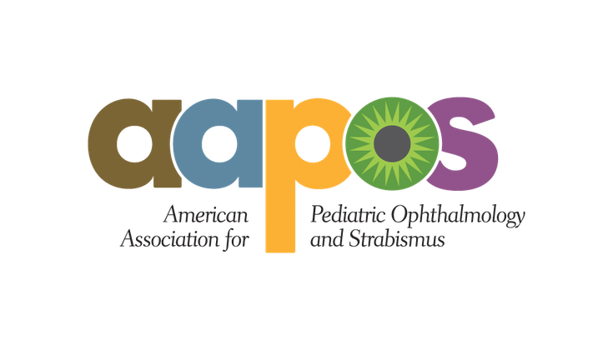
Children's Vision and Learning​

Slide 2

Why this matters in your classrooms
Vision problems are routinely mistaken for behavioral and learning issues.​
A child who squints, avoids reading or seems inattentive may simply not be able to see clearly.​
A failed screening usually means a real, correctable problem.​
Nearly 40% of U.S. children 17 and under have seen an eye doctor. (National Survey of Children's Health, 2021)​
A vision screening is not a diagnosis. It is a filter -- and what happens after a child does not pass is where outcomes are decided.​

Slide 3
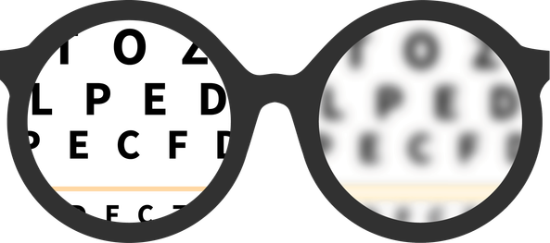
The common conditions to know
Refractive Error
Myopia (nearsightedness)
Amblyopia (“lazy eye”)
Convergence and focusing problems:
Strabismus
The eye does not focus light correctly. Usually correctable with glasses. Includes hyperopia (farsightedness), astigmatism and myopia.
Distance vision blurs. Rising sharply and progressive -- it worsens through childhood.​
The brain suppresses input from one eye. The leading cause of preventable vision loss in children.​
The eyes do not align. Can cause double vision, poor depth perception and amblyopia if untreated.​
The child can see the board but cannot sustain near work without fatigue or headaches.​

Slide 4
Myopia is rising,
and screens are part of the story
  About 40% of U.S. children and adolescents are now myopic, nearly double the 1970s figure. (National Academies, 2024)​
  Toddlers average two hours of screen use a day. By the teen years that climbs to four or more. (Surgeon General's Advisory, May 2026)​
  A 2024 meta-analysis in BMC Public Health found a statistically significant association between screen time and myopia across all device types.​
  Myopia is not just an inconvenience. Higher myopia raises lifetime risk of retinal detachment, macular degeneration, glaucoma and early cataracts.​
  The younger the onset, the more years the eye has to keep elongating.​

Slide 5
The national health
community is responding​
Two developments in 2026 changed the policy conversation​
Surgeon General's Advisory, May 2026​
The advisory identified myopia among the health concerns tied to excessive screen use in children, placing pediatric eye health inside a national conversation that had focused largely on mental health and sleep.​
AMA House of Delegates Resolution, June 2026​
The AMA adopted a resolution calling for myopia to be formally recognized as a significant public health concern and for insurance coverage of evidence-based pediatric myopia treatments.​

Slide 6

Vision and learning: what the research shows
A systematic review of spectacle correction found vision impairment significantly affects cognitive and educational well-being, mental health and quality of life. (Paudel et al., 2023)​
In a randomized trial of school-based screening, untreated amblyopia produced reading impairment -- and treatment proved more effective when started before age 7. (Asare et al., 2024)​
School readiness and early cognitive performance are strongly associated with educational attainment and health decades later. (Millennium Cohort Study, 2020)​

Slide 7
Why timing is not negotiable​
  The visual system develops on a biological schedule. The critical period for binocular vision runs from roughly 3 to 8 months, with sensitivity to damage extending to at least age 3.​
  Untreated vision conditions during those windows can cause permanent impairment; not because of the condition, but because the visual cortex never received the input it needed.​
  Amblyopia treatment is most effective before age 7. Significant plasticity remains in school-age children, but it narrows every year.​
  For children ages 3 to 5, regular vision screening can help identify eye problems early. Screening tests are reliable, and children who need treatment can benefit from getting care early.

Slide 8
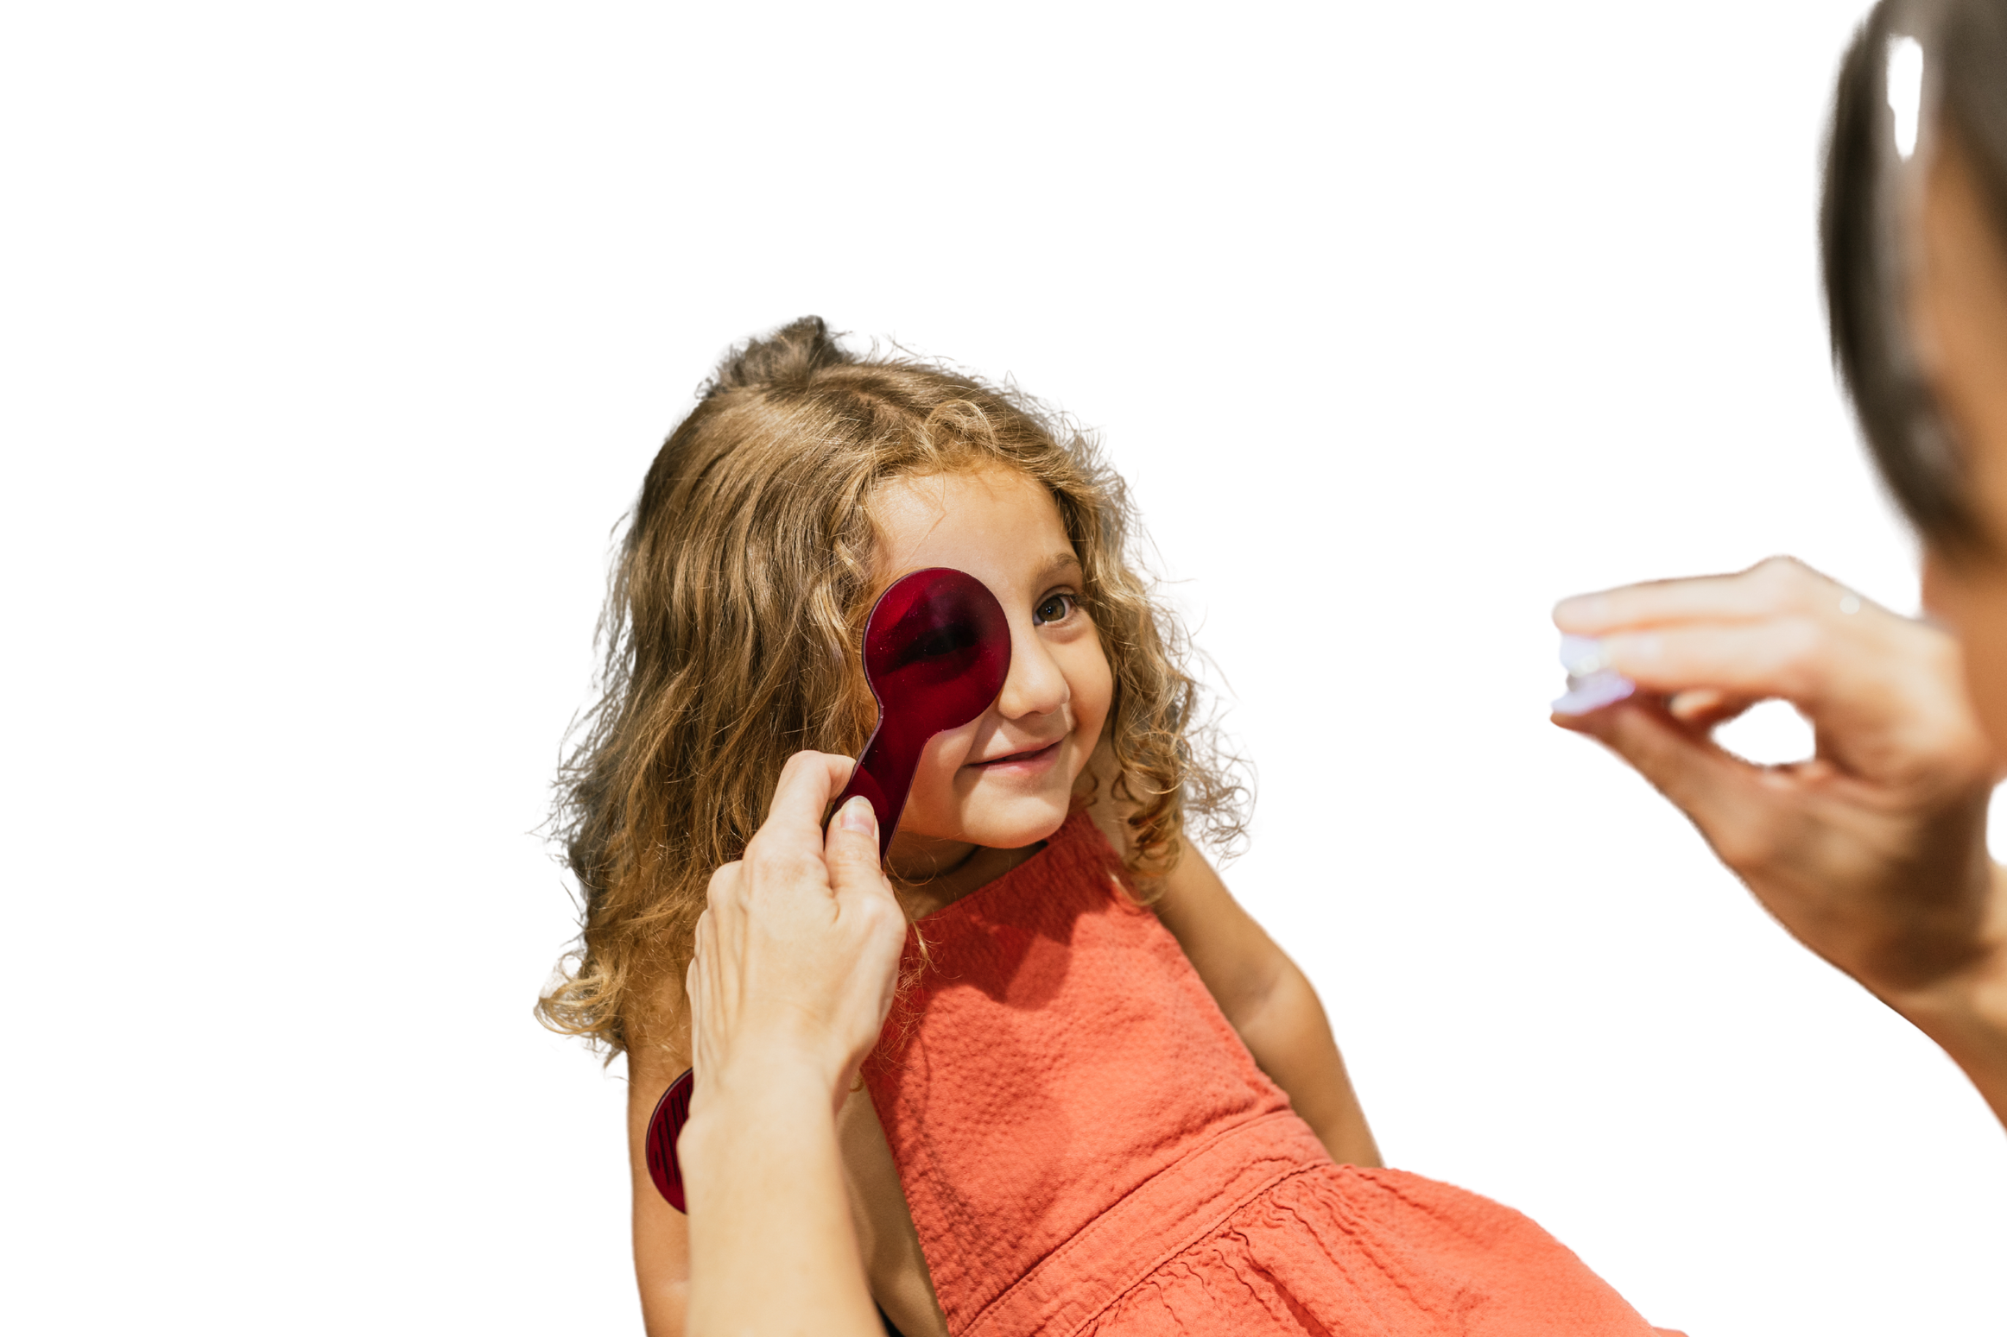
When a child does not pass the screening
Refer promptly to a pediatric ophthalmologist. Do not schedule a recheck.
​
A recheck delays diagnosis by months during years when months matter. Time is the variable school staff have the most control over.​
Close the loop. A referral that never reaches an exam room is not a referral. Track whether the appointment happened.​
Ask about barriers. Among U.S. families who could not get needed vision care for a child, caregivers cited cost (59.9%), difficulty getting an appointment (47.7%) and eligibility concerns (32.4%)(American Journal of Ophthalmology)

Slide 9

What to watch for
Behaviors worth a second look, in the classroom and the health office​
1.
Squinting, or closing/covering one eye
2.
Sitting close to the board or holding books unusually close
3.
Tilting or turning the head to look at something
4.
Losing place while reading, skipping lines or using a finger to track
5.
Frequent eye rubbing, headaches or complaints of tired eyes after near work
6.
Avoiding reading and close work, or short attention span only during those tasks
7.
Eyes that appear misaligned, even intermittently

Slide 10
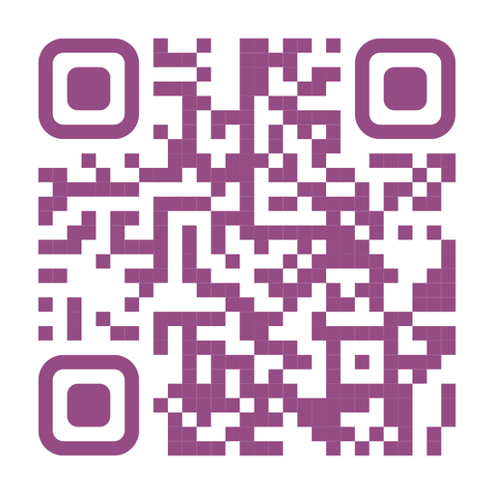
Resources for familiies
All Children See
The SCREENS
Framework
Simple Guidance Worth Repeating
Supported by the Children's Eye Foundation, the program matches children who have not passed a screening with pediatric ophthalmologists who provide comprehensive eye exams at no cost. ​
AAPOS developed SCREENS for families who ask what they can do at home about screen use and eye health.​
Follow the 20-20-20 rule: every 20 minutes of screen use, look 20 feet away for 20 seconds. Keep screens at arm's length. Protect outdoor time -- it is associated with slower myopia progression.​
Screen Limits
Comfortable Watching
Rest (20/20/20 rule)
Eye Drops for Dryness
Exit Outside
No Nightime Screens
Screen Settings on Low

Slide 11
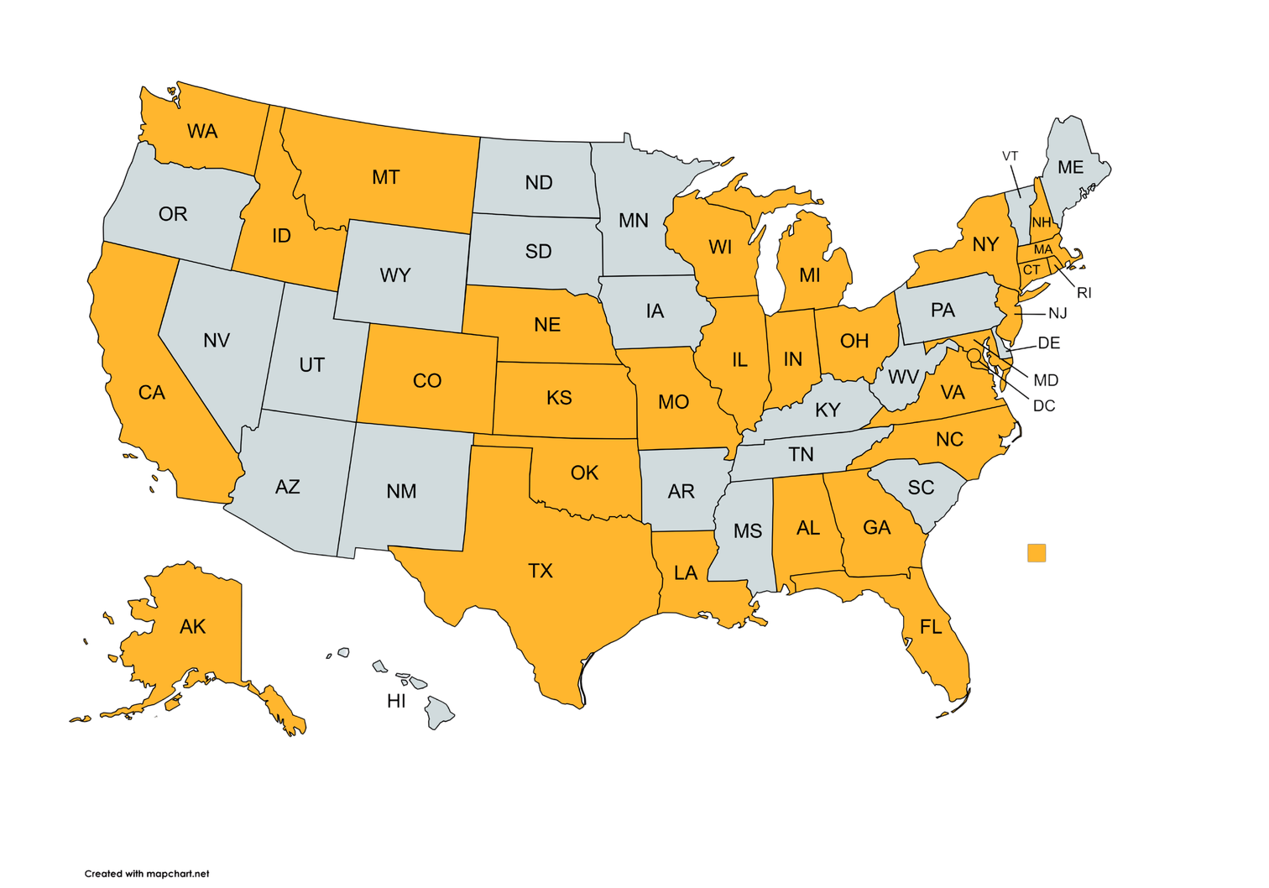
About All Children See
  A program of the Children’s Eye Foundation of AAPOS that connects eligible children with volunteer pediatric ophthalmologists for no-cost comprehensive eye exams
  Available in 30 states and Washington, D.C. for children who are U.S. citizens or legal residents and uninsured or underinsured
  Helps children who have failed a vision screening, were unable to complete a screening, or have an eye concern access the care they need
Scan to learn more

Slide 12

What to take back to your school
Vision problems look like behavior problems. Rule out the eyes before you draw conclusions about attention or motivation.​
Myopia is rising fast and carries lifetime consequences. The Surgeon General and the AMA both said so in 2026.​
The consequences of untreated vision problems reach learning, mental health, social development and motor skills.​
The treatment window closes. Refer, do not recheck.​
Cost is a solvable barrier through All Children See.

Slide 13
Sources
U.S. Department of Health and Human Services. Surgeon General's Advisory on Children and Adolescent Screen Time. May 2026.​
American Medical Association House of Delegates. Resolution on Myopia Classification and Insurance Coverage for Pediatric Myopia Treatment. June 2026.​
National Academies of Sciences, Engineering, and Medicine. Myopia: Causes, Prevention, and Treatment of an Increasingly Common Disease. 2024.​
Zong Z, et al. The association between screen time exposure and myopia in children and adolescents: a meta-analysis. BMC Public Health, 2024.​
Du K, Patil P, Boland M. Mental Health of US Children With Vision Impairment: An Analysis of the National Health Interview Survey. American Journal of Ophthalmology, 2025.​
Paudel P, et al. The impact of spectacle correction on the well-being of children with vision impairment due to uncorrected refractive error. 2023.​
Asare AO, et al. Cluster-randomized controlled trial of school-based vision screening. 2024.​
Sylvia S, et al. The Effect of Providing Free Eyeglasses on Children's Mental Health Outcomes in China. 2019.​
Black LI, Boersma P, Jen A. Vision Testing Among Children Aged 3-5 Years in the United States, 2016-2017. NCHS Data Brief No. 353, November 2019.​
Antonio-Aguirre B, et al. Association of Sociodemographic Characteristics with Pediatric Vision Screening and Eye Care: An Analysis of the 2021 National Survey of Children's Health. Ophthalmology, 2024.​
Socioeconomic Determinants of Unmet Vision Care Needs and Gaps in Eye Examinations in Pediatric Populations From 2016 to 2022. American Journal of Ophthalmology, 2025.​
Garcia-Lorente M, et al. Vision screening in newborns and early childhood. 2021. Dekker TM, et al. The development of human visual cortex and clinical implications. 2018.​

