Slide 1


Advanced Practice COI April Journal Club
SGLT2i and T1D on Integrated Pump/CGM Reduce the Need for CHO Count?
Presented by: Lucia M. Novak, MSN, ANP-BC, BC-ADM

Slide 2
Aim: To determine if adding SGLT2i will reduce need for CHO Counting in pts with T1D on integrated pump – NON-IFERIORITY (= AS GOOD AS SOC)
Canadian participants with T1D on personally owned insulin pump (n=26)
PUMPS
MT 630G (n=14)
MT 670G open Loop (n=1)
MT 670G Veo (n-2)
Omnipod (n=5)
Animas Ping (n=2)
Animas Vibe (n=2)
DEXCOM G5
(in addition to whatever sensor they have with pump – applied 24-48 hours before intervention)
Empagliflozin 25 mg
Intervention at 2 sites
Automated insulin delivery for 9-14 hours (depending on site)
Staff present entire time
Participants lived life as usual – no restrictions – no limit on CHO intake, timing
Ketones measured every morning
Basal dosing kept consistent in all interventions
Receiver held by STAFF and Bolus by STAFF
Every 10 min CGM data manually entered into algorithm that determined BASAL insulin delivery using TEMP BASAL every 10 min.
CHO count – 10 min ac (accuracy not verified)
Simple meal announcements – 10 min ac, 25 gm CHO
No CHO count, no meal announcements

Slide 3
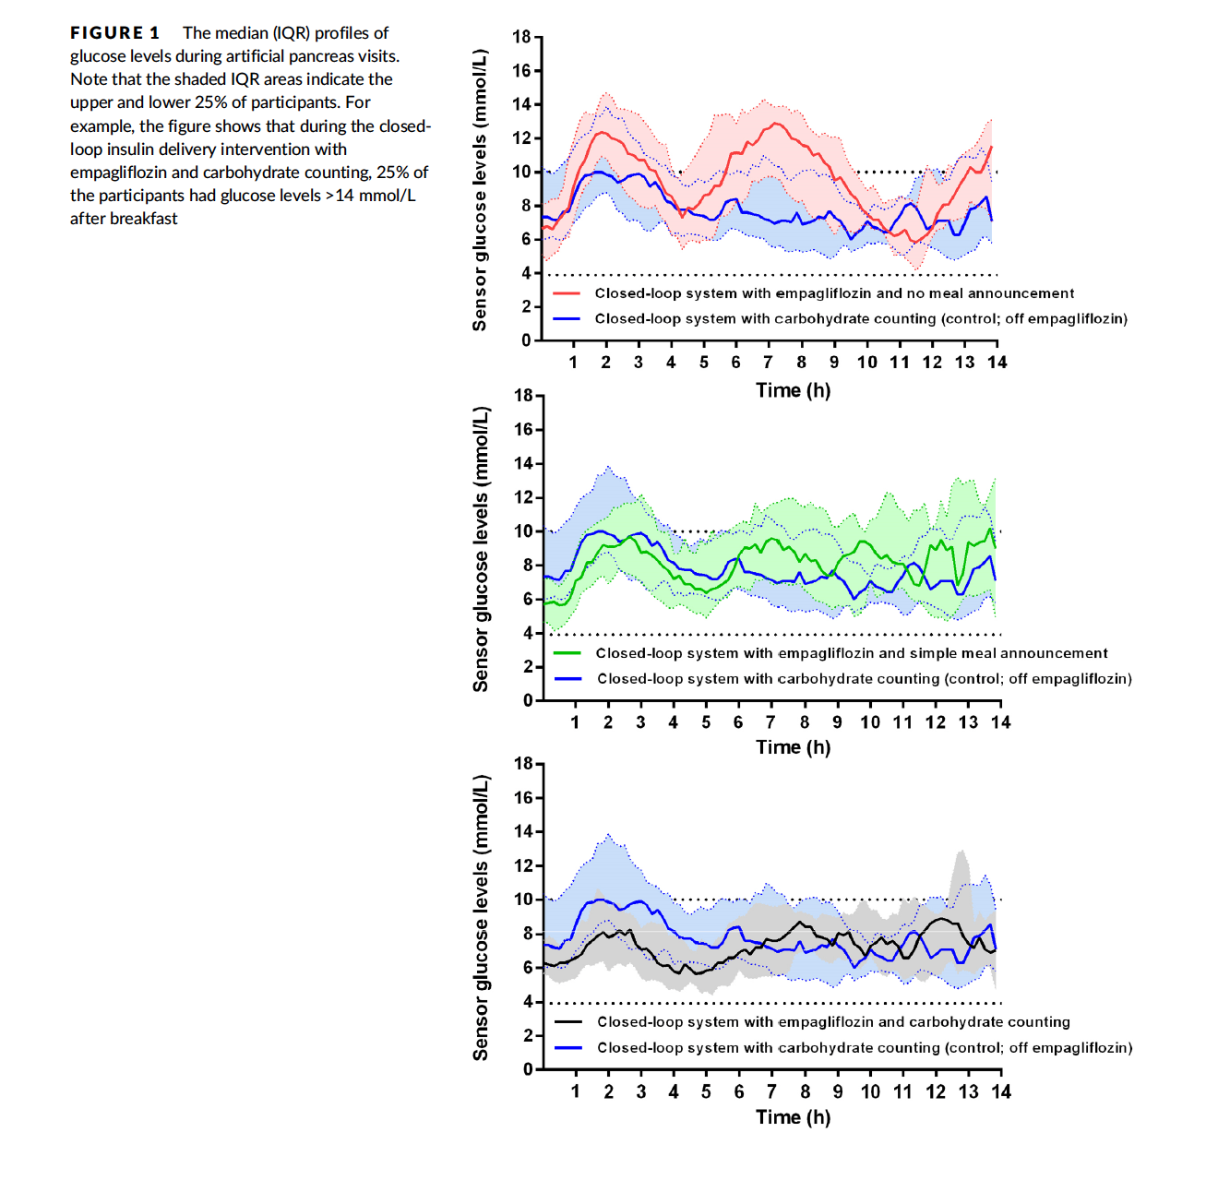
EMPA ONLY VS CHO Count no EMPA
EMPA + meal announce VS CHO Count no EMPA
X
WITH LESS INSULIN REQUIRED!
Time (hours)
Time (hours)
mmol to mg/dL
4= 72
6= 108
8= 144
10= 180
12= 216
14= 252
16= 288
EMPA + CHO Count VS CHO Count no EMPA
14% inc. TIR
WITH LESS INSULIN REQUIRED!
Time (hours)

Slide 4
Discussion
1) Canadian and types of pumps and CGM used (2018-2019)
No Tandem
No Dexcom G6 or Libre
2) Small study (but it is a pilot)
3) High risk for DKA, esp. in women (EASE trials with MDI)
Future CGM technology may help mitigate/prevent
4) Optimal dose of SGLT2i unknown
5) Other SGLT2i?

Slide 5
Case Discussion if Applicable

Slide 6


