Slide 1
Pulmonary Hypertension in Rehab: How It Shows Up and What To Do
Jay Balachandran, MD Mar 20, 2026
Notes:
Most of the pulmonary hypertension you see in rehab is not PAH. It’s patients with heart failure, COPD, interstitial lung disease… who happen to have elevated pulmonary pressures. And what that means in practice is this: these patients don’t fail because they’re deconditioned. They fail because their ability to deliver oxygen during exercise is limited.
So what I want to do today is not walk through guidelines. I want to give you a simple way to think about these patients: What’s the physiologic problem, how does it actually show up when you’re working with them, and what should you change in real time during rehab.
If you walk out with a framework you can use on your next patient, this will have been worth it.

Slide 2
Disclosures
None

Slide 3
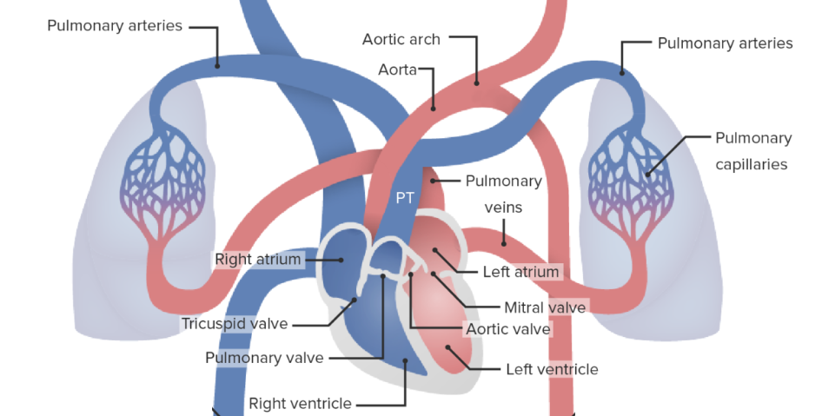
Pulmonary Hypertension Overview
Notes:
Let’s just orient ourselves to normal flow, because everything we’ll talk about builds on this. Blood comes back from the body into the right side of the heart… into the right atrium, then the right ventricle. From there, the right ventricle pumps blood forward into the pulmonary arteries… and into the lungs.
In the lungs, blood moves through a very large, low-pressure vascular bed… where gas exchange happens. Oxygen comes in, CO₂ goes out. Then that oxygenated blood returns to the left side of the heart… left atrium, then left ventricle…and the left ventricle pumps it out to the body.
So under normal conditions, this system is designed to be:
low resistance in the lungs
and efficient forward flow from the right ventricle
And that’s the key idea to hold onto. The right ventricle is not built to pump against high pressure. It’s built for a low-resistance system.
Everything we call pulmonary hypertension is some version of this system becoming harder to push blood through

Slide 4
Pulmonary Hypertension Overview
Defined as mean pulmonary artery (mPA) pressure ≥ 20 mmHg (even “mildly increased” pressures of 20-40 mmHg carries increased risk)
Hemodynamic diagnosis, not symptom-based
Not ONE disease but a consequence of multiple disorders
Notes:
Let’s define what we mean by pulmonary hypertension. It’s a hemodynamic diagnosis, based on mean pulmonary artery pressure… now defined as 20 mmHg or higher.
So this is not a symptom-based diagnosis. Patients don’t need to look sick or feel dramatically different to meet this definition.
And one nuance that’s worth knowing: Even what used to be considered ‘borderline’ pressures… say in the low 20s, like 22, 23, 24… those patients actually have higher risk over time.
So this is not a binary normal vs abnormal situation. It’s more of a spectrum.
The other key point is that pulmonary hypertension is not one disease. In rehab, most of what you’re seeing is pulmonary hypertension as a consequence of:
left heart disease
or lung disease and hypoxia
Or some combination
And that distinction matters, because the physiology driving exercise limitation is different.

Slide 5
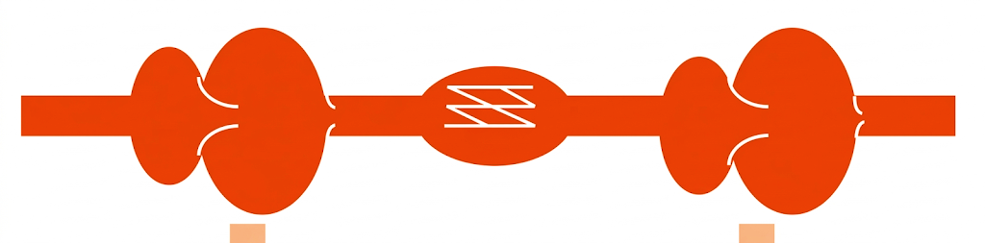
Pulmonary Hypertension Mechanisms
Precapillary Disease:
↑ resistance in small pulmonary arteries (arterioles)
RA
RV
PA
PV
LA
LV
Cap
Causes:
Pulmonary arterial hypertension (Group 1; rare)
Lung disease and other causes of low oxygen (Group 3)
Chronic pulmonary embolism (Group 4)
Flow problem → limits ability to increase output
Notes:
Let’s start with precapillary disease. The key idea is simple: the problem is before the capillary bed.
In the small pulmonary arteries, resistance goes up. The vessels are narrowed and stiff. So now the right ventricle is pushing blood into a tighter system.
That raises pulmonary artery pressure, even though the left heart can still be completely normal. So this is a forward resistance problem the right heart is pushing into a high-resistance circuit.

Slide 6
Pulmonary Hypertension Mechanisms
↑ back pressure from the left heart
Postcapillary Disease:
RA
RV
PA
PV
LA
LV
Cap
Causes: (Group 2)
Left heart failure (HFpEF, HFrEF)
Valvular heart disease
Back-pressure problem → volume-sensitive system
Notes:
Now contrast that with postcapillary disease. Here, the problem is after the capillary bed. The left heart is not accepting blood well, so pressure builds up in the left atrium. That pressure gets transmitted backward into the pulmonary veins and capillaries. So even though the pulmonary arteries themselves may be normal, the pressures are elevated because of this back-pressure.
So this is a back-pressure problem - the lungs are congested from the left heart.
Same number, completely different mechanism.
You’ll see five groups in textbooks, but for what we do, it really comes down to two mechanisms.

Slide 7

PH- A Problem of Oxygen Delivery
RV cannot increase cardiac output with exercise
Pulmonary circulation cannot adapt to increased flow
Oxygen delivery cannot meet muscle demand
Notes:
When patients with pulmonary hypertension try to exercise, they run into a few key limitations.
First, the right ventricle can’t increase cardiac output the way a normal heart can. It’s already working against a high-resistance system.
Second, the pulmonary circulation can’t adapt to increased flow. In a healthy person, those vessels dilate and recruit. Here, they behave more like a fixed system.
And because of that, oxygen delivery can’t keep up with what the muscles are asking for.
So very quickly, demand exceeds supply, and that’s when patients feel short of breath and fatigued.

Slide 8
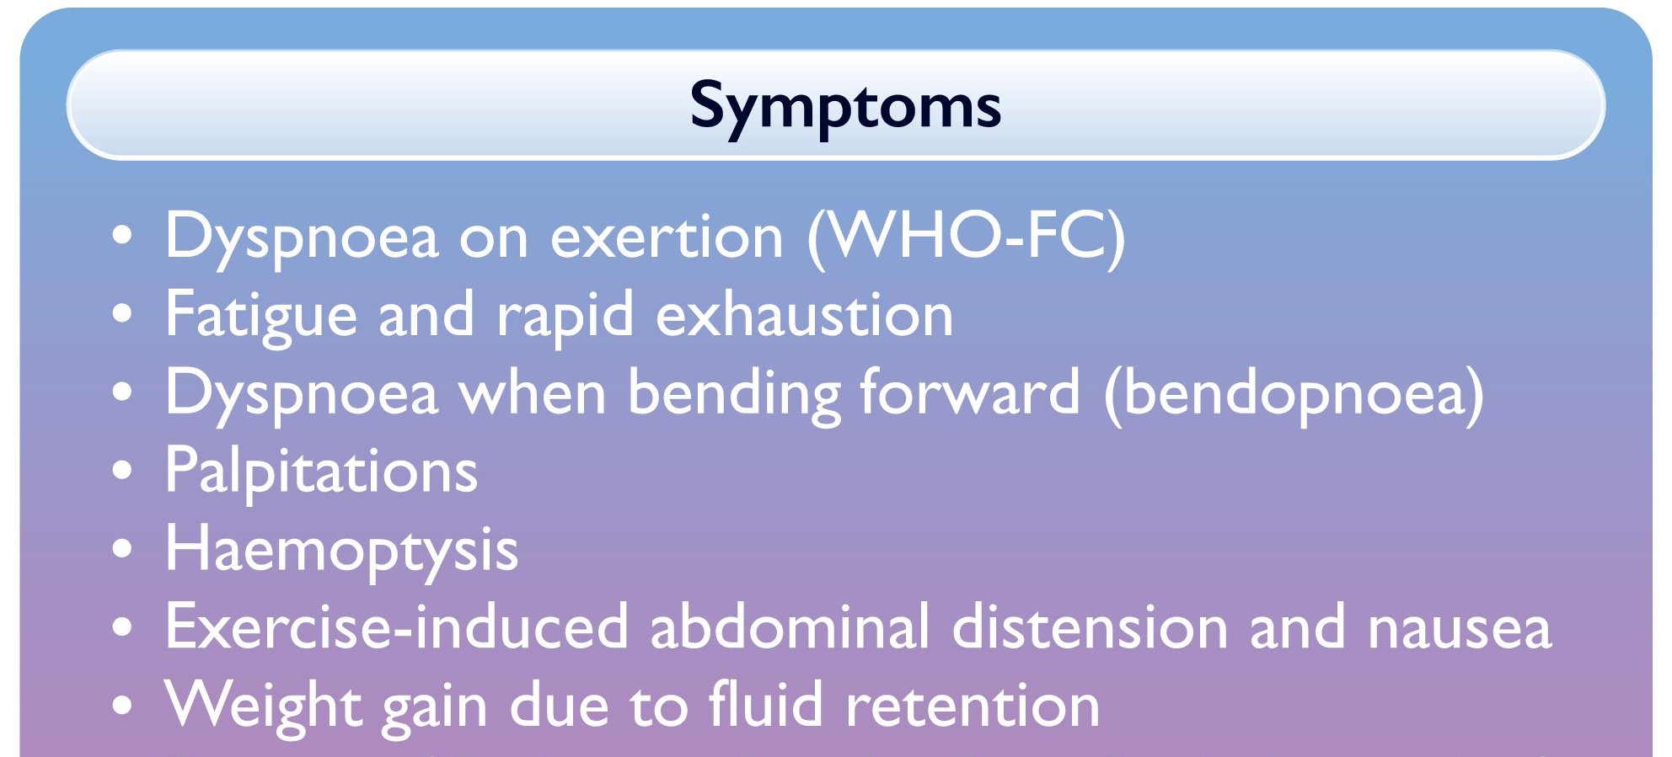
Pulmonary Hypertension Symptoms
WARNING SYMPTOMS
Fluid retention indicates right heart strain
Exertional lightheadedness, syncope suggest severely limited cardiac output
Notes:
Symptoms in pulmonary hypertension reflect how much reserve the right ventricle has, not just how high the pressures are.
So don’t just think of this as a list. Each symptom is telling you something about the physiology:
Dyspnea is a mismatch between what the body needs and what the system can deliver.
Fatigue and rapid exhaustion reflect inadequate oxygen delivery to the muscles.
Palpitations often reflect strain on the right heart or atrial arrhythmias. When those show up, patients can lose what little cardiac output reserve they have.
Hemoptysis is less common, but when it happens, it’s a red flag. That’s high-pressure pulmonary circulation or vascular injury.
Lightheadedness is especially important. That often means the heart cannot increase cardiac output during exercise. Lightheadedness during exercise is not deconditioning in this population. It’s a cardiac output problem until proven otherwise.
Edema and fluid retention are later findings. That’s right heart failure.
So what you’re seeing clinically is a spectrum, from limited reserve… to overt RV failure

Slide 9
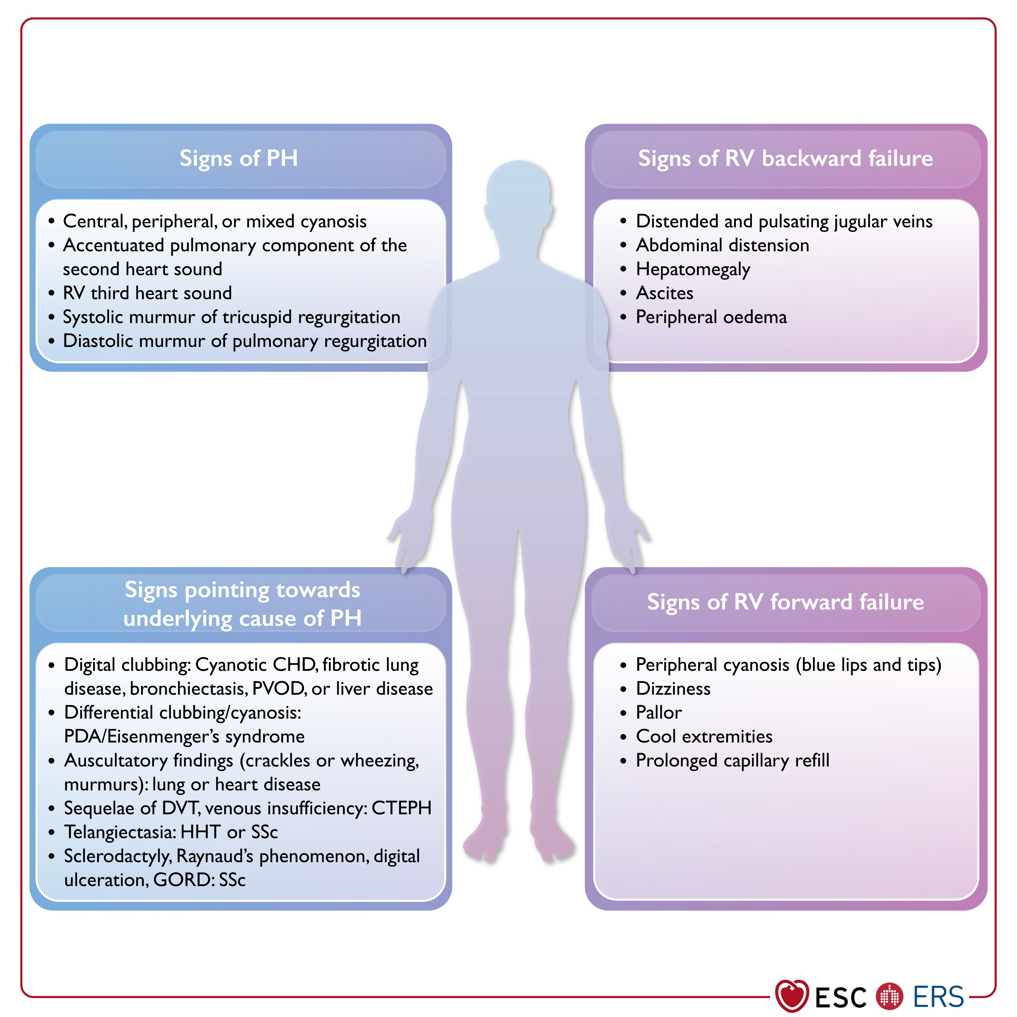
Pulmonary Hypertension Exam
Notes:
“Physical exam findings reflect right heart strain and volume status. This matters most when thinking about day-to-day variability

Slide 10
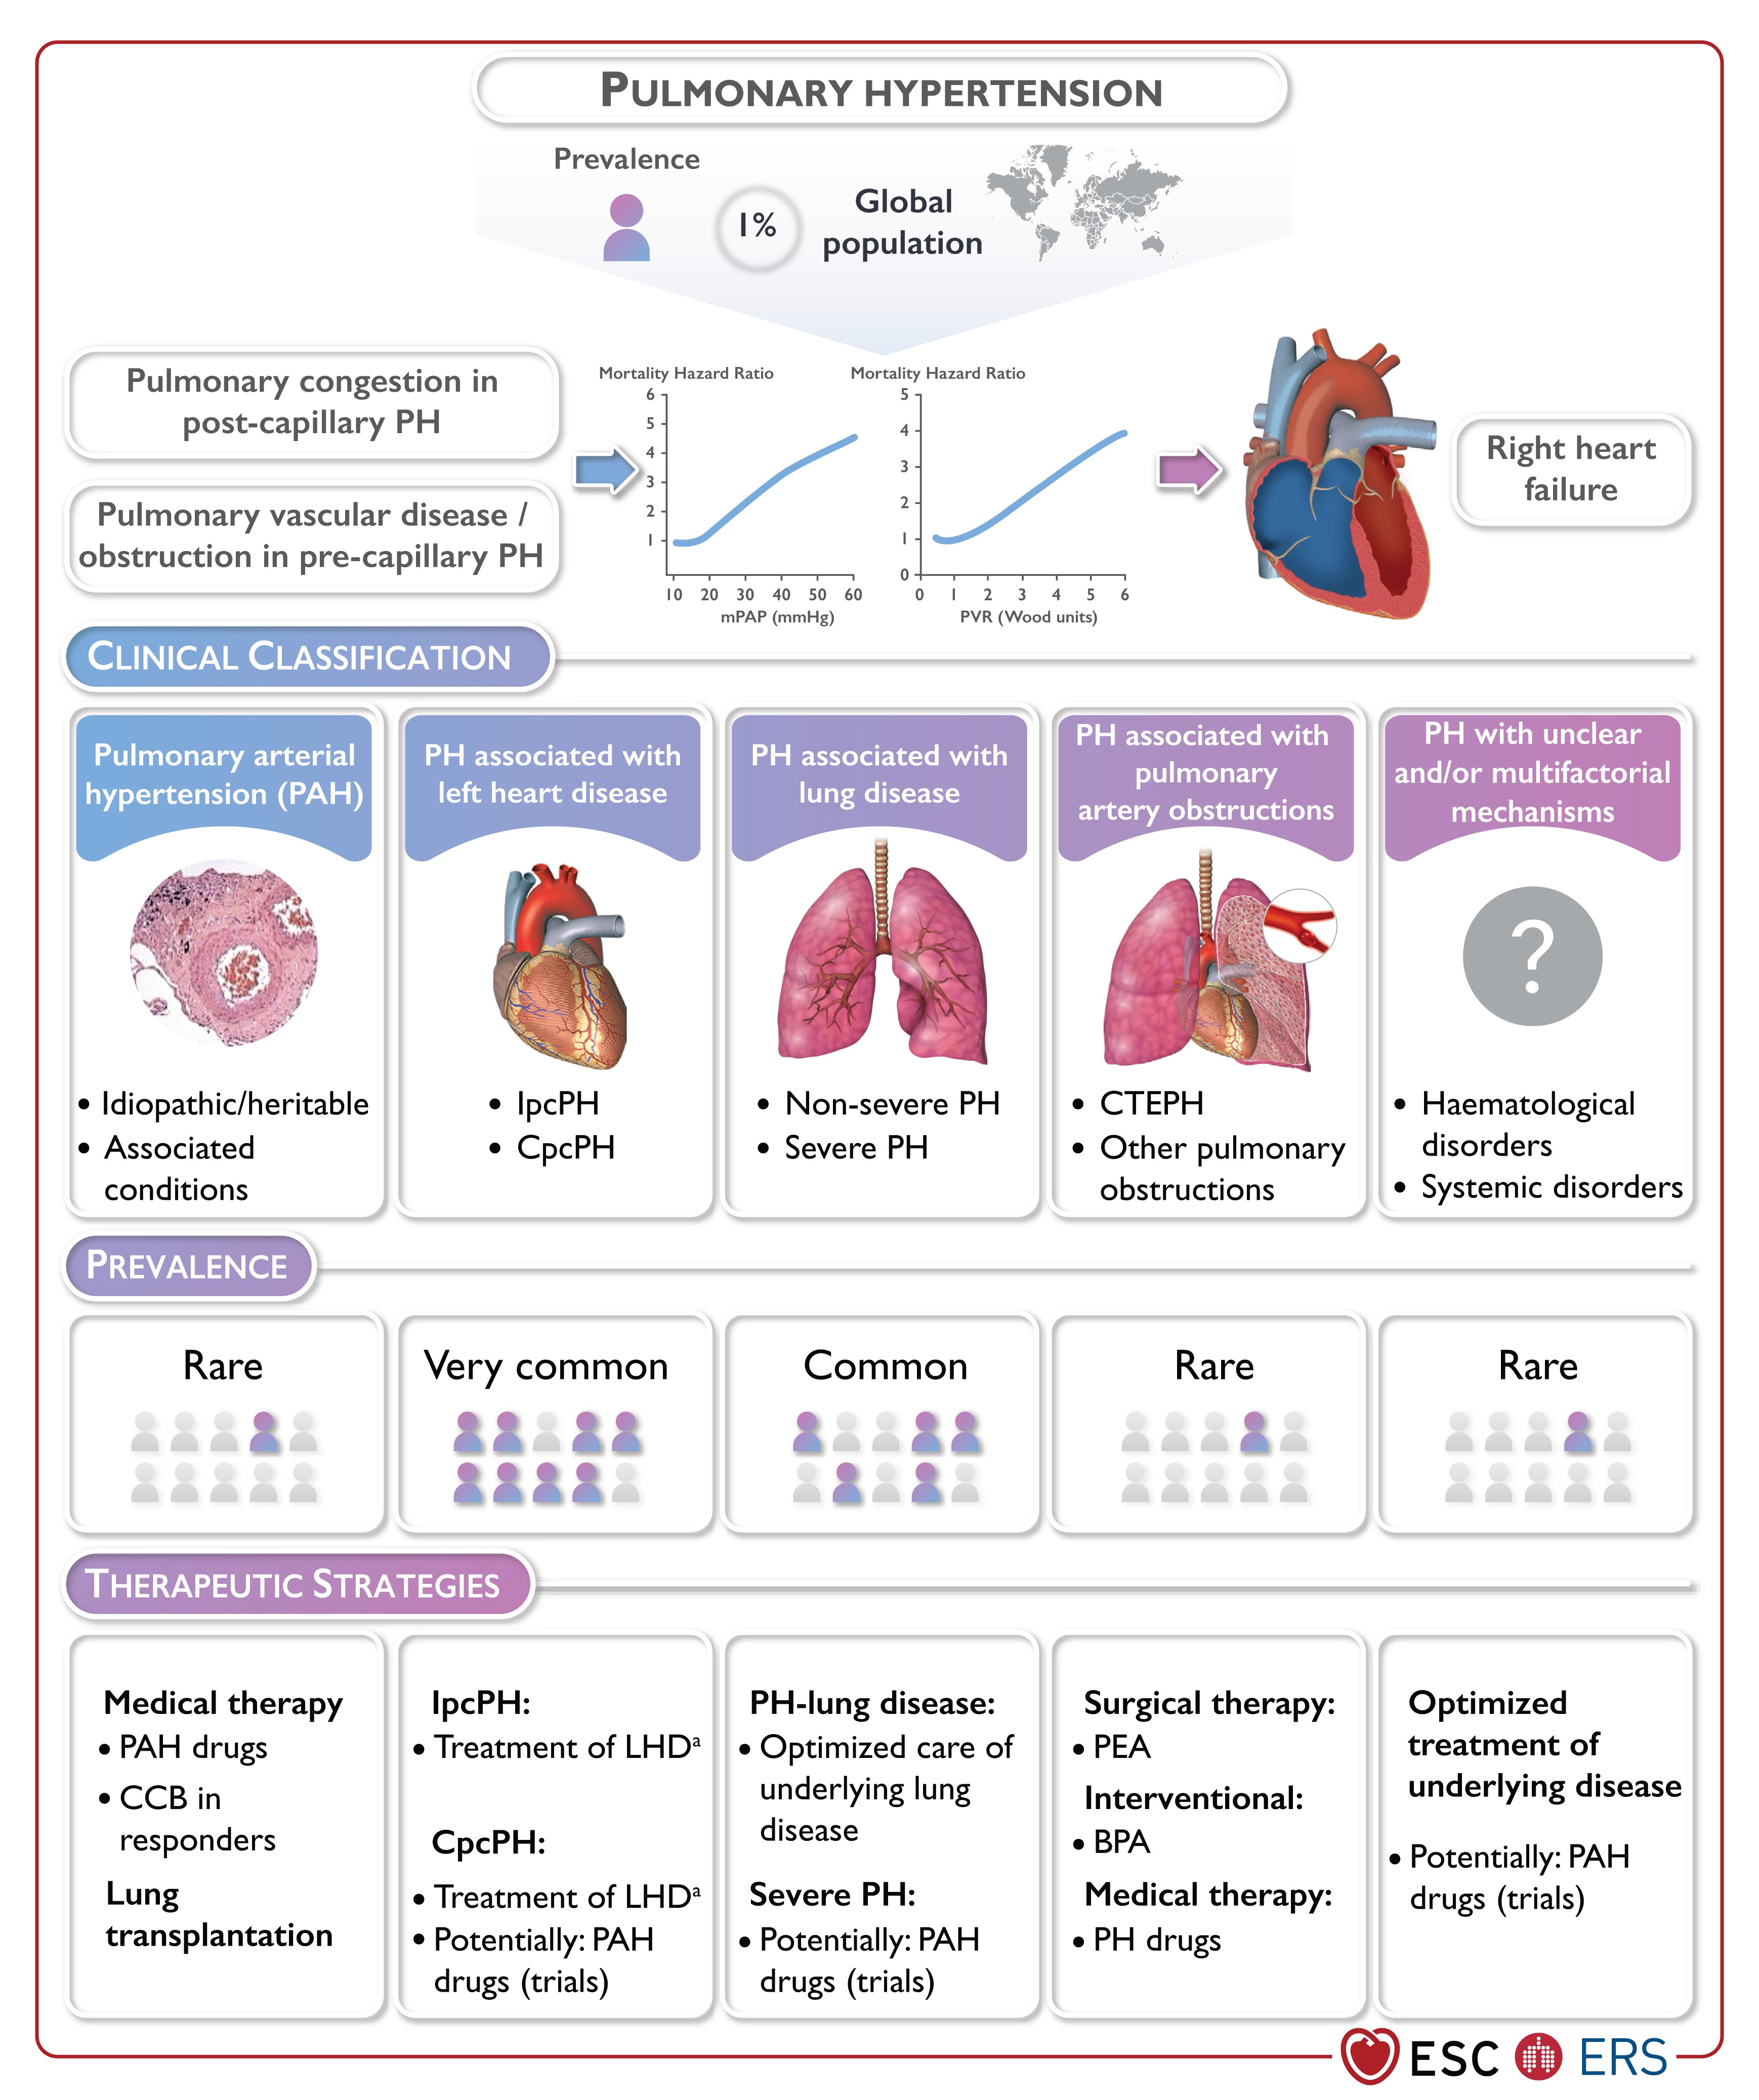
Implications of Pulmonary Hypertension Classification
↑ left-sided pressures limit right heart cardiac output
Volume-sensitive symptoms
Day-to-day variability
Notes:
In patients with pulmonary hypertension due to left heart disease, the key limitation here is not just the pulmonary circulation. It’s elevated left-sided filling pressures. So when they exercise, cardiac output is limited… but just as importantly, they develop pulmonary congestion.
Instead of handling increased flow, pressure backs up into the lungs. That’s why these patients are very volume sensitive.
On a day when they’re fluid overloaded, they’ll feel more short of breath and fatigue quickly. On a day when they’re well diuresed, their exercise tolerance can look completely different.
You may see the same patient perform very differently from one day to the next, not because they’re inconsistent… but because their physiology is different that day.
Same patient, different day, different physiology.

Slide 11
Implications of Pulmonary Hypertension Classification
Ventilatory and gas exchange limitation
Exertional hypoxemia shows up early
Symptoms are less volume-driven (until late disease)
Notes:
These are patients with pulmonary hypertension due to lung disease. The primary limitation here is not congestion. It’s impaired gas exchange and ventilatory limitation. So when they exercise, oxygenation worsens.
They often desaturate, sometimes quite early. And that desaturation is expected in this population. Not all desaturation means something dangerous is happening.
What’s limiting them is oxygen delivery from the lungs, not fluid status. They are generally less volume-sensitive, especially early in the disease
If Group 2 is about congestion and volume…this is about gas exchange and oxygenation.

Slide 12
Group 2 vs Group 3 PH
Group 2
Group 3
Cardiac output limit
Back pressure/congestion
Variable / volume-dependent symptoms
Less prominent desaturation
Treat with cardiac optimization
Oxygenation limit
V/Q mismatch, hypoxia
Lower variability / volume-insensitive
Desaturation is common
Treat with O2, underlying condition
Notes:
If you remember nothing else, remember this slide.
These are two very different physiologies. “Group 2 fails because it can’t move blood forward. Group 3 fails because it can’t oxygenate the blood it has.
Everything you see in rehab comes back to this difference. Your job is to recognize which physiology is in front of you.
So when you’re watching a patient exercise, you’re really asking one question…Is this a flow problem… or an oxygenation problem… or both?

Slide 13
PH Diagnostic Framework
Echo
RHC
Great screening tool
Operator dependent
DLCO tracks disease over time
Effort dependent
6MWT reflects function and therapy response
PFT / 6MWT
Required for diagnosis
Guides treatment and prognosis
Notes:
I’m not going to spend much time on diagnosis, but you need a simple framework. Think of this in three layers.
Echo is your screening tool. It tells you who might have pulmonary hypertension, but it’s operator dependent and not definitive.
And then right heart catheterization is the gold standard. That’s how you confirm the diagnosis and guide treatment.
And finally, PFTs and the six-minute walk test tell you about function. They help you understand gas exchange, track disease over time, and see how patients are responding.
So echo suggests it… cath confirms it, and functional testing shows you how it behaves

Slide 14
PH Risk Assessment
Risk model integrates:
Labs- BNP/NT-proBNP
Hemodynamics
Imaging
Functional class
6-minute walk distance
Goal: achieve low-risk profile.
Treat / Support
Assess Response
Assess Severity

Slide 15
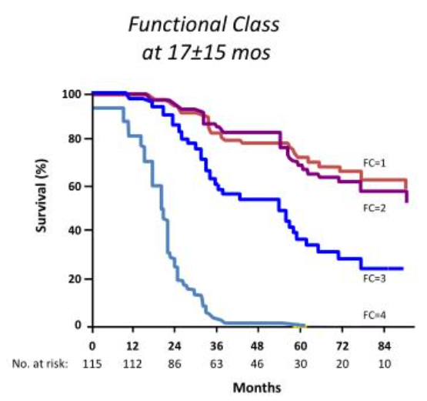
WHO Functional Class in PH
Class I
Symptom-free
Class II
No resting symptoms
Symptoms with mild exertion
Class III
No resting symptoms
Symptoms with minimal exertion/ ADLs
Class IV
Symptoms even at rest
McLaughlin VV et al. Circulation 2002.
Notes:
Survival chart is for group 1 PAH but holds up for other groups
This is how we stage patients with pulmonary hypertension. It’s simple, but very powerful.
Class I is asymptomatic.
Class II means symptoms with ordinary activity. Things like walking, stairs.
Class III means symptoms with minimal activity. Even basic daily tasks become difficult.
Class IV is symptoms at rest.
This is not just a description. It’s a measure of physiologic reserve. As patients move from Class II to III to IV, their ability to increase cardiac output and deliver oxygen is progressively lost.
And that matters, because functional class strongly predicts survival You can see that here. As class worsens, outcomes drop significantly.
In rehab, you are often the ones seeing this progression first. You’re the ones who notice when a patient goes from tolerating activity… to struggling with basic tasks.

Slide 16

6-Minute Walk Performance in PH
Not just distance
Test performance reflects:
Cardiac output reserve (RV function)
Pulmonary vascular limitation
Muscle efficiency
Oxygen delivery & extraction
Deconditioning vs conditioning
*It’s a whole-system measure*
Notes:
When you see a six-minute walk distance, don’t think distance. Think integrated physiology.
This is a whole-system test. You’re seeing cardiac output, pulmonary vascular limitation, oxygen delivery, and muscle efficiency all interacting in real time. That’s why it’s so powerful. It reflects how well the entire system is functioning under stress.
This is one of the best real-world measures of how well the system is working. And when patients do poorly here, it’s usually because that delivery-demand equation is failing.

Slide 17
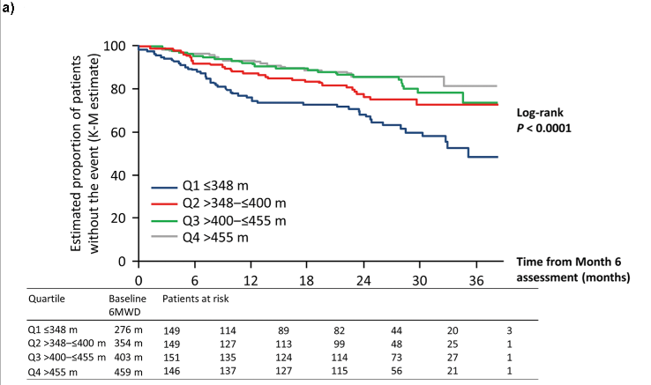
6-Minute Walk Performance in PH
At 6 months, patients grouped by walk distance
Lower distance → higher hospitalization & mortality
Higher distance → better long-term outcomes
Souza R et al. Plos One 2018.
Notes:
By six months, the six-minute walk distance is not just a functional measure. It strongly predicts outcomes.
Patients who walk shorter distances have higher rates of hospitalization and death. Patients who walk farther do significantly better. And this separation is not subtle. It’s a very strong signal.
If you look at the extremes, patients under roughly 300–350 meters do much worse…and those above 450 meters do much better.
And importantly, changes matter. A 40 to 70 meter improvement is clinically meaningful. So improving walk distance is not just about function. It’s about prognosis.
What you’re doing in rehab is not just improving symptoms. You’re influencing outcomes.

Slide 18
PH Treatment Principles
Management depends on PH group:
Group 1 (PAH) Targeted vasodilator therapy
Group 2 (Due to heart disease) Treat underlying heart disease
Group 3 (Due to lung disease/ hypoxemia/ sleep disorder) Treat lung/sleep disease and hypoxia
Group 4 (Due to pulmonary vascular obstruction) Pulmonary endarterectomy or balloon angioplasty
Notes:
Treatment depends on the underlying group. For most of your patients, that means treating the underlying heart or lung disease. Targeted pulmonary vasodilators are mainly for Group 1, but have limited roles in other groups.
So where do you fit in? You’re not changing the underlying disease… but you are optimizing function.”
Rehab is about improving how well the system performs, even within those limitations.

Slide 19
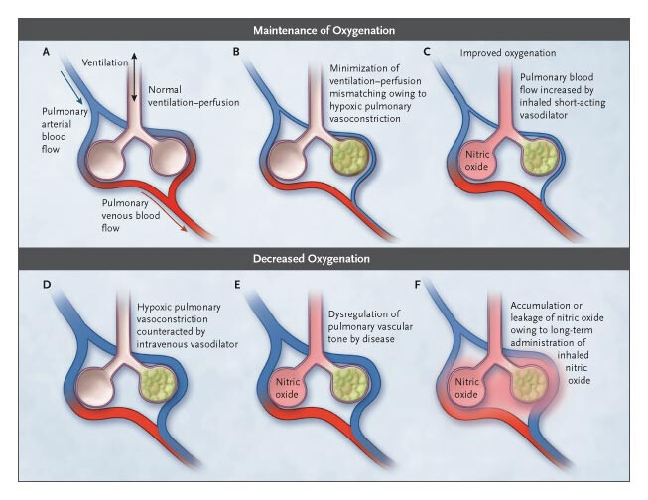
O2 in PH Removes a Constraint
Hypoxia → vasoconstriction
↑ PVR → ↑ RV afterload
Supplemental O2
May ↓ pulmonary artery pressures (modest)
↑ oxygen delivery
↑ exercise tolerance (especially Group 3)
Griffith MJ, Evans TW, NEJM 2005.
Notes:
Now if the six-minute walk tells us how the system is performing… the next question is: what can we actually do to improve it?” Think of oxygen not just as supportive therapy… but as a physiologic intervention. In low oxygen states, the lung constricts its blood vessels. That’s hypoxic pulmonary vasoconstriction. That’s helpful if it’s regional. But in diseases like COPD or ILD, it becomes global.
That increases pulmonary vascular resistance… and increases right ventricular afterload. When we give oxygen, we’re not just improving saturation. We’re actually reversing that vasoconstriction. We lower pulmonary vascular resistance… and reduce RV strain.
This effect is modest compared to targeted PAH therapies… But in Group 3 disease, especially during exertion, it’s one of the most meaningful interventions we have. Oxygen is not just correcting saturation. It’s reducing RV afterload. In Group 2 disease, oxygen plays a different role. The primary problem is elevated left-sided filling pressures, not pulmonary vasoconstriction. So oxygen is not a primary treatment for pulmonary hypertension in this group. Volume optimization is
However, if a patient is hypoxemic, we still treat the hypoxemia. Because low oxygen can worsen pulmonary vascular resistance and increase strain on the right ventricle.
But if they’re short of breath without hypoxemia…Think congestion, think cardiac output, think volume status.

Slide 20

O2 in PH- Who Benefits Most
Group 3 Disease
Any PH with exertional desaturation
Goal SpO2 >/= 90%
Limits
Doesn’t reverse disease
Less impactful in postcapillary (Group 2) disease
Notes:
If oxygen helps us restore some degree of oxygen delivery…Pulmonary rehab is where we actually train the system.
The evidence here is very consistent. Patients improve their exercise tolerance, their symptoms, and their ability to function day to day. But I want to frame this a little differently.
In pulmonary hypertension, you’re not fixing the pulmonary vasculature. You’re training everything around it to work more efficiently under constraint.
Peripheral muscles become more efficient. Ventilatory demand becomes better matched. And patients learn how to operate closer to their physiologic ceiling… without crashing into it.
This is where you all have the biggest impact. Rehab doesn’t change the disease. It changes how the body performs with it.

Slide 21

What Rehab Can Improve in PH
Rehab can directly improve:
Peripheral muscle efficiency
Oxygen extraction
Symptom tolerance
Patient confidence
You can’t always fix the pulmonary vasculature, but you can alter the patient’s symptoms
Notes:
So if oxygen helps support the system during exercise… This is where rehab actually changes what the system can do.”
In pulmonary hypertension, cardiac output is limited. You’re not fixing that. But you can change how efficiently the body uses that limited delivery.
Muscles become more efficient. Oxygen extraction improves.
Patients tolerate symptoms better… and regain confidence.
And that combination changes how far they can go.
You can’t fix the pulmonary vasculature…but you can change the patient’s trajectory.

Slide 22
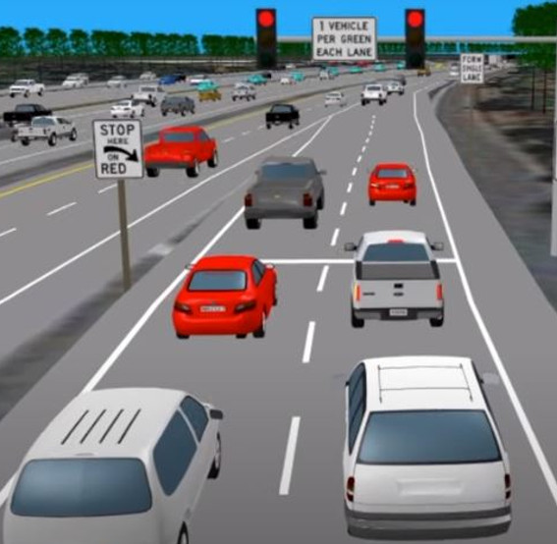
How PH Physiology Changes Rehab
Fixed cardiac output → avoid sustained high intensity
RV strain → favor interval training
Hypoxia → titrate oxygen early
Volume sensitivity (Group 2) → expect session-to-session variability
Notes:
Now let’s translate the physiology we’ve reviewed into what you actually do in rehab.
First, in pulmonary hypertension, cardiac output is relatively fixed. So sustained high intensity doesn’t work well. Patients hit a ceiling quickly.
Second, the right ventricle is under strain. So instead of pushing continuously, interval training allows recovery and protects the RV.
Third, hypoxia matters. Oxygen isn’t just correcting a number… It’s a performance tool that helps maintain flow and reduce strain during exertion/
And finally, especially in Group 2 disease, volume status fluctuates. So expect day-to-day variability in performance. Some days will look very different than others.
Think of the pulmonary circulation like a highway with a bottleneck due to lane closure.
The # lanes are reduced… that’s pulmonary hypertension. Blood flow becomes traffic. And the right ventricle is traffic pushing into that congestion.
Intervals are like letting traffic clear before sending more cars through. Oxygen adds an additional lane. And pacing controls how many cars enter at once.
You’re not increasing capacity… you’re managing flow through a bottleneck.

Slide 23
Core Exercise Prescription Principles
Low to moderate intensity
Target RPE/RPD is 3-5
Symptom-limited progression
Individualized goals
Cycle ergometry often better tolerated
Low-workload treadmill walking
Resistance training with caution
Interval training often better early on
Allows partial recovery between efforts
Reduces sustained RV strain
Often improves tolerance
Notes:
These patients don’t need to be pushed to their maximum. They need a consistent, repeatable, moderate stimulus that builds efficiency.
So intensity stays low to moderate. And you guide that with symptoms, not heart rate. RPE in that 3 to 5 range is usually where you want to live.
Progression should be symptom-limited and individualized. Not protocol-driven.
Modality matters. Cycle ergometry is often better tolerated than treadmill early on. It creates more stable loading conditions for the right ventricle. On the treadmill, you get more fluctuation in venous return and RV load. On the bike, things are more controlled.
Resistance training can be helpful, but with caution. The key is avoiding breath holding because that can spike pulmonary pressures very quickly.
Now the big one: interval training. Continuous exercise creates sustained right ventricular strain. Intervals allow partial recovery between efforts. And that makes exercise more tolerable and safer.
We’re not training for peak performance. We’re training for tolerance and sustainability. And in pulmonary hypertension, pushing through symptoms isn’t heroic. It’s harmful.

Slide 24


Unsafe Signals in PH Rehab- Adjust vs Stop
ADJUST IF
STOP IF
Findings:
Mild desaturation
Fatigue out of proportion to exertion
Session-to-session variability
Actions:
Titrate oxygen
Lower intensity
Add intervals
Syncope or near-syncope
Chest pain
Persistent desaturation <90% despite O2 adjustment
New edema or rapid weight gain
Notes:
So if that’s how we prescribe exercise in pulmonary hypertension…Let’s talk about what not to do.
Because most of the harm in this population doesn’t come from under-training…It comes from pushing in the wrong way.
First, don’t push through dizziness or lightheadedness. In PH, that’s not just fatigue. That’s a warning sign that cardiac output isn’t keeping up.
Second, don’t focus purely on heart rate targets. These patients often can’t augment cardiac output normally. So heart rate becomes an unreliable guide. Symptoms/RPE tell you more than numbers here.
“Third, don’t ignore desaturation trends. If oxygen levels are falling, that’s increasing pulmonary vascular resistance and right heart strain.” That’s something to act on in real time.
And finally, don’t assume all fatigue is just deconditioning. Sometimes it’s the disease. Sometimes it’s volume status. Sometimes it’s right ventricular limitation.
So building on that idea of not pushing through warning signs…here are the situations where you stop… and escalate care.
First, syncope or near-syncope. In pulmonary hypertension, that’s a red flag for inadequate cardiac output. That’s not something to work through. That’s something to stop immediately.
Second, chest pain. This may reflect right ventricular ischemia or strain. Again, not something to push through.
Third, marked desaturation. If oxygen levels are dropping significantly despite support…“That’s telling you pulmonary vascular resistance is rising and the system is failing under load.
And finally, new edema or rapid weight gain. That’s often a sign of worsening right heart failure or volume overload. And those patients may need medical optimization before continuing rehab.

Slide 25
PH in Rehab
What’s the problem?
● Limited cardiac output or oxygen delivery
How does it show up?
● Early fatigue / dyspnea
What do you do?
● Intensity low-moderate (RPE 3-5)
● Desaturation (Group 3)
● Variability (Group 2)
● Lightheadedness = warning
● Intervals
● Cycling early
● O2 early if needed
● Stop for red flags
● ↑ pulmonary vascular resistance
● RV under strain
Match the workload to what the heart and lungs can deliver,
not always what the patient wants to do
Notes:
Let’s bring it all together.
This is the entire talk… on one slide.
Starting with the physiology. These patients have limited cardiac output and oxygen delivery. The system is constrained from the beginning.
Then recognize how that shows up. Early fatigue. Desaturation. Day-to-day variability. And symptoms like lightheadedness that you have to respect.
Then adjust what you do. Keep intensity low to moderate. Use intervals. Use oxygen early when needed. And let symptoms guide progression.
Match the workload to what the heart and lungs can deliver…Not always what the patient wants to do.

Slide 26


Slide 27
CEU Question #1
A patient with pulmonary hypertension becomes lightheaded during moderate exercise in rehab. Oxygen saturation remains stable at 94%.
What is the most likely underlying mechanism?
A. Deconditioning B. Inadequate cardiac output response to exercise C. Ventilation–perfusion mismatch D. Exercise-induced arrhythmia limiting cardiac output

Slide 28
CEU Question #1
Which of the following patterns is most consistent with pulmonary hypertension due to lung disease (Group 3)?
A. Marked day-to-day variability in symptoms based on volume status B. Early exertional desaturation with relatively stable volume status C. Improvement in symptoms primarily with diuresis D. Minimal gas exchange abnormalities during exercise

Slide 29
CEU Question #3
During a rehab session on recumbent cycle, a patient with pulmonary hypertension develops persistent oxygen saturation of 88% despite oxygen titration.
What is the most appropriate next step?
A. Continue current exercise at lower intensity B. Switch to treadmill exercise C. Stop exercise and reassess D. Encourage the patient to push through symptoms

