Slide 1
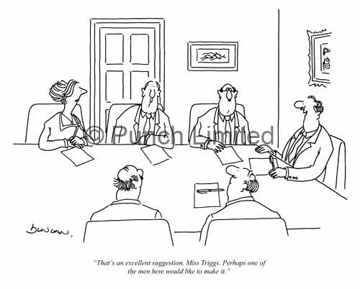
Why Women Matter?
Embracing Female Engineers in O&G
That’s an excellent suggestion .Ms.Triggs. Perhaps one of the one of the men here would like to make it

Slide 2
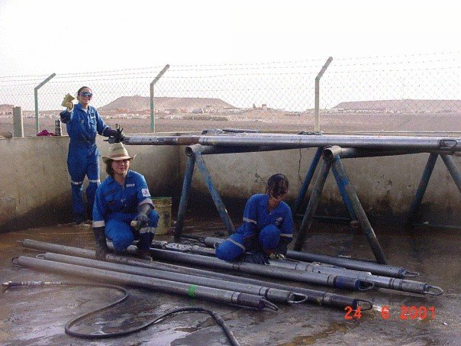

A bit about me!
Graduated in Engineering
Joined SLB as Wireline Engineer
Spent years in field & enjoyed it
Spent 2 years in Telecom
Joined Falcon in 2006
Proud mother of 2 children Aden & Jude

Slide 3
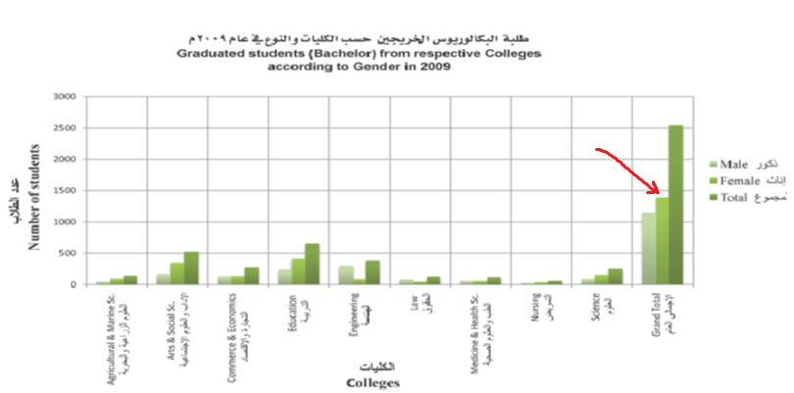
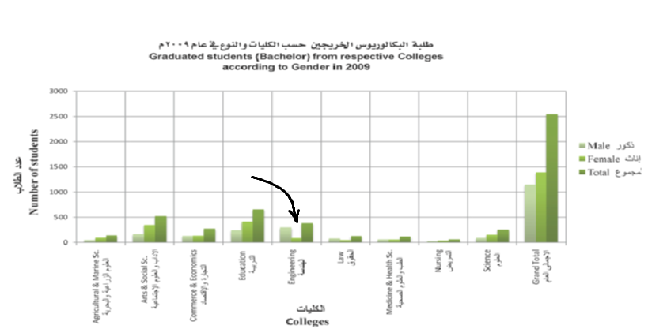
Why Not Women?
50% of raw talent & ‘person-power’
More females graduates.
Under represented in and Engineering
Is it Culture to blame?
Notes:
I’ll assume because of your presence here today that you believe that men and women are equal but not necessary the same..
Women comprise 50% or raw untapped talent and 50% of men power
Pre conceived ideas is not always the right one.

Slide 4
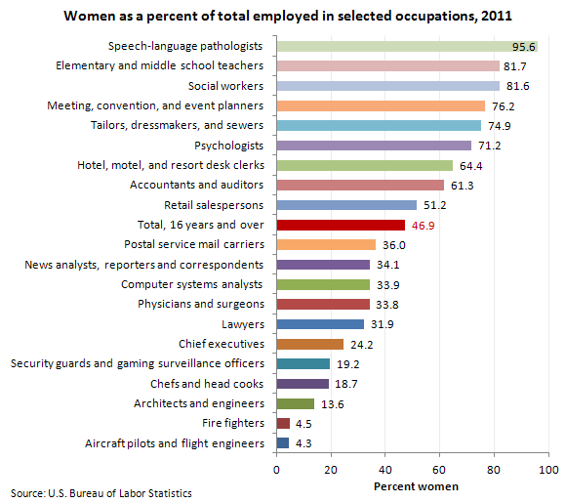
US & Women in Engineering
Notes:
Pre conceived ideas is not always the right one.
Statistical figures show that the US has very low percentage of women pursing Engineering in general.
Is it due to low impact of oil in the US economy?

Slide 5
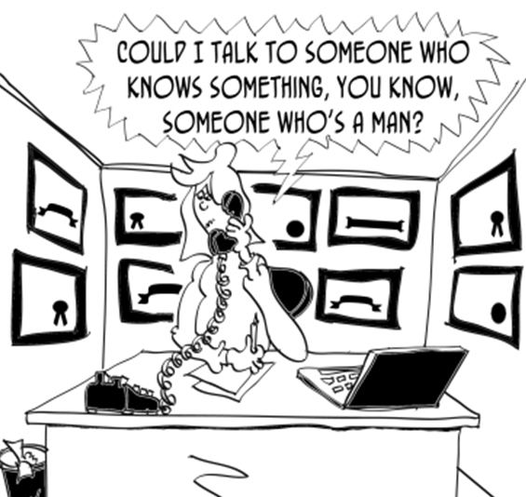
What’s the Problem?
Lack of interests
Perception & Social Stigma
Lack of opportunities
Recruitment
Retention
Mentoring
Development
Working condition
What can be done differently to overcome?
Notes:
We live in a country which economy is dependent heavily on Oil.

Slide 6
Future Technical Women
Education Starts from childhood
Guide towards technical carriers
Mentoring at early career stage
Improving working condition
Fast career track for technical disciplines.. Maybe?

Slide 7
Why Women?
Clear correlation between gender diversity and higher profitability
  “……having a critical mass of at least 30 percent women in higher-level leadership positions significantly improves financial performance (DDI- Global Leadership Forecast 2011).
Positive correlation Quality of leadership positively to number of Women leaders in an organization
Notes:
Companies with higher number of women in snr management roles all the way to CEO level had higher profitability. Interestingly the same group of executive were asked to rate thier companies leadership, companies with more women gave higher ratings to their leadership.
Data from DDI’s Global Leadership Forecast 2011
Research was on organizational trends and best practices used to the strength leadership.
The study uncovered differences in the organizational trends which were gender related.
74 countries
12,500 leaders participated

