Slide 1
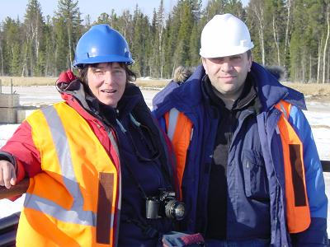
Women in the O&G industry: an example
Barbara Lak
Development Manager MENA
Shell Upstream International

Slide 2
Biography – 25 years in Shell
Masters in Geophysics - joined Shell in 1987
UK – Aberdeen - Wellsite Petroleum Engineer
Gabon – Rabi Geologist
Holland – Research – Seismic interpretation & static modeling
Norway – Quantitative Seismic Interpreter
Norway – Head of Planning & Economics
Holland – Head of Global Exploration Strategy & Planning
Russia – Moscow – Salym Board Director
Nigeria – Port Harcourt – Portfolio Manager
Nigeria – Lagos – Commercial & Economics Services Manager
UAE – Dubai – MENA Development Manager & Chief Petroleum Engineer

Slide 3
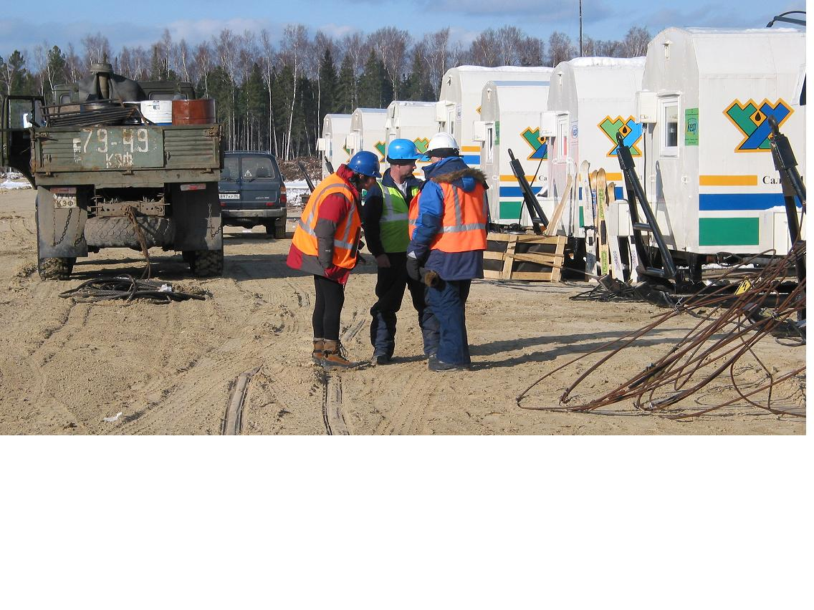
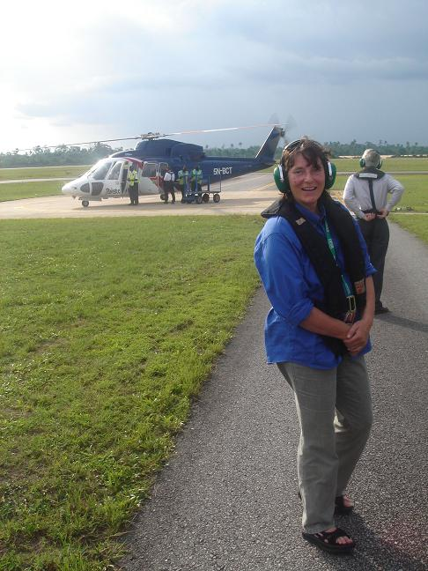
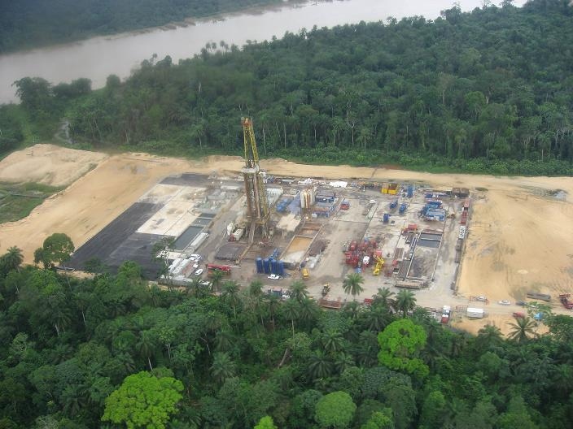

Slide 4
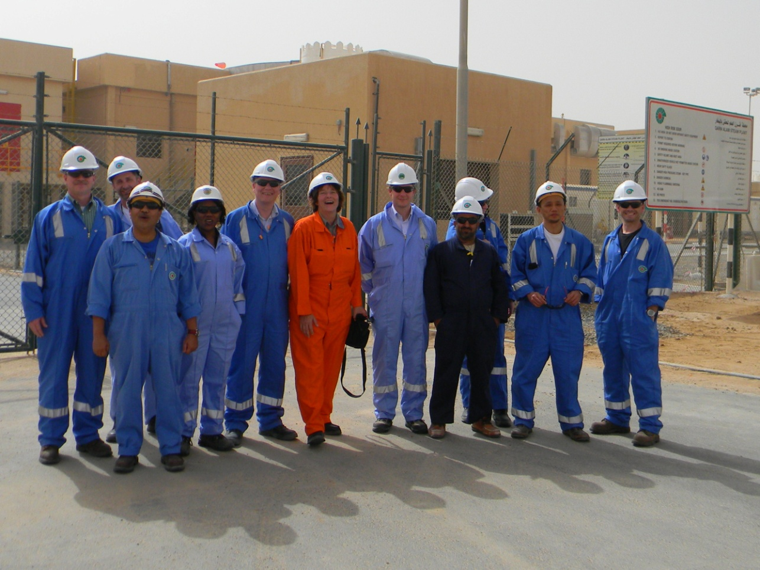
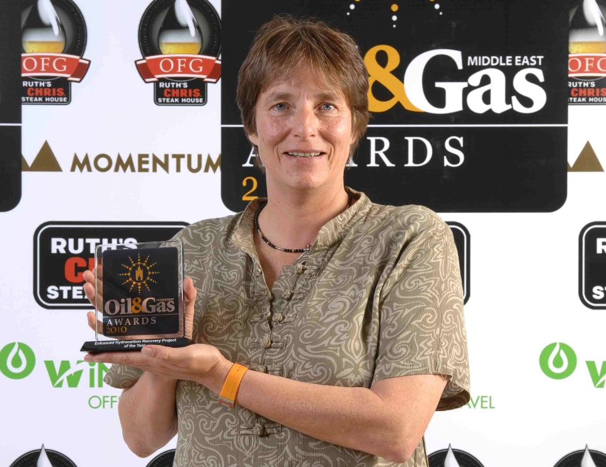
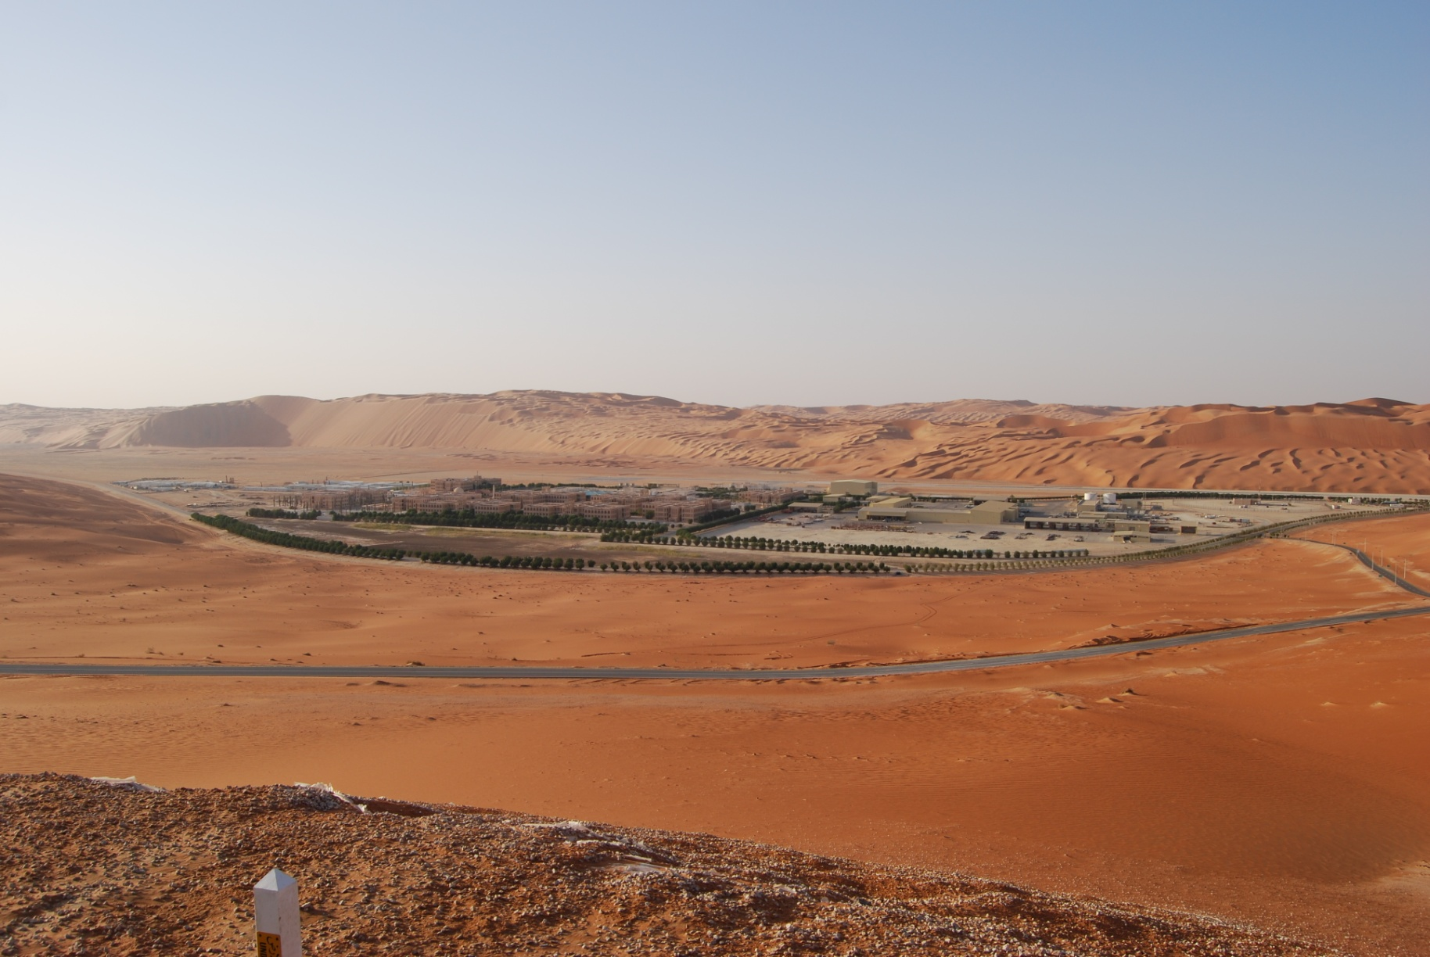
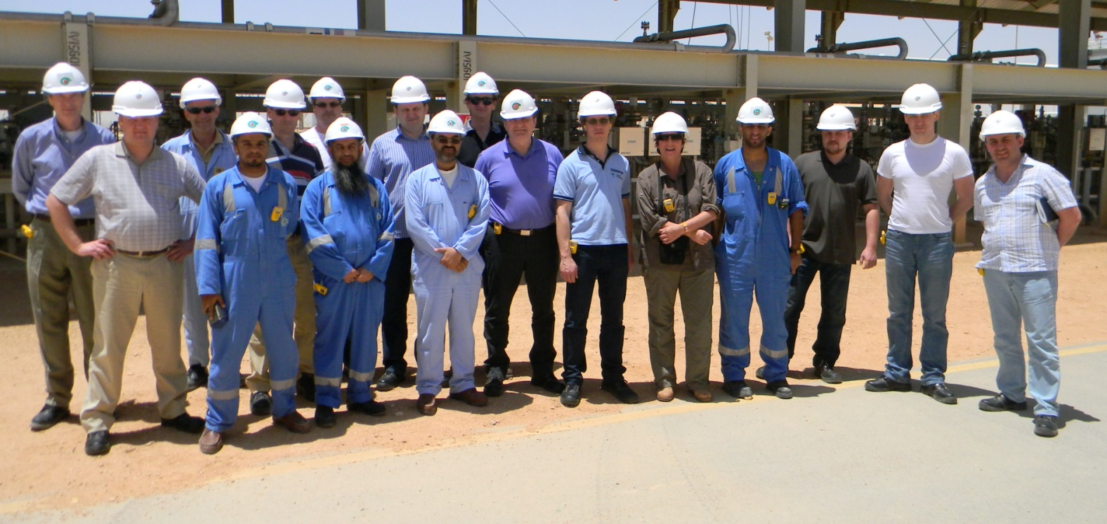

Slide 5
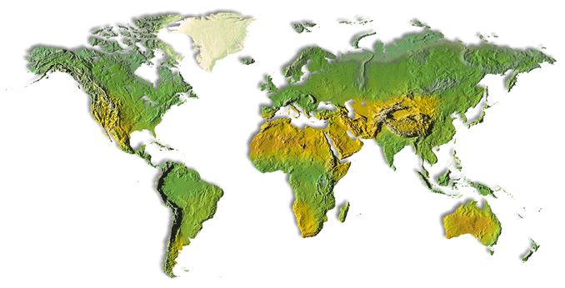
Achievements
Multiple Fields
QI & Economics
Salym Field
New venture to 1st Oil
Drilling Single Wells
4
Modeling & Seismic R&D
1
6
3
5
Global Exploration
Strategy & Planning
8
7
MENA Region
Development Manager &
Chief Petroleum Engineer
Country
Portfolio & Commercial
2
Geologist Rabi Field
Notes:
Achievements
Widened my scope and view: from single well to field to country portfolio to regional porfolio
Doubled recoverable volumes from Rabi by proposing aggressive appraisal
Took Salym field from the negotiating table to creating a new Venture to setting up the Venture with over 600 employees and producing oil and gas.
Coached and recruited junior staff – saw them grow in the Company

Slide 6
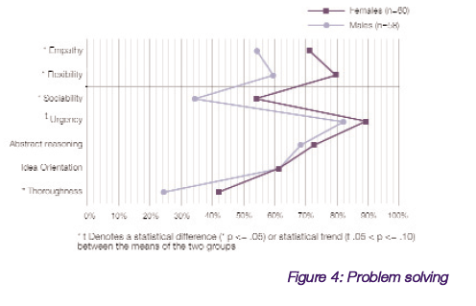
Business Imperatives: Women in the Business
female
male
Notes:
There’s an additional bonus to having a diverse workforce. I believe a team of employees cutting across multiple dimensions of diversity ultimately yield better solutions to problems. Just look at the examples on the slide on women leaders.
A recent issue of the Harvard Business Review highlights a study that showed the collective intelligence of mixed-gender groups does not depend on the IQs of its individual members. It depends on the percentage of women in the group. Groups with more women tended to have above-average scores on problem-solving assignments; teams with more men tended have below-average scores. The best scores, however, were achieve by groups around the 50-50 mix of genders.
The latest McKinsey Global Survey results shows that the kinds of leadership behaviour that executives say will help their companies through turbulent times, such as inspiring others and defining expectations and rewards. And these kinds of leadership behaviour are the ones most used by women.
So that’s all good news for us women leaders.

Slide 7
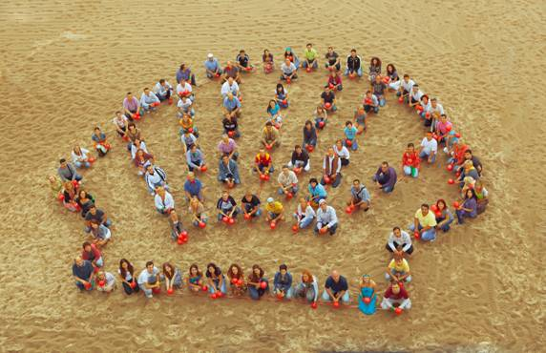
Business Imperatives: Diversity is a strategy for winning
“I strongly believe that Diversity & Inclusion is a strategy for winning and directly supports our ambition to be the world’s most competitive and innovative energy company. It’s about unleashing talent and matching it to business success. It’s an important part of who we are and what we stand for and a necessity for our sustainable growth.”
Peter Voser, Chief Executive
FLOATING LNG FACILITY

Slide 8


