Slide 1
Senior Management Support or
How to make your boss tolerable?
Or better yet!!
Look good?

Slide 2
Time Management
Organize your day
Manage your time in order to manage boss
Drop-in visitors and time-wasters
Prevent crises, manage conflicts
Control difficult people
Understand the importance of your position

Slide 3
Get to Know your Boss
Most are workaholics
Understand their home environment
Keep note of special dates
Over time, you will know your boss better than their spouse
Separation of home and work is a myth at the executive level
Bosses have feelings too

Slide 4
The Difficult Boss
Understand where the pressure is coming from
  Home
  The other Boss
  Job
What was their last job?
Learn their history
  Why do they act the way they do?
Loyalty and kindness will always win

Slide 5
Loyalty
Key to a successful team
  Trust
  Teamwork
  Professionalism
  Integrity
Find a hidden hour for your boss every day
Listen to the rumor mill
  This can head off discord and morale issues

Slide 6
Travel
Most bosses hate it
Most bosses are cruel to themselves
  Makes them hate it more
Anticipate change
  Be cognizant of the weather
When boss is on travel
  Know where the individual is
  Know what other flights are available
Maps, Maps, Maps

Slide 7
Avoid death by powerpoint!
LM’s understanding is: Today, 3 Bombardiers carrying BACN fly a 24/7 track over Afghanistan, one asset on station at a time. The orbital track is sufficiently long that any SINCGARS range extension communications via BACN must be scheduled. The need for communications bridging and range extension is so great the AF is outfitting its first GH Block 20 with BACN in lieu of ISR. Within 12-24 months the Block 20 GH will be flying in Afghanistan, adding a second track during peak times.
CENTCOM originally gained interest in BACN ops for Afghanistan after hearing the Bombardier carried a multi-beam phased array to minimize co-channel interference and provide a large quantity of beam-specific range-extended full duplex SINCGARS nets.
Present BACN is not flying with a multi-net capable radio supporting each phased array VHF beam, instead it carries 9 ea ARC-210 SINCGARS radios which requires a pair of these radios to provide 1 ea full duplex net, thus BACN today supports 4 full duplex nets, with each net rebroadcasting to the entire BACN FOR. The 9th ARC-210 is assumed used for Have Quick ops. The 4 SINCGARS nets are assumed to be: Fires, Logistics, C2, and Intel.

Slide 8
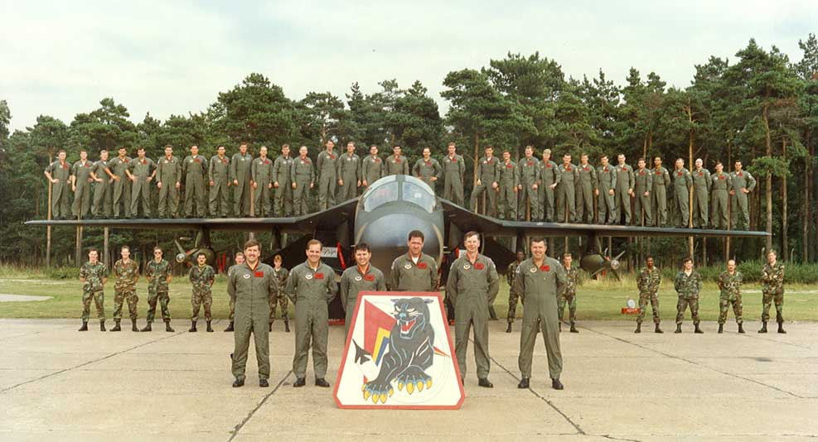
The better way to brief
Tell them what you are going to tell them
Tell them
Tell them what you told them
Pictures are ok!!

Slide 9
You must become a team
Know when the door needs to be closed
  Anger, loudness, personnel issues, finances
Know when to kill a meeting
  Bosses need bio breaks as well
Know and understand when it’s ice breaking time
Know when it’s time to celebrate
Know when it’s time to go home
  Sometimes you just have to say “see you tomorrow”

Slide 10

Questions

