Slide 1
Business Professional Etiquette
Paula O’Keefe CPS/CAP
Pikes Peak Chapter, IAAP
8 February 2011

Slide 2
Overview
Customer Greeting
Telephone Etiquette
E-Mail Etiquette
International Etiquette
Dress for Success
Q & A
Notes:
Transition: Let’s begin our journey by first looking at the definition of Etiquette

Slide 3
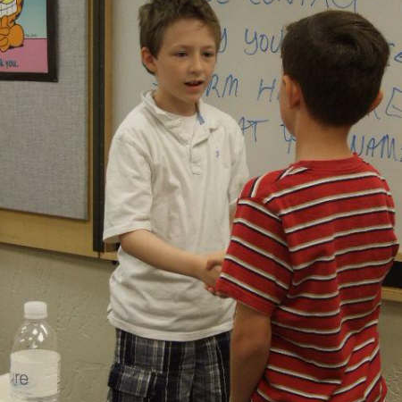
What is Etiquette & Why is it Important?
According to Wikipedia it is a code of behavior that delineates expectations for social behavior according to contemporary conventional norms within a society, social class, or group.
The rules of etiquette dictate the proper way people should behave in society. Each culture has its own unique set of rules.
Notes:
Definition of Etiquette: According to Wikipedia it is a code of behavior that delineates expectations for social behavior according to contemporary conventional norms within a society, social class, or group
Why it is important:
The rules of etiquette dictate the proper way people should behave in society. Each culture has its own unique set of rules.
Transition: The culturally-savvy business person understands the rules of business and social etiquette when interacting with people from different cultural backgrounds. Understanding will assist you in building relationships.
Our first area to explore is the Customer Greeting

Slide 4
Customer Greeting
Develop an Appropriate Greeting
Greet Effectively
Immediate recognition
Be warm and sincere
Have a positive attitude and keep smiling
Notes:
The Customer Greeting is a face to face interaction. When greeting a customer, you only have 5 seconds to make a good first impression
It is important to develop a appropriate a greeting. This will be your standard greeting for people that come into the office
Immediately recognize that they have stepped into the room
Project a warm and sincere attitude and act like you are glad to see them.
Have a positive attitude. Keep your conversation lighthearted, yet professional. Maintaining a positive attitude while conducting business is a great way to begin a business relationship.
Smile. Keep smiling. This helps keep things friendly and upbeat through the course of the business conversation

Slide 5
Customer Greeting
The Greeting
Keep good notes—keep it personal and professional
Use their name
Ask a few personal questions as “icebreakers”
shake hands
steady eye contact
then move into professional mode
Notes:
Greet with their name. Greet them using their name, and make sure you continue using it throughout the conversation. Don’t overdo it, but using their name puts them at ease and helps them feel like you care about them personally and professionally.
Shake hands properly. Regardless of your gender, make sure you have a firm handshake. A firm handshake exudes confidence in yourself, your company, and in your ability to transact business effectively. Females should especially pay attention to this, as most males expect women to have a handshake that resembles a dead fish. Make sure that you have a firm handshake, grip the other individual’s hand, and let go.
Make steady eye contact. Along with a strong handshake, steady eye contact is very important in making an excellent first impression. Throughout the conversation, make sure you look your client in the eyes as much as possible without seeming overbearing. This will help you to appear confident and will develop trust within your client as you continue working with them.
Keep good notes—keep it personal and professional. Ask a few personal questions as “icebreakers”, and then move into professional mode. Make sure you maintain your lighthearted attitude while getting down to business. Keep good notes of your conversation so that when you are finished with your meeting, you will have a good record of what was discussed.

Slide 6
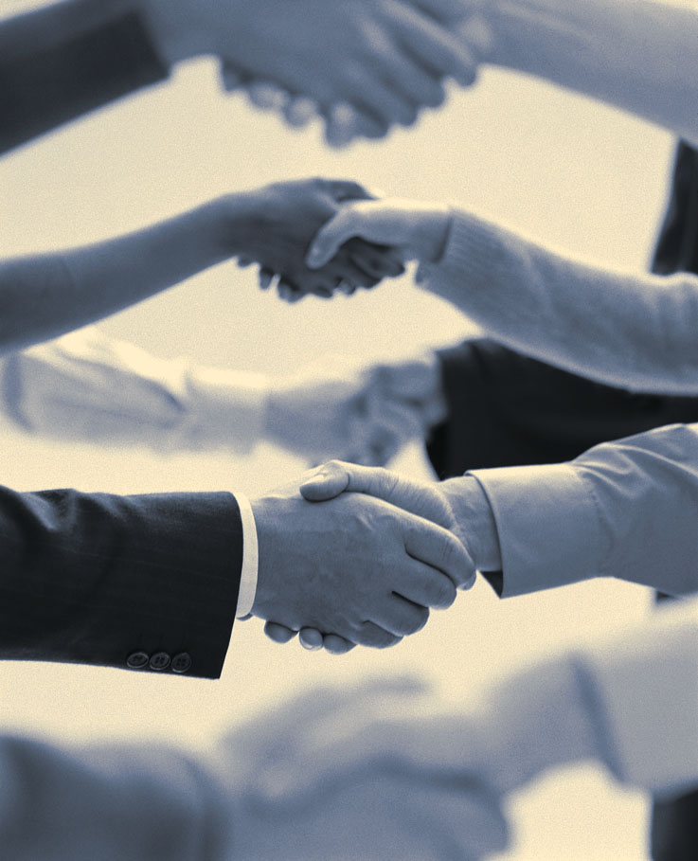
Customer Greeting
Keep focus on customer—not on self
Ask specifically how you can help them
Use their name
Ask a few personal questions as “icebreakers”
shake hands
steady eye contact
then move into professional mode
Notes:
Keep focus on customer—not on self. Especially if you are meeting your customer for the first time, keep your focus on your customer and their needs. Keep any conversation surrounding you to a minimum, and enable the customer to talk about themselves. Most people like to hear themselves talk, so training yourself to be an excellent listener will make the difference in building an effective business relationship with your customer.
Ask specifically how you can help them. Once you have a good idea of what they need, ask how they want you to help them. Be specific about the products and services your company provides, and ask them which ones they believe would most effectively meet their needs.
These key tips will help you to build strong relationships for you and your company.
TRANSITION: For some greeting our customers in person is hard, but if develop a standard greeting and practice it you feel more comfortable. What may be easier is greeting them on the telephone, cause we feel they can’t see us. Ah, but your personality does comes through the phone. Lets now discuss some telephone etiquette

Slide 7
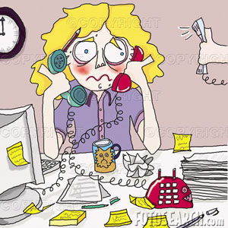
Telephone Etiquette
Answering techniques
Placing calls
Messages
Notes:
Stay on task and know how you’ll answer the phone before you answer. Practice makes perfect.

Slide 8
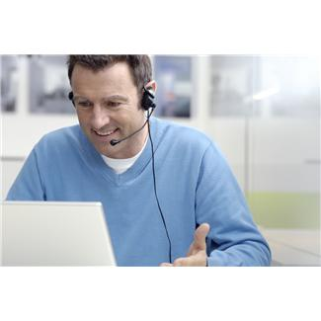
Answering techniques
Preparation
  Speak Clearly
  Dignity and Respect
  Proper Tone of Voice
  Positive Speech
Effective On-Hold Techniques
Effective Call-Transferring
Notes:
First and foremost - Answer in a timely, professional and friendly manner. How many times should you let the phone ring? 2 or 3
Preparation—You can actually prepare to take a phone call. Think about answering with smile on your face. A warm, friendly, professional greeting including company name, dept name (if appropriate) and the person's name who answered the call. It is suggested that the greeting end with a helpful statement that assures the caller you are willing to help. Ex: ABC Shutter Company, this is Betty, how may I assist you or how can I direct your call.
Practice the Golden Rule —Wouldn’t it be a better world if we all treated each other the way we wish to be treated? When you’re on the telephone with a customer, you should treat the caller with the same dignity and respect you extend to the owner of your company.
Speaking Clearly —Anyone who wants to succeed in business today should be able to enunciate and speak clearly. Remember tongue twisters? You can actually use them as a warm-up for doing telephone work!
Proper Tone of Voice —Tone of voice is the nonverbal component of your telephone personality. Learn how to treat each phone call as a separate “performance”. Your voice quality and should always be positive and enthusiastic. Remember, the image the customer has of the person who is answering your company's phone is the image the customer has of YOUR COMPANY.
Positive Speech —Your use of language can make or break a call. There are certain words and phrases that can quickly turn off a caller; conversely, there are words and phrases that are music to a caller’s ears. AVOID COMPANY JARGON & RULES
Effective On-Hold Techniques —There’s a right way and a wrong way to put a caller on hold. For example, when’s the last time a receptionist politely asked you if you were able to hold? Most of us can remember all too clearly a time when we were placed on eternal hold and wondered if we had been forgotten. A simple rule to remember: call the customer by name when you return to the line and wait for her to respond, then continue
Effective Call-Transferring — Know how to transfer a call and practice before trying it on a business call. Write step by step instructions for yourself.
When a call must be transferred, the most desirable procedure is to tell the caller to whom he/she will be transferred, “I’ll give you Ms Brown; she handles those matters; just a moment, please.” Be sure you are transferring the caller to the proper person or department

Slide 9
Placing Calls
Announce yourself
  "Hello, it's Mary from Secretarial Site Dot com calling on behalf of Mr. Brown. Would Mrs. Smith be available to speak with Mr. Brown?
  If they are not in:
    find out the most convenient time to try again
    have them return your call
Notes:
When the caller answers, always announce yourself and either say who you wish to speak to or what the matter is about.
You would say:
"Hello, it's Mary from Secretarial Site Dot com calling on behalf of Mr Brown. Would Mrs Smith be available to speak with Mr Brown?
If the caller isn't in, find out the most convenient time to try again, or have them return your call.
You would then say:
"Hello, it's Mary from Secretarial Site Dot com calling on behalf of Mr Brown. Could I leave a message for Mrs Smith to call Mr Brown when it's convenient. His phone number is 1234 56789. Thank you. Bye."

Slide 10
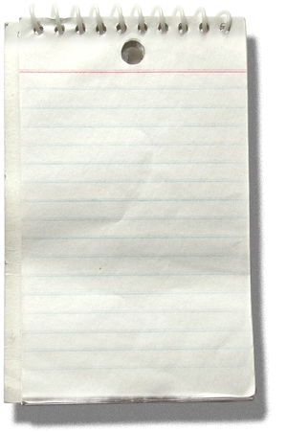
Messages
Get the correct name of the caller
Phone number
Why
Date/Time
Name
Phone
Company
Reference Topic
Notes:
MESSAGES
It's most important that you get the following details from the caller:
Name
Phone Numbers - mobile, office or home
What the call is about
Your written message should also contain:
Date
Time
Your name - so he know's who took the call
The caller may also give you additional information, such as:
Times the caller will be unavailable
File reference on a letter
If you do get a file reference, make sure a copy of the letter is available for Mr Brown's reference before he makes the call - he may just not remember the content of the letter without seeing it again.
If you're having difficulty understanding what the caller is saying, try spelling out the particular words e.g.
Her name is Smith but you can't quite get it. Give examples, like 'S' for Secretarial, 'M' for Mother, 'I' for whatever springs to mind etc etc etc
Now always end your call with a 'goodbye' message.
Thanks for calling Mrs Smith, Goodbye.
TRANSITION: So far we have talked about greeting in person, greeting on the telephone and in today’s world we also have e-mail. Which sometimes seems to triumph in-person and telephone contact! Even when using e-mail there is business etiquette to follow

Slide 11

E-Mail Etiquette
Develop a Professional Signature
Reply to all? No!
Top 6 Rules
Notes:
Email has brought about many positive advancements in the workplace-it's quicker than snail mail, less intrusive than a phone call and an efficient way to keep track of correspondence details. When used improperly, however, email can be an impediment to your career. Use some common sense to stay on the right side of email etiquette and maximize its potential as a helpful and efficient tool in the workplace.
Develop a Professional Signature
Reply to all? No!
Top 6 Rules

Slide 12
Develop a Professional Signature
Information
Name and contact info
Proof Read
Effect on the recipient
Triple check
Old School Internet User
Newbie
Watch the graphics
Notes:
Information: Signature block typically gives basic information that makes a person findable in the real world or online, such as a telephone number or a website. If they are from a business, they also take the place of the letterhead on a piece of company stationery
Always triple proofread your signature before you take it live. Make sure your spelling and punctuation are spot on. Use spaces instead of tabs to make indents in your content. Make sure you include the http:// in any web address or some email programs won't recognize it as a link. Be appropriate and use a business-like tone for professional email. Keep humorous or controversial material for personal emails. Not every signature file is appropriate for every piece of email. If your email software permits, have several signature files and vary them as needed for the particular audience you are addressing.
Effects Email signatures can have a variety of effects on their recipients.
An old school Internet user may be offended by an overly elaborate or graphic signature, while a relative "newbie" may not understand traditional usage and find it entertaining. Graphic email signatures can be a problem because many email programs save these graphics as attachments in a special folder that becomes crowded quite quickly. The graphic also may not be displayed as a part of the email but instead require the reader to open a separate window to view the graphic. Many people will find this annoying, even if they appreciate the intent of the graphic.

Slide 13
Reply to all? No!
Caution: only use when necessary
In many instances, your comments may not be appropriate for "all" or "all" may not be interested in your comments. If you've received a group message and all who have received the message are part of the conversation to which you are contributing, then you should send a "Reply All."
Notes:
As a general rule, the "Reply All" function should only be used when necessary
Before sending out a "Reply All" message, consider whether or not it is necessary. In many instances, your comments may not be appropriate for "all" or "all" may not be interested in your comments. If you've received a group message and all who have received the message are part of the conversation to which you are contributing, then you should send a "Reply All."

Slide 14
6 Rules
Greeting
Subject
Concise
Begin each email with a greeting
Ensure your subject line accurately reflects the contents and nature of your email
Be as concise as possible
Notes:
Begin each email with a greeting. No matter how pressed for time you are, a simple greeting such as "Hi," "Hello," or "Dear X" is good etiquette. Otherwise, if you launch into your email without a greeting or introduction you run the risk of seeming impolite or impatient.
Take the time to ensure your subject line accurately reflects the contents and nature of your email. This will go a long way to ensure that your email gets the attention and consideration it deserves.
Be as concise as possible. Your recipients will appreciate it if you keep your email short, sweet and to the point, and you'll also increase your chance of getting a timely reply.
Ask permission before forwarding another person's email correspondence. Even if you're confident that the other person wouldn't mind if you forward their email to someone else, it's good etiquette to check first so you don't risk violating their trust.
Reply to emails in a timely fashion. If you know in advance that you can't give an email the attention it deserves at the moment, give the sender a quick heads-up that you have received their email but haven't had time to review it yet.
Send personal emails from your non-work account. Sending personal emails from work is generally "frowned upon" in business, but occasionally we all need to send a personal email during working hours. In this instance, use a web-based email account such as Yahoo or Hotmail. Remember that your work email, both the address and all correspondence, is the property of the company you work for. Anything you've ever sent or received--even if you've deleted it--could potentially be retrieved from the system by a database administrator at any time.

Slide 15
6 Rules
Forwarding
Reply
Personal
Ask permission before forwarding another person's email correspondence
Reply to emails in a timely fashion.
Send personal emails from your non-work account
Notes:
Begin each email with a greeting. No matter how pressed for time you are, a simple greeting such as "Hi," "Hello," or "Dear X" is good etiquette. Otherwise, if you launch into your email without a greeting or introduction you run the risk of seeming impolite or impatient.
Take the time to ensure your subject line accurately reflects the contents and nature of your email. This will go a long way to ensure that your email gets the attention and consideration it deserves.
Be as concise as possible. Your recipients will appreciate it if you keep your email short, sweet and to the point, and you'll also increase your chance of getting a timely reply.
Ask permission before forwarding another person's email correspondence. Even if you're confident that the other person wouldn't mind if you forward their email to someone else, it's good etiquette to check first so you don't risk violating their trust.
Reply to emails in a timely fashion. If you know in advance that you can't give an email the attention it deserves at the moment, give the sender a quick heads-up that you have received their email but haven't had time to review it yet.
Send personal emails from your non-work account. Sending personal emails from work is generally "frowned upon" in business, but occasionally we all need to send a personal email during working hours. In this instance, use a web-based email account such as Yahoo or Hotmail. Remember that your work email, both the address and all correspondence, is the property of the company you work for. Anything you've ever sent or received--even if you've deleted it--could potentially be retrieved from the system by a database administrator at any time.

Slide 16
International Etiquette
Because Manners Count
Speaking
Test your international social and business savvy
Notes:
Never make the assumption that a person does not understand English
English is frequently the language used in global business even though it is not the language spoken by the majority of people in the world.
It is therefore very important for native English speakers to be sensitive to the fact that English is a foreign language for many of their associates around the world, and the extent to which it is understood and spoken may vary widely.

Slide 17
Manners Count
Dress
Handshake
Titles
Business Cards
Notes:
Dress: It's best to be conservatively dressed when meeting with international business partners. This shows respect and consideration for the people you are meeting with, and gives the impression that your company should be taken seriously. While offices in the U.S. may accept more casual attire from employees, it's best to wear a suit (for men and women) when doing a business deal with someone from another country
Handshake: The handshake is an integral part of any business deal. Individuals from different countries shake hands in different ways, and it's up to you to be prepared for this before your in-person meeting. People from the U.S. usually smile and make eye contact when shaking hands, and give "two quick pumps" as a firm and professional gesture. However, individuals from the Middle East may shake your hand throughout the entire greeting--taking your hand away during this time is considered rude. Germans only give one pump when shaking hands, so two pumps may be looked at as strange, and will dictate that you haven't taken time to learn about the culture.
Titles: When you are conducting business deals with someone from another country, you should listen for the way everyone is addressed so that you can use the right titles. While U.S. businesspeople often use each other's first names when addressing one another, this is not the norm in other countries. In Latin American and Asian countries, it's best to use a person's title or last name when addressing them, even after you've been doing business with them for a while.
Business Cards: Make sure your business cards are presented in a respectful fashion. If you are presenting business cards to professionals from China, Hong Kong or Japan, it is good manners to give the card with both hands. Also, it's always best to take a good look at any cards that are given to you before putting them away.

Slide 18
Speaking
Slow down and be patient
Enunciate clearly
Watch gestures
Keep sentences short
Notes:
Slow down and be patient. Avoid the temptation to speak more loudly or show irritation
Remember that others are trying to speak your language -Enunciate clearly and summarize your point frequently and when necessary repeat key points
Watch gestures – do not over do and be sure that they mean the same thing in other cultures
Try to keep sentences short --Some things to try and avoid are:
Either/or questions
Idioms or colloquialisms, slang, jargon
Reduction of speech
Negative questions and contractions
Complicated sentences
Use visuals whenever possible, such as graphs, charts.

Slide 19
Grooming and Hygiene
General Grooming Standards
  Hair Style
  Smells
  Fingernails
  Jewelry
Good Hygiene Counts Too
  Definition: Body hygiene pertains to hygiene practices performed by an individual to care for one's bodily health and well being, through cleanliness
  Hair
  Teeth and breath
  Hands
  Body
Notes:
Grooming and Hygiene are as much a part of business etiquette as a speaking. When we are meeting in person we need to keep in mind some additional things:
Hair Style: Style should be neat and conservative, and preferably off the face. With few exceptions, hair color should not be shocking or unusual (leave blue hair for Halloween). Hair sprays and gels that have a strong scent or odor should be avoided.
Smells: Avoid wearing perfume and heavily-scented products in all business settings. You might like them, but they have no place in a business environment. Scents can trigger asthma, overpower a room, and are often more offensive than pleasing to others.
Fingernails: It is important to have hands and fingernails looking professional -- not like you are heading out for a wild night on the town.
Nails should be clean, and trimmed or sculpted. Avoid wearing unusual or shocking nail colors. Nail art and nail jewels are not acceptable for business meetings.
Jewelry: Jewelry should not be noisy (no metal bangle bracelets), too large or too many pieces. It is better to wear no jewelry at all, than too wear too much jewelry. A nice, conservative wrist watch is always in style.
Definition of Hygiene : Body hygiene pertains to hygiene practices performed by an individual to care for one's bodily health and well being, through cleanliness. Always practice good hygiene.
Hair should be clean and well-maintained.
Teeth brushed daily will control breath
Hands should be washed frequently
Body should be bathed daily and the use of deodorant is preferred in our society.

Slide 20
Summary
Customer Greeting
Telephone Etiquette
E-Mail Etiquette
International Etiquette
Grooming and Hygiene
Q & A

Slide 21
Test your international social and business savvy

Slide 22
Questions

Slide 23
summary
Customer Greeting
Telephone Etiquette
E-Mail Etiquette
International Etiquette
Grooming and Hygiene
Q & A

