Slide 1
New Strategies for the New Job Hunt
The Sunday classifieds just don’t cut it anymore!

Slide 2
The toughest job you’ll ever have. . .
Searching for a new job!

Slide 3


Slide 4
Today
Internet
  Search engines
  Articles
Networking
  Social media
  Email

Slide 5
The Job Search
Know yourself
Take aim
Be assertive & proactive
Sleuth
Network
Be flexible
The right resume
Keep records
Don’t give up

Slide 6
KNOW YOURSELF
Skills
Interests
Goals
Values
What makes you special?

Slide 7
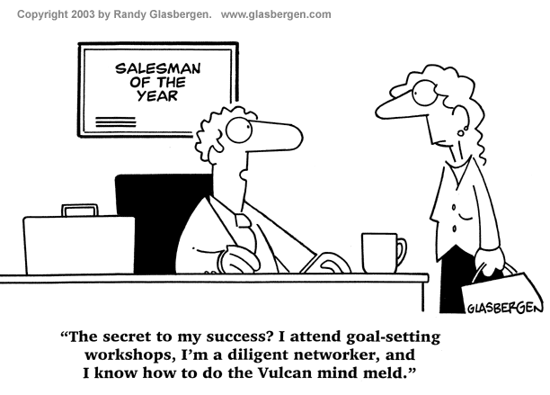
Show how you’re special!

Slide 8

TAKE AIM
New career field?
Higher salary?
New level of responsibility?
Research
Be realistic

Slide 9
My favorite job search engines
Career Builder – www.careerbuilder.com
Indeed – www.indeed.com
Monster – www.monster.com
Simply hired – www.simplyhired.com
Yahoo – http://hotjobs.yahoo.com
USA Jobs – www.usajobs.com
Craigslist – www.craigslist.org

Slide 10
BE ASSERTIVE & PROACTIVE
They probably aren’t going to be knocking on your door!
Post your resume online
Cold call on companies that interest you.
Stay in touch with current events.

Slide 11

SLEUTH
Be a job detective
Be the right candidate before the job is even there!
Ask people if they know
people
Watch the news

Slide 12

NETWORK
Tell everyone!
Ask friends to tell friends
Social media
  Facebook
  Twitter
  LinkedIn
Associations
School connections

Slide 13
Social Media
LinkedIn
  Online resume
  Connections
  Research tool
Facebook
  Keep it professional
  Notes on your “wall”
Twitter
  Creates a profile & presence
  Connections and advice

Slide 14
Social Media
Can a presence on Facebook, LinkedIn, Twitter, and other sites get me a job?

Slide 15
BE FLEXIBLE
Consider anything- you don’t have to take it
  Commission jobs
  Temp jobs
  Part time
  A foot in the door
Do your research

Slide 16
THE RIGHT RESUME
Say it clearly
Use keywords
Tailor each resume to the job
Find a way to stand out from the others!
Make it flawless

Slide 17
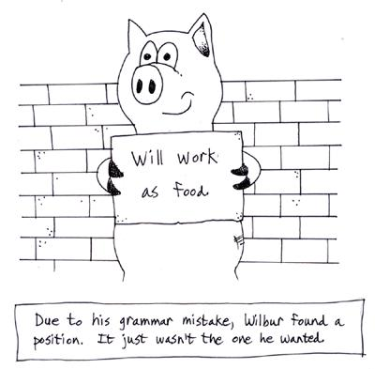
Attention to Detail

Slide 18
What format?
Chronological
  Lists jobs and accomplishments
  Best with long term assignments and a specific skill set
Functional
  Lists skills and accomplishments
  Ideal for those with a wide variety of skills or many jobs

Slide 19
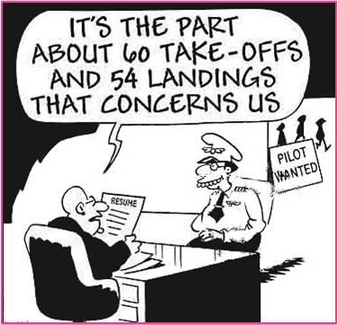
Resume, not Job Description
Avoid “duties/responsibilities include”
Give numbers, details, specific accomplishments
Only the good
stuff!

Slide 20
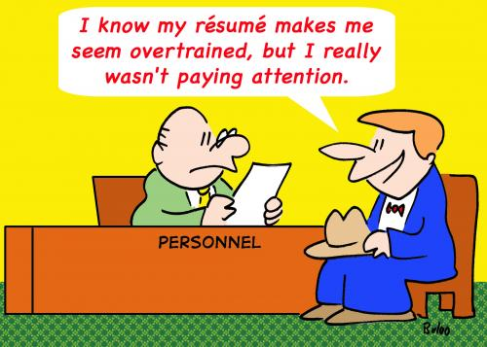
Over Qualified?
You’re extremely qualified!!

Slide 21
KEEP RECORDS
Know which resume went where
Track your progress
  Communications
  Interviews
  Follow up
Create a contacts list

Slide 22

DON’T GIVE UP
Check back with employers
Ask why when you get a no
Keep a positive attitude
The right job is out there!

Slide 23
Good luck!

